Slide 1


“A Structural Principled Framework”
Talks 10 & 11
LAWF 3780
Challenges of In-House & Corporate Counsel
TRU Faculty of Law
Spring, 2019
Jon Festinger Q.C.
Centre for Digital Media
QMUL School of Law (CCLS)
http://commlaw.allard.ubc
@jonfestinger
jon_festinger@thecdm.ca

Slide 2
Hello
LAW F 3780
Challenges of In-House
& Corporate Counsel

Slide 3
Logistics

Slide 4
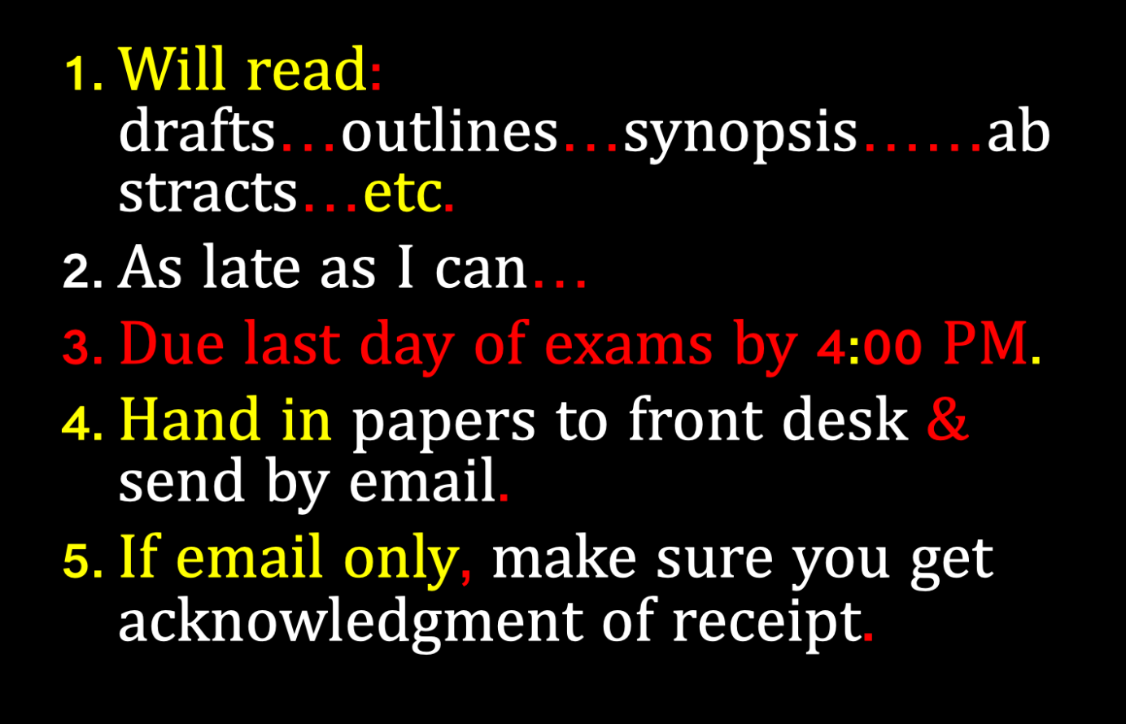

Slide 5
QUESTIONS?
THOUGHTS?
DISCUSSION?

Slide 6

Pause

Slide 7
Law Society Futures Committee
Large numbers of lawyers covered by Law Society rules are in-house counsel for companies or governments. Could be as high as a third of all BC layers. The number of such lawyers is growing.
Commentaries on the LSBC rules perhaps ought to be re-thought and redrafted to reflect this reality.
The possibilities around insurance for in-house counsel also needs to be considered.

Slide 8


Slide 9
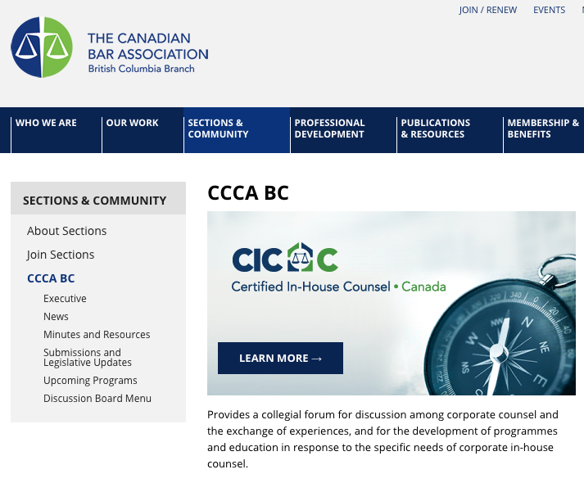

Slide 10
News of the Week

Slide 11
Yours?

Slide 12
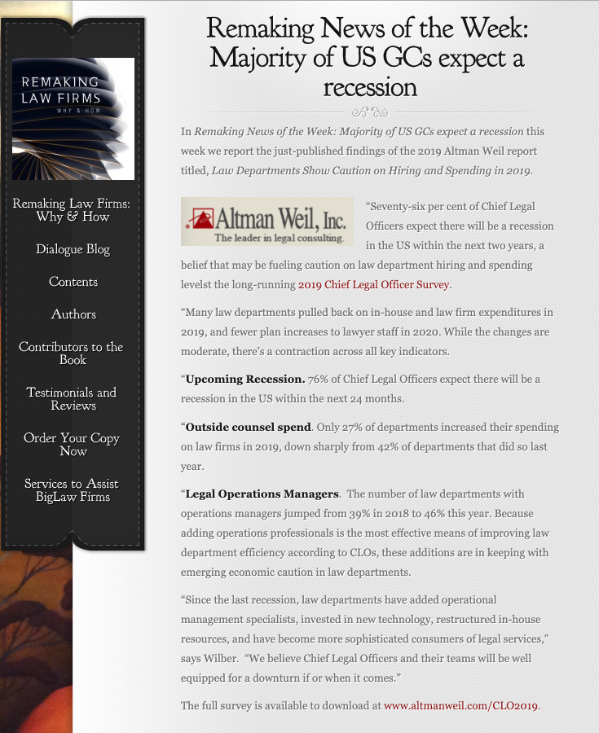

Slide 13
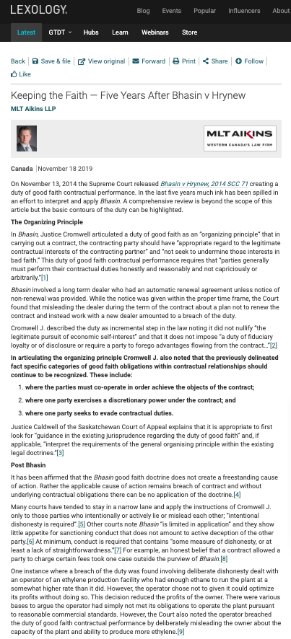

Slide 14
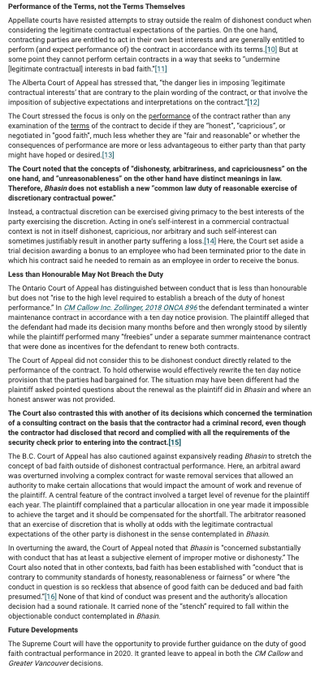

Slide 15
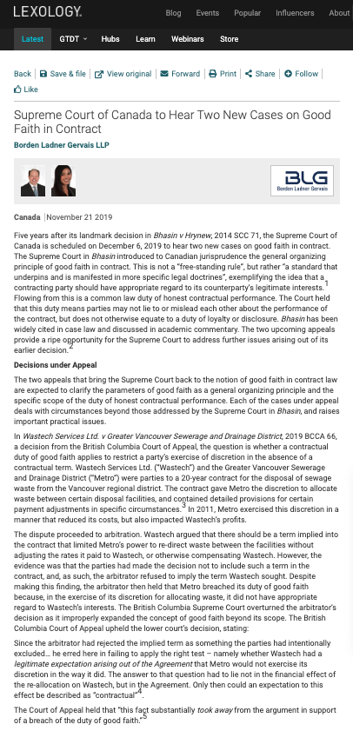

Slide 16
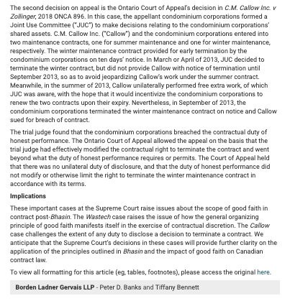

Slide 17
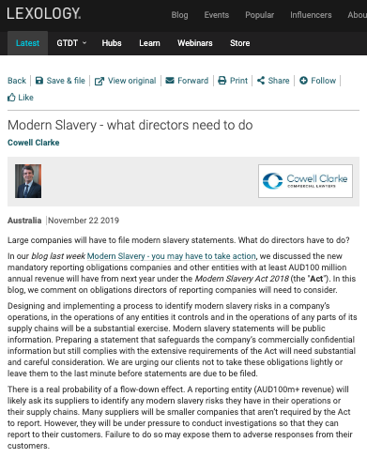

Slide 18
Last Semester This Time

Slide 19
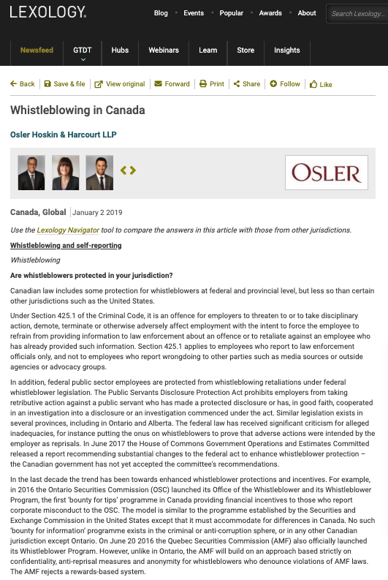

Slide 20
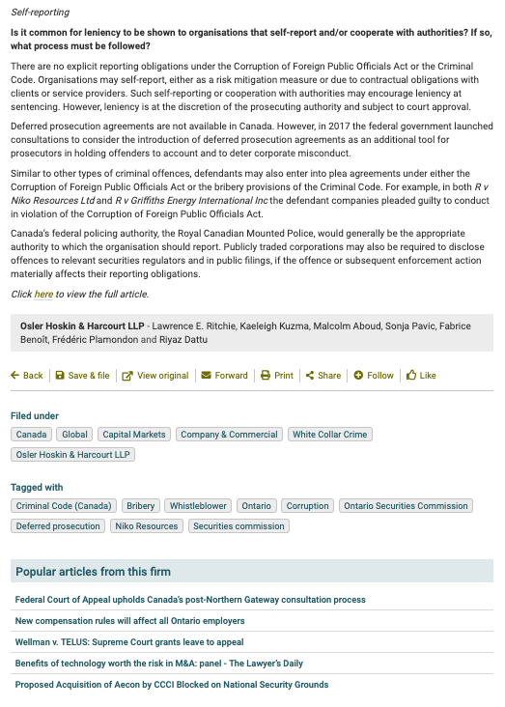

Slide 21
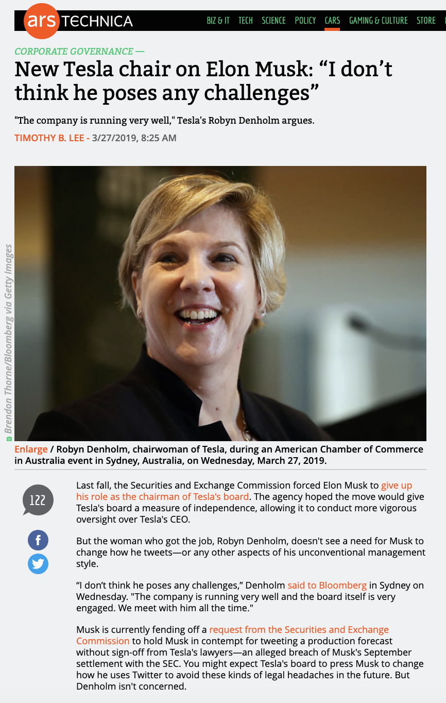
Last Semester This Time
Because Elon Edition…

Slide 22
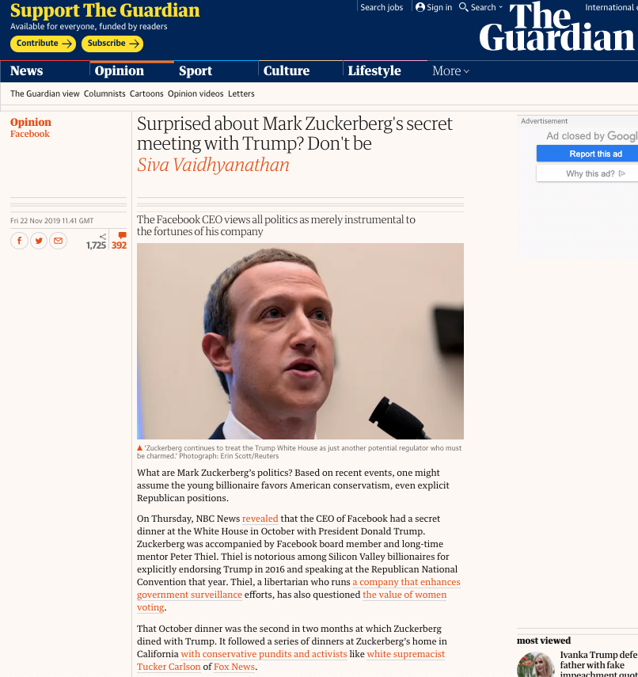
Worst CEO to be GC to????

Slide 23
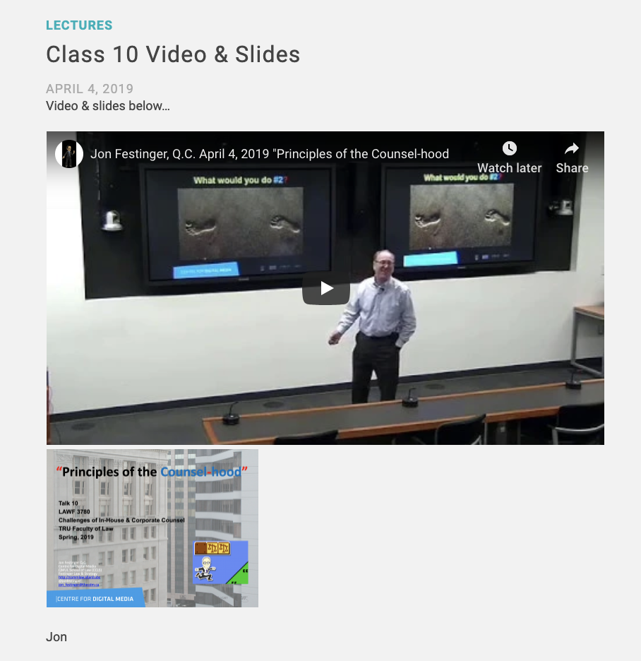
Recap…

Slide 25
Pause

Slide 26
QUESTIONS?
THOUGHTS?
DISCUSSION?

Slide 27
Yours?

Slide 28

Now, back to our regularly scheduled programming…

Slide 29

Starting Point 1 - Review

Slide 30
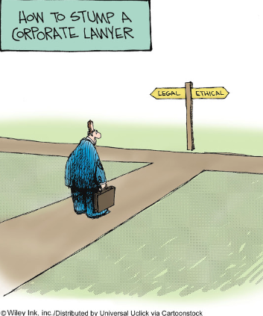
The course in one cartoon

Slide 31
Examine the question from the perspective of:
1. An out-side counsel
2. An in-house counsel
What do you see?

Slide 32
Basic Conundrum?
Good governance is invisible

Slide 33

…invisible.
Measured by the number of crises that don’t manifest.

Slide 34

Poor Governance is SUPER VISIBLE

Slide 35

Two Questions…
Where were the Directors?
What views did Counsel transmit?

Slide 36
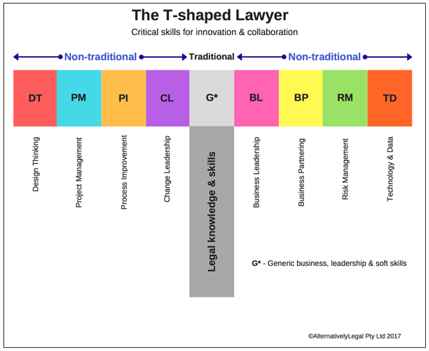

Slide 37
Plus shaped lawyer?
+
ETHICAL
LEADERSHIP

Slide 38

“With great power…”

Slide 39
Useful metaphor only
You are a hero (because everyone is per Campbell & Post-structuralism)
Don’t be a “Hero”.

Slide 40
LEAD

Slide 41
In practical terms meaning what?…
Educate
Don’t let non-lawyers second guess your legal views – only other counsel – bring in outside counsel
Provide alternatives (including possible non-legal ones)
Use PR fallout fear?
Don’t hide behind the technical

Slide 42
Pause

Slide 43
QUESTIONS?
THOUGHTS?
DISCUSSION?

Slide 44
Starting Point 2

Slide 45

Structural
Principled
Framework

Slide 46
Or should we call them…
RULES

Slide 47

1. Lawyer First
“Hat” you were trained for
Law Society obligations not mitigated by being in-house
Attracts privilege

Slide 48
1A. Canons of Legal Ethics
(Chapter 2 – Standards of the Legal Profession)
These Canons of Legal Ethics in rules 2.1-1 to 2.1-5 are a general guide and not a denial of the existence of other duties equally imperative and of other rights, though not specifically mentioned. A version of these Canons has formed part of the Code of Professional Conduct of the Law Society of British Columbia since 1921. They are included here both for their historical value and for their statement of general principles that underlie the remainder of the rules in this Code.
A lawyer is a minister of justice, an officer of the courts, a client’s advocate and a member of an ancient, honourable and learned profession.
In these several capacities, it is a lawyer’s duty to promote the interests of the state, serve the cause of justice, maintain the authority and dignity of the courts, be faithful to clients, be candid and courteous in relations with other lawyers and demonstrate personal integrity.

Slide 49
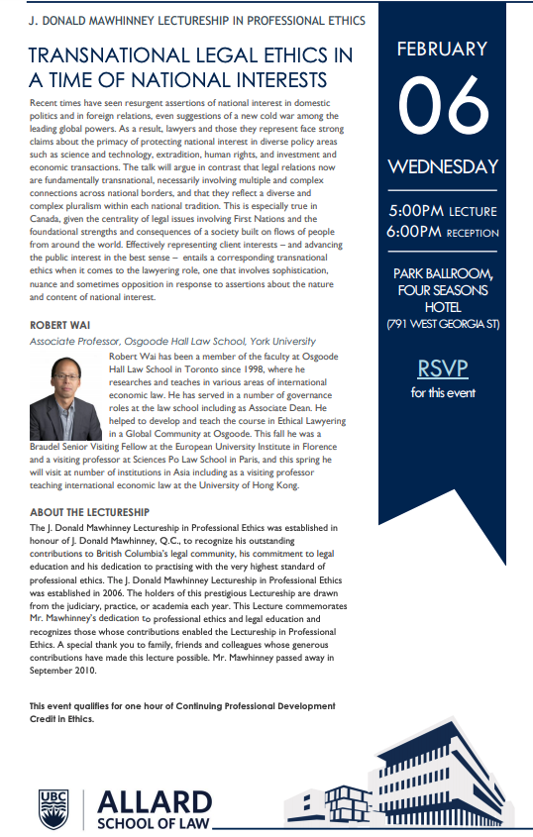

2.1-1 To the state
(a) A lawyer owes a duty to the state, to maintain its integrity and its law. A lawyer should not aid, counsel or assist any person to act in any way contrary to the law…

Slide 50
2.1-3 To the client
(a) A lawyer should obtain sufficient knowledge of the relevant facts and give adequate consideration to the applicable law before advising a client, and give an open and undisguised opinion of the merits and probable results of the client’s cause. The lawyer should be wary of bold and confident assurances to the client, especially where the lawyer’s employment may depend on such assurances. The lawyer should bear in mind that seldom are all the law and facts on the client’s side, and that audi alteram partem (hear the other side) is a safe rule to follow.
(b) A lawyer should disclose to the client all the circumstances of the lawyer’s relations to the parties and interest in or connection with the controversy, if any, that might influence whether the client selects or continues to retain the lawyer. A lawyer must not act where there is a conflict of interests between the lawyer and a client or between clients.

Slide 51
(c) Whenever the dispute will admit of fair settlement the client should be advised to avoid or to end the litigation…
(e) A lawyer should endeavour by all fair and honourable means to obtain for a client the benefit of any and every remedy and defence that is authorized by law. The lawyer must, however, steadfastly bear in mind that this great trust is to be performed within and not without the bounds of the law. The office of the lawyer does not permit, much less demand, for any client, violation of law or any manner of fraud or chicanery. No client has a right to demand that the lawyer be illiberal or do anything repugnant to the lawyer’s own sense of honour and propriety…
(g) A lawyer should not, except as by law expressly sanctioned, acquire by purchase or otherwise any interest in the subject-matter of the litigation being conducted by the lawyer. A lawyer should scrupulously guard, and not divulge or use for personal benefit, a client’s secrets or confidences. Having once acted for a client in a matter, a lawyer must not act against the client in the same or any related matter

Slide 52
2.1-5 To oneself
(a) A lawyer should assist in maintaining the honour and integrity of the legal profession, should expose before the proper tribunals without fear or favour, unprofessional or dishonest conduct by any other lawyer and should accept without hesitation a retainer against any lawyer who is alleged to have wronged the client…
(d) No client is entitled to receive, nor should any lawyer render any service or advice involving disloyalty to the state or disrespect for judicial office, or the corruption of any persons exercising a public or private trust, or deception or betrayal of the public.
(e) A lawyer should recognize that the oaths taken upon admission to the Bar are solemn undertakings to be strictly observed.
(f) All lawyers should bear in mind that they can maintain the high traditions of the profession by steadfastly adhering to the time-honoured virtues of probity, integrity, honesty and dignity.

Slide 53
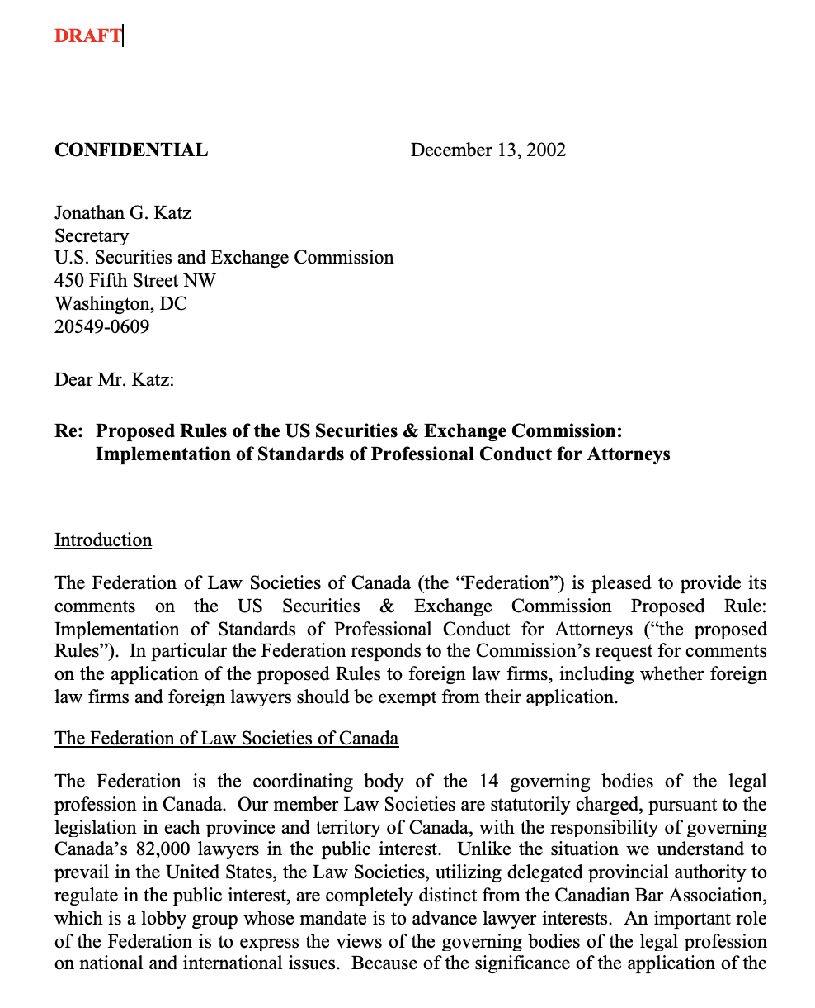

Slide 54
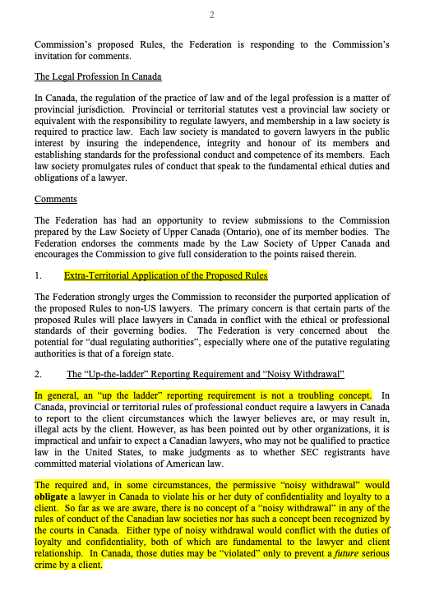

Slide 55
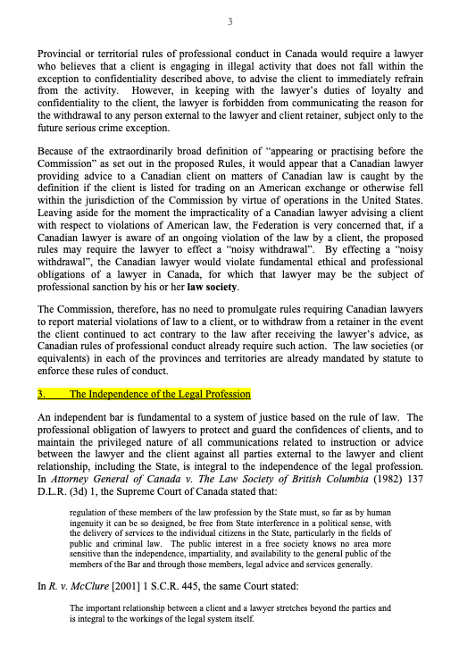

Slide 56
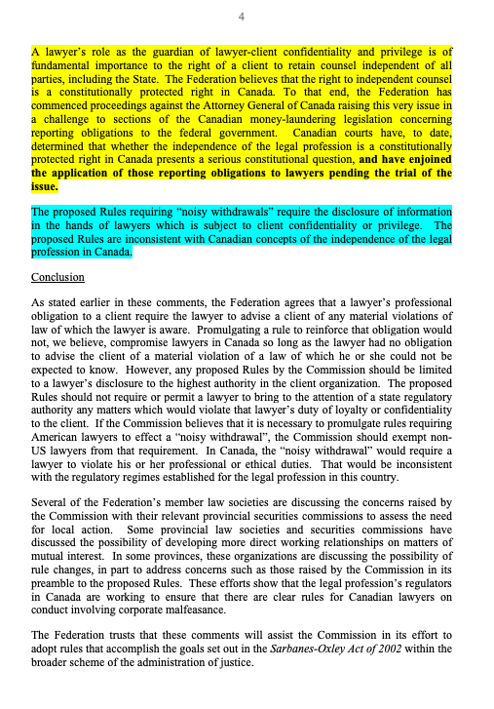

Slide 57
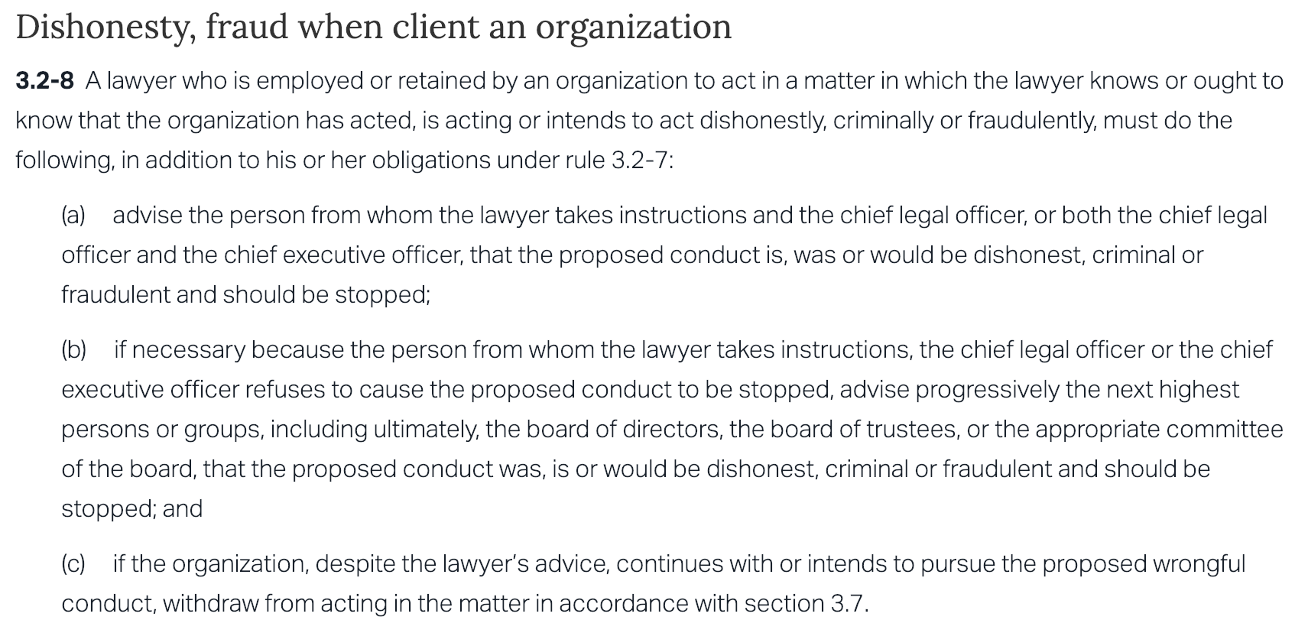

Slide 58

Filed for bankruptcy Dec. 2, 2001

Slide 59
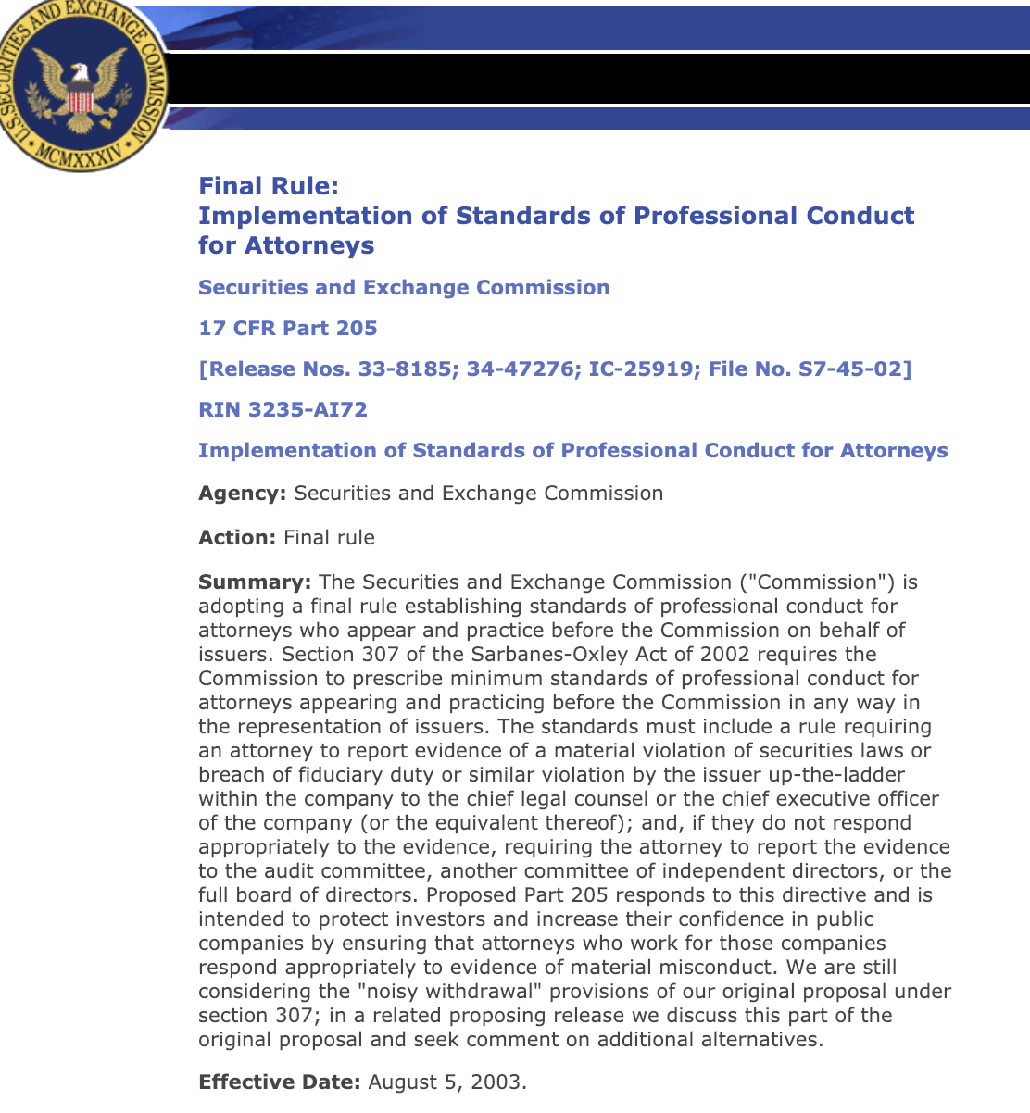

Slide 60
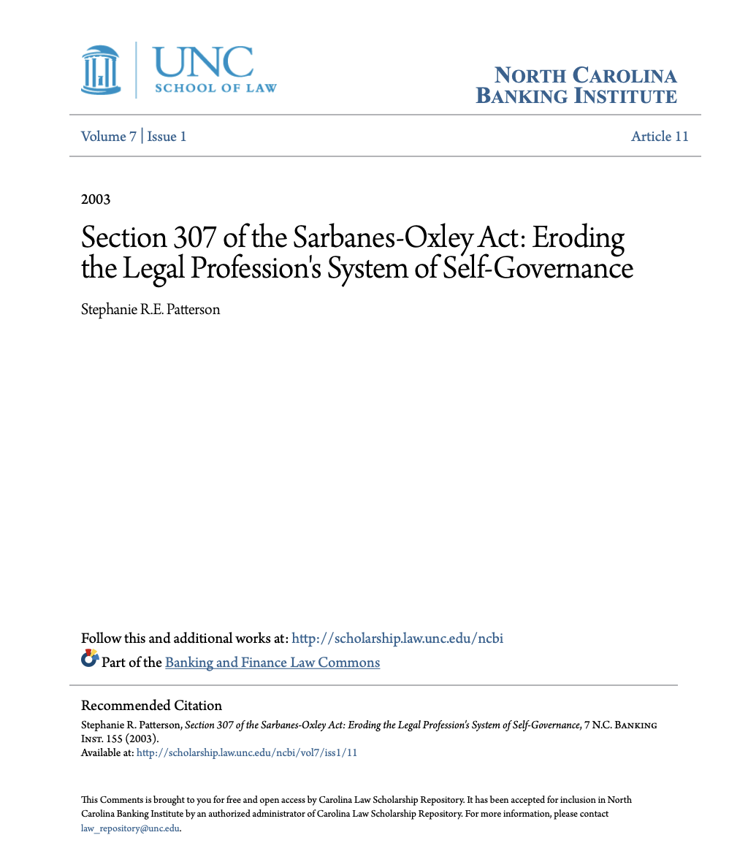

Slide 61
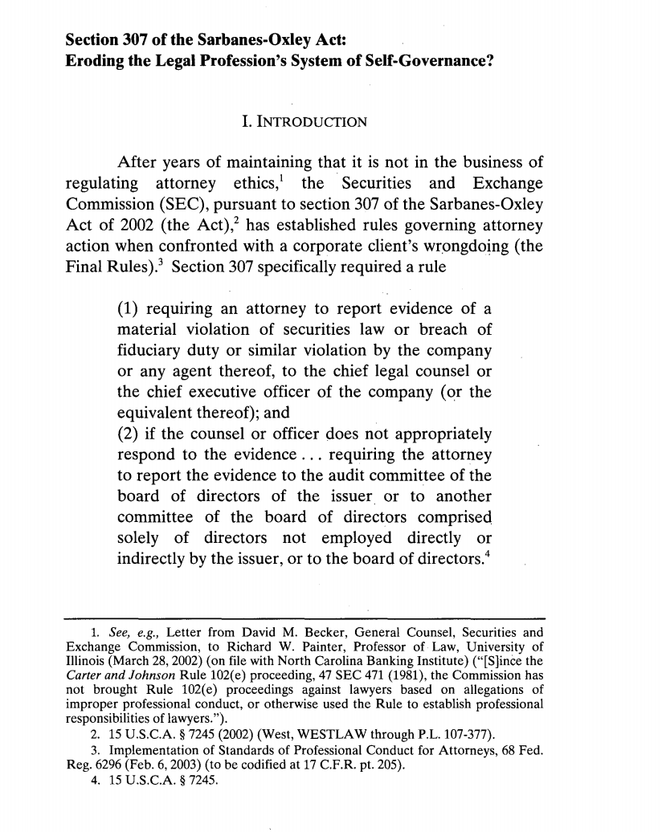

Slide 62
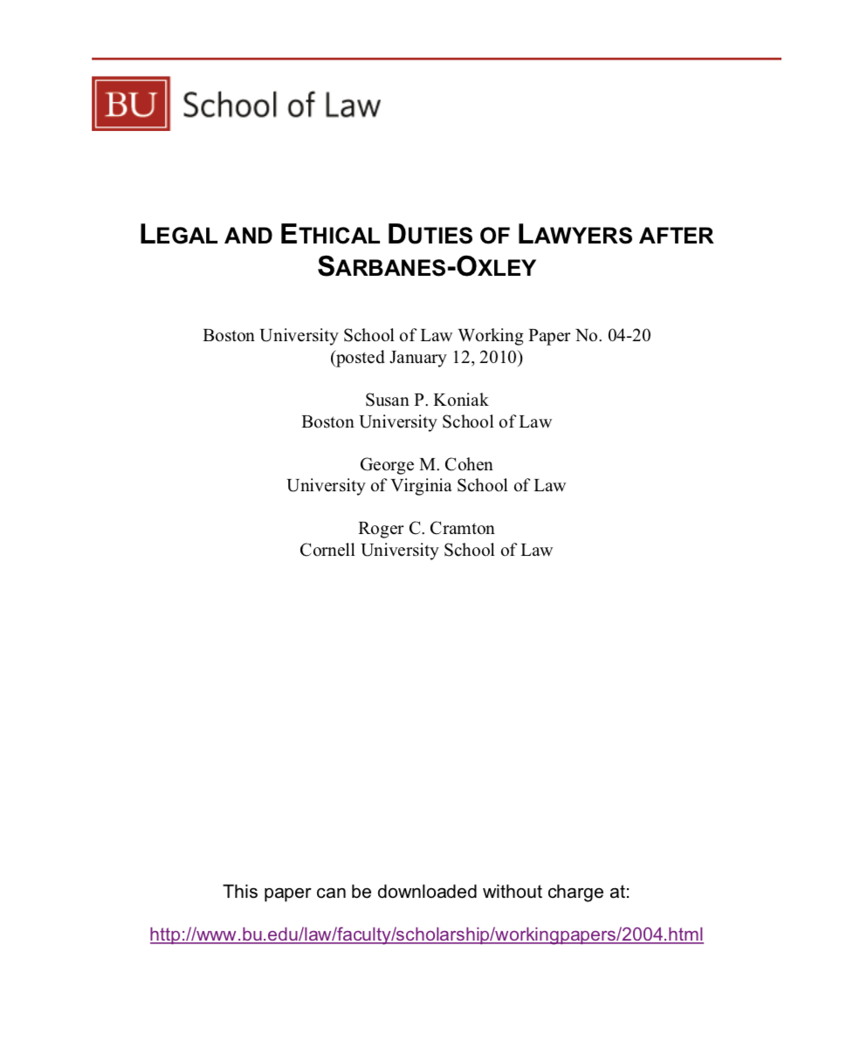

Slide 63
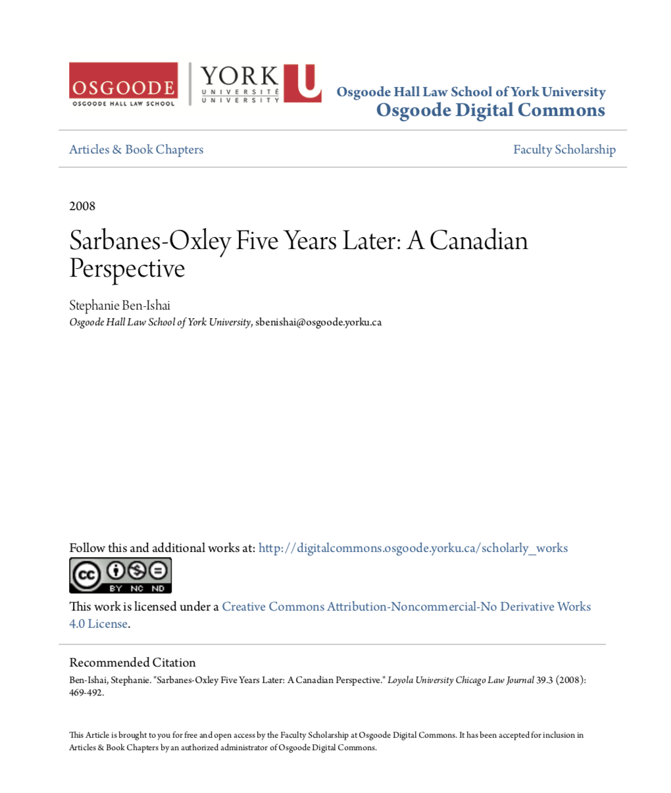

Slide 64
2. Avoid conflicts
Understand & acknowledge conflicts are possible, even likely, and realistically inevitable.
Identify conflicts that that affect your ability to act as counsel.
Where there is a conflict, disclose and dis-engage
When in doubt refer the work…

Slide 65
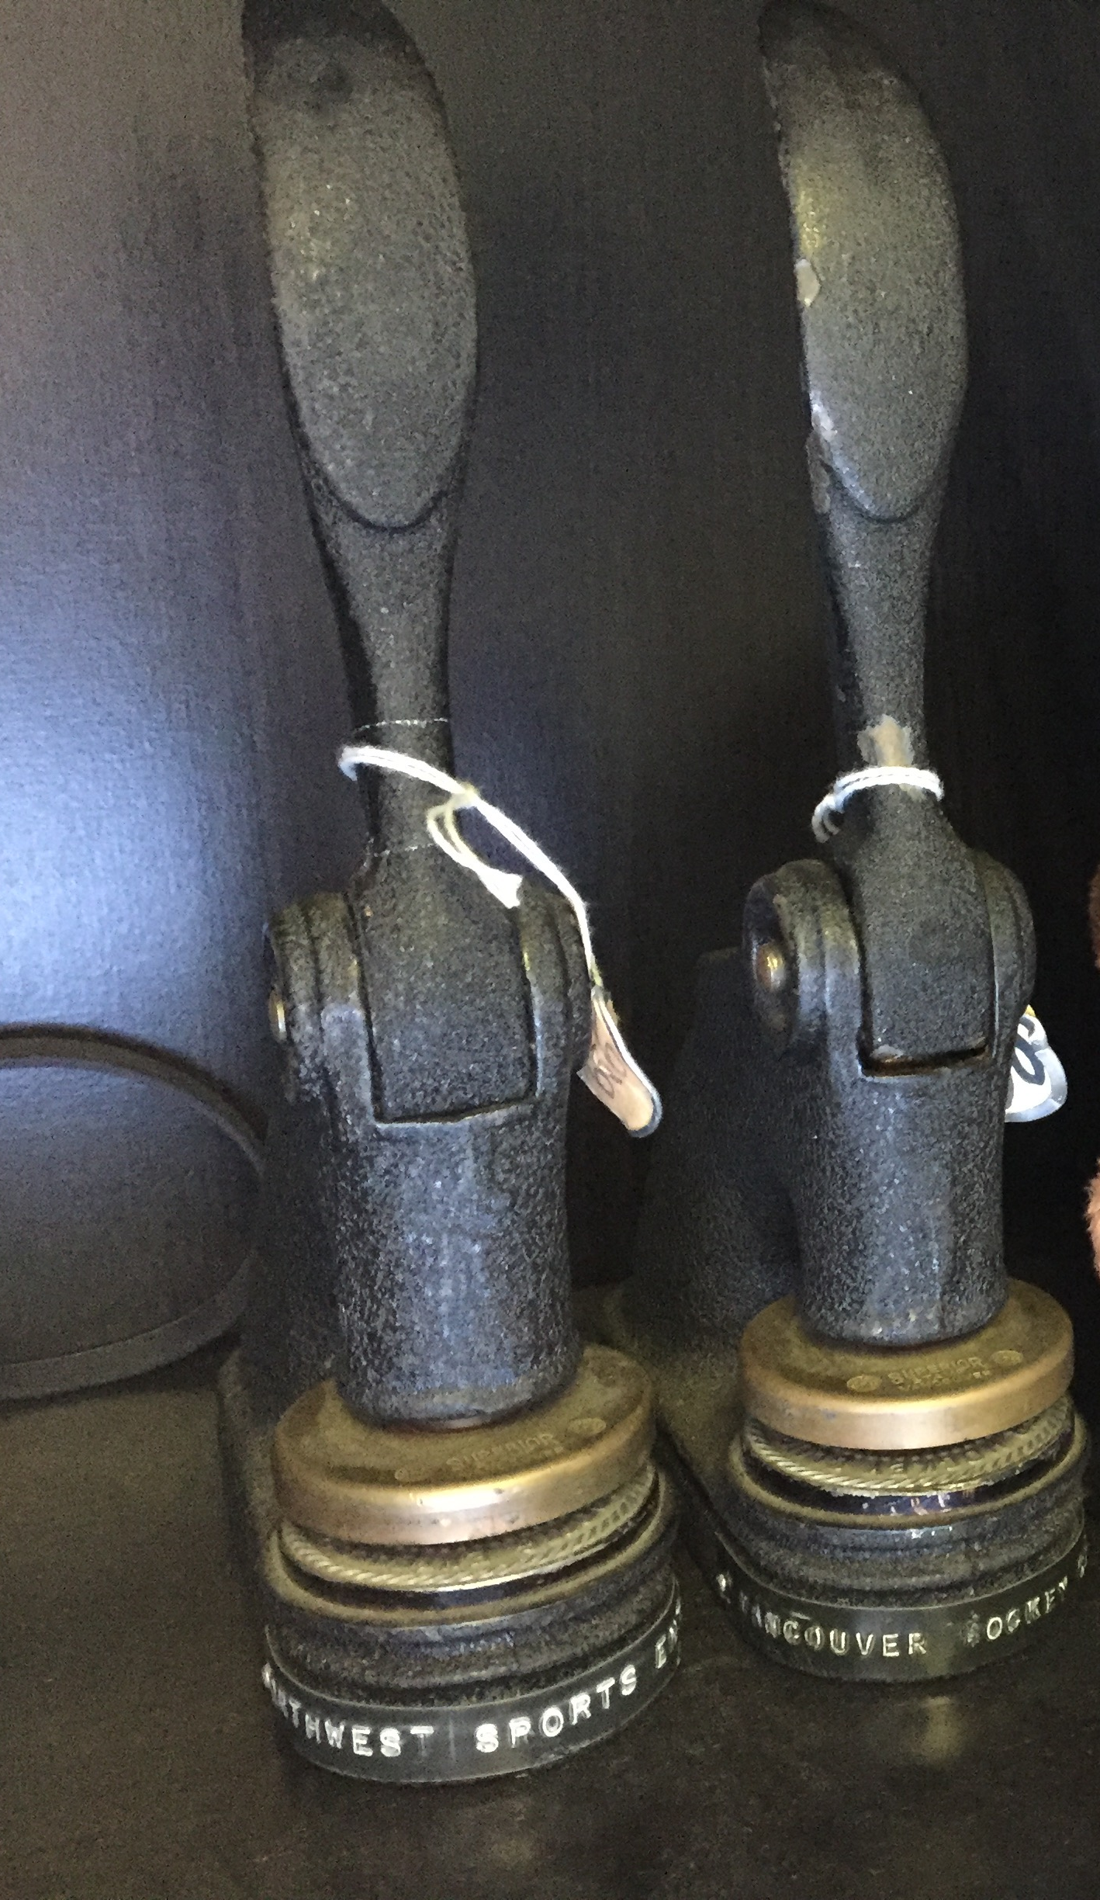
2A. You act only for the company; & act only “in the best interests of the company”.

Slide 66
3. Identify your hat in context
If you are acting in another capacity than lawyer, should you be acting as your own lawyer or have the lawyering referred out (either internally or externally)?

Slide 67

Which hat?

Slide 68


Slide 69

4. Establish the scope of your lawyer hat

Slide 70
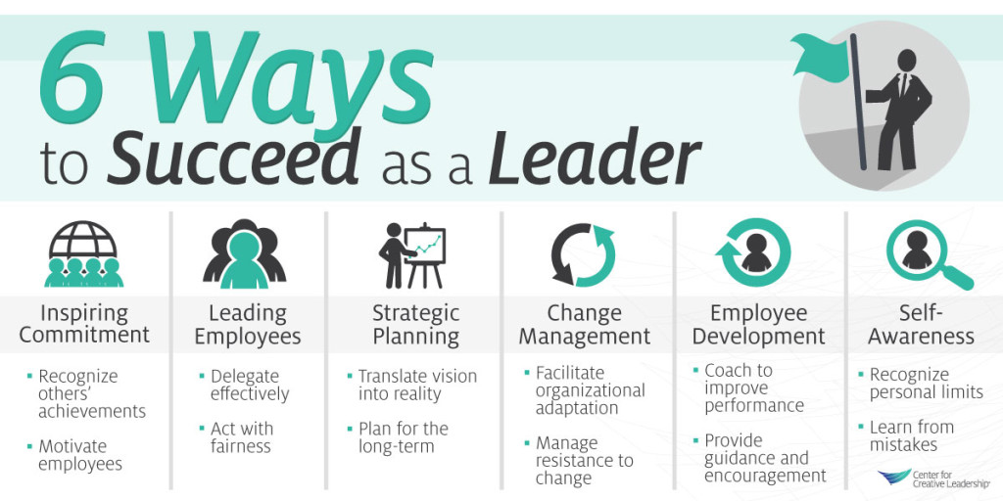
5. LEAD

Slide 71
LEAD

Slide 72
In practical terms meaning what?…
Educate
Don’t let non-lawyers second guess your legal views – only other counsel – bring in outside counsel
Provide alternatives (including possible non-legal ones)
Use PR fallout fear?
Don’t hide behind the technical

Slide 73
Pause

Slide 74
QUESTIONS?
THOUGHTS?
DISCUSSION?

Slide 75


Slide 76
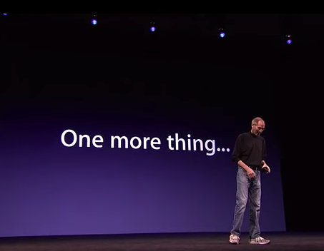

Slide 77
Nominate a great in-house counsel

Slide 78
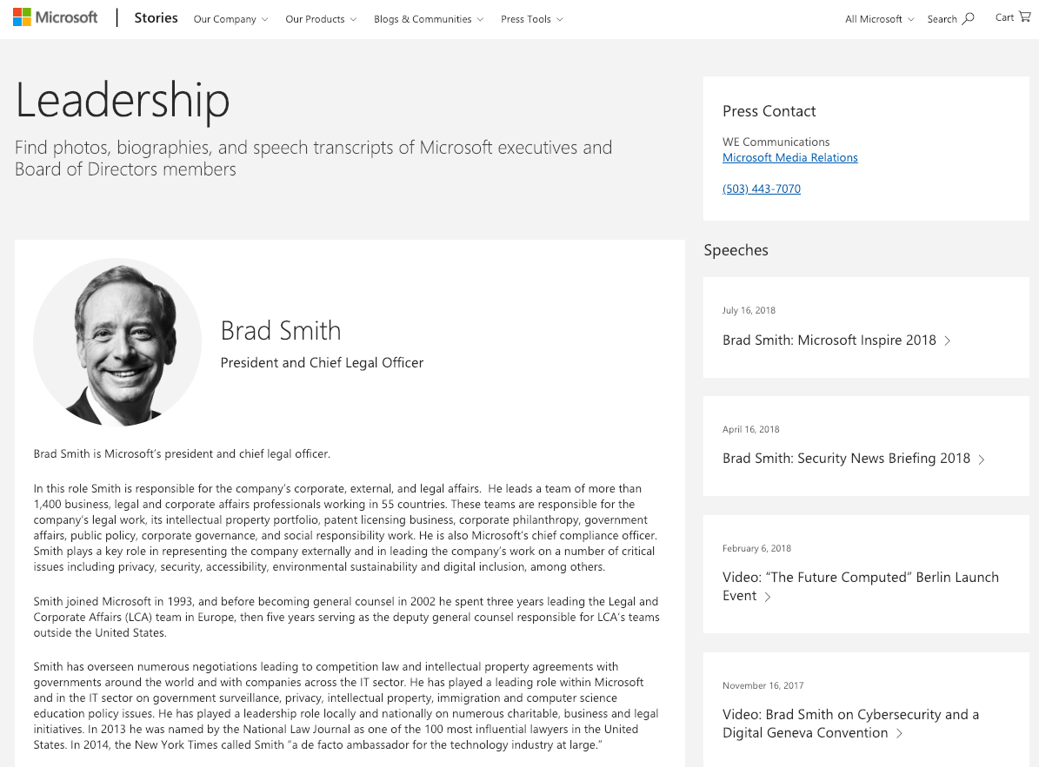

Slide 79


Slide 80


A MATTER OF PERSPECTIVE

Slide 81

Conclusion

Slide 82

Always include a cat picture

Slide 83
In learning you will teach
And in teaching you will learn
Phil Collins' Son of Man (1999)

Slide 84
Our Academic Partners

Slide 86
Nominate a great in-house counsel

Slide 87
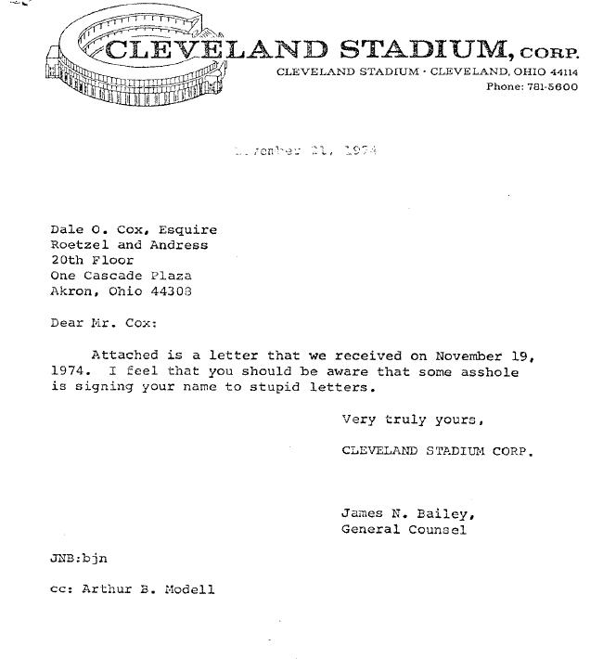

Slide 88

Wait!…What?…Rewind…

