Slide 1
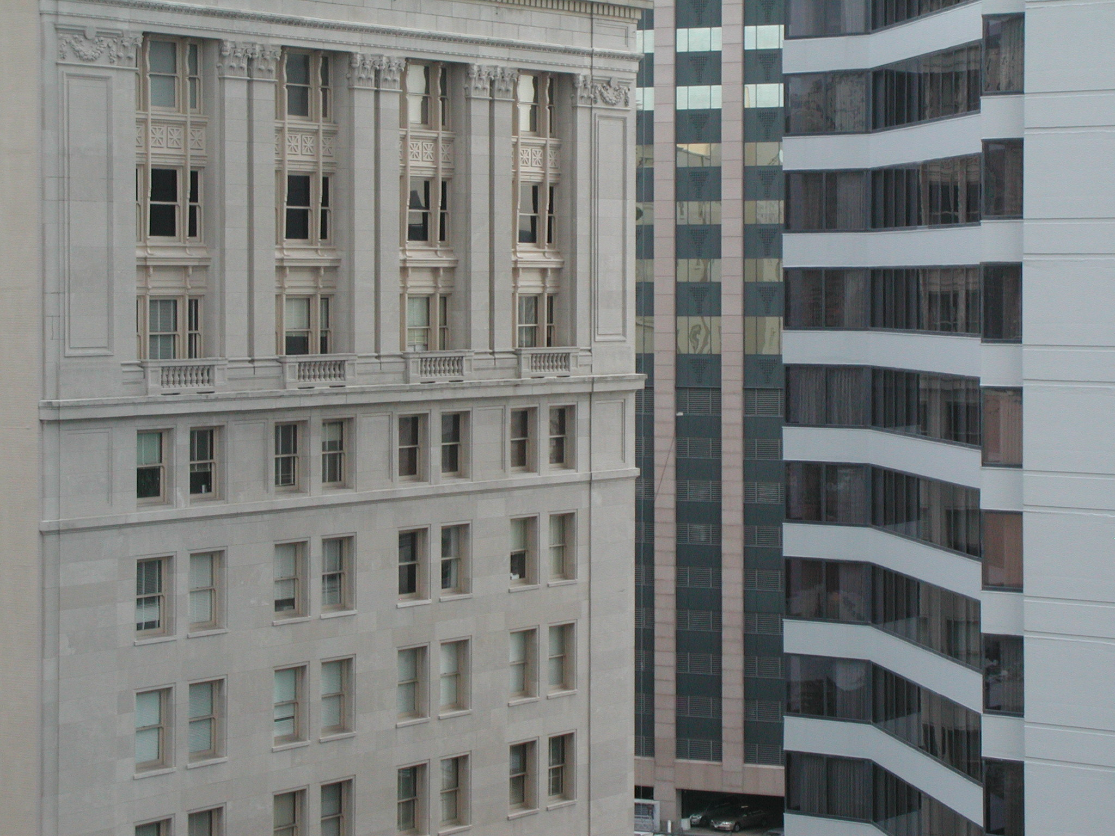

“With great power…”
Talks 9
LAWF 3780
Challenges of In-House & Corporate Counsel
TRU Faculty of Law
Spring, 2019
Jon Festinger Q.C.
Centre for Digital Media
QMUL School of Law (CCLS)
http://commlaw.allard.ubc
@jonfestinger
jon_festinger@thecdm.ca

Slide 2
Hello
LAW F 3780
Challenges of In-House
& Corporate Counsel

Slide 3
Logistics

Slide 4
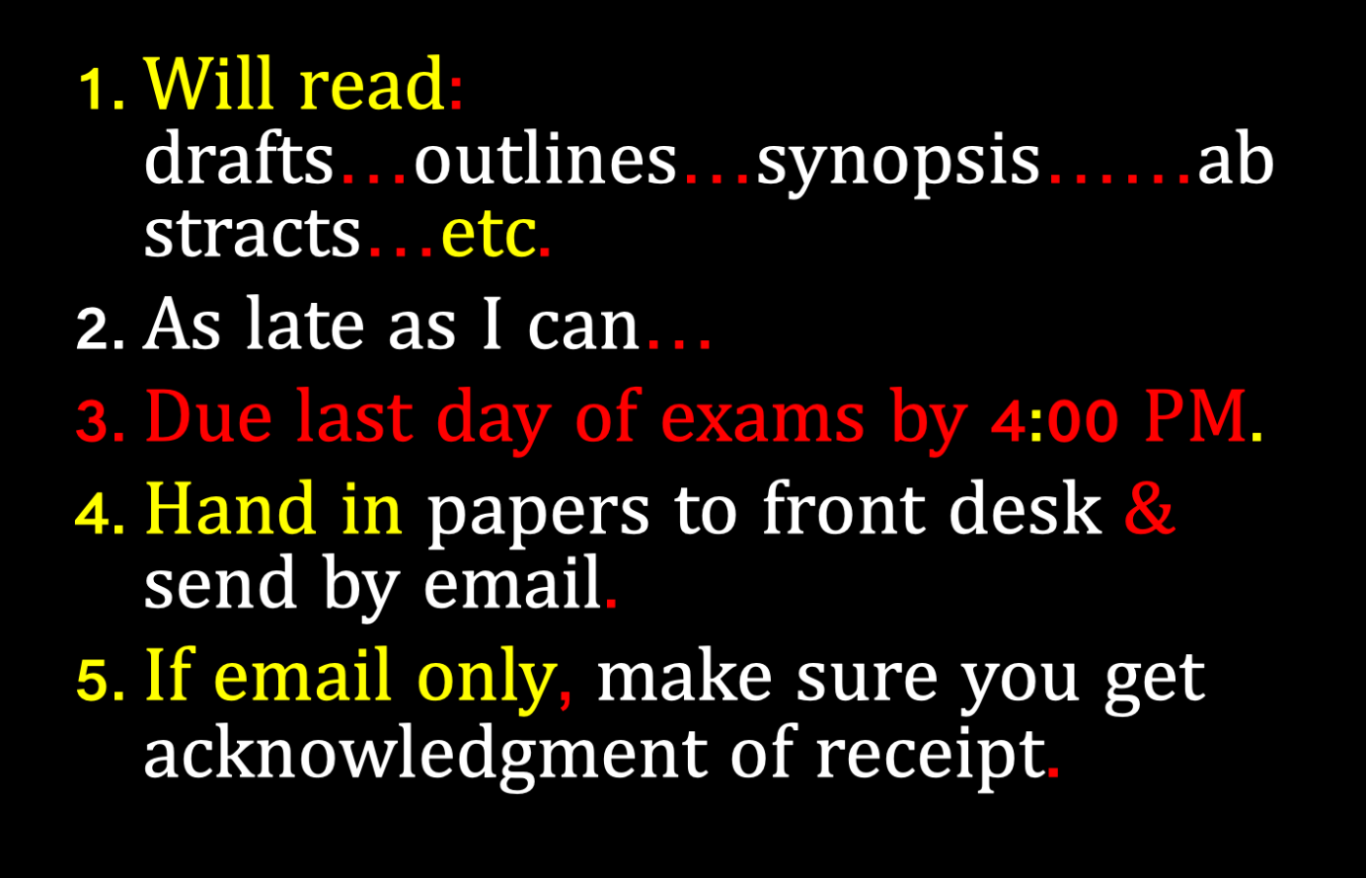

Slide 5
QUESTIONS?
THOUGHTS?
DISCUSSION?

Slide 6

Pause

Slide 7
IS ANY JURISDICTION
KEEPING GOOD
STATS?

Slide 8
Latest BC Stats…
3500 practicing members who are exempt from mandatory insurance of 12,736 lawyers = 27.5%

Slide 9
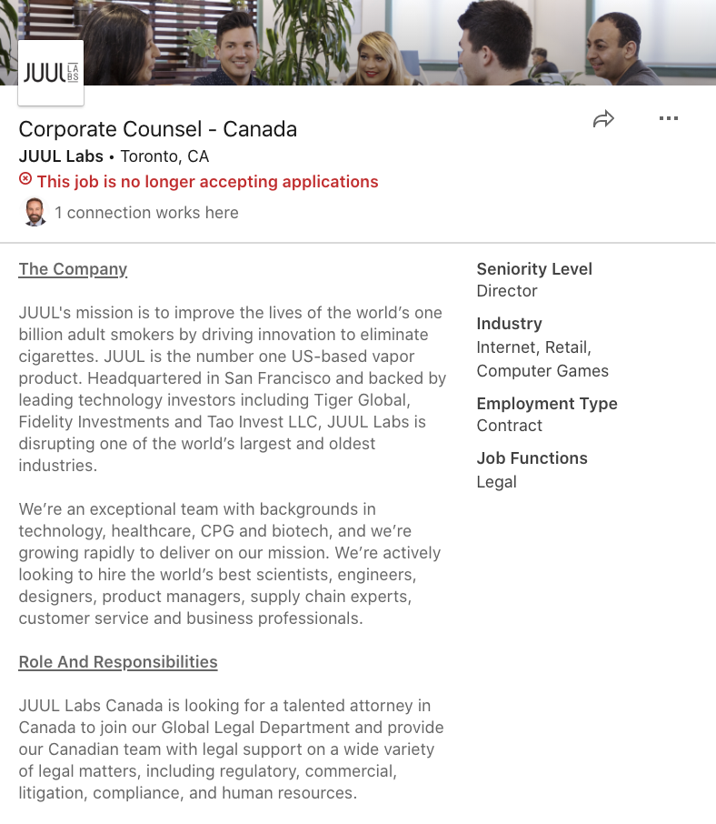
Follow-up to Cannabis → Vaping

Slide 10
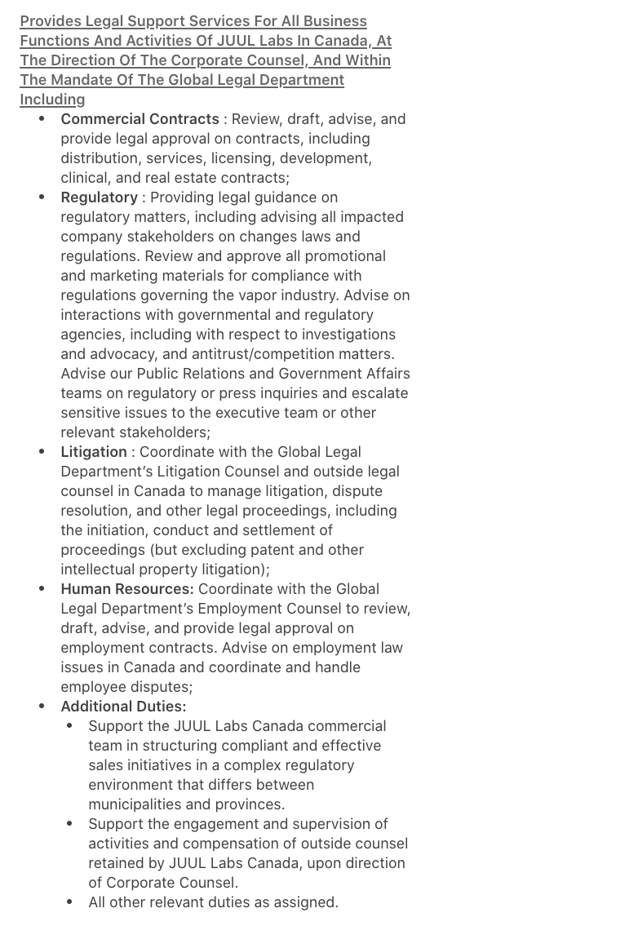

Slide 11
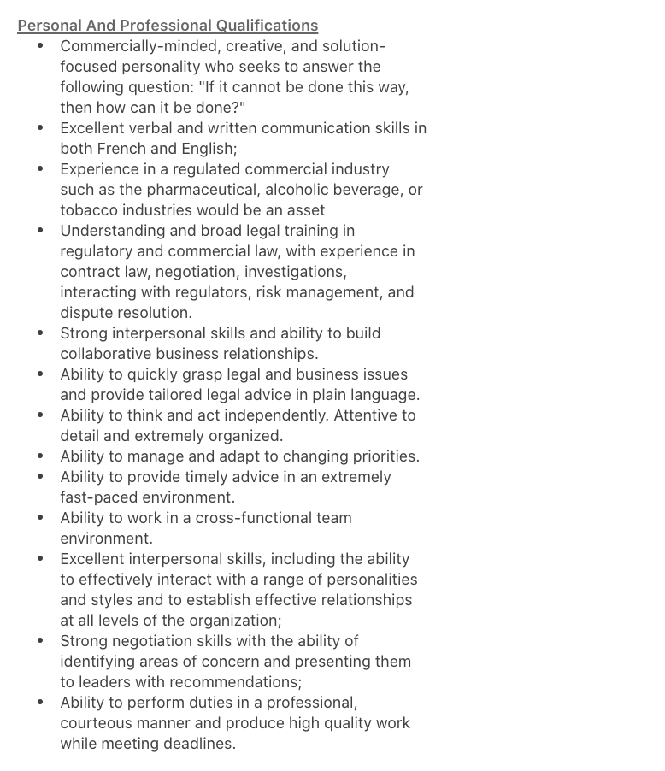

Slide 12
News of the Week

Slide 13
Yours?

Slide 14
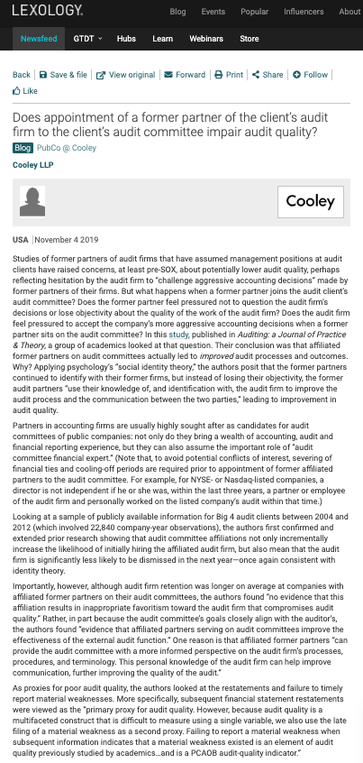

Slide 15
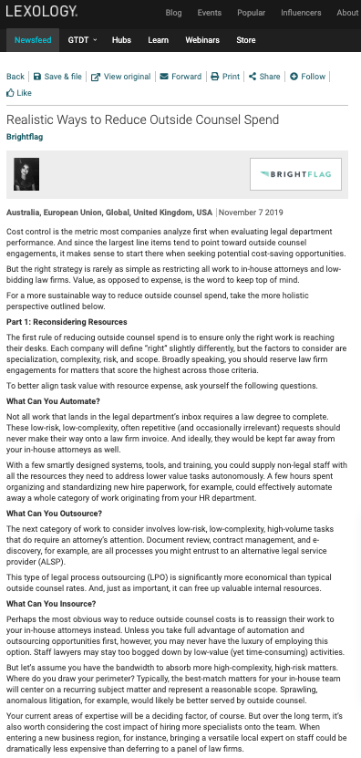

Slide 16
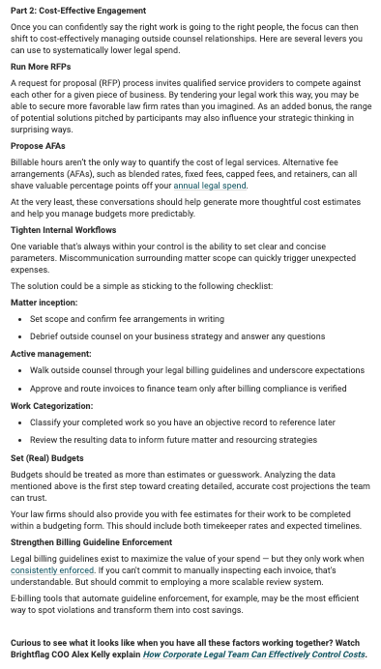

Slide 17
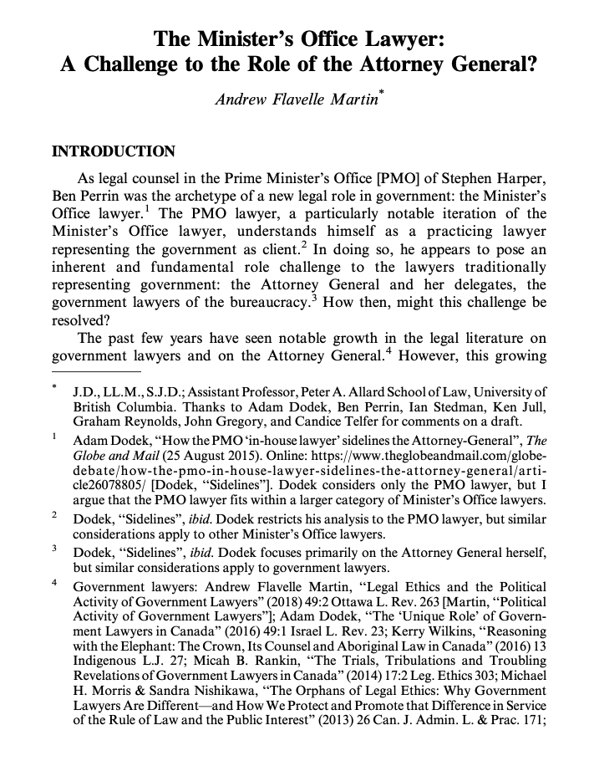

Slide 18
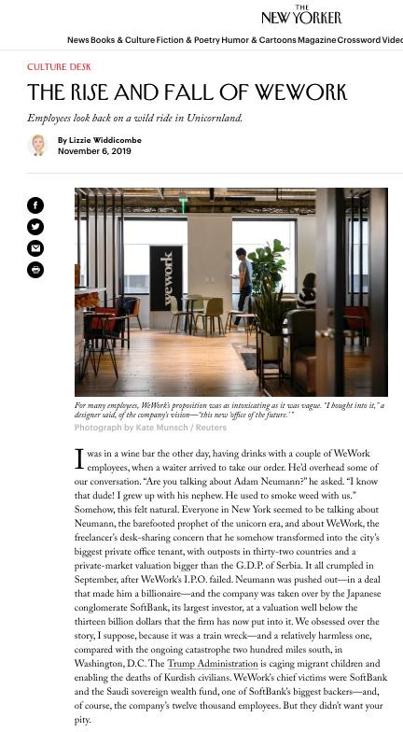

Slide 19
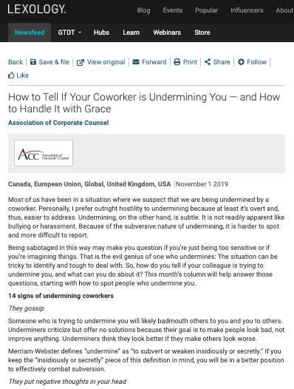

Slide 20
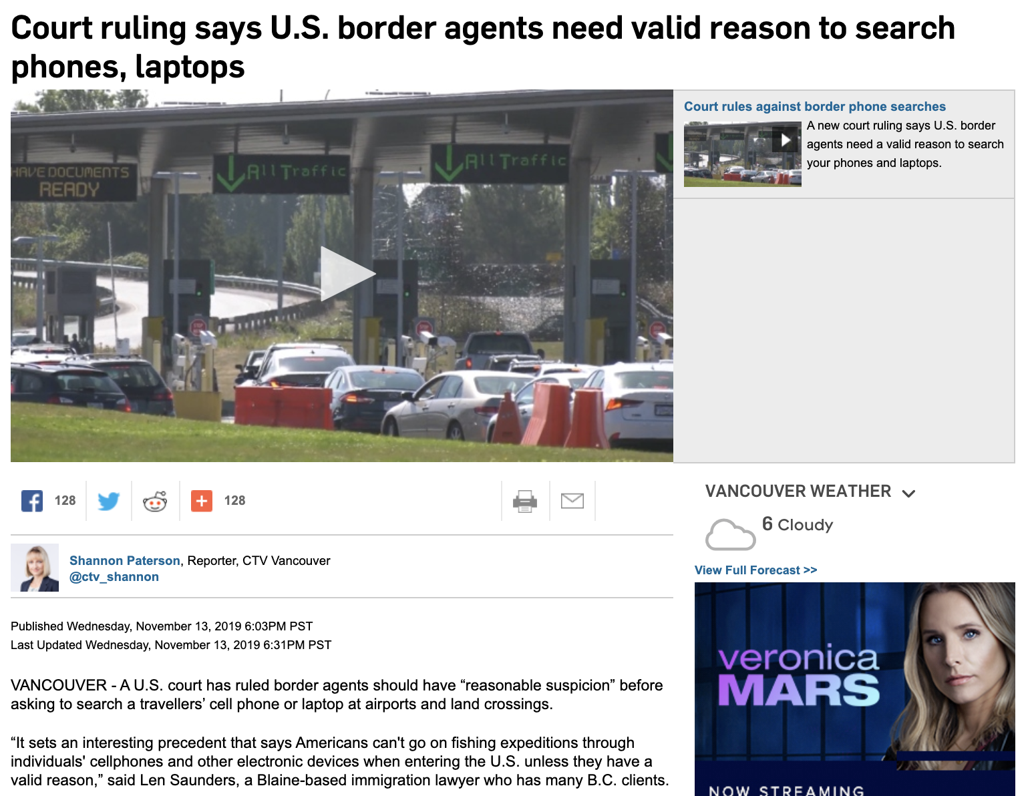

Slide 21
Last Semester This Time

Slide 22
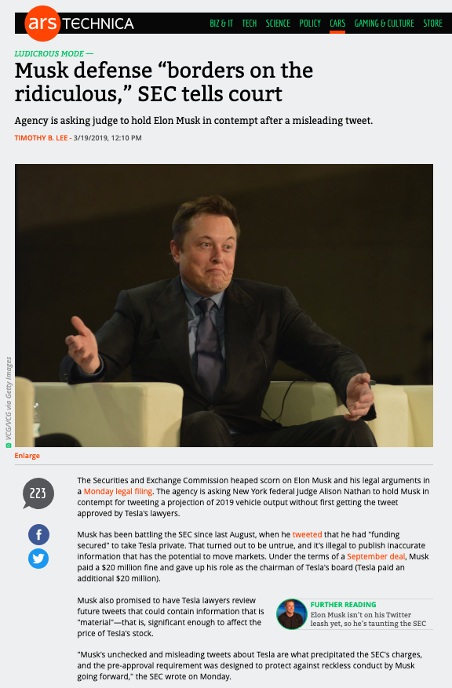
Because Elon…

Slide 23
Pause

Slide 24
QUESTIONS?
THOUGHTS?
DISCUSSION?

Slide 25
Yours?

Slide 26
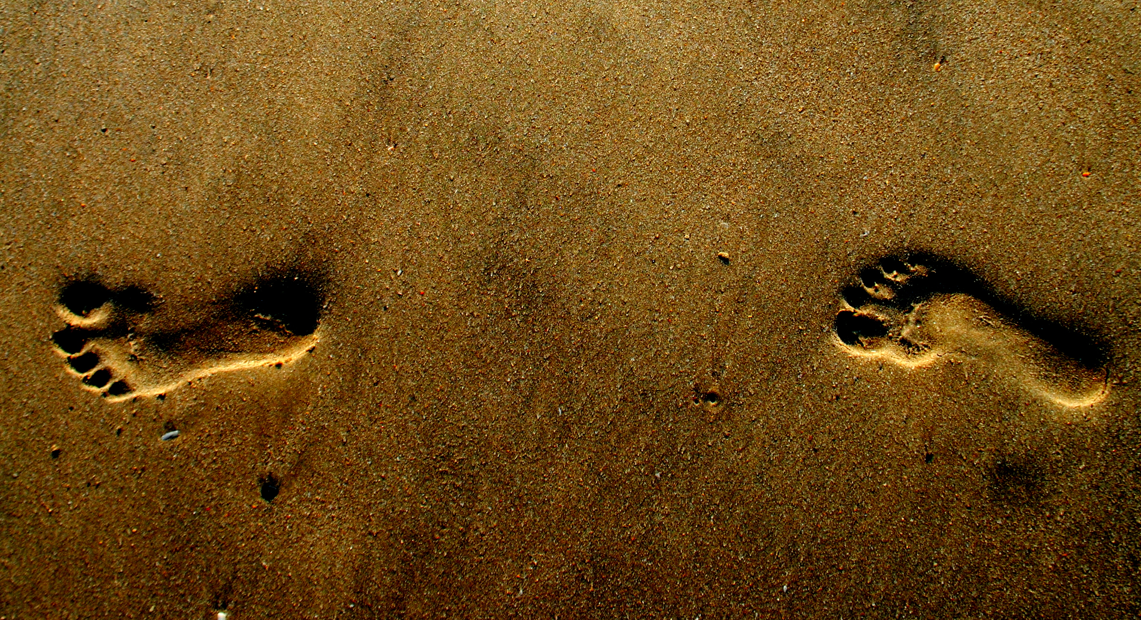
What would you do?

Slide 27


Slide 28
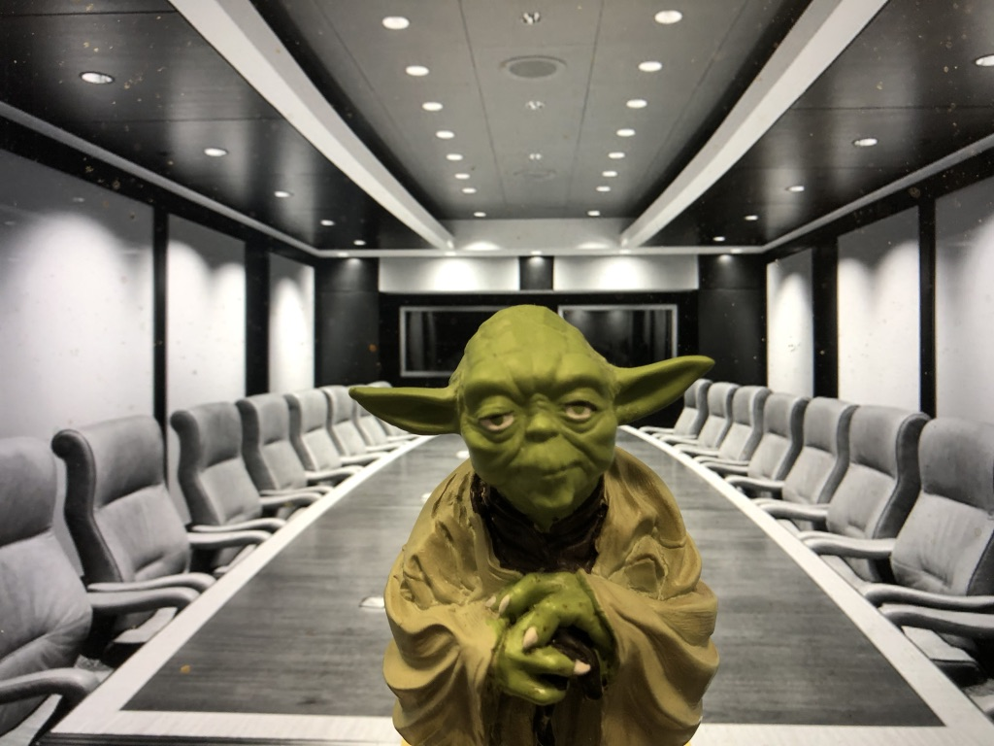
Two Questions…
Where were the Directors?
What views did Counsel transmit?

Slide 29
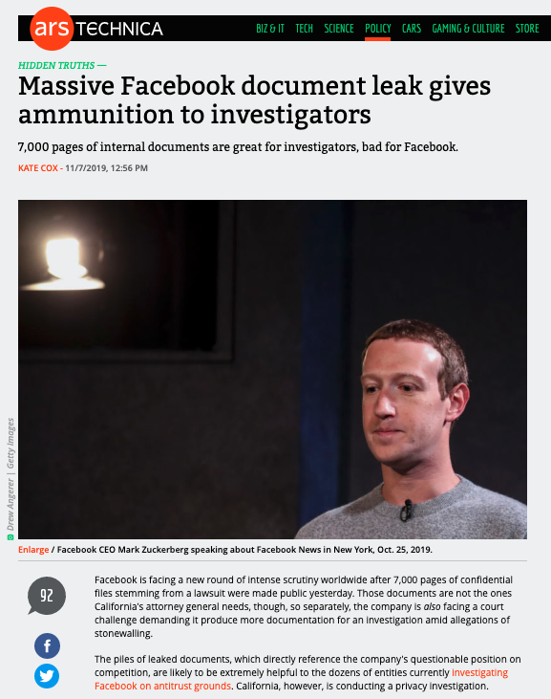

Slide 30
What would you do?

Slide 32
Two Questions…
Where were the Directors?
What views did Counsel transmit?

Slide 33
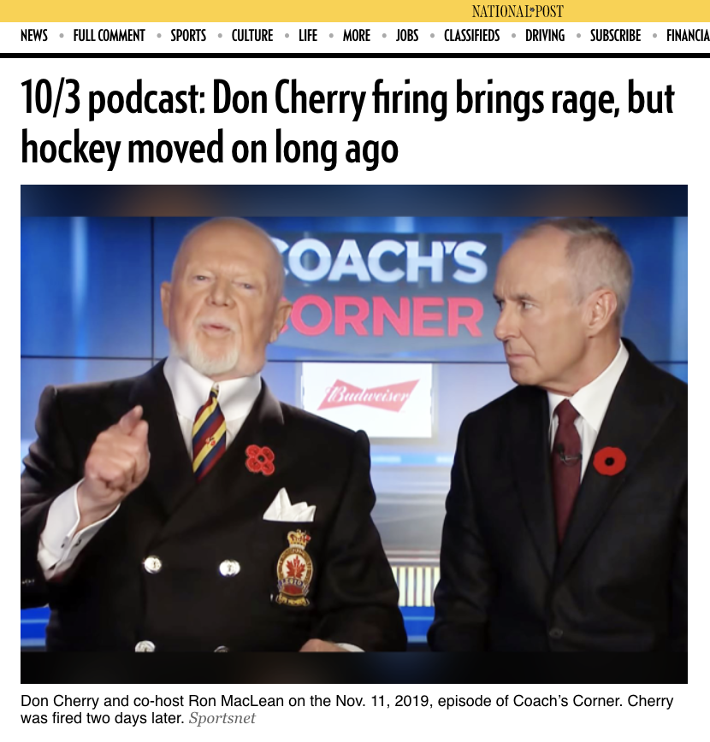

Slide 34
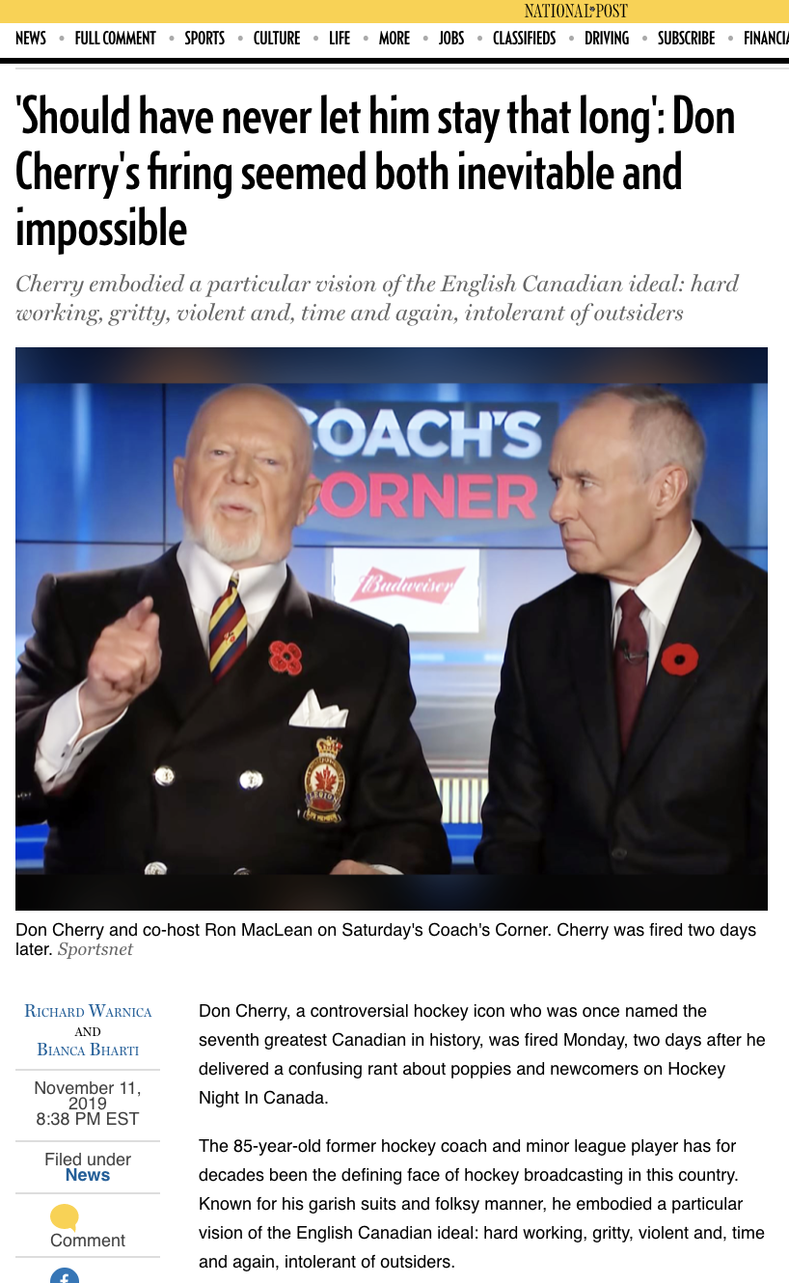

Slide 35
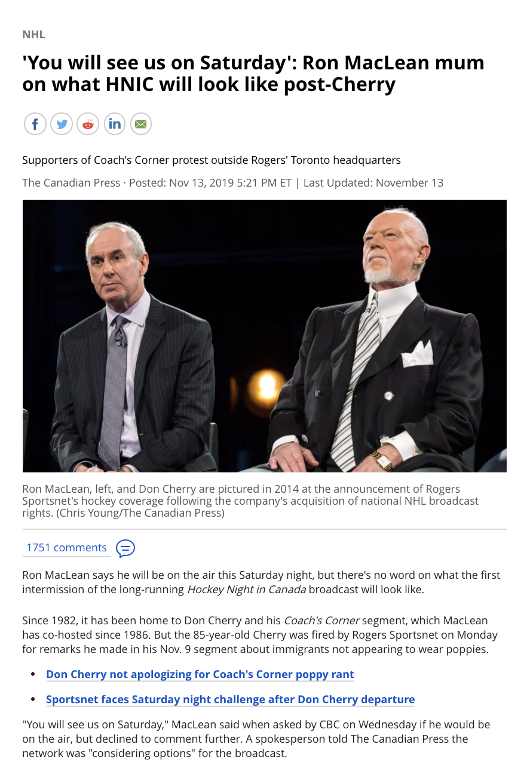

Slide 36
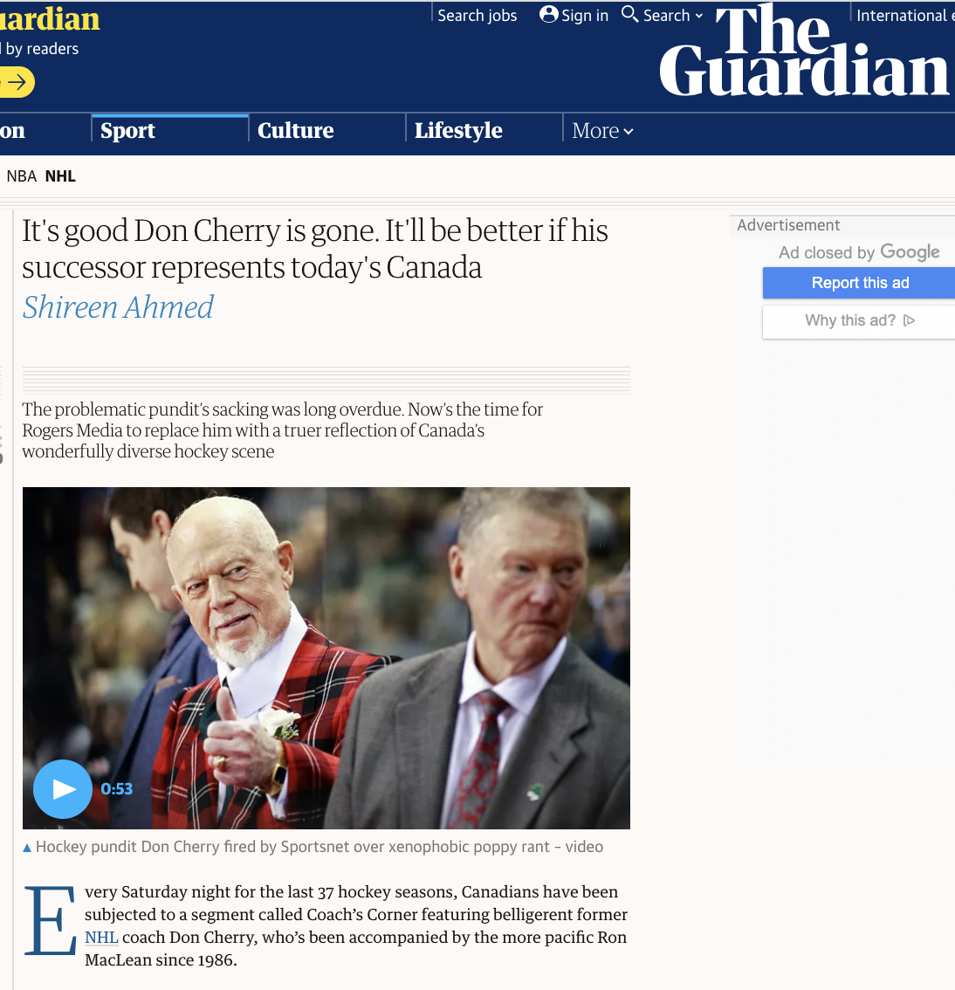

Slide 37
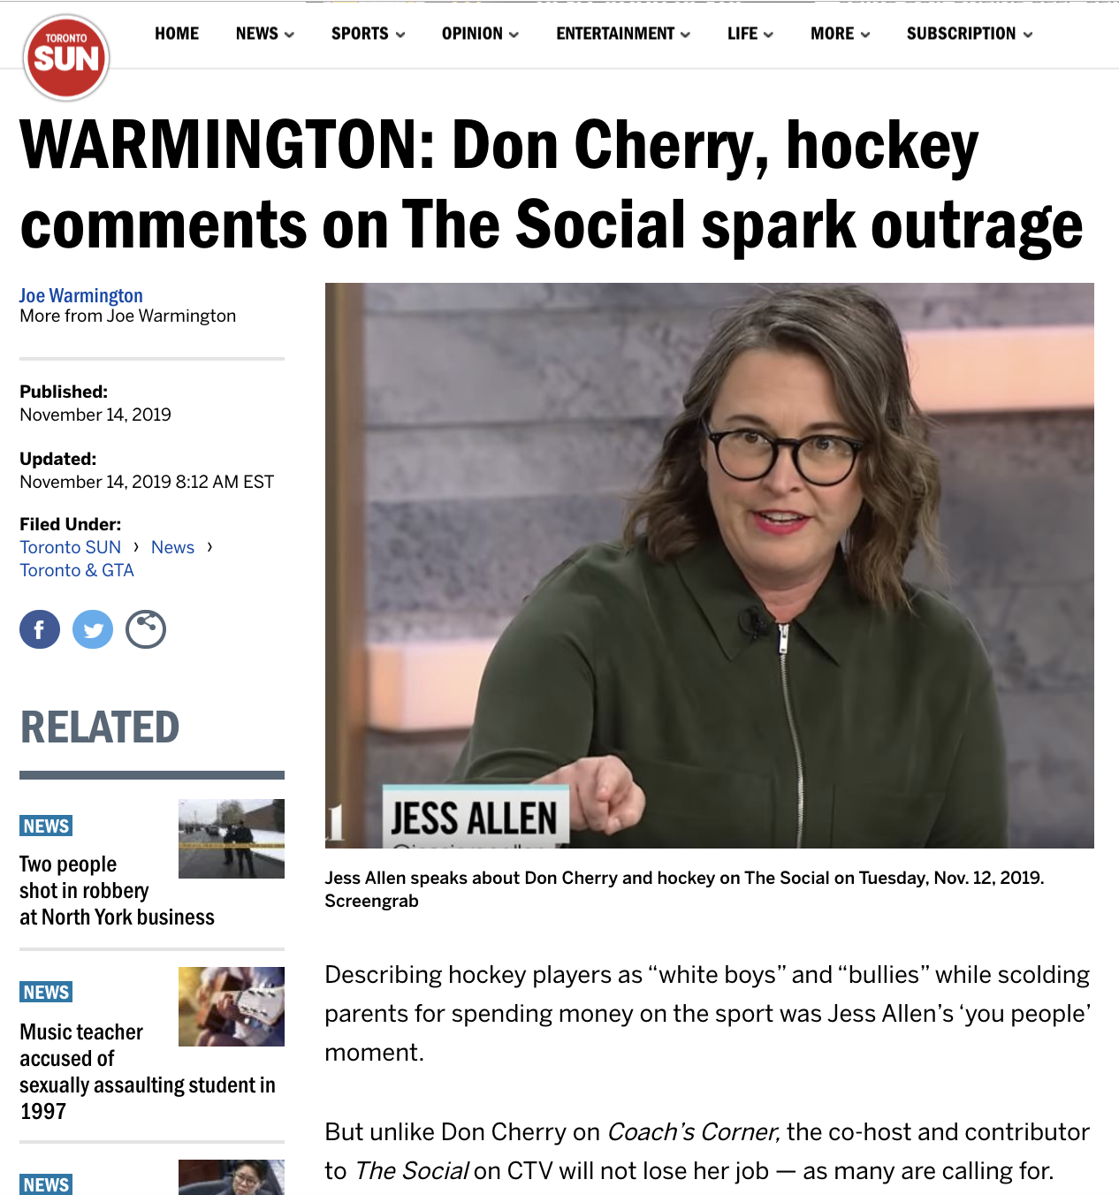

Slide 38
Pause

Slide 39
QUESTIONS?
THOUGHTS?
DISCUSSION?

Slide 40

Now, back to our regularly scheduled programming…

Slide 41

Starting Point 1

Slide 42
Two Questions…
Where were the Directors?
What views did Counsel transmit?

Slide 43
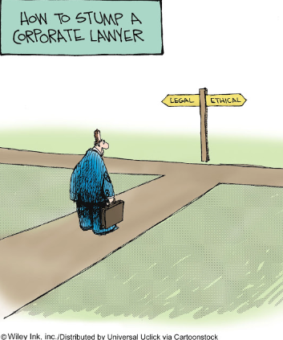
The course in one cartoon

Slide 44
Examine the question from the perspective of:
1. An out-side counsel
2. An in-house counsel
What do you see?

Slide 45
Complications
Employer
Good governance is invisible
Others????

Slide 46

→Structural Framework

Slide 47
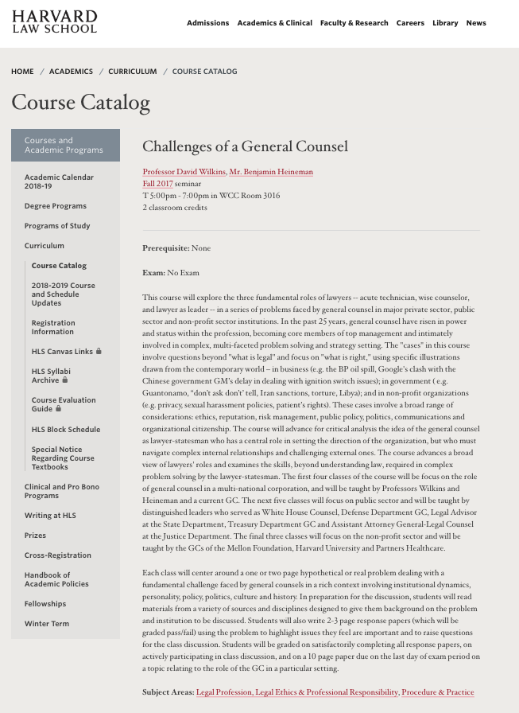
https://hls.harvard.edu/academics/curriculum/catalog/default.aspx?o=72164

Slide 48
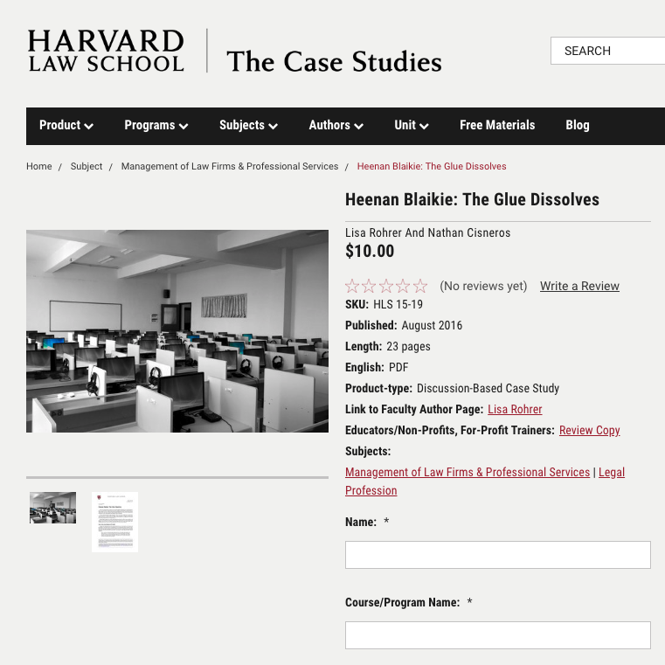
Case Study Method?

Slide 49
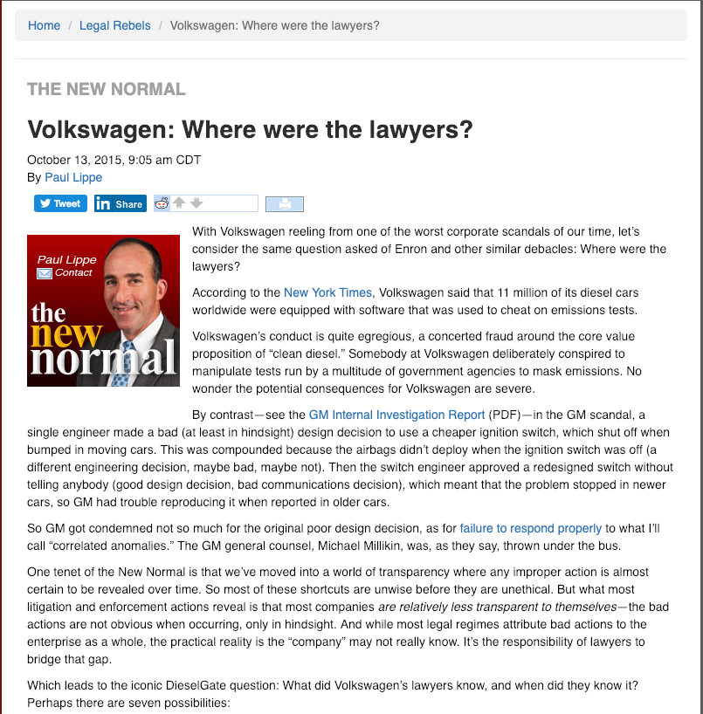
ABA Journal

Slide 50
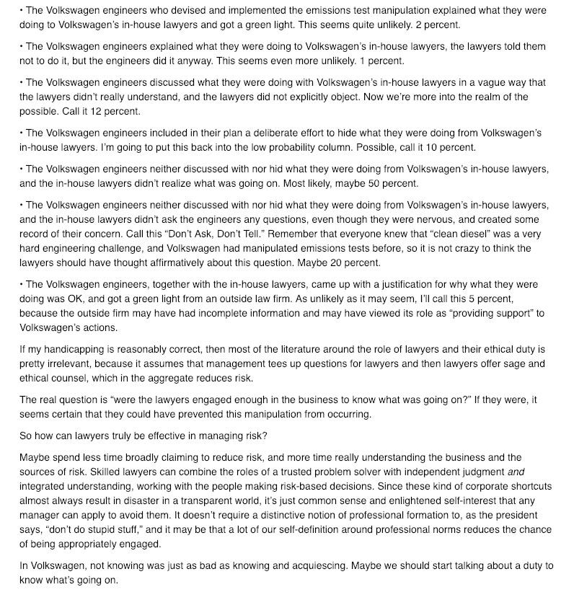

Slide 51
Examine the question from the perspective of:
1. An out-side counsel
2. An in-house counsel
What do you see?

Slide 52
Basic Problem?
Employer/employee relationship is a conflict of interest?
3.4-1 A lawyer must not act or continue to act for a client where there is a conflict of interest, except as permitted under this Code. Commentary
[1] As defined in these rules, a conflict of interest exists when there is a substantial risk that a lawyer’s loyalty to or representation of a client would be materially and adversely affected by the lawyer’s own interest… A client’s interests may be seriously prejudiced unless the lawyer’s judgment and freedom of action on the client’s behalf are as free as possible from conflicts of interest.

Slide 53
[5] The value of an independent bar is diminished unless the lawyer is free from conflicts of interest…The lawyer-client relationship is a fiduciary relationship…This obligation is premised on an established or ongoing lawyer client relationship in which the client must be assured of the lawyer’s undivided loyalty, free from any material impairment of the lawyer and client relationship.
[8] Conflicts of interest can arise in many different circumstances. The following examples are intended to provide illustrations of circumstances that may give rise to conflicts of interest. The examples are not exhaustive.
  (d) A lawyer,..or a family member has a personal financial interest in a client’s affairs or in a matter in which the lawyer is requested to act for a client…
    (i) A lawyer owning a small number of shares of a publicly traded corporation would not necessarily have a conflict of interest…because the holding may have no adverse influence on the lawyer’s judgment...

Slide 54
Basic Problem? Huge?
Separation of Legal Advice
& Decision Making?
Are you doing both?
Should you be doing both?
'A man who is his own lawyer
has a fool for a client.'

Slide 55
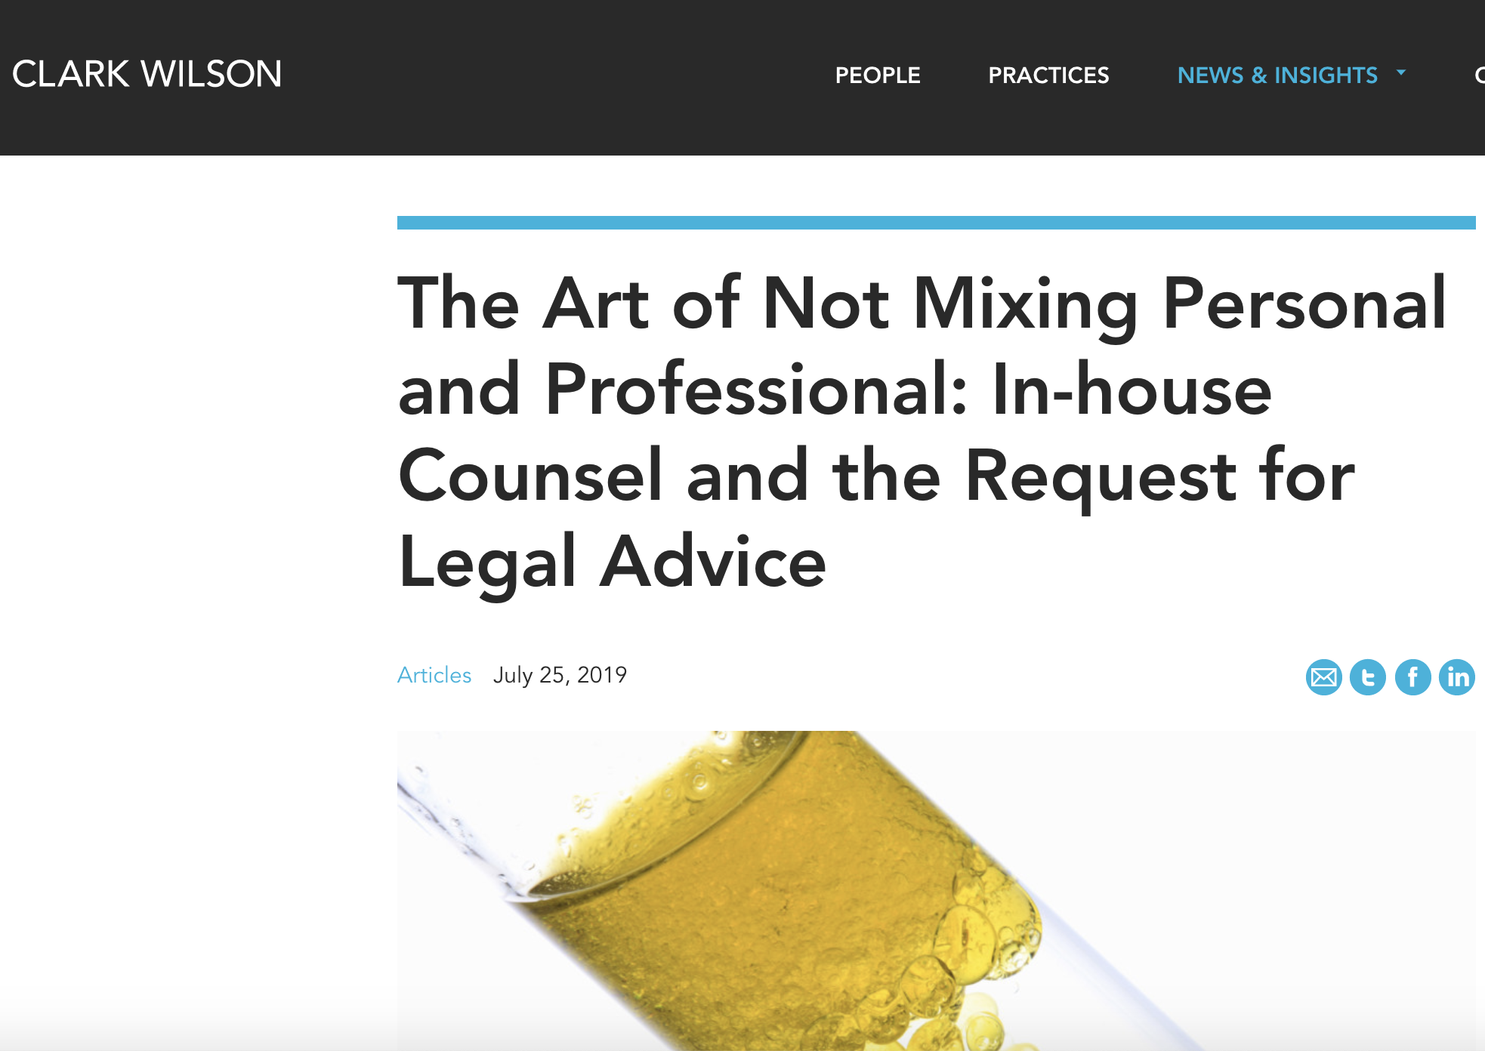
Don’t forget about this either…

Slide 56
Basic Conundrum?
Good governance is invisible

Slide 57

…invisible.
Measured by the number of crises that don’t manifest.

Slide 58
Poor Governance is SUPER VISIBLE
ABA Journal

Slide 59
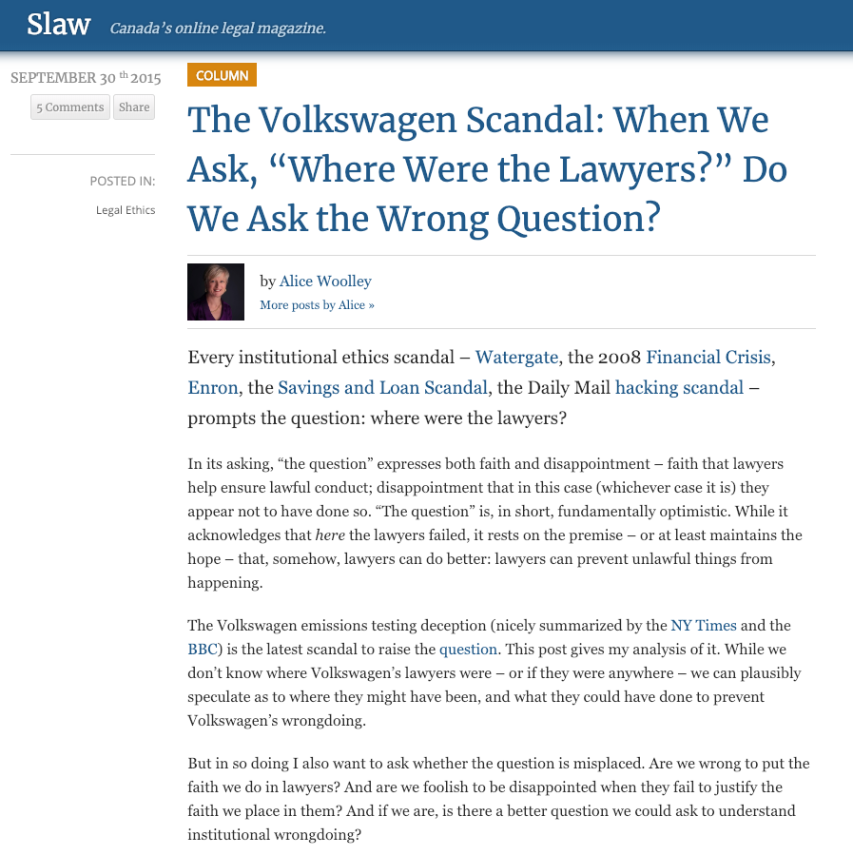

Slide 60
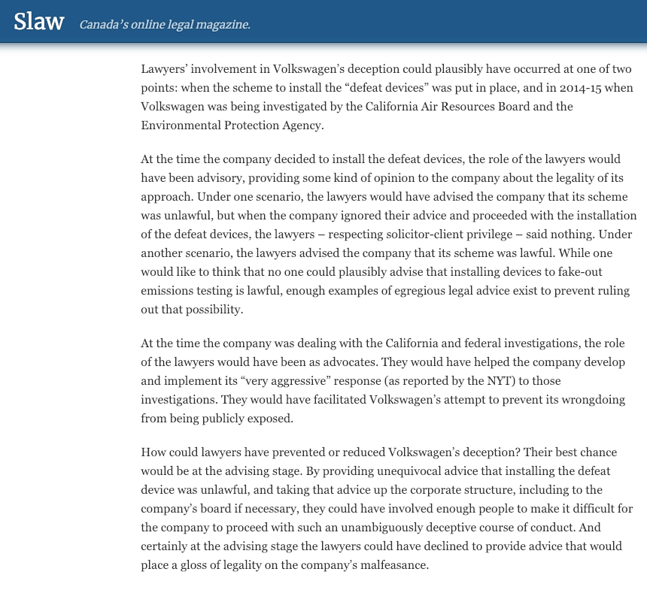

Slide 61
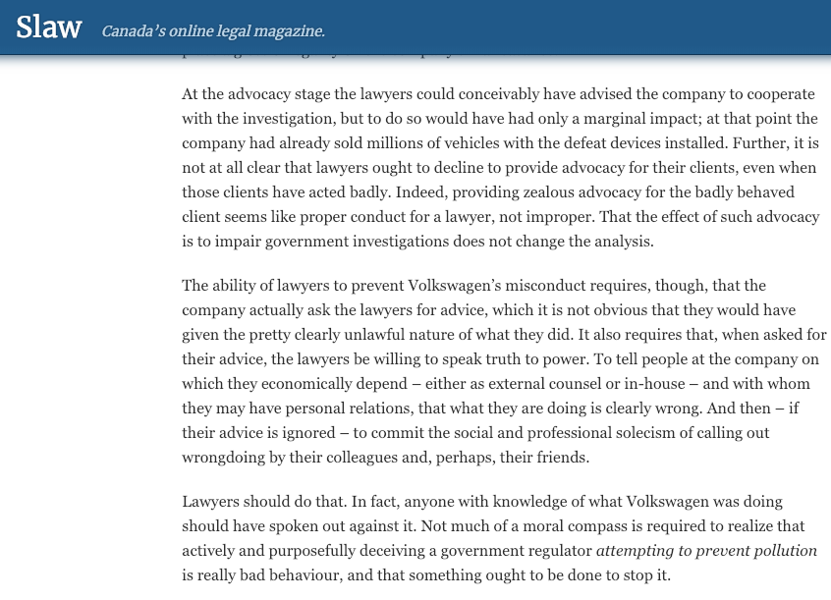

Slide 62
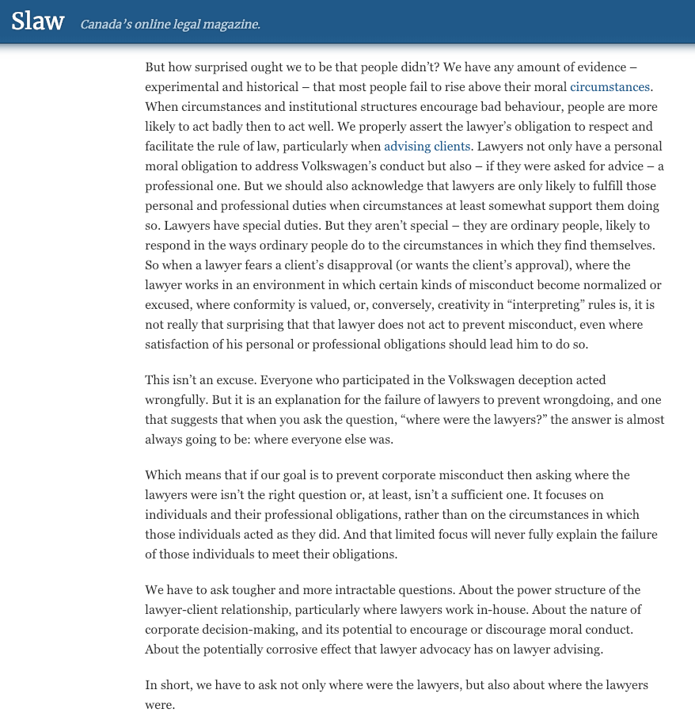

Slide 63
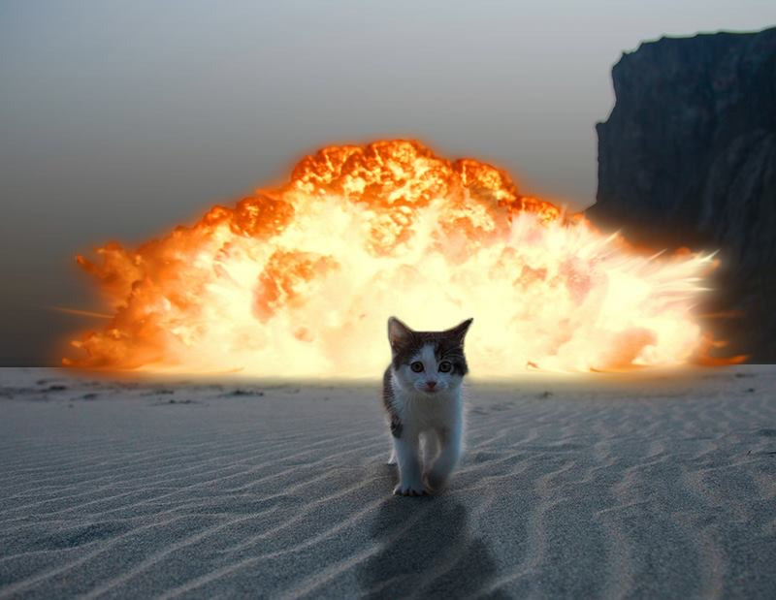
Poor Governance is SUPER VISIBLE

Slide 64
Pause

Slide 65
QUESTIONS?
THOUGHTS?
DISCUSSION?

Slide 66
Starting Point 2

Slide 67
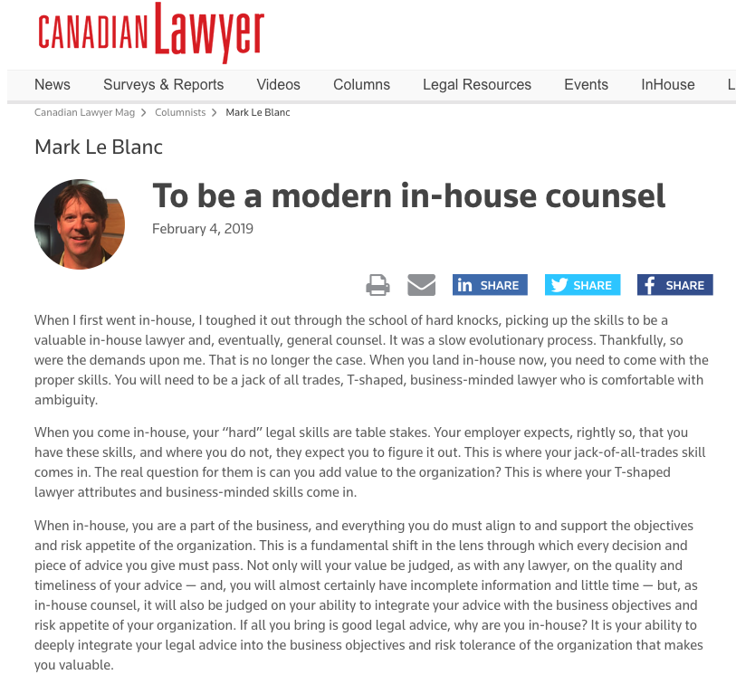

Slide 68
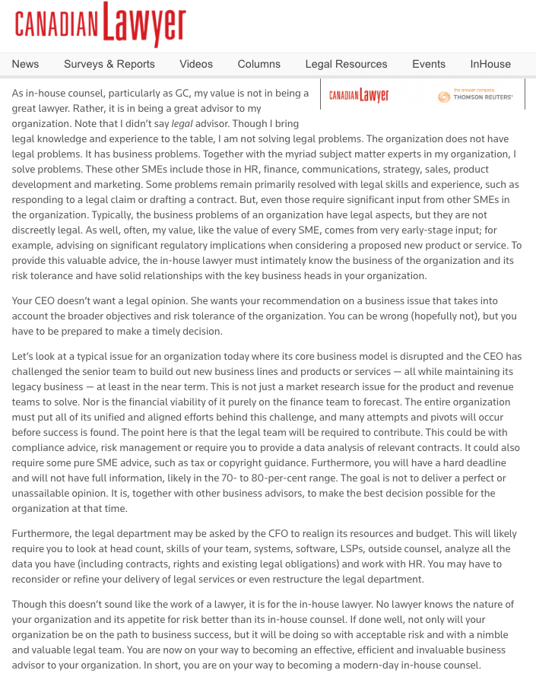

Slide 69
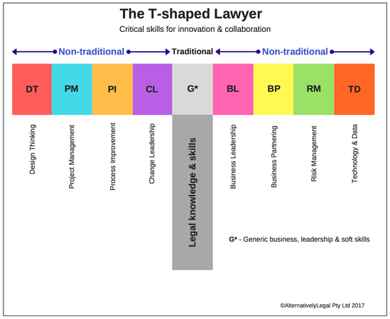

Slide 70
Plus shaped lawyer?
+
ETHICAL
LEADERSHIP

Slide 71
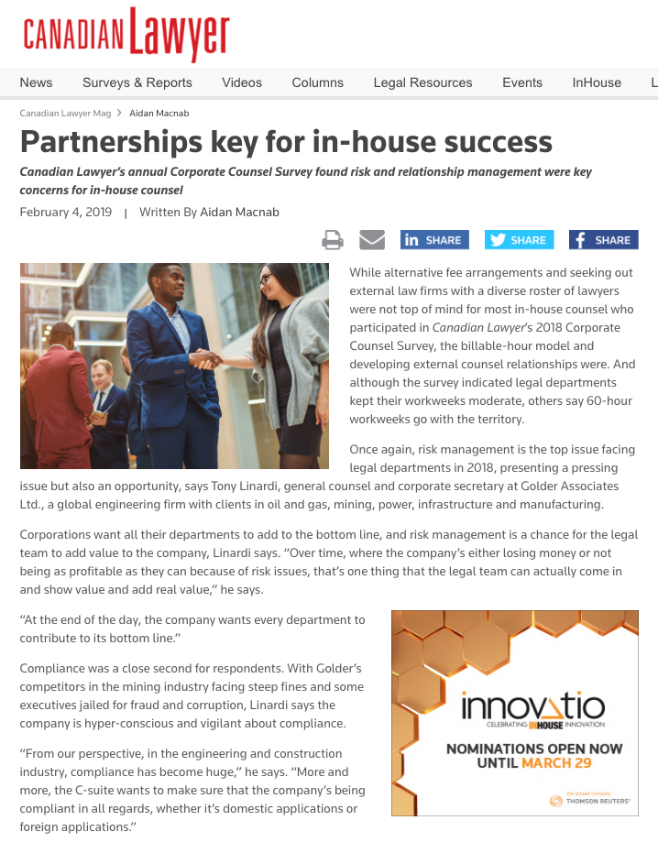

Slide 72
Bottom Line Contribution
Through Risk Management
?

Slide 73
Pause

Slide 74
QUESTIONS?
THOUGHTS?
DISCUSSION?

Slide 75
Starting Point 3

Slide 76
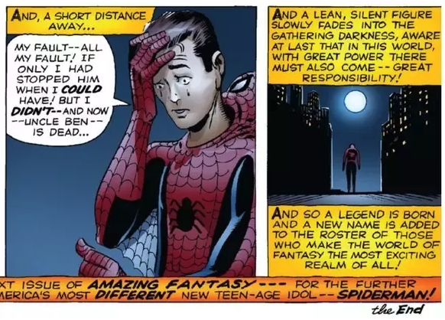
“With great power…”

Slide 77
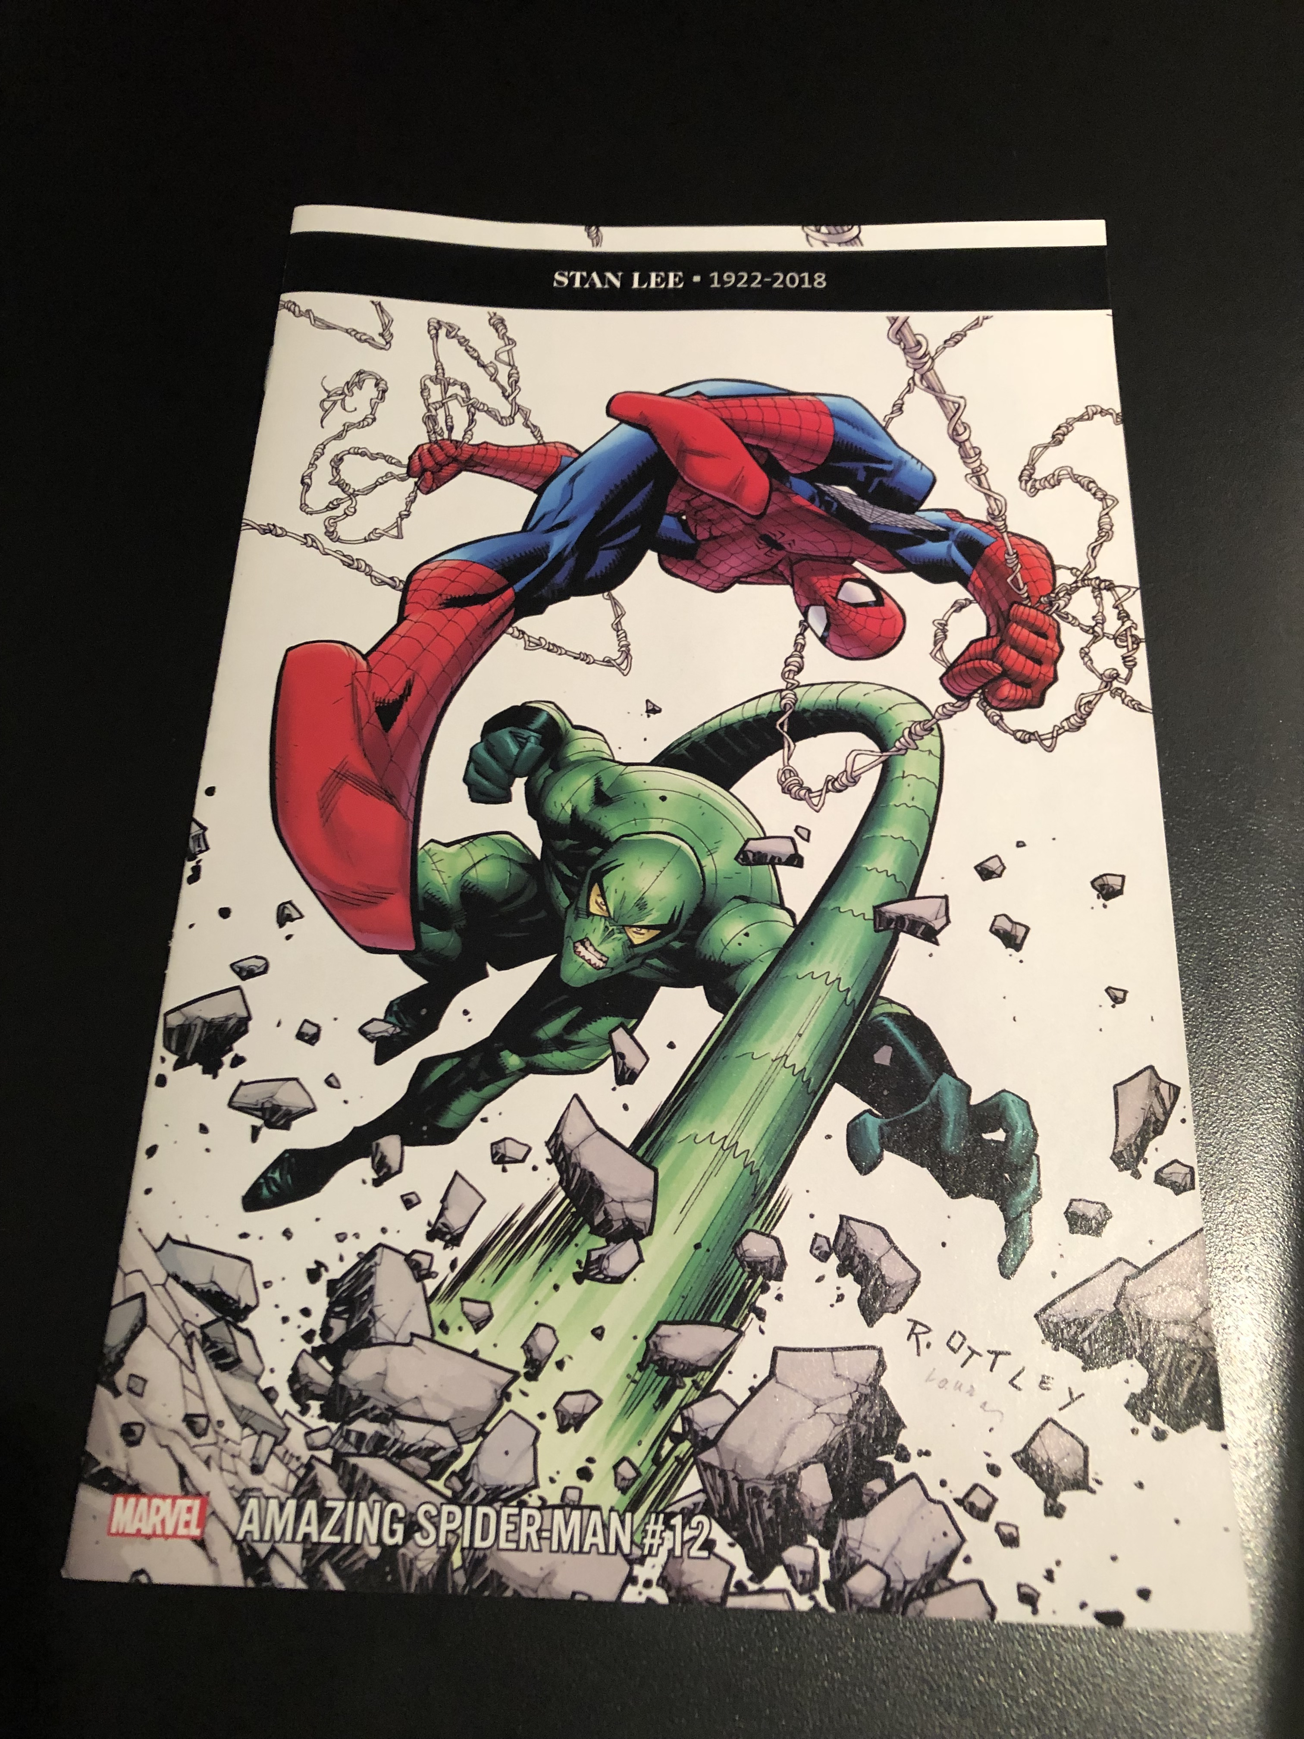

Slide 78

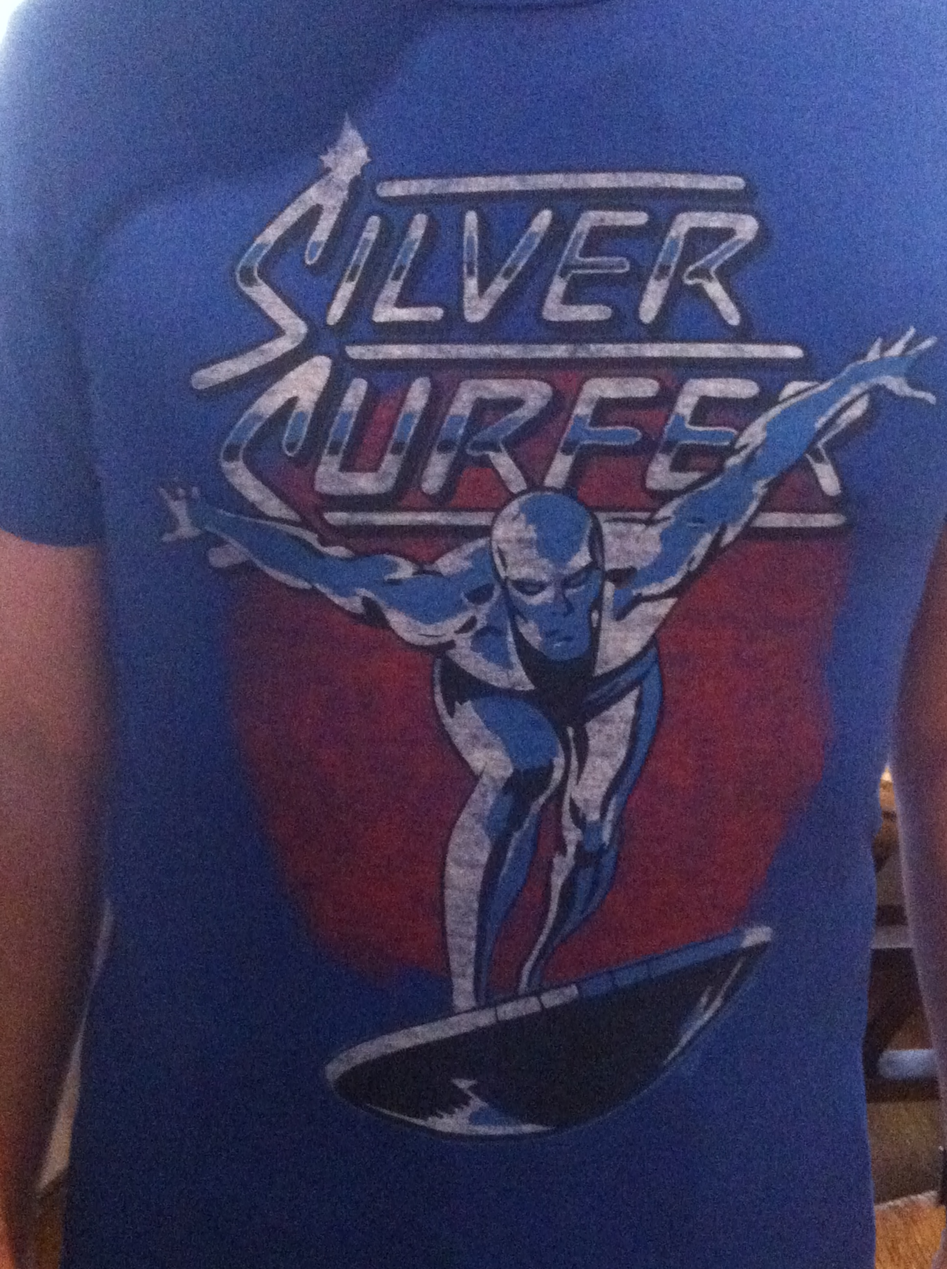

Slide 79
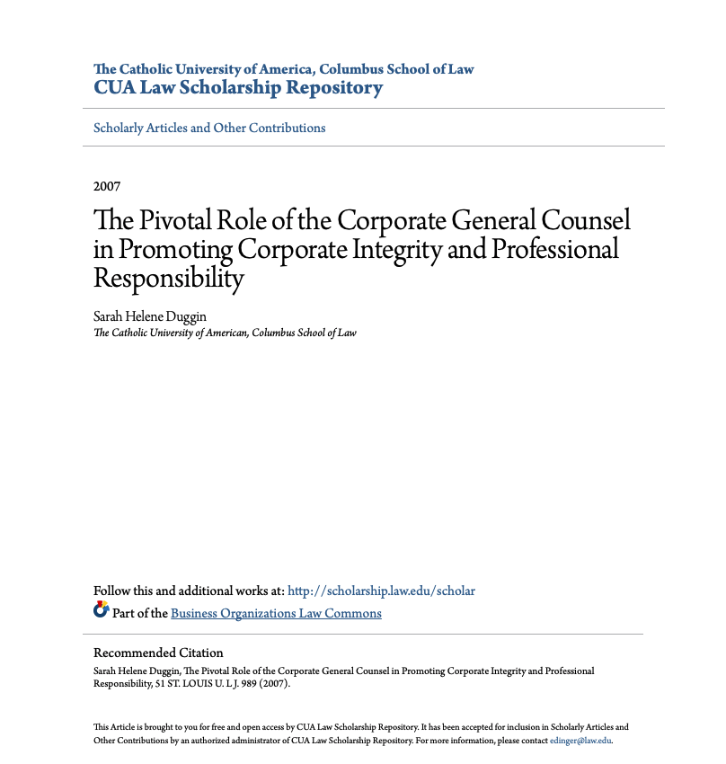

Slide 80
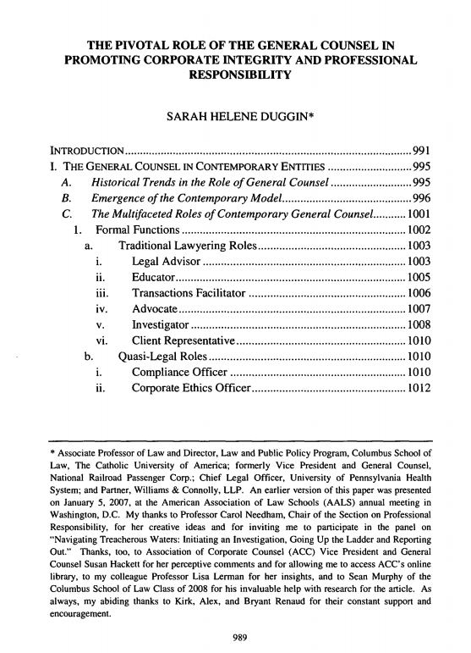

Slide 81
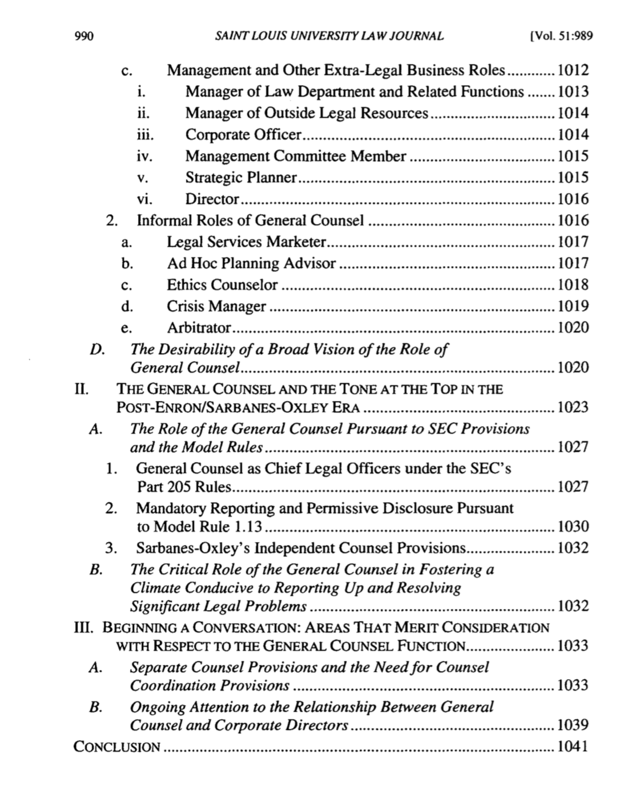

Slide 82


Slide 83
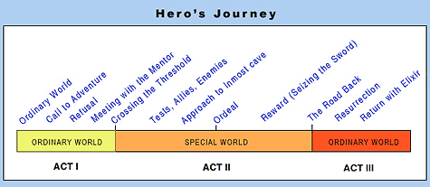

Slide 84
Useful metaphor only
You are a hero (because everyone is per Campbell & Post-structuralism)
Don’t be a “Hero”.

Slide 85
Pause

Slide 86
QUESTIONS?
THOUGHTS?
DISCUSSION?

Slide 87


A MATTER OF PERSPECTIVE

Slide 88

Conclusion

Slide 89

Always include a cat picture

Slide 90
In learning you will teach
And in teaching you will learn
Phil Collins' Son of Man (1999)

Slide 91
Our Academic Partners

