Slide 1


“News, Issues & ‘What would you do?’ of the Weeks”
Talks 7 & 8
LAWF 3780
Challenges of In-House & Corporate Counsel
TRU Faculty of Law
Spring, 2019
Jon Festinger Q.C.
Centre for Digital Media
QMUL School of Law (CCLS)
http://commlaw.allard.ubc
@jonfestinger
jon_festinger@thecdm.ca

Slide 2
Hello
LAW F 3780
Challenges of In-House
& Corporate Counsel

Slide 3
Logistics

Slide 4
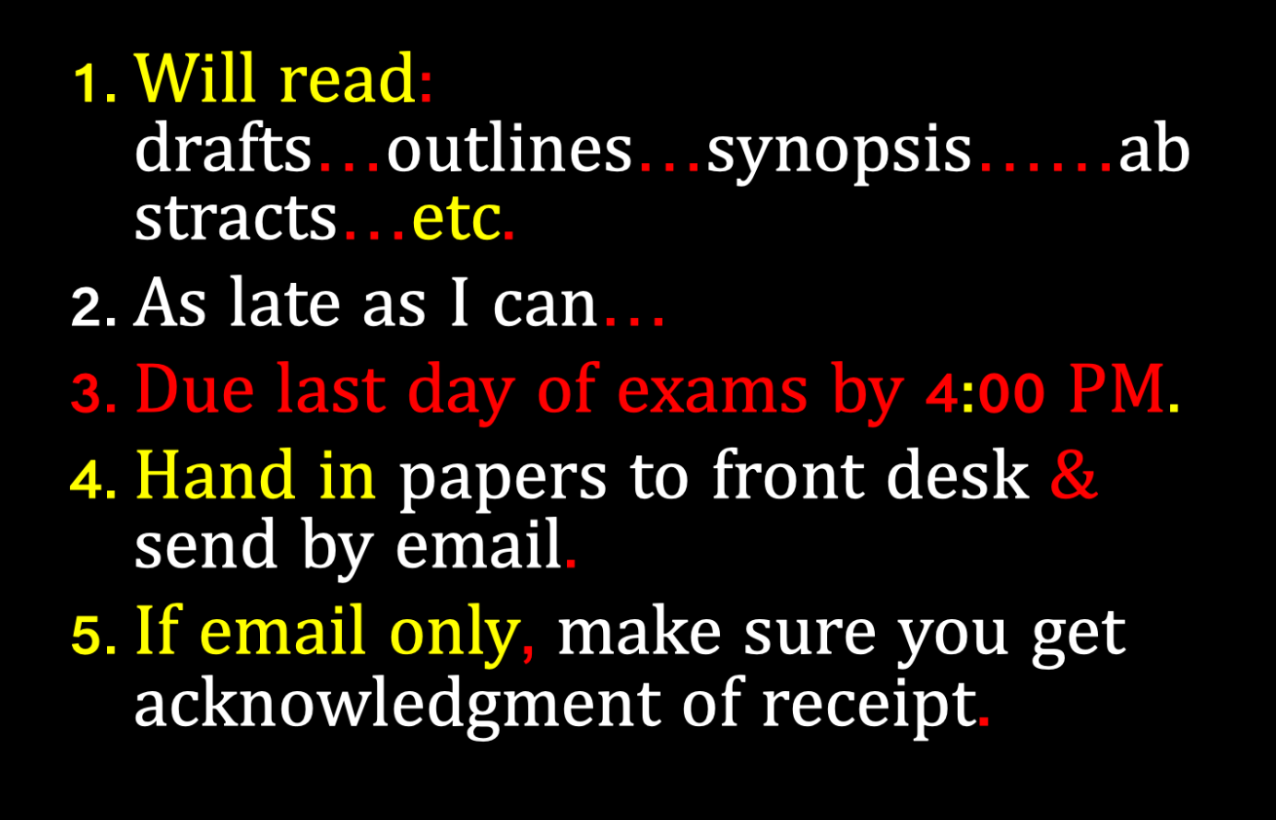

Slide 5
QUESTIONS?
THOUGHTS?
DISCUSSION?

Slide 6

Pause

Slide 7
IS ANY JURISDICTION
KEEPING GOOD
STATS?

Slide 8
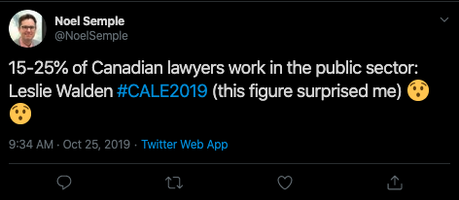

Slide 9
News of the Week

Slide 10
Yours?

Slide 11
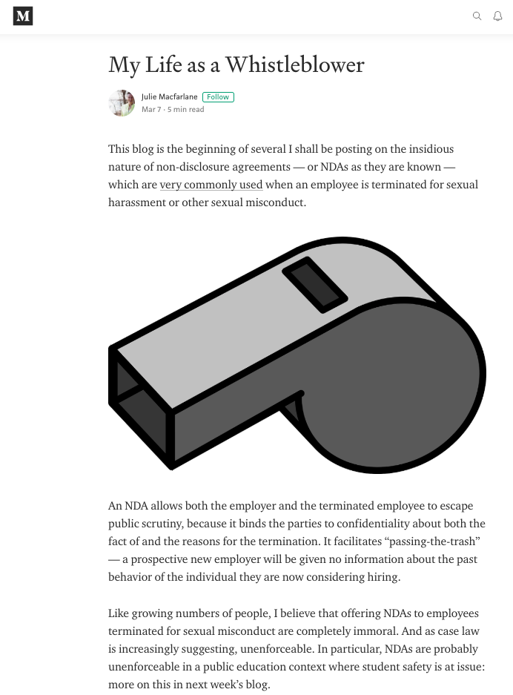


Slide 12
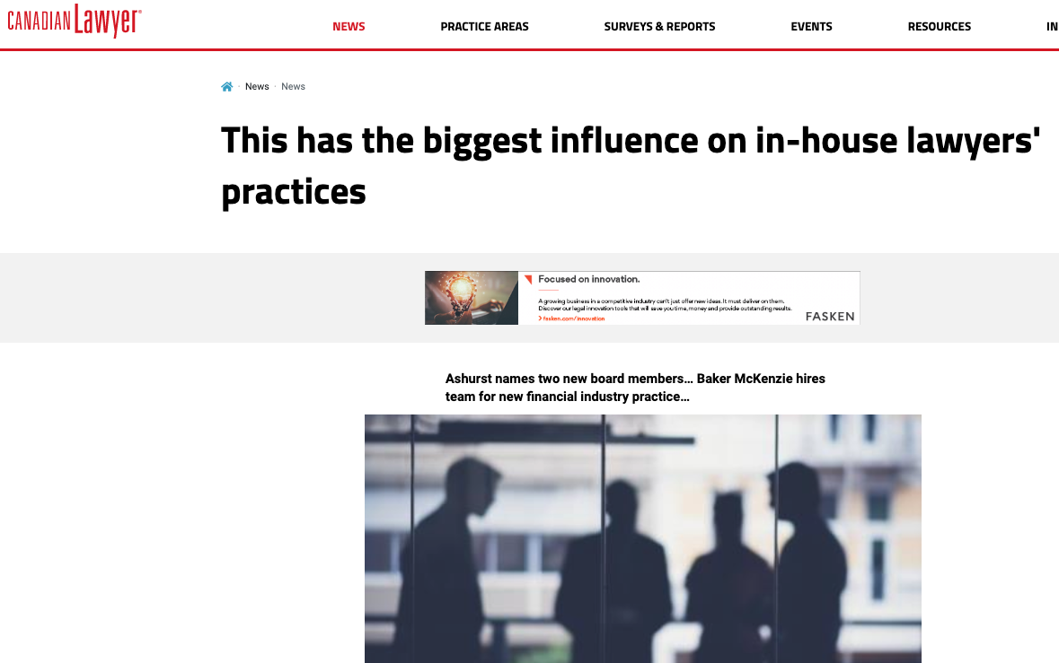

Slide 13
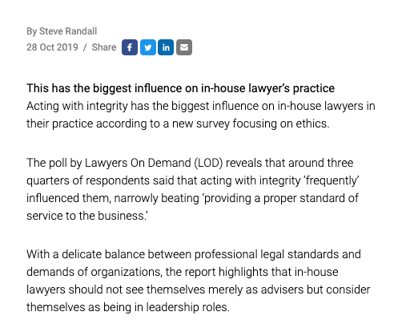

Slide 14
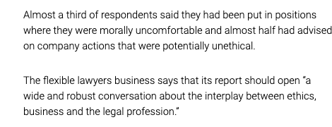

Slide 15
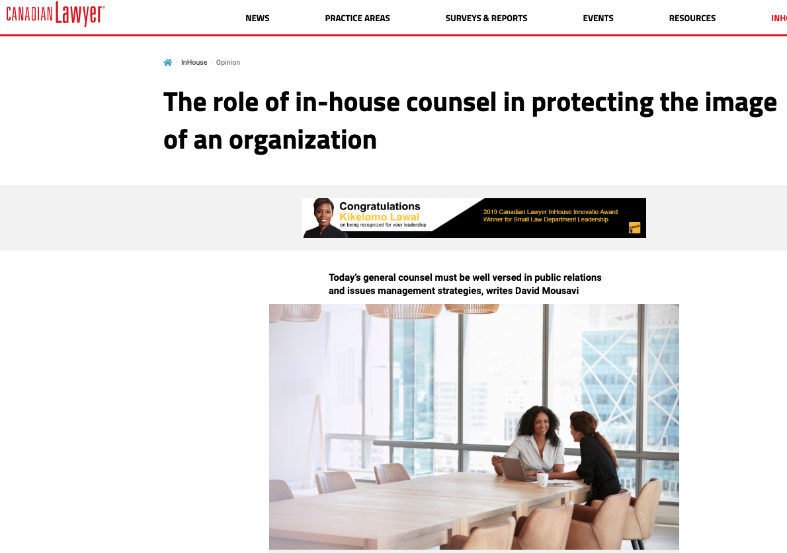

Slide 16

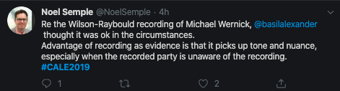

Slide 17



Slide 18
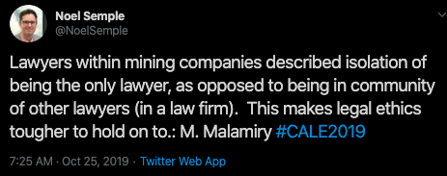


Slide 19

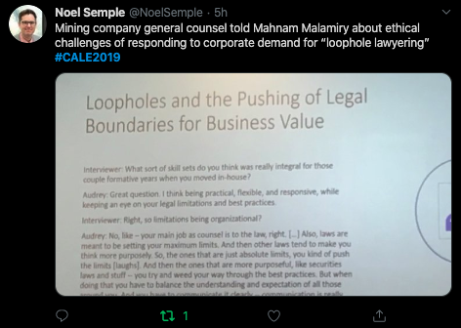

Slide 20
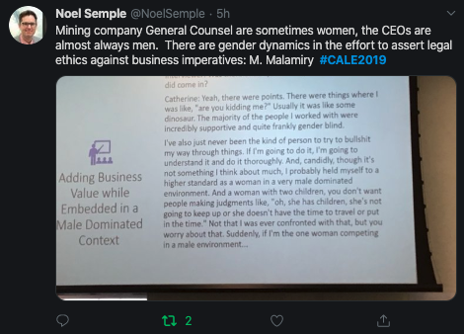

Slide 21


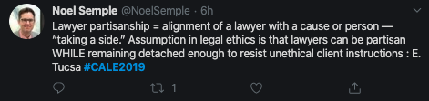

Slide 22
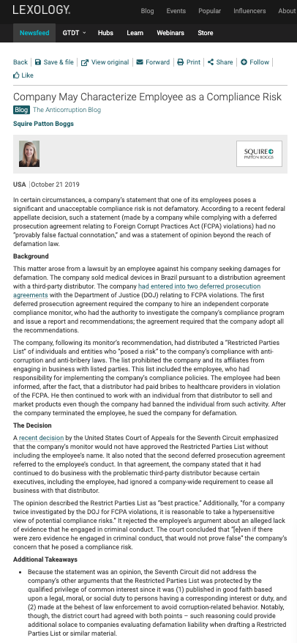

Slide 23


Slide 24
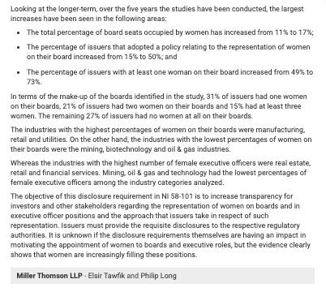

Slide 25
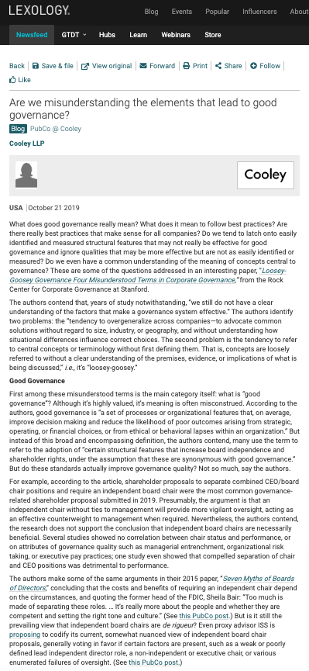

Slide 26


Slide 27
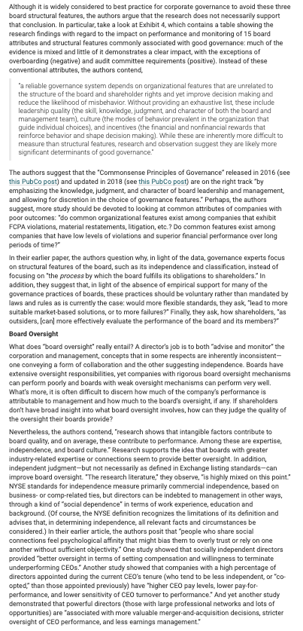

Slide 28


Slide 29
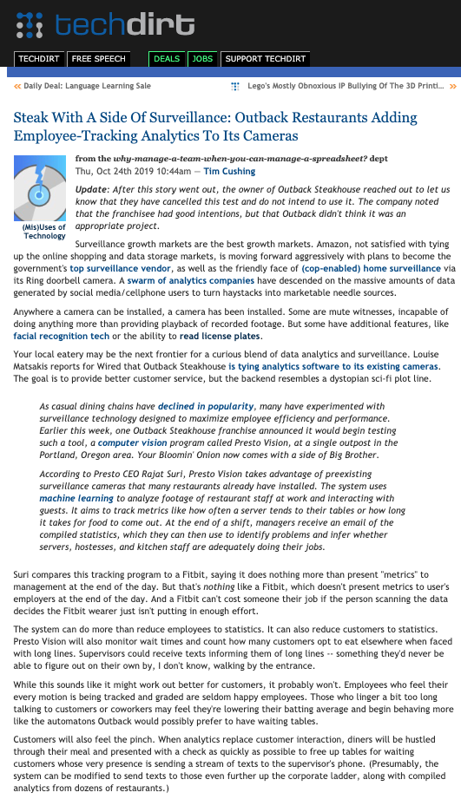

Slide 30
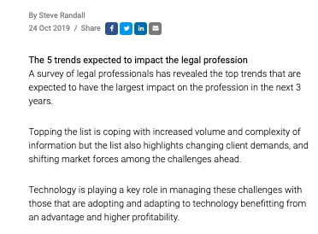

Slide 31


Slide 32


Slide 33
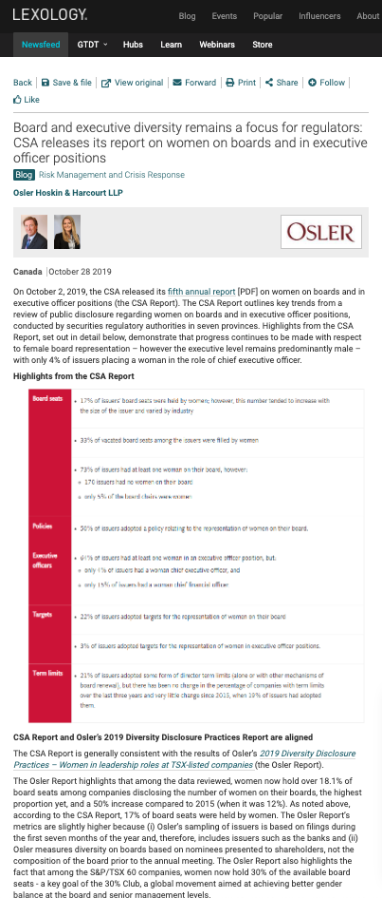

Slide 34
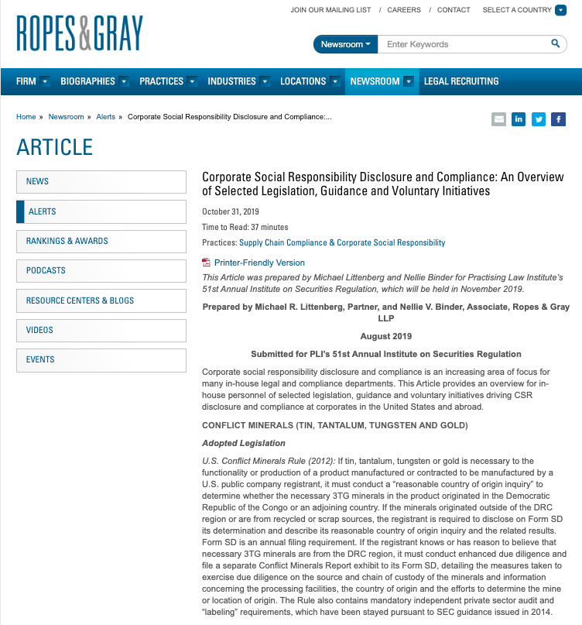

Slide 35
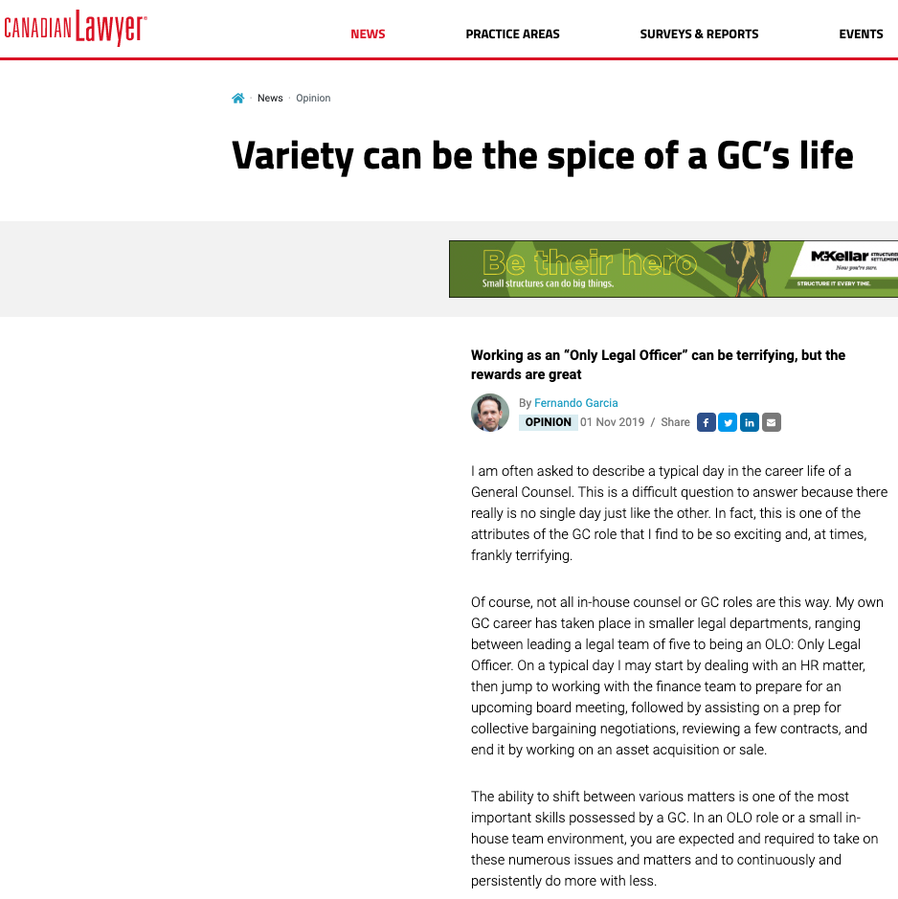

Slide 36


Slide 37
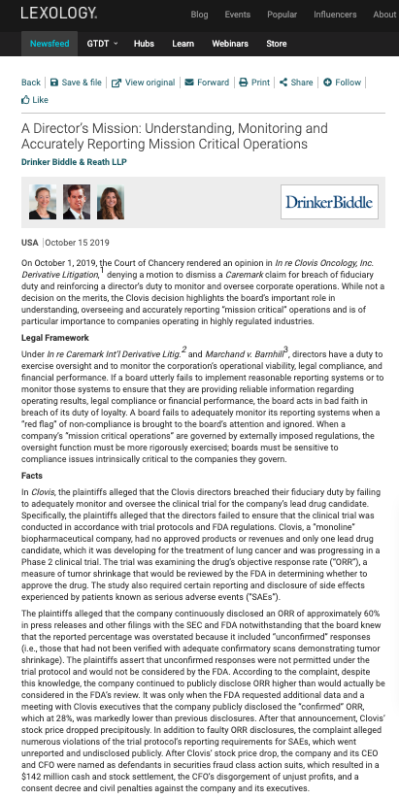

Slide 38

Because…ELON

Slide 39


Slide 40

Cannabis supplement

Slide 41


Slide 42
Last Semester This Time

Slide 43
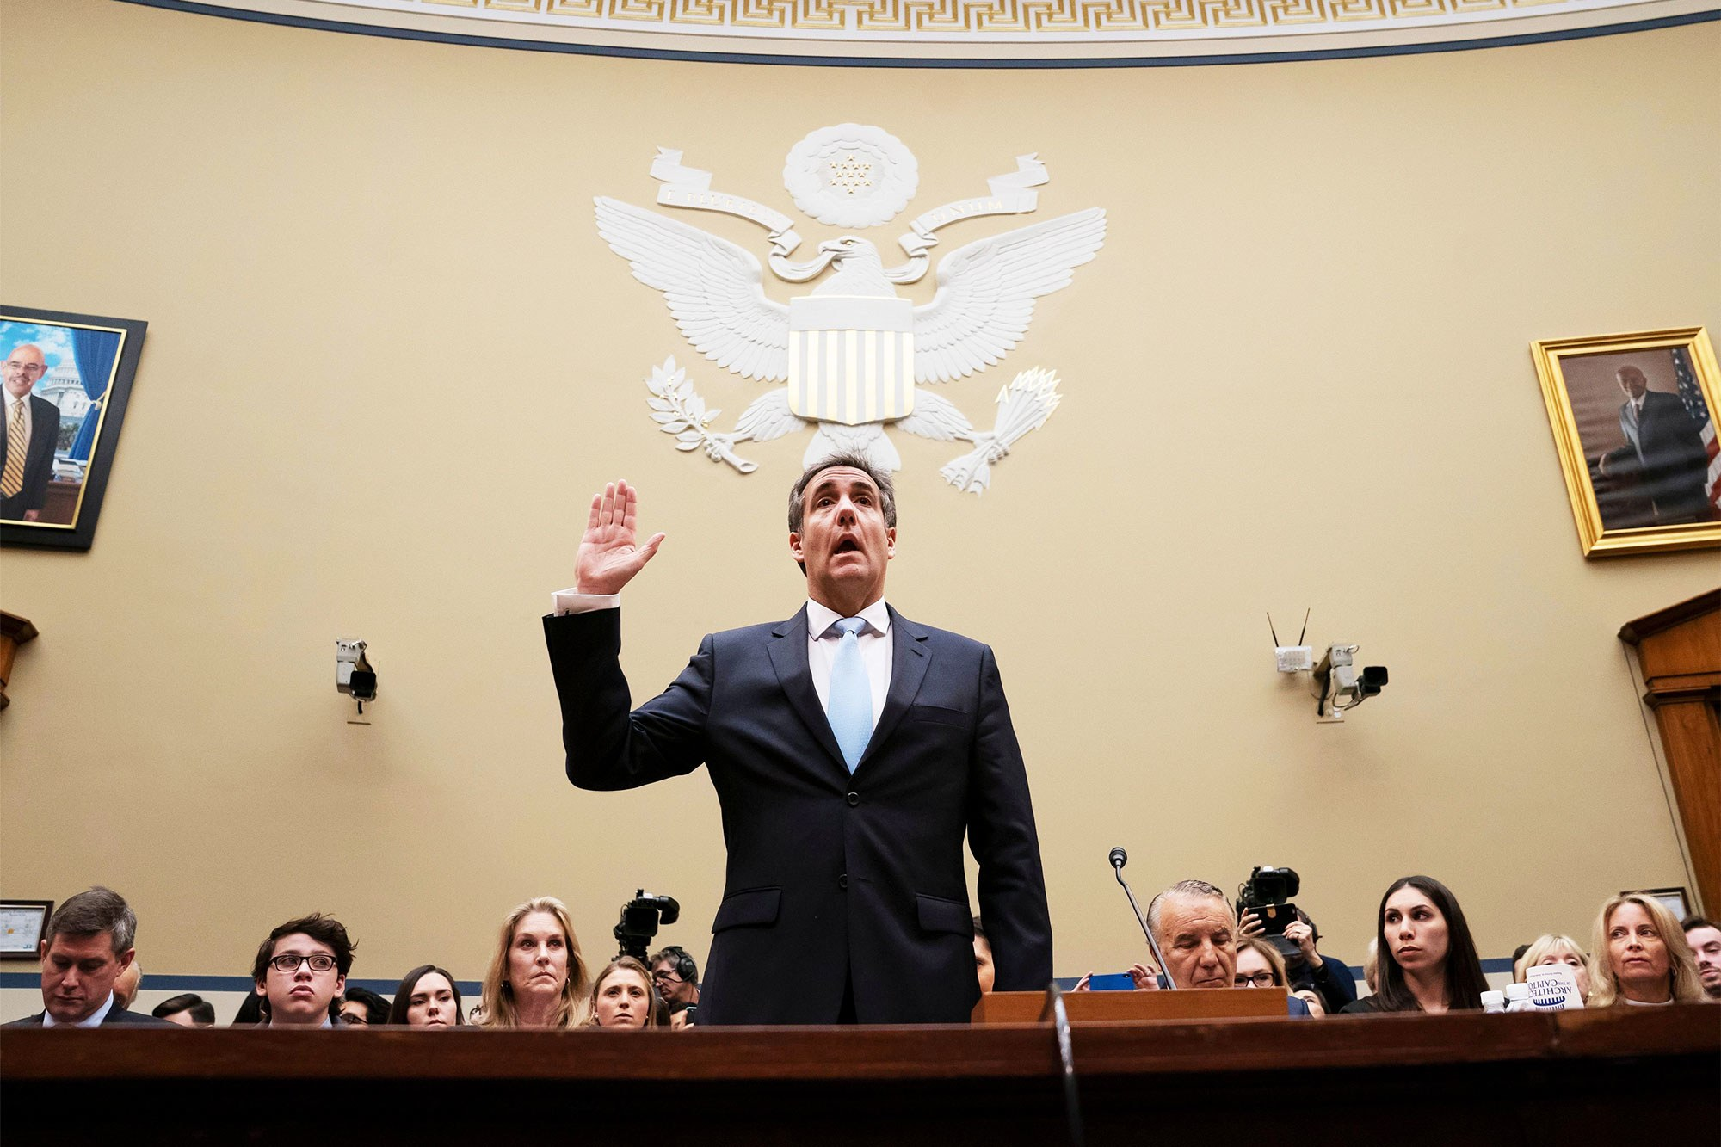
News of the Week Case Study

Slide 44

Michael Cohen - Fixers as lawyers
Fixer & lawyer

Slide 45


Slide 46


Slide 47
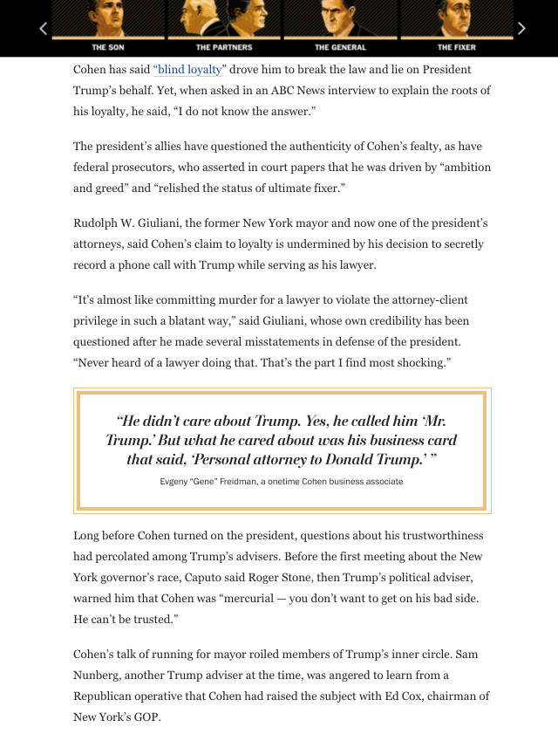

Slide 48
Solicitor-client privilege
Belongs to the client
Applies where you act as a lawyer
Wigmore: “Where legal advice of any kind is sought from a professional legal adviser in his capacity as such, the communications relating to that purpose, made in confidence by the client, are at his instance permanently protected from disclosure by himself or by the legal adviser, except the protection be waived.”
Privilege cannot be relied upon where the communication is used to facilitate a crime.

Slide 49
Pause

Slide 50
QUESTIONS?
THOUGHTS?
DISCUSSION?

Slide 51
Yours?

Slide 52

What would you do?

Slide 53


Slide 54
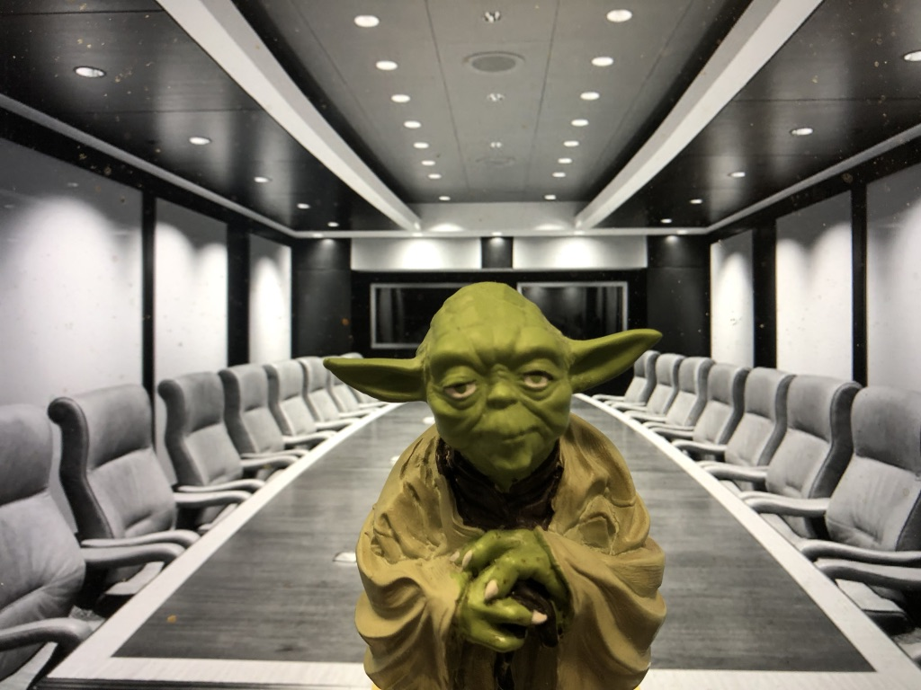
Two Questions…
Where were the Directors?
What views did Counsel transmit?

Slide 55
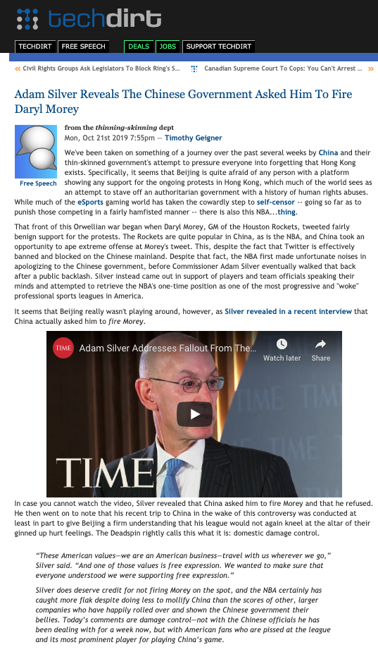

Slide 56
What would you do?

Slide 58
Two Questions…
Where were the Directors?
What views did Counsel transmit?

Slide 59
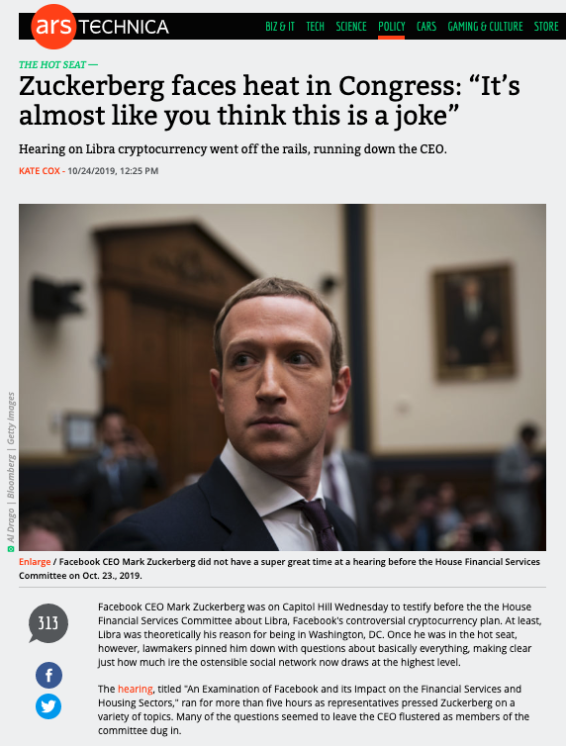

Slide 60
Pause

Slide 61
QUESTIONS?
THOUGHTS?
DISCUSSION?

Slide 62


A MATTER OF PERSPECTIVE

Slide 63

Conclusion

Slide 64

Always include a cat picture

Slide 65
In learning you will teach
And in teaching you will learn
Phil Collins' Son of Man (1999)

Slide 66
Our Academic Partners

