Slide 1
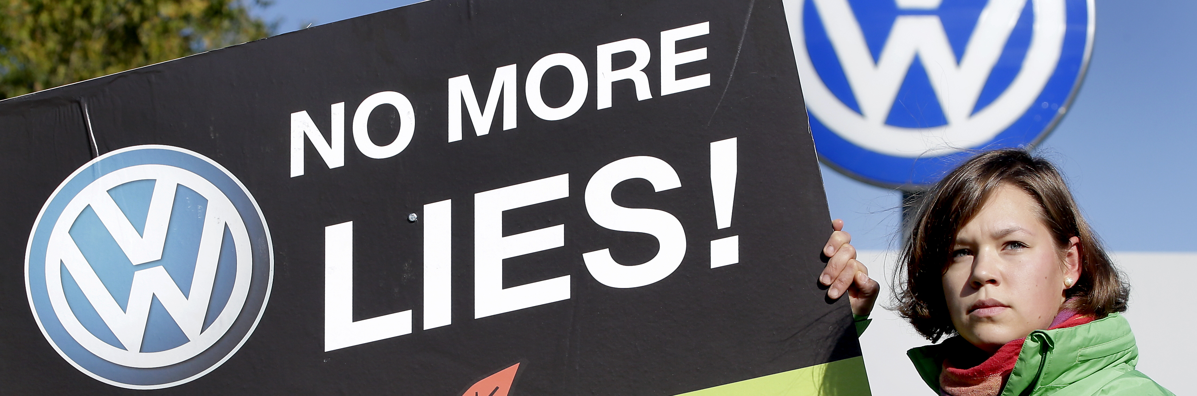
SCANDALS IN THE AUTO INDUSTRY

Slide 2
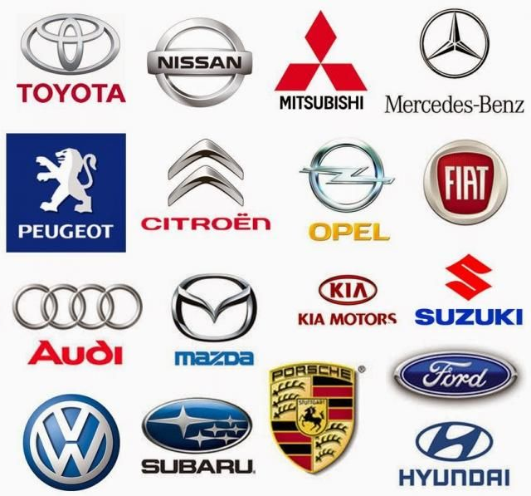
IN HOUSE COUNSEL IN THE AUTO SECTOR

Slide 3
“it’s like a little law firm dropped in the middle of a big company,” - NORMAN STEWART, ford motor company of canada ltd.
source: canadianlawyermag.com

Slide 4
CASE STUDIES
THE TUCKER CORPORATION INVESTMENT SCANDAL
DAIMLER/MERCEDES DIESEL EMISSIONS SCANDAL
TOYOTA: UNINTENDED ACCELERATION
TAKATA CORPORATION

Slide 5
THE TUCKER 48

Slide 6
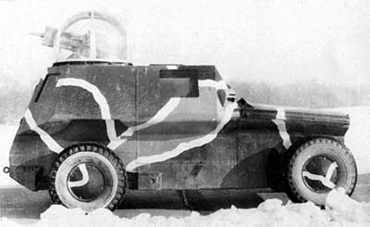
EARLY EFFORTS THE TUCKER COMBAT CAR

Slide 7
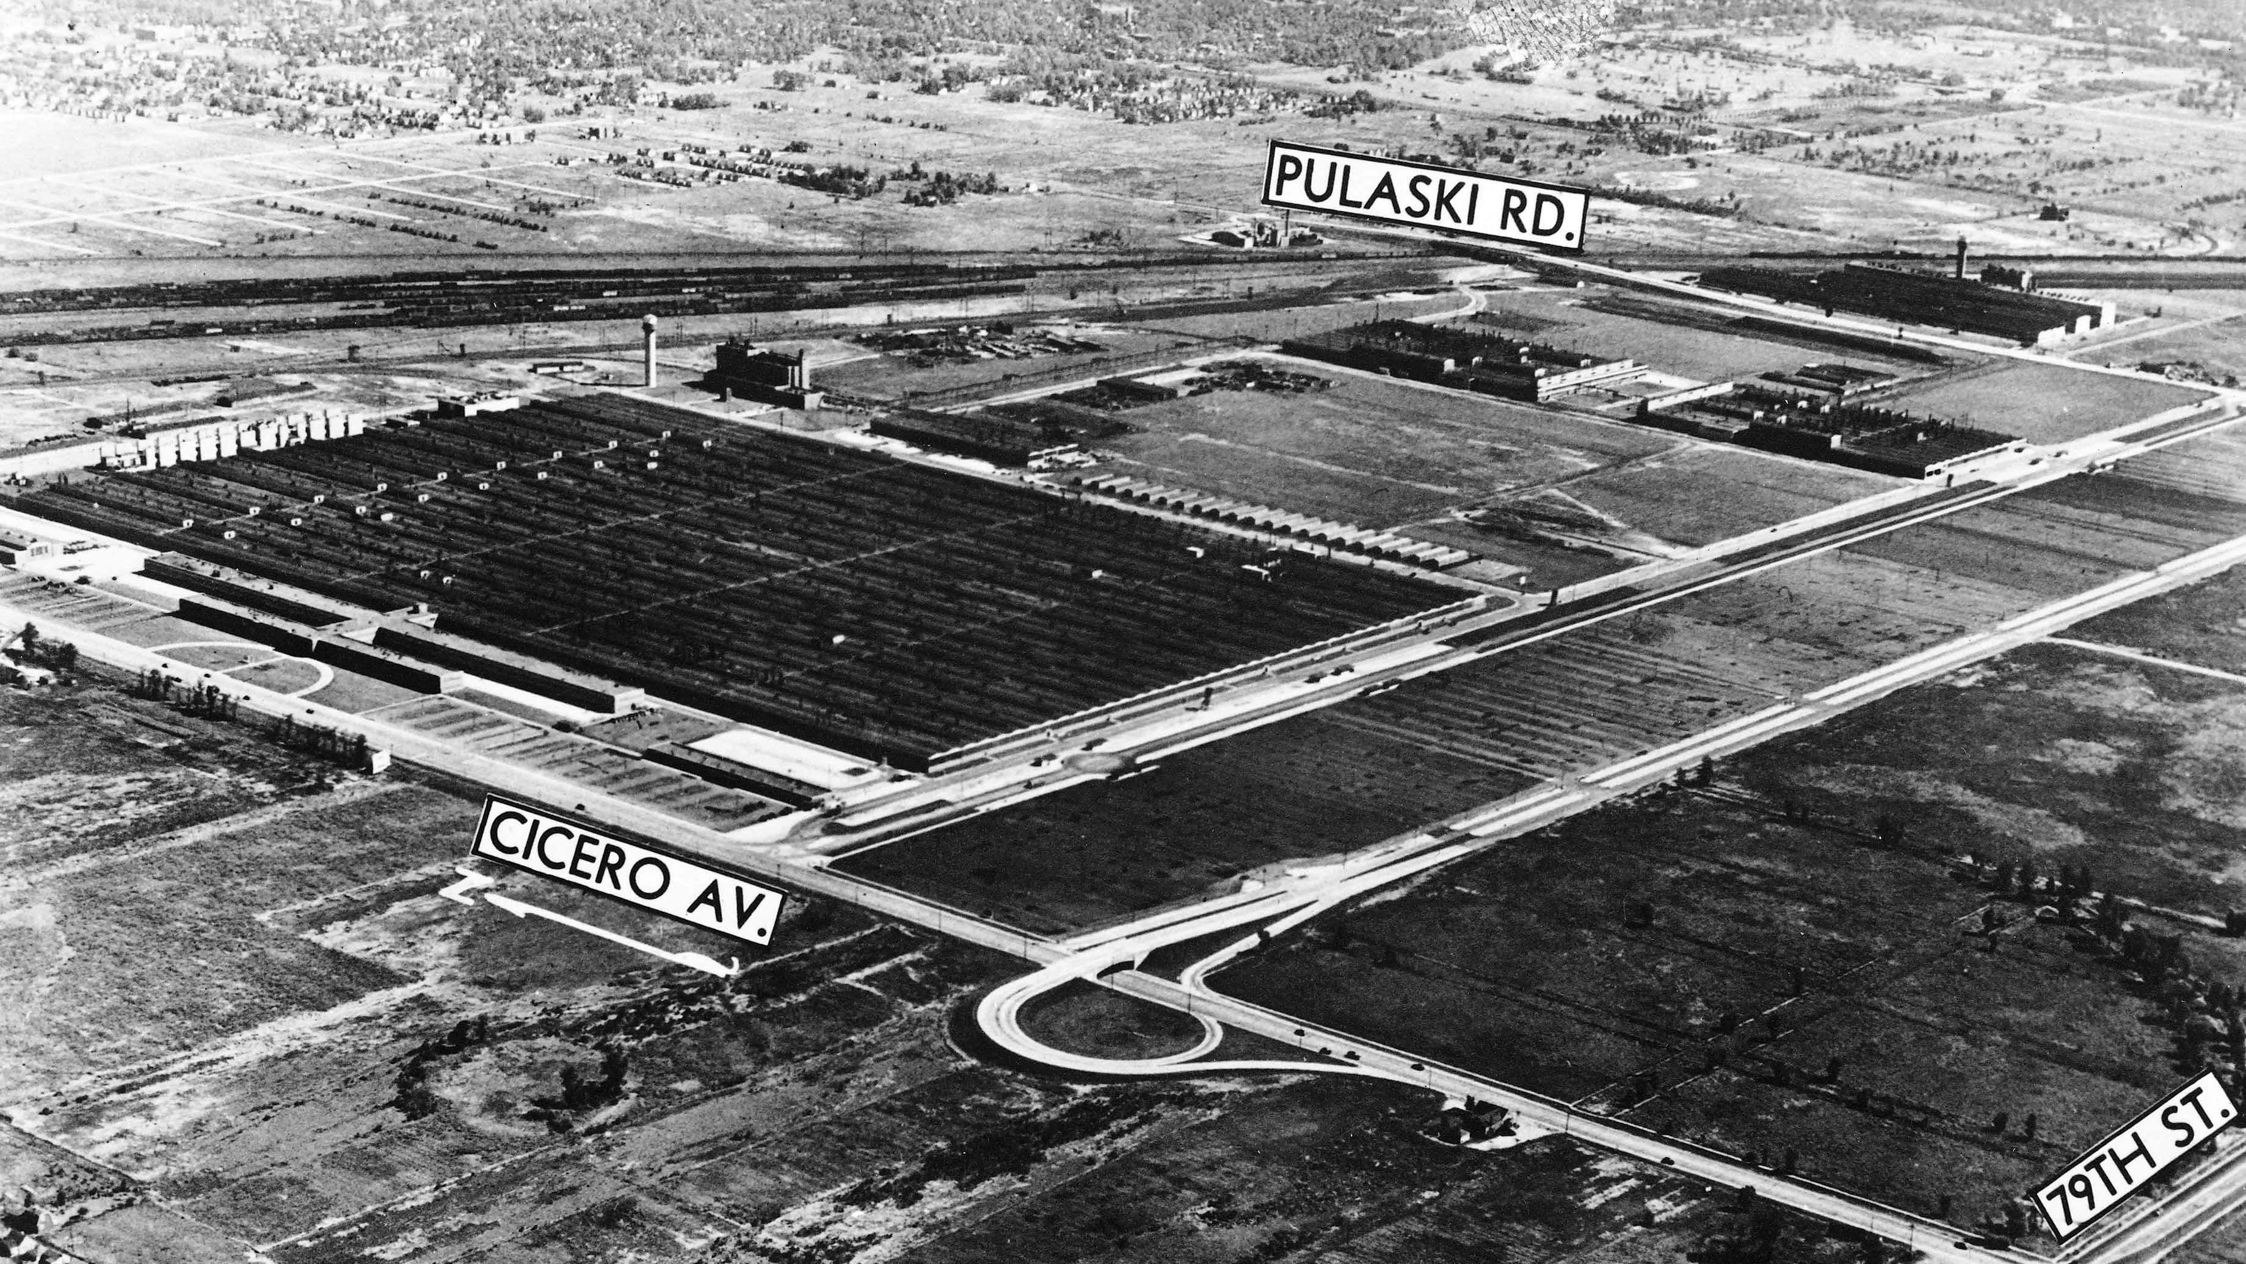
BEGGININGS TUCKER CAR CORPORATION

Slide 8
THE CAR OF THE FUTURE

Slide 9
PREMIERE

Slide 10
AN INNOVATIVE INVESTMENT STRATEGY

Slide 11
SEC INVESTIGATION

Slide 13
OTTO KERNER, US ATTORNEY WHO PROSECUTED TUCKER CORPORATION

Slide 14
LESSONS

Slide 15
Daimler/Mercedes Diesel Emissions Scandal

Slide 16
What’s the Connection
The cars are believed to have been equipped with emissions-cheating software just like VW
Notes:
Dieselgate scandals erupted in September 2015 when Europe's biggest carmaker Volkswagen admitted to installing so-called "defeat devices" in 11 million vehicles worldwide that allowed them to cheat emissions testing.
Daimler, is the parent company of Mercedes which is potentially facing a big fine. In February 2019, German prosecutors said they had opened legal proceedings against the firm.

Slide 17
Another “Dieselgate” Scandal
German media, suspected Daimler
of installing "illegal software" aimed
at making the cars appear greener than
they really were.
Tests found that the European Union's emissions limit of 180 milligrams of nitrogen oxide per kilometer was exceeded once the software was deactivated during the tests of select Mercedes diesel models.
Notes:
The German Federal Motor Transport Authority has requested the return of Daimler vehicles on a number of occasions in recent years after discovering excessive emissions. However, Daimler has steadfastly pleaded its innocence in the so-called dieselgate scandal that arose in 2015, when Volkswagen admitted having installed illegal "defeat devices" in 11 million diesel vehicles across the globe.
Daimler later added it would "cooperate with the authorities.”

Slide 18
Recall
Notes:
Daimler has already been told to recall 700,000 diesel vehicles worldwide, including 280,000 in Germany, models built in 2012-2015 in connection with the Dieselgate scandal.

Slide 19
Emissions Effects: Climate Change
UUN PARIS AGREEMENT: GOAL
Notes:
To give you a better understanding: currently motor vehicles are accounting for 40% of the emissions in the world. That’s a pretty significant %
In Canada, since we have signed the UN Paris Agreement, the federal govt has initiated a climate action plan. This plan is a framework to develop legislation with the support of provincial governments to enforce standards for emissions with potential penalties.
The Goal of the Paris Agreement GOAL is to decrease long-term temperature goal is to keep the increase in global average temperature to well below 2 °C above pre-industrial levels; and to pursue efforts to limit the increase to 1.5 °C, recognizing that this would substantially reduce the risks and impacts of climate change.
In BC, the Greenhouse Gas Reduction (Vehicle Emission Standards) Act passed in May 2008 has set out the implementation of government commitment to vehicle emission standards cut GHG emissions by 30%. This would ultimately mean that there will be better fuel efficiency and cost savings for BC residents. These standards will be enforced against vehicle manufacturer’s in the hopes of regulating to reduce green house gas emissions

Slide 20
Daimler’s Defiance
Daimler denies charges that it installed illegal software to manipulate exhaust tests. The company spokesperson said it looks forward to the chance to defend itself legally against the allegations.
KBA continues to investigate the widespread use, by multiple German manufacturers, of software that reduced the number of dangerous particles emitted by vehicles during testing.
Daimler’s Zetsche Steps Down
https://www.dw.com/en/daimler-ordered-to-recall-thousands-of-mercedes-in-germany-over-emissions-cheating-report/a-49307129
Notes:
https://www.dw.com/en/daimler-ordered-to-recall-thousands-of-mercedes-in-germany-over-emissions-cheating-report/a-49307129

Slide 21
A New Face: Rebuilding Reputation
Chairman of the Board of Management of Daimler AG. Head of Mercedes-Benz Cars
Notes:
Ola Källenius has been a member of the Board of Management of Daimler AG since January 1, 2015, and Chairman of the Board of Management of Daimler AG since end of Annual Meeting of Daimler AG on May 22, 2019. He is also Head of Mercedes-Benz Cars Division.
Ironic: On Sept 20/2019, Mr Kallenius posted on his Linkedin:
“The fight against climate change calls for specific measures. That’s why we support the decision of the German govt to put a price tag on CO2. This creates additional incentives for innovation. We particularly welcome the fact that govt invests in change- just as industry does. At Daimler we’re investing a double digit billion euro amt across all divisions into the expansion of our electric fleet. We aim to deliver sustainable technologies and products that customers don’t have to buy, but want to buy. This is our path to improving both climate protection and individual mobility.”
This statement demonstrates the company trying to cover up the “mess” by introducing a new head that is currently supporting carbon tax and lowered CO2 emissions in order rebuild Daimler’s image.

Slide 22
Daimler’s New Head of Legal Affairs: Renata Jungo Brüngger
In January 2016, German carmaker Daimler agreed to appoint a new management board member for legal and compliance issues, Renata Jungo Brüngger.
Notes:
She has led the carmaker’s legal division since 2011. The position became free after Daimler’s board member for legal and compliance switched to Volkswagen, which is in the middle of a major scandal involving cheating on emissions tests.
Renata Jungo Brüngger was a member of the Board of Management of Daimler AG since January 1, 2016, with responsibility for Integrity and Legal Affairs. She was also a member of the Board of Management of Mercedes-Benz AG at the time of her employment.
Appointed until: December 2023. First appointed: 2016. Nationality: Swiss.
This Board of Management position protects Daimler and its brands and steers the group-wide Legal and Compliance Organization. She is responsible for the sustained anchoring of a corporate culture of integrity at Daimler. Further work areas include Sustainability, Corporate Social Responsibility and Data Protection as well as Corporate Audit.
Renata Jungo Brüngger was born on August 7, 1961, in Fribourg, Switzerland. After completing her bilingual studies of jurisprudence at the University of Fribourg in Switzerland in 1985, she became a licensed attorney-at-law in 1989. While working as a lawyer, she attended an additional course of studies at the University of Zurich and gained a Master of Laws (LL.M.) in international commercial law, specializing in intellectual property rights and technology and information rights, in 1998. She joined the Daimler AG as Head of Legal in 2011.

Slide 23
Internal Turmoil: Another New Face at Daimler
Dr. Thomas Laubert is the most current Head of the Daimler AG Legal department since March 1, 2016. He has taken over the position of Renata Jungo Brüngger.
Notes:
Dr. Thomas Laubert job specific: globally responsible for criminal law, public law and antitrust law.
Interview: Q&A Thomas Laubert, Daimler June 26, 2017
Interviewed by: Yola Verbruggen a multimedia journalist at the international Bar Association
https://www.ibanet.org/Article/NewDetail.aspx?ArticleUid=F2E6F218-93D8-4FE7-9AC8-0C0CCDA250A5
YV: How is Daimler working to meet the European Union (EU) carbon dioxide (CO₂) emissions targets that come into force in 2021?
TL: It is our clear goal to meet all legal CO₂ emissions requirements. This also applies to the EU limits for the years 2020/2021. Therefore, the market success of electrified vehicles is of decisive importance for these demanding fleet targets. To meet those requirements, we will intensify our e-mobility range in the coming years. The smart electric drive has just been launched. In addition, we will present our next-generation, fuel-cell vehicle, based on the Mercedes-Benz GLC-Class, with plug-in hybrid by the end of this year. In 2019, we will launch the first model of the purely electric EQ model family. No later than 2022, we plan to have more than ten electric vehicles in our portfolio. We are also pushing forward with our plug-in hybrid offensive.
YV: In April 2016, Daimler announced that it had begun an internal investigation into its diesel emissions testing. The investigation was launched on the request of the US Department of Justice (DoJ). Can you say anything about the ongoing investigation?
TL: At present, we are conducting an internal investigation regarding the certification process related to exhaust emissions in the US upon the request of the DoJ. We are cooperating fully with the authorities and will consequently investigate possible indications of irregularities, of course taking all necessary action. Our experience with the US authorities has clearly shown that our conservative communication supports a constructive dialogue with the authorities. We don't comment on pending proceedings and therefore cannot provide further details.
YV: How has the emissions case affected the company’s approach to risk management and the General Counsel’s role in that process?
TL: From my point of view, legal teams and General Counsel always have to deal with risk management: it’s the core of their business. Of course, the subjects differ and the impact varies. However, I consider it part of our daily work to quickly take up an issue and act as professional legal managers and advisers.
YV: What are your goals for the future as General Counsel of Daimler?
TL: I consider it a great privilege to be part of a transformation of the automotive industry and to be leading Daimler’s Legal Department into this future. Early involvement in business matters and new developments brings a new flavour to the daily business of in-house lawyers. At Daimler, we have initiated a ‘swarm organisation’ (a management technique that emphasises working across departments or functions), where we are working together with colleagues from other areas of the business in a new way. All in all, we are working in a dynamic and fast-moving environment that requires flexibility and direct actions. I very much enjoy shaping this future together with my legal team.

Slide 24
“The chances of success for damages have never been so high”
What rights do I have as a Mercedes owner in the exhaust scandal?
The Mercedes owner can return his diesel car to Daimler and receive a refund of the purchase price paid at the time less a small compensation for the mileage he drove.
The return of the vehicle against reimbursement of the purchase price paid at that time is currently the most attractive and legally best option.
Since we cannot achieve the return of the vehicle by contractual regulations but by tort law, you do not have to have had a contract with Mercedes.
Notes:
https://www.balduin-partner.de/en/news/lawyer-mercedes-emissions-scandal-what-rights-do-owners-have/ Lawyer & Attorneys in Germany Balduin & Pfnür
Example:
You bought a new Mercedes C Class in 2014 for EUR 35,000 and have covered 50,000 kilometres so far. If you want to sell this cheating diesel with threatening driving bans now on the free market, you may still get approx. 10,000.00 EUR. If you enforce the return of the vehicle against the manufacturer, Mercedes will refund you the purchase price of EUR 35,000.00 and deduct only EUR 5,000.00 for the kilometres.
Instead of 10.000,00 EUR you get 30.000 EUR.
In the VW exhaust scandal there are thousands of court rulings for this example, which were announced exactly the same in favour of the vehicle owners. The fact is, however, that you can only achieve such a goal if you take legal action against Daimler with the help of a lawyer. There are already several verdicts against Daimler from Stuttgart, Hanau, Karlsruhe and Münster.
Rely on the many years of experience of the law firm Balduin & Partner, which has already helped thousands of car owners. In the Ruhr area we are one of the leading law firms in the diesel affair.
Since the exhaust affair against Mercedes was only published in 2018, car owners have the opportunity to take action against dealers and manufacturers.
This will prevent you from being affected by driving bans in the future. You also avoid a useless software update, which can even cause consequential damage to the vehicle.
At this point we advise against installing the software update. As soon as you receive an invitation to do so, you have already received proof of the exhaust gas manipulation and can immediately commission a lawyer to do so.
If Mercedes has installed the update without your knowledge, have a certificate issued and then contact a specialist lawyer for traffic law.
However, the update is harmless for your claims. Even if it has already been installed, you can continue to successfully sue Mercedes.
II.
New delivery of a new Mercedes model, if you bought a new car at that time.
This option is only possible against the dealer if the warranty period of one to 2 years since purchase has not expired. This option is particularly attractive as no kilometre compensation has to be paid to the dealer after a successful procedure.
III.
Compensation in money to compensate for the loss in value
This possibility also exists if the car buyer wants to keep his Mercedes. Compensation payments of up to 30 percent based on the purchase price are enforceable.
However, there is a risk that the vehicle may be subject to official driving bans and immobilisation at a later date.
IV.
A class action suit against Mercedes or Daimler is not possible. Each injured party must bring his rights individually before a German court. The sample determination procedure, which came in November 2018, is not a class action suit. In this case, only the guilt of the injuring party is established. The proceedings will last for years, where an individual action by you is usually concluded in one year.
You will only be awarded damages if you bring an action against Daimler. You can still do this in 2019.

Slide 25
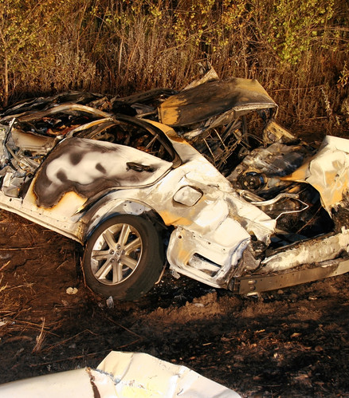
Toyota: Unintended Acceleration
https://www.youtube.com/watch?v=NDYou3B8-hs

Slide 26
Issue: Toyota Vehicles were allegedly experiencing unintended acceleration
First recall stated that the UIA was due to gas pedal being stuck on improper floormats
Some blame the new electronic throttle, brakes could not overpower gas input
Second recall changed out gas pedal
Delays in implementing recall
NHTSA findings do not believe electronic was issue, suggesting it could have been wrong pedal application
Note Lexus needs 3 seconds to turn car off when driving. Recommended that brakes overpower gas input

Slide 27
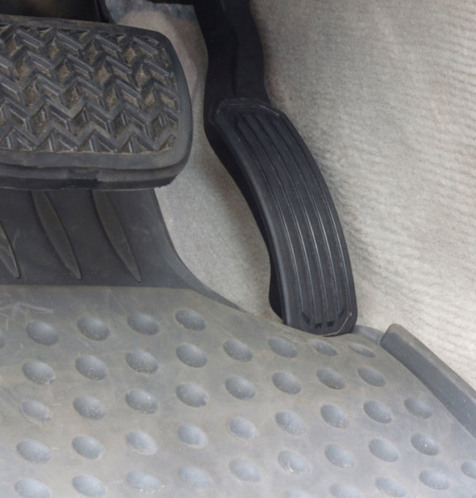
The first recall, directing owners to remove the floor mats from their vehicles and place them in the trunk, or to have the floor mats zip-tied in place by a Toyota dealer, covers 4.2 million Toyota and Lexus models over seven model years. They are:
2005 to 2010 Toyota Avalon
2007 to 2010 Toyota Camry (not including Camry Hybrid)
2008 to 2010 Toyota Highlander
2009 to 2010 Toyota Matrix
2004 to 2009 Toyota Prius
2005 to 2010 Toyota Tacoma
2007 to 2010 Toyota Tundra
2009 to 2010 Toyota Venza
2007 to 2010 Lexus ES350
2006 to 2010 Lexus IS250
2005 to 2010 Lexus IS350
2009 to 2010 Pontiac Vibe

Slide 28
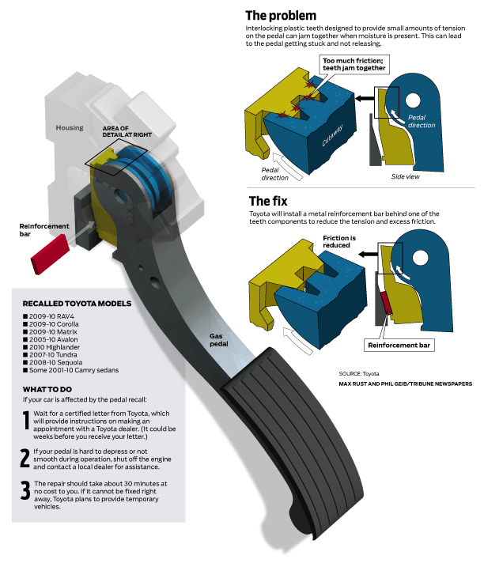
The second recall covers 2.3 million vehicles which together account for over 50% of Toyota's U.S. sales. Affected models include:
2005 to 2010 Toyota Avalon
2007 to 2010 Toyota Camry
2009 to 2010 Toyota Corolla
2010 Toyota Highlander
2009 to 2010 Toyota Matrix
2009 to 2010 Toyota Rav4
2008 to 2010 Toyota Sequoia
2008 to 2010 Toyota Tundra

Slide 29
August 28, 2009: Off-duty California Highway Patrol officer Mark Saylor is traveling on Highway 125 in Santee, California (northeast of San Diego), with three family members. The 2009 Lexus ES350 accelerates out of control, hits another car, tumbles down an embankment and catches fire. All four are killed in the ensuing crash.
September 14, 2009: Preliminary reports from Toyota and local authorities indicate that the Lexus may have had the wrong floor mats installed, interfering with the gas pedal.
September 29, 2009: Toyota announces it is recalling the floor mats on 4.2 million Toyota and Lexus vehicles. The company advises owners to remove their floor mats and place them in the trunk and directs dealers to use zip ties to secure the floor mats in their vehicles so they could not interfere with the gas pedal.
October 18, 2009: The Times article reveals there have been nine separate NHTSA investigations into claims of unintended acceleration by Toyota vehicles in the past decade. Two involved floor mats, and one a trim piece on the Toyota Sienna minivan. Six were dismissed due to lack of evidence. A Toyota spokesperson admits there is no safety override programmed into its computer to disable the throttle pedal when the brake pedal is pressed.

Slide 30
October 30, 2009: Toyota begins sending letters to owners notifying them of an unspecified upcoming recall to fix the unintended acceleration issue. In the letters Toyota says "no defect exists.“
November 2, 2009: NHTSA takes the highly unusual step of publicly rebuking Toyota, calling a company press release re-iterating the statements made in the 30 October letter to owners "inaccurate" and "misleading," noting that the floor mat recall was an "interim" measure and that it "does not correct the underlying defect." Toyota publicly apologizes.
November 4, 2009: Toyota issues another press release denying media reports a problem exists with its drive-by-wire electronic throttle system. However, to support the claim, Toyota simply cites a NHTSA report released two days earlier showing the agency has refused a petition by a Toyota owner to open a new investigation into Toyota's drive-by-wire system.
December 23, 2009: Another story in the Los Angeles Times, this time accusing Toyota of hiding defects from customers and regulators over the past decade. The story notes the company has been fined and rebuked by judges several times for failing to turn over evidence in lawsuits, and that many suits brought against the company have been settled out of court for undisclosed sums of money.
December 26, 2009: A Toyota Avalon crashes into a lake in Texas after accelerating out of control. All four occupants die. Floor mats are ruled out as a cause because they are found in the trunk of the car.
January 11, 2010: Toyota announced its brake override software fix will be made global by 2011.
January 21, 2010: Toyota recalls another 2.3 million Toyota-brand vehicles because of a problem with the gas pedal. Toyota says "a rare set of conditions which may cause the accelerator pedal to become harder to depress, slower to return or, in the worst case, stuck in a partially depressed position." The company says the new recall is unrelated to the floor mat recall, but also announces 1.7 million Toyota vehicles would be affected by both recalls.

Slide 31
Dimitrios Biller
Former Toyota Lawyer Dimitrios Biller from April 15, 2003 – September 17, 2007 as National Managing Counsel in charge of the National Rollover Program
Roll over lawsuits, one unintended acceleration
Claims Toyota knew and knowingly sold unsafe cars to consumers
Suing Toyota for wrongful termination and emotional distress
Produce and conduct investigations up to time of production
Toyota interfered with investigation

Slide 32
Biller’s Claims
In February 2010, Biller’s Toyota documents were subpoenaed by the House Oversight Committee looking into the unintended acceleration issue. Although Biller’s documents weren’t related to unintended acceleration, the committee was interested in how Toyota approached safety.
n reviewing the documents, Committee chair Rep. Edolphus Towns found evidence that Toyota routinely withheld company records rather than turn them over to the court, settling personal injury cases to avoid revealing engineering data. Towns indicated this was a violation of court discovery orders in litigation.
Was asked to hide information not to produce any documents
Violates golden rule do everything to protect the client even if it means to commit crimes
Subpoena allowed him to bypass NDA
Toyota sued him, alleged he released information

Slide 33
At the time he filed suit he said he was released from attorney-client privilege
Toyota said then that Biller violated attorney-client privilege, his ethical and professional obligations, and a restraining order Toyota had obtained against him.
The company accused Biller of making inaccurate and misleading allegations because Toyota had committed criminal acts.
After Toyota sued him, Biller sued Toyota back, accusing the company of racketeering, defamation, inflicting emotional distress, and wrongful termination.

Slide 34
Toyota’s countersuit
Biller’s lawsuit against Toyota went to arbitration. Last week the arbitrator, Judge Gary Taylor, found that Biller betrayed the confidences of his client, Toyota, and “violated ethical, statutory, and contractual prohibitions.”
Judge Taylor ordered Biller to return the documents, drop his lawsuit, and pay $2.6 million in damages to Toyota. Toyota in a statement expressed vindication and said the Judge’s award “completely discredits his (Biller’s) meritless attacks on our company and our people.” Biller represented himself in arbitration and hasn’t yet made a statement.

Slide 35
Biller misused the term whistleblower. His methods were ruled a violation of attorney-client privilege and he behaved unethically, further jeopardizing his professional reputation. Whatever damage Biller’s accusations have done to Toyota, the company has been deluged by federal criticism and international media on its handling of safety and unintended acceleration. In the absence of transparency, Toyota has found public trust and reputation are jeopardized.
While Toyota might say it is vindicated by the ruling, and Biller might say he is vindicated by Congressional criticism of the automaker, this is a sad tale without vindication.

Slide 36
Compton v Toyota Canada, [2018] NJ No 150
Newfoundland and Labrador court
Application by the defendant for a summary trial dismissal of the plaintiff's action. The plaintiff sought damages for personal injuries and property loss, alleging the brakes on her 2009 Toyota Yaris vehicle failed, causing her to rear-end another vehicle. The plaintiff purchased her vehicle in 2010 and used it continuously until the accident in 2016. She had complained 18 times about the vehicle, including previous complaints about the brakes making noise. The defendant had inspected and serviced the brakes several times. They had always been found to be functioning normally. The event data recorder from the plaintiff's vehicle indicated the brakes had been applied less than 1.5 seconds prior to impact. The vehicle was inspected after the collision and the brakes were found to be operating normally.
Yvonne Compton sued Toyota Canada in damages, claiming that the brakes on her 2009 Toyota Yaris motor vehicle failed, causing her to collide with another vehicle, damaging her vehicle and injuring herself. Toyota Canada applied for a summary trial.
The Court allowed a summary trial. It dismissed Ms. Compton's claim and ordered her to pay costs. Ms. Compton failed to prove on a balance of probabilities that the brakes on her vehicle failed, causing her to crash it.

Slide 38
Lasting effects

Slide 39
Bibliography
Jurisprudence
Compton v Toyota Canada, [2018] NJ No 150
Secondary Sources
Anne Marie Kelly, “Has Toyota’s Image Recovered From The Brand’s Recall Crisis?”, Forbes (10 March 2012), online: <https://www.forbes.com/sites/annemariekelly/2012/03/05/has-toyotas-image-recovered-from-the-brands-recall-crisis/#4b34a01f324d>.
Edward Niedermeyer, “Former Toyota Attorney Cleared To Present Documents Which “Indicate A Systematic Disregard For The Law" - The Truth About Cars”, (14 September 2010), online: The Truth About Cars <https://www.thetruthaboutcars.com/2010/09/former-toyota-attorney-cleared-to-present-documents-which-%e2%80%9cindicate-a-systematic-disregard-for-the-law/#more-365710>.
Reuters Editorial, “Timeline: Toyota from rise to recall crisis, hearings”, (23 February 2010), online: US <https://www.reuters.com/article/us-toyota-timeline/timeline-toyota-from-rise-to-recall-crisis-hearings-idUSTRE61M0IT20100223>.
Scott Evans & Angus MacKenzie, “The Toyota Recall Crisis - A chronology of the Toyota pedal, floormat recall - Motor Trend - Motor Trend”, (27 January 2010), online: Motor Trend <https://www.motortrend.com/news/toyota-recall-crisis/>.

Slide 40
Takata Corporation
Takata was a Japanese automotive parts company. The company had production facilities on four continents.

Slide 41
Late 1990s: Takata begins making air-bag inflators with ammonium nitrate propellant.

Slide 44
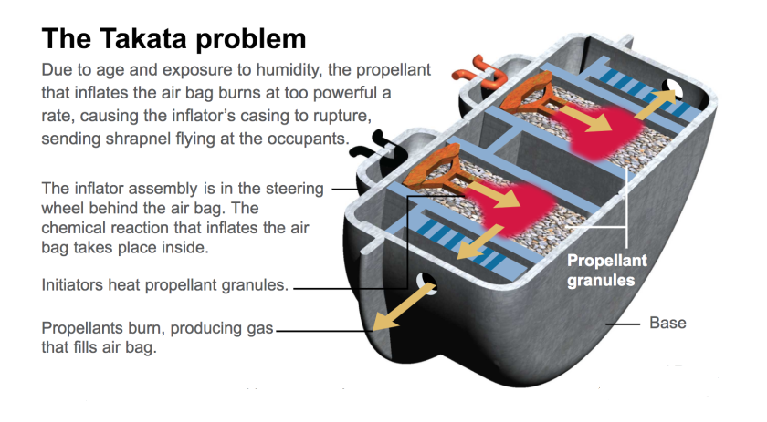

Slide 45
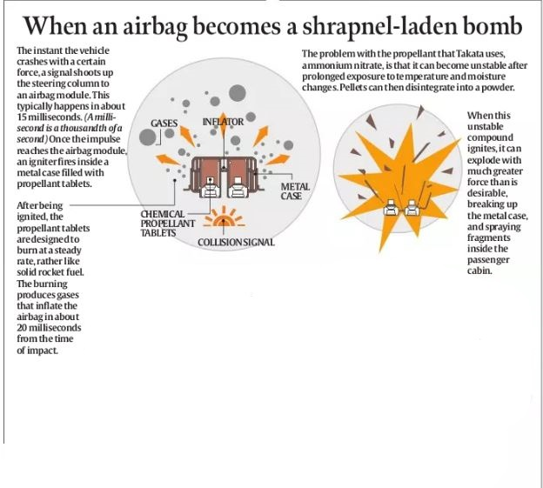

Slide 46
