Slide 1


Poor Judgment Recidivism & the Culpability of Board Governance - IMHO
(without mentioning Facebook even once)
Talk 6
LAWF 3780
Challenges of In-House & Corporate Counsel
TRU Faculty of Law
Spring, 2019
Jon Festinger Q.C.
Centre for Digital Media
QMUL School of Law (CCLS)
http://commlaw.allard.ubc
@jonfestinger
jon_festinger@thecdm.ca

Slide 2
Hello
LAW F 3780
Challenges of In-House
& Corporate Counsel

Slide 3

Terrific Thursdays

Slide 4
Logistics

Slide 5
Website password for Posting
lawf3780!

Slide 6
EVALUATION
Term paper = 60% of the final grade.
5000 word paper
The paper is due on the last day of the exam period at 4:00 p.m.
Class Participation = 40% of the final grade
25% of the mark will be based on group preparation of a Class Discussion, with a Discussion Outline provided to the class—preferably by posting on the course website—a week before.
15% for student participation in other course activities including seminar discussions etc.

Slide 7
Paper Confessional
(or what I learned one winter holiday)
Legal/normative reasoning/argument including footnote/bibliography support & Contribution/Move forward → 60%
Presentation including layout, headings, grammar, language/writing skills, “tightness” → 25%
Topic/Originality/Degree of Difficultly → 15%
THIS IS NOT A RUBRIC. IT IS A SELF ASSESSMENT.

Slide 8
Group Presentations
2-3 (ideally) per group
Sign-up at the break or email me
Any topic – not constrained by what I’m talking about that week
Consult with me re the topic you want to take on
Post one thing you want us to read or watch

Slide 9
Group Presentations
Confirm at the break

Slide 10
Evaluation Tips
Term paper topics need not be discussed with me, but often helpful to you if you do.
Term paper can be on your presentation topic.
Participation: In-class or other contributions, including attendance.
Group presentation need not be on that week’s topic (20 minute per student multiplier suggested 2-4 per group to 60 minute max).

Slide 11
Grades (primarily)
Paper → Quality
Participation → Effort

Slide 12
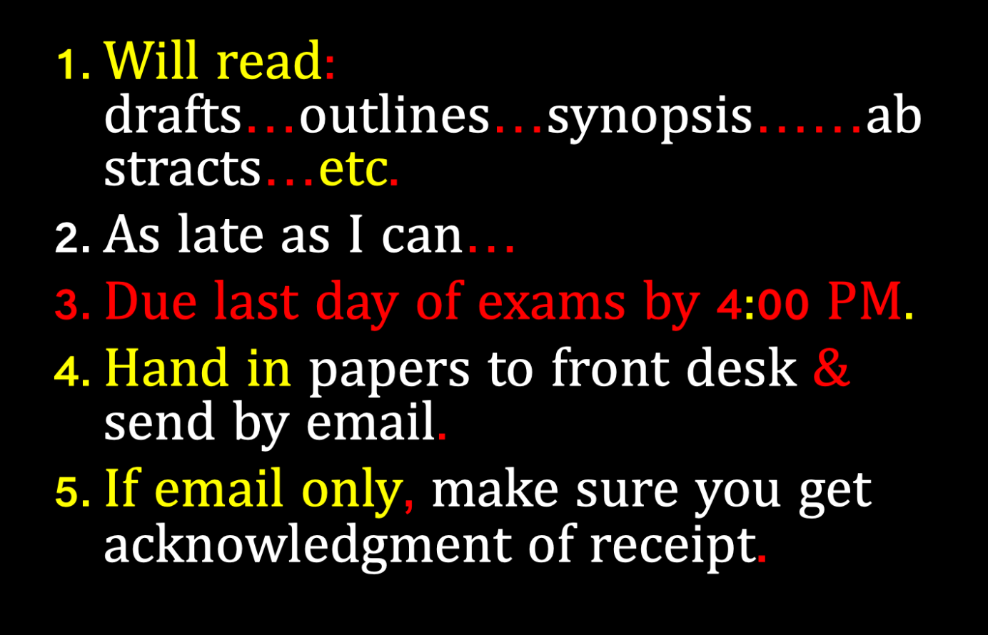

Slide 13
QUESTIONS?
THOUGHTS?
DISCUSSION?

Slide 14

Pause

Slide 15
News of the Week

Slide 16
Yours?

Slide 17
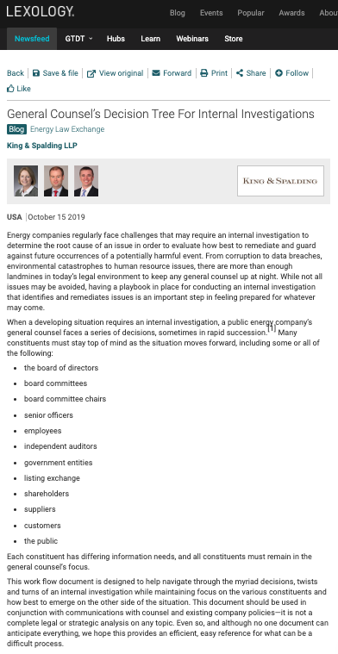

Slide 18
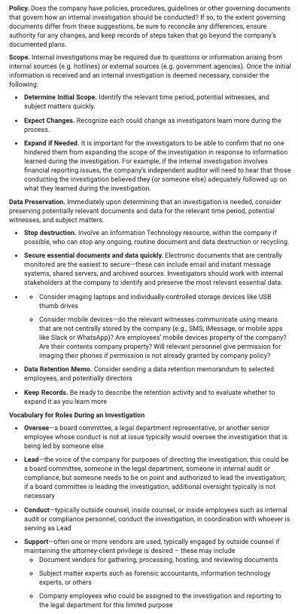

Slide 19
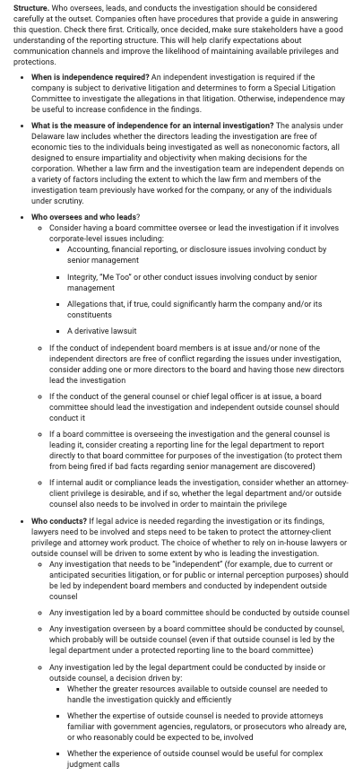

Slide 20
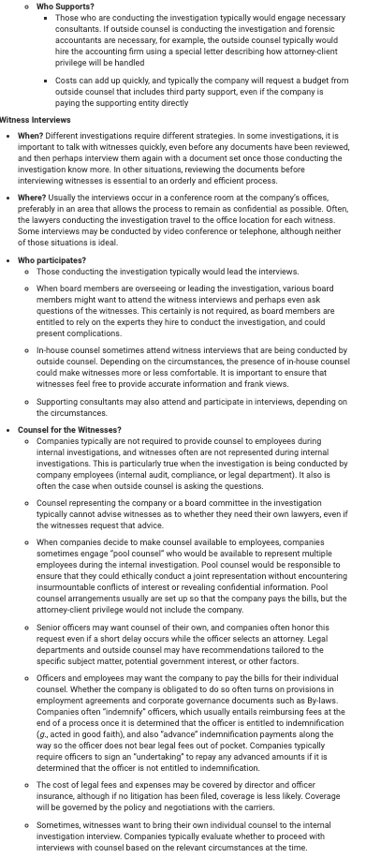

Slide 21
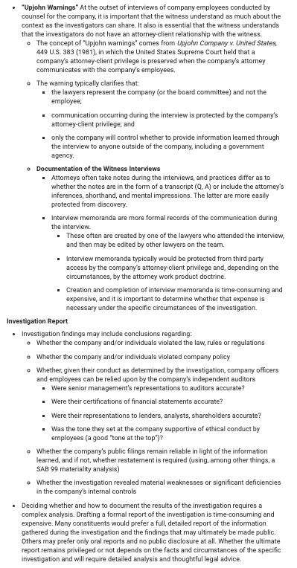

Slide 22
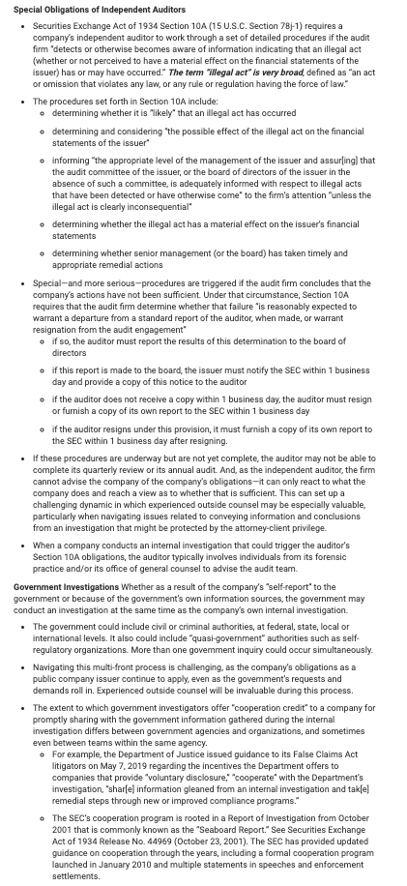

Slide 23
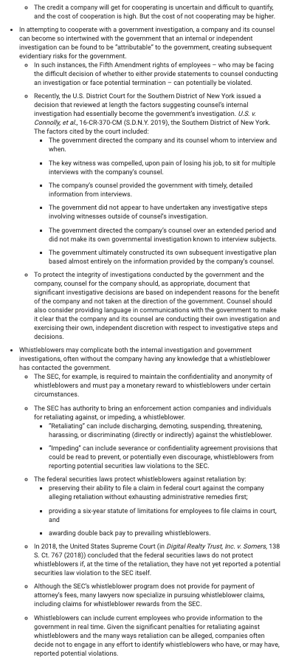

Slide 24
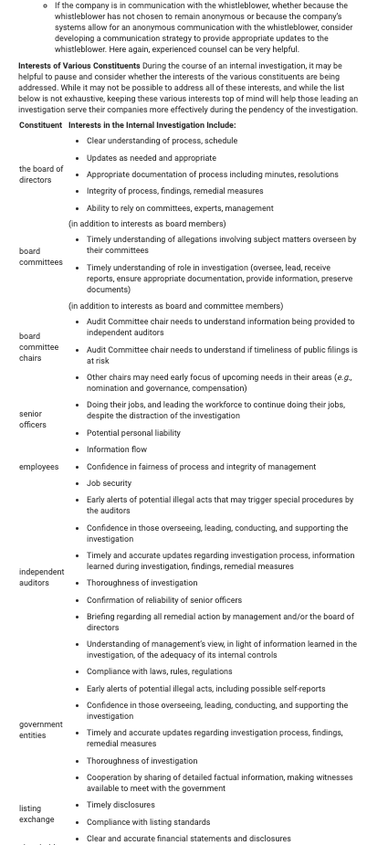

Slide 25
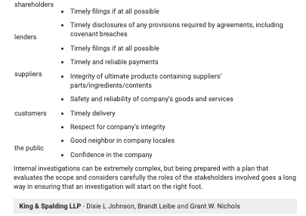

Slide 26
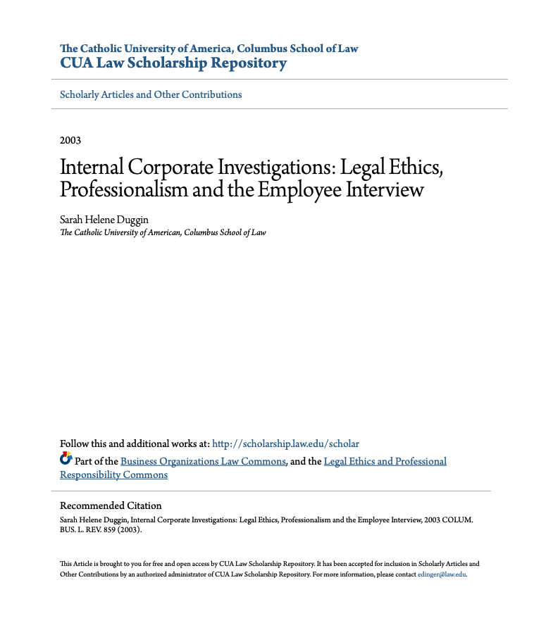

Slide 27
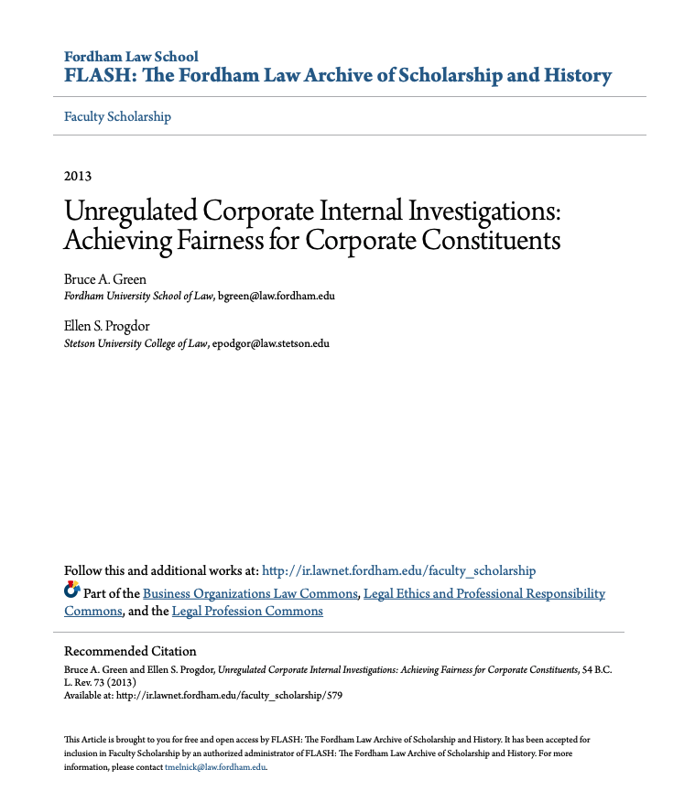

Slide 28


Slide 29
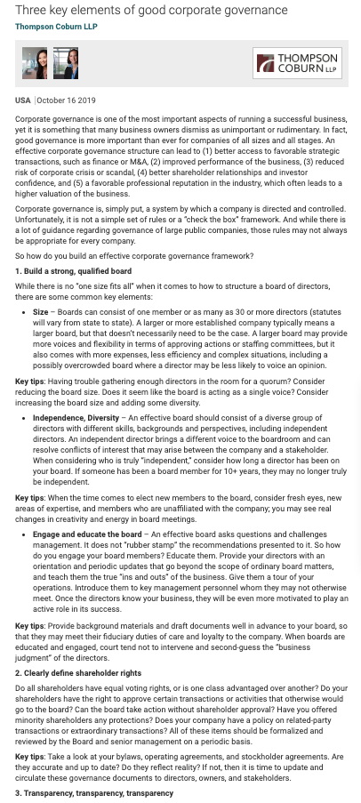

Slide 30
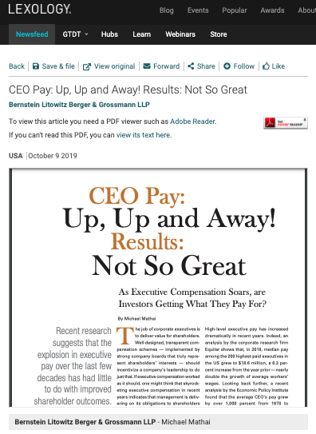

Slide 31
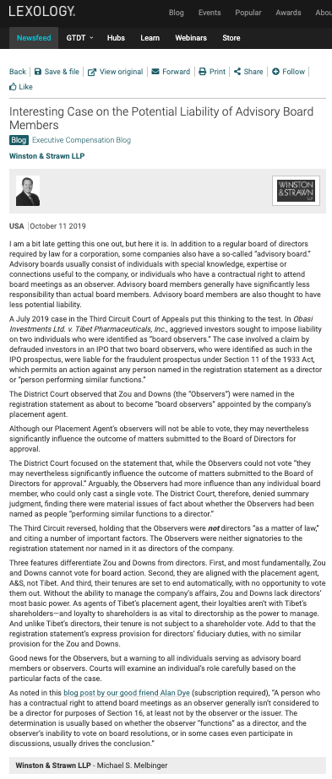

Slide 32
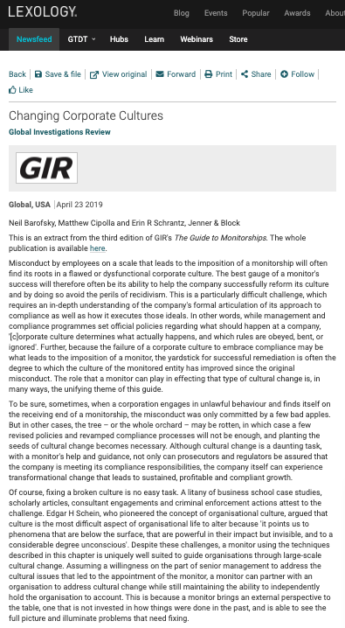

Slide 33
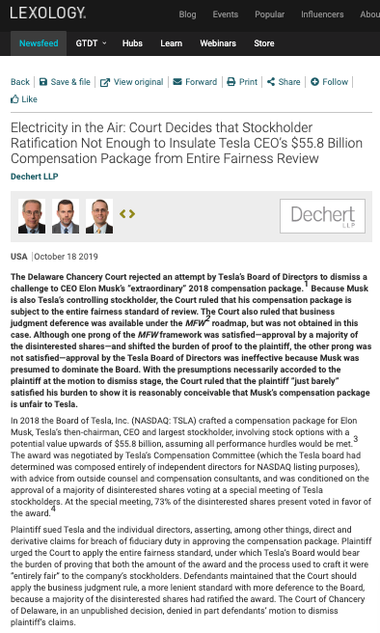
Because…ELON

Slide 34
Pause

Slide 35
QUESTIONS?
THOUGHTS?
DISCUSSION?

Slide 36
Yours?

Slide 37


Why does this keep happening to the same entities?

Slide 38

Two Questions…
Where were the Directors?
What views did Counsel transmit?

Slide 39

What would you do?

Slide 40


Slide 41
S. 142 BC BCA
Duties of directors and officers
142 (1) A director or officer of a company, when exercising the powers and performing the functions of a director or officer of the company, as the case may be, must
  (a) act honestly and in good faith with a view to the best interests of the company,
  (b) exercise the care, diligence and skill that a reasonably prudent individual would exercise in comparable circumstances,
  (c) act in accordance with this Act and the regulations, and
  (d) subject to paragraphs (a) to (c), act in accordance with the memorandum and articles of the company.
(2) This section is in addition to, and not in derogation of, any enactment or rule of law or equity relating to the duties or liabilities of directors and officers of a company.

Slide 42
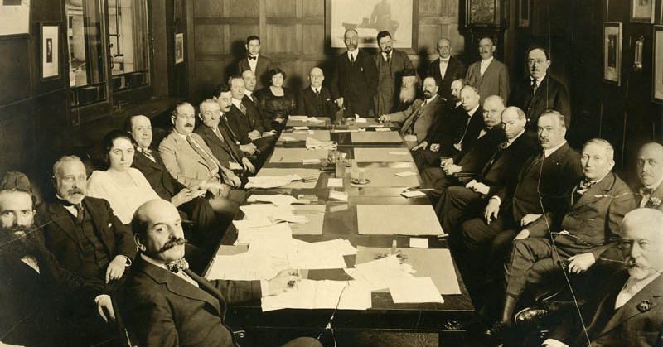
Meaning in the “real” corporate world?

Slide 43
Issue:
If a corporate Director takes offence to something said or done, is that OK or acting with a view to their own interests and not those of the corporation?

Slide 44
Personal opinion….
Hugely important and underrated factor in boardroom issues is personal status/feeling offended or disrespected
Possible examples of this surface rarely if ever
Proceeding by analogy (as in university governance other considerations may, or may not, be relevant).

Slide 45
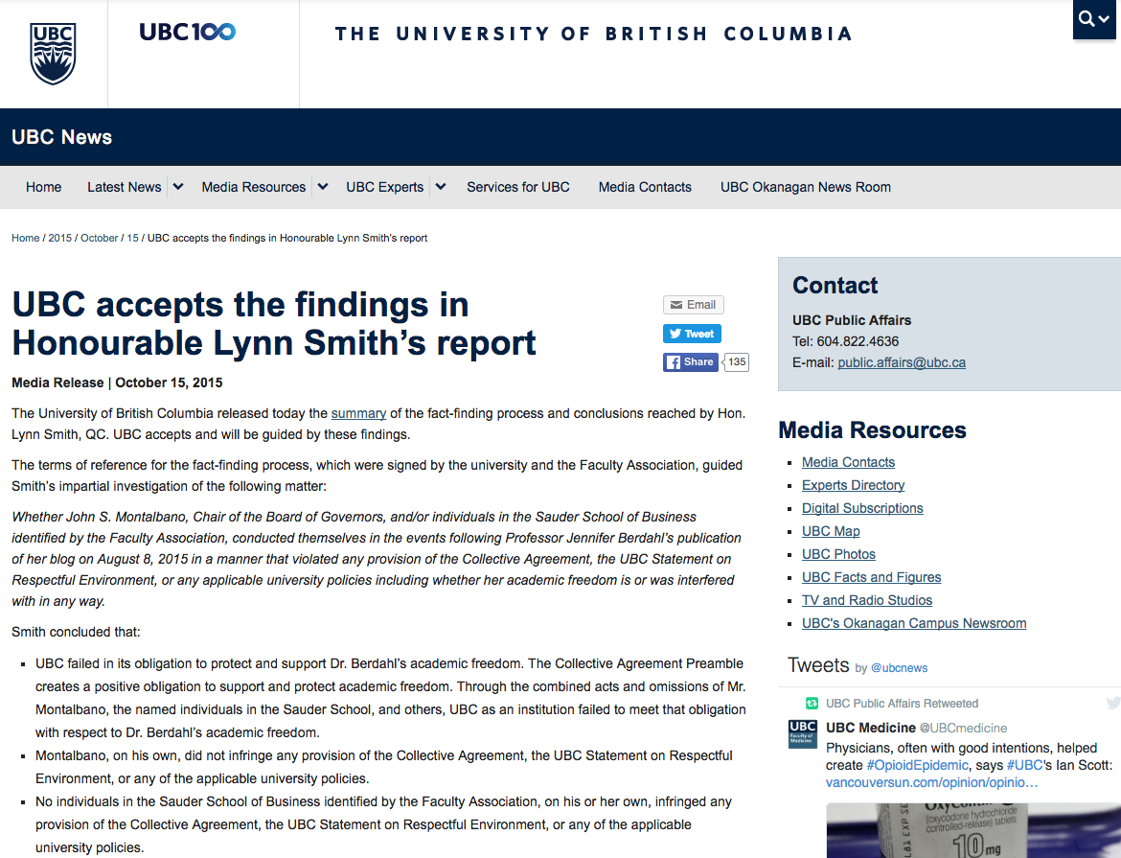

Slide 46
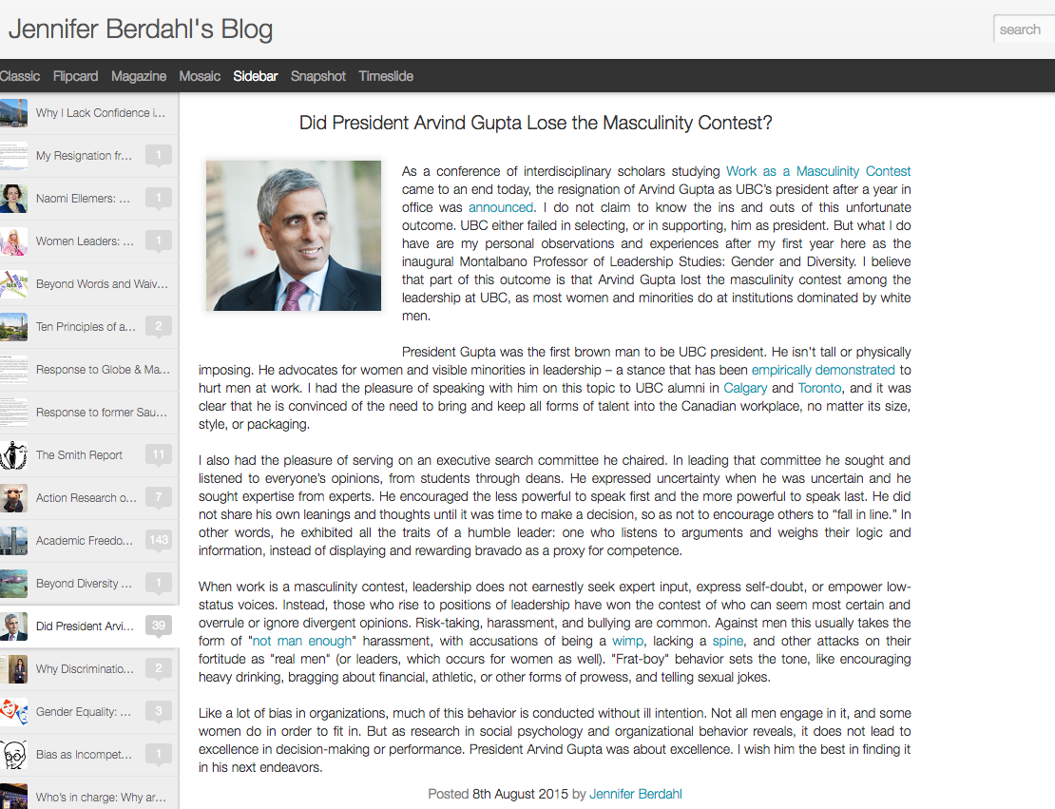

Slide 47
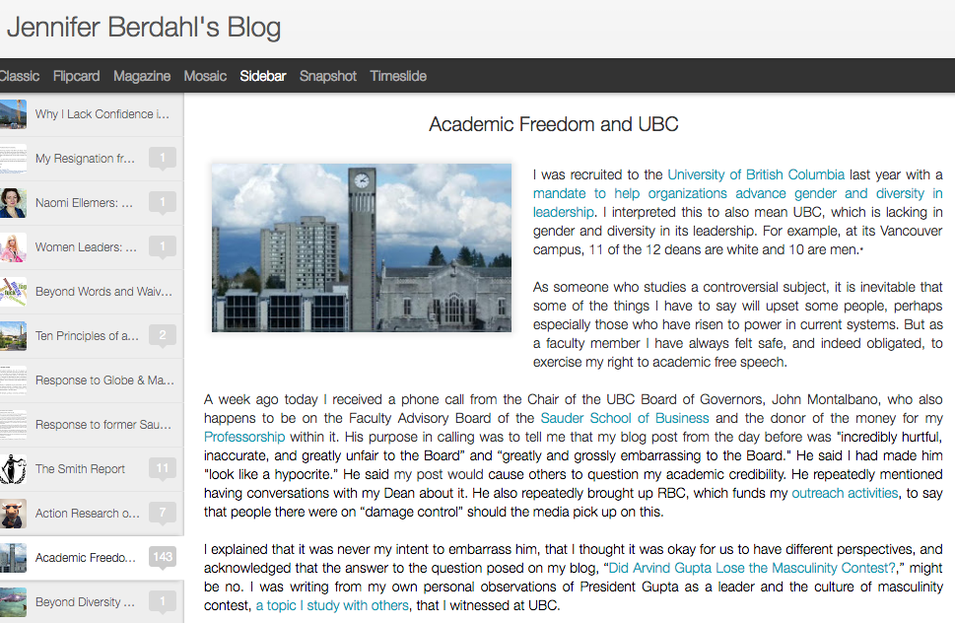

Slide 48


Slide 49
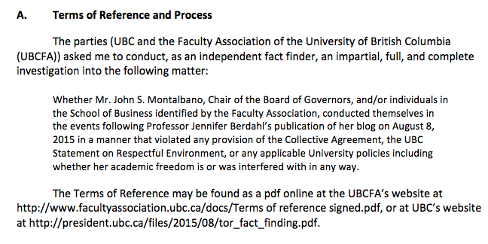

Slide 50
“1….no-one thought to advise Mr. Montalbano against telephoning Dr. Berdahl when he said that he intended to do so. When Mr. Montalbano called Dr. Berdahl and told her about his deep concerns with respect to her blog post, he was mindful of the need to protect academic freedom and did not intend to interfere with it. He made the call in the context of a pre-existing positive relationship with Dr. Berdahl…Such a call from the Chair of the Board of Governors to a faculty member was unprecedented and unwise…
2.…The Dean’s Office in Vancouver was aware that Mr. Montalbano found the blog post offensive and that he had telephoned Dr. Berdahl...”

Slide 51
“(e) Policy 97, “Conflict of Interest and Conflict of Commitment” This Policy recognizes that “[o]ccasionally and as a result of normal and productive engagements inside and outside the University, Faculty Members, staff and students may find themselves in a conflict of commitment, an actual or potential conflict of interest, or in a situation where there is a perception of a conflict of interest.” It also provides procedures for determining if, when, and how such conflicts can be managed. My Terms of Reference do not require me to determine whether Mr. Montalbano was in breach of Policy 97.”

Slide 52
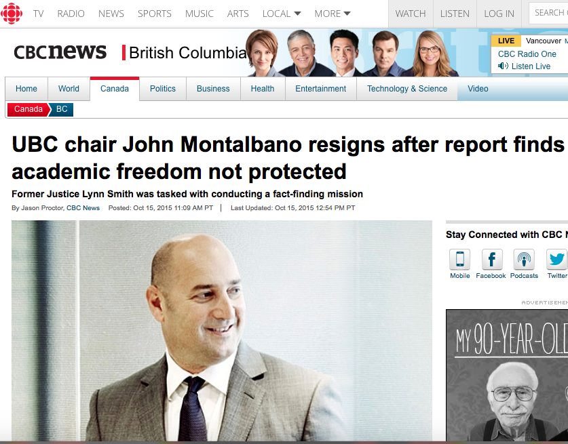

Slide 53
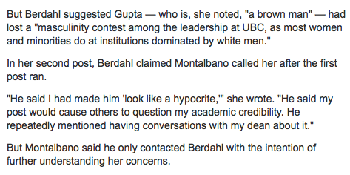
If personal feelings…???

Slide 54
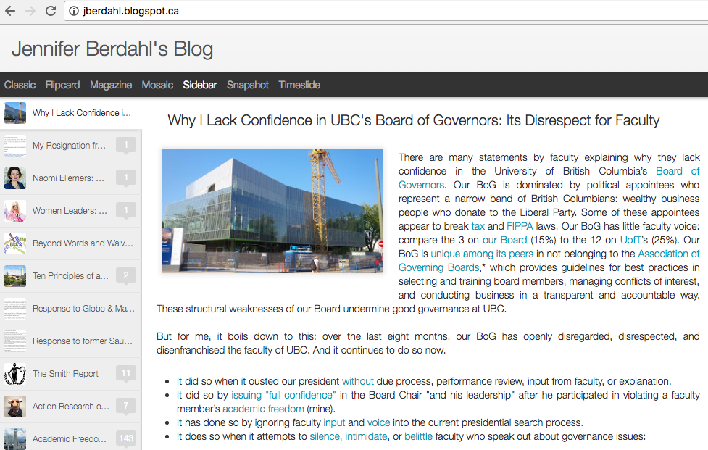
Postscript re governance #1

Slide 55
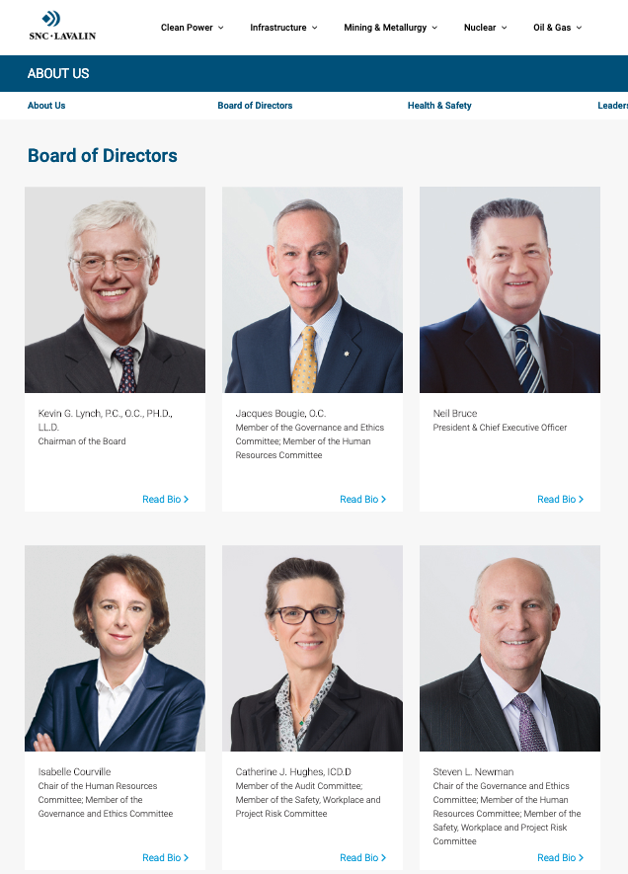
Postscript re governance #2:
SNC Lavalin Edition

Slide 56
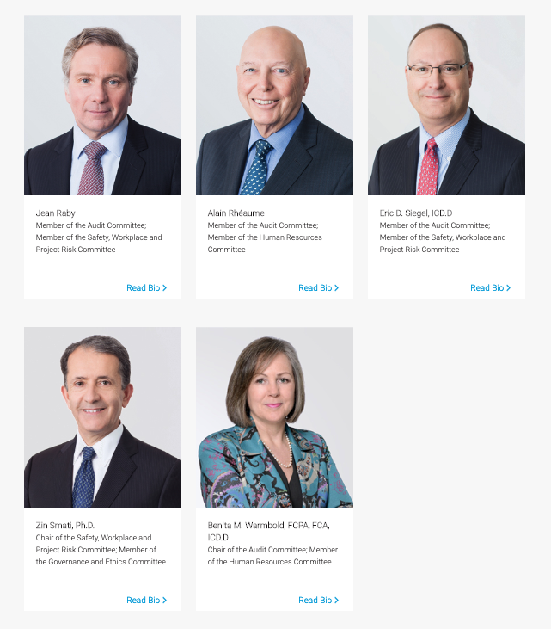
A Remarkable Sameness…

Slide 57

Opinion: Clones become Clowns

Slide 58

Follow-up: The Racist Logo Tale

Slide 59


Slide 60


Slide 61


Slide 62
QUESTIONS?
THOUGHTS?
DISCUSSION?

Slide 63
Pause

Slide 64
Boards & their blind spots:
What’s a good G.C. to do?

Slide 65
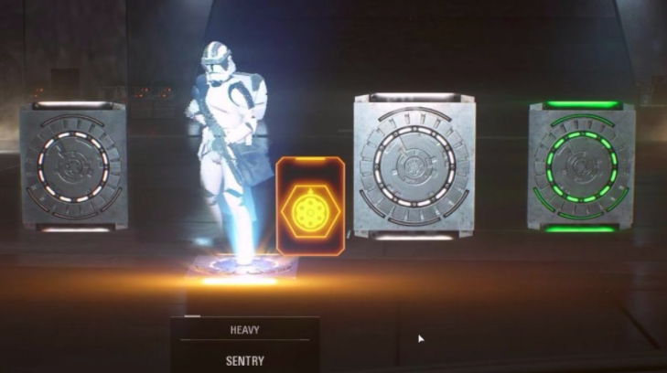
Loot Boxes

Slide 66
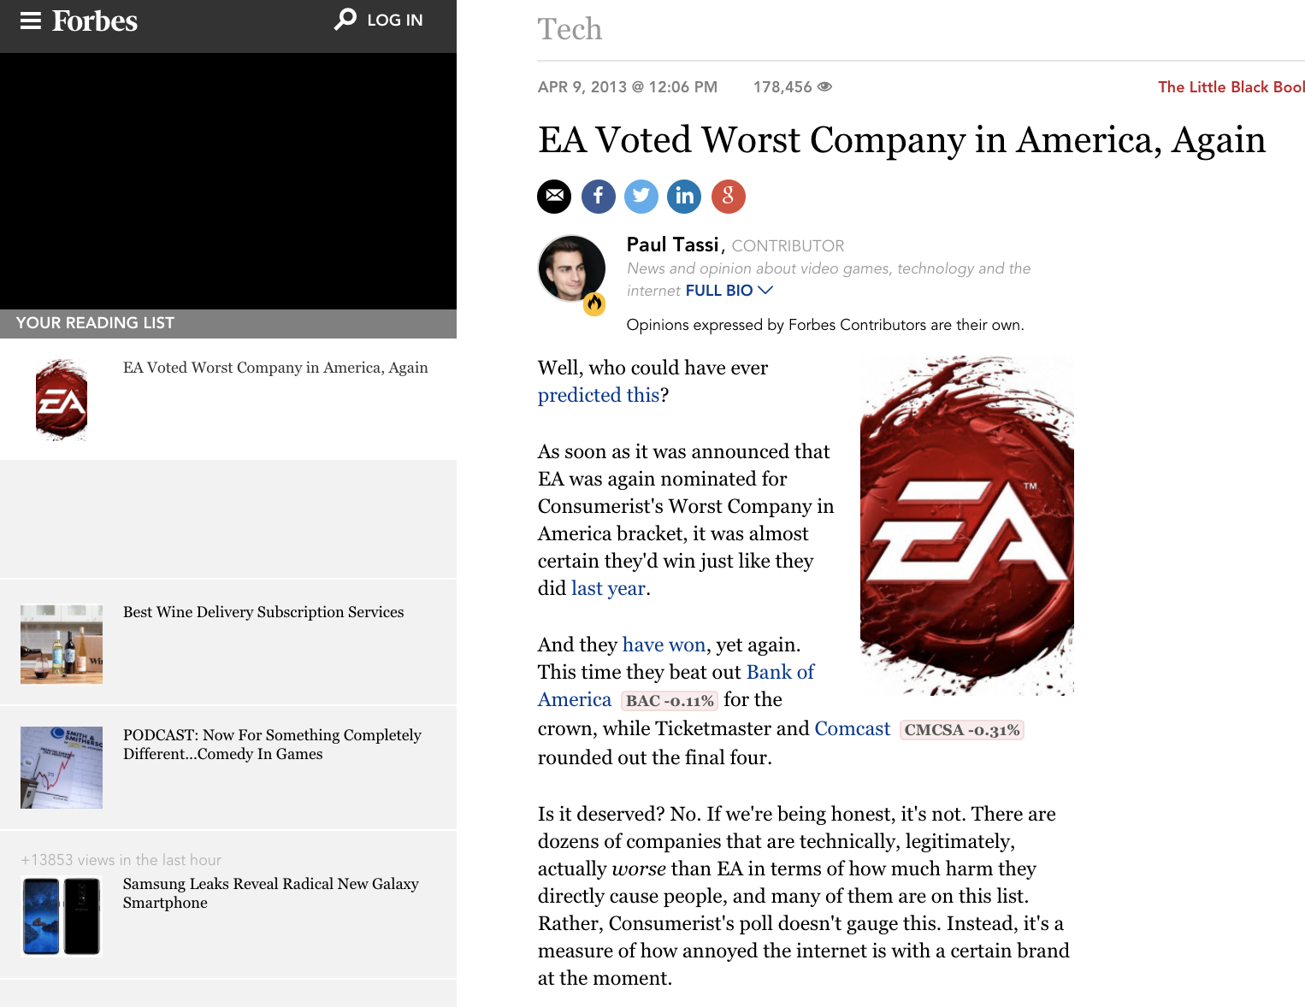
Understand the past to get the present

Slide 67
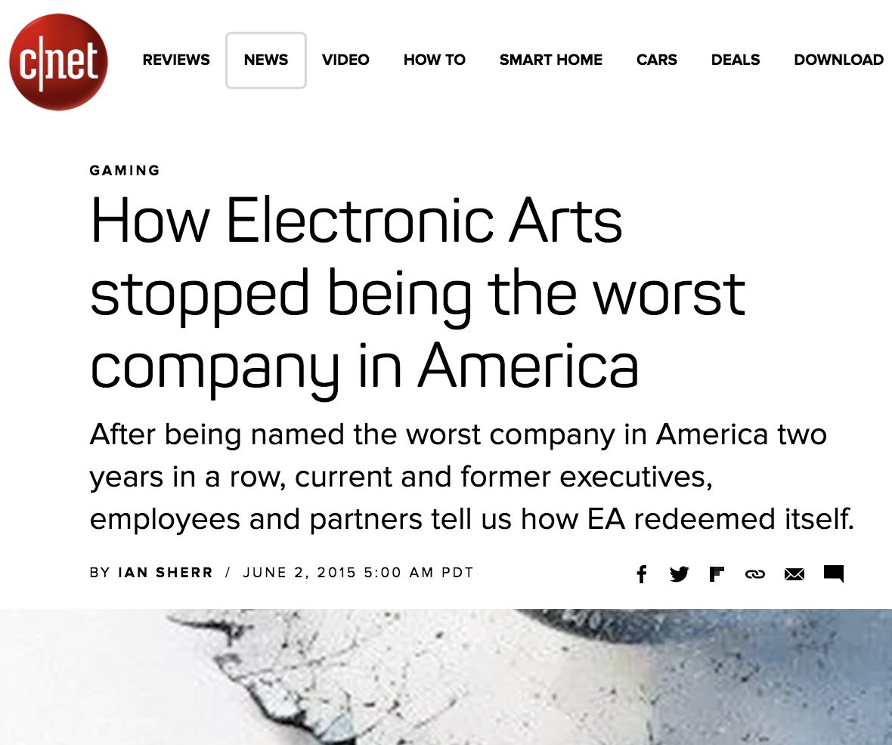

Slide 68
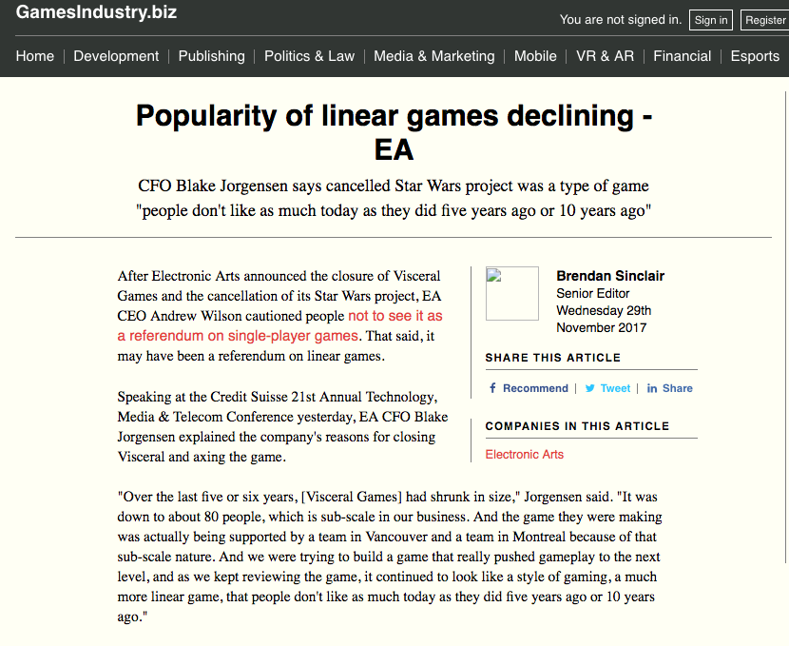

Slide 69
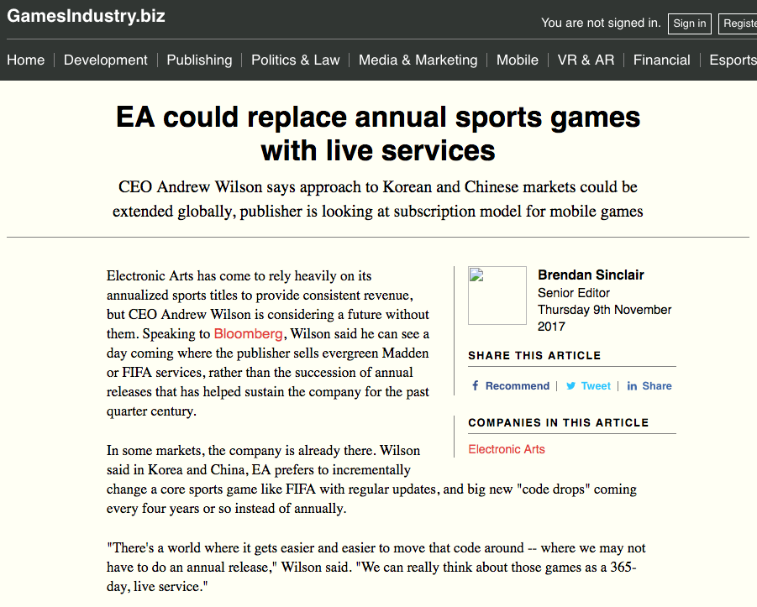

Slide 70
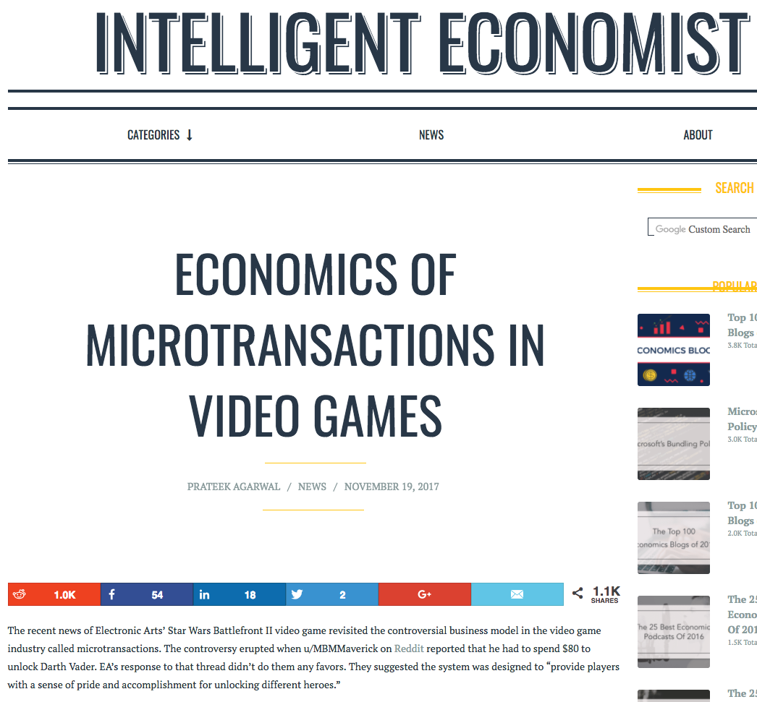

Slide 71
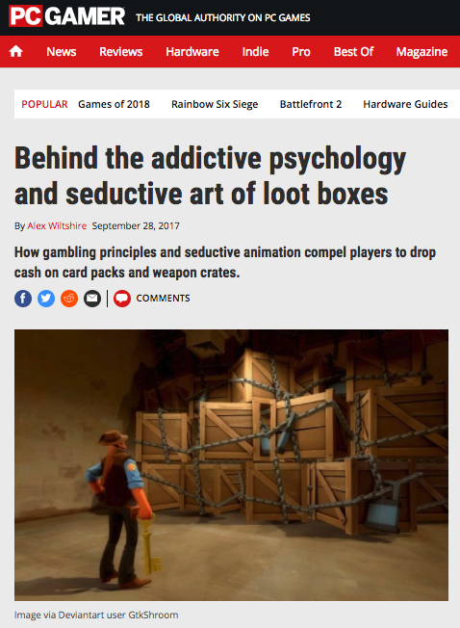

Slide 72
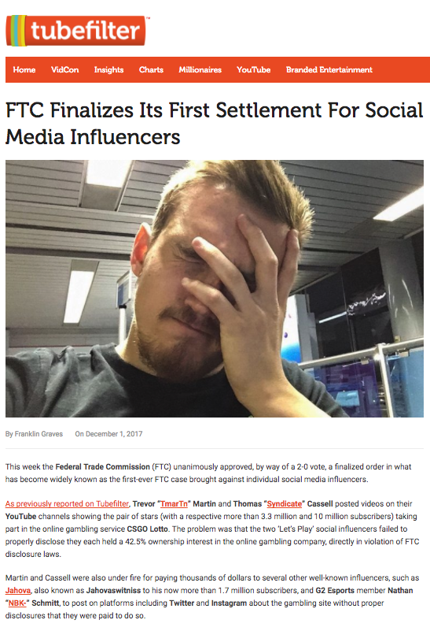
Games are “Influencers”?

Slide 73


Slide 74
EPISODE LOOT BOX
A NEW FAILURE
Not long ago
in this very galaxy
a remarkably unfortunate
set of circumstances occurred…

Slide 75
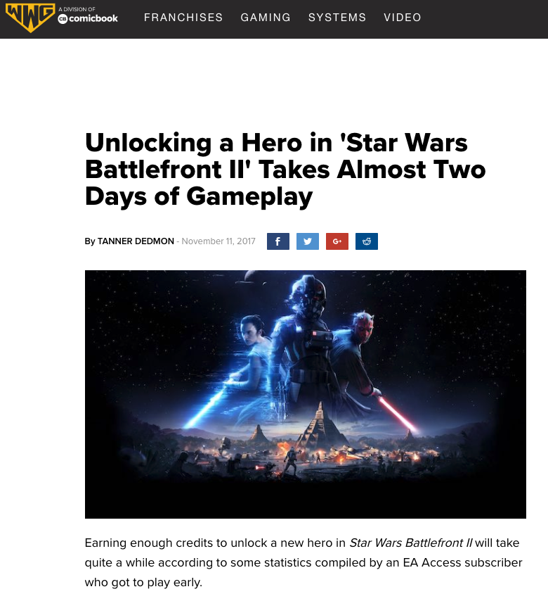

Slide 76
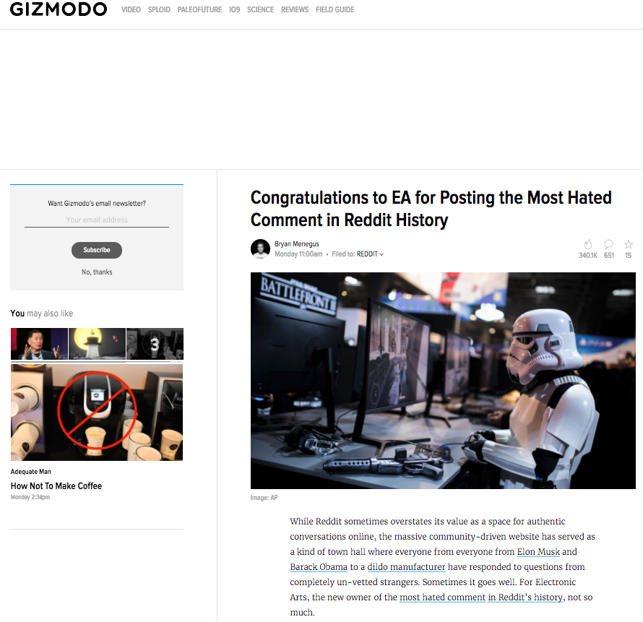

Slide 77
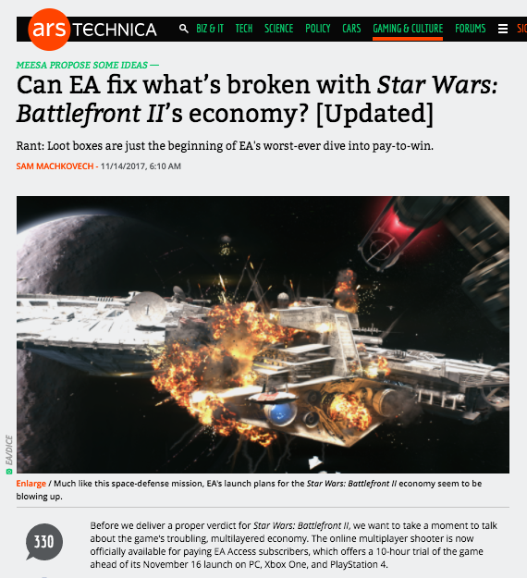

Slide 78
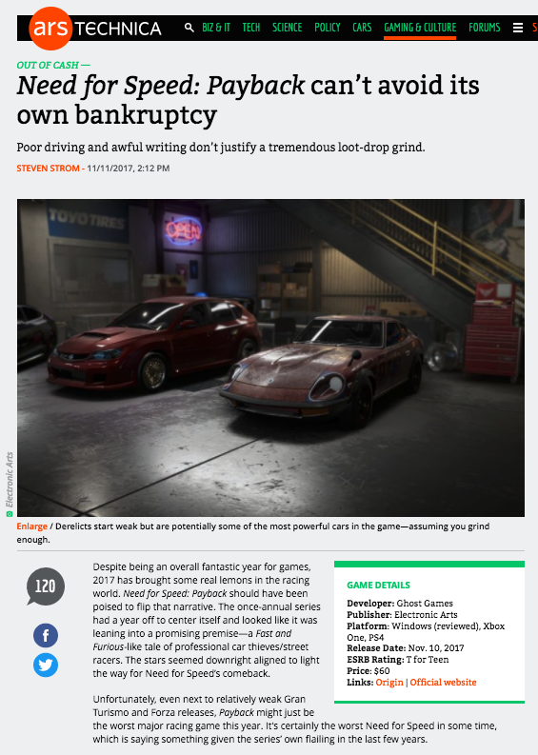

Slide 79


Slide 80
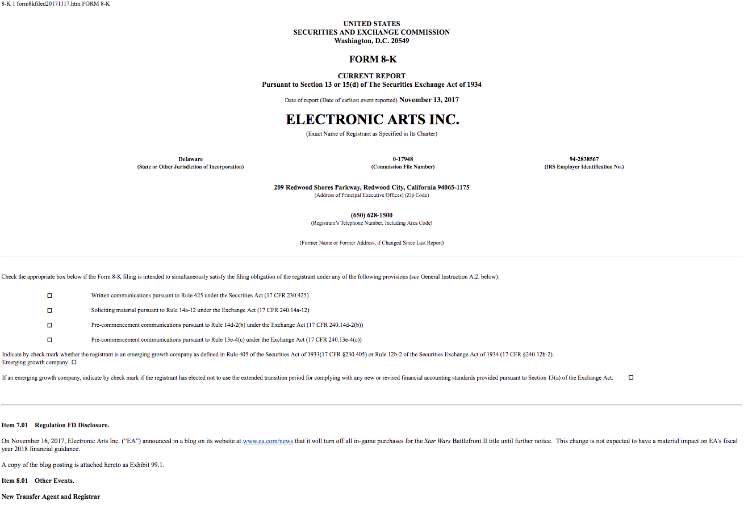

Slide 81
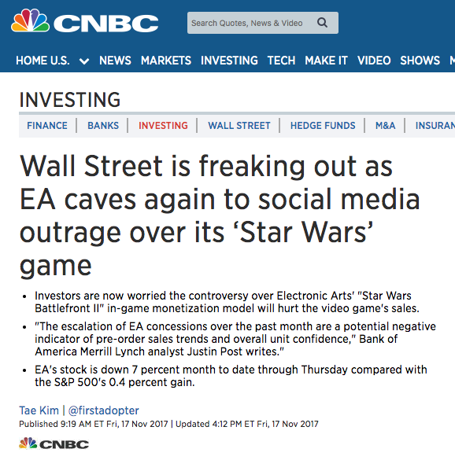

Slide 82
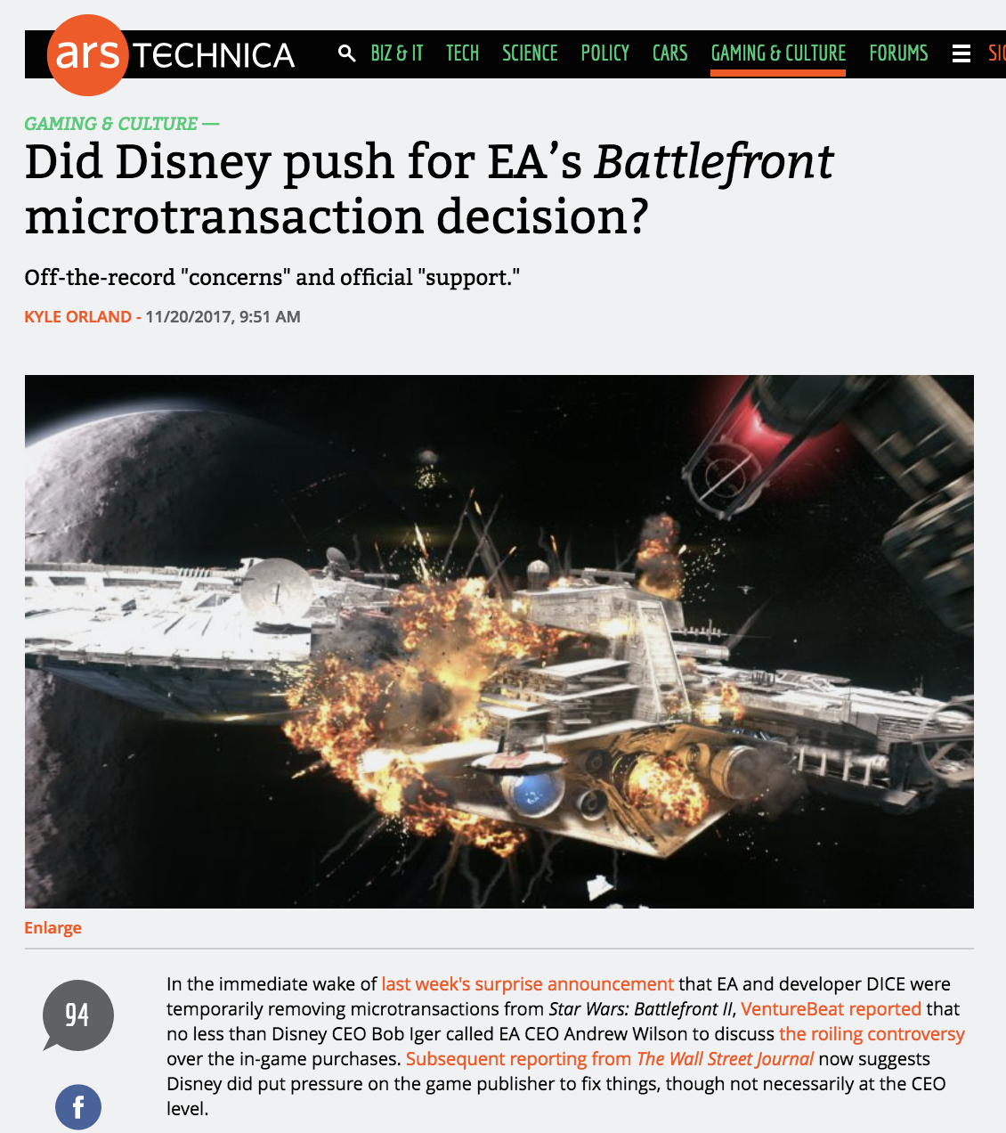

Slide 83
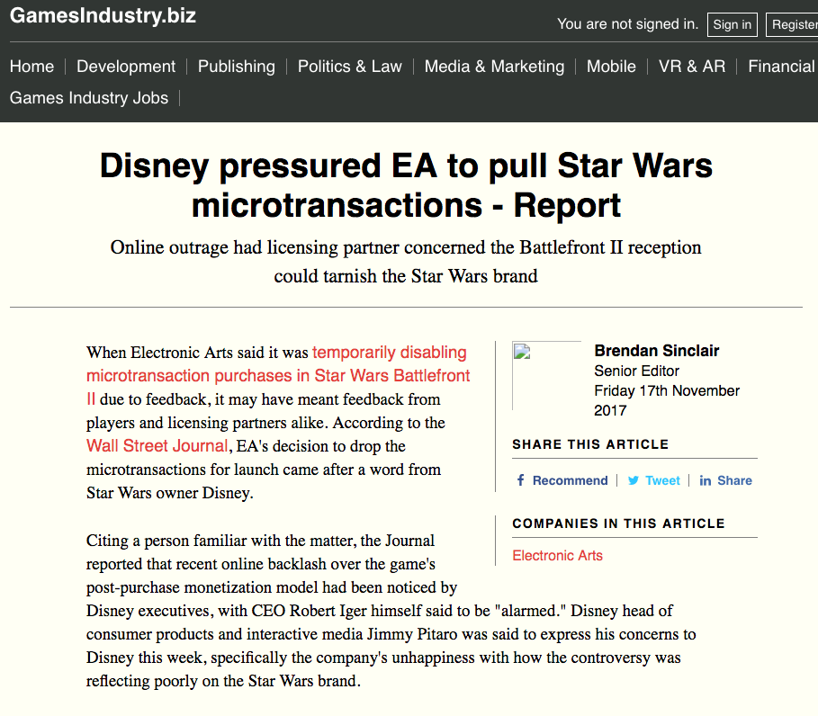

Slide 84


Slide 85


Slide 86
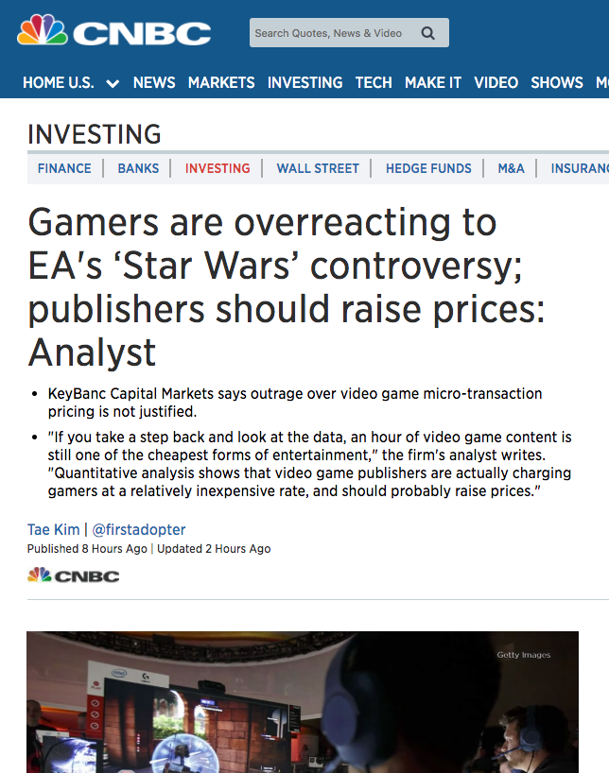

Slide 87
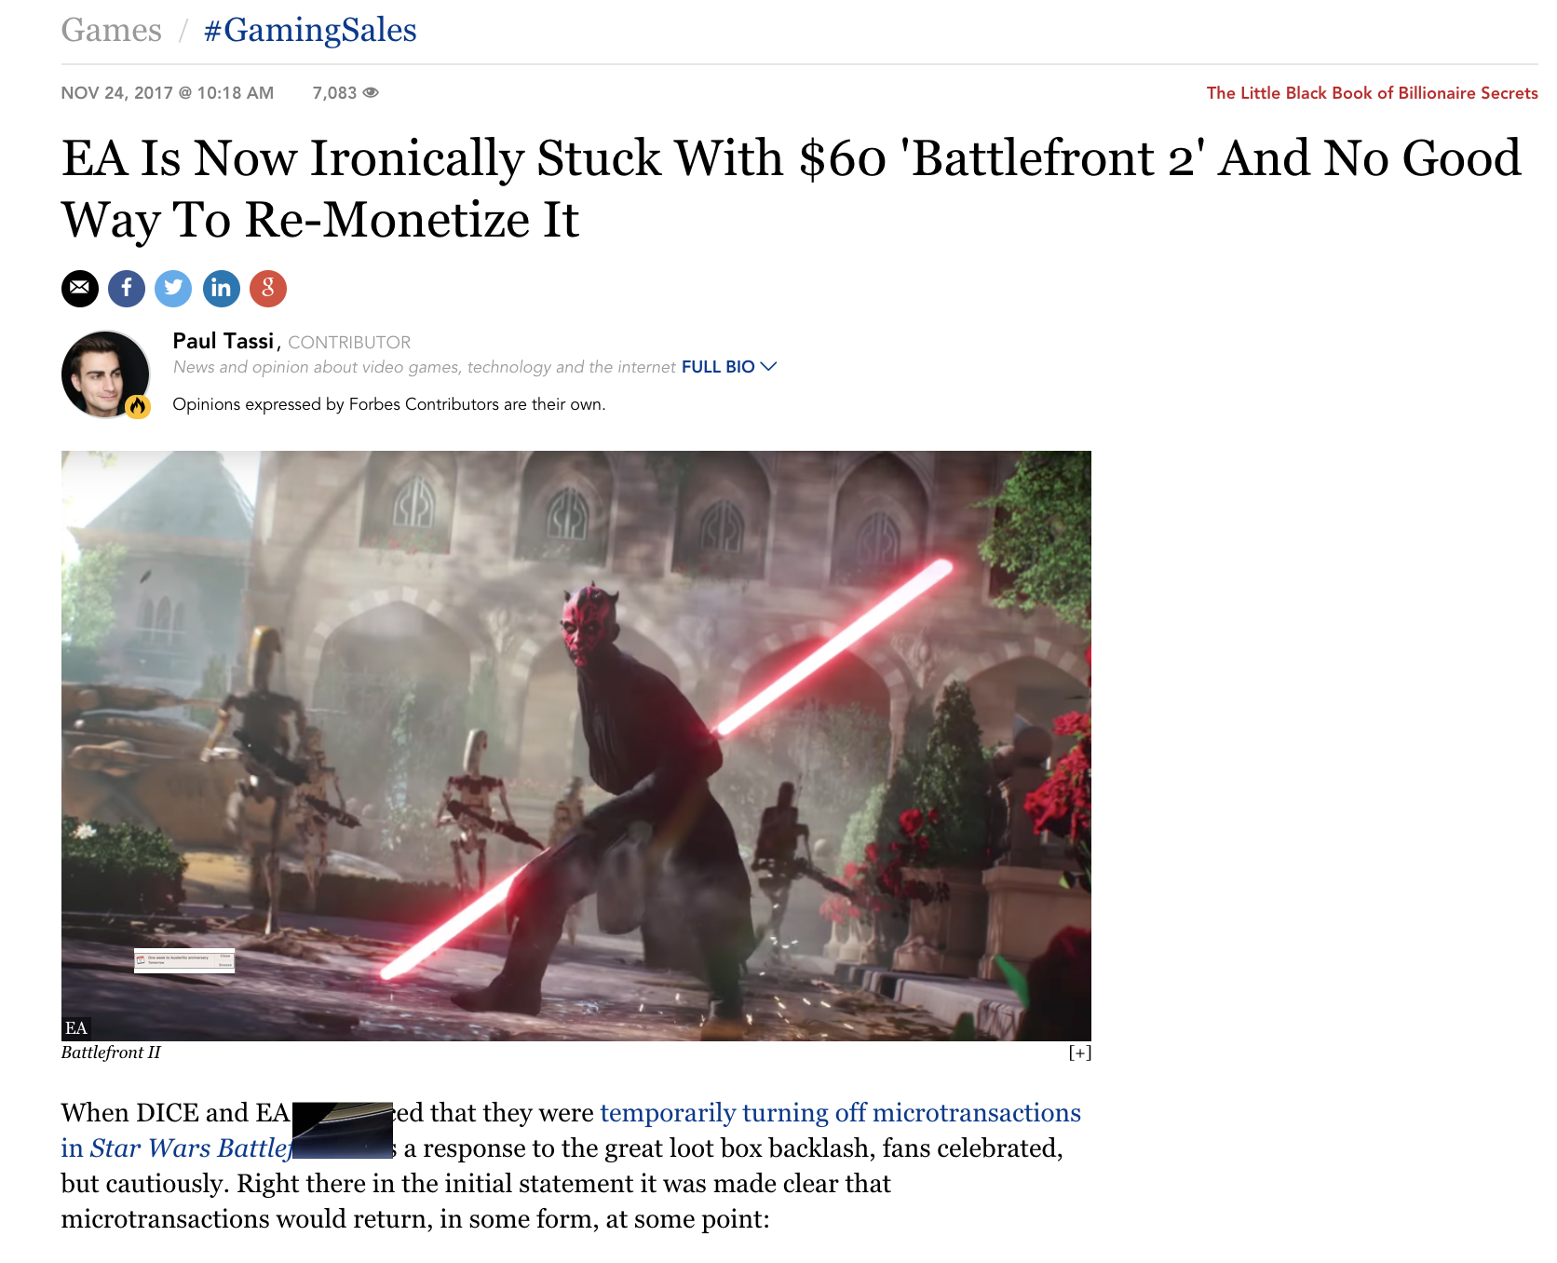

Slide 88


Slide 89
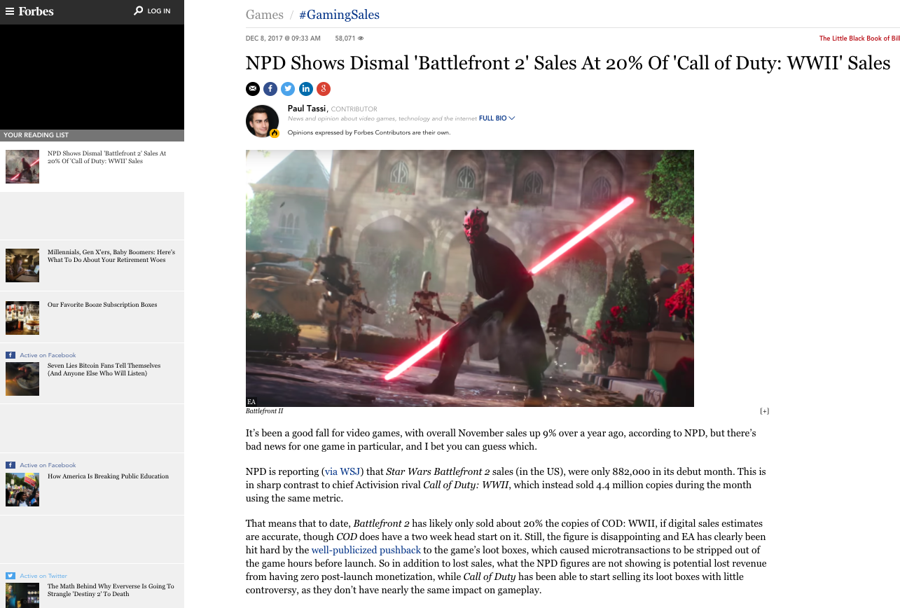

Slide 90


Slide 91
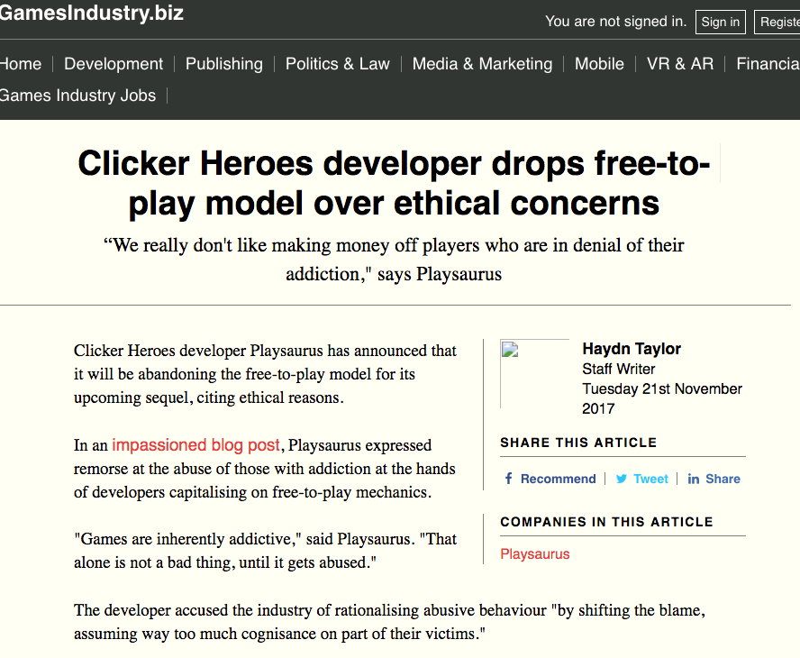

Slide 92
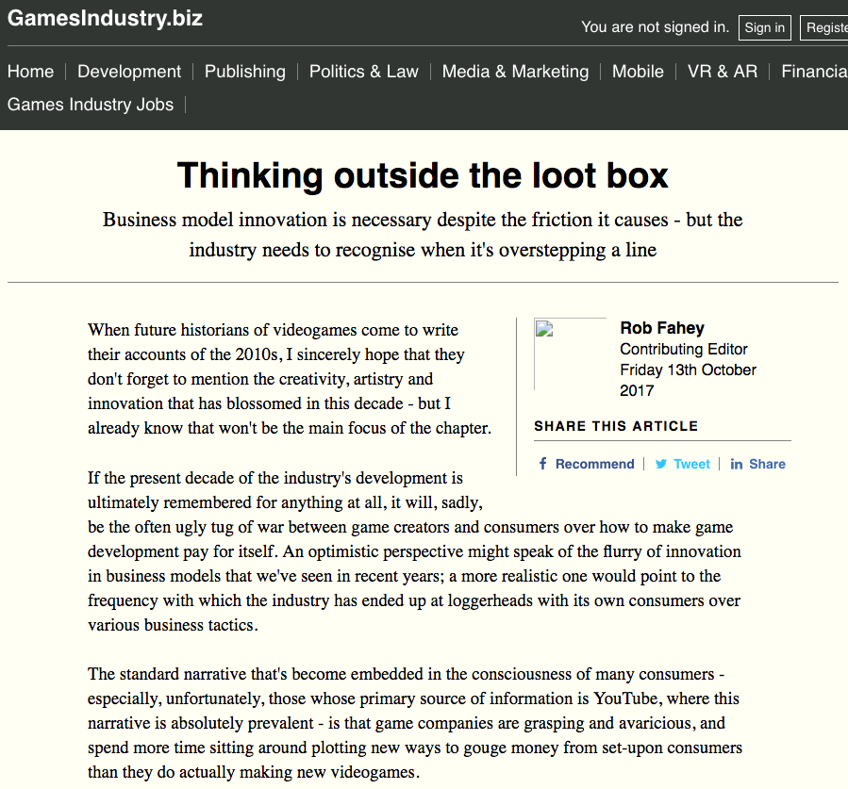

Slide 93
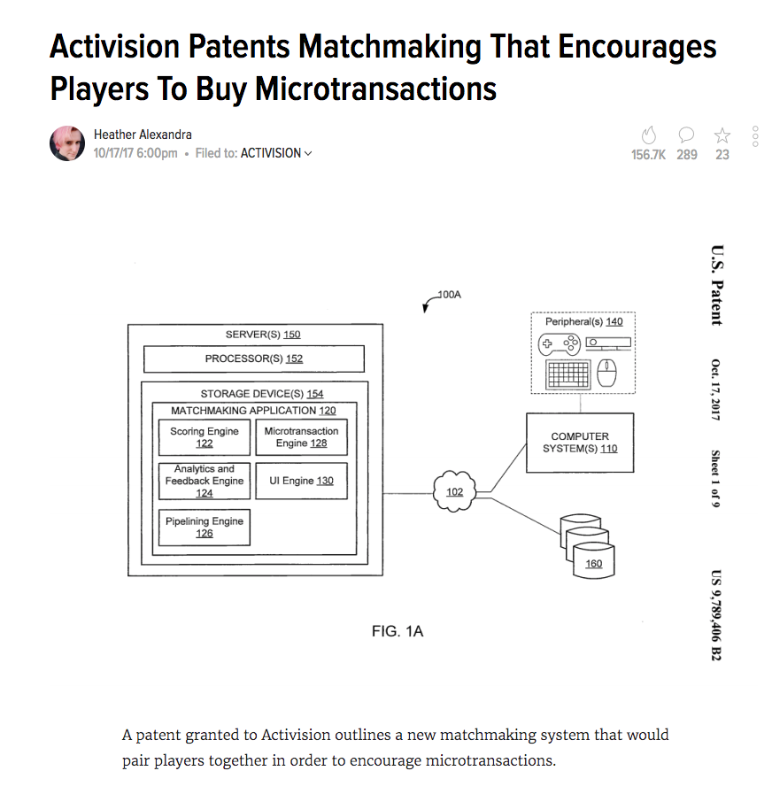

Slide 94
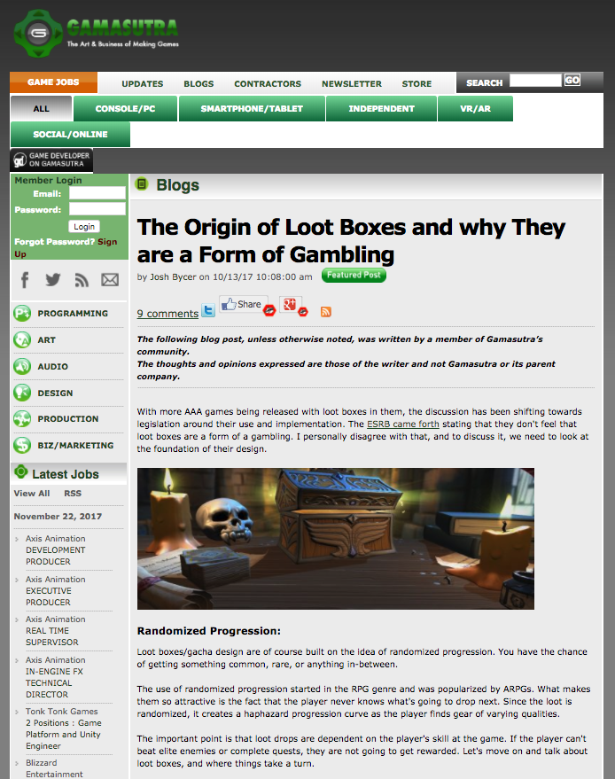

Slide 95


Slide 96


Slide 97


Slide 98


Slide 99


Slide 100


Slide 101


Slide 102


Slide 103


Slide 104


Slide 105


Slide 106


Slide 107


Slide 108


Slide 109


Slide 110


Slide 111


Slide 112


Slide 113


Slide 114


Slide 115


Slide 116


Slide 117


Slide 118


Slide 119


Slide 120


Slide 121


Slide 122


Slide 123


Slide 124


Slide 125


Slide 126


Slide 127


Slide 128


Slide 129


Slide 130


Slide 131


Slide 132


Slide 133


Slide 134


Slide 135


Slide 136


Slide 137


Slide 138


Slide 139


Slide 140


Slide 141


Slide 142


Slide 143


Slide 144


Slide 145


Slide 146


Slide 147


Slide 148


Slide 149


Slide 150


Slide 151


Slide 152


Slide 153


Slide 154


Slide 155


Slide 156


Slide 157


Slide 158


Slide 159


Slide 160


Slide 161


Slide 162


Slide 163


Slide 164


Slide 165


Slide 166


Slide 167


Slide 168


Slide 169


Slide 170


Slide 171


Slide 172

What a difference 2 years makes!
See Slide 23

Slide 173


Slide 174


Slide 175


Slide 176


Slide 177


Slide 178


Slide 179
Two Questions…
Where were the Directors?
What views did Counsel transmit?

Slide 180

The Board of E.A.

Slide 181


Slide 182


Slide 183


Slide 184
Observations
9 Directors.
Only 2 overtly or directly involved in the video-game industry.
Those two are the current CEO of EA and a past-CEO of EA who is EA’s current Chair.
None of the other Directors CV’s mention direct involvement in video-games beyond EA.
In the circumstances cited, it does not seem unfair to wonder whether:
  1. Those Directors play video-games regularly?
  2. Those Directors have engaged in the context of playing games with loot-boxes?
  3. Depending on the answers to the above questions whether those Directors were really in a position to contradict EA’s managements position

Slide 185
Pause

Slide 186
QUESTIONS?
THOUGHTS?
DISCUSSION?

Slide 187


A MATTER OF PERSPECTIVE

Slide 188

Conclusion

Slide 189

Always include a cat picture

Slide 190
In learning you will teach
And in teaching you will learn
Phil Collins' Son of Man (1999)

Slide 191
Our Academic Partners

