Slide 1


“Yoda’s Questions…”
Talk 5
LAWF 3780
Challenges of In-House & Corporate Counsel
TRU Faculty of Law
Spring, 2019
Jon Festinger Q.C.
Centre for Digital Media
QMUL School of Law (CCLS)
http://commlaw.allard.ubc
@jonfestinger
jon_festinger@thecdm.ca

Slide 2
Hello
LAW F 3780
Challenges of In-House
& Corporate Counsel

Slide 3

Terrific Thursdays

Slide 4
Logistics

Slide 5
Website password for Posting
lawf3780!

Slide 6
NO CLASSES
THURSDAY
OCTOBER 3
+ THURSDAY
OCTOBER 10

Slide 7
EVALUATION
Term paper = 60% of the final grade.
5000 word paper
The paper is due on the last day of the exam period at 4:00 p.m.
Class Participation = 40% of the final grade
25% of the mark will be based on group preparation of a Class Discussion, with a Discussion Outline provided to the class—preferably by posting on the course website—a week before.
15% for student participation in other course activities including seminar discussions etc.

Slide 8
Paper Confessional
(or what I learned one winter holiday)
Legal/normative reasoning/argument including footnote/bibliography support & Contribution/Move forward → 60%
Presentation including layout, headings, grammar, language/writing skills, “tightness” → 25%
Topic/Originality/Degree of Difficultly → 15%
THIS IS NOT A RUBRIC. IT IS A SELF ASSESSMENT.

Slide 9
Group Presentations
2-3 (ideally) per group
Sign-up at the break or email me
Any topic – not constrained by what I’m talking about that week
Consult with me re the topic you want to take on
Post one thing you want us to read or watch

Slide 10
Group Presentations
Confirm at the break

Slide 11
Evaluation Tips
Term paper topics need not be discussed with me, but often helpful to you if you do.
Term paper can be on your presentation topic.
Participation: In-class or other contributions, including attendance.
Group presentation need not be on that week’s topic (20 minute per student multiplier suggested 2-4 per group to 60 minute max).

Slide 12
Grades (primarily)
Paper → Quality
Participation → Effort

Slide 13
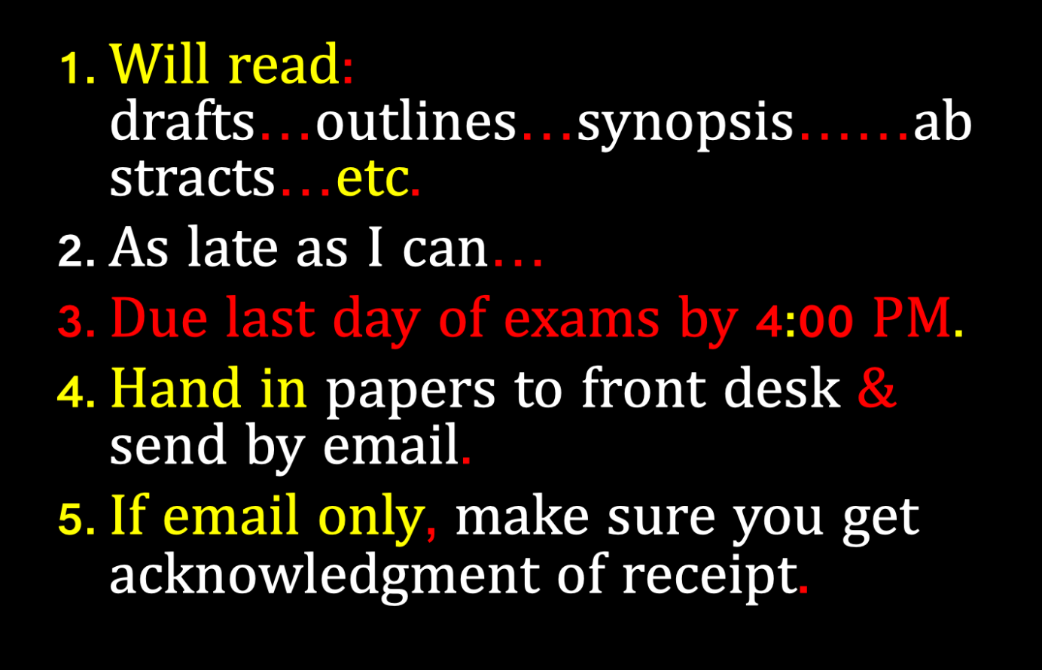

Slide 14

The question
of GUESTS?

Slide 15

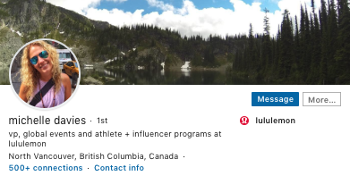

Slide 16
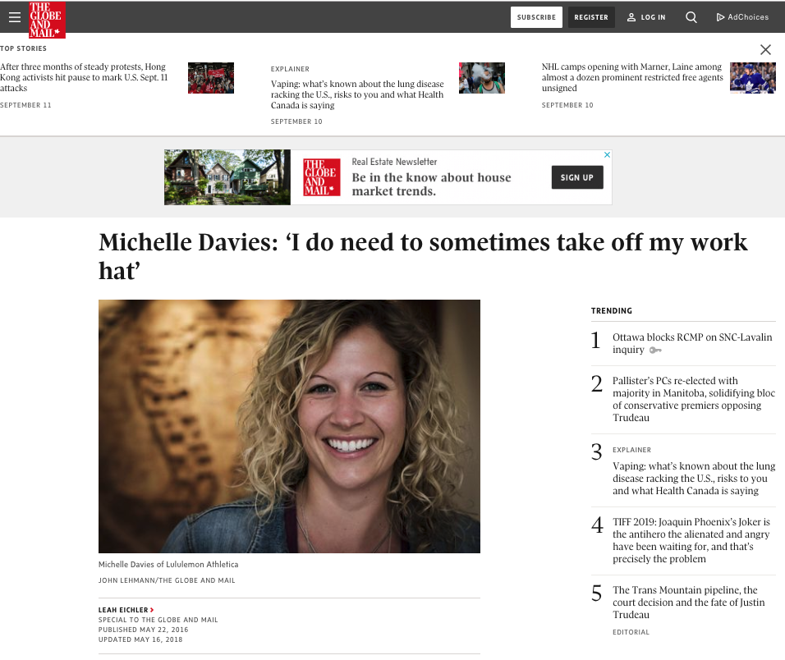

Slide 17
QUESTIONS?
THOUGHTS?
DISCUSSION?

Slide 18

Pause

Slide 19
IS ANY JURISDICTION
KEEPING GOOD
STATS?

Slide 20
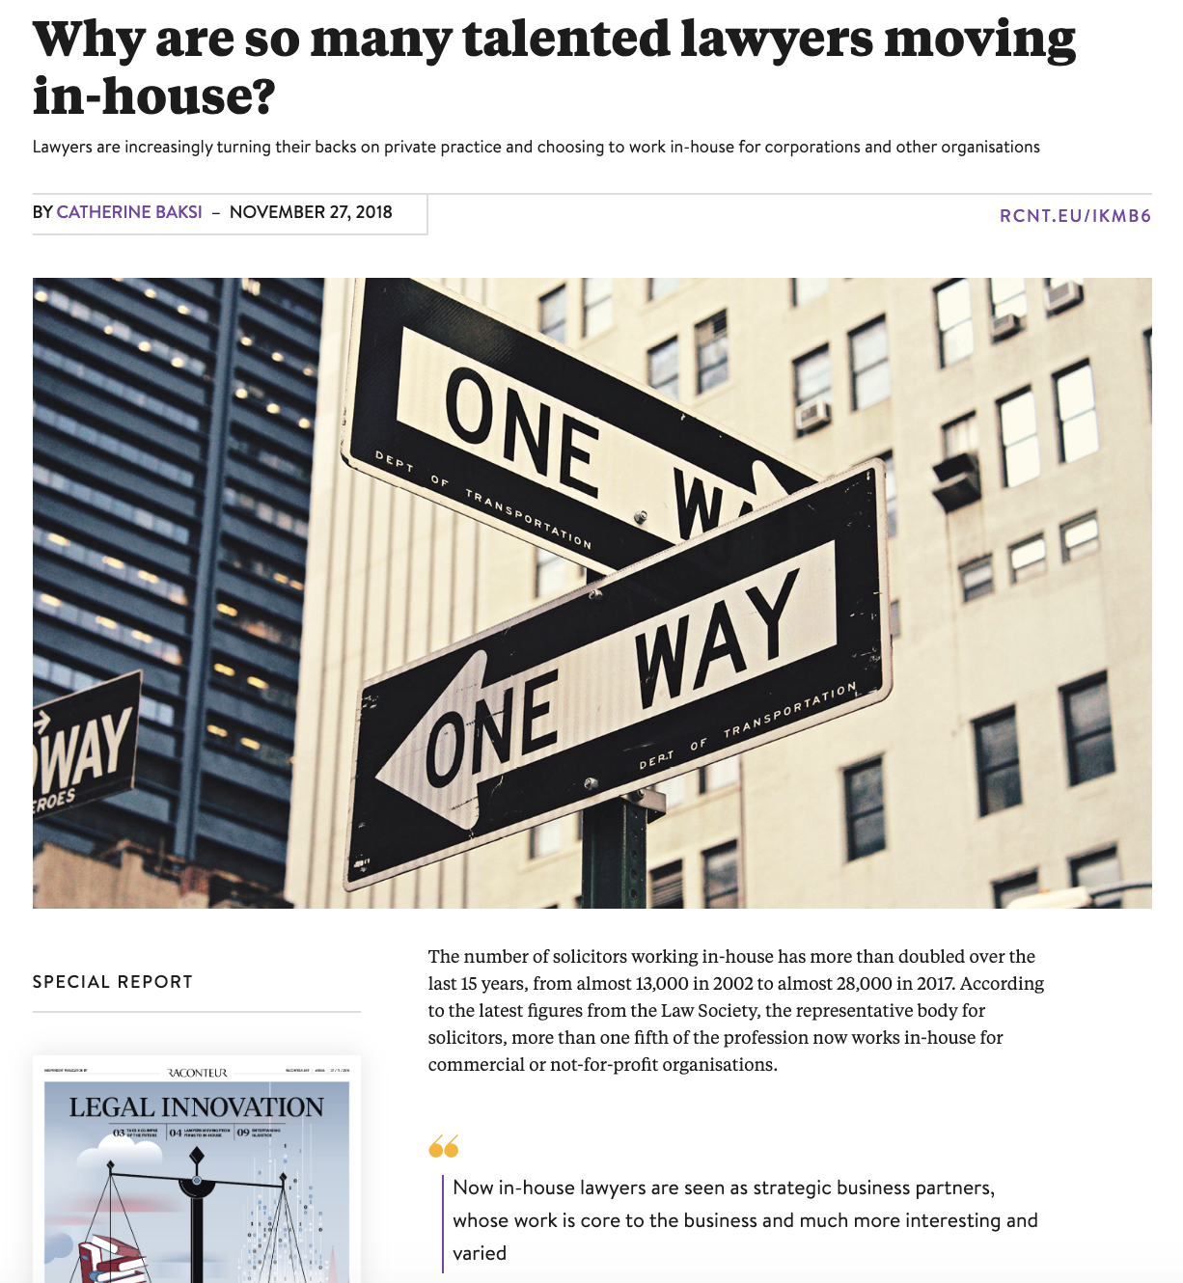

Slide 21


Slide 22
QUESTIONS?
THOUGHTS?
DISCUSSION?

Slide 23
Pause

Slide 24
News of the Week

Slide 25
Yours?

Slide 26


Slide 27
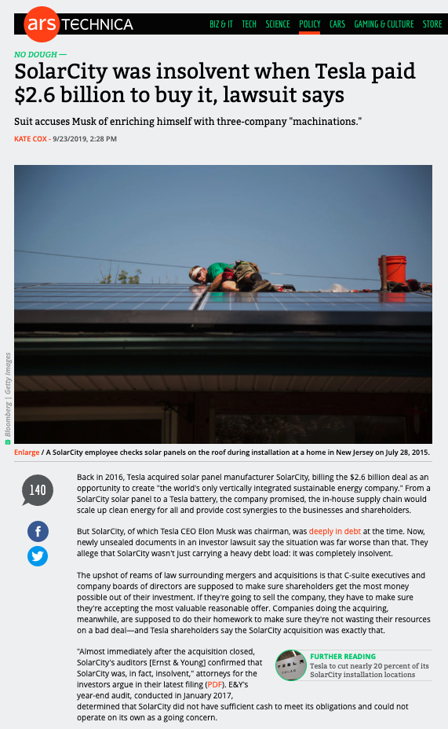

Slide 28
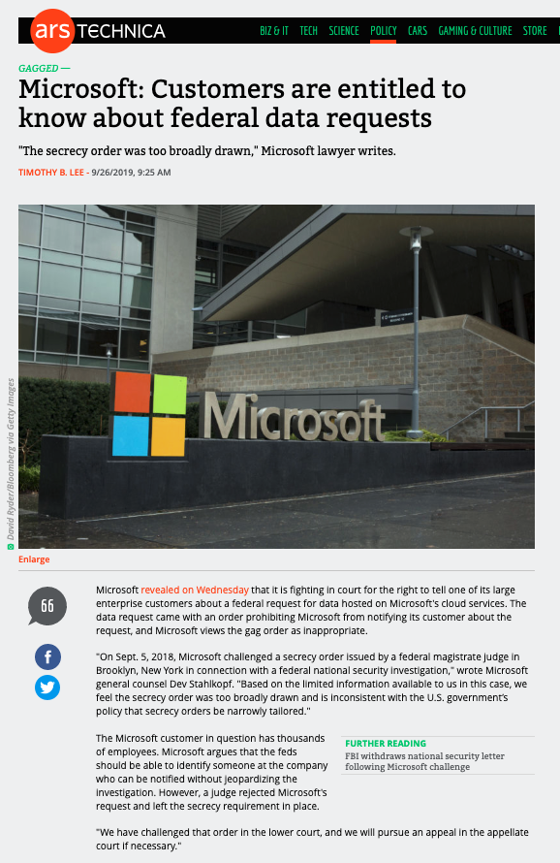

Slide 29


Slide 30
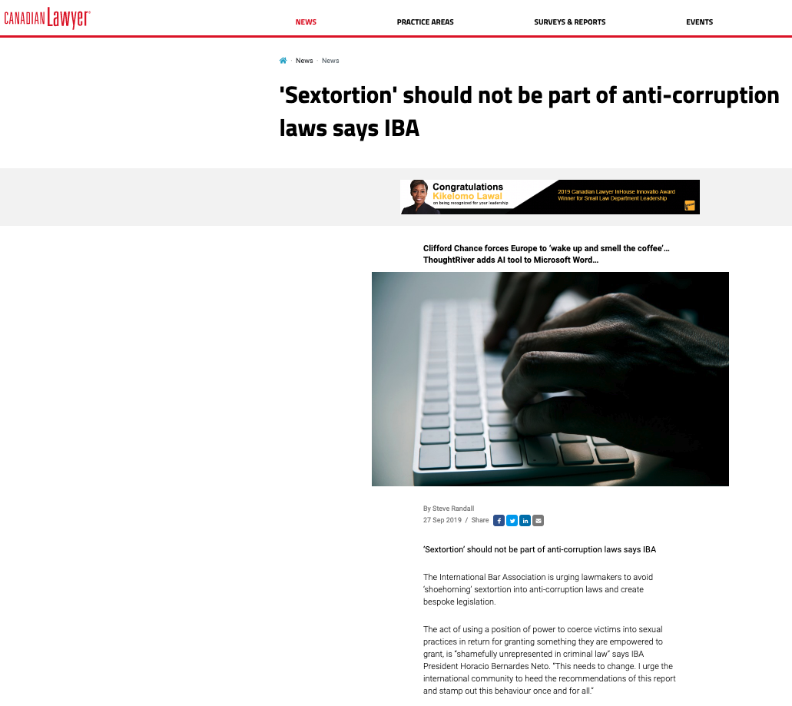

Slide 31
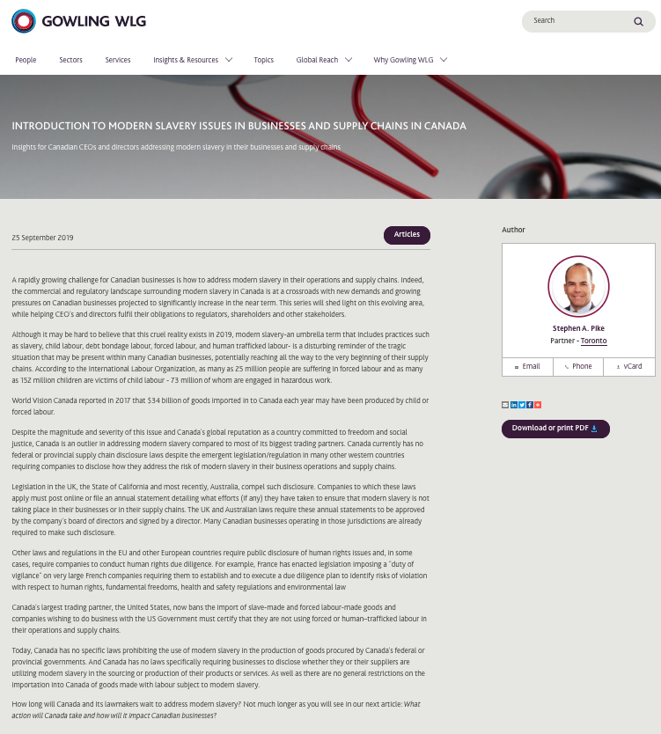

Slide 32


Slide 33
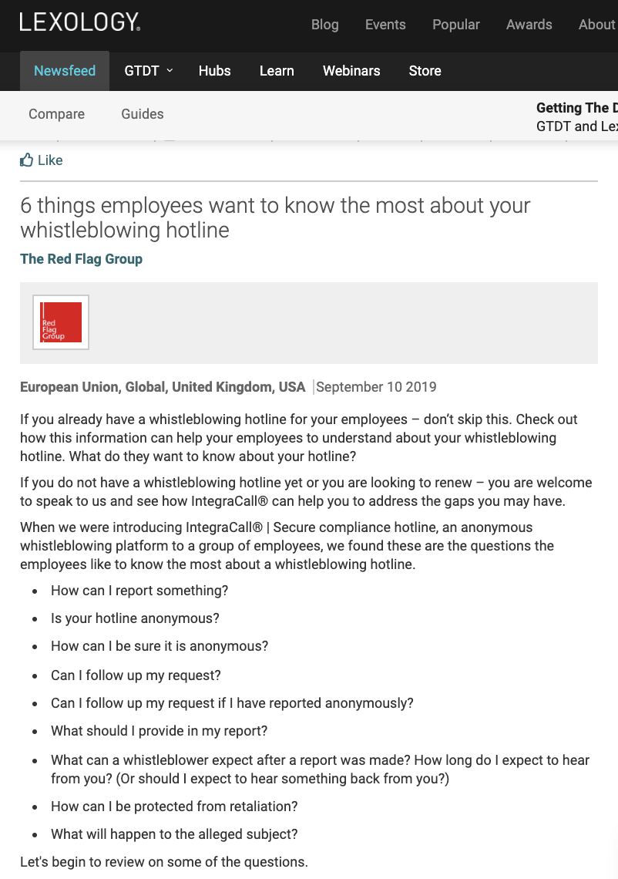

Slide 34
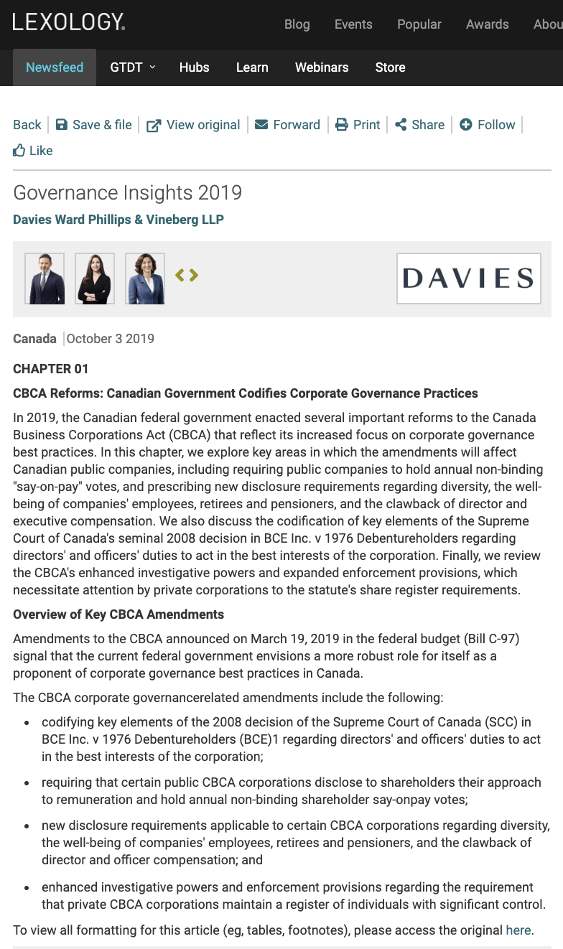

Slide 35


Slide 36
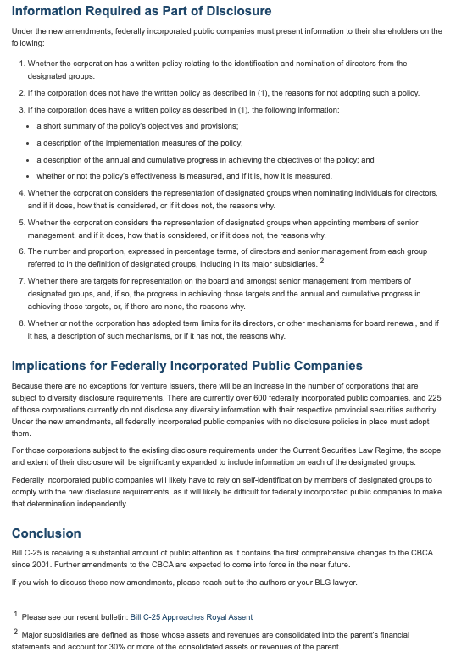

Slide 37
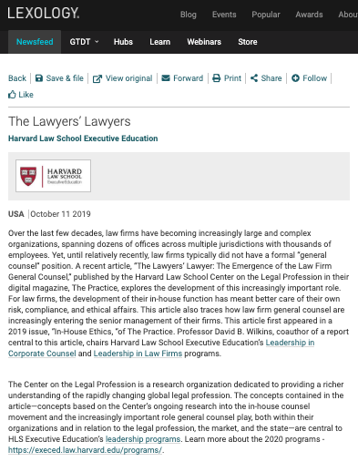

Slide 38
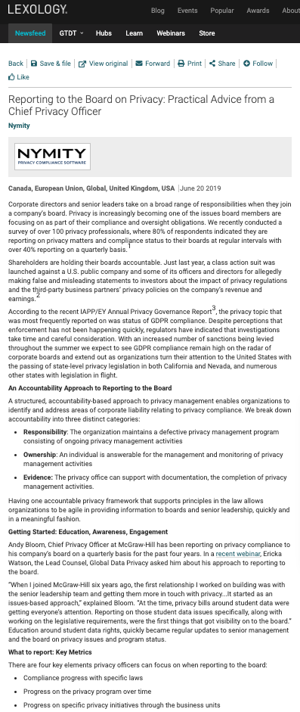

Slide 39
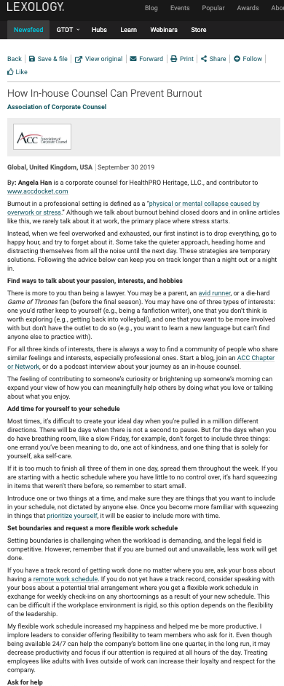

Slide 40
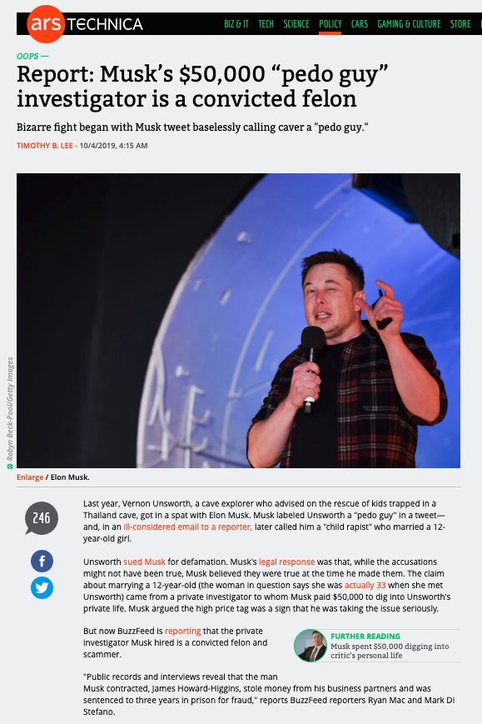
Because…ELON

Slide 41
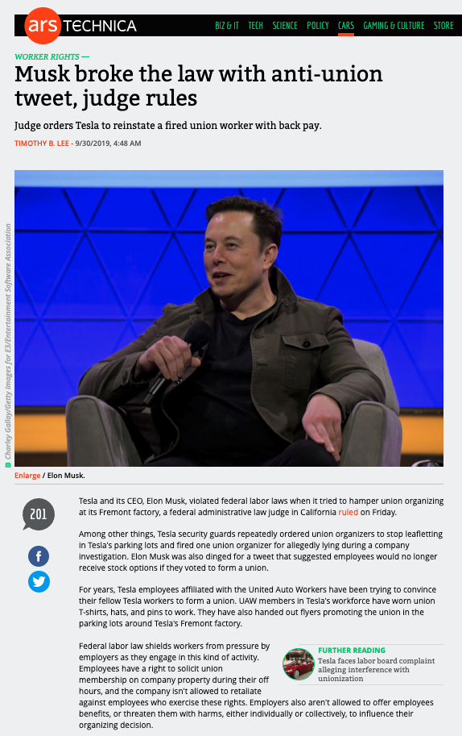

Slide 42
Last Semester This Time

Slide 43
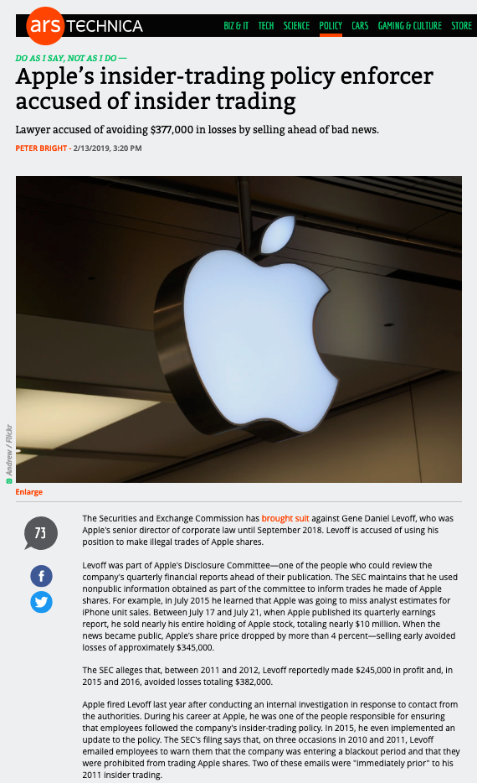

Slide 44
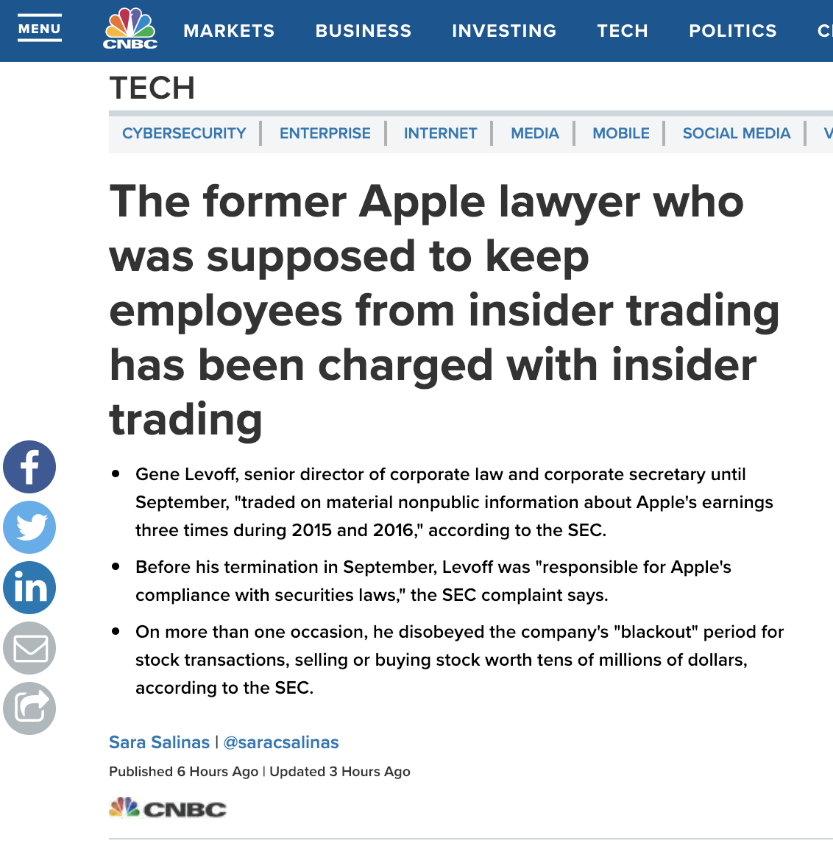

Slide 45
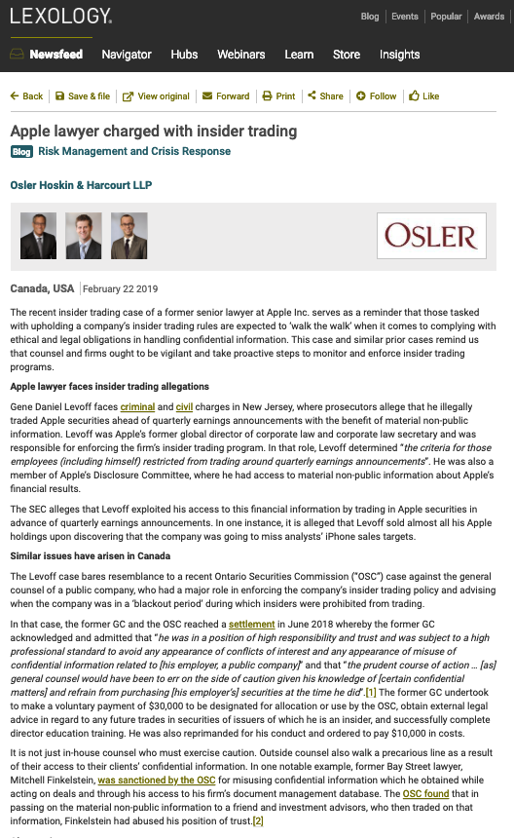

Slide 46
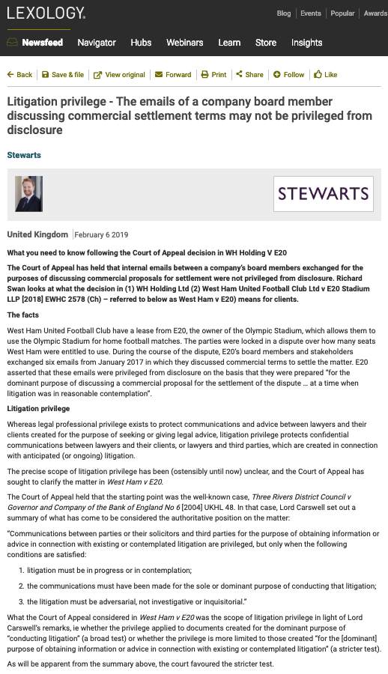

Which
hat?

Slide 47


Slide 48

What would you do?

Slide 49


Slide 50
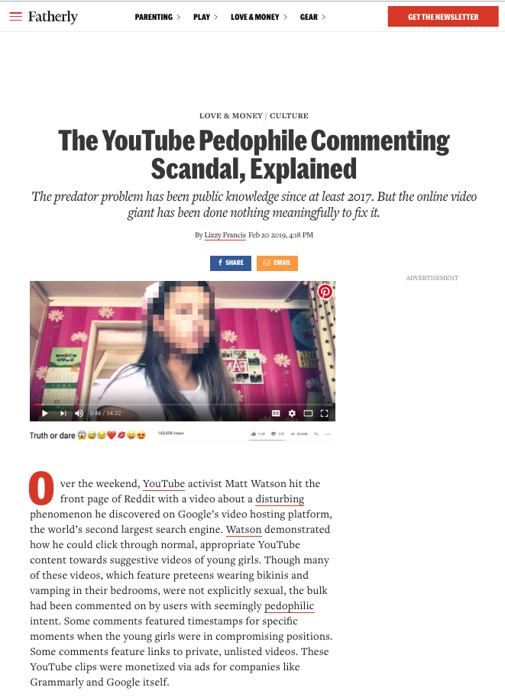

Slide 51
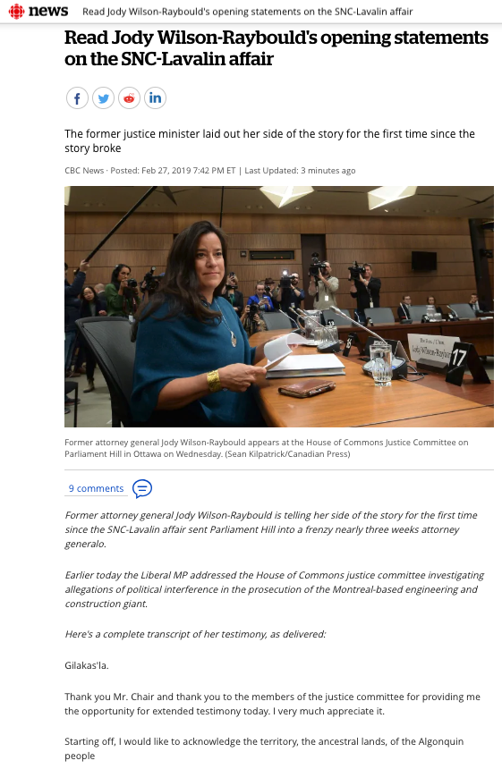

Slide 52


Slide 53
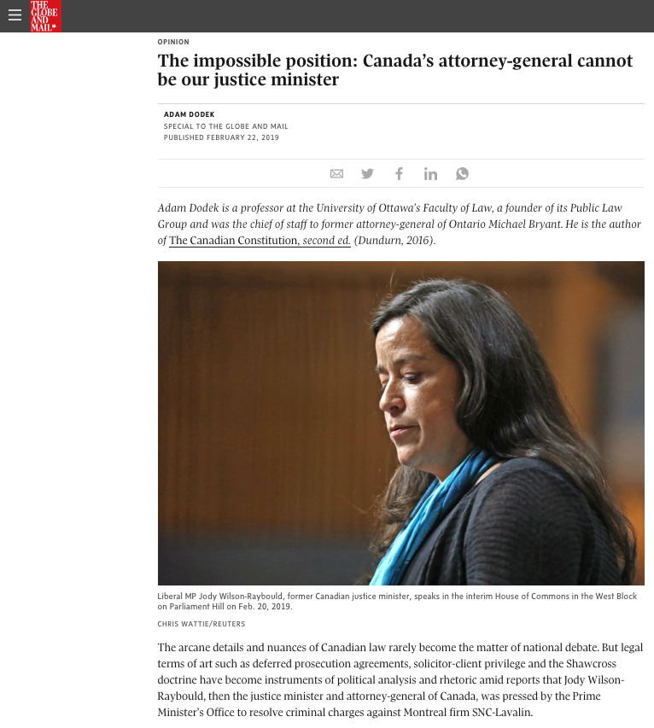

Slide 54
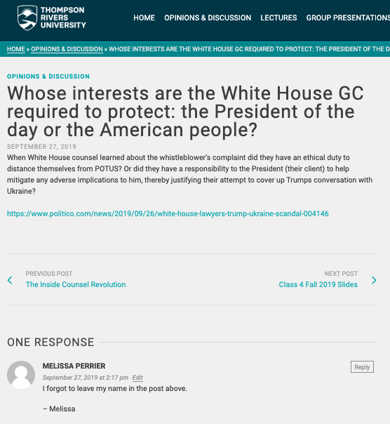

Slide 55
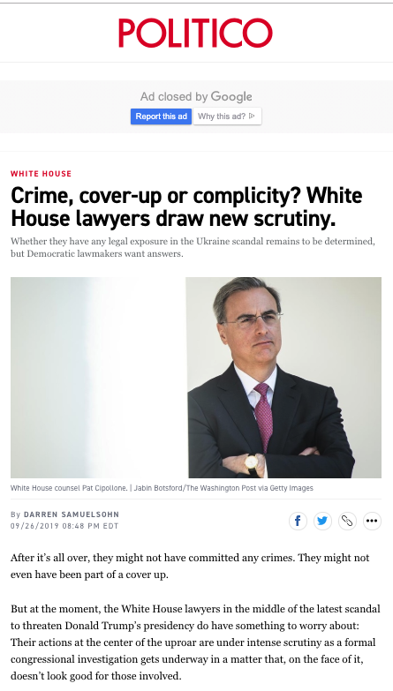

Slide 56
Pause

Slide 57
QUESTIONS?
THOUGHTS?
DISCUSSION?

Slide 58
Yours?

Slide 59

Now, back to our regularly scheduled programming…

Slide 60

Starting Point 1

Slide 61
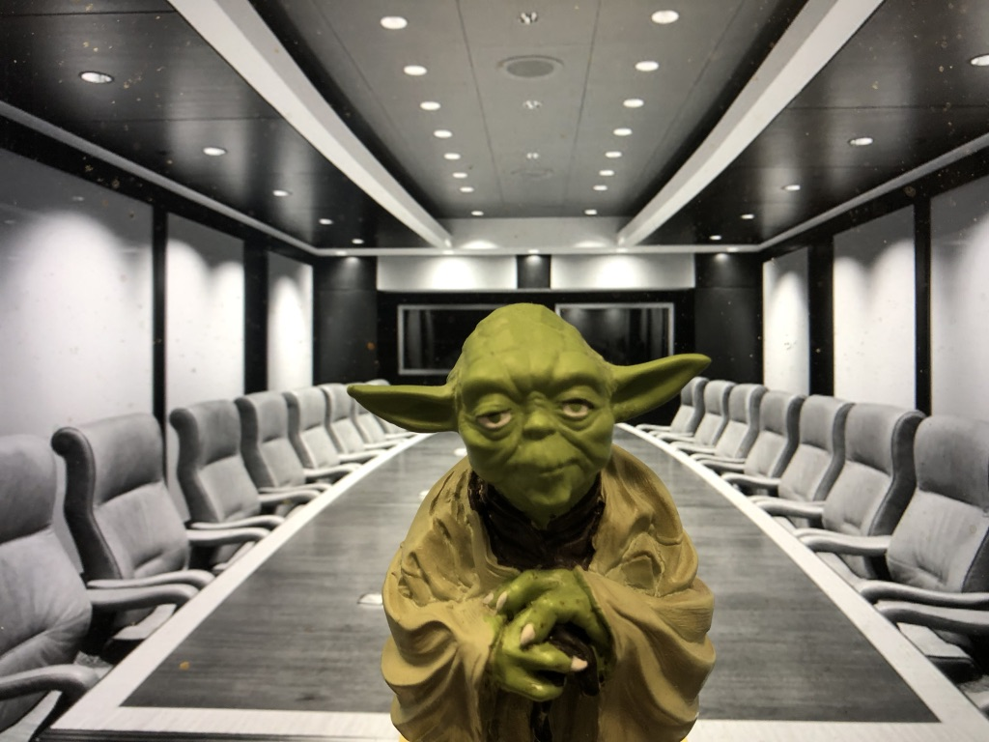
Two Questions…
Where were the Directors?
What views did Counsel transmit?

Slide 62

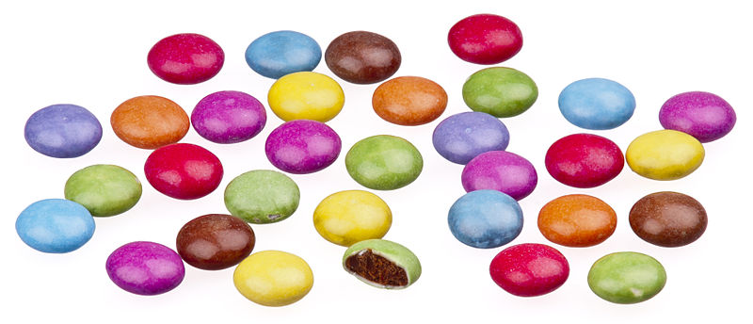
A MATTER OF PERSPECTIVE

Slide 63

Conclusion

Slide 64

Always include a cat picture

Slide 65
In learning you will teach
And in teaching you will learn
Phil Collins' Son of Man (1999)

Slide 66
Our Academic Partners

