Slide 1
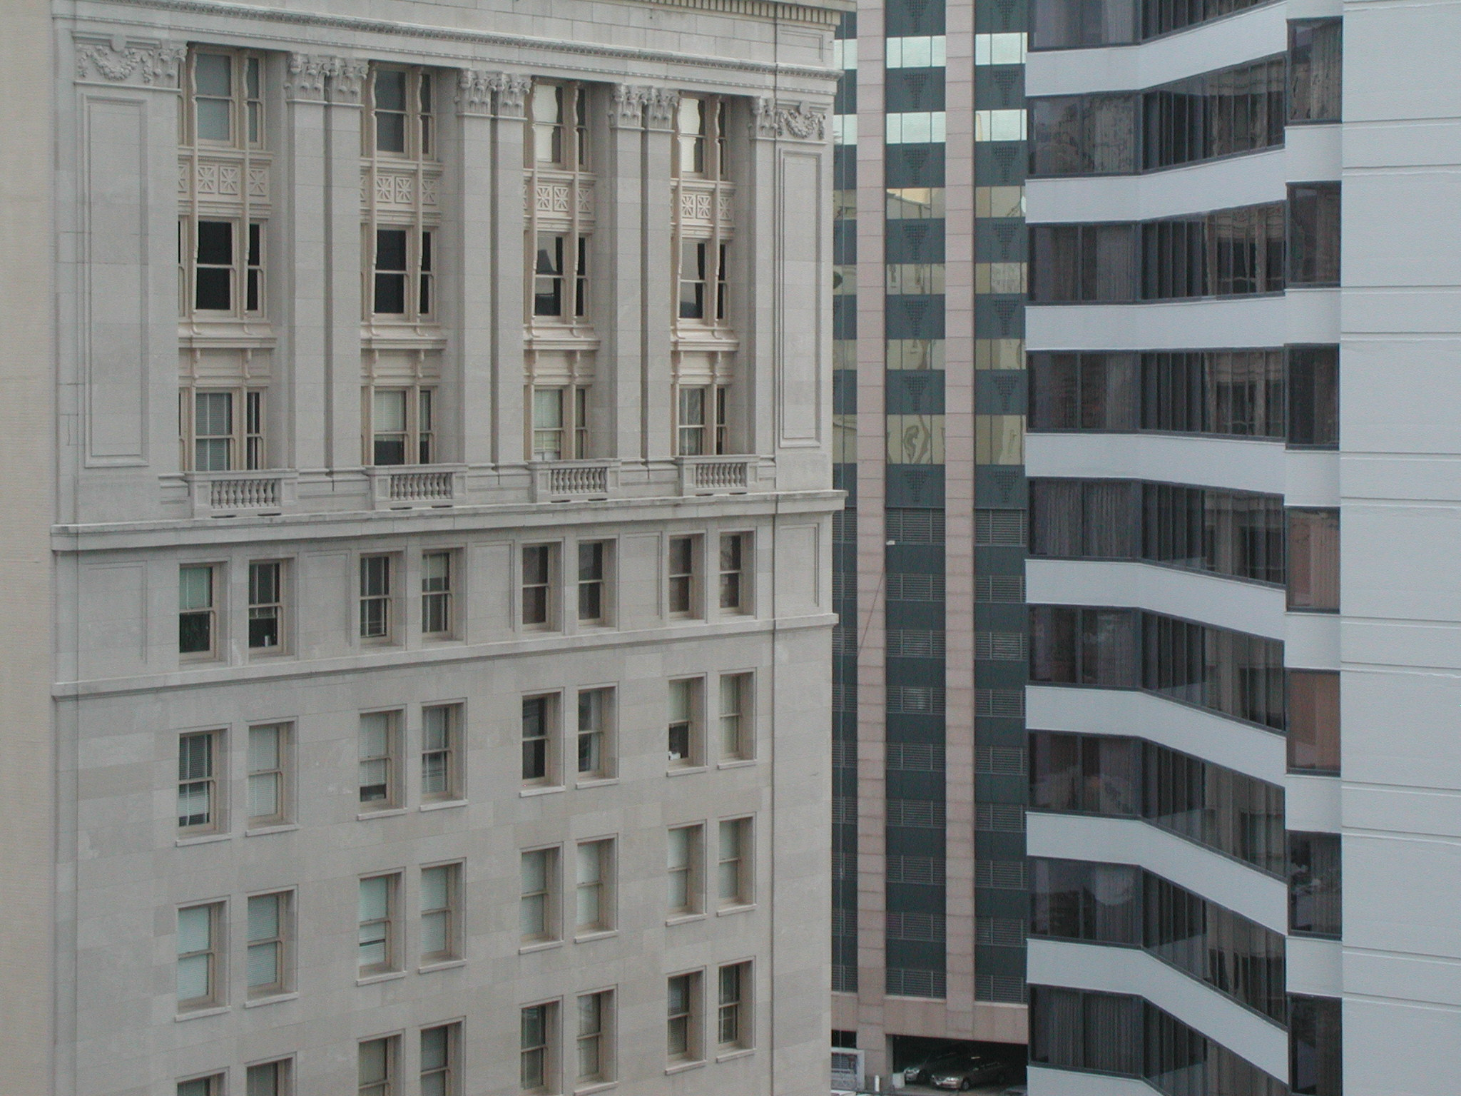

“Personalities & Prerogatives”
Talk 4
LAWF 3780
Challenges of In-House & Corporate Counsel
TRU Faculty of Law
Spring, 2019
Jon Festinger Q.C.
Centre for Digital Media
QMUL School of Law (CCLS)
http://commlaw.allard.ubc
@jonfestinger
jon_festinger@thecdm.ca

Slide 2
Hello
LAW F 3780
Challenges of In-House
& Corporate Counsel

Slide 3

Terrific Thursdays

Slide 4
Logistics

Slide 5
Website password for Posting
lawf3780!

Slide 6
NO CLASSES
THURSDAY
OCTOBER 3
+ THURSDAY
OCTOBER 10

Slide 7
EVALUATION
Term paper = 60% of the final grade.
5000 word paper
The paper is due on the last day of the exam period at 4:00 p.m.
Class Participation = 40% of the final grade
25% of the mark will be based on group preparation of a Class Discussion, with a Discussion Outline provided to the class—preferably by posting on the course website—a week before.
15% for student participation in other course activities including seminar discussions etc.

Slide 8
Paper Confessional
(or what I learned one winter holiday)
Legal/normative reasoning/argument including footnote/bibliography support & Contribution/Move forward → 60%
Presentation including layout, headings, grammar, language/writing skills, “tightness” → 25%
Topic/Originality/Degree of Difficultly → 15%
THIS IS NOT A RUBRIC. IT IS A SELF ASSESSMENT.

Slide 9
Group Presentations
2-3 (ideally) per group
Sign-up at the break or email me
Any topic – not constrained by what I’m talking about that week
Consult with me re the topic you want to take on
Post one thing you want us to read or watch

Slide 10
Group Presentations
Confirm at the break

Slide 11
Evaluation Tips
Term paper topics need not be discussed with me, but often helpful to you if you do.
Term paper can be on your presentation topic.
Participation: In-class or other contributions, including attendance.
Group presentation need not be on that week’s topic (20 minute per student multiplier suggested 2-4 per group to 60 minute max).

Slide 12
Grades (primarily)
Paper → Quality
Participation → Effort

Slide 13
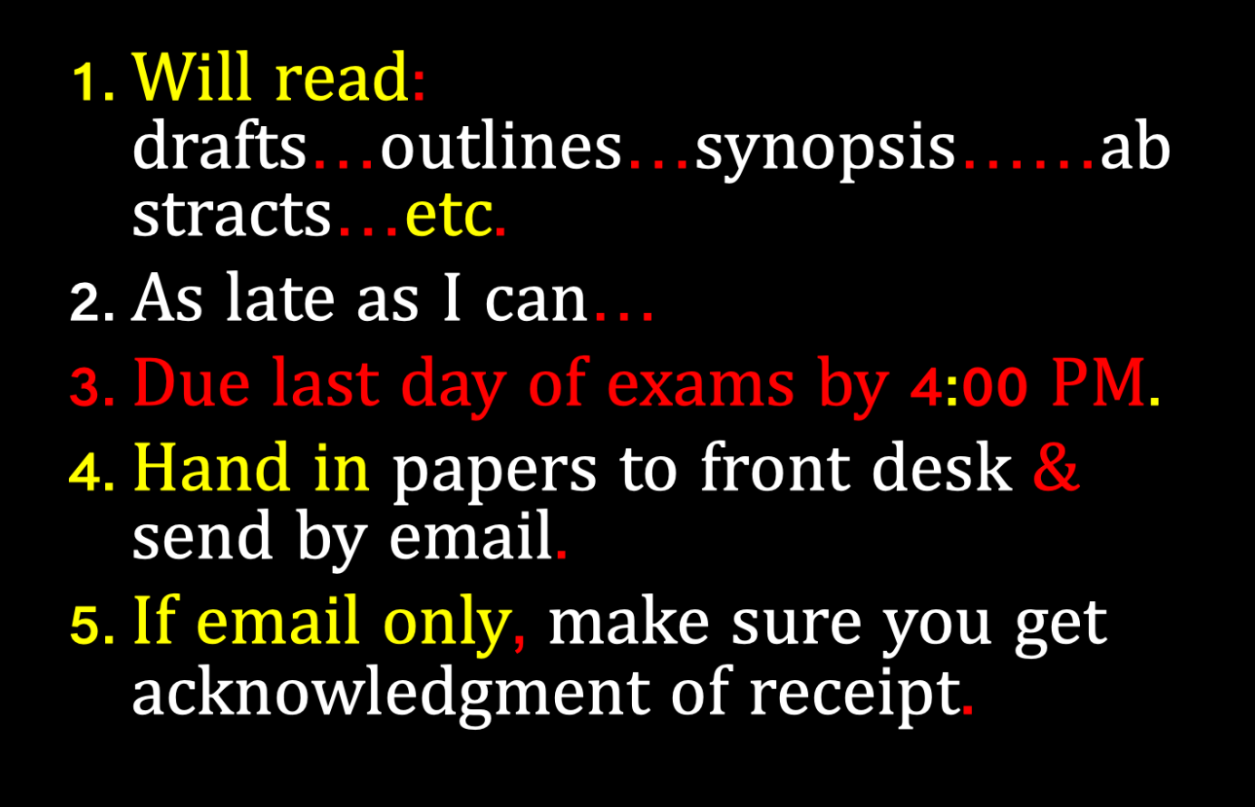

Slide 14
QUESTIONS?
THOUGHTS?
DISCUSSION?

Slide 15

Pause

Slide 16
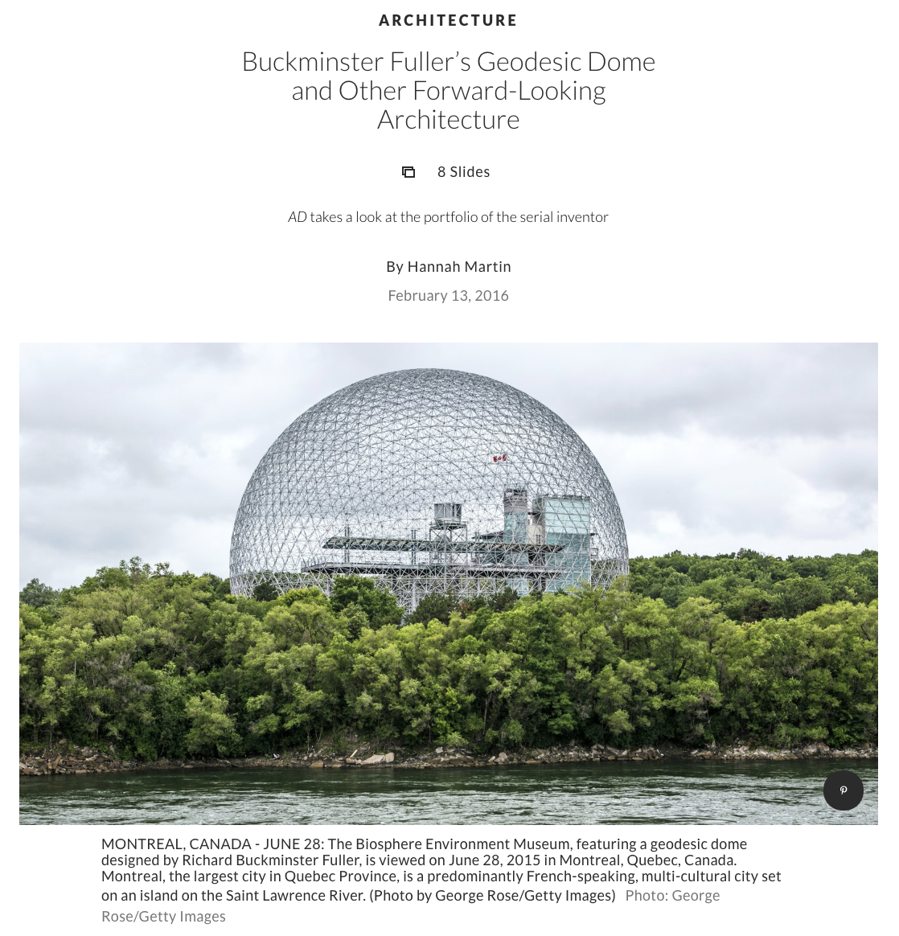
Follow-Up on Group Presentation

Slide 17
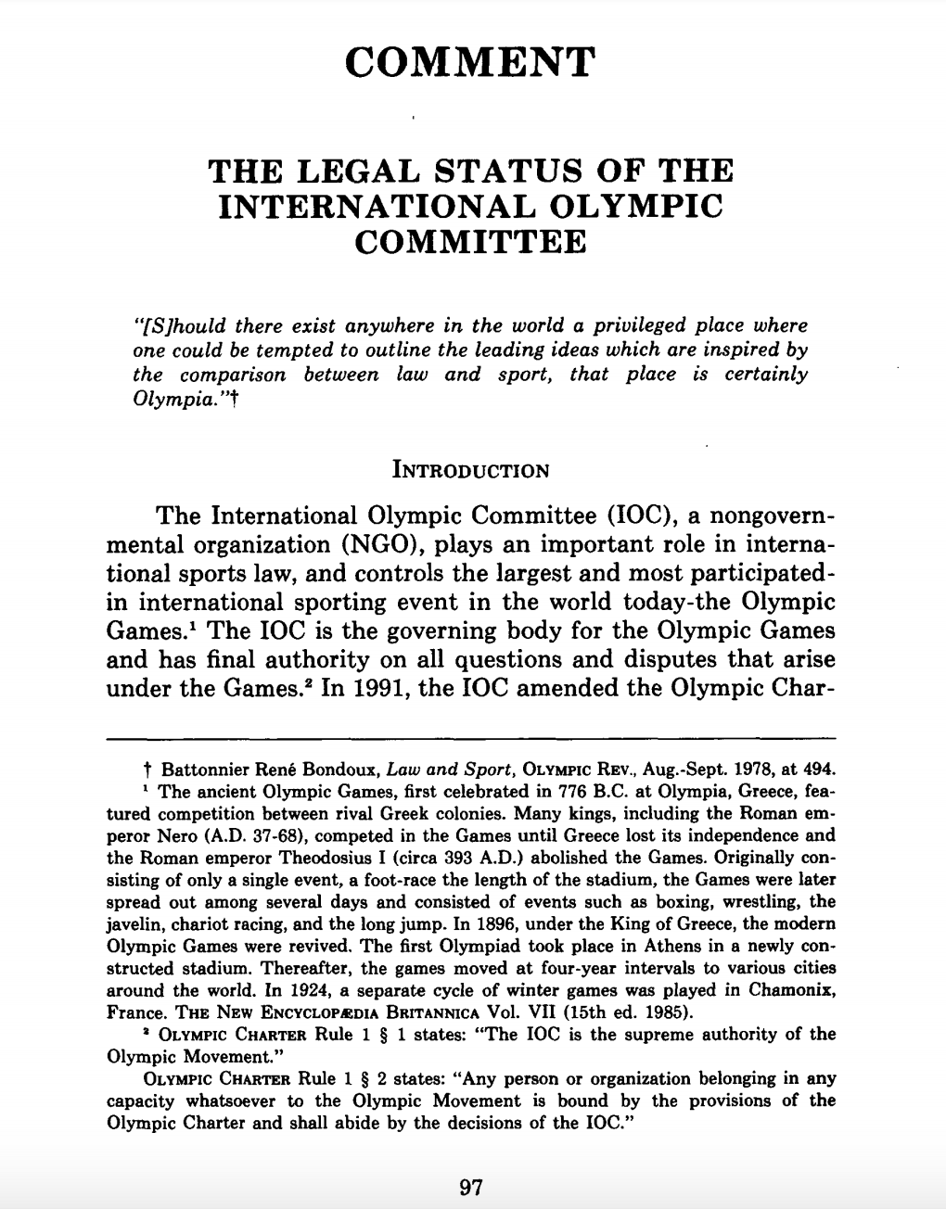

Slide 18
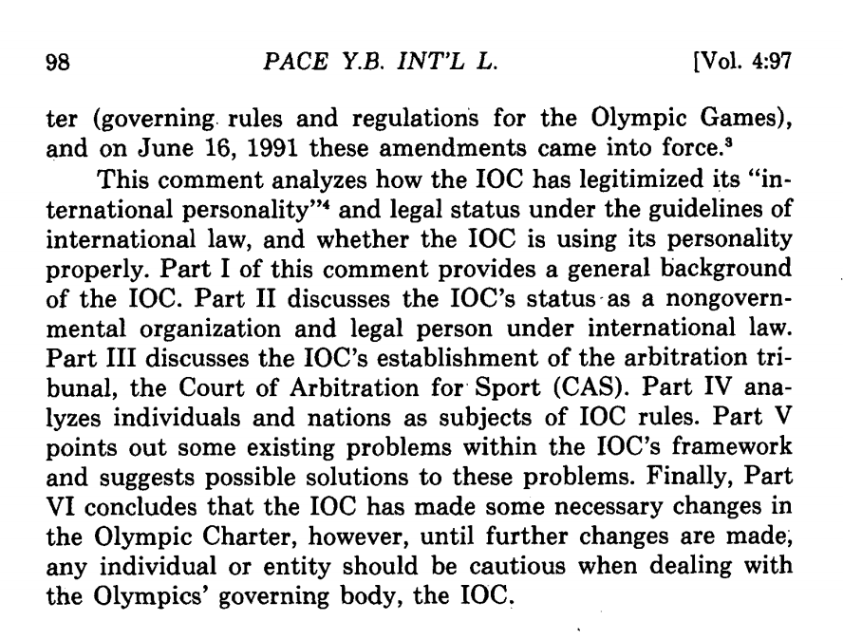

Slide 19
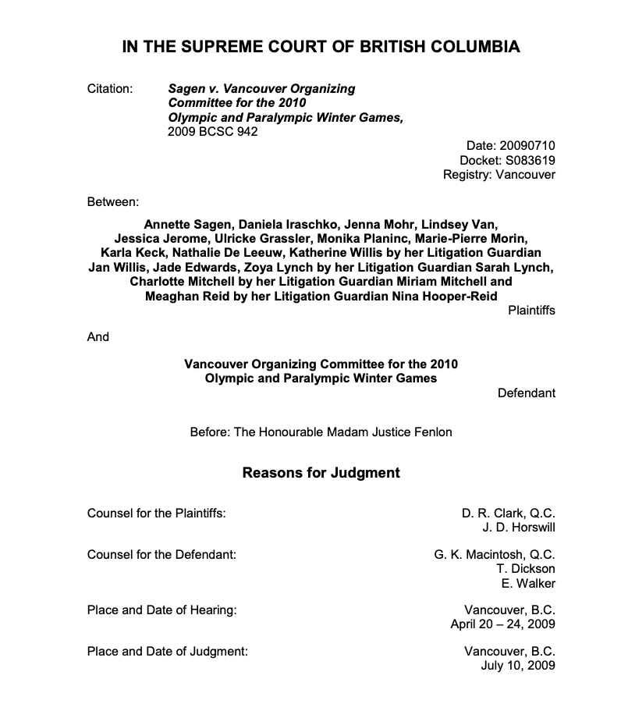

Slide 20
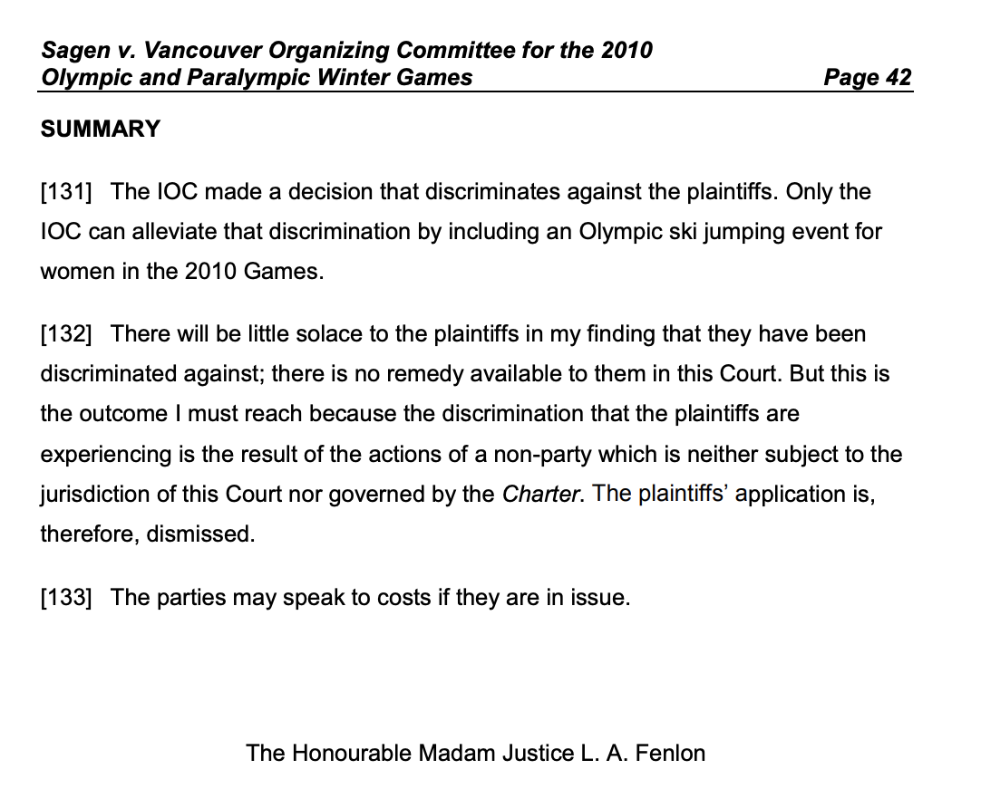

Slide 21
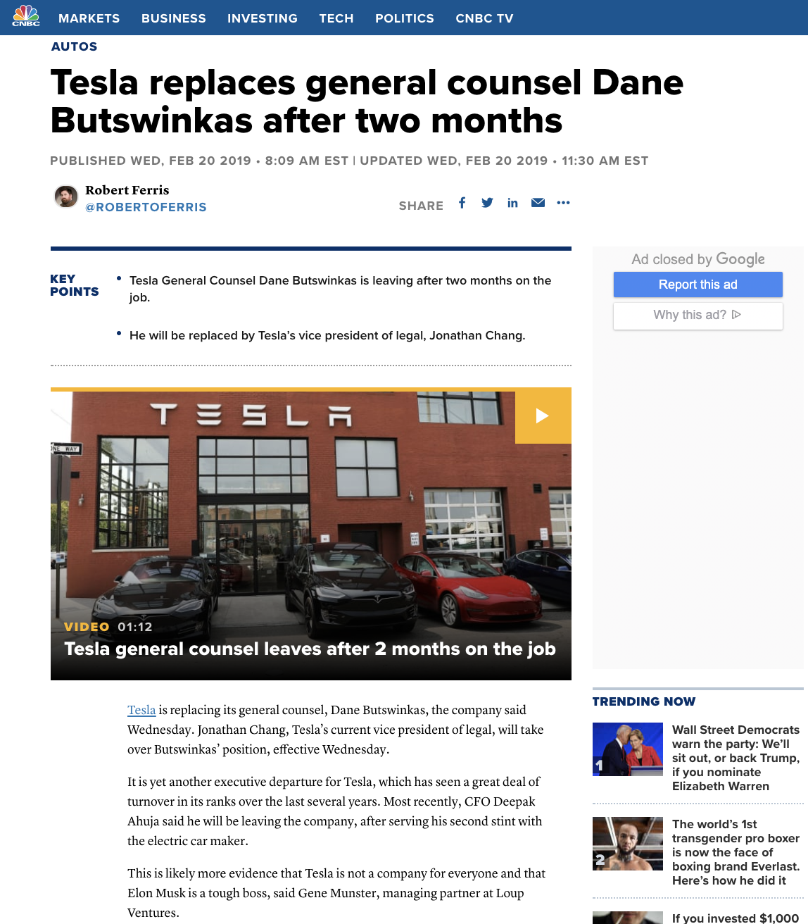

Slide 22
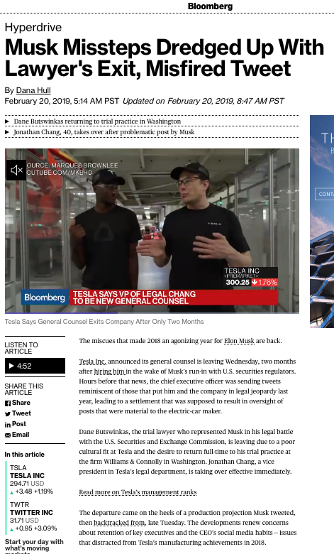

Slide 23
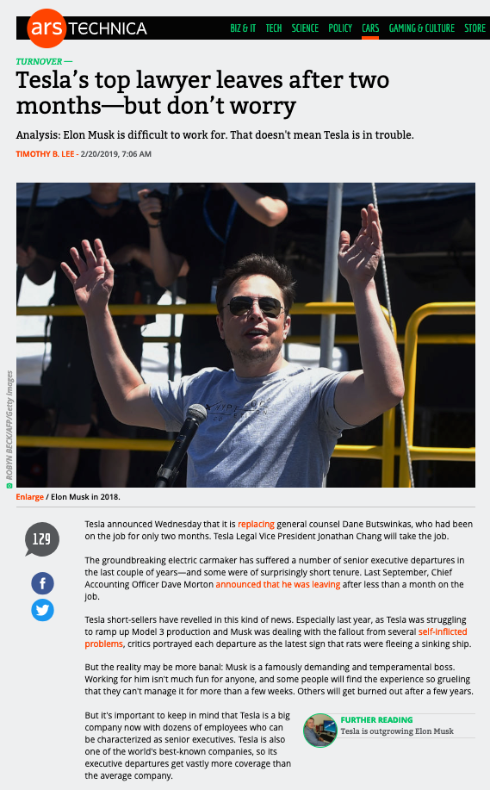

Slide 24
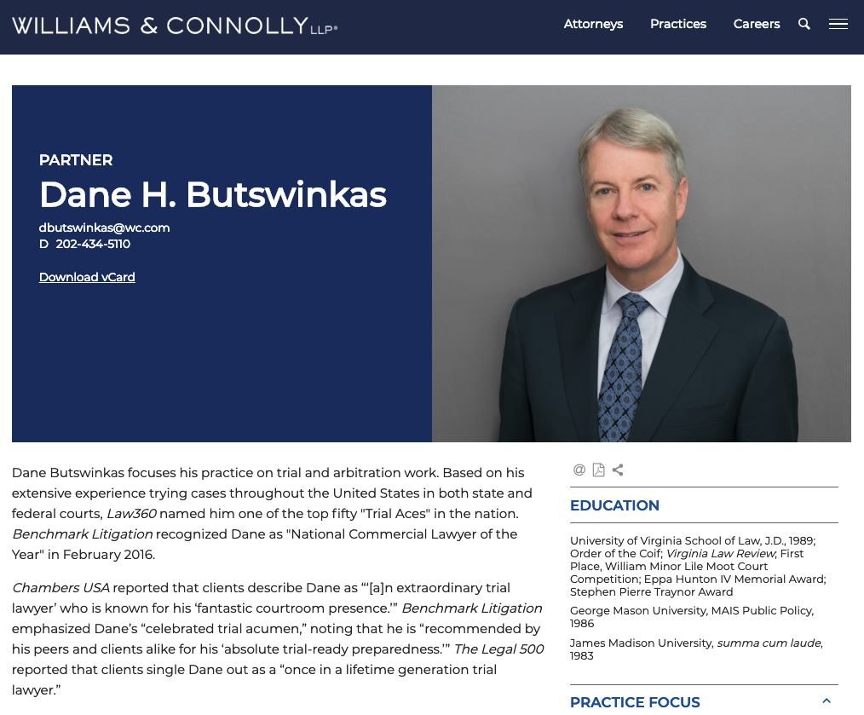

Slide 25
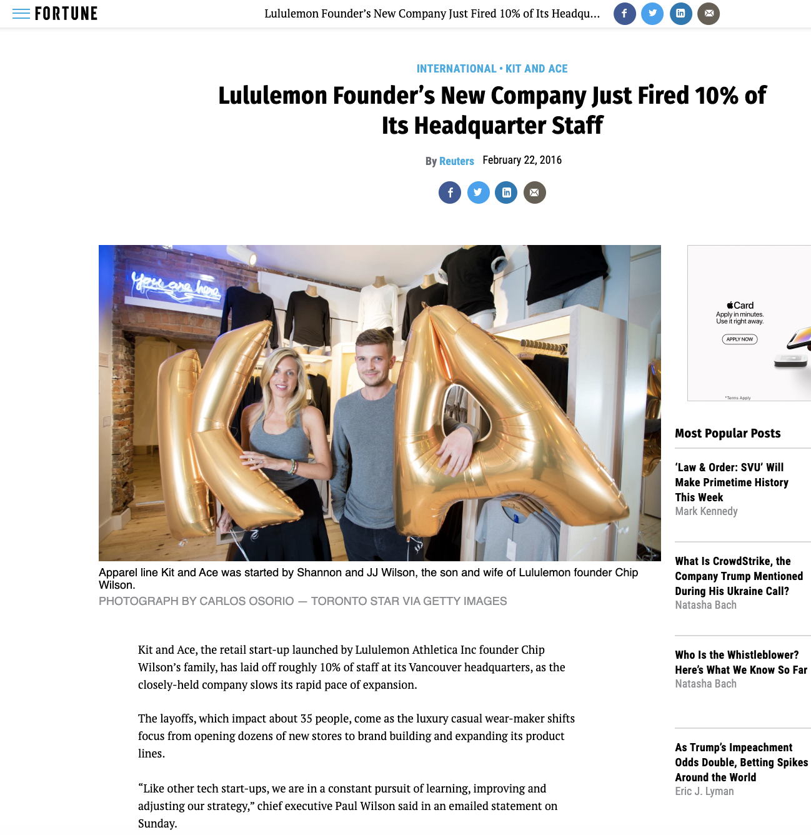

Slide 26
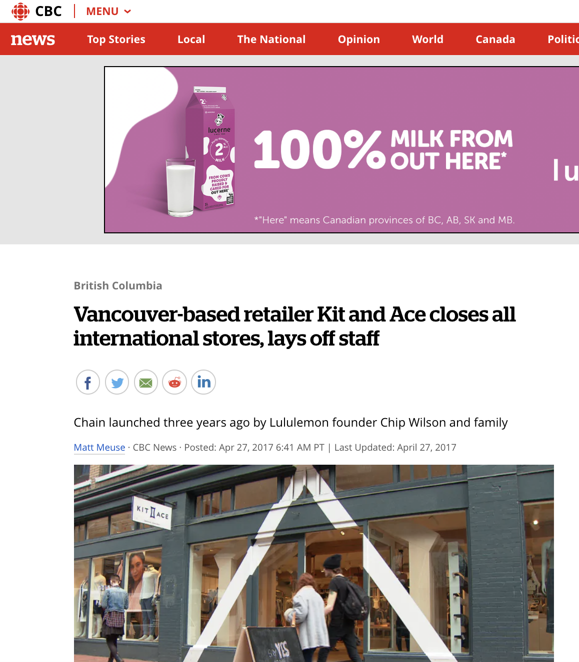

Slide 27
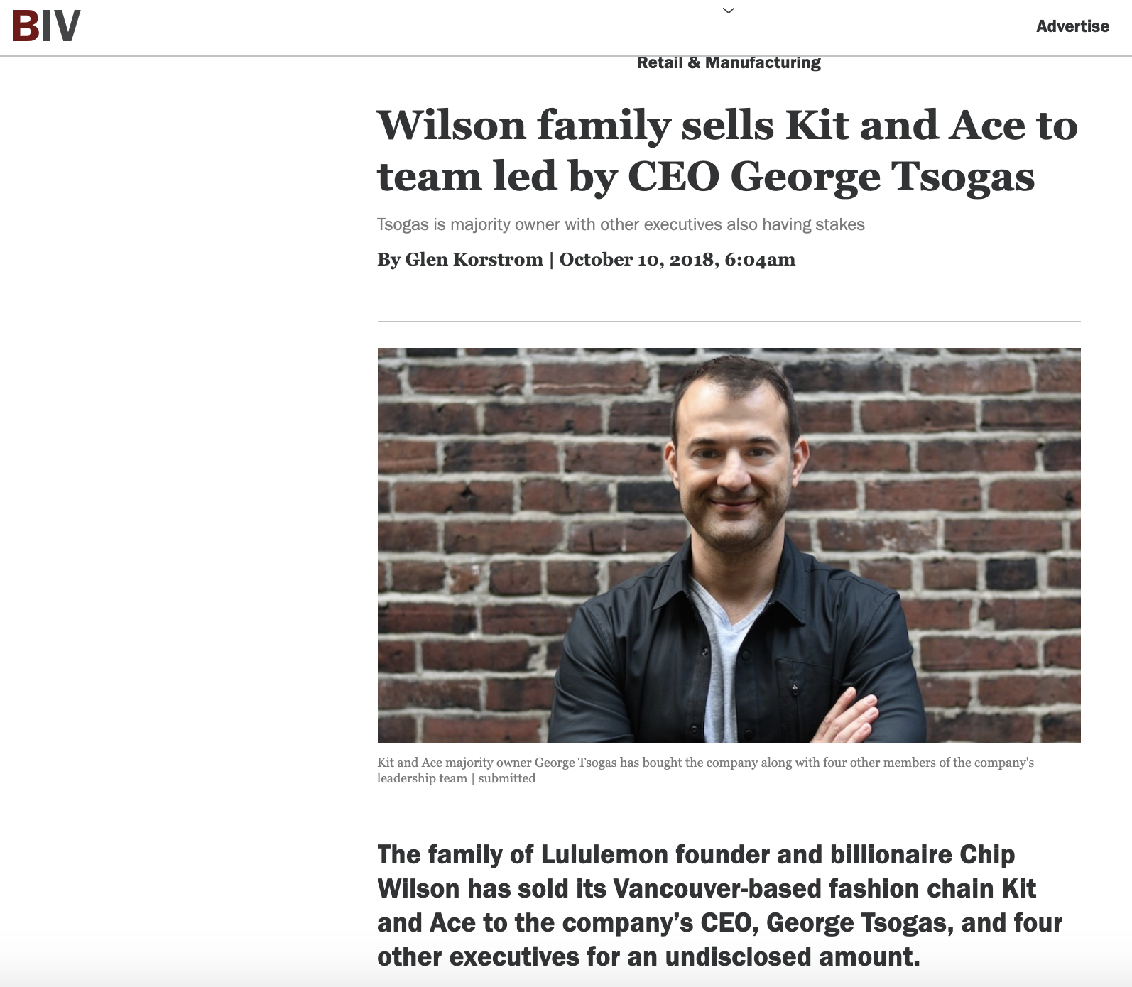

Slide 28
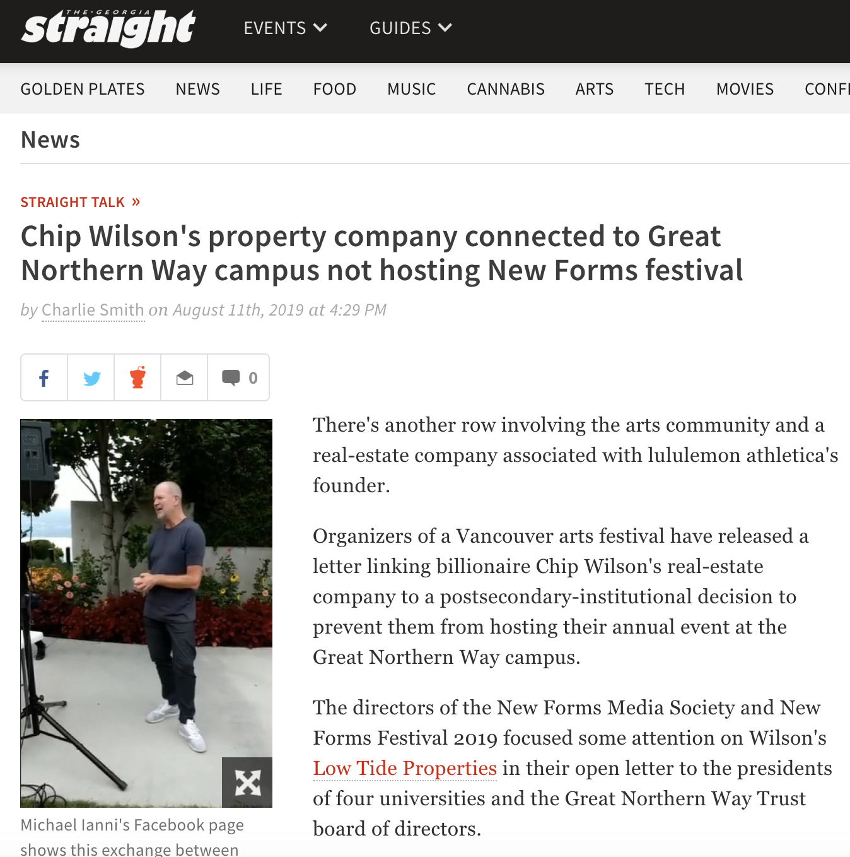

Slide 29
IS ANY JURISDICTION
KEEPING GOOD
STATS?

Slide 30
Australia
“The most recent Law Society National Profile Report (April 2015) found that 15.8% of practising lawyers in Australia worked for corporations and 9.6% worked in government. More relevantly, while between 2011 and 2014 the number of practising lawyers in Australia increased by 12%, the number of corporate lawyers increased by 22% and the number of government lawyers increased by 19%. In addition, in particular legal markets the proportions of corporate and government lawyers are significant, for example, in the ACT 44.3% of practising lawyers are employed in government while in NSW 19.3% of practising lawyers are employed by corporations. It is also important to note that for these purposes "corporations" include not-for-profit organisations and NGOs.”
https://programsandcourses.anu.edu.au/2019/course/LAWS8325#terms

Slide 31
QUESTIONS?
THOUGHTS?
DISCUSSION?

Slide 32
Pause

Slide 33
News of the Week

Slide 34
Yours?

Slide 35
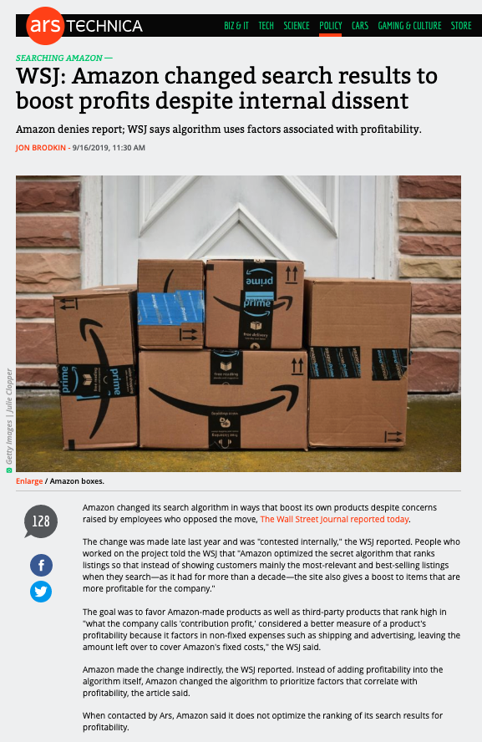

Slide 36
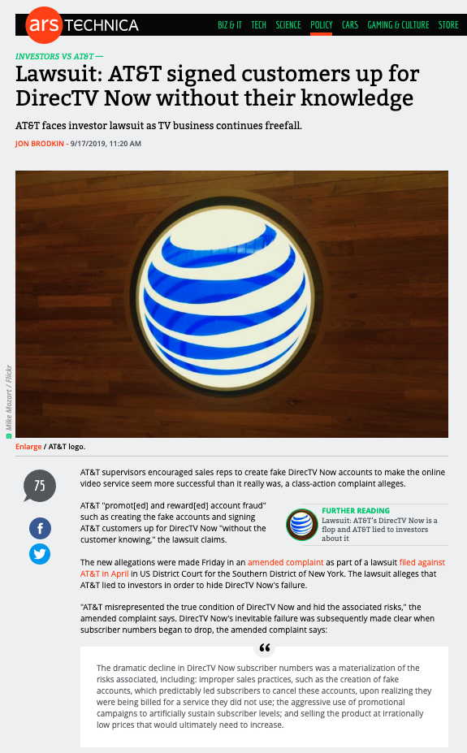

Slide 37
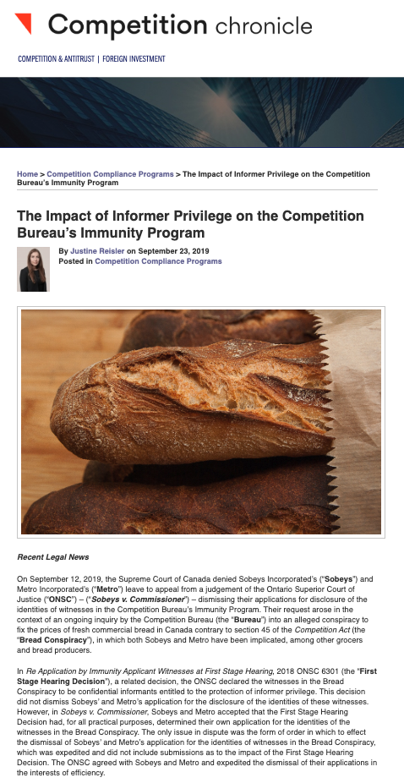

Slide 38
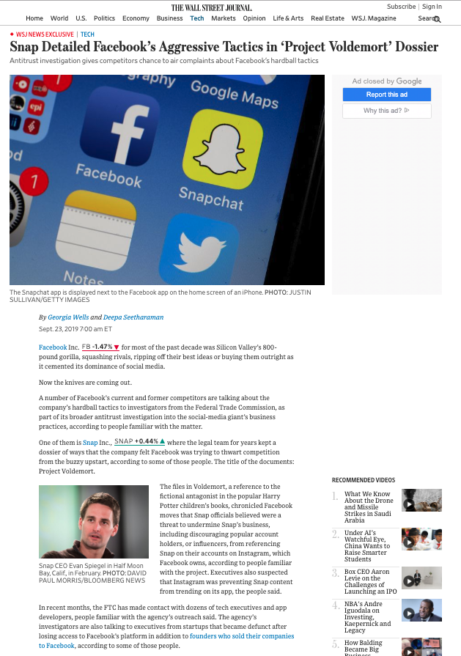

Slide 39
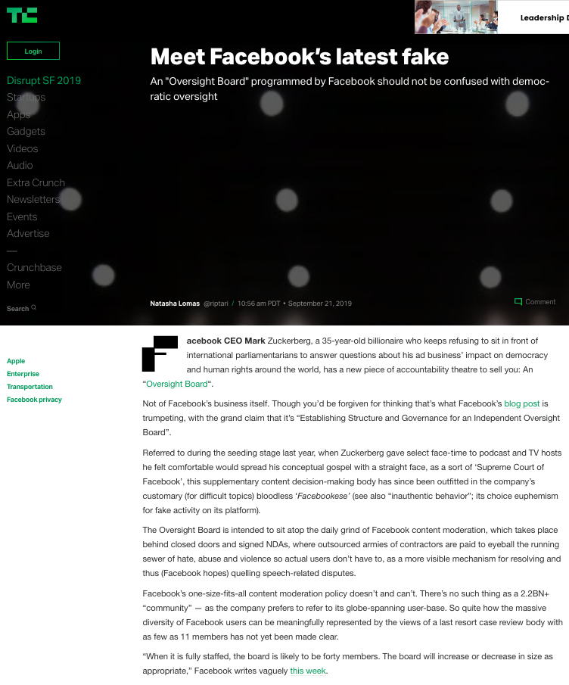

Slide 40
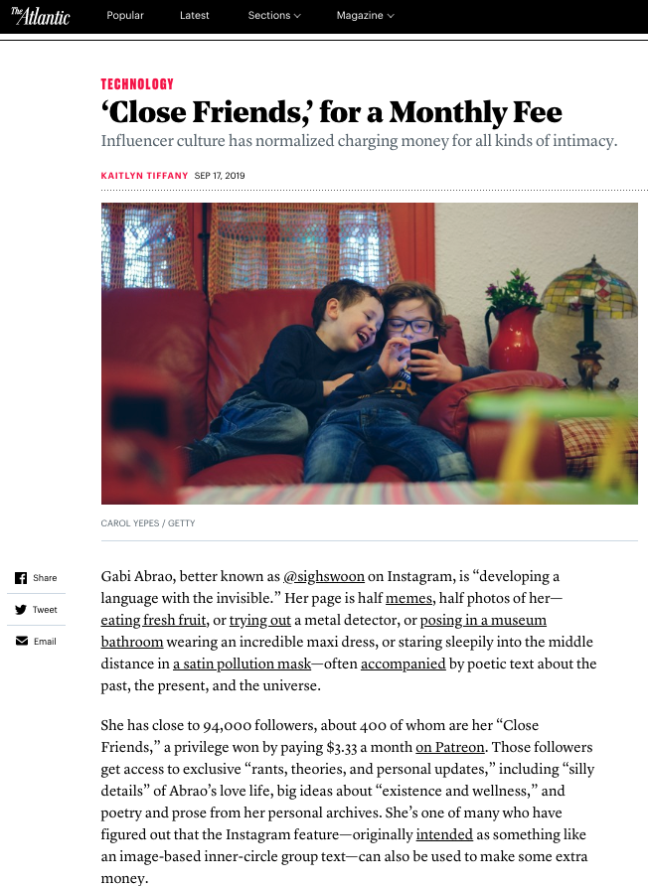

Slide 41
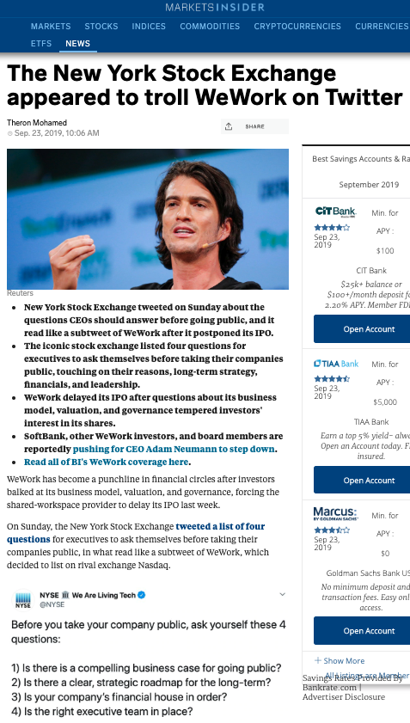

Slide 42
Last Semester This Time

Slide 43
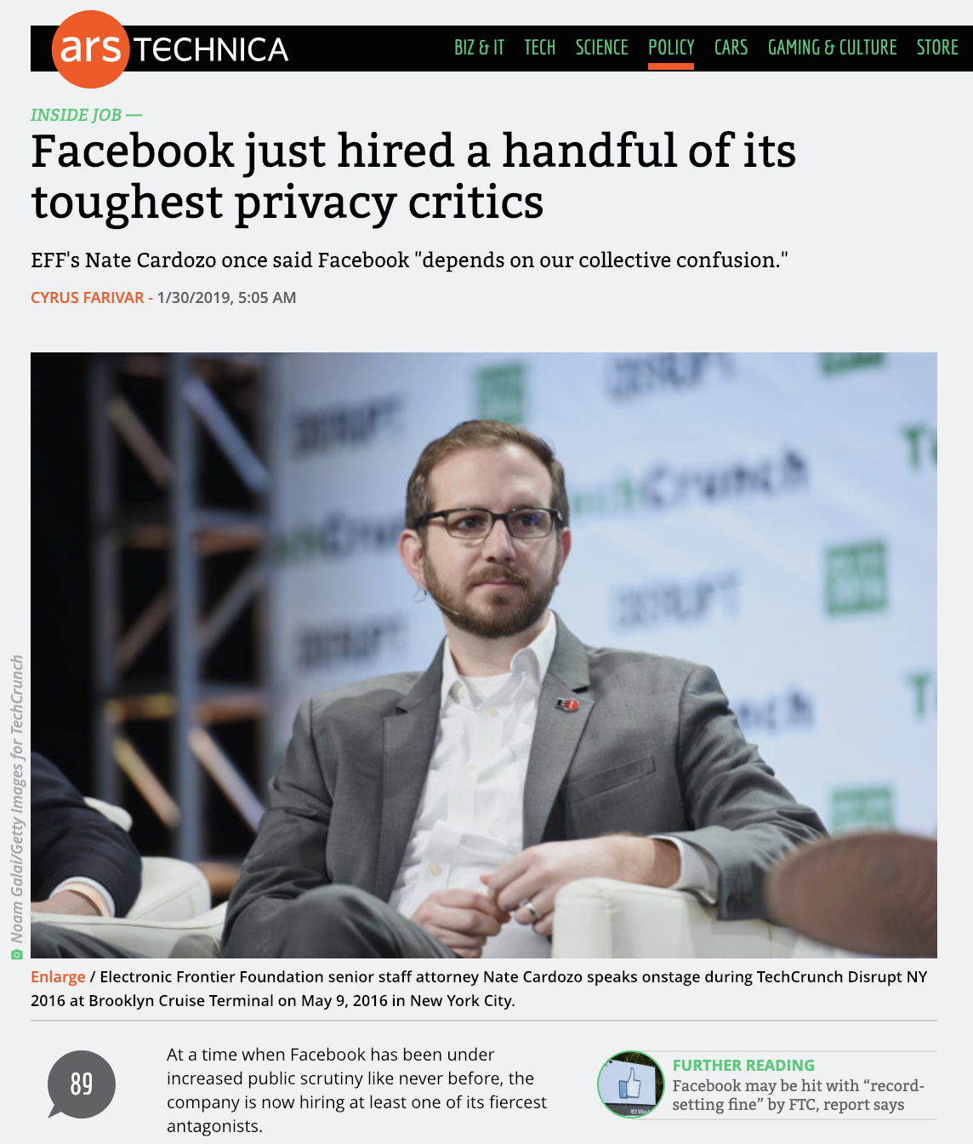

Slide 44
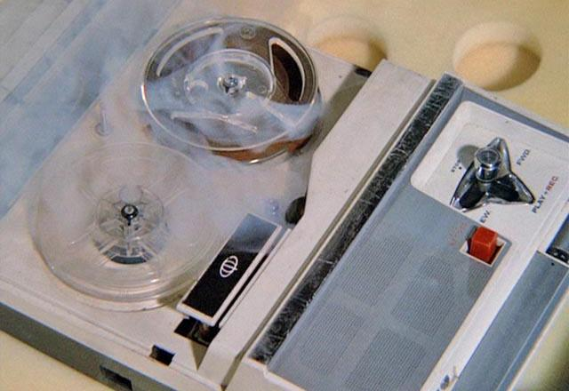
Wait!…What?…Rewind…

Slide 45
Just a couple of moments ago(?)…

Slide 46
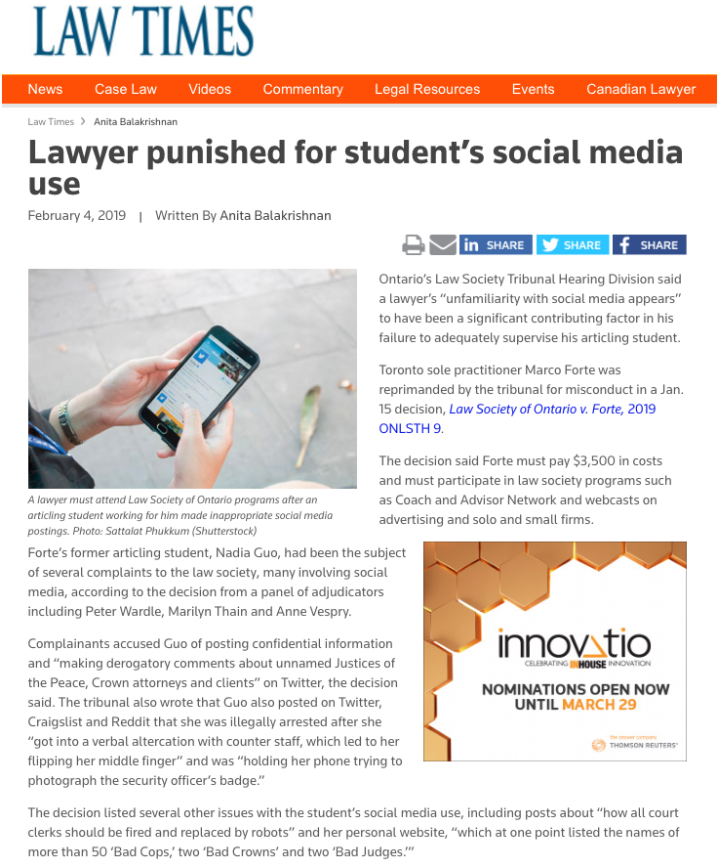
Continuing…Last Semester This Time

Slide 47
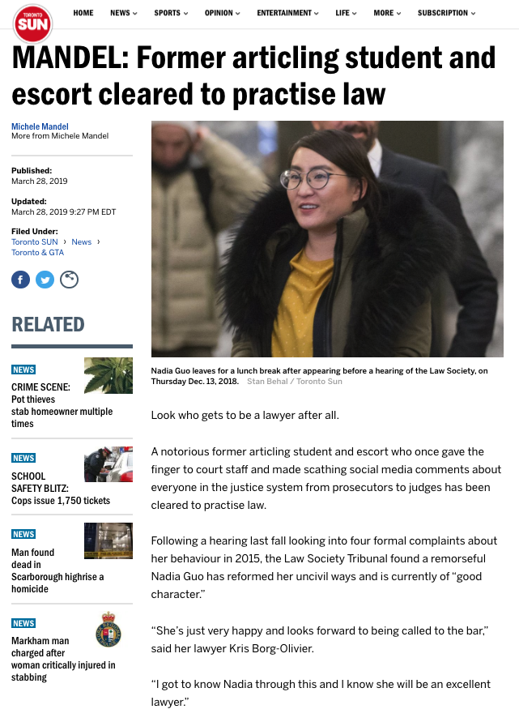

Slide 48
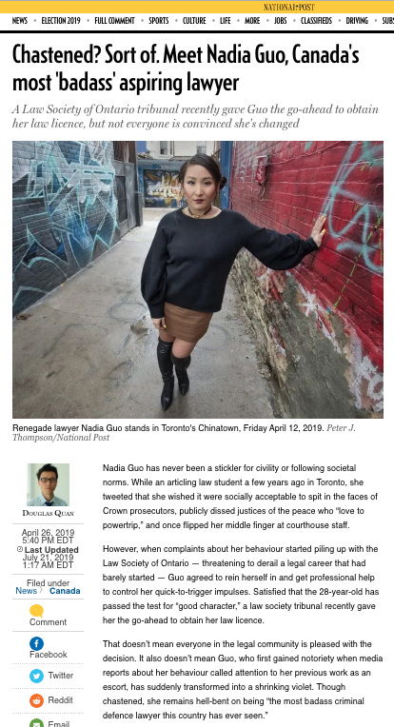

Slide 49
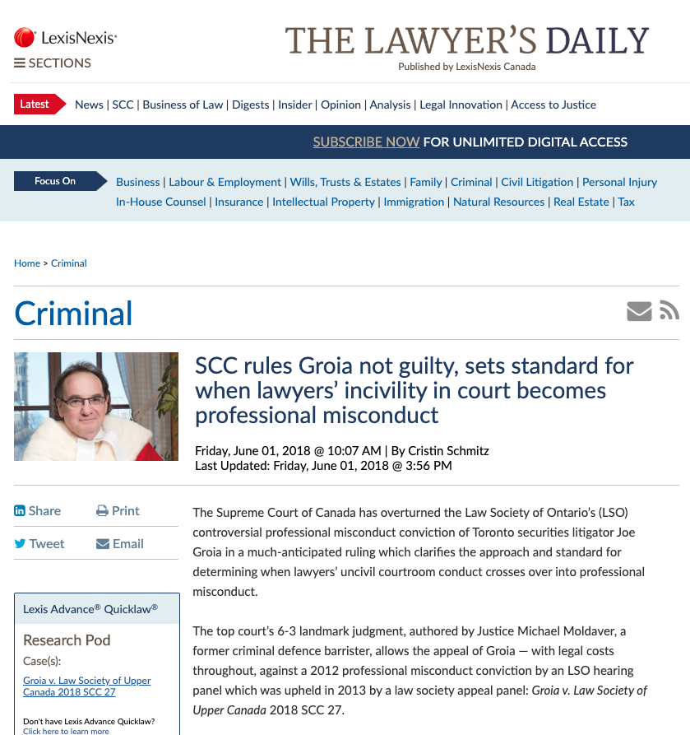
Compare & Contrast

Slide 50
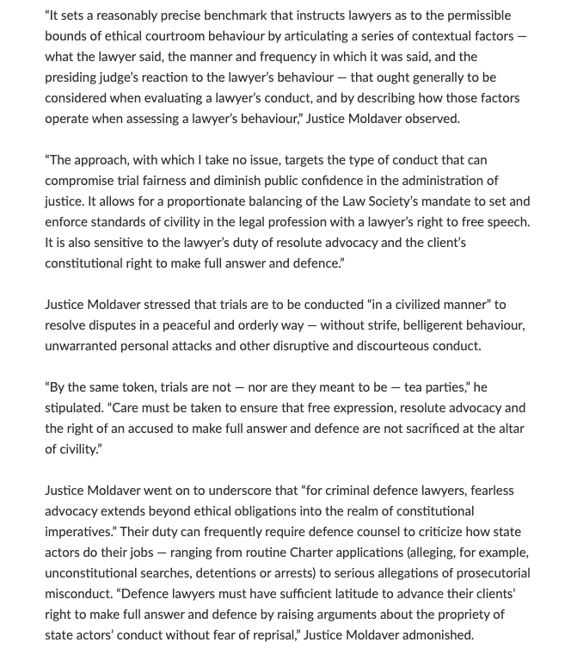

Slide 51
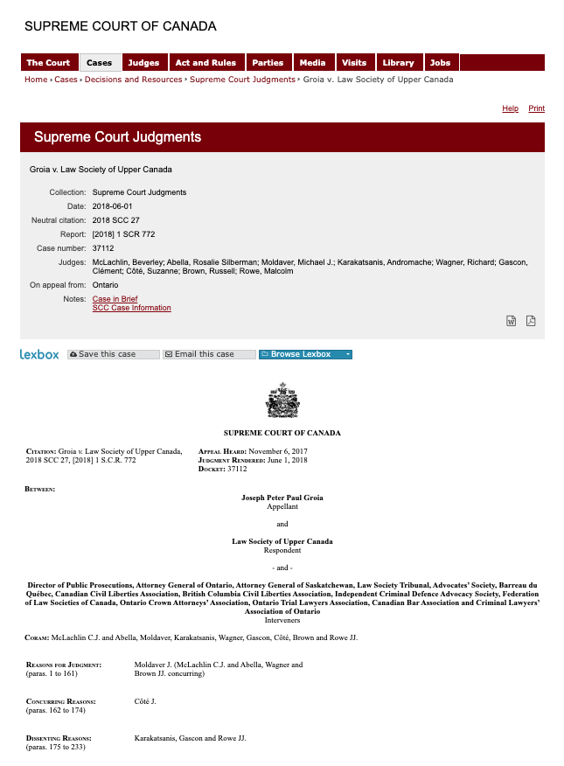

Slide 52
What is the standard of civility for in-house counsel?

Slide 53
Continuing…Last Semester This Time

Slide 54


Slide 55
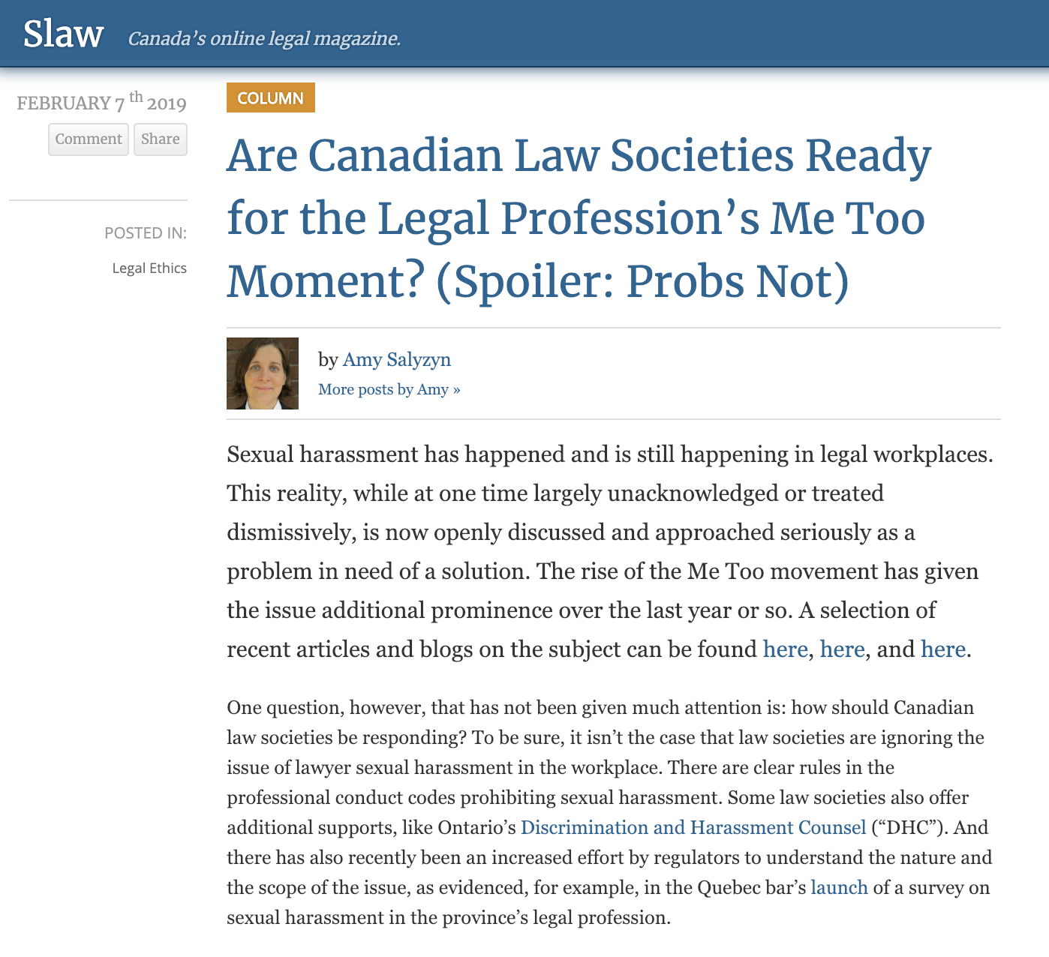

Slide 56
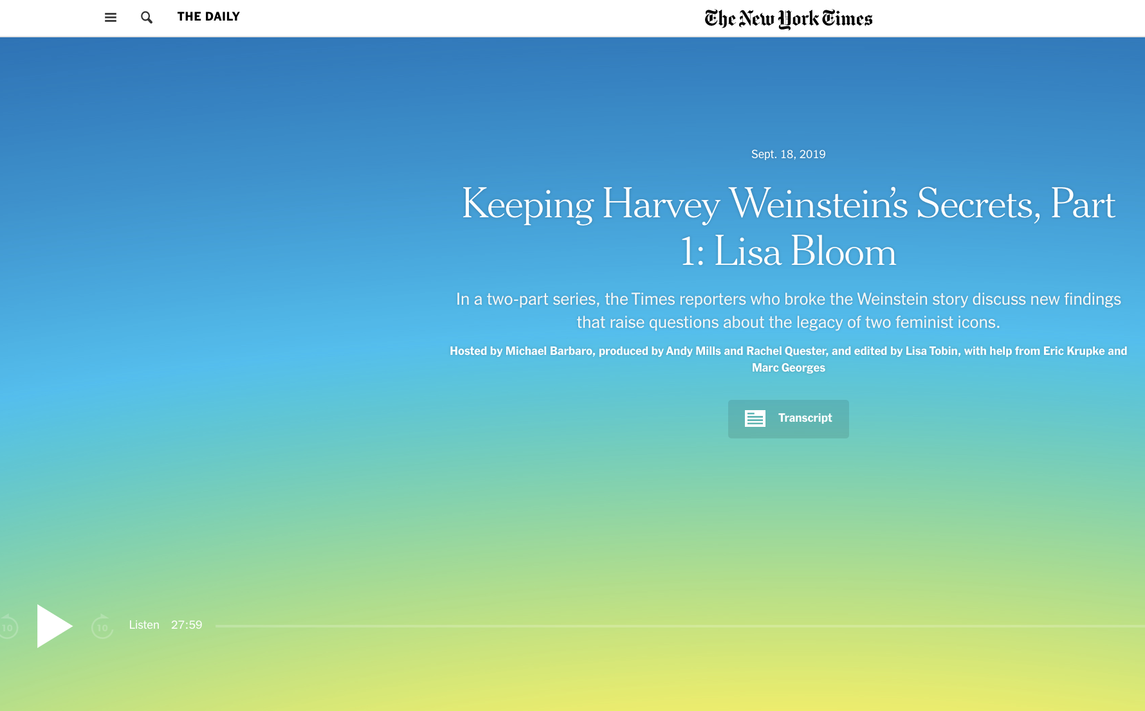

Slide 57
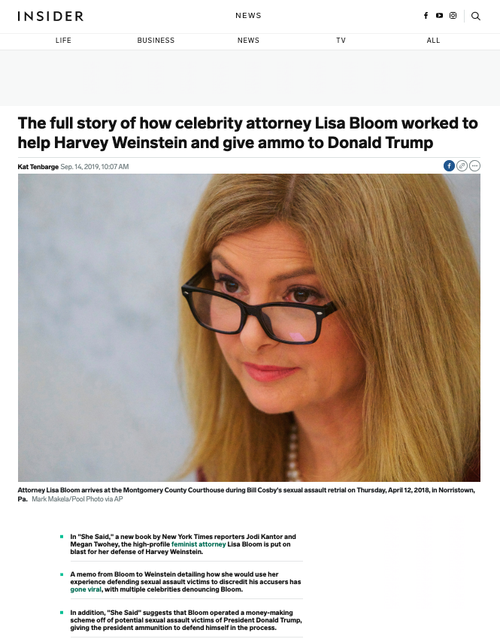

Slide 58
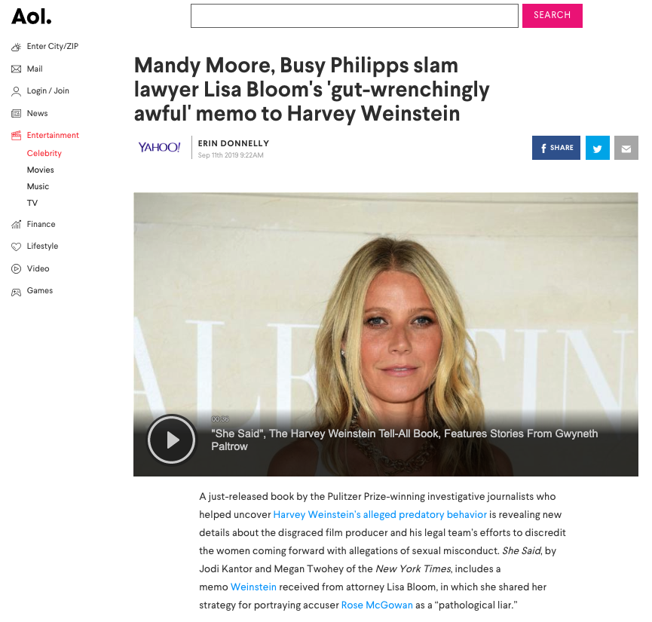

Slide 59


Slide 60
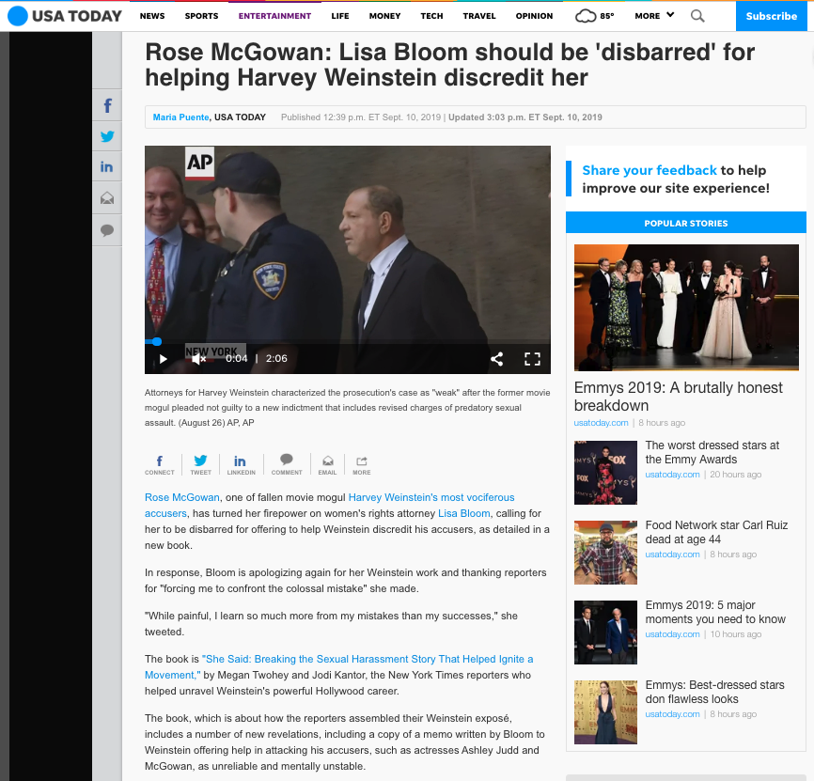

Slide 61
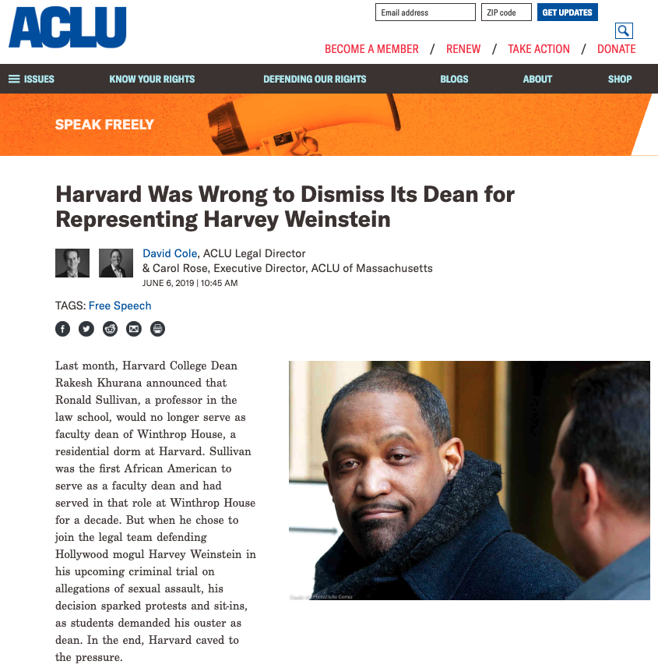

Slide 62
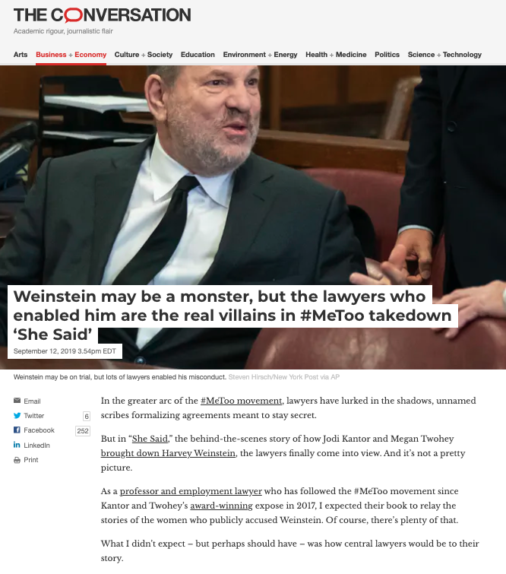

Slide 63
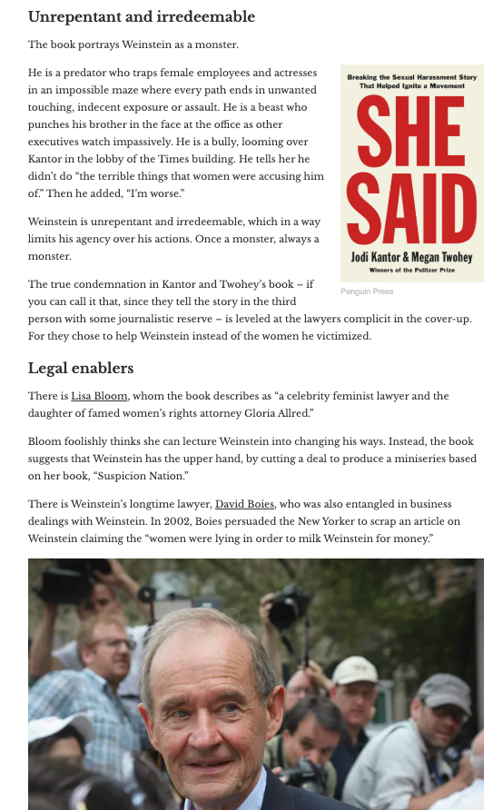

Slide 64
Pause

Slide 65
QUESTIONS?
THOUGHTS?
DISCUSSION?

Slide 66


A MATTER OF PERSPECTIVE

Slide 67

Conclusion

Slide 68
SEE YOU
IN A FEW WEEKs!

Slide 69

Always include a cat picture

Slide 70
In learning you will teach
And in teaching you will learn
Phil Collins' Son of Man (1999)

Slide 71
Our Academic Partners

