Slide 1
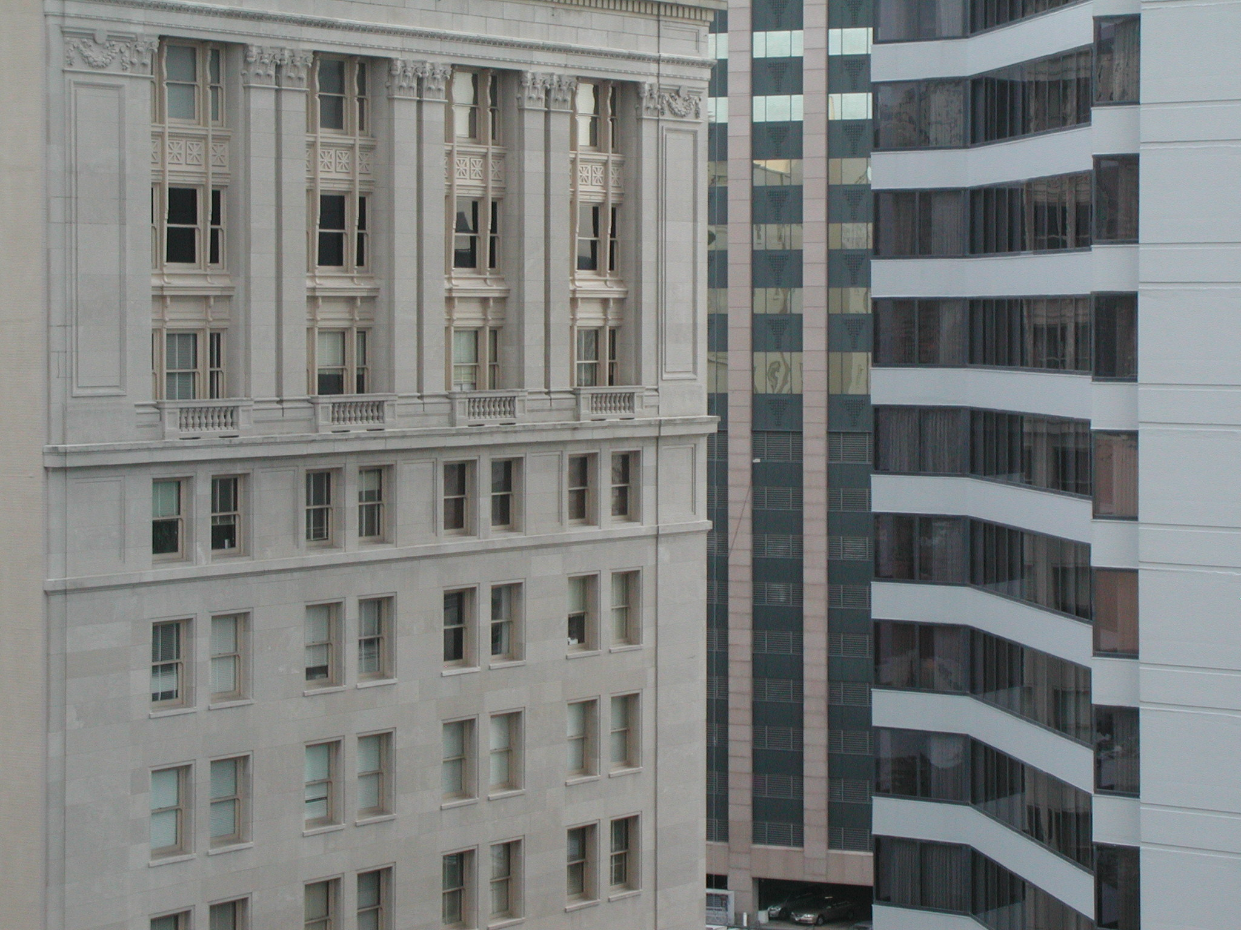

“Prime Directives?!!?”
Talk 3
LAWF 3780
Challenges of In-House & Corporate Counsel
TRU Faculty of Law
Spring, 2019
Jon Festinger Q.C.
Centre for Digital Media
QMUL School of Law (CCLS)
http://commlaw.allard.ubc
@jonfestinger
jon_festinger@thecdm.ca

Slide 2
Hello
LAW F 3780
Challenges of In-House
& Corporate Counsel

Slide 3

Terrific Thursdays

Slide 4
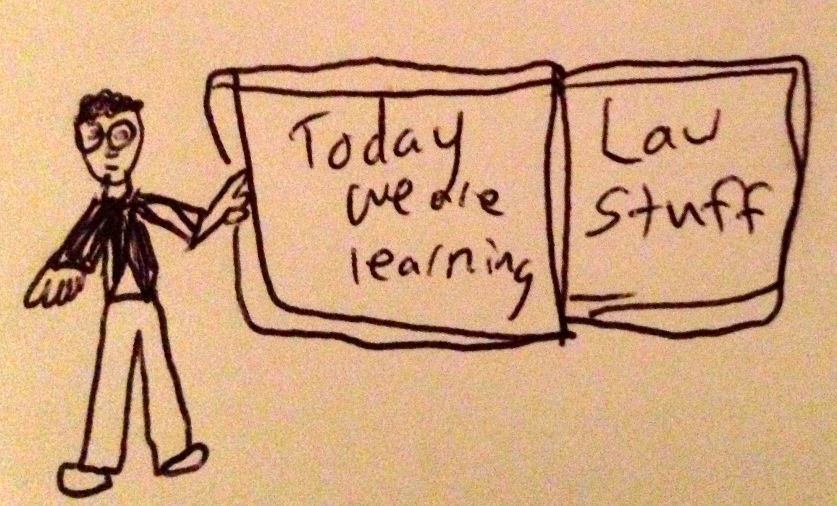

Slide 5
Logistics

Slide 6
EVALUATION
Term paper = 60% of the final grade.
5000 word paper
The paper is due on the last day of the exam period at 4:00 p.m.
Class Participation = 40% of the final grade
25% of the mark will be based on group preparation of a Class Discussion, with a Discussion Outline provided to the class—preferably by posting on the course website—a week before.
15% for student participation in other course activities including seminar discussions etc.

Slide 7
Paper Confessional
(or what I learned one winter holiday)
Legal/normative reasoning/argument including footnote/bibliography support & Contribution/Move forward → 60%
Presentation including layout, headings, grammar, language/writing skills, “tightness” → 25%
Topic/Originality/Degree of Difficultly → 15%
THIS IS NOT A RUBRIC. IT IS A SELF ASSESSMENT.

Slide 8
Group Presentations
2-3 (ideally) per group
Sign-up at the break or email me
Any topic – not constrained by what I’m talking about that week
Consult with me re the topic you want to take on
Post one thing you want us to read or watch

Slide 9
Group Presentations
Sign-up at the break

Slide 10
Possible Methodology for this…
Coming
Up

Slide 11
Evaluation Tips
Term paper topics need not be discussed with me, but often helpful to you if you do.
Term paper can be on your presentation topic.
Participation: In-class or other contributions, including attendance.
Group presentation need not be on that week’s topic (20 minute per student multiplier suggested 2-4 per group to 60 minute max).

Slide 12
Grades (primarily)
Paper → Quality
Participation → Effort

Slide 13
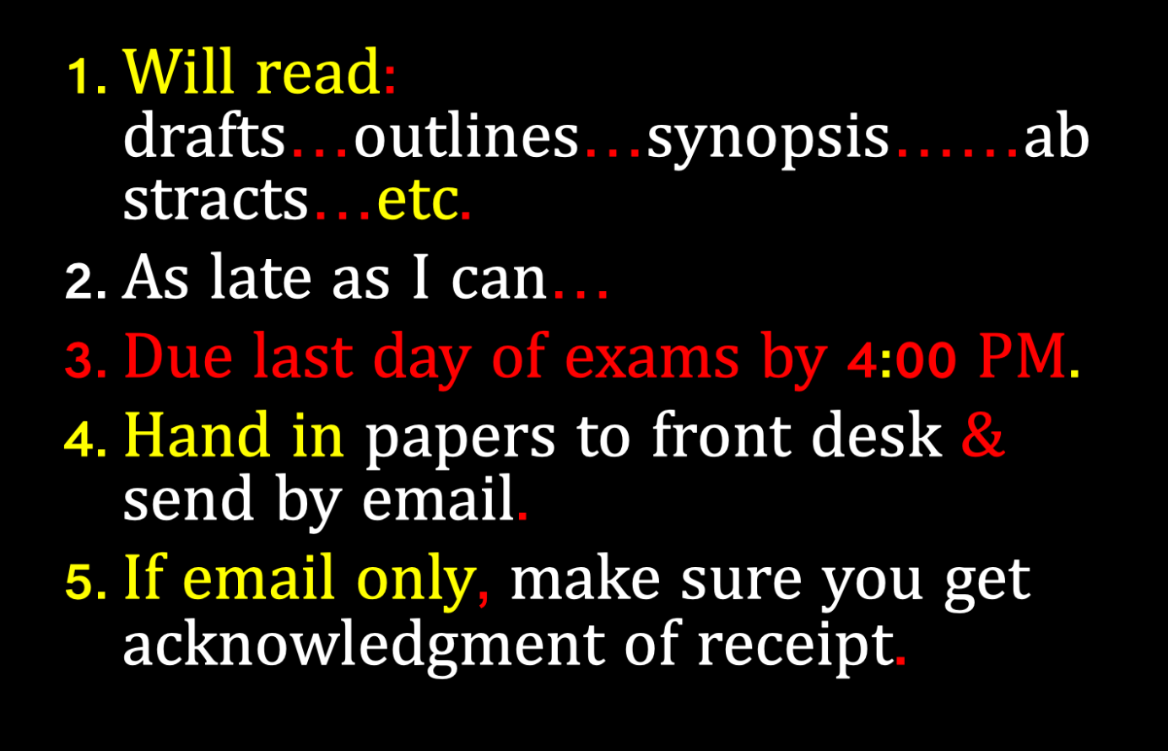

Slide 14
QUESTIONS?
THOUGHTS?
DISCUSSION?

Slide 15
IS ANY JURISDICTION
KEEPING GOOD
STATS?

Slide 16
News of the Week

Slide 17
Yours?

Slide 18
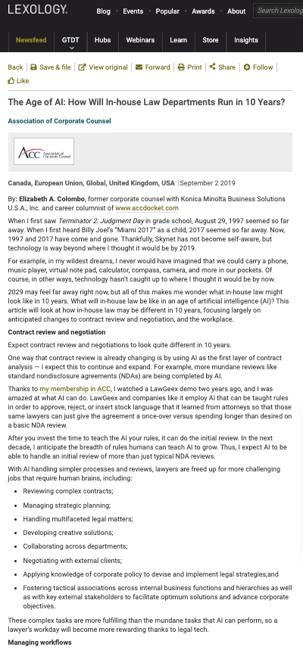

Slide 19
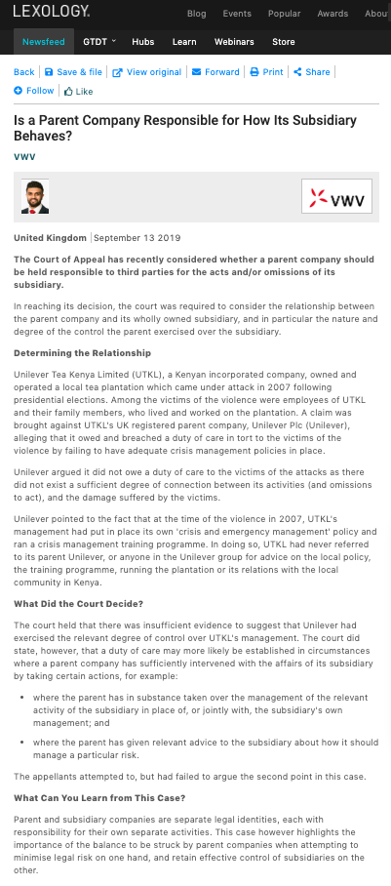

Slide 20
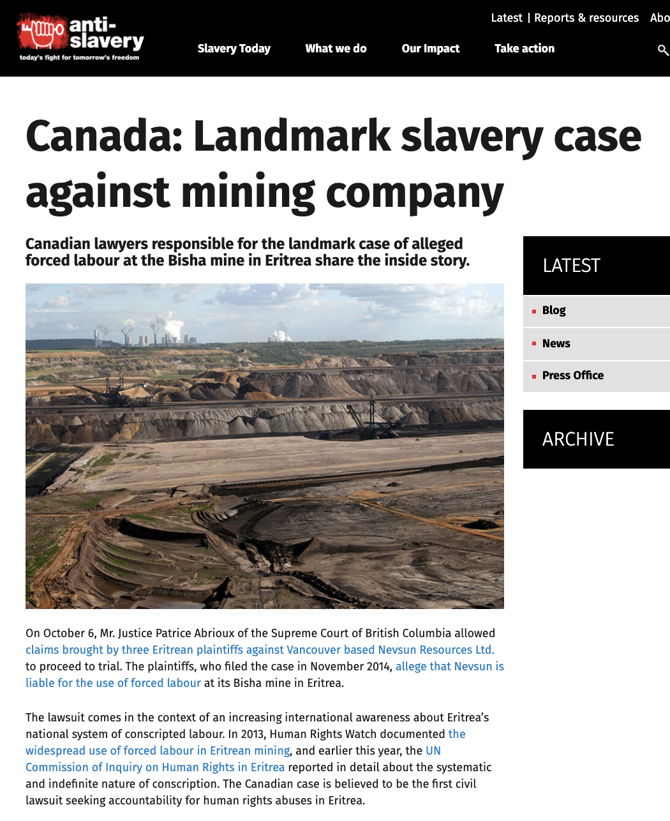
Nevsun Resources Ltd.

Slide 21
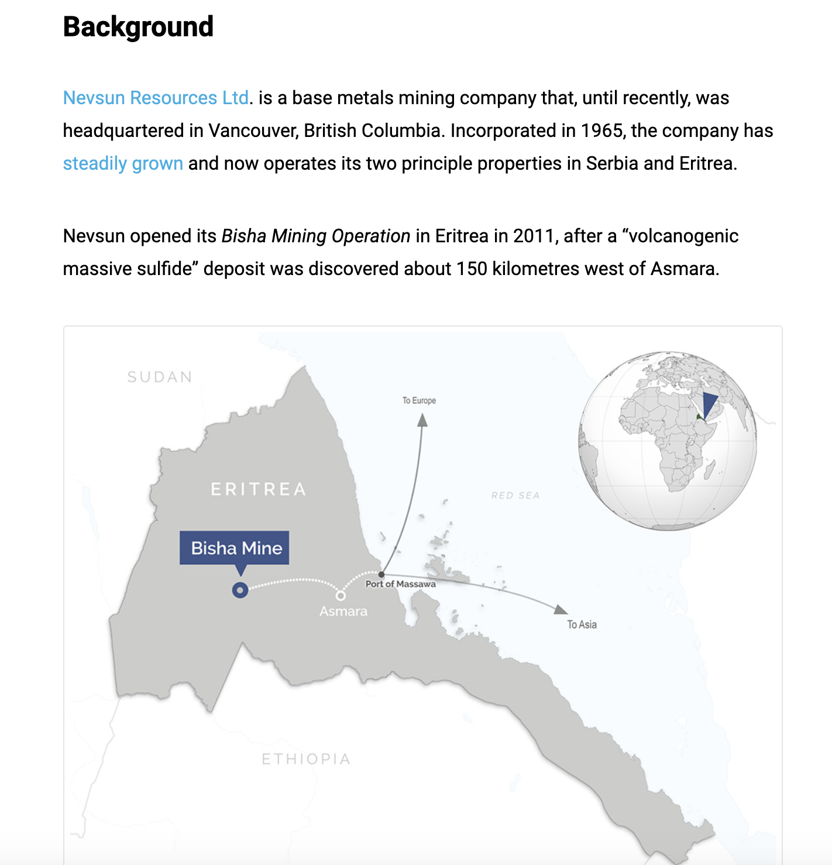

Slide 22
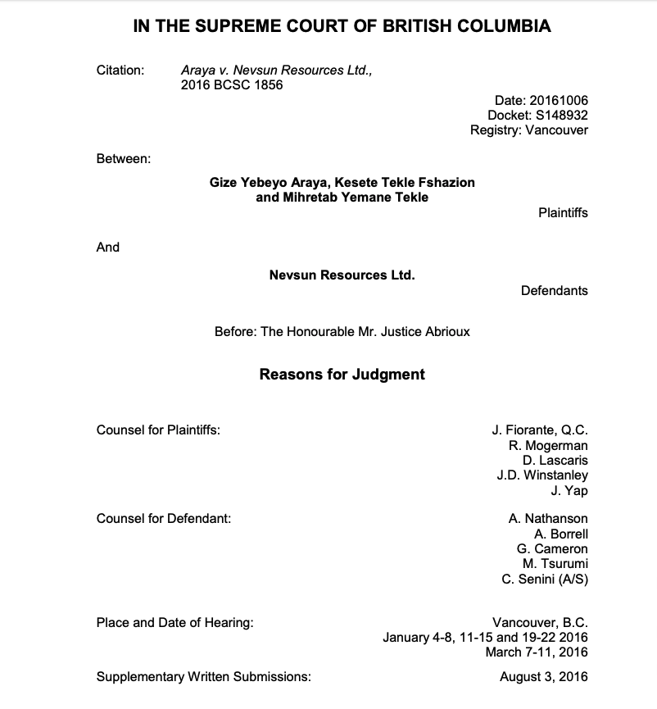

Slide 23
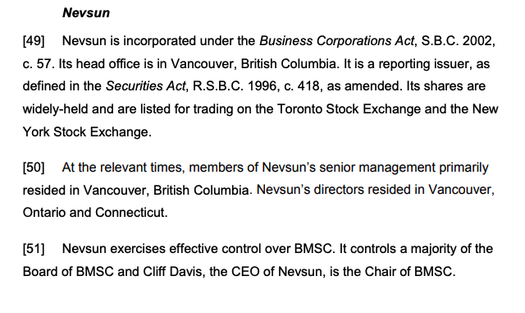

Slide 24
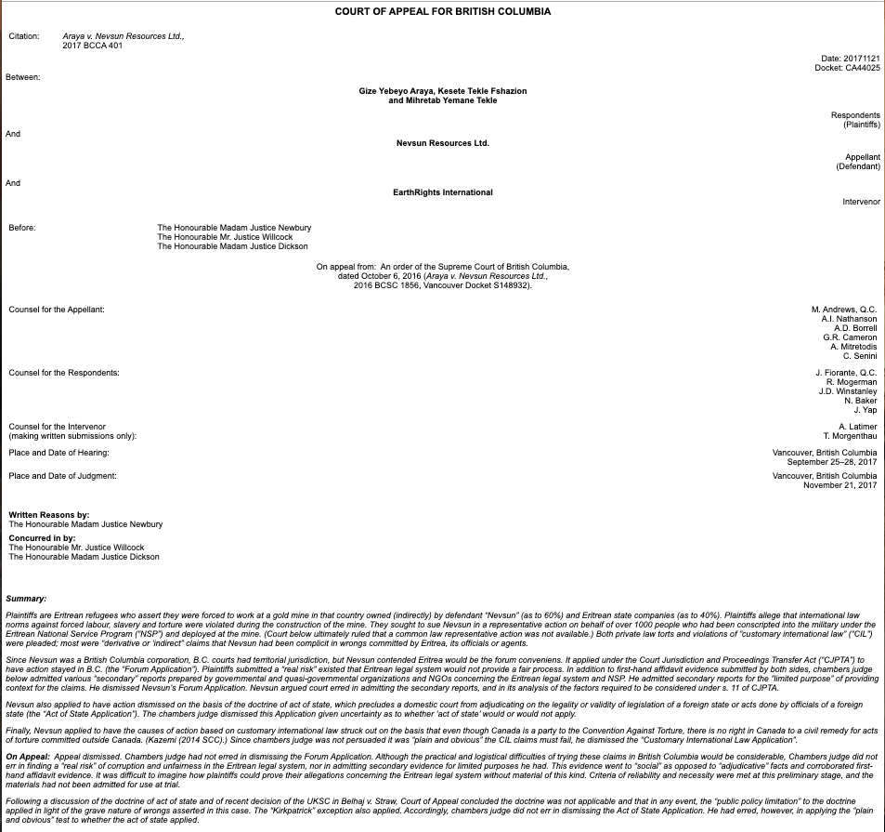

Slide 25
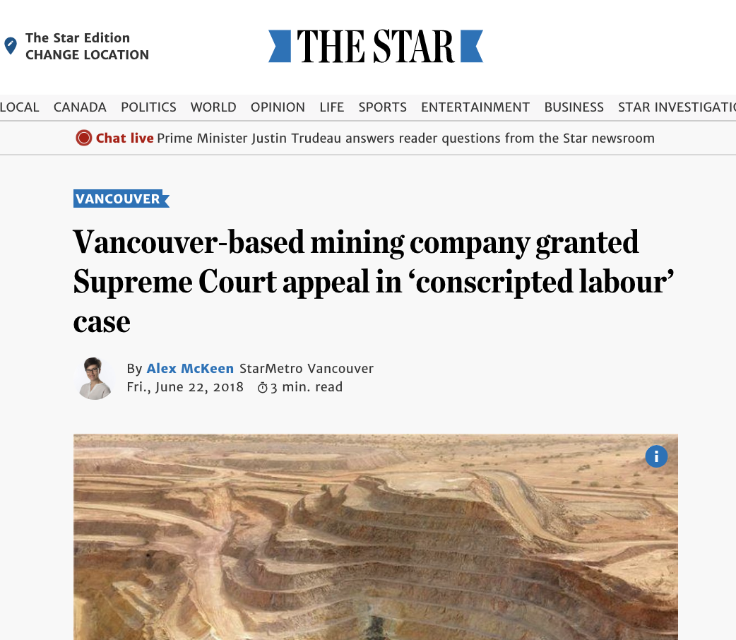

Slide 26
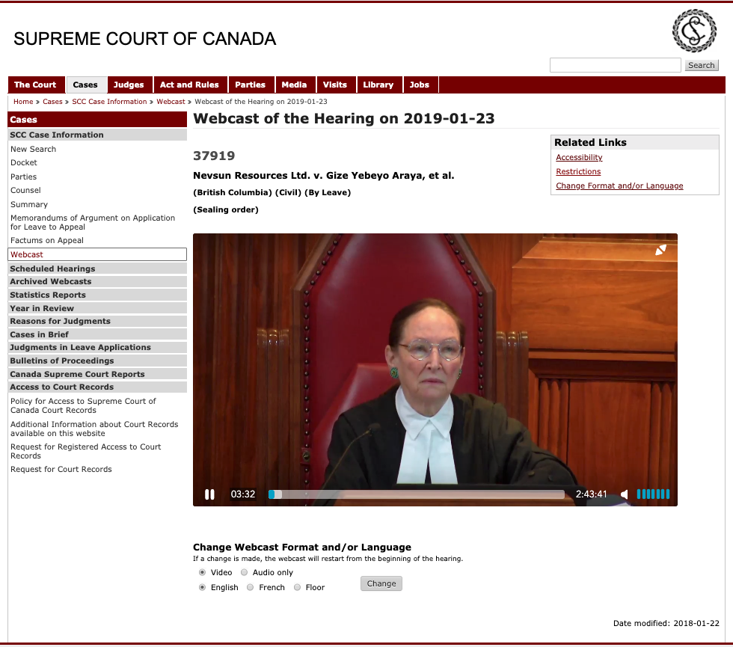

Slide 27
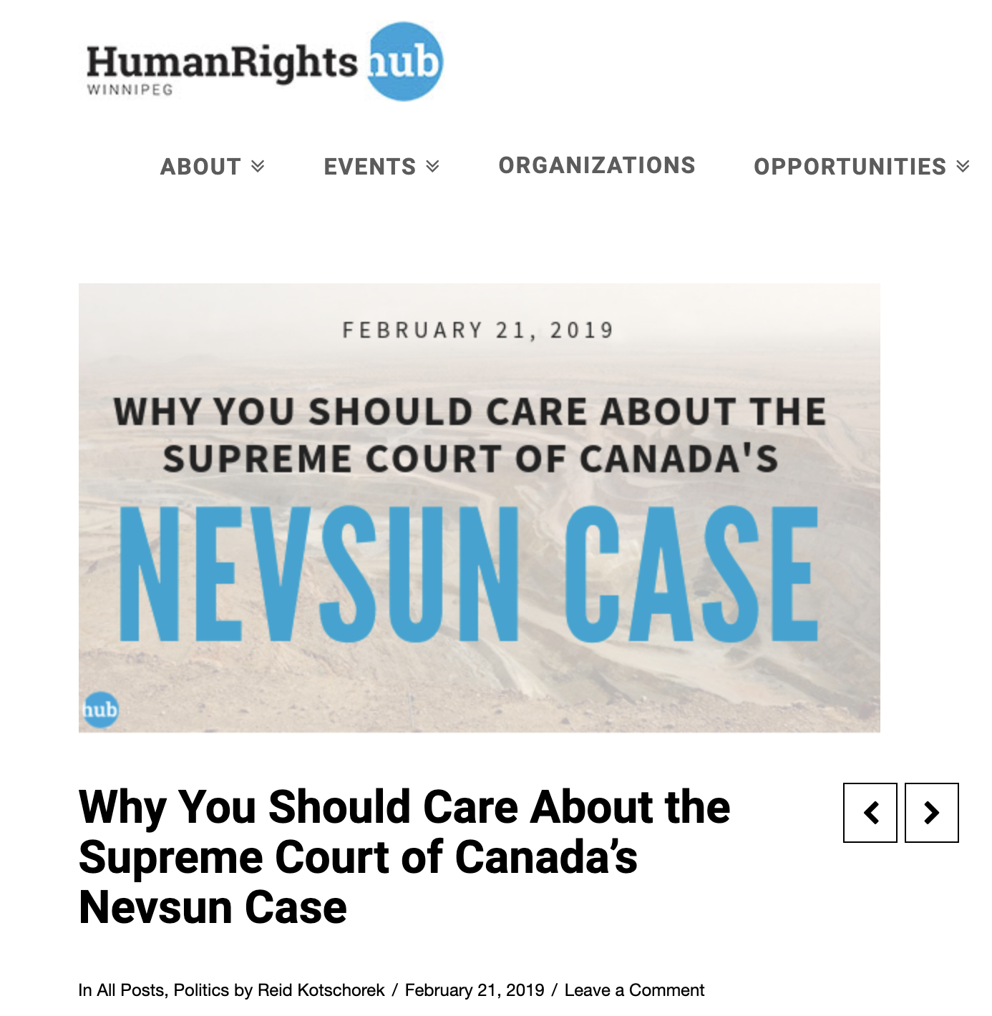

Slide 28
Last Semester This Time

Slide 29
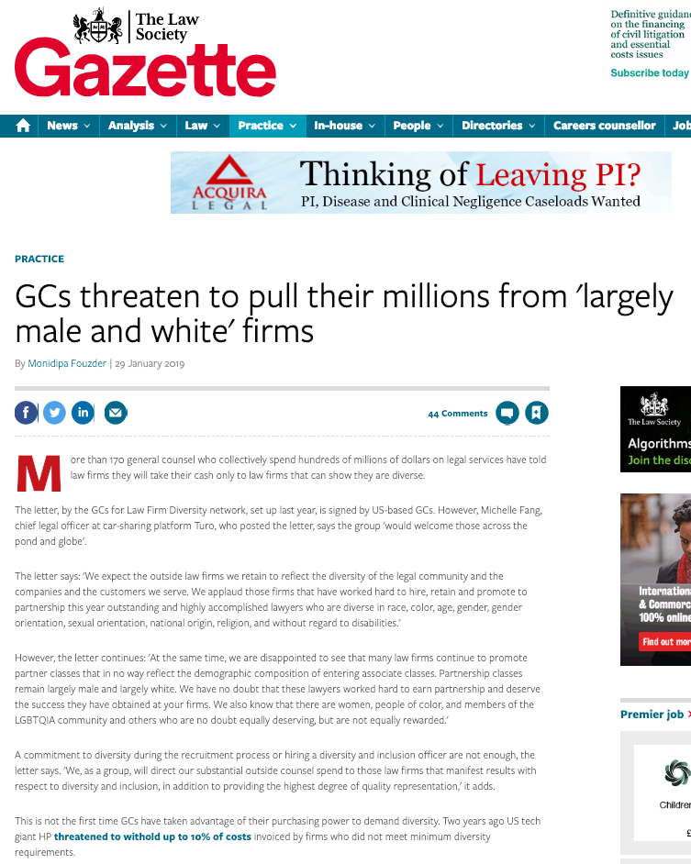

Slide 30
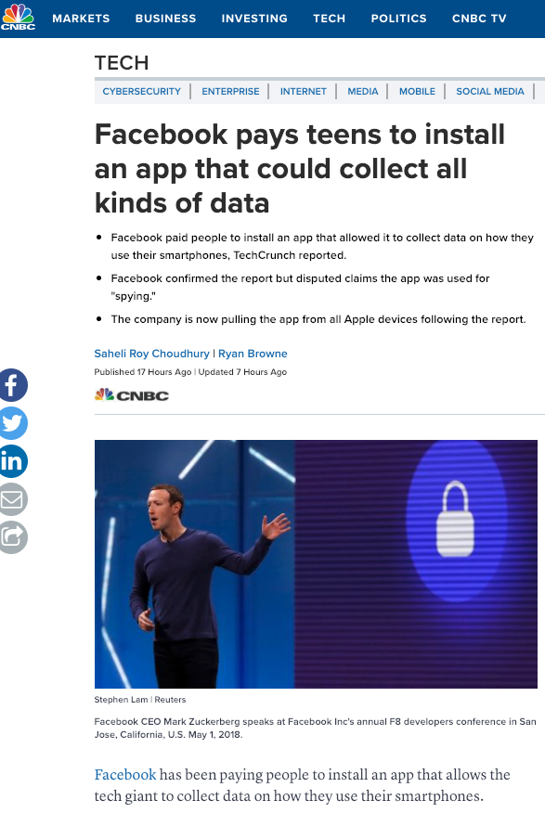

Slide 31
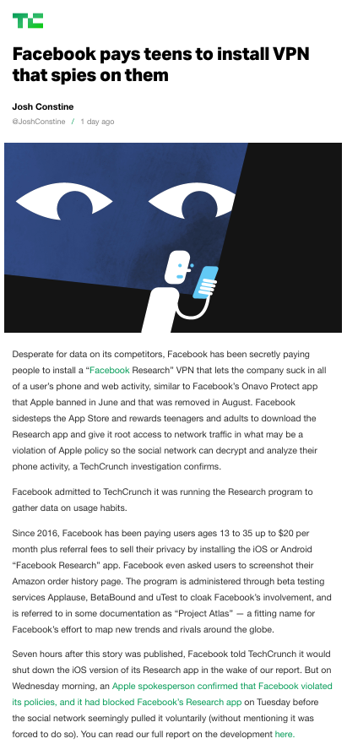

Slide 32
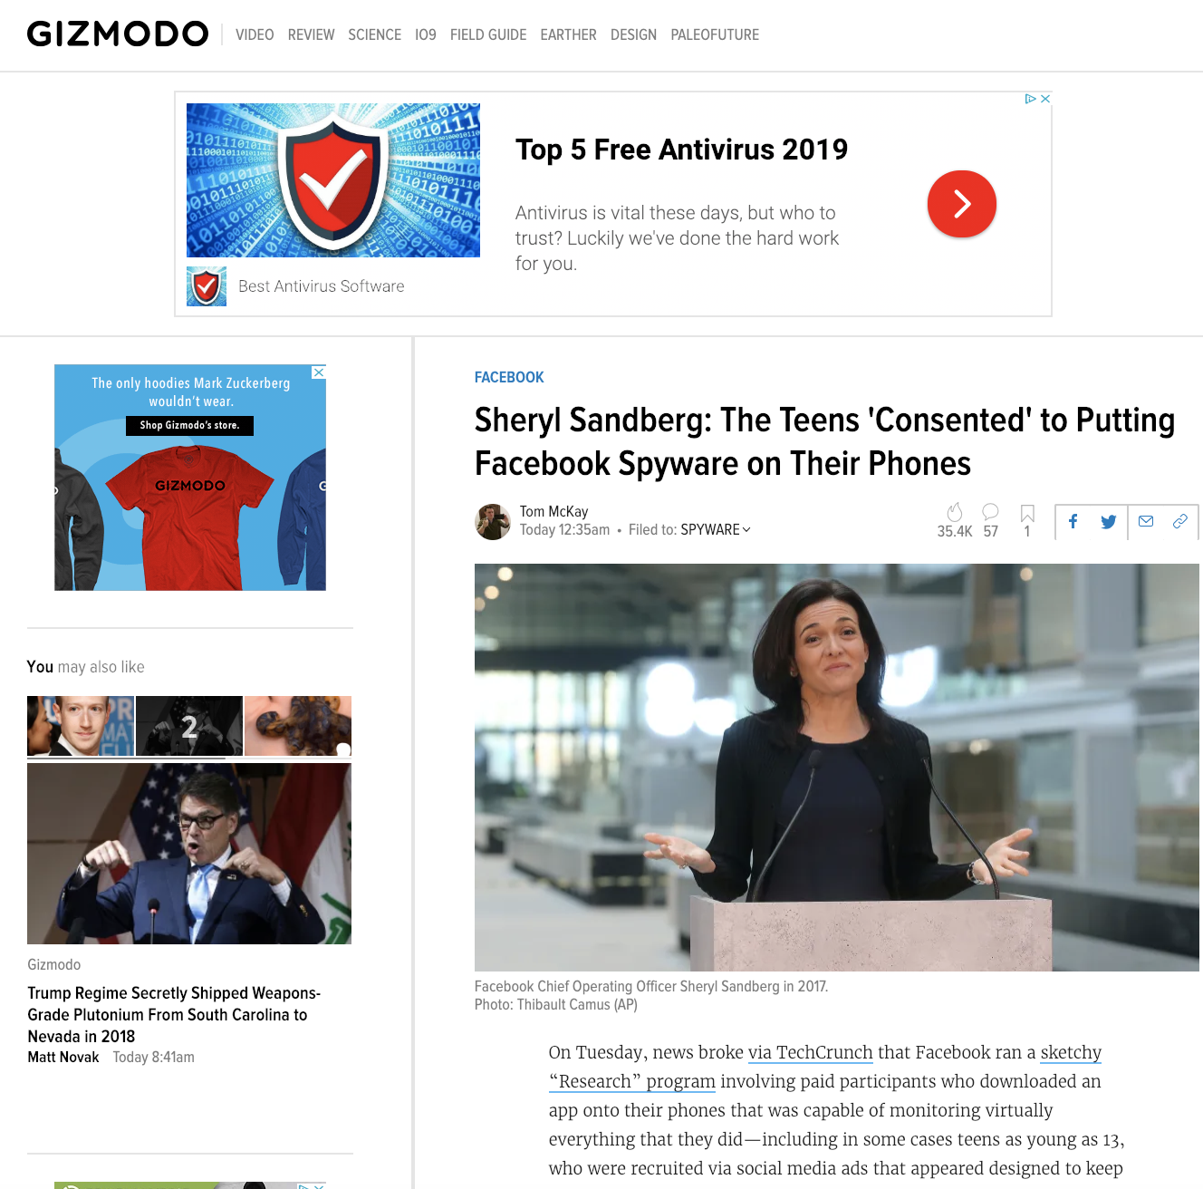

Slide 33

Pause

Slide 34
QUESTIONS?
THOUGHTS?
DISCUSSION?

Slide 35
Yours?

Slide 36
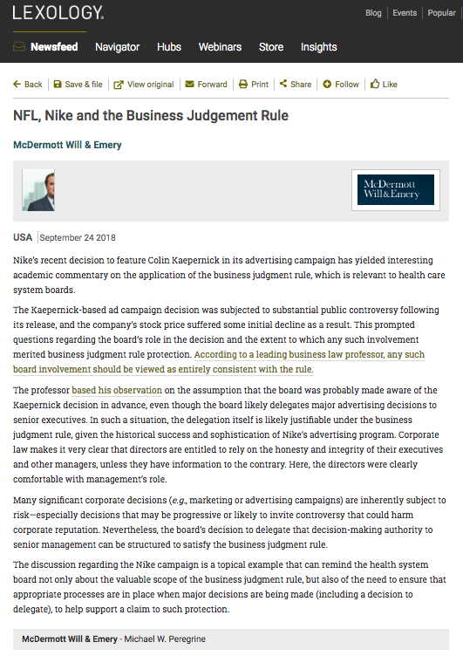
Follow-Up 1

Slide 37
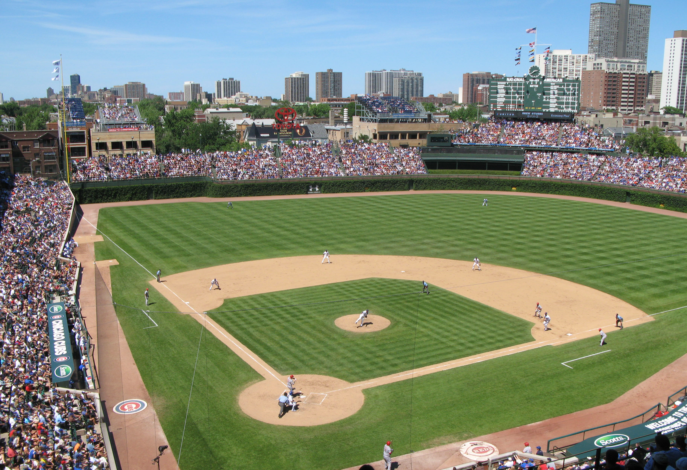
Shlensky v. Wrigley
237 N.E.2d 776 (Ill. App.1968)?

Slide 38
Mr. Phillip K. Wrigley was a director of the Chicago National League Ball Club (Inc.), which was the company that owned the Chicago Cubs. The Board tended to follow Mr. Wrigley’s lead for a variety of reasons not relevant to the outcome of this case. Although every other major league team had installed lights to allow for night games, Defendant did not install them for the Cubs because he was concerned that night baseball would be detrimental to the surrounding neighborhood.
Mr. Shlensky, a minority shareholder of the Chicago National League Ball Club (Inc.), brought a derivative action against the decision not to install lights. A derivative action is where an action is brought against the corporation in essence in the name of the corporation. Hence the word “derivative” as the right to bring action is derived from the corporation itself, and what is in the best interests of the corporation. Much more on this concept later in this course, but Wrigley v. Shlensky is a useful introduction to the concept.

Slide 39
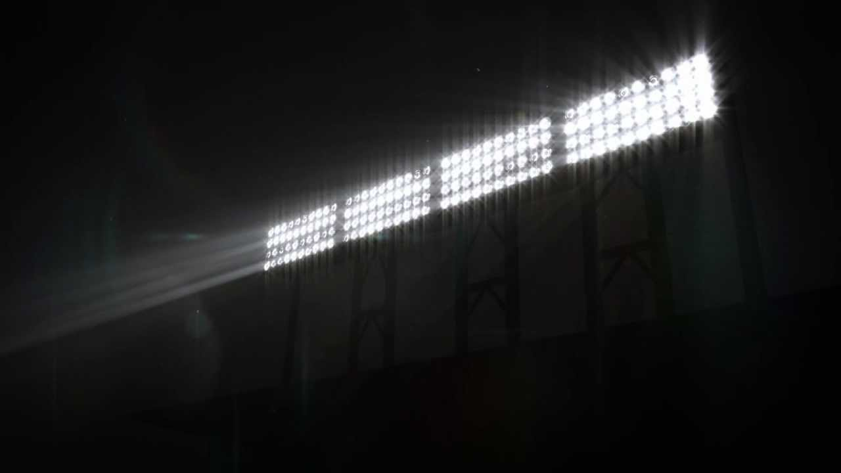
In his argument, ostensibly on behalf of the Chicago National League Ball Club (Inc.), Mr. Shlensky pointed out that the team was losing money, and that the other Chicago team, the White Sox, had higher attendance during the weekdays because they played at night. Therefore in his view the Cubs would draw more people with weekday night games. Shlensky argued that Wrigley’s first concern ought to be with the shareholders rather than the neighborhood.
The issue in the case was whether decisions made by Wrigley should be overruled absent a showing of fraud, illegality or a conflict of interest?

Slide 40
The decision was not to overrule Wrigley’s determination on the issue of lights. The court cited some reasons why the light installation could be detrimental, such as lowering the property value of the park itself, a lack of proof that financing would be available for lights and some uncertainty whether the costs would in fact be offset by increasing revenues. In essence the court set out that business decisions should not be disturbed just because a reasonable case can be made that the policy chosen by the company might not be the wisest possible. This was all the more true where there was no evidence of illegality, fraud or a conflict of interest
The court upheld the directors’ decision. Moreover the court reasoned (as the directors themselves had not) that a decline in the quality of life in the local neighbourhoods might in the long run hurt property values around Wrigley Field, harming shareholders’ economic interests.
In many ways this decision on those like it can be seen as a form of abstention by judiciary; an unwillingness to supplant the business judgment of a properly constituted and motivated Board of Directors. This so-called “BUSINESS JUDGMENT RULE” establishes a presumption against judicial review of duty of care claims.

Slide 41
Pause

Slide 42
QUESTIONS?
THOUGHTS?
DISCUSSION?

Slide 43

Starting Point 1

Slide 44


Slide 45
12,000 lawyers practicing law in B.C
8,700 insured
Therefore 3,300 government, in-house & other lawyers practicing law
0 citations (disciplinary cases)
Some, not many, complaints
In-house lawyers not insured

Slide 46
Punishments for corporate counsel wrongdoing?
BC Law Society data…0 citations (disciplinary cases)
Some, not many, complaints
In-house lawyers not insured
But Robert Strother of Davis & Co.?

Slide 47
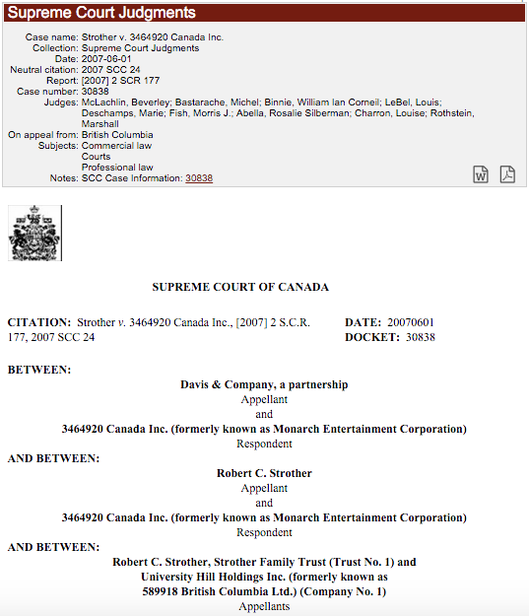

Slide 48
Strother v. 3464920 Canada Inc., [2007] 2 S.C.R. 177
Breach of fiduciary duty & breach of confidence
Fiduciary duty includes duty of loyalty
Relationship between duty of loyalty and avoiding conflicts of interest

Slide 49
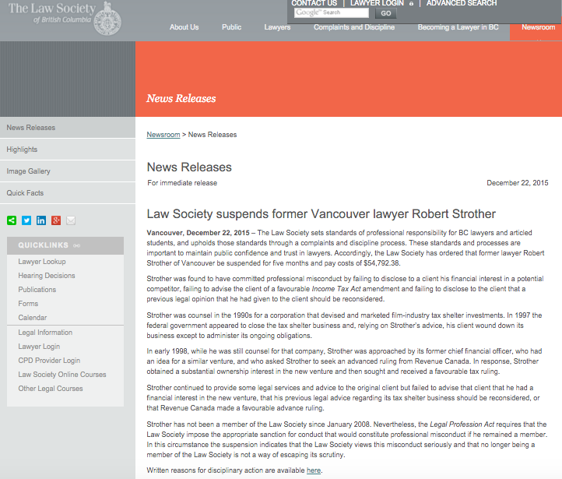

Slide 50
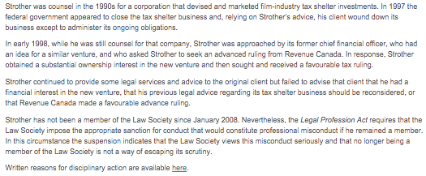

Slide 51
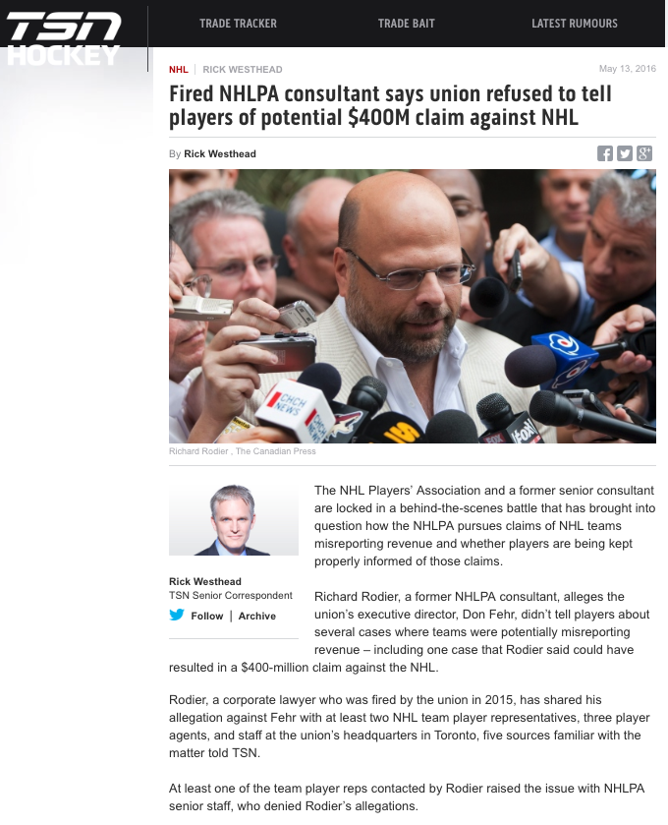

Slide 52
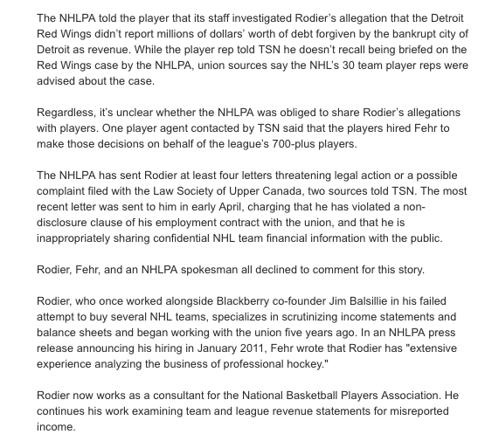

Slide 53
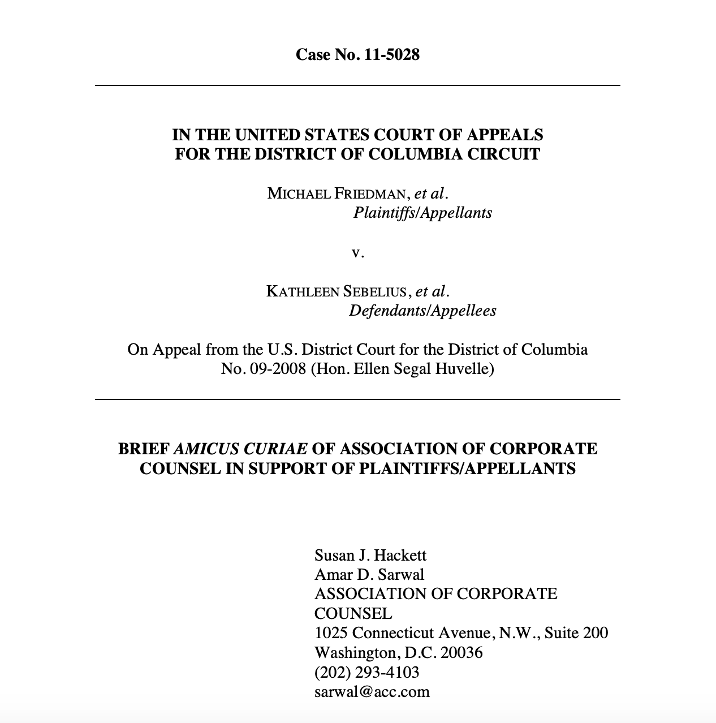

Slide 54
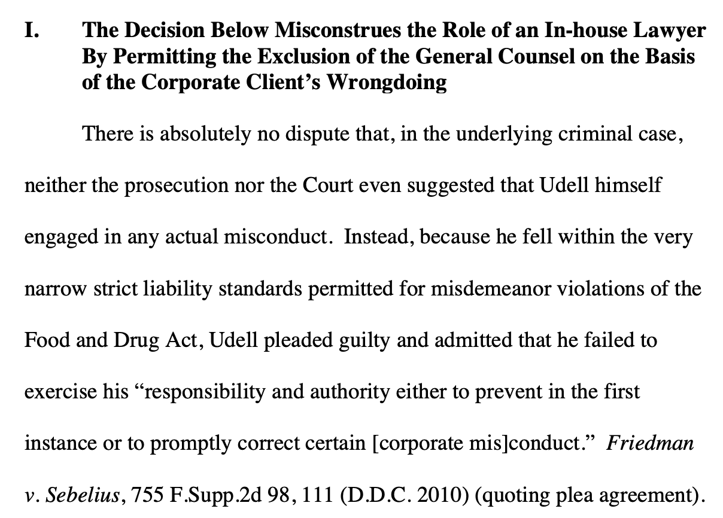

Slide 55
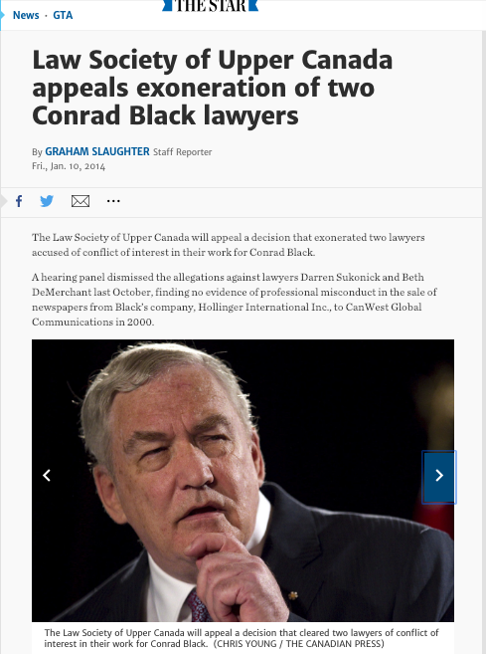
Most serious of all…

Slide 56
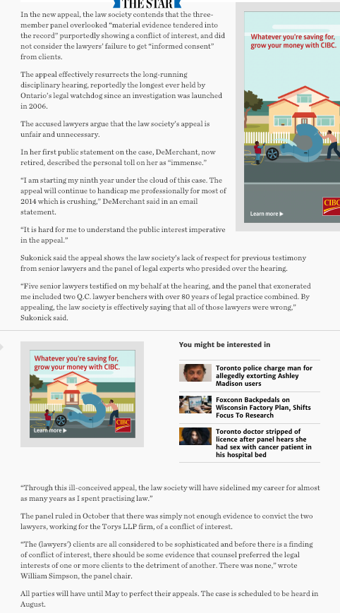

Slide 57
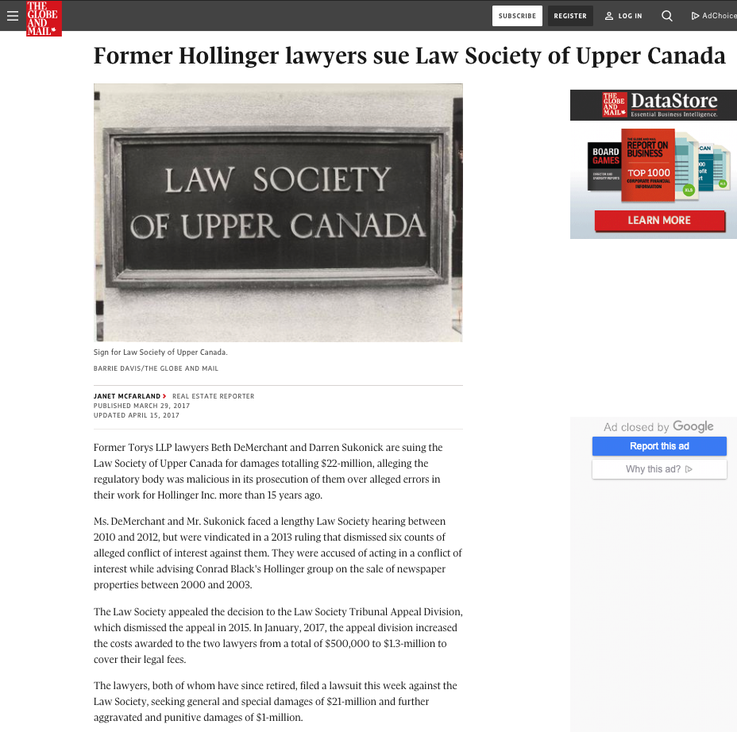

Slide 58
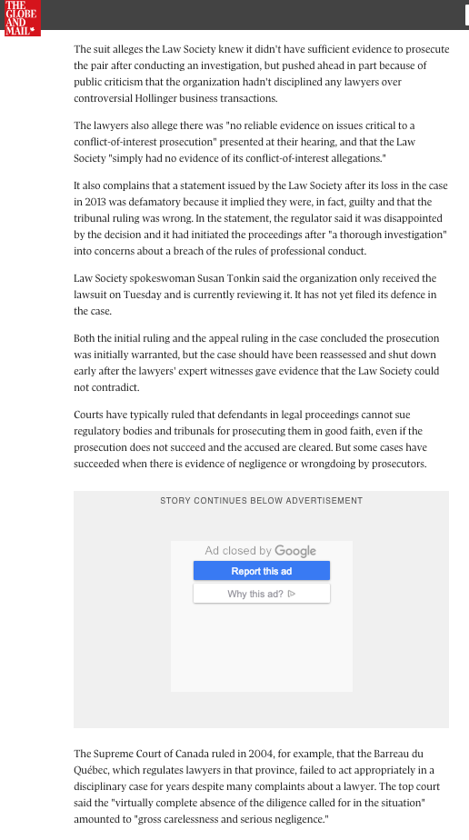

Slide 59
What are the limits of in-house counsel? When do outside lawyers need to be hired?

Slide 60
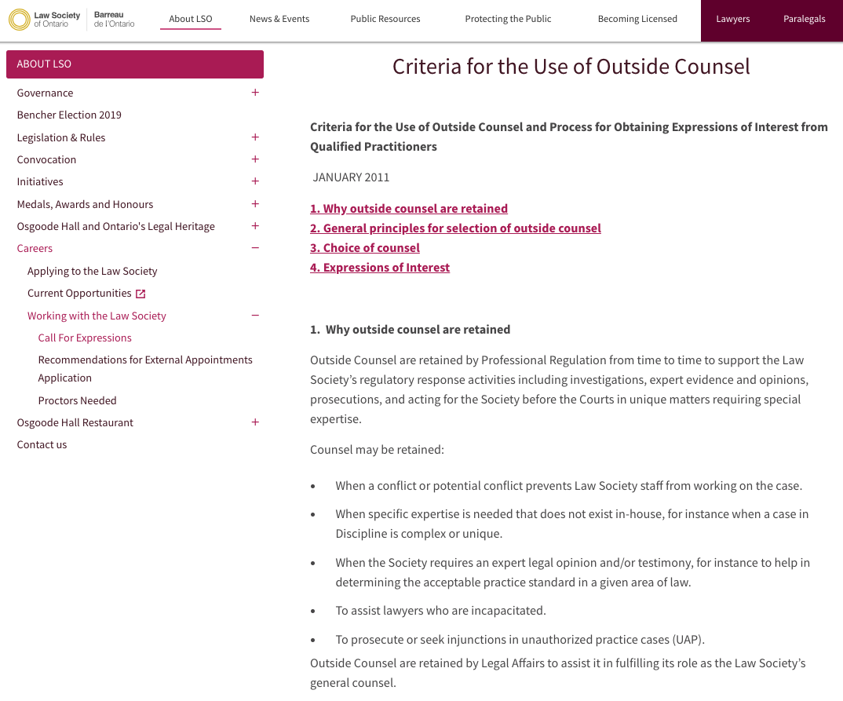

Slide 61
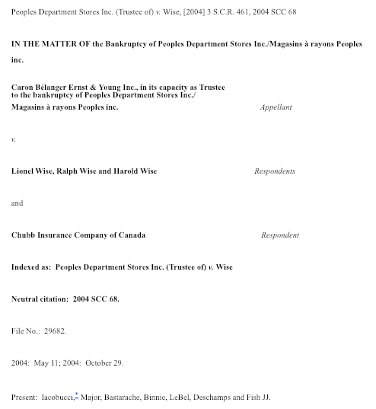

Slide 62
123. (4) A director is not liable under section 118, 119 or 122 if he relies in good faith on
(a) financial statements of the corporation represented to him by an officer of the corporation or in a written report of the auditor of the corporation fairly to reflect the financial condition of the corporation; or
(b) a report of a lawyer, accountant, engineer, appraiser or other person whose profession lends credibility to a statement made by him.

Slide 63
Query in this context…
C.L.O.
(Who is not member of local bar)

Slide 64
What about
SOLICITOR-CLIENT PRIVILEDGE?
In R. v. Campbell [1999] 1 SCR 565, the Supreme Court of Canada held (citing Minter v. Priest, [1929] 1 K.B. 655 C.A.)that whether a lawyer works as in-house counsel or external counsel does not affect the creation or the character of solicitor-client privilege. In either context, only advice given by lawyers within a solicitor-client relationship is protected.

Slide 65
In a 2004 decision, Pritchard v. Ontario (Human Rights Commission), 2004 1 SCR 809 the Supreme Court of Canada (citing R v. Campbell) reaffirmed the highly context-specific evaluation required to determine whether privilege attaches to an in-house lawyer's advice:
  "Owing to the nature of the work of in-house counsel, often having both legal and non-legal responsibilities, each situation must be assessed on a case-by-case basis to determine if the circumstances were such that the privilege arose. Whether or not the privilege will attach depends on the nature of the relationship, the subject matter of the advice, and the circumstances in which it is sought and rendered."

Slide 66
You are VP Business Development in your organization and are sometimes asked for legal advice. Is your legal advice privileged?

Slide 67

Differences between in-house lawyers the world over???

Slide 68
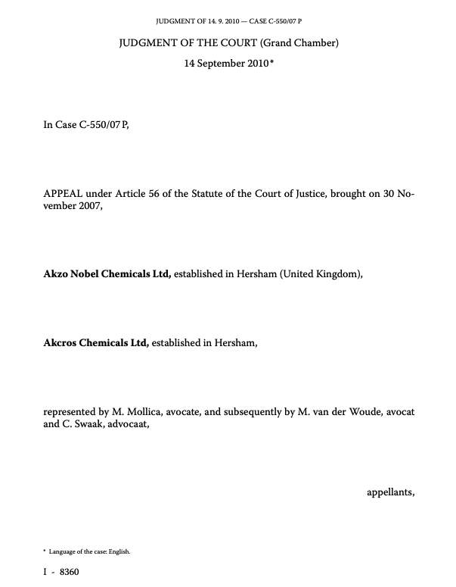
Speaking of solicitor-client privilege…

Slide 69
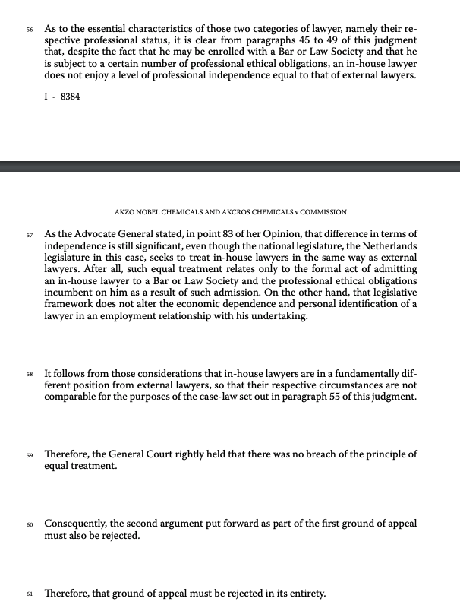

Slide 70


A MATTER OF PERSPECTIVE

Slide 71

Conclusion

Slide 72
SEE YOU NEXT WEEK!

Slide 73

Always include a cat picture

Slide 74
In learning you will teach
And in teaching you will learn
Phil Collins' Son of Man (1999)

Slide 75
Our Academic Partners

