Slide 1
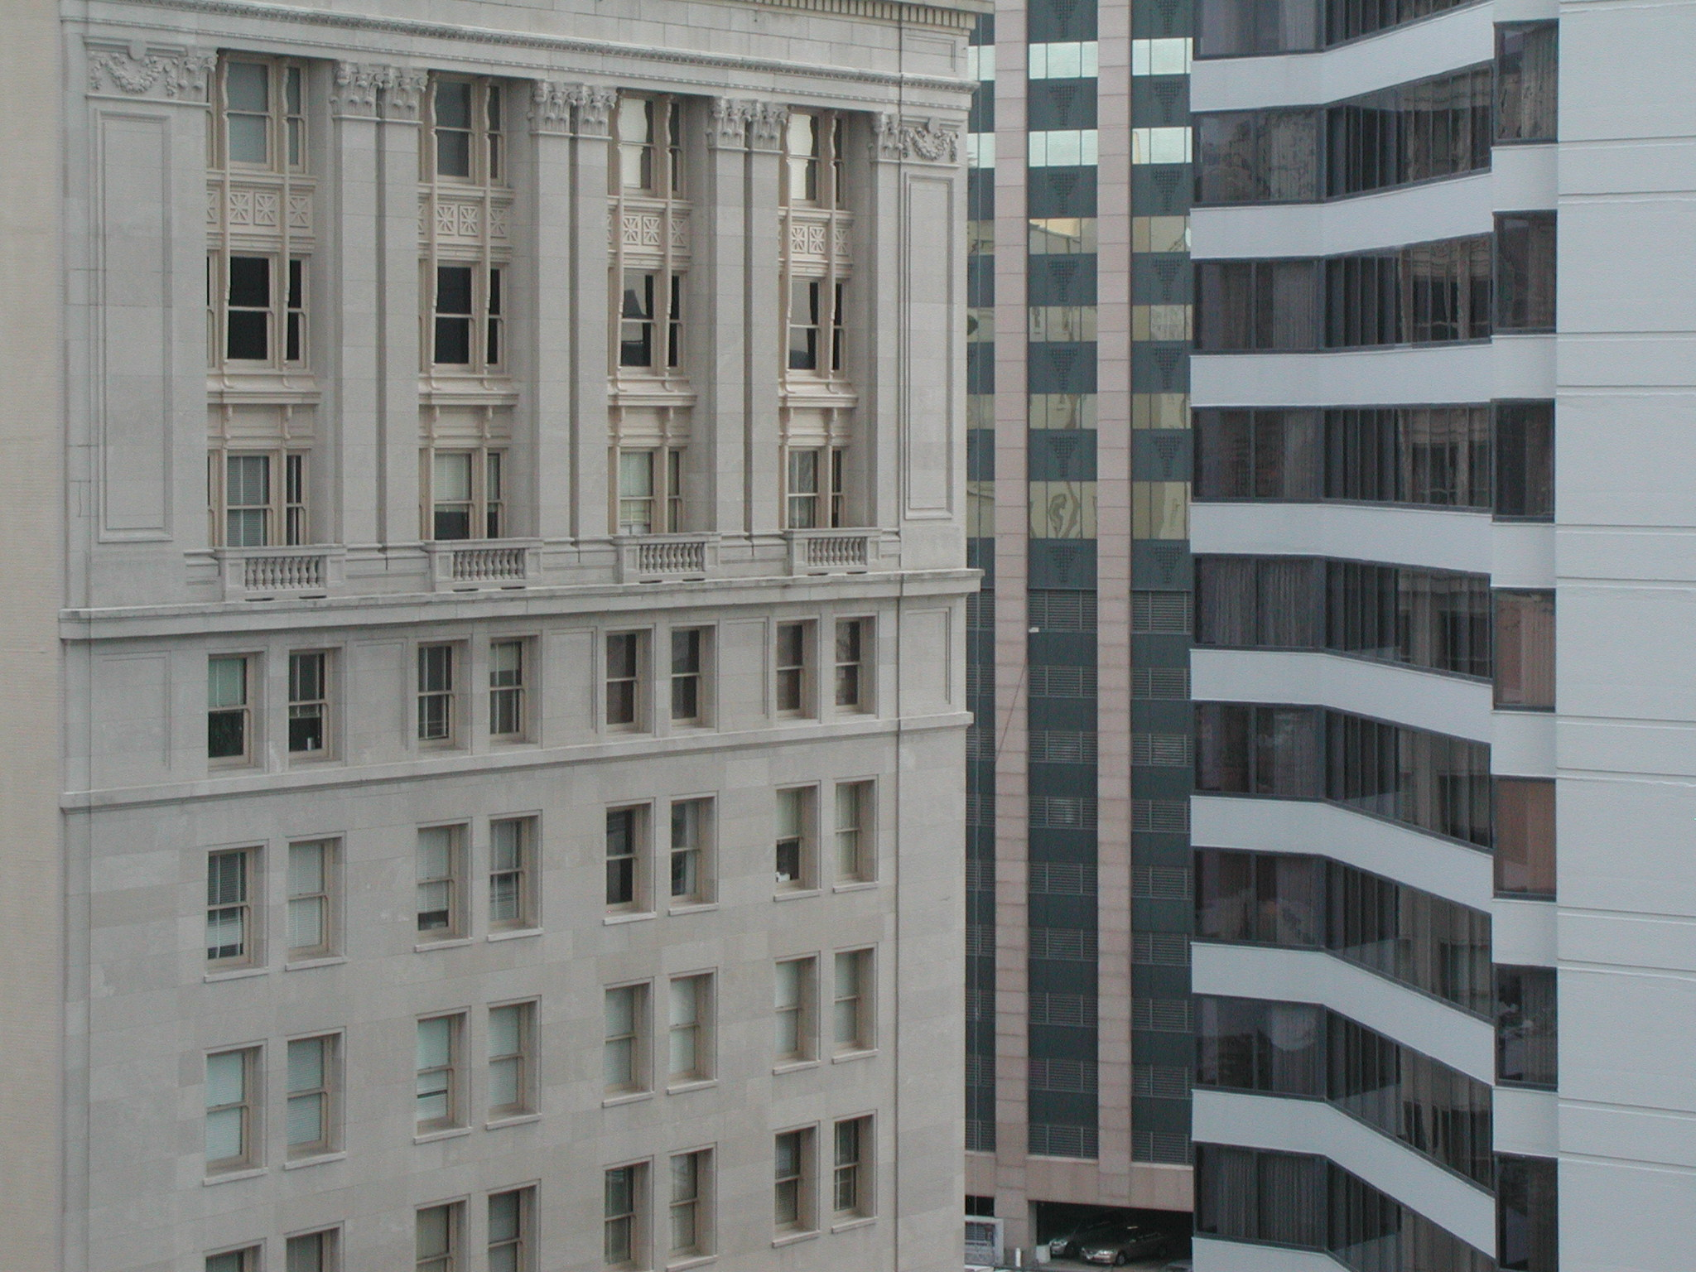

“Corporate Law:
What you need to know”
Talk 2
LAWF 3780
Challenges of In-House & Corporate Counsel
TRU Faculty of Law
Fall, 2019
Jon Festinger Q.C.
Centre for Digital Media
QMUL School of Law (CCLS)
Festinger Law & Strategy
http://commlaw.allard.ubc
@jonfestinger
jon_festinger@thecdm.ca

Slide 2
Hello
LAW F 3780
Challenges of In-House
& Corporate Counsel

Slide 3

Terrific Thursdays

Slide 4
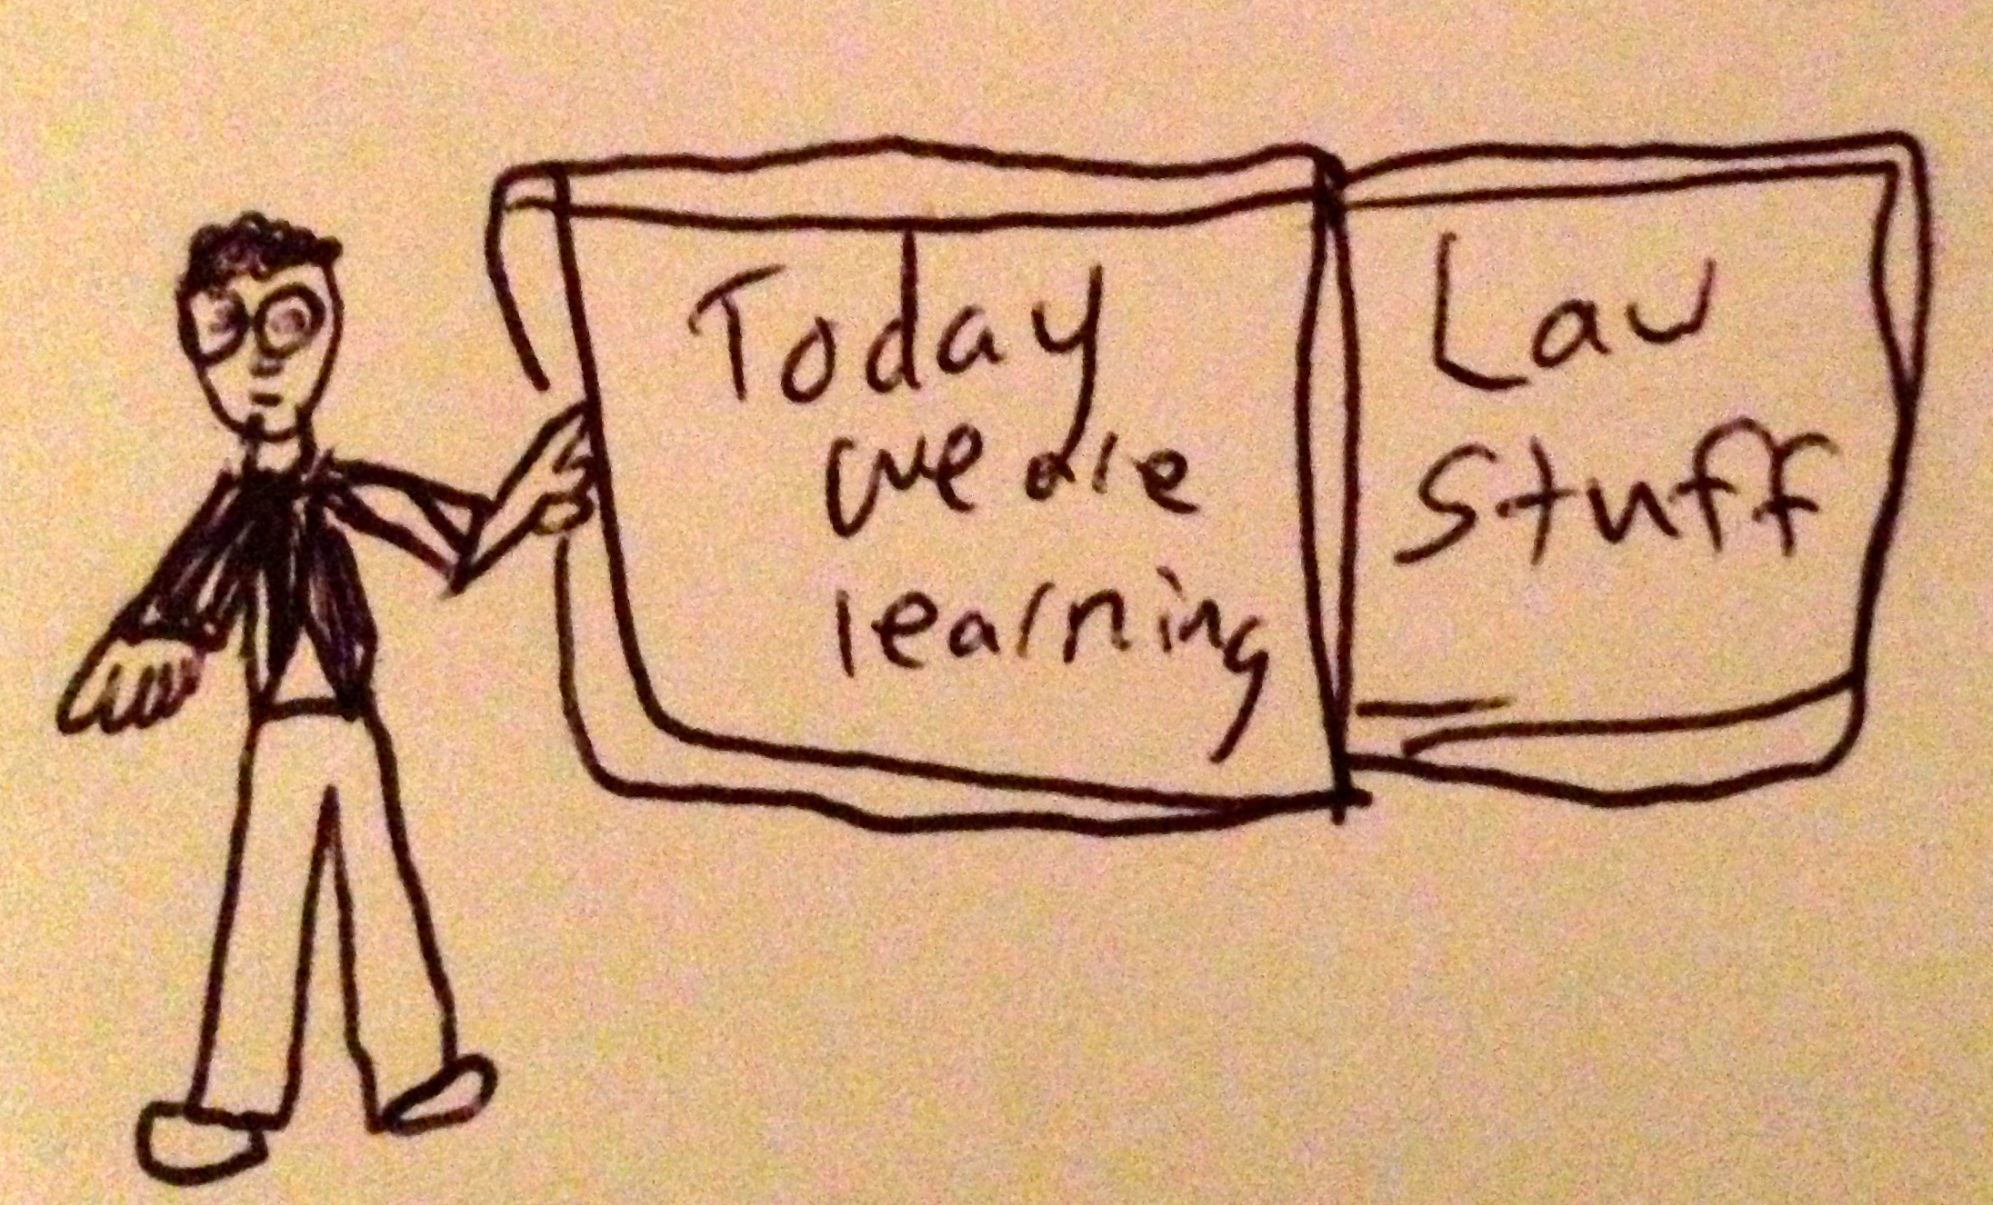

Slide 5
Logistics

Slide 6
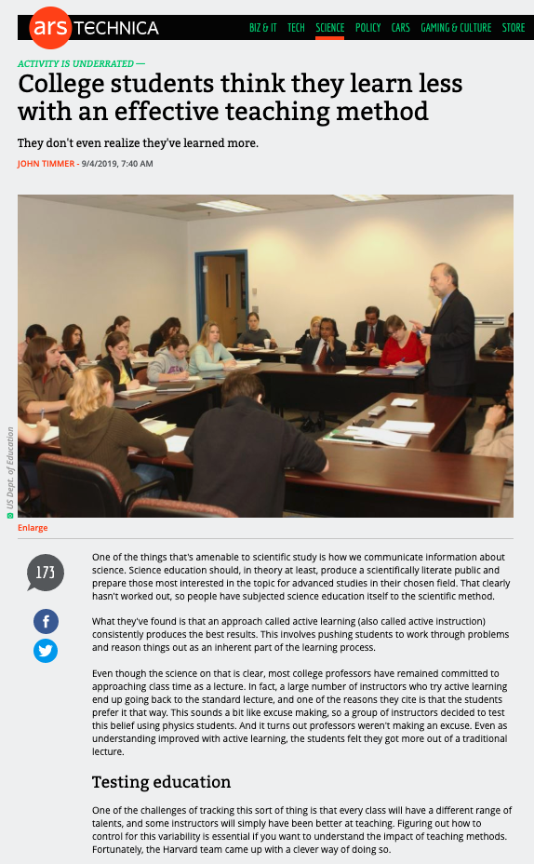
Follow-up on Pedagogy…

Slide 7
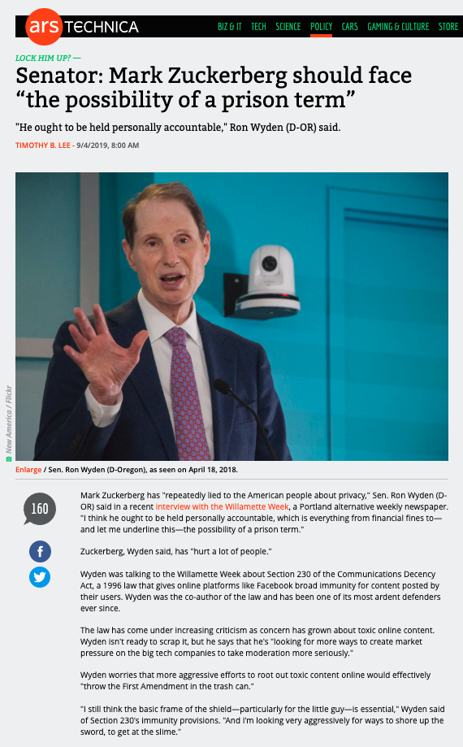
Follow-up on Discussion…

Slide 8
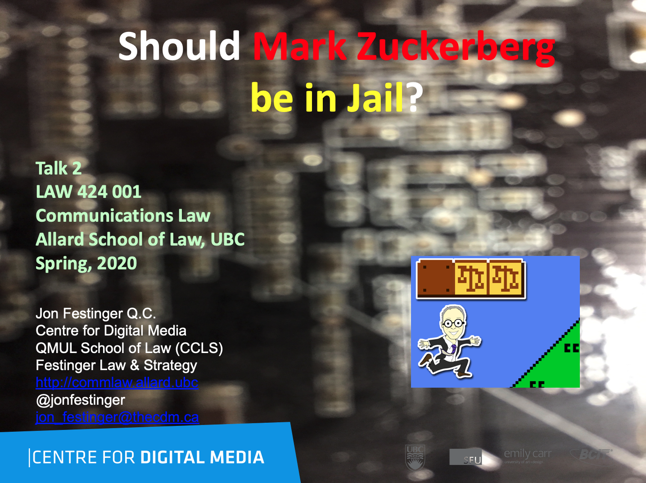

Slide 9
Grading

Slide 10
EVALUATION
Term paper = 60% of the final grade.
5000 word paper
The paper is due on the last day of the exam period at 4:00 p.m.
Class Participation = 40% of the final grade
25% of the mark will be based on group preparation of a Class Discussion, with a Discussion Outline provided to the class—preferably by posting on the course website—a week before.
15% for student participation in other course activities including seminar discussions etc.

Slide 11
Paper Confessional
(or what I learned one winter holiday)
Legal/normative reasoning/argument including footnote/bibliography support & Contribution/Move forward → 60%
Presentation including layout, headings, grammar, language/writing skills, “tightness” → 25%
Topic/Originality/Degree of Difficultly → 15%
THIS IS NOT A RUBRIC. IT IS A SELF ASSESSMENT.

Slide 12
Group Presentations
4-5 (ideally) per group
Sign-up at the break or email me
Any topic – not constrained by what I’m talking about that week
Consult with me re the topic you want to take on
Post one thing you want us to read or watch

Slide 13
One (of many) possible methodologies…
Coming
Up

Slide 14
Evaluation Tips
Term paper topics need not be discussed with me, but often helpful to you if you do.
Term paper can be on your presentation topic.
Participation: In-class or other contributions, including attendance.
Group presentation need not be on that week’s topic (20 minute per student multiplier suggested 2-4 per group to 60 minute max).

Slide 15
Grades (primarily)
Paper → Quality
Participation → Effort

Slide 16
Will read: drafts…outlines…synopsis……abstracts…etc.
As late as I can…
Due last day of exams by 4:00 PM.
Hand in papers to front desk & send by email.
If email only, make sure you get acknowledgment of receipt.

Slide 17
QUESTIONS?
THOUGHTS?
DISCUSSION?

Slide 18
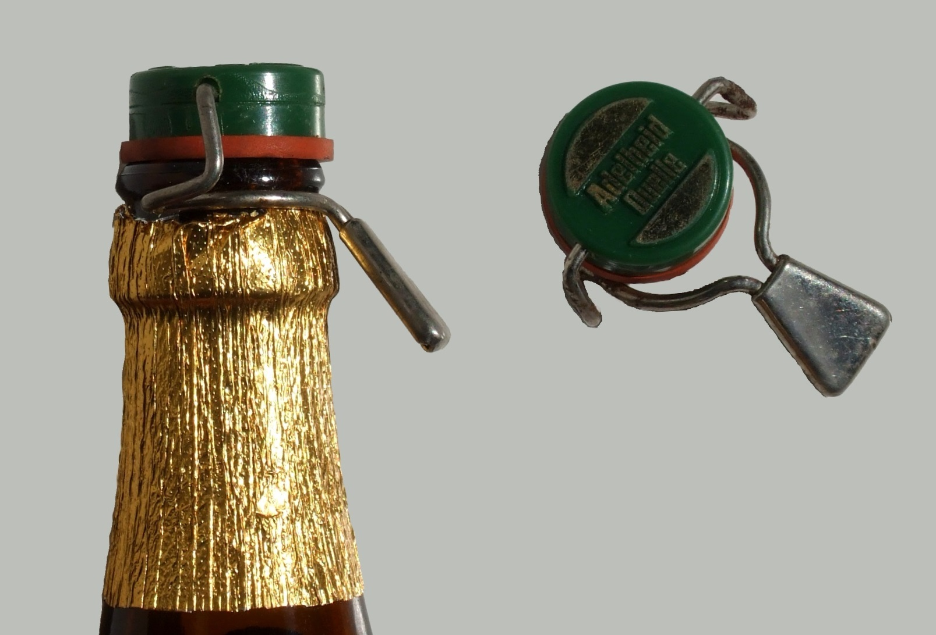
Recapping

Slide 19

Pick your meme

Slide 20
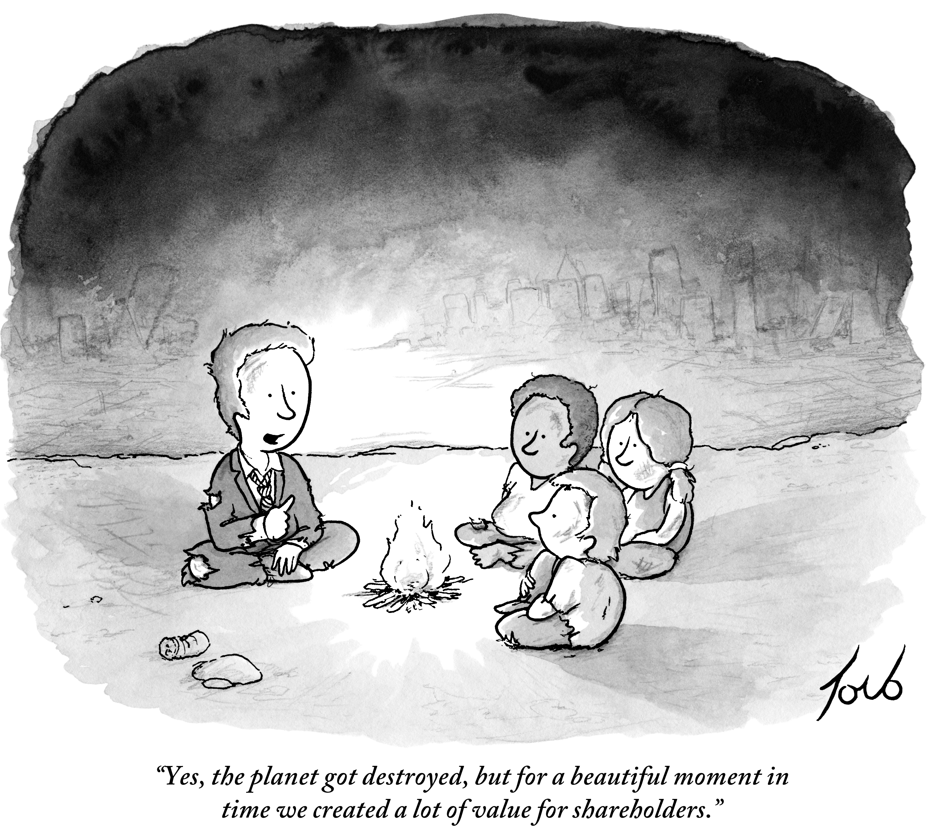
1

Slide 21
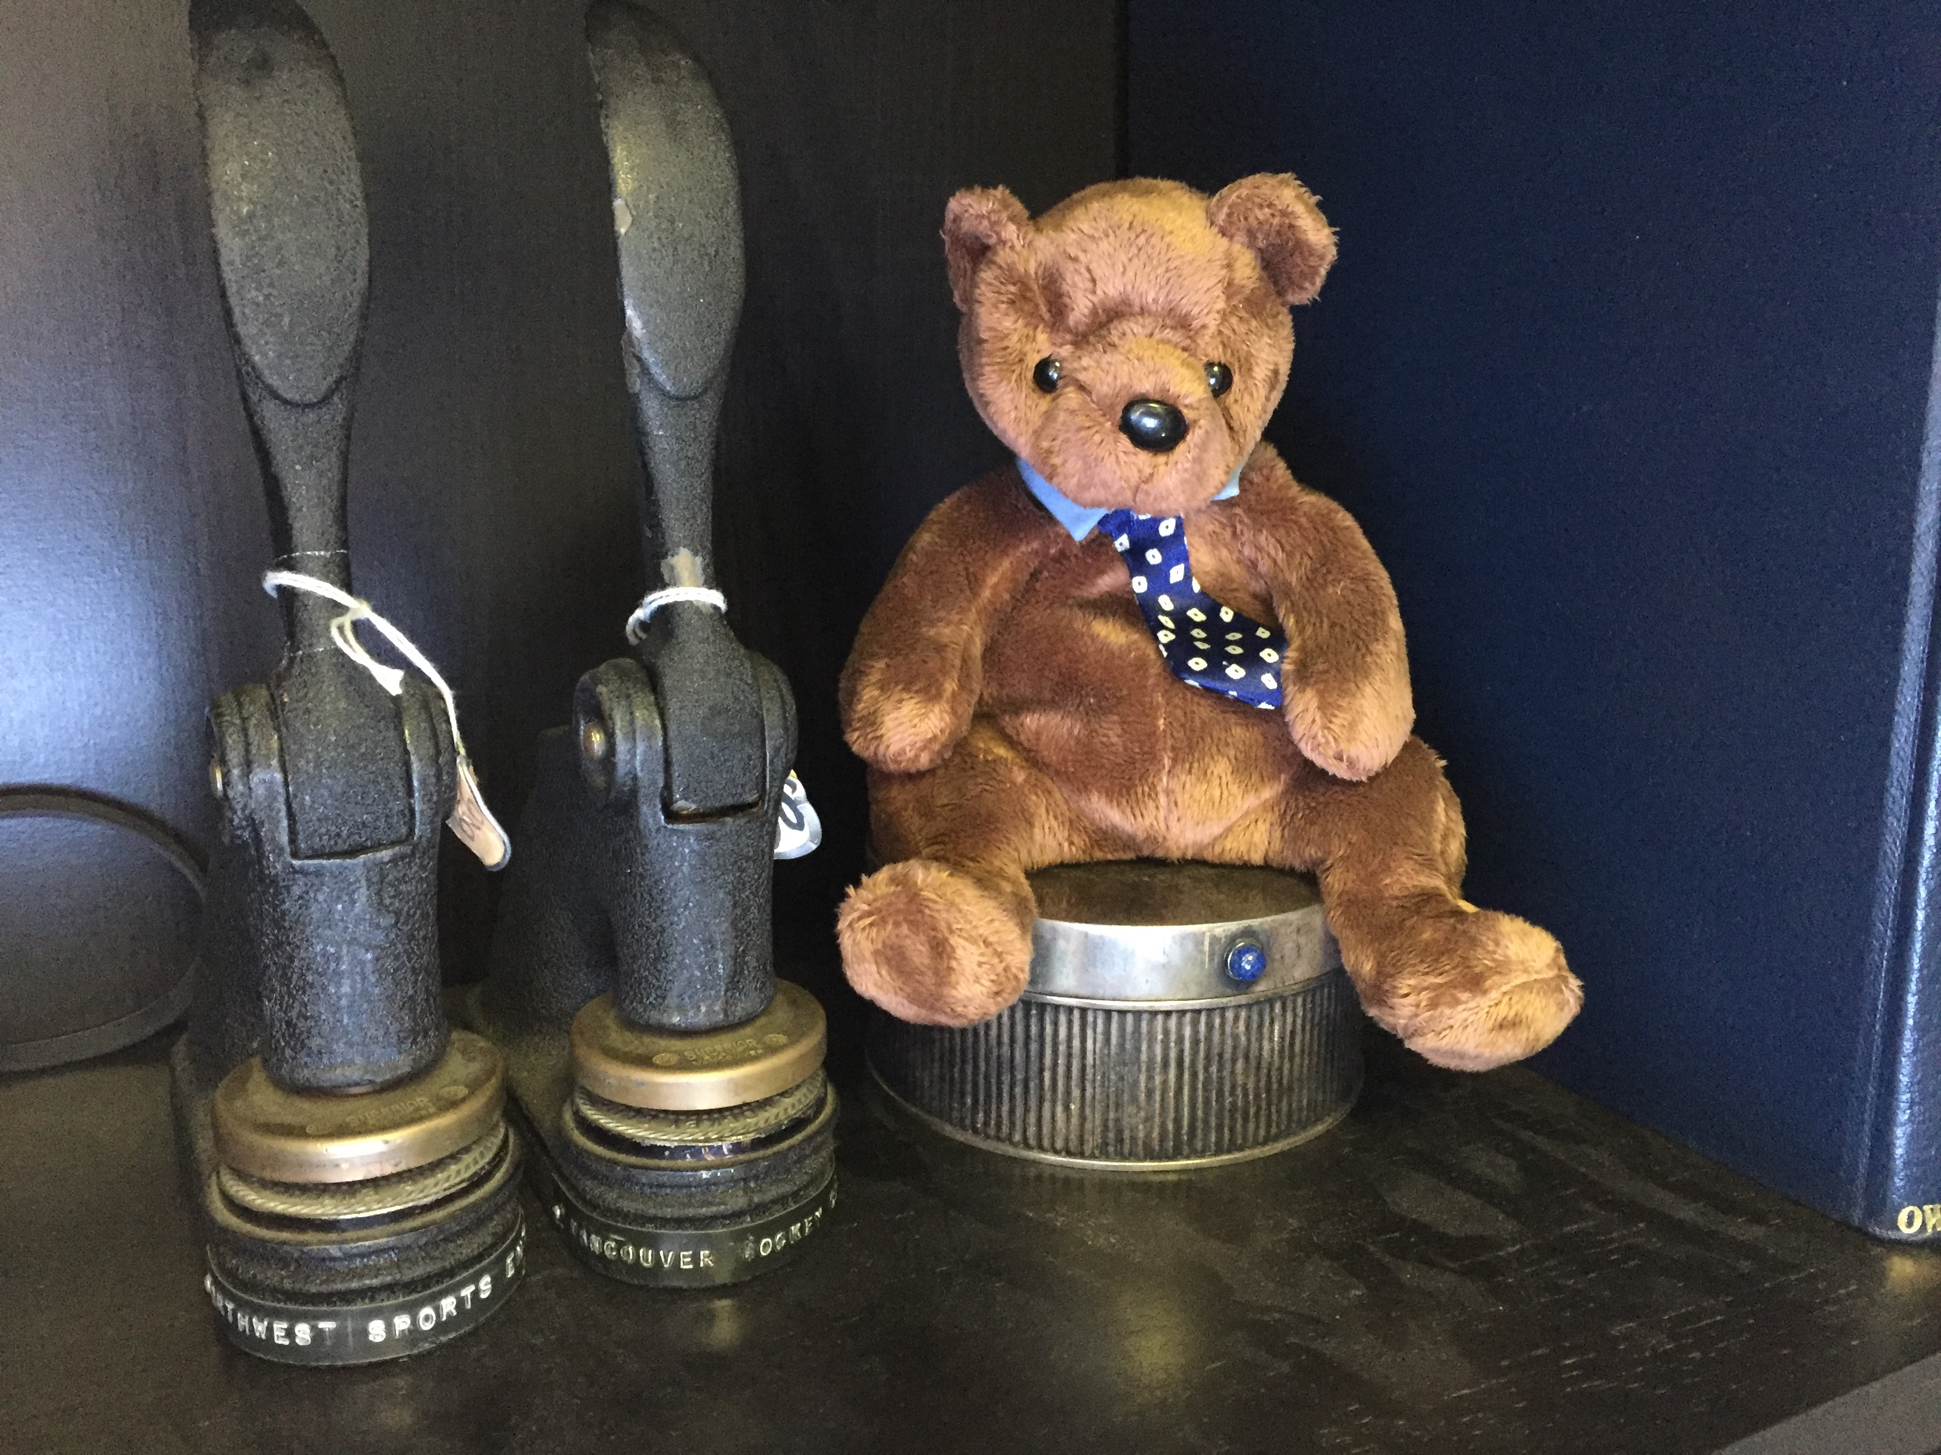
2

Slide 22
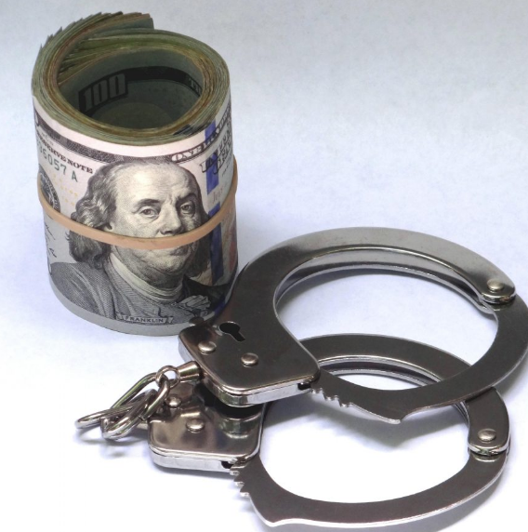
3

Slide 23
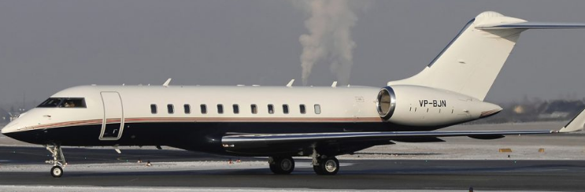
4

Slide 24
Which meme appeals to you most in the context of this course?

Slide 25
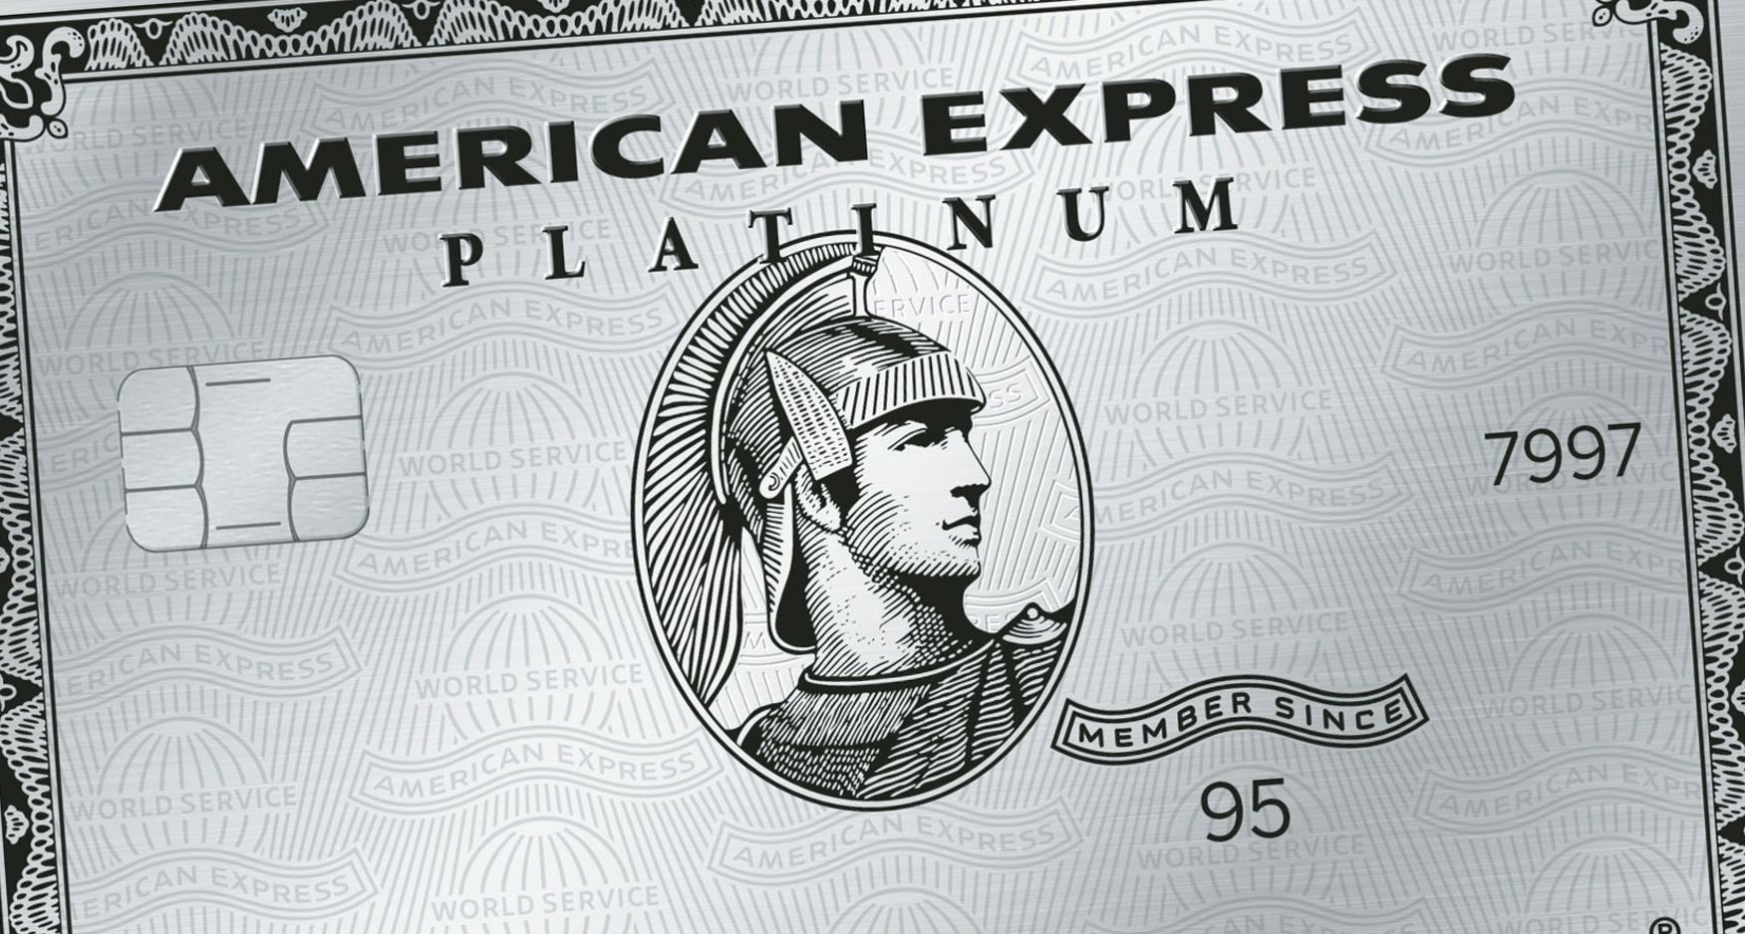
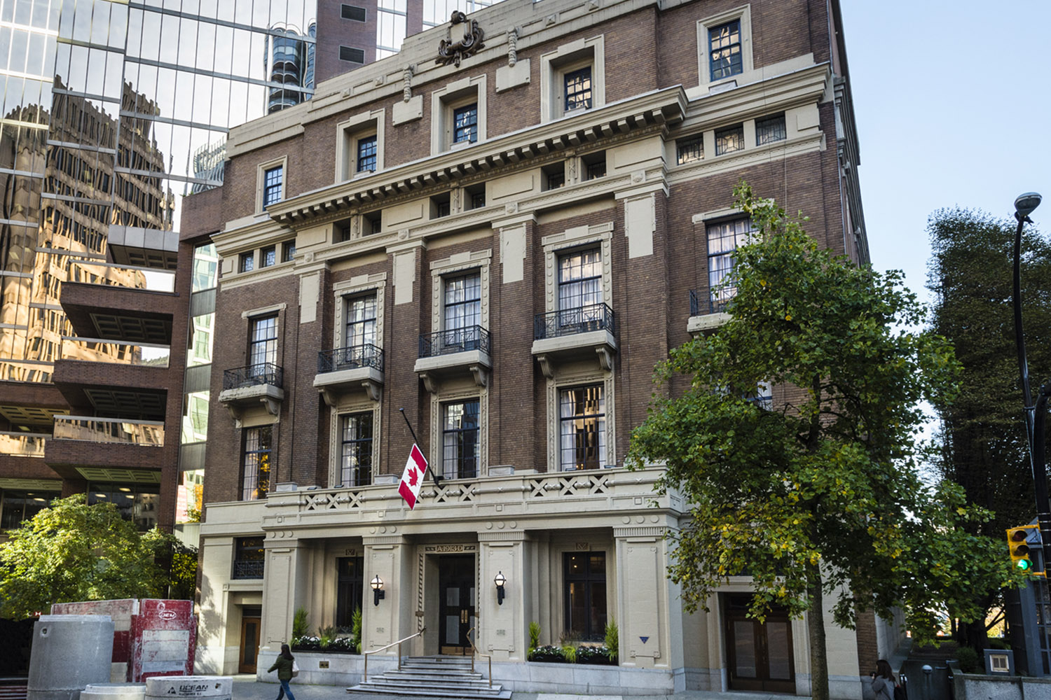
Speaking of Excess…trapped or team player?

Slide 26

What about…?

Slide 27
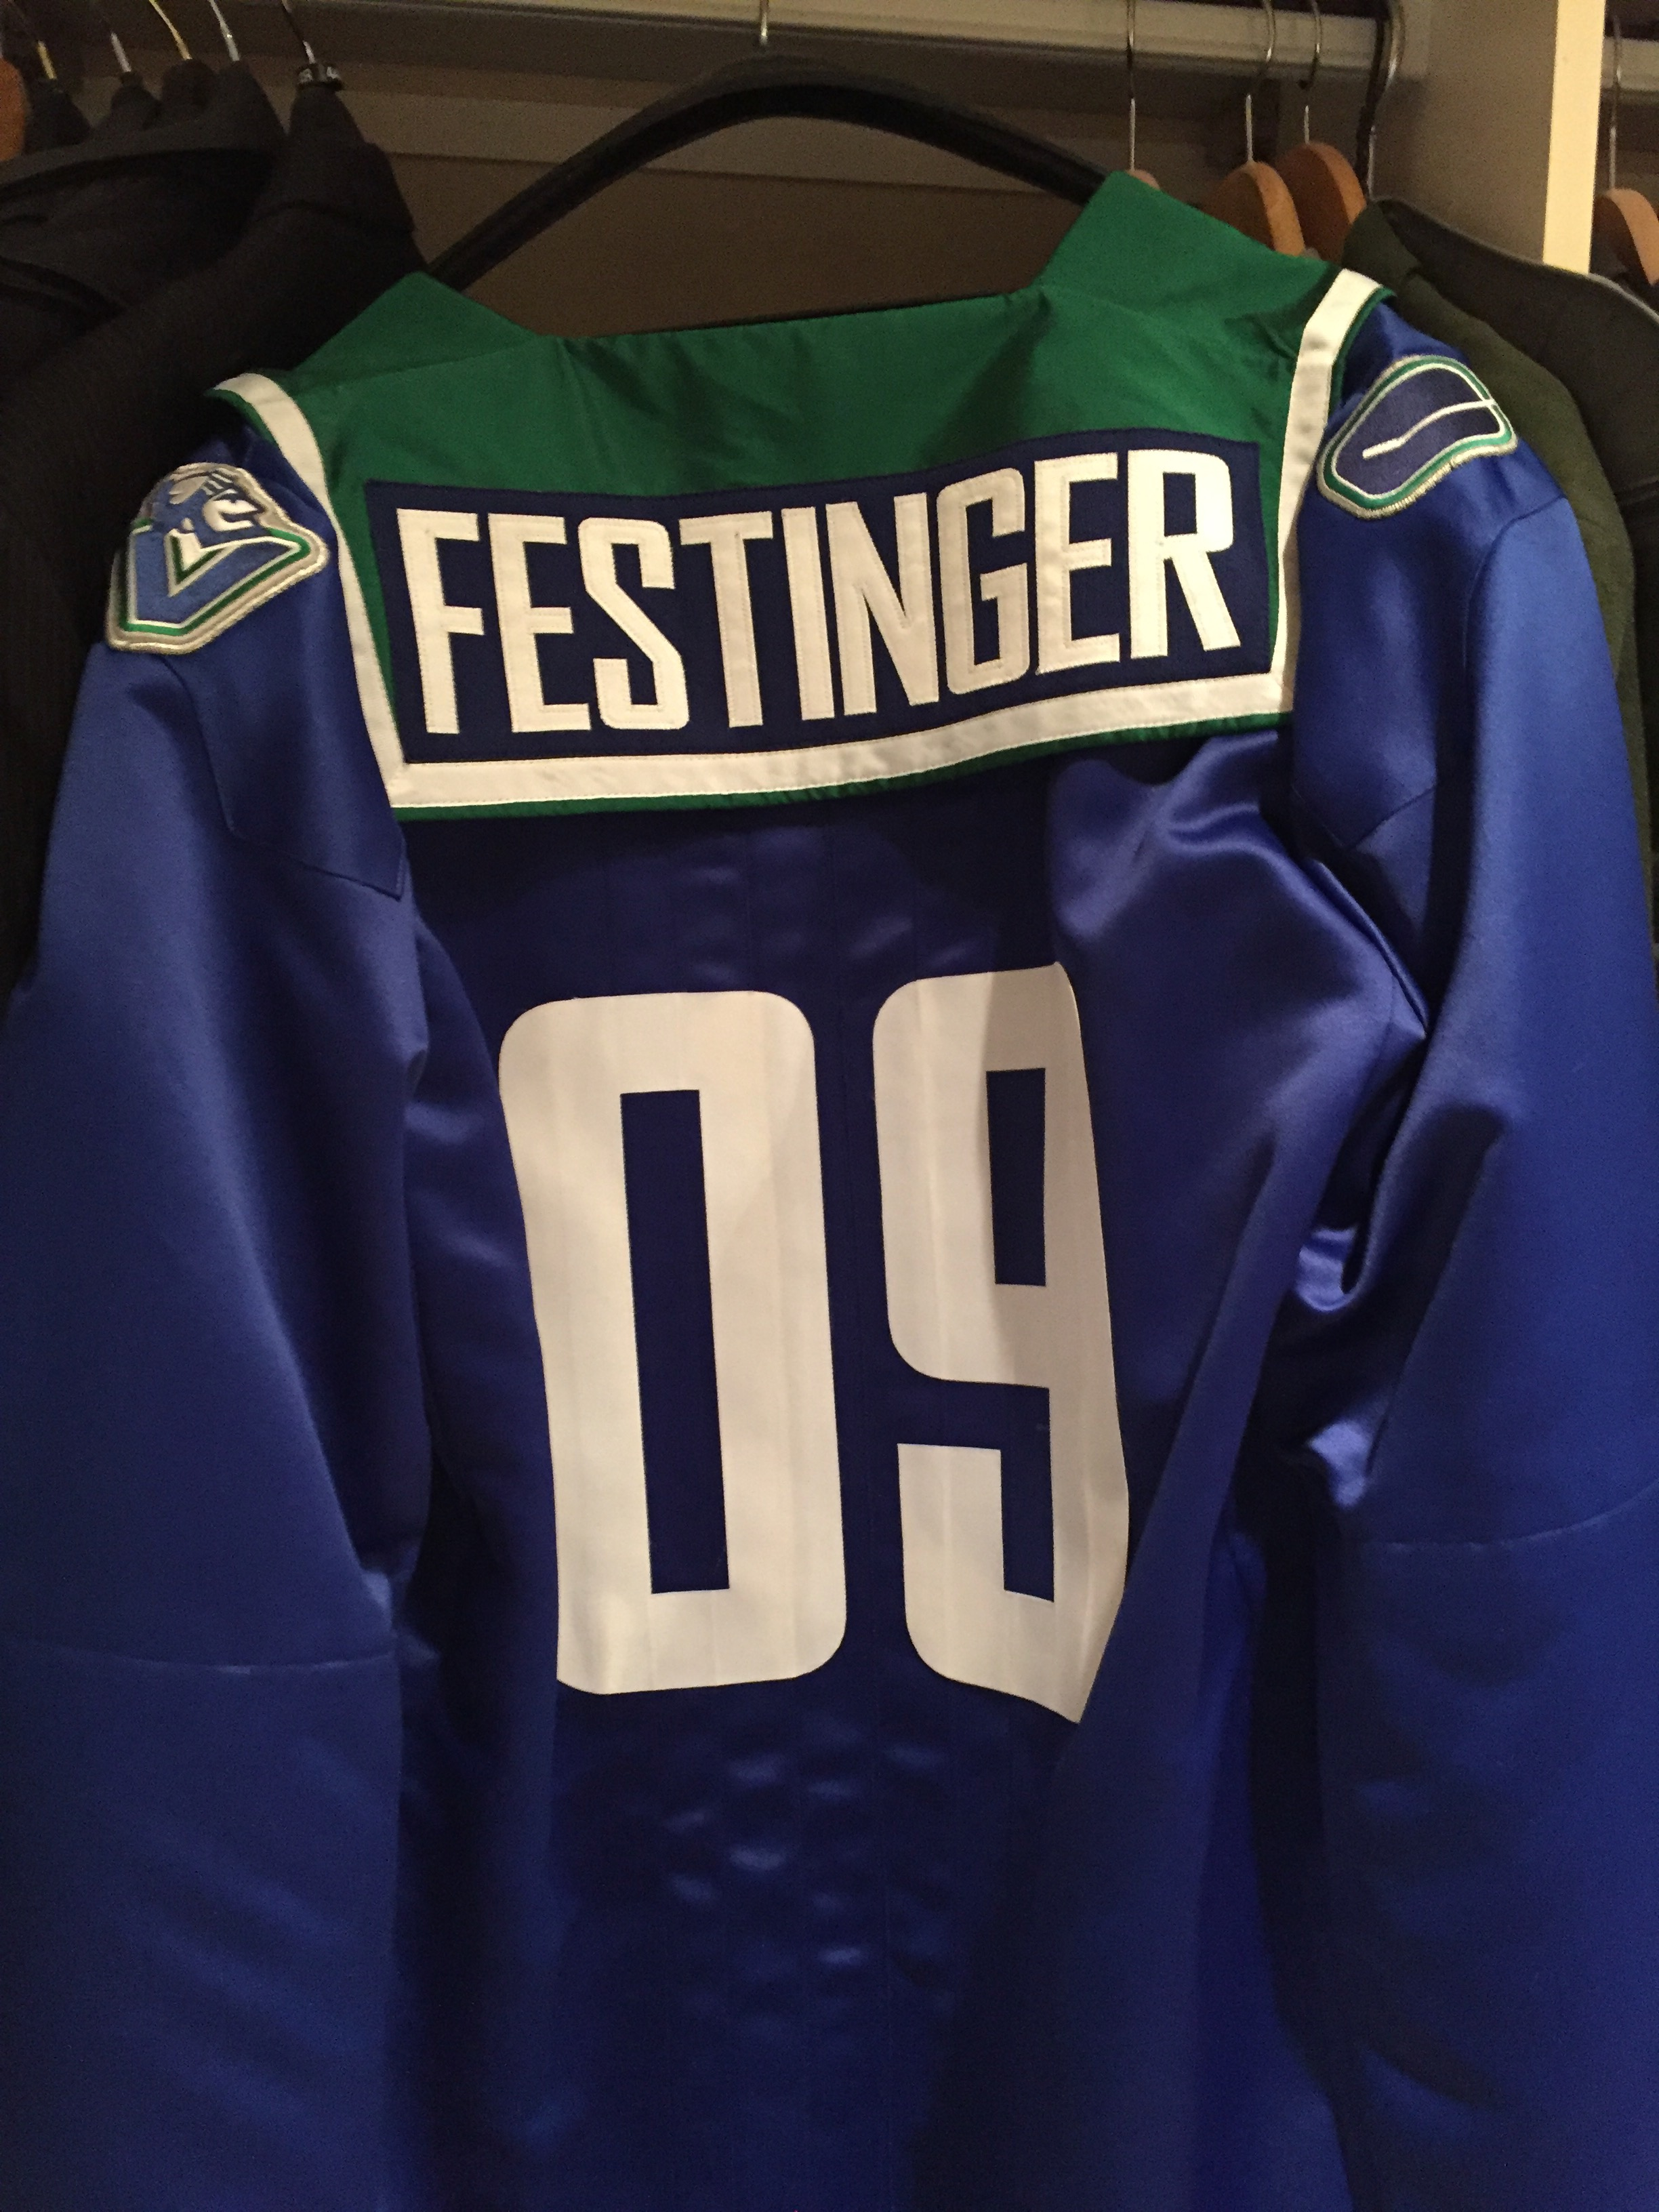
Perks that mean something…

Slide 28
QUESTIONS?
THOUGHTS?
DISCUSSION?

Slide 29

Pause

Slide 30
News of the Week

Slide 31
Yours?

Slide 32
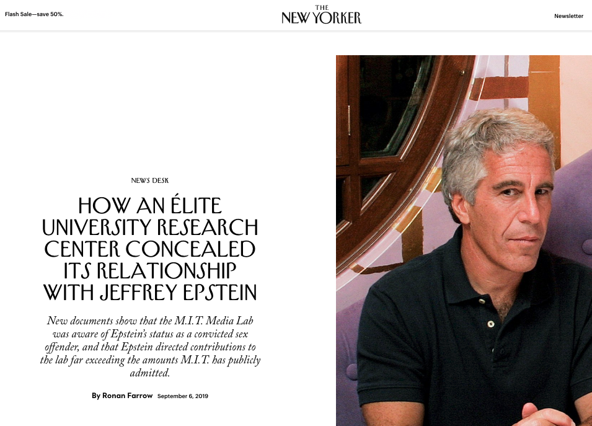

Slide 33
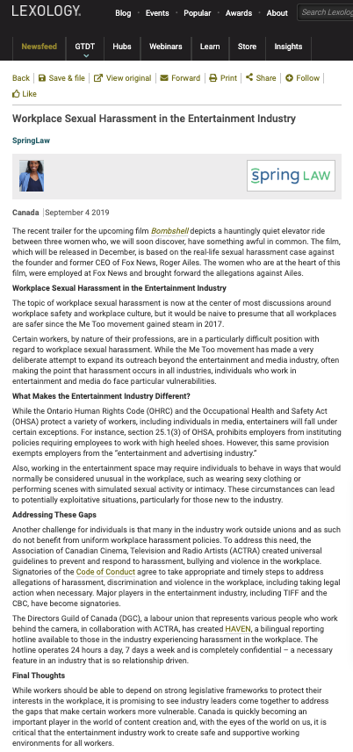

Slide 34
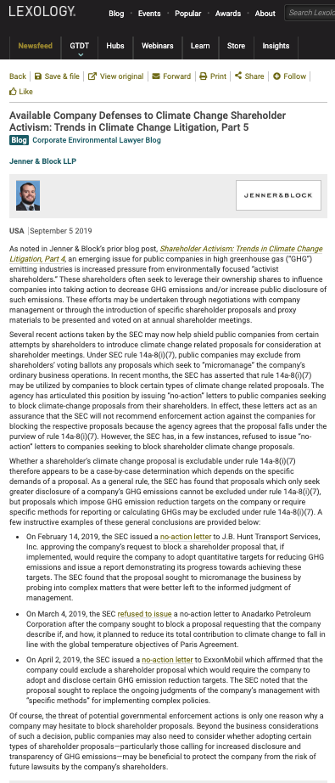

Slide 35
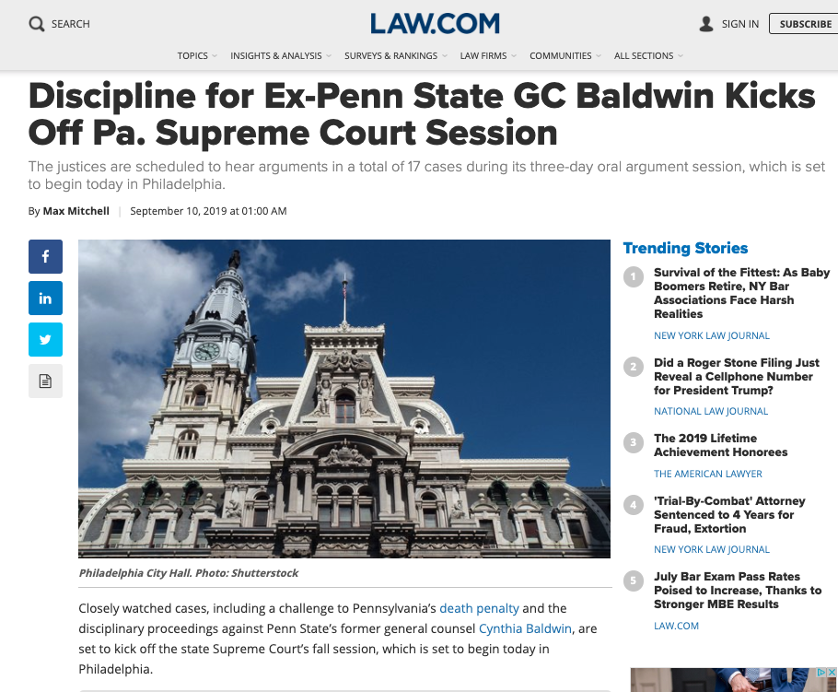

Slide 36
Last Year This Time

Slide 37
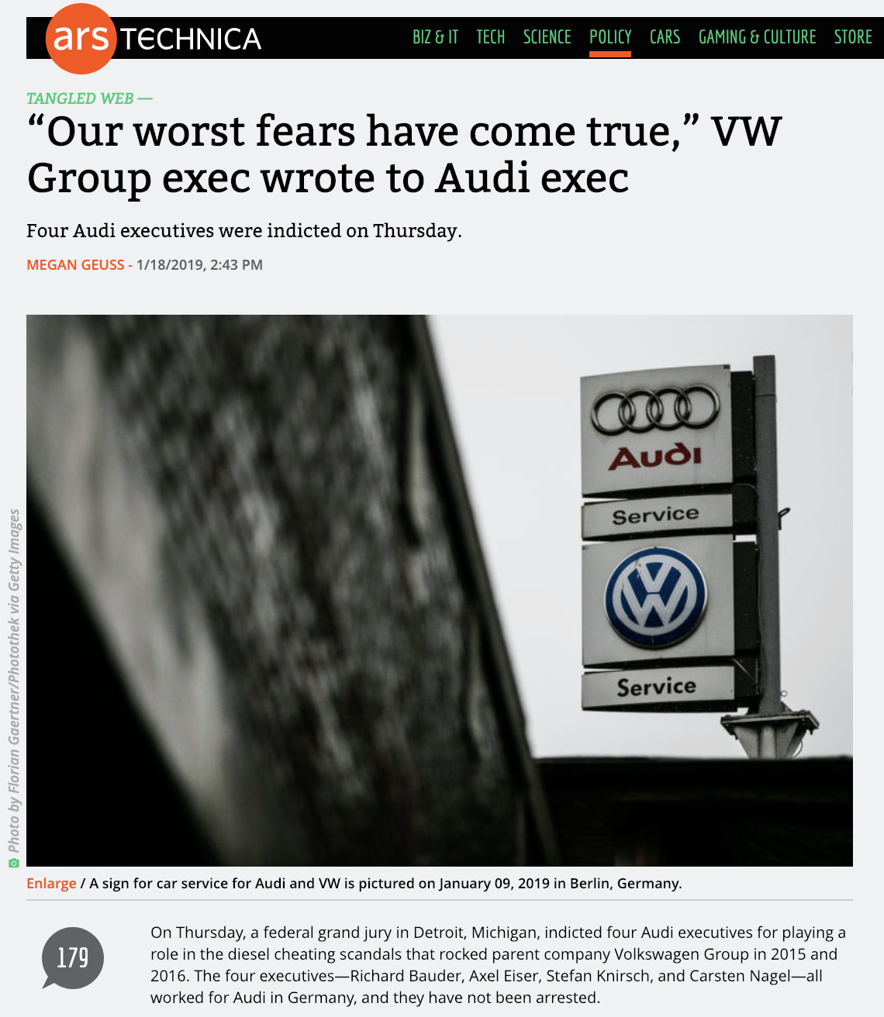

Slide 38
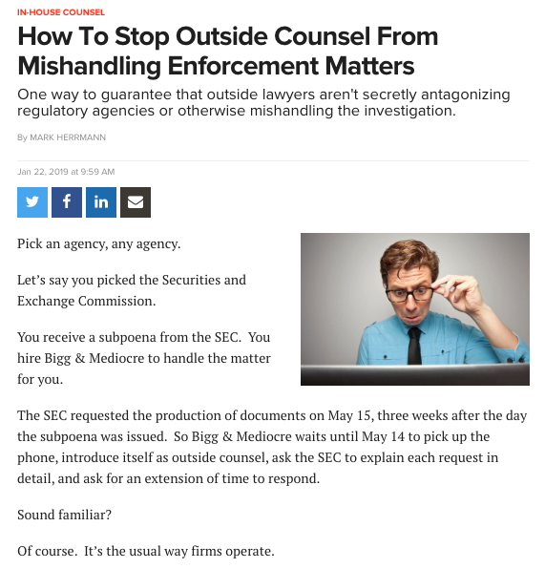

Slide 39
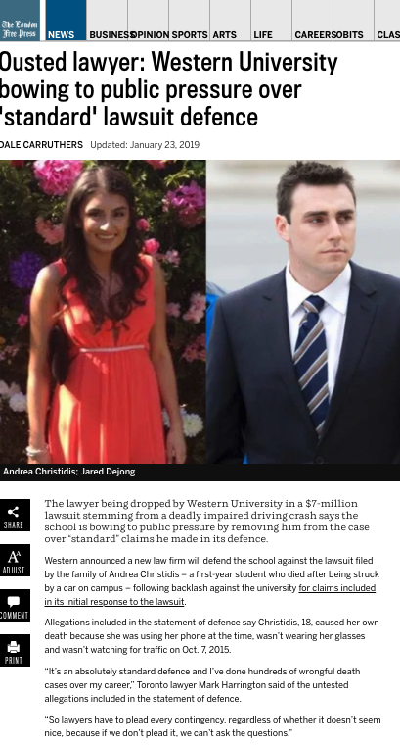

Slide 40
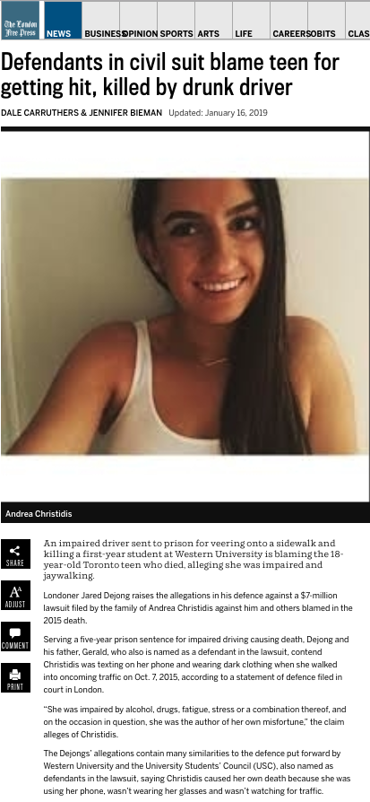

Slide 41
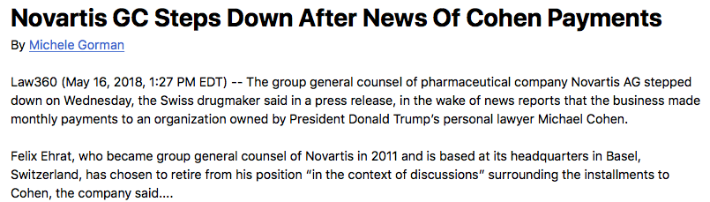

Slide 42
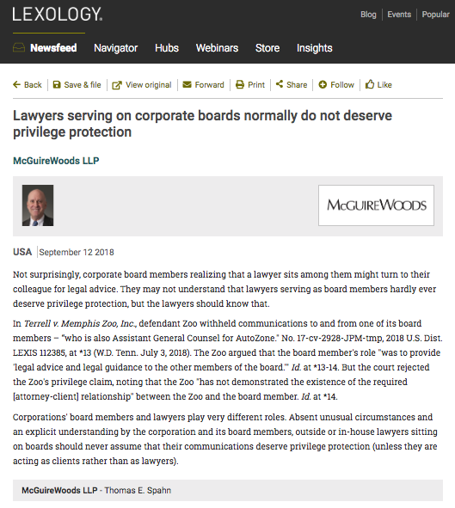

Slide 43
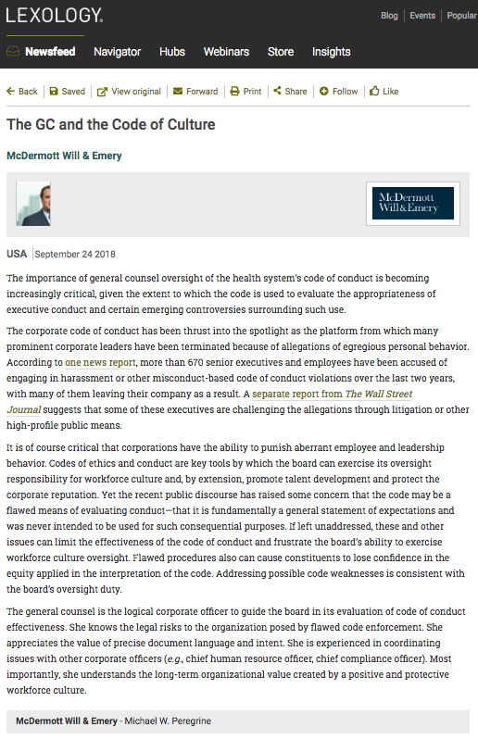

Slide 44
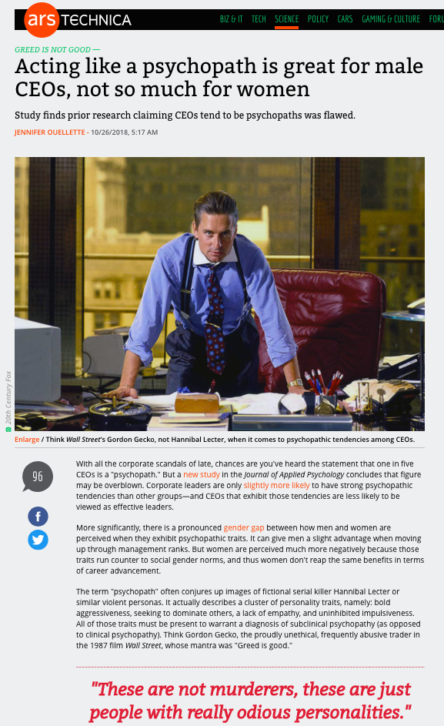

Slide 45
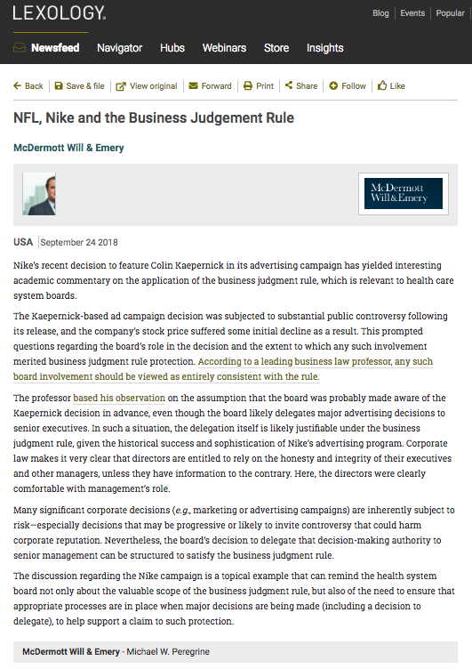

Slide 46
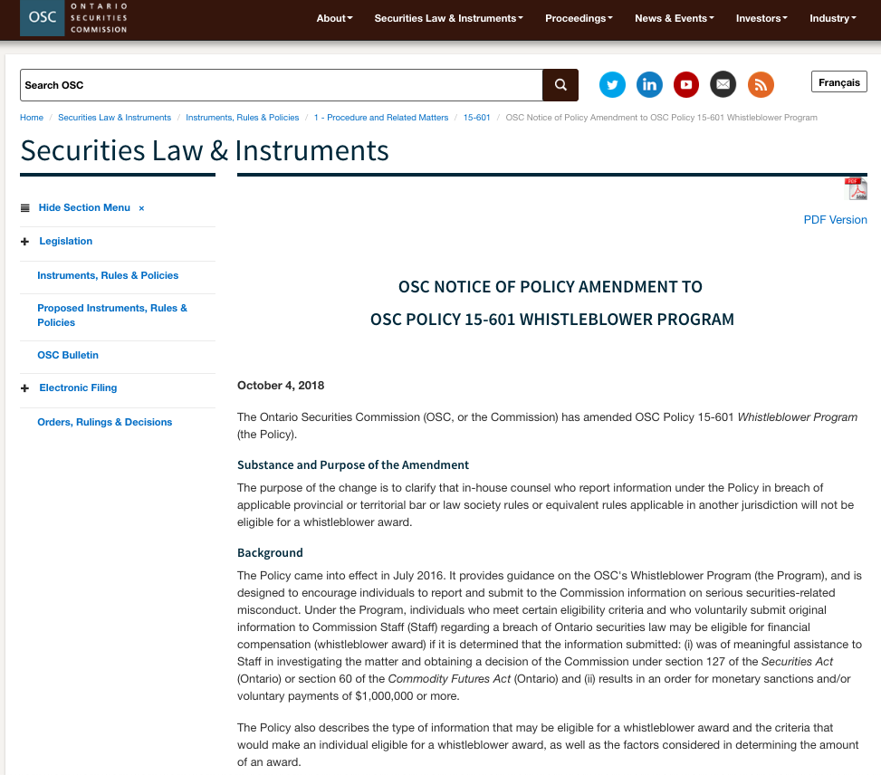

Slide 47
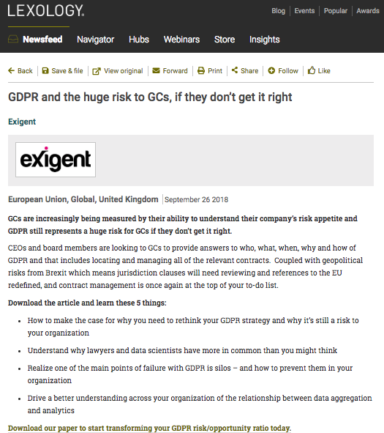

Slide 48
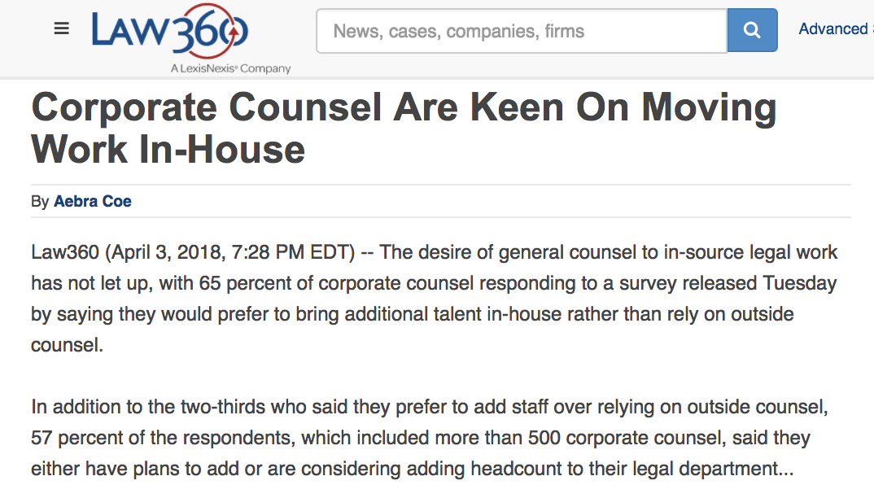

Slide 49
QUESTIONS?
THOUGHTS?
DISCUSSION?

Slide 50
Pause

Slide 51
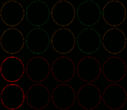
Starting Point

Slide 52
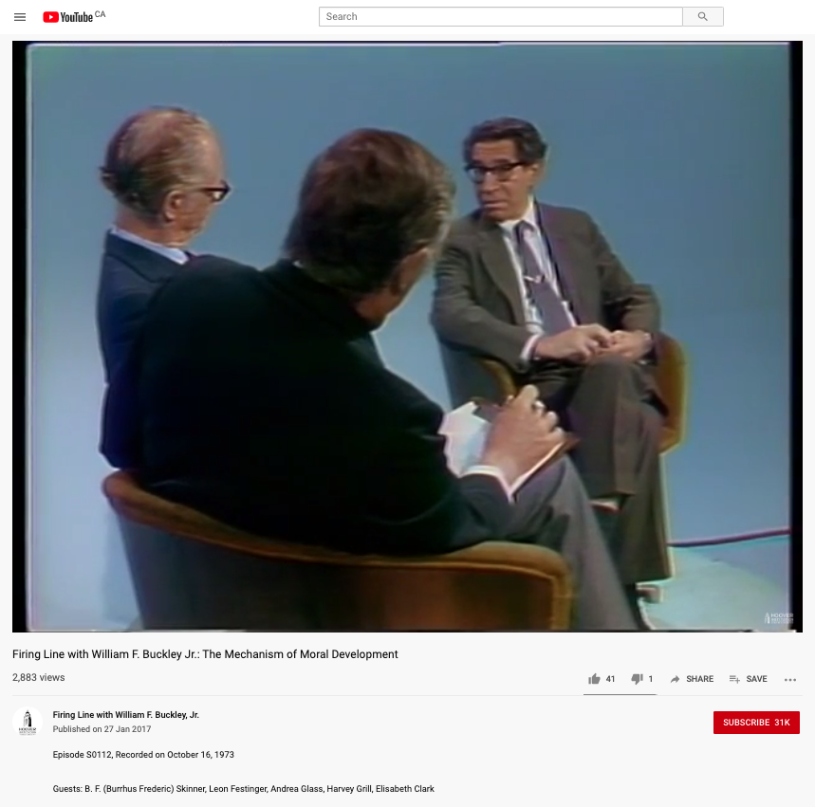
My (Sub) Conscious Biases
Anti Skinner Behaviorism (pro-Cognitive - Dissonance)
For Free Expression
Rule of Law absolutist
New England Patriots hater

Slide 53
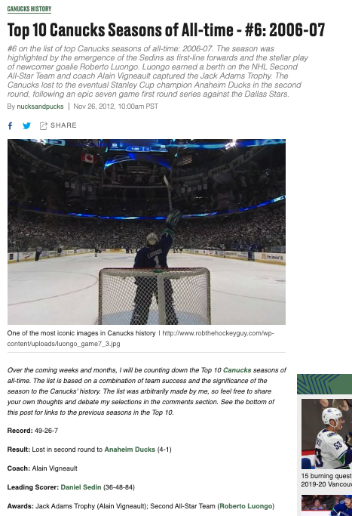
Not “Psychologically Minded”

Slide 54
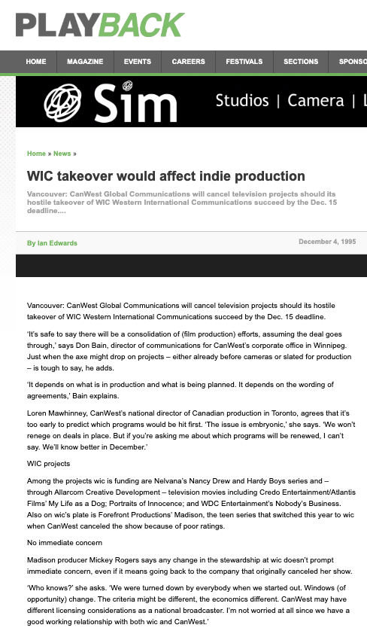
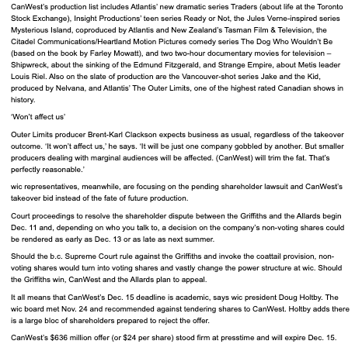

Slide 55
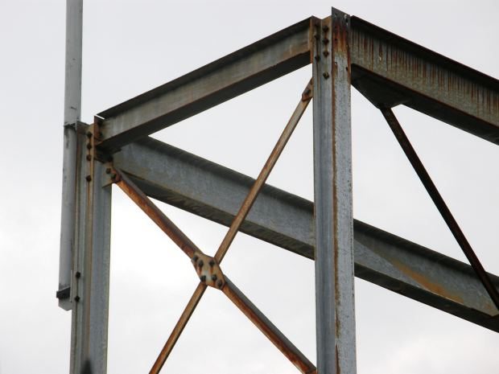
Legal
Framework
Basics Part 1

Slide 56
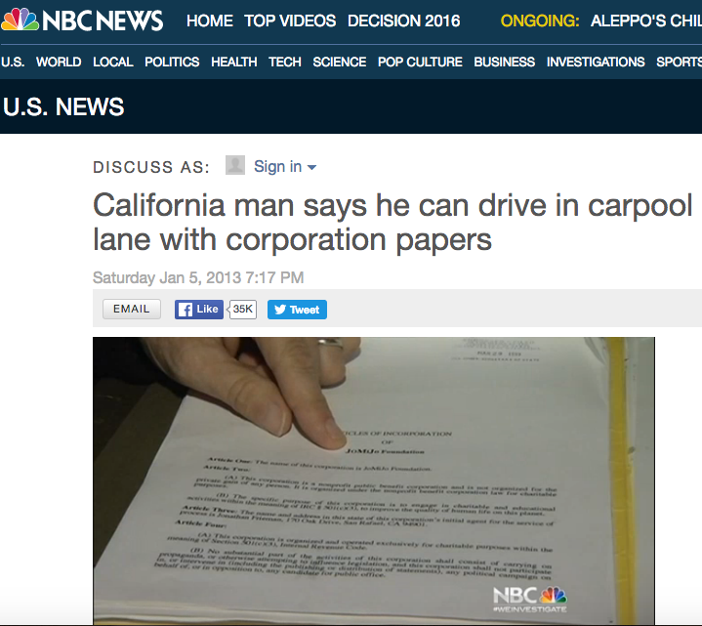
Context

Slide 57
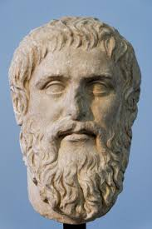
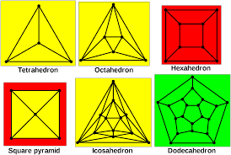
Problem 1 = Artificiality
Platonic forms

Slide 58

Problem 2 = Confusion
The Trinity
Roles of Management
Roles of Directors
Roles of Shareholders
Who is the corporation?

Slide 59
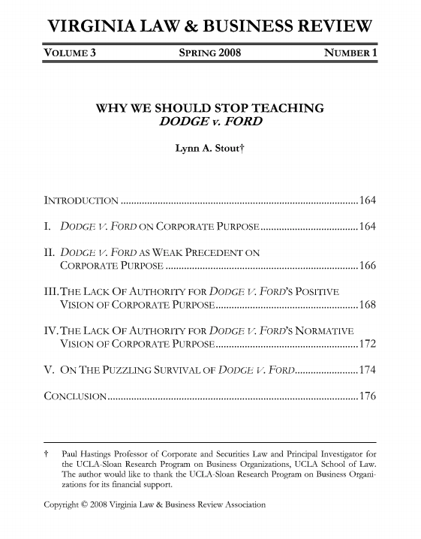
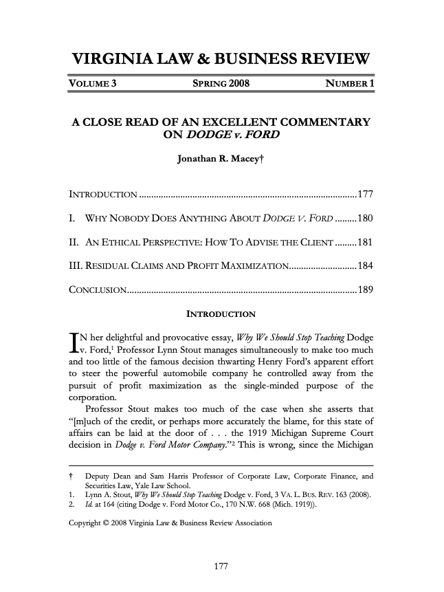
Duty of maximize shareholder value
= Duty to maximize profits?

Slide 60
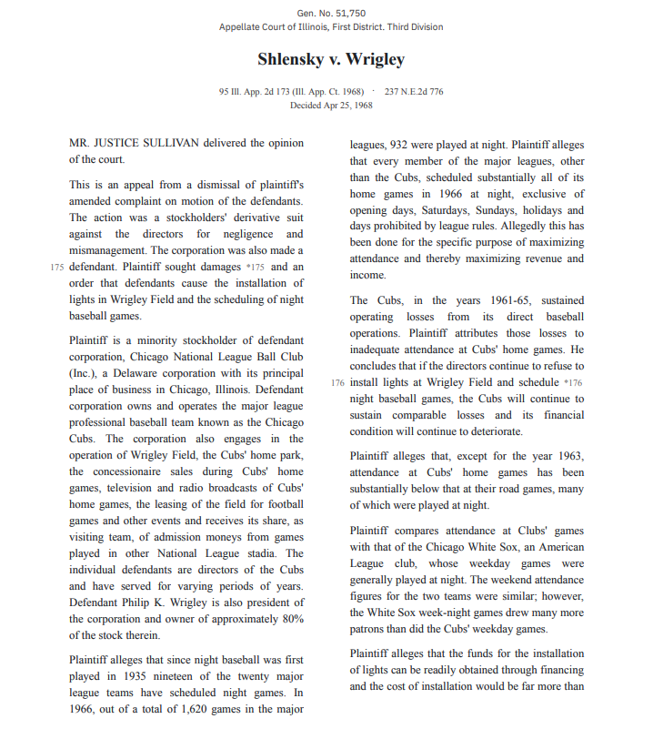
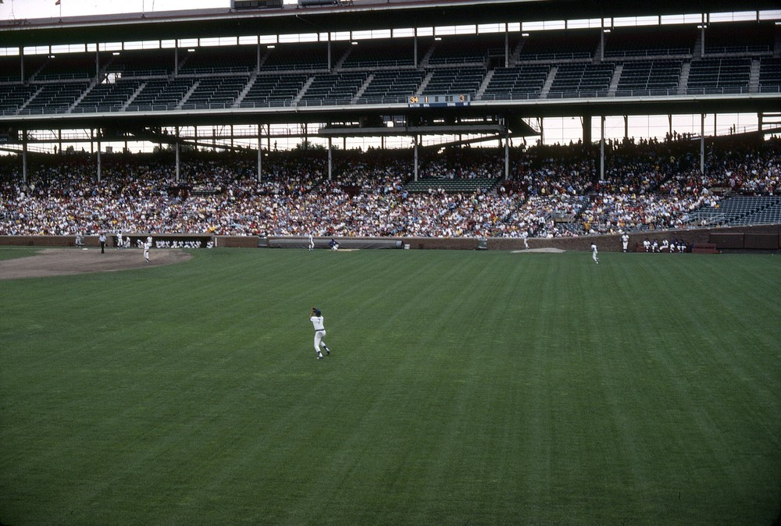
The “Business Judgment Rule”

Slide 61
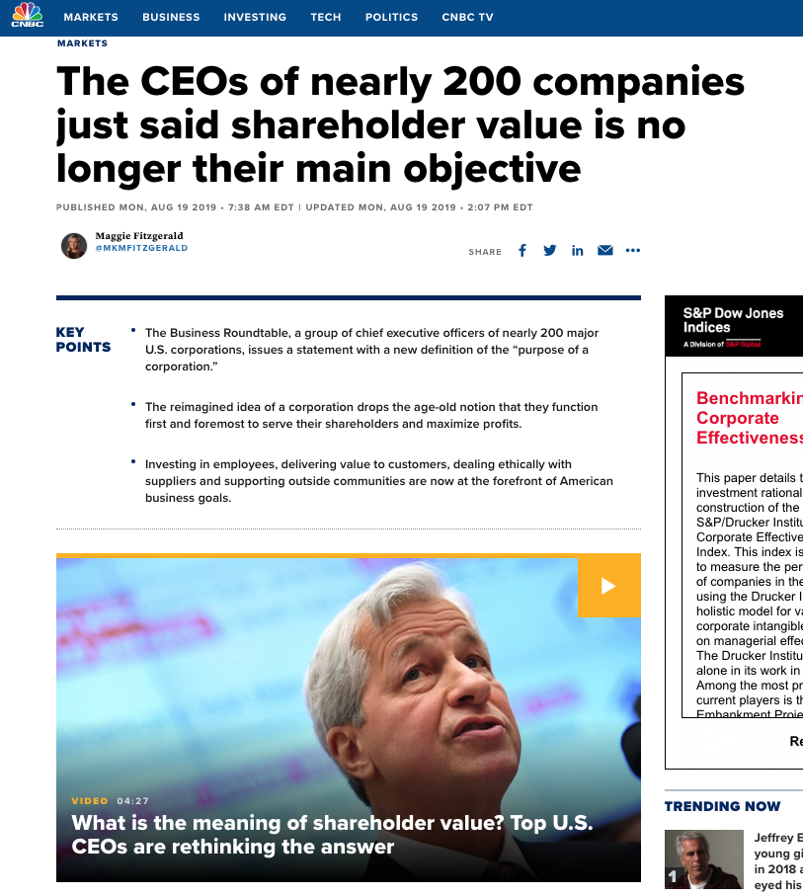

Slide 63
Impacts…
Ethics
Governance
Pierce the corporate veil?
Regulate?

Slide 64
QUESTIONS?
THOUGHTS?
DISCUSSION?

Slide 65
Pause

Slide 66

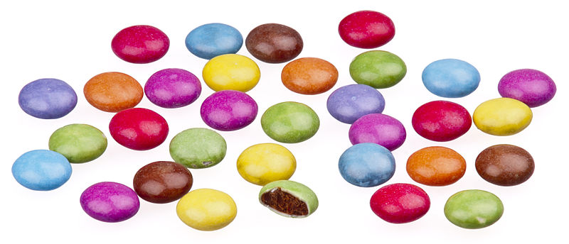
A MATTER OF PERSPECTIVE

Slide 67

Conclusion

Slide 68
SEE YOU NEXT WEEK!

Slide 69

Always include a cat picture

Slide 70
In learning you will teach
And in teaching you will learn
Phil Collins' Son of Man (1999)

Slide 71
Our Academic Partners

