Slide 1


“News of the Week &
Counsel: The Game”
Talk 11
LAWF 3780
Challenges of In-House & Corporate Counsel
TRU Faculty of Law
Spring, 2019
Jon Festinger Q.C.
Centre for Digital Media
QMUL School of Law (CCLS)
Festinger Law & Strategy
http://commlaw.allard.ubc
@jonfestinger
jon_festinger@thecdm.ca

Slide 2
Hello
LAW F 3780
Challenges of In-House
& Corporate Counsel

Slide 3
WELCOME
BACK

Slide 4


Slide 5
Logistics

Slide 6
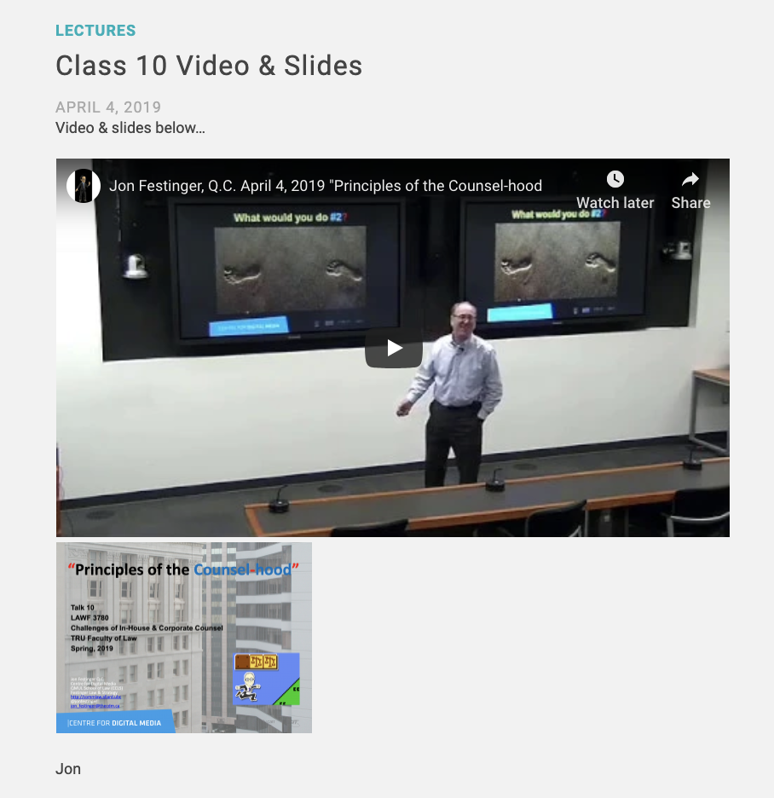

Slide 7
QUESTIONS?
THOUGHTS?
DISCUSSION?

Slide 8

Pause

Slide 9
News of the Week

Slide 10
Yours?

Slide 11
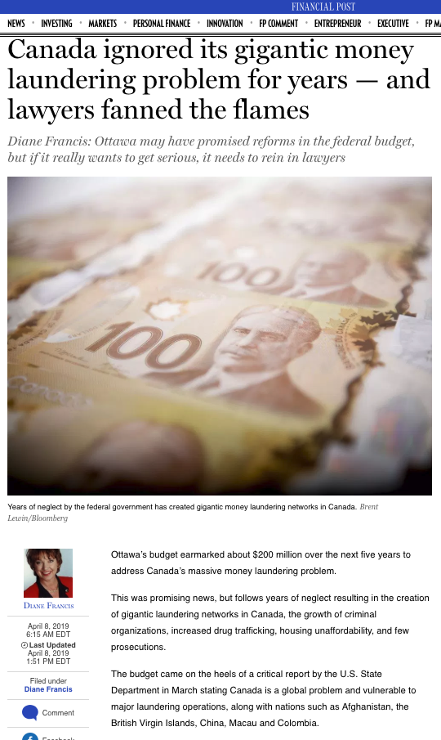

Slide 12

2 almost identical stories

Slide 13
QUESTIONS?
THOUGHTS?
DISCUSSION?

Slide 14
Pause

Slide 15
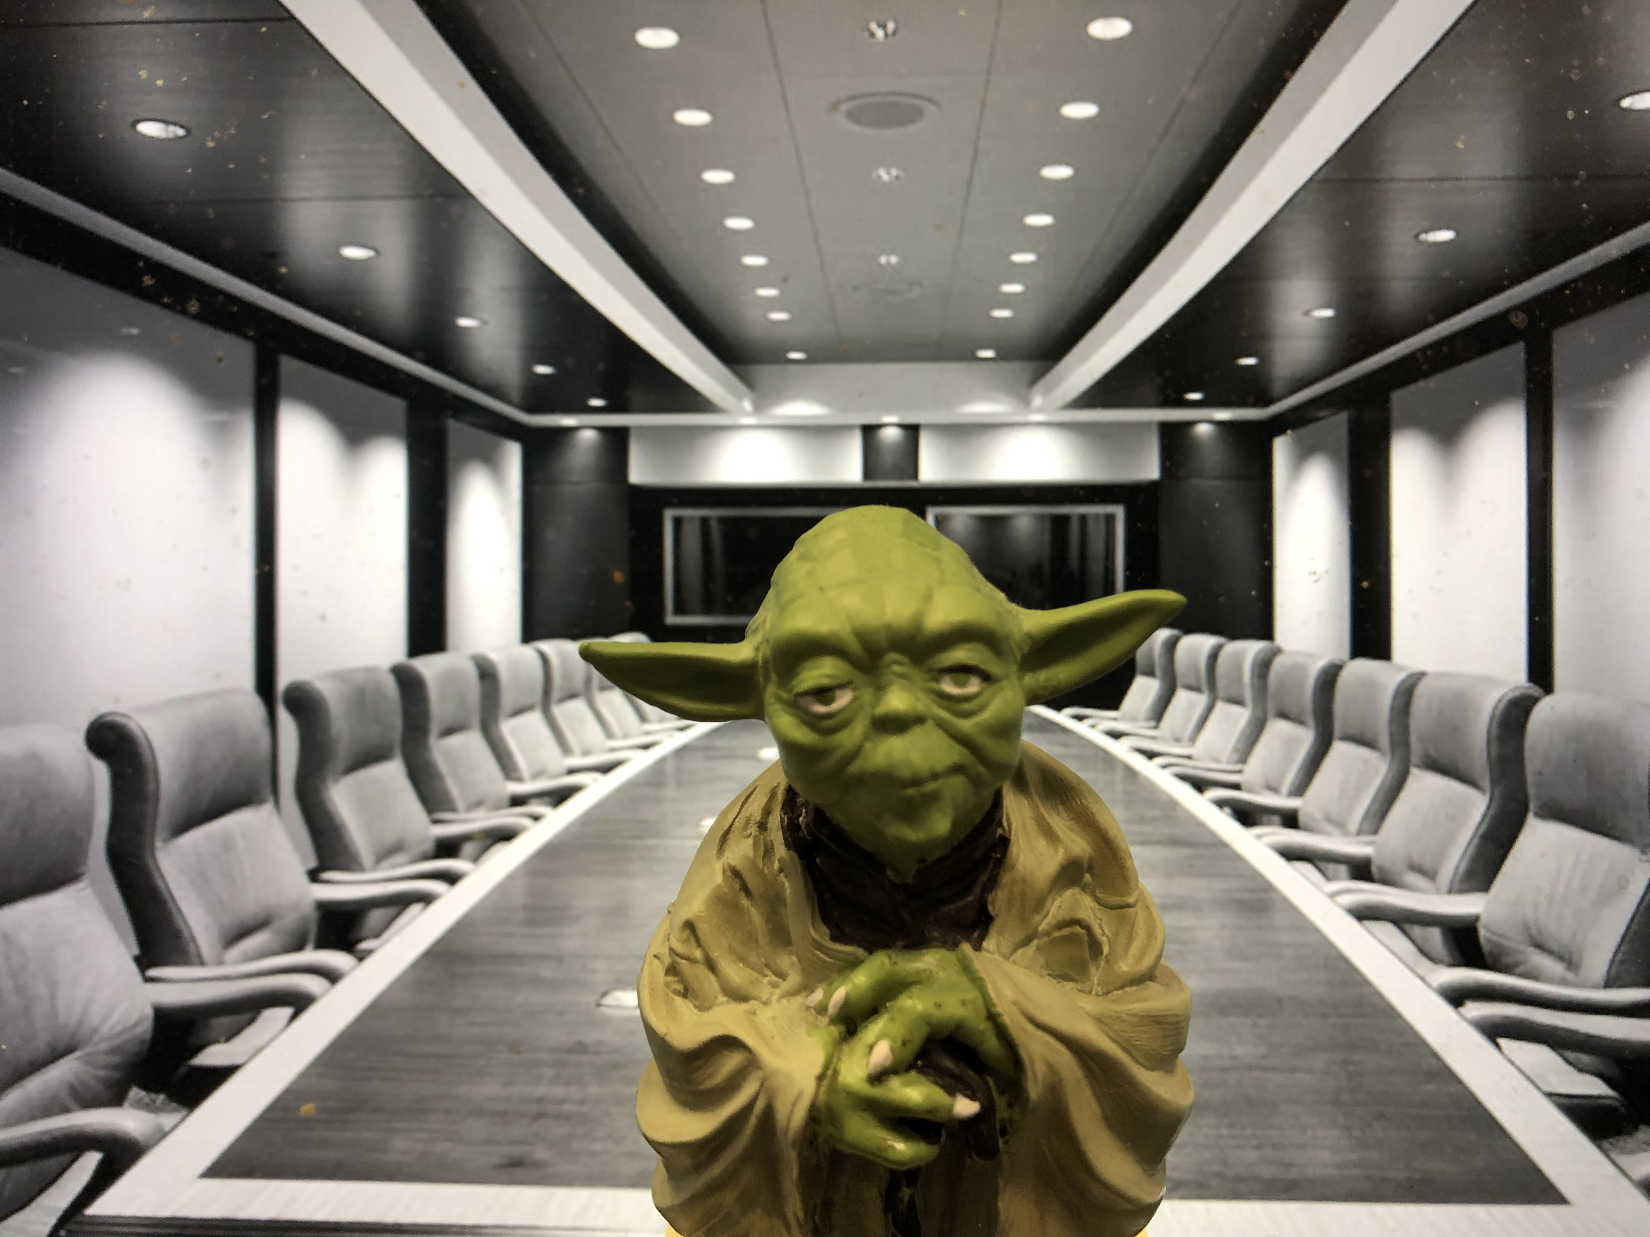
The Yoda Principle

Slide 16

Review of GC behavior coming

Slide 17
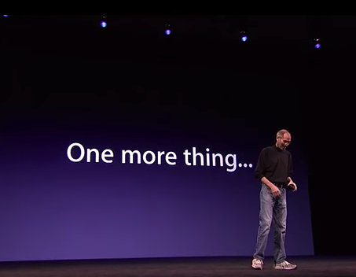

Slide 18

Conclusion

Slide 19

Always include a cat picture

Slide 20
In learning you will teach
And in teaching you will learn
Phil Collins' Son of Man (1999)

Slide 21
Our Academic Partners

