Slide 1


“Scenarios…Part 2”
Talks 6 & 7
LAWF 3780
Challenges of In-House & Corporate Counsel
TRU Faculty of Law
Spring, 2019
Jon Festinger Q.C.
Centre for Digital Media
QMUL School of Law (CCLS)
Festinger Law & Strategy
http://commlaw.allard.ubc
@jonfestinger
jon_festinger@thecdm.ca

Slide 2
Hello
LAW F 3780
Challenges of In-House
& Corporate Counsel

Slide 3
WELCOME
BACK

Slide 4


Slide 5
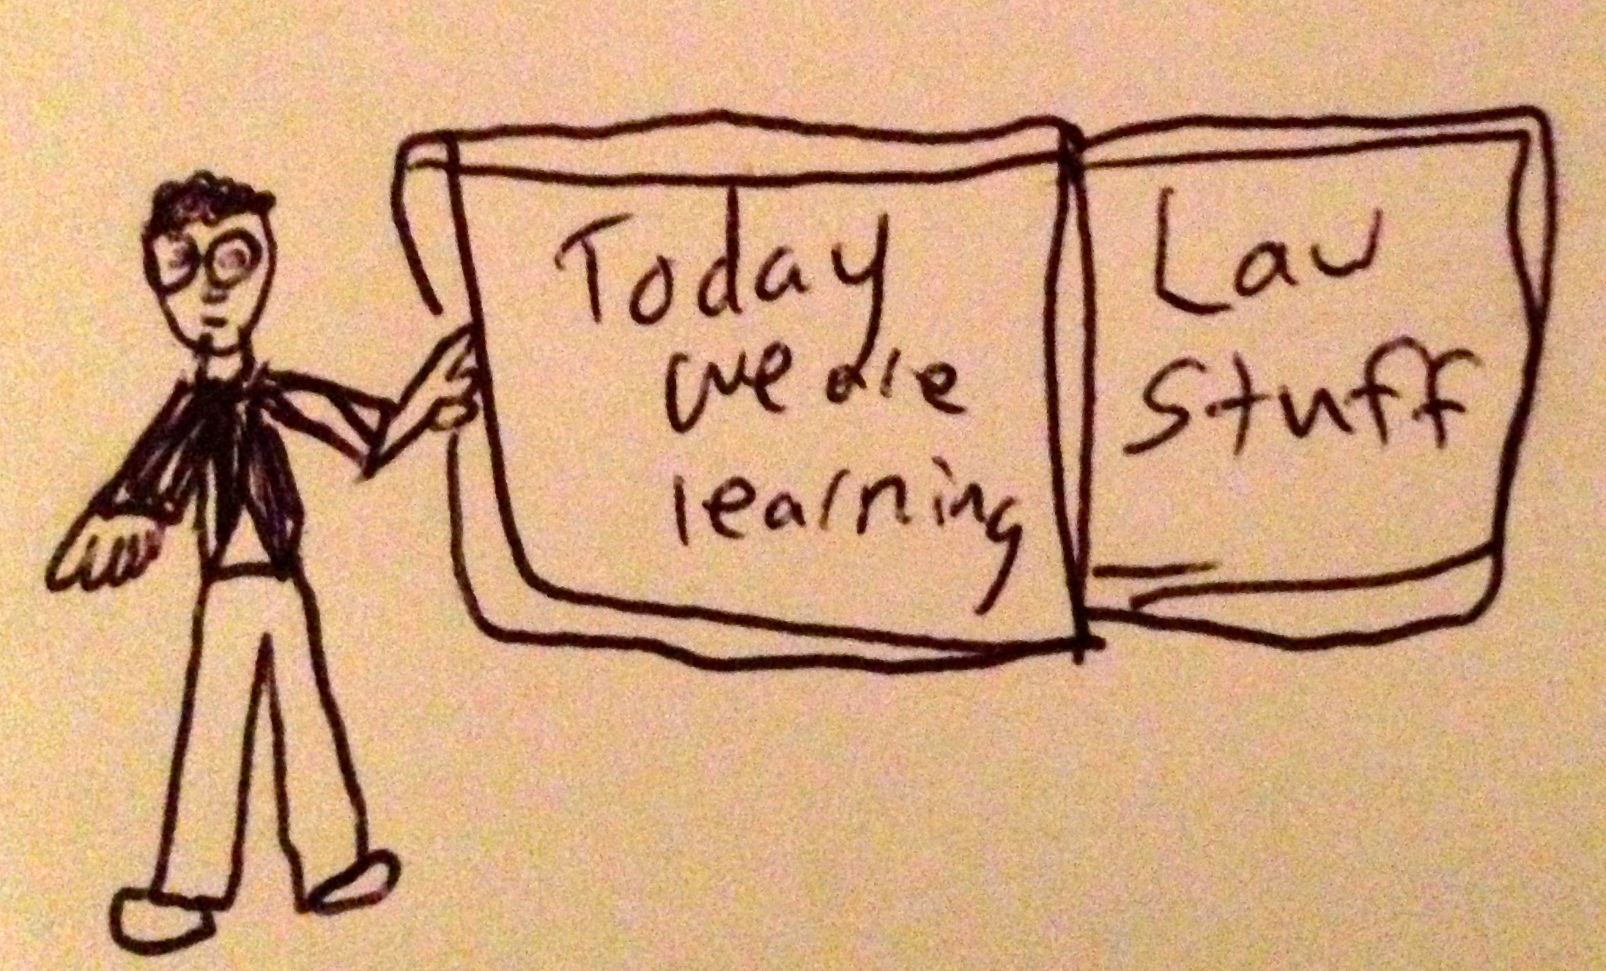

Slide 6
Logistics

Slide 7
EVALUATION
Term paper = 50% of the final grade.
5000 word paper
The paper is due on the last day of the exam period at 4:00 p.m.
Class Participation = 50% of the final grade
30% of the mark will be based on group preparation of a Class Discussion, with a Discussion Outline provided to the class—preferably by posting on the course website—a week before.
20% for student participation in other course activities including seminar discussions etc.

Slide 8
Paper Confessional
(or what I learned one winter holiday)
Legal/normative reasoning/argument including footnote/bibliography support & Contribution/Move forward → 60%
Presentation including layout, headings, grammar, language/writing skills, “tightness” → 25%
Topic/Originality/Degree of Difficultly → 15%
THIS IS NOT A RUBRIC. IT IS A SELF ASSESSMENT.

Slide 9
Group Presentations
2-3 (ideally) per group
Sign-up at the break or email me
Any topic – not constrained by what I’m talking about that week
Consult with me re the topic you want to take on
Post one thing you want us to read or watch

Slide 10
Group Presentations:
All in?

Slide 11
Evaluation Tips
Term paper topics need not be discussed with me, but often helpful to you if you do.
Term paper can be on your presentation topic.
Participation: In-class or other contributions, including attendance.
Group presentation need not be on that week’s topic (20 minute per student multiplier suggested 2-4 per group to 60 minute max).

Slide 12
Grades (primarily)
Paper → Quality
Participation → Effort

Slide 13
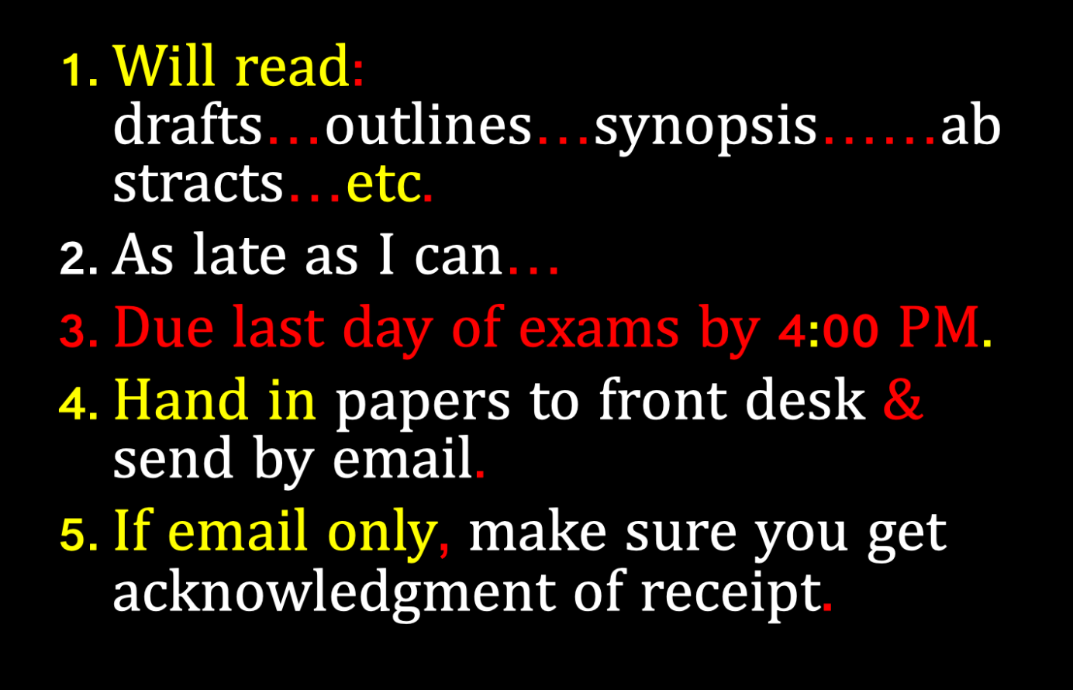

Slide 14
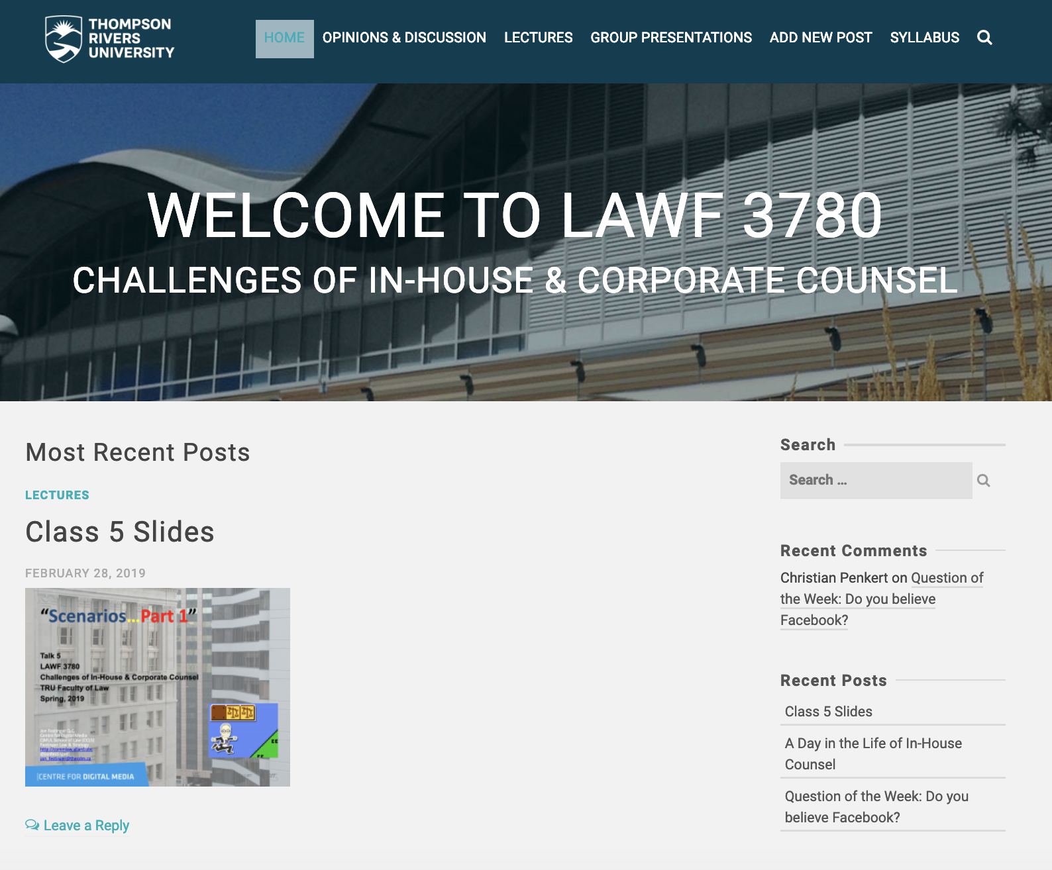
Website

Slide 15
QUESTIONS?
THOUGHTS?
DISCUSSION?

Slide 16

Pause

Slide 17
News of the Week

Slide 18
Yours?

Slide 19

Which
hat?

Slide 20
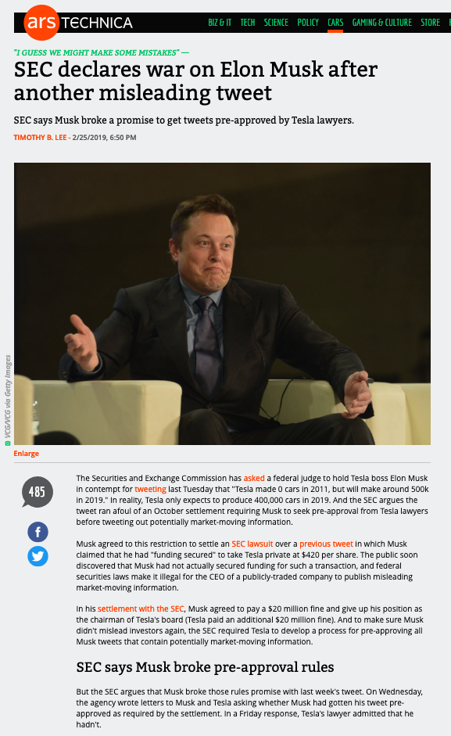

Slide 21
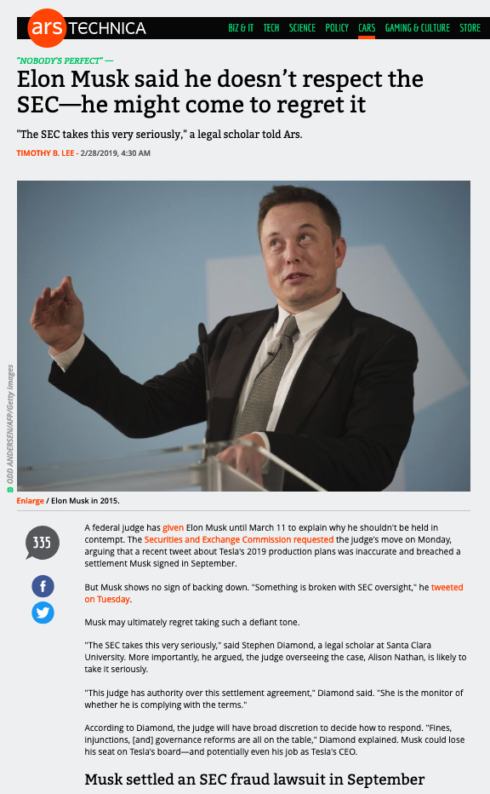

Slide 22
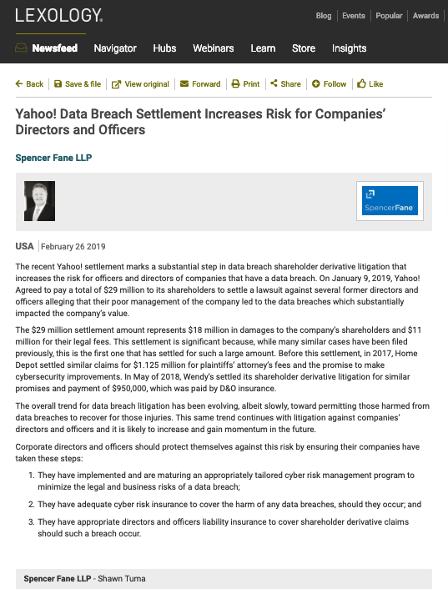

Slide 23
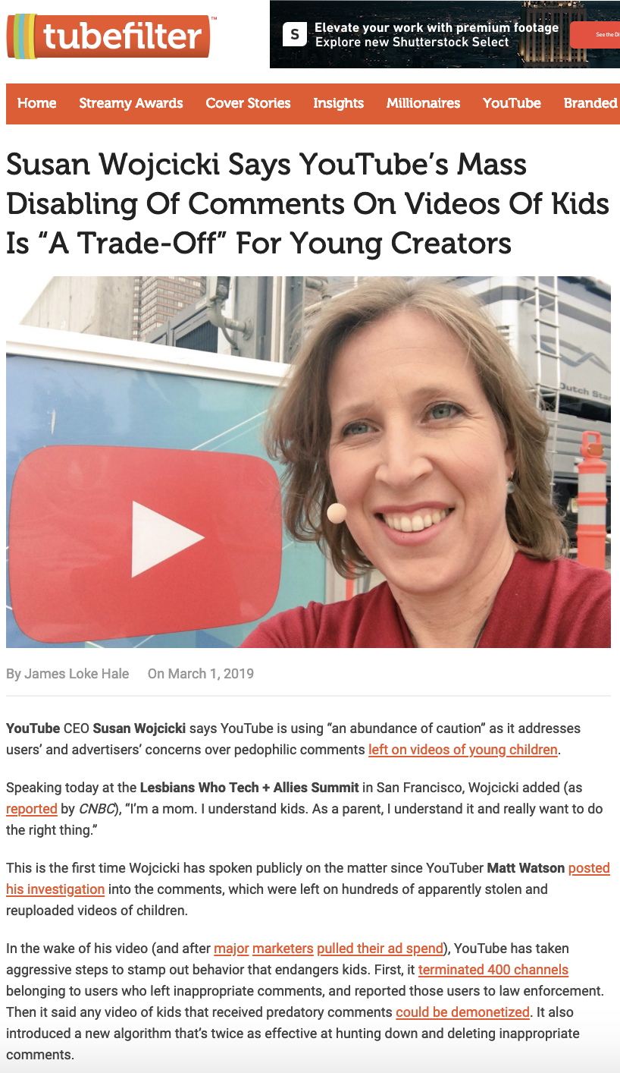

Slide 24
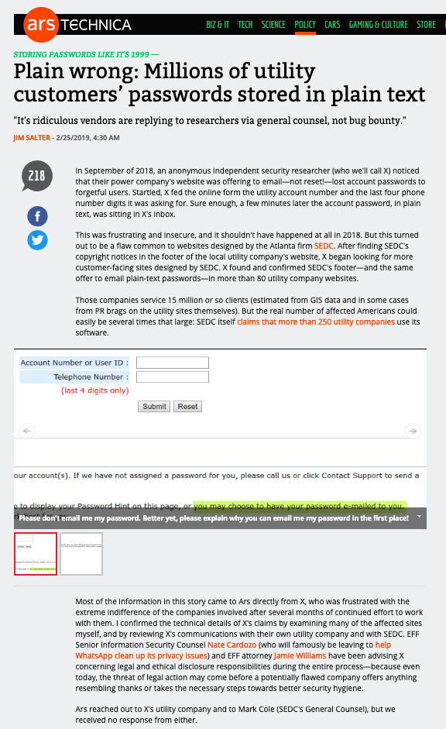

Slide 25
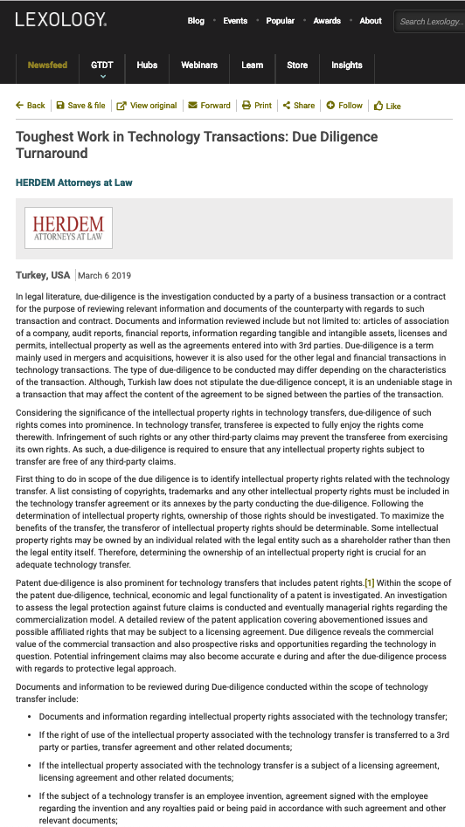

Slide 26
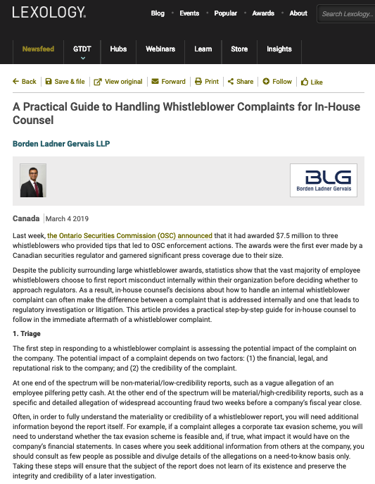

Slide 27
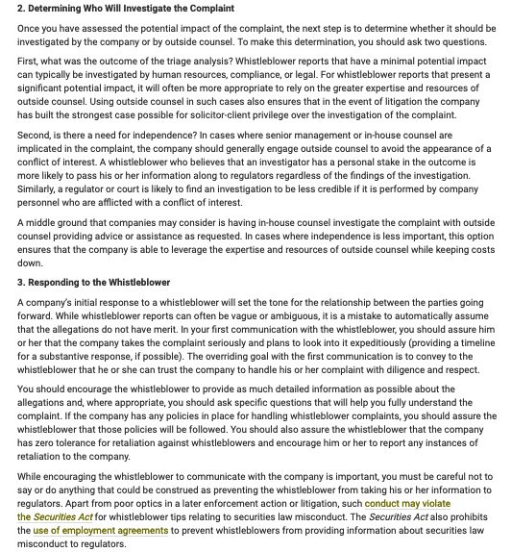

Slide 28
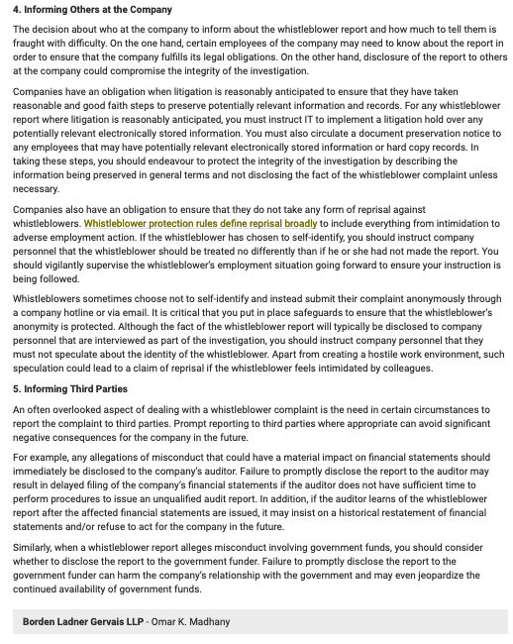

Slide 29


Slide 30
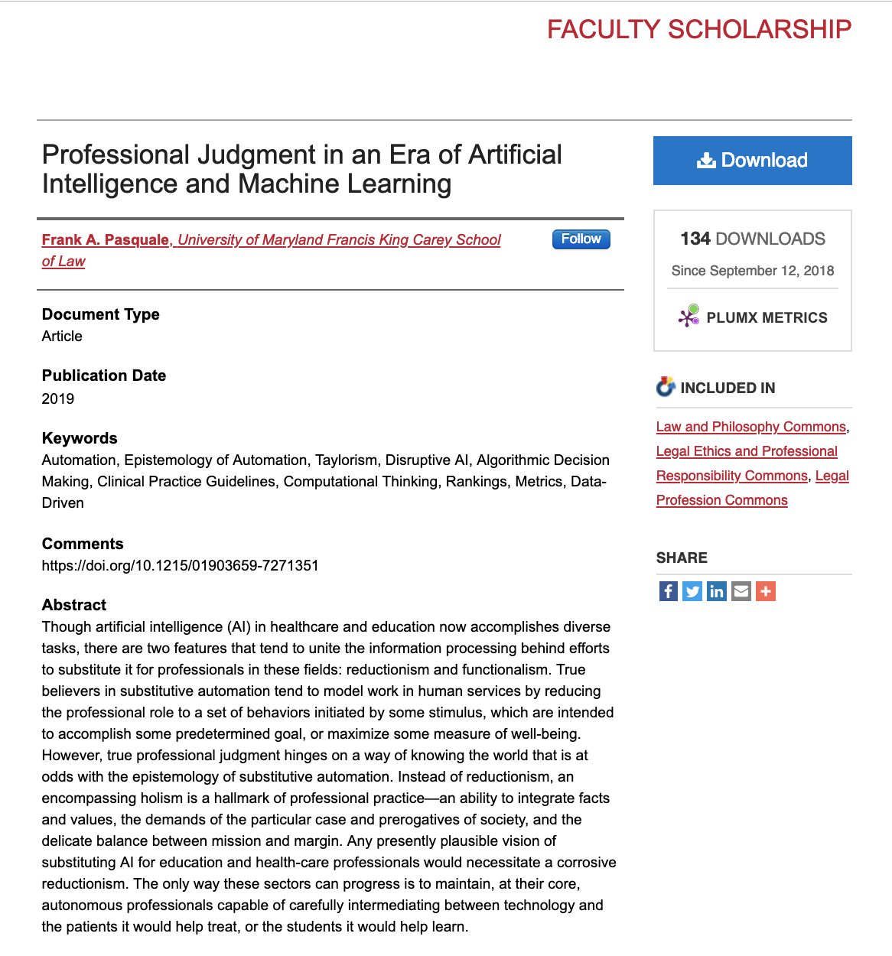
The Good News

Slide 31
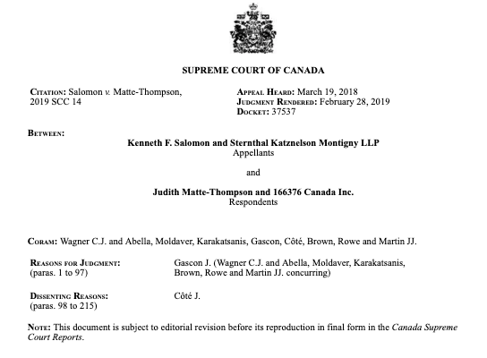
The Bad News

Slide 32
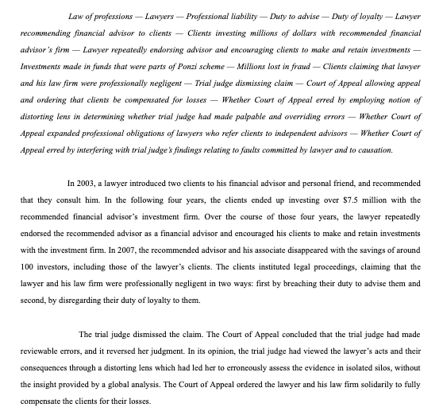

Slide 33
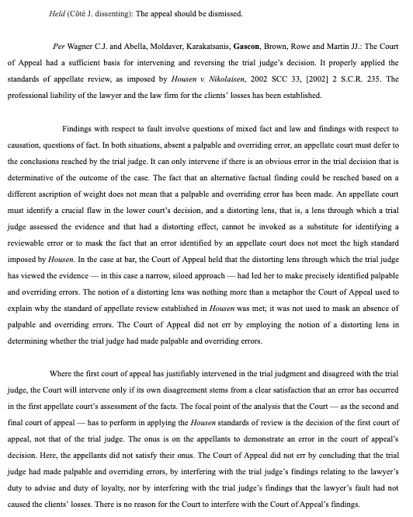

Slide 34
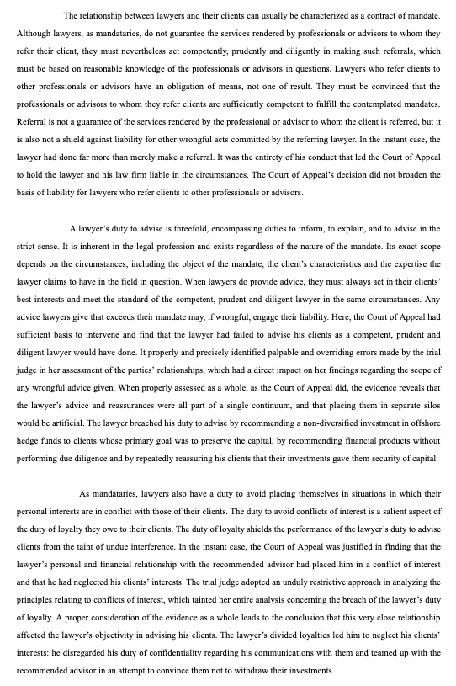

Slide 35
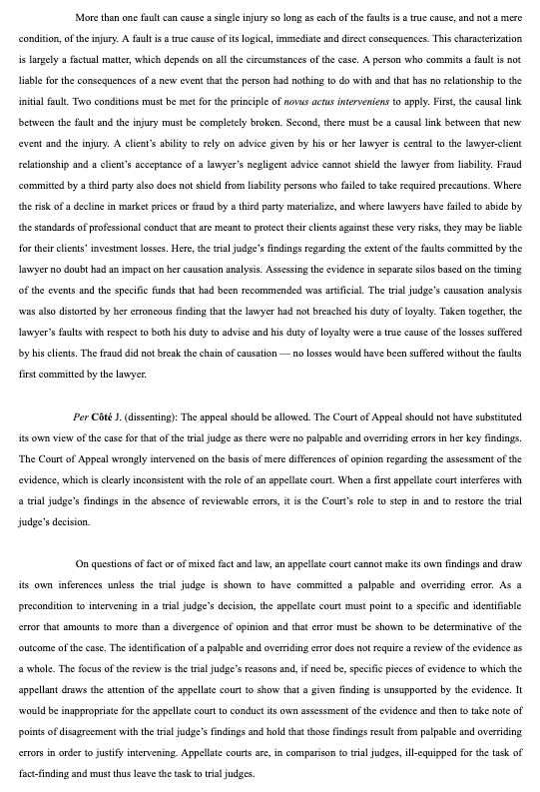

Slide 36
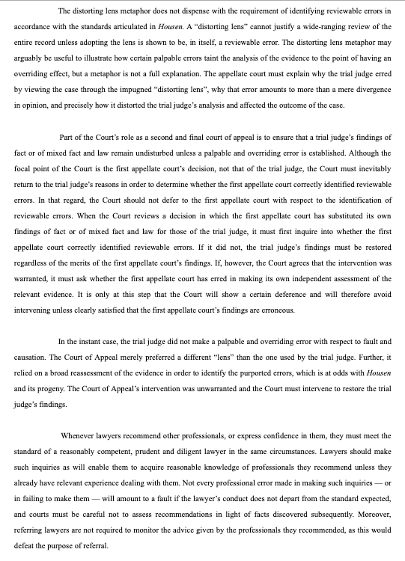

Slide 37
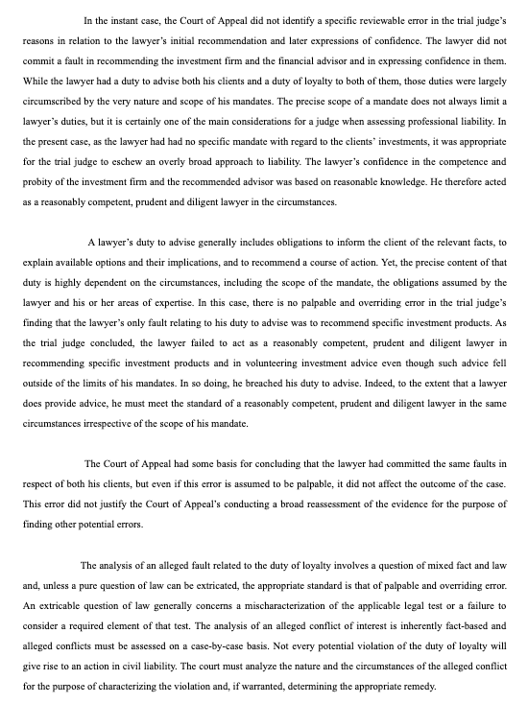

Slide 38
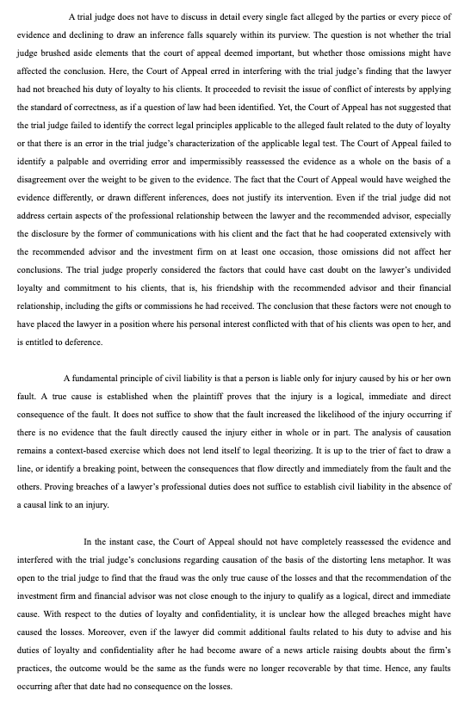

Slide 39

Follow-up on Insurance

Slide 40


Slide 41
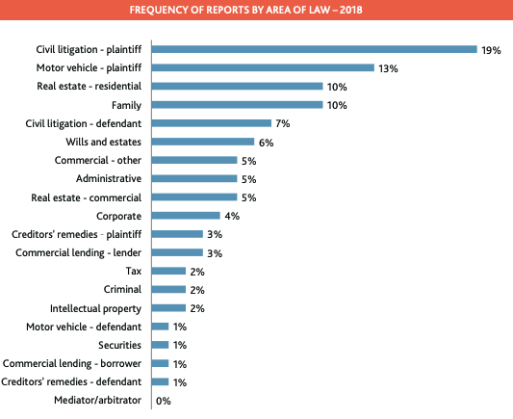

Slide 42
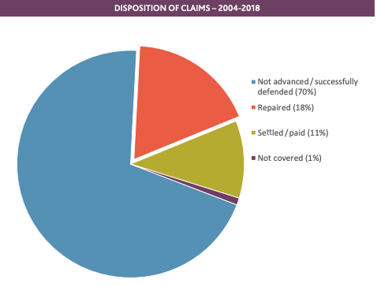

Slide 43
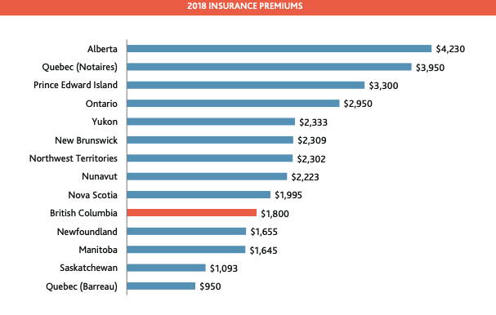

Slide 44
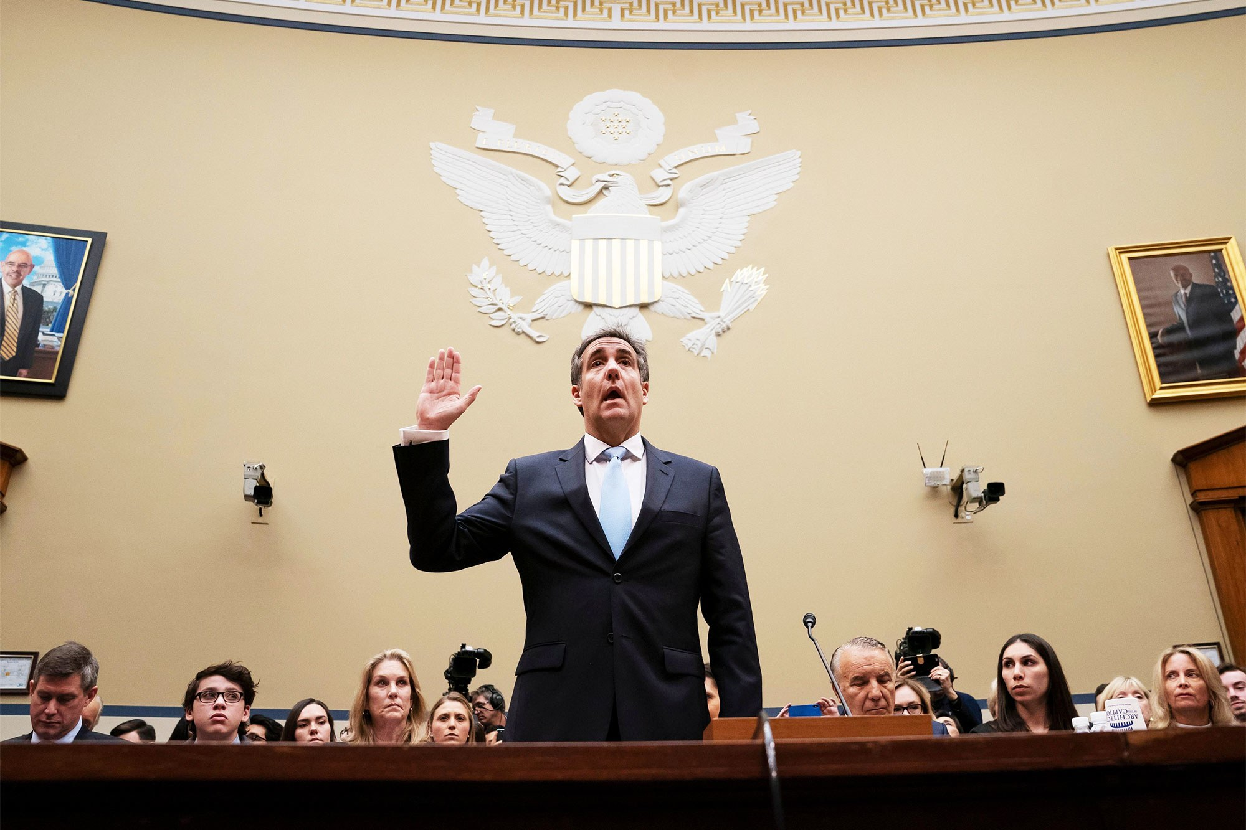
News of the Week Case Study

Slide 45
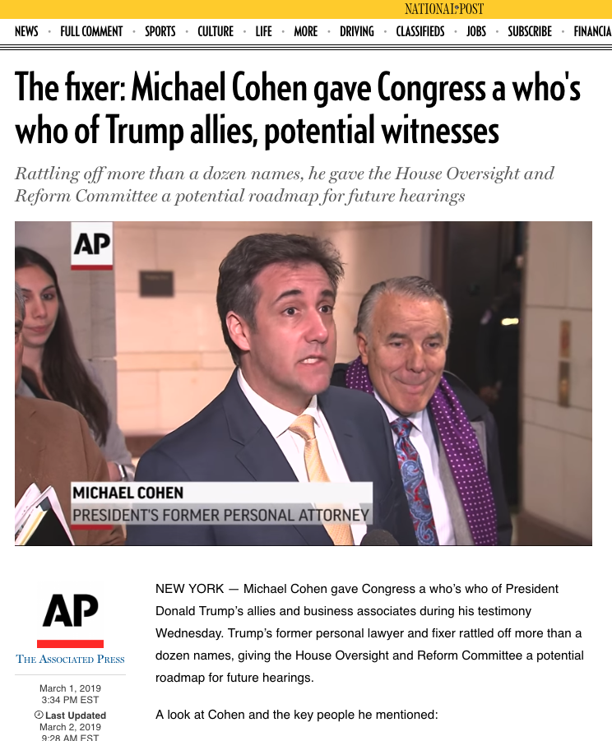
Michael Cohen - Fixers as lawyers
Fixer & lawyer

Slide 46


Slide 47
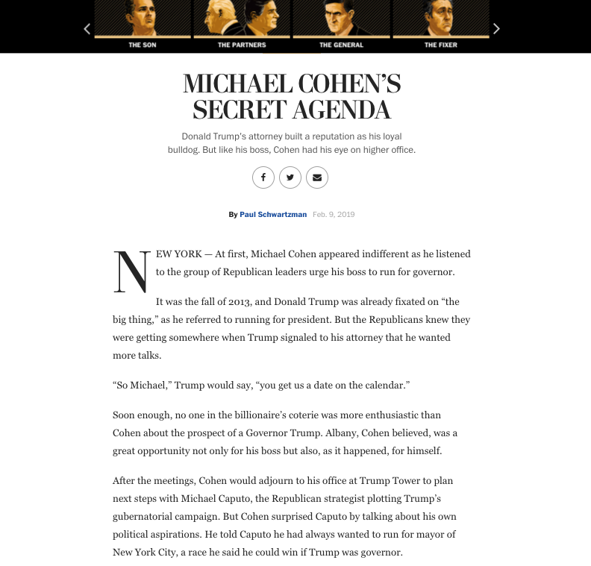

Slide 48
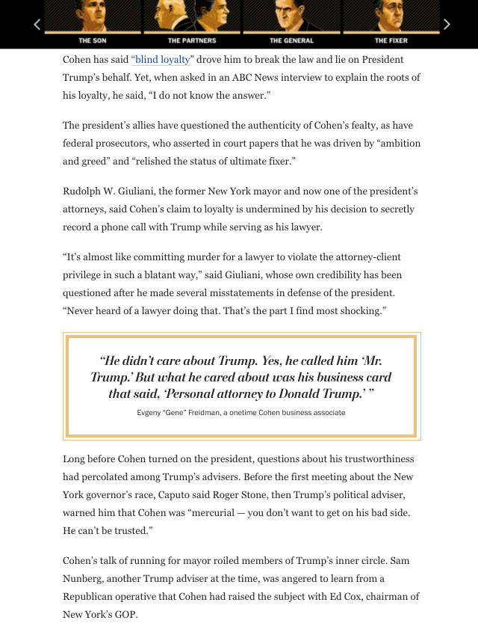

Slide 49
Solicitor-client privilege
Belongs to the client
Applies where you act as a lawyer
Wigmore: “Where legal advice of any kind is sought from a professional legal adviser in his capacity as such, the communications relating to that purpose, made in confidence by the client, are at his instance permanently protected from disclosure by himself or by the legal adviser, except the protection be waived.”
Privilege cannot be relied upon where the communication is used to facilitate a crime.

Slide 50
QUESTIONS?
THOUGHTS?
DISCUSSION?

Slide 51
Pause

Slide 52
QUESTION
OF THE
WEEK

Slide 53
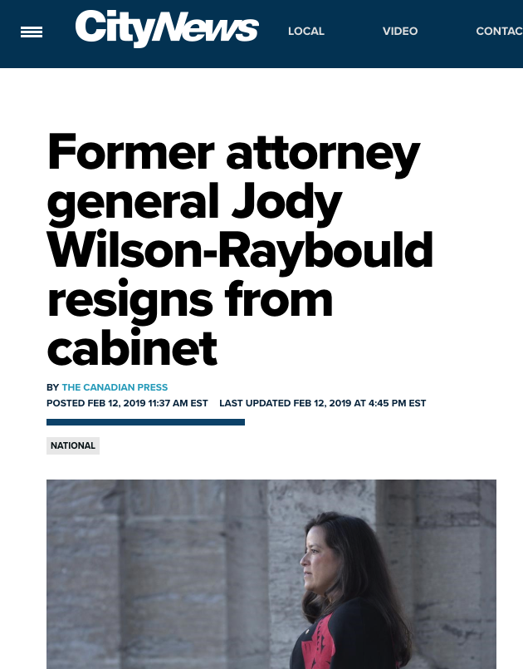

Slide 54
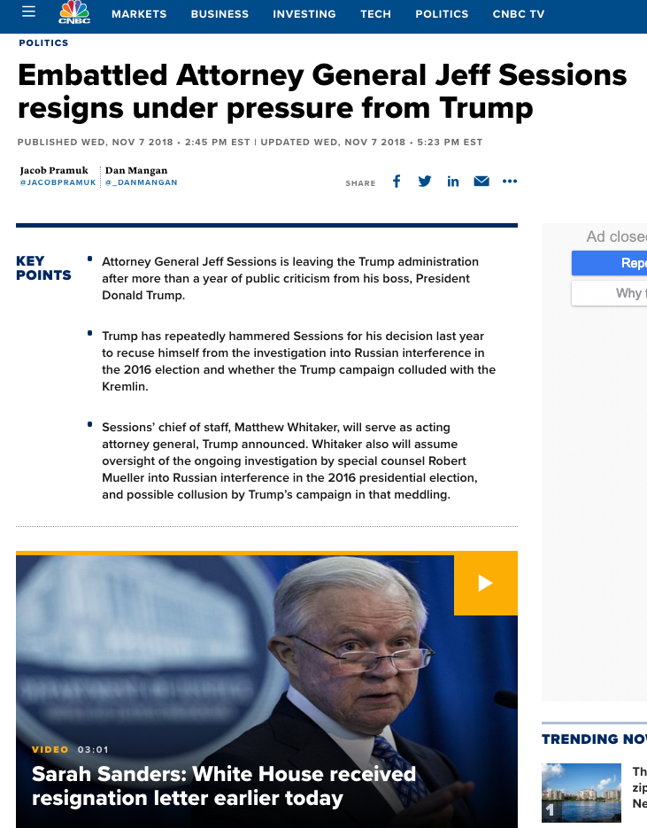

Slide 55
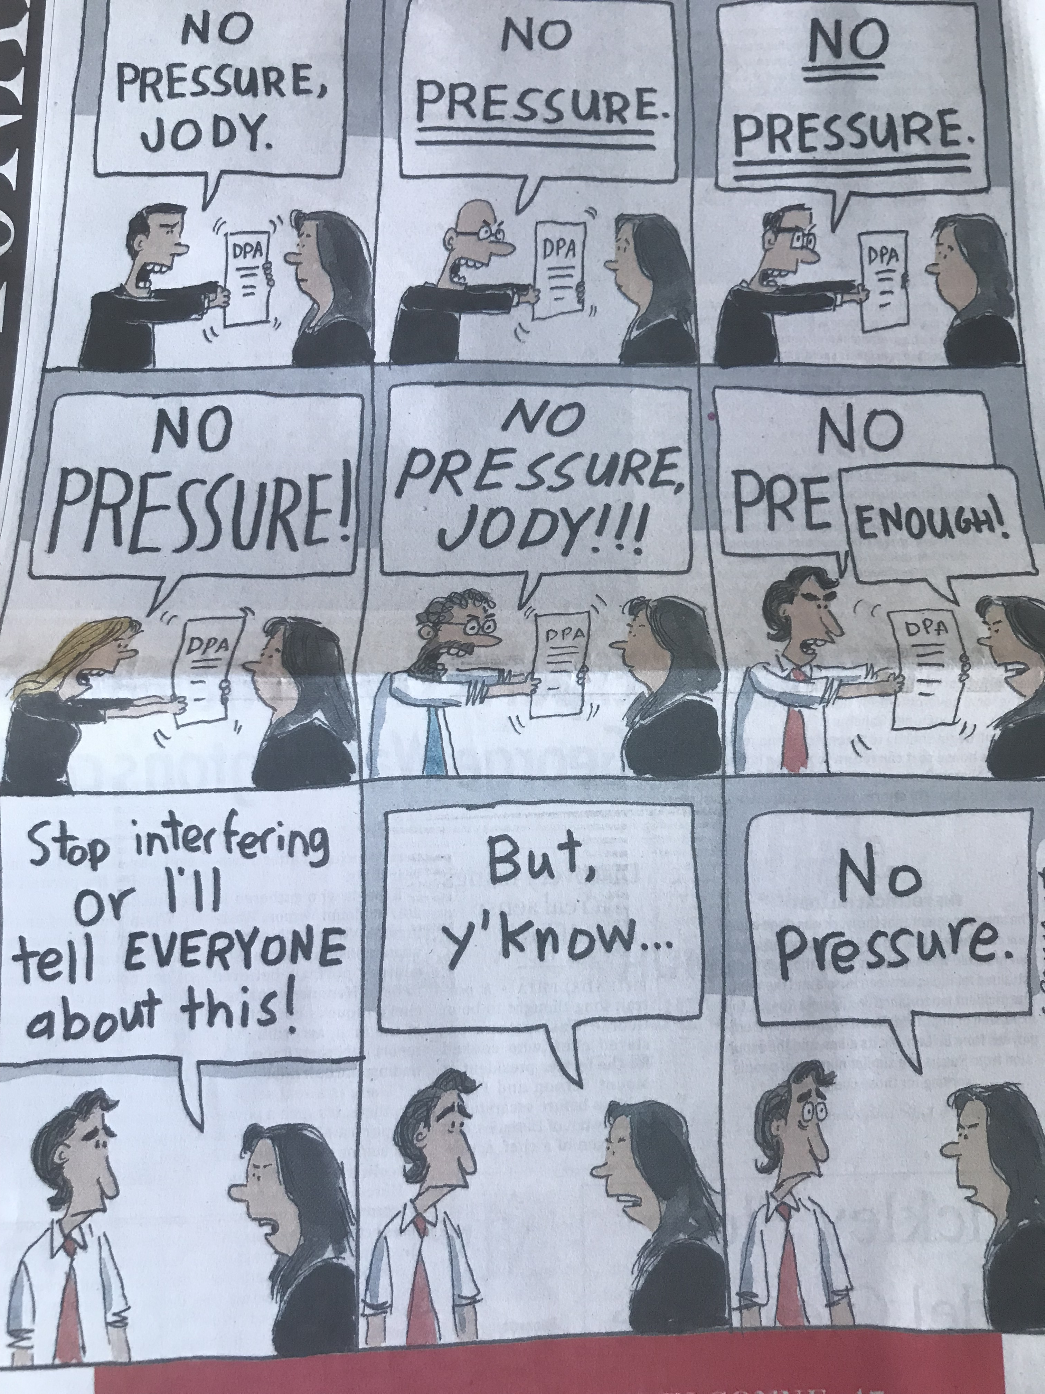

Slide 56
JR-W as G.C.: Mistakes?
Opinion explaining substantive decision?
Paper trail/witness on saying “No, have made up my mind”

Slide 57
QUESTIONS?
THOUGHTS?
DISCUSSION?

Slide 58
Pause

Slide 59

What would you do (#1)?

Slide 60


Slide 61
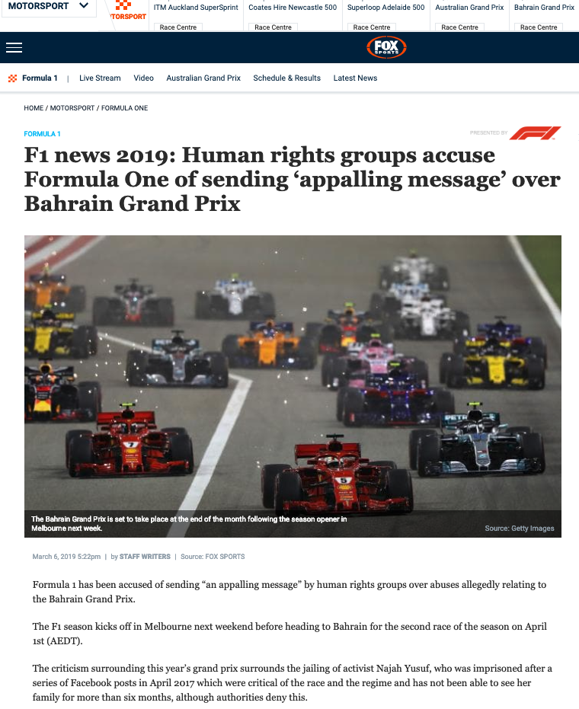

Slide 62
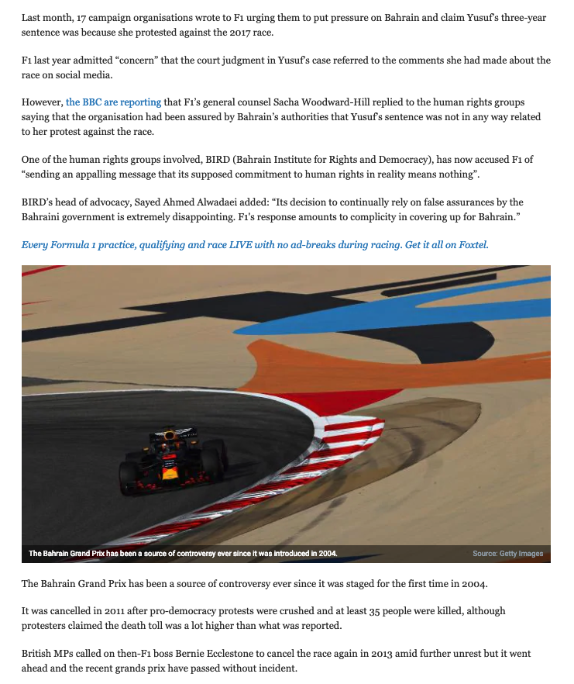

Slide 63
What would you do (#2)?

Slide 65
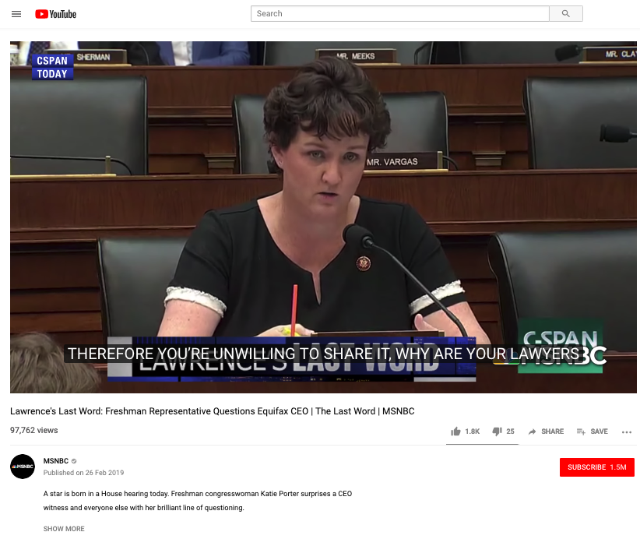
https://youtu.be/7tgZEgSlhA0

Slide 66
What would you do (#3)?

Slide 68
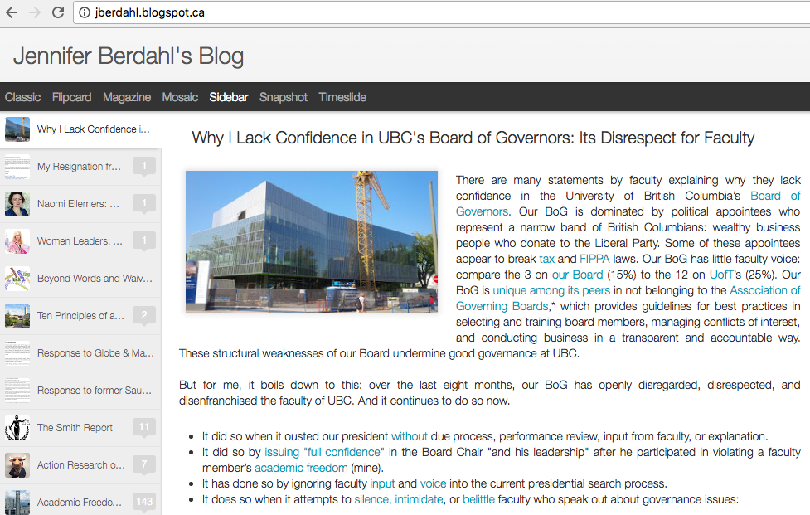
+ Postscript re governance #1

Slide 69
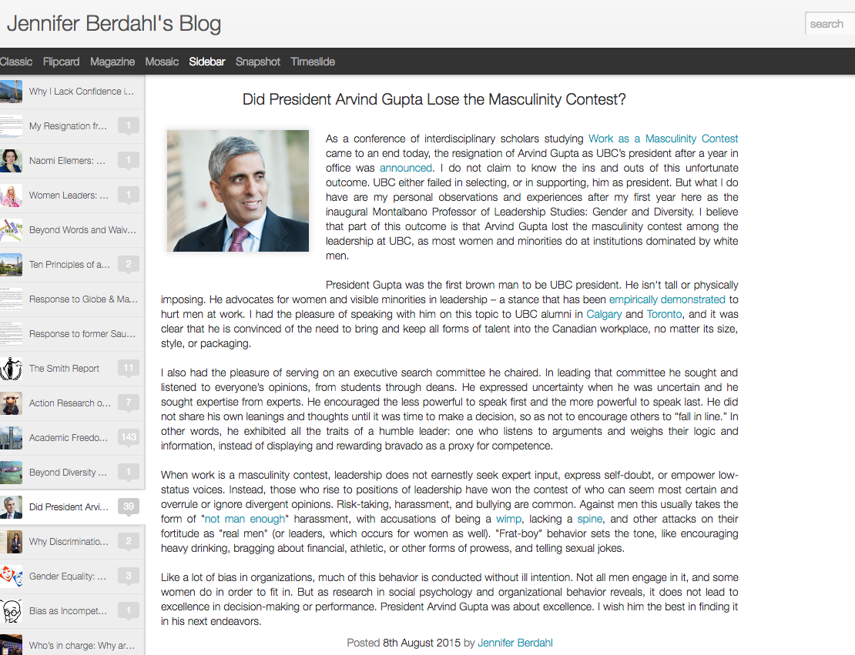

Slide 70
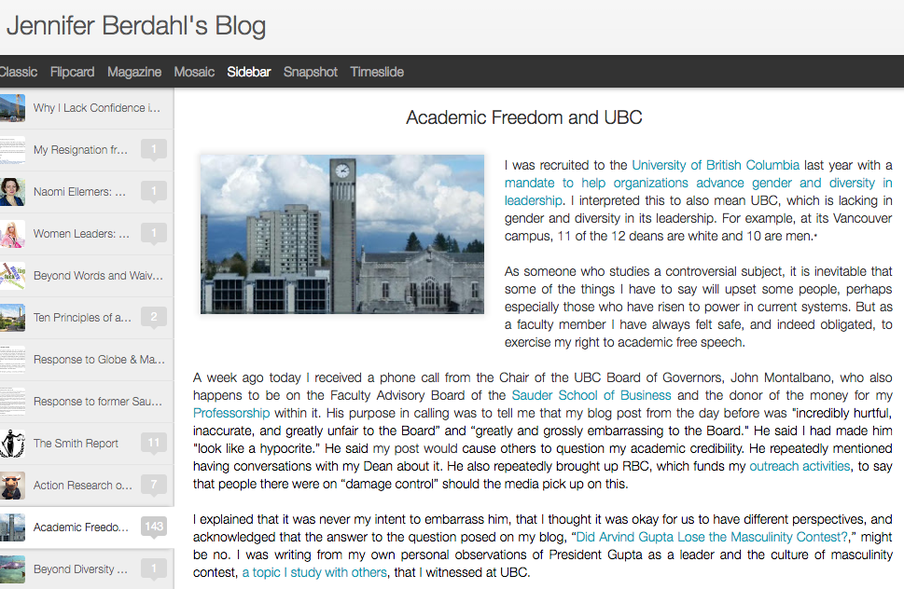

Slide 71
S. 142 BC BCA
Duties of directors and officers
142 (1) A director or officer of a company, when exercising the powers and performing the functions of a director or officer of the company, as the case may be, must
  (a) act honestly and in good faith with a view to the best interests of the company,
  (b) exercise the care, diligence and skill that a reasonably prudent individual would exercise in comparable circumstances,
  (c) act in accordance with this Act and the regulations, and
  (d) subject to paragraphs (a) to (c), act in accordance with the memorandum and articles of the company.
(2) This section is in addition to, and not in derogation of, any enactment or rule of law or equity relating to the duties or liabilities of directors and officers of a company.

Slide 72
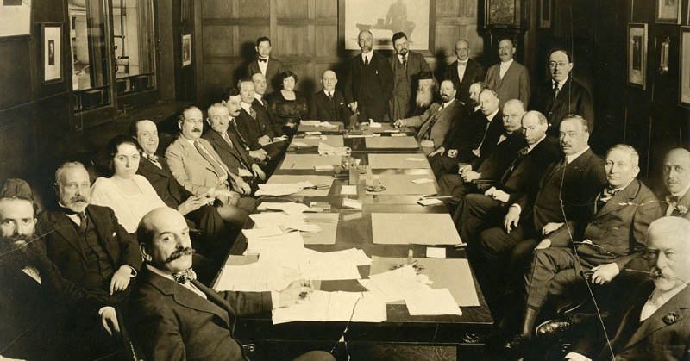
Meaning in the “real” corporate world?

Slide 73
Issue:
If a corporate Director takes offence to something said or done, is that OK or acting with a view to their own interests and not those of the corporation?

Slide 74
Personal opinion….
Hugely important and underrated factor in boardroom issues is personal status/feeling offended or disrespected
Possible examples of this surface rarely if ever
Proceeding by analogy (as in university governance other considerations may, or may not, be relevant).

Slide 75
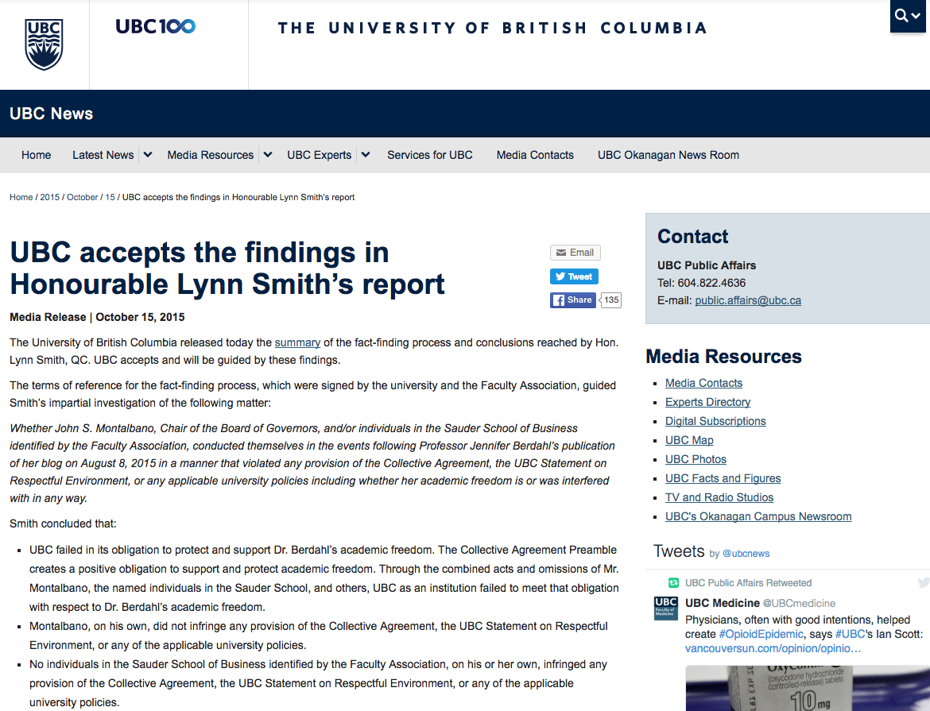

Slide 76


Slide 77
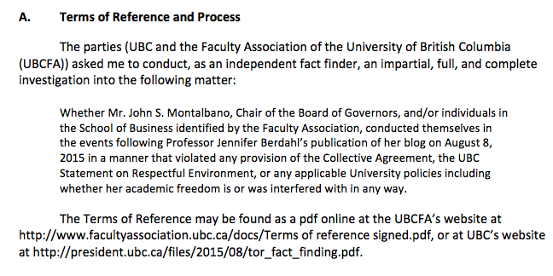

Slide 78
“1….no-one thought to advise Mr. Montalbano against telephoning Dr. Berdahl when he said that he intended to do so. When Mr. Montalbano called Dr. Berdahl and told her about his deep concerns with respect to her blog post, he was mindful of the need to protect academic freedom and did not intend to interfere with it. He made the call in the context of a pre-existing positive relationship with Dr. Berdahl…Such a call from the Chair of the Board of Governors to a faculty member was unprecedented and unwise…
2.…The Dean’s Office in Vancouver was aware that Mr. Montalbano found the blog post offensive and that he had telephoned Dr. Berdahl...”

Slide 79
“(e) Policy 97, “Conflict of Interest and Conflict of Commitment” This Policy recognizes that “[o]ccasionally and as a result of normal and productive engagements inside and outside the University, Faculty Members, staff and students may find themselves in a conflict of commitment, an actual or potential conflict of interest, or in a situation where there is a perception of a conflict of interest.” It also provides procedures for determining if, when, and how such conflicts can be managed. My Terms of Reference do not require me to determine whether Mr. Montalbano was in breach of Policy 97.”

Slide 80
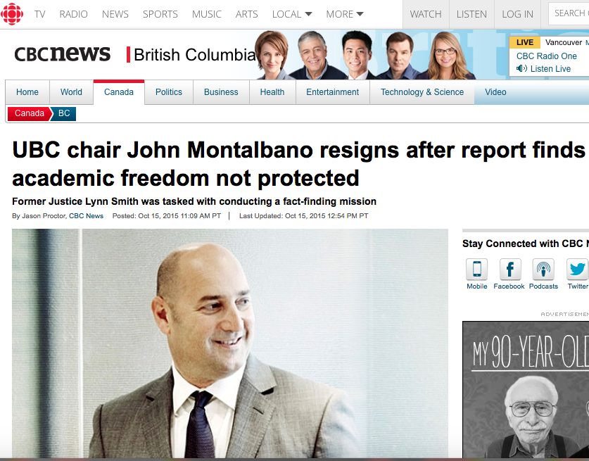

Slide 81
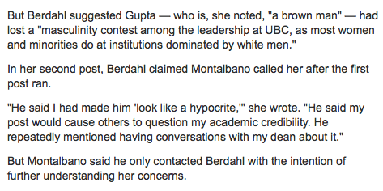
If personal feelings…???

Slide 82
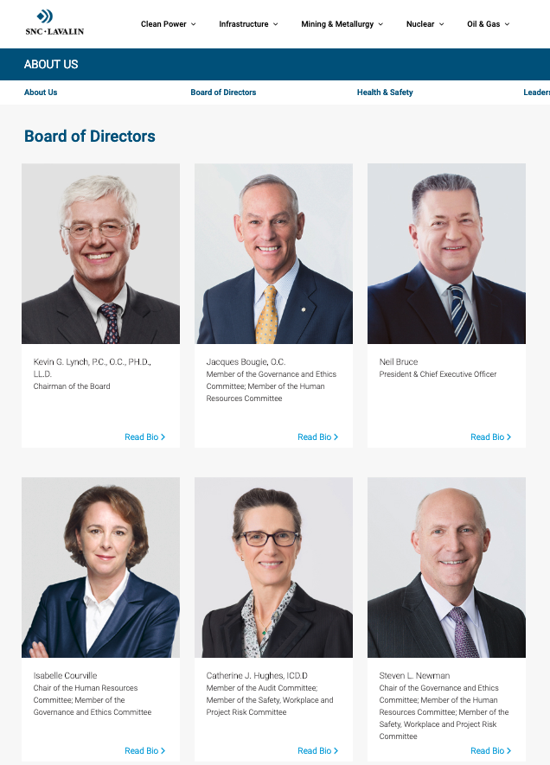
Postscript re governance #2:
SNC Lavalin Edition

Slide 83
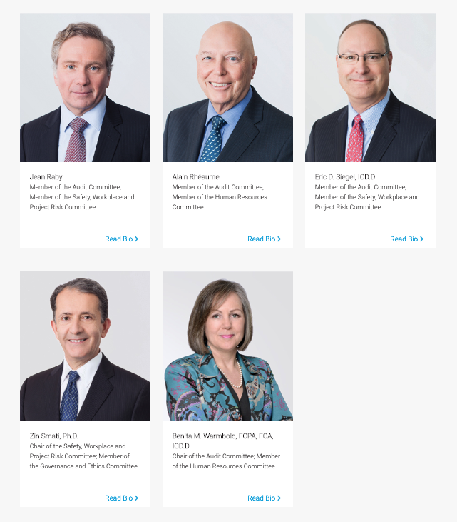
A Remarkable Sameness…

Slide 84

Opinion: Clones become Clowns

Slide 85

Follow-up: The Racist Logo Tale

Slide 86


Slide 87


Slide 88


Slide 89
QUESTIONS?
THOUGHTS?
DISCUSSION?

Slide 90
Pause

Slide 91
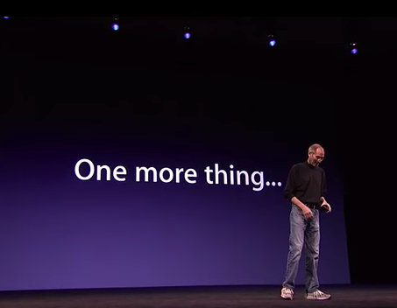

Slide 92
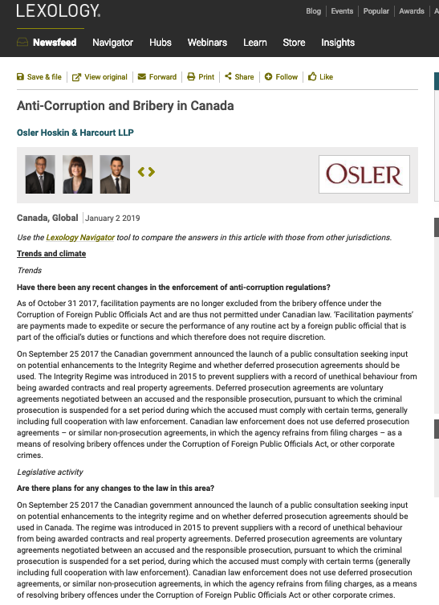

Slide 93
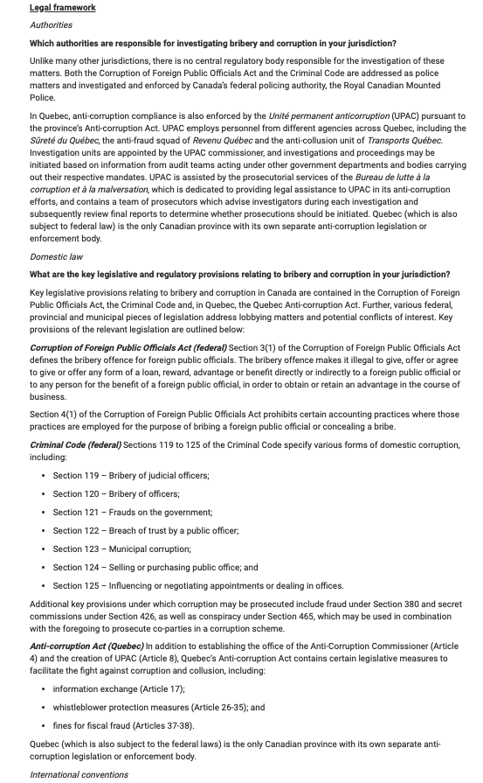

Slide 94
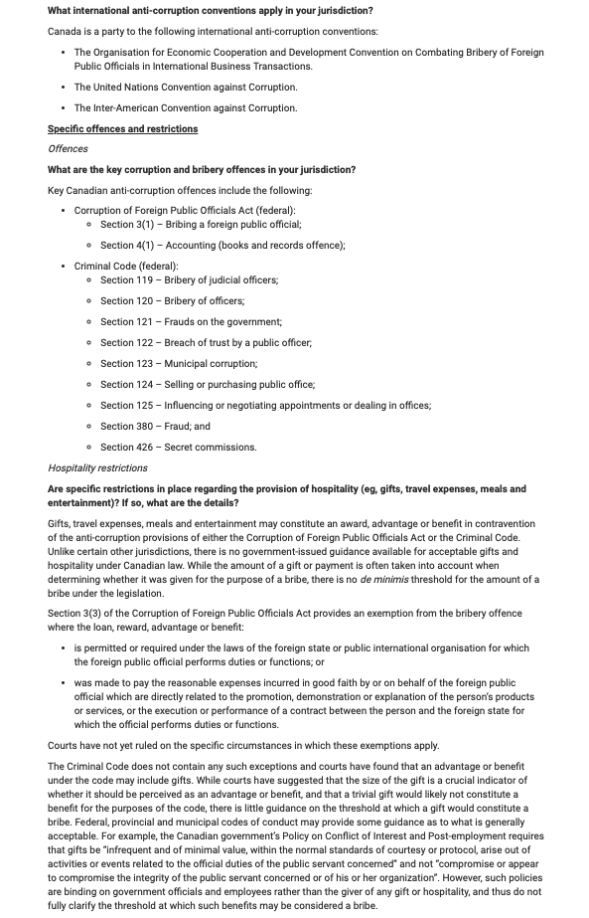

Slide 95
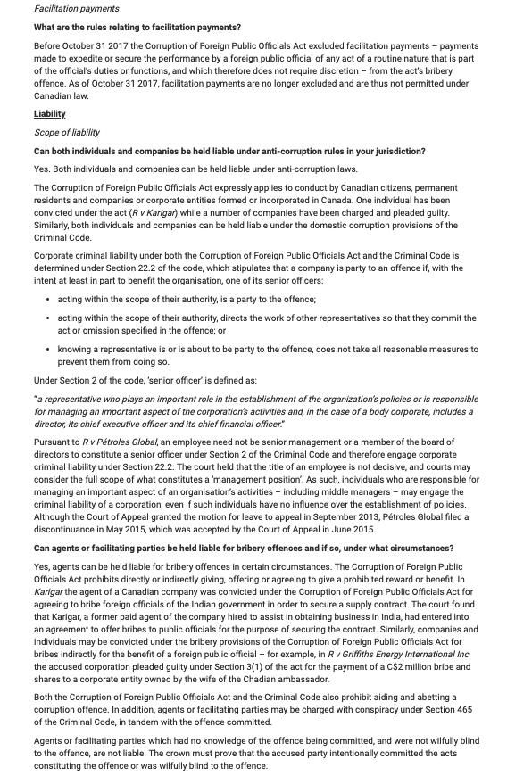

Slide 96
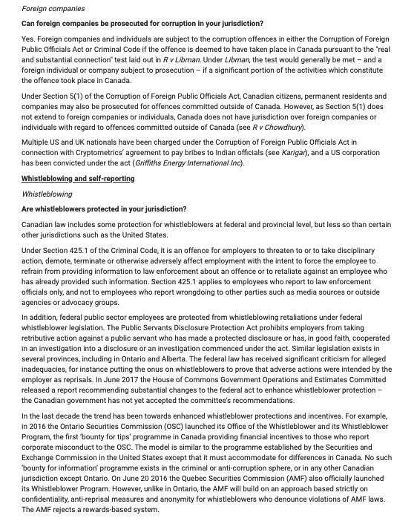

Slide 97


Slide 98


Slide 99


Slide 100
QUESTIONS?
THOUGHTS?
DISCUSSION?

Slide 101
Pause

Slide 102


A MATTER OF PERSPECTIVE

Slide 103

Conclusion

Slide 104
SEE YOU
NEXT WEEK!

Slide 105

Always include a cat picture

Slide 106
In learning you will teach
And in teaching you will learn
Phil Collins' Son of Man (1999)

Slide 107
Our Academic Partners

