Slide 1
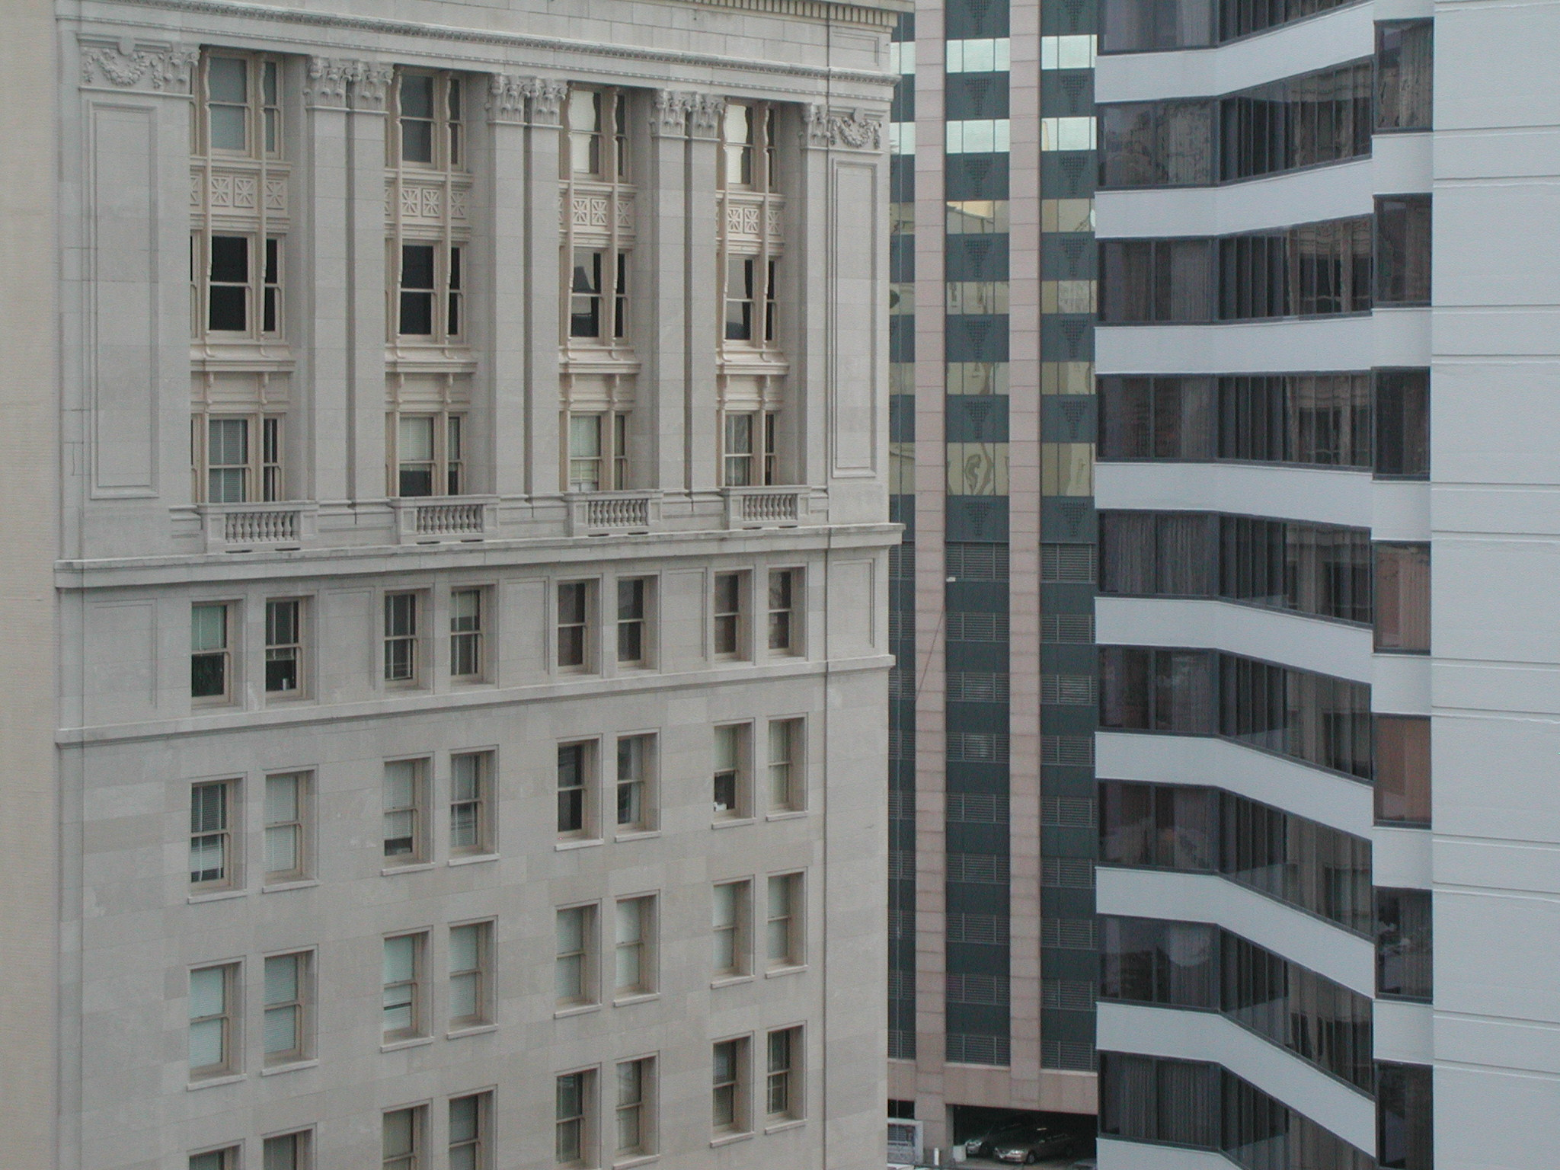

“Law firms, Law Departments & the Future of Law”
Talk 9
LAWF 3780
Challenges of In-House & Corporate Counsel
TRU Faculty of Law
Spring, 2019
Jon Festinger Q.C.
Centre for Digital Media
QMUL School of Law (CCLS)
Festinger Law & Strategy
http://commlaw.allard.ubc
@jonfestinger
jon_festinger@thecdm.ca

Slide 2
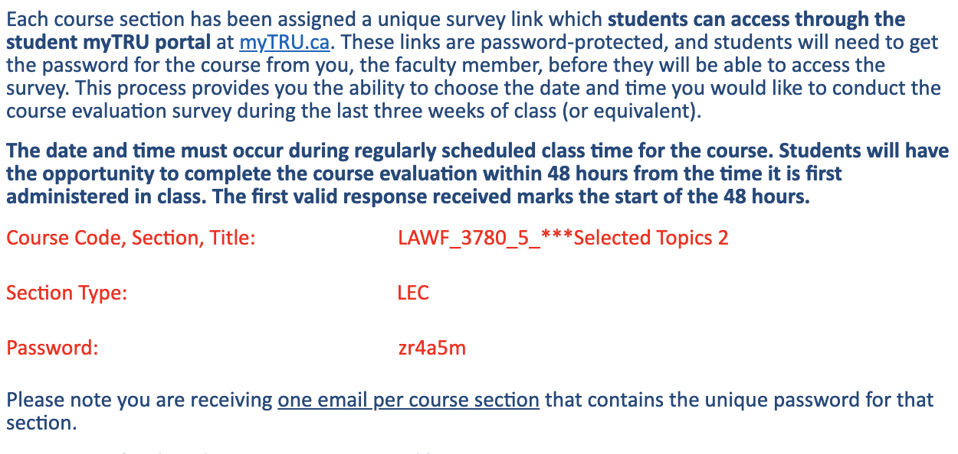
Course Evaluations

Slide 3
Hello
LAW F 3780
Challenges of In-House
& Corporate Counsel

Slide 4
WELCOME
BACK

Slide 5


Slide 6
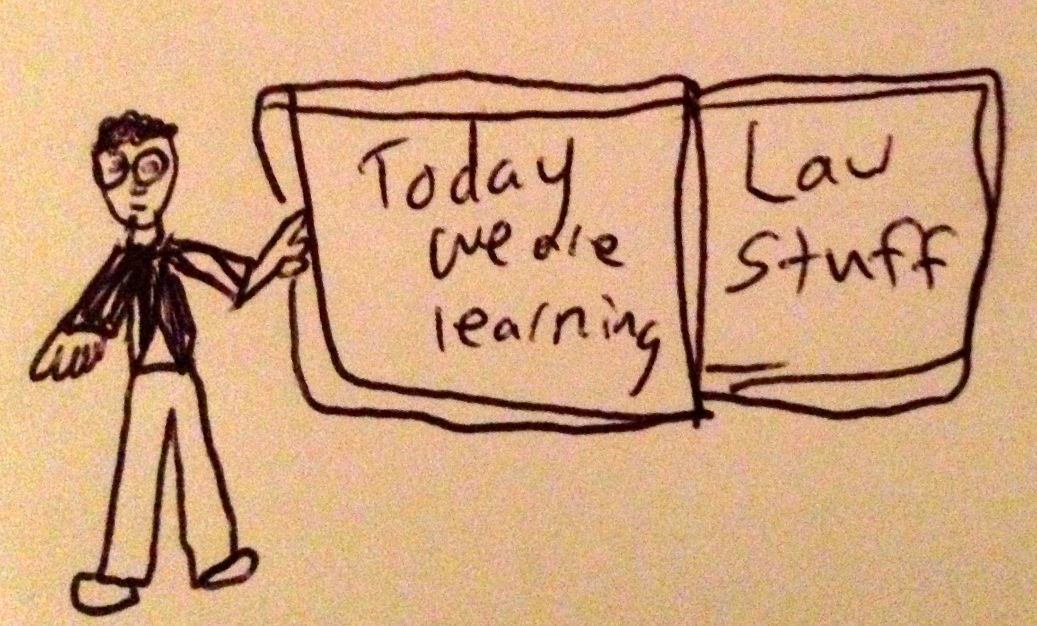

Slide 7
Logistics

Slide 8
EVALUATION
Term paper = 50% of the final grade.
5000 word paper
The paper is due on the last day of the exam period at 4:00 p.m.
Class Participation = 50% of the final grade
30% of the mark will be based on group preparation of a Class Discussion, with a Discussion Outline provided to the class—preferably by posting on the course website—a week before.
20% for student participation in other course activities including seminar discussions etc.

Slide 9
Paper Confessional
(or what I learned one winter holiday)
Legal/normative reasoning/argument including footnote/bibliography support & Contribution/Move forward → 60%
Presentation including layout, headings, grammar, language/writing skills, “tightness” → 25%
Topic/Originality/Degree of Difficultly → 15%
THIS IS NOT A RUBRIC. IT IS A SELF ASSESSMENT.

Slide 10
Evaluation Tips
Term paper topics need not be discussed with me, but often helpful to you if you do.
Term paper can be on your presentation topic.
Participation: In-class or other contributions, including attendance.
Group presentation need not be on that week’s topic (20 minute per student multiplier suggested 2-4 per group to 60 minute max).

Slide 11
Grades (primarily)
Paper → Quality
Participation → Effort

Slide 12
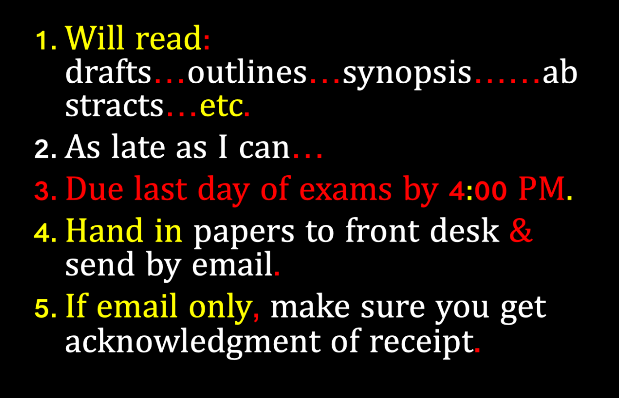

Slide 13
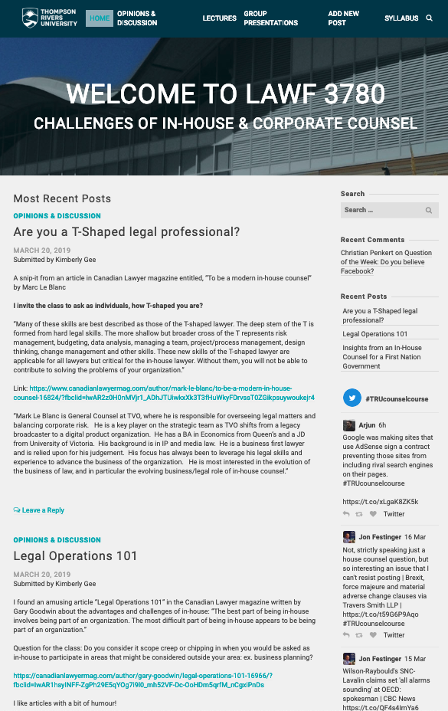
Website

Slide 14

No class next week
Back April 11, 2019

Slide 15
Counsel:
The Game

Slide 16
QUESTIONS?
THOUGHTS?
DISCUSSION?

Slide 17

Pause

Slide 18
News of the Week

Slide 19
Yours?

Slide 20
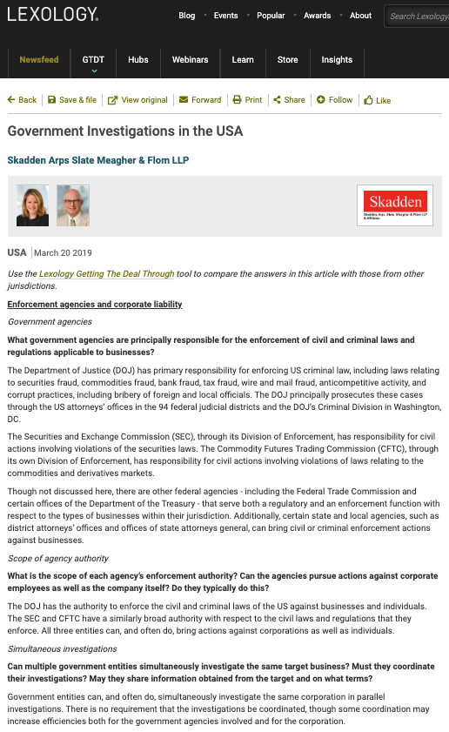

Slide 21
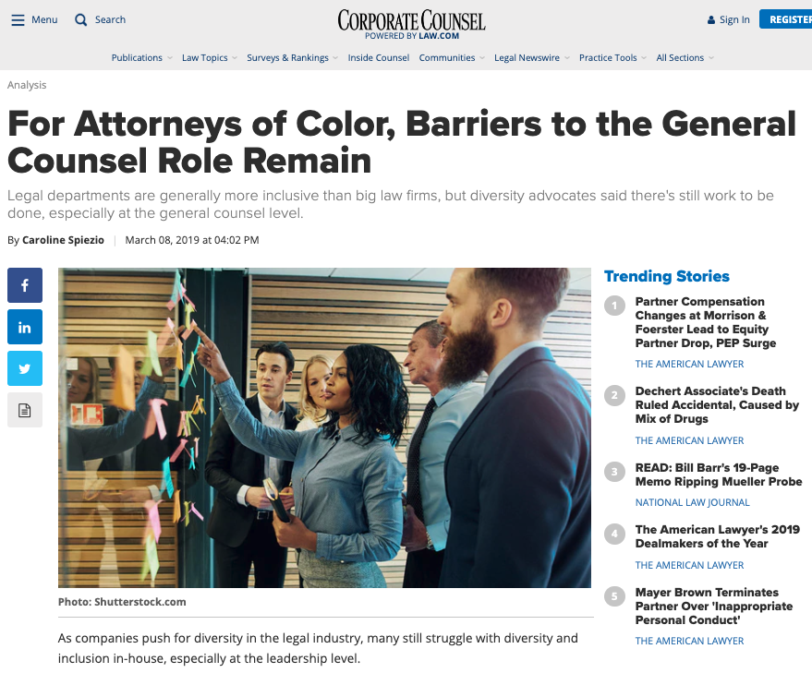

Slide 22
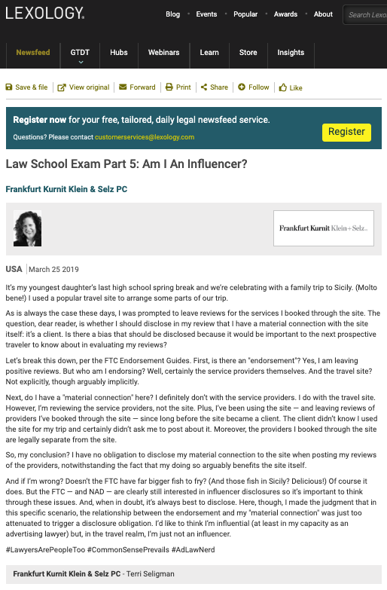

Slide 23
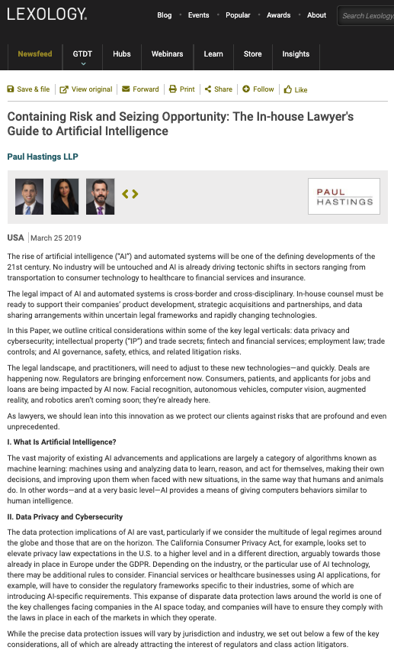

Slide 24
QUESTIONS?
THOUGHTS?
DISCUSSION?

Slide 25
Pause

Slide 26
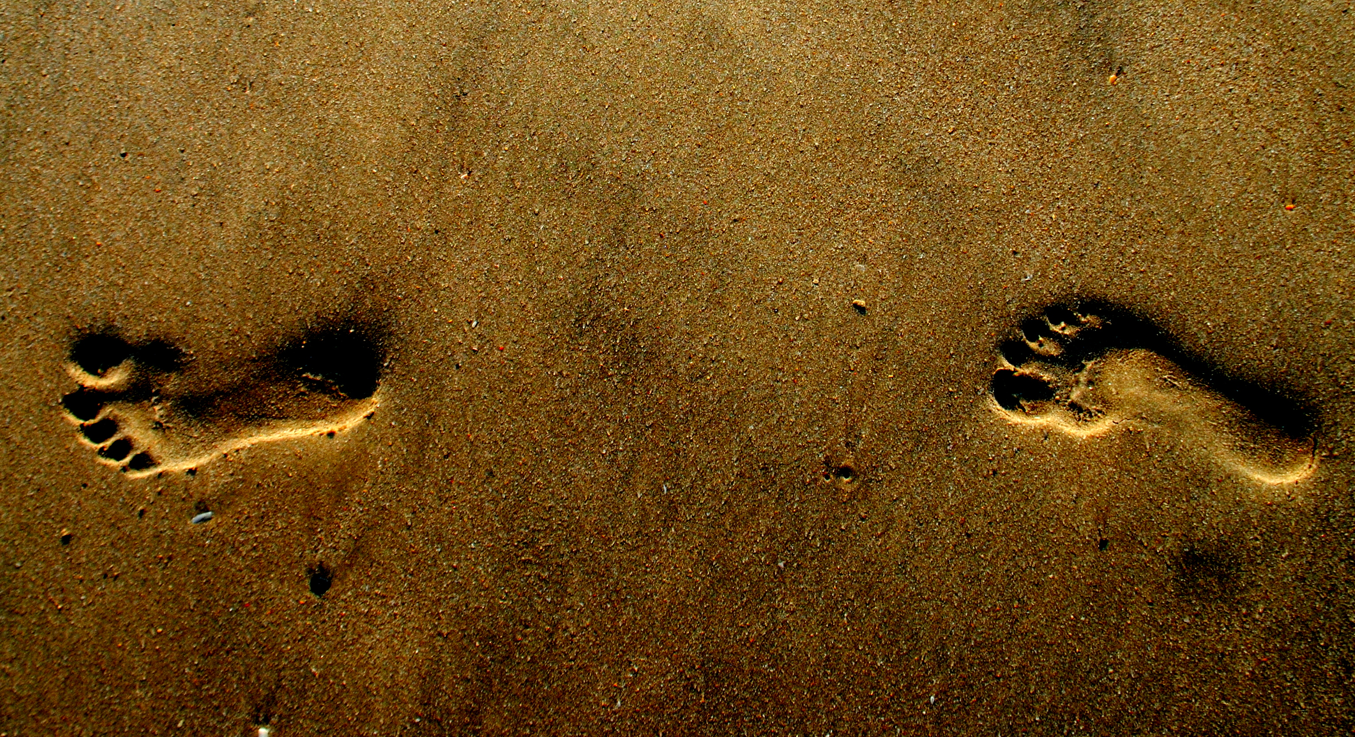
What would you do?

Slide 27


Slide 28


Slide 29
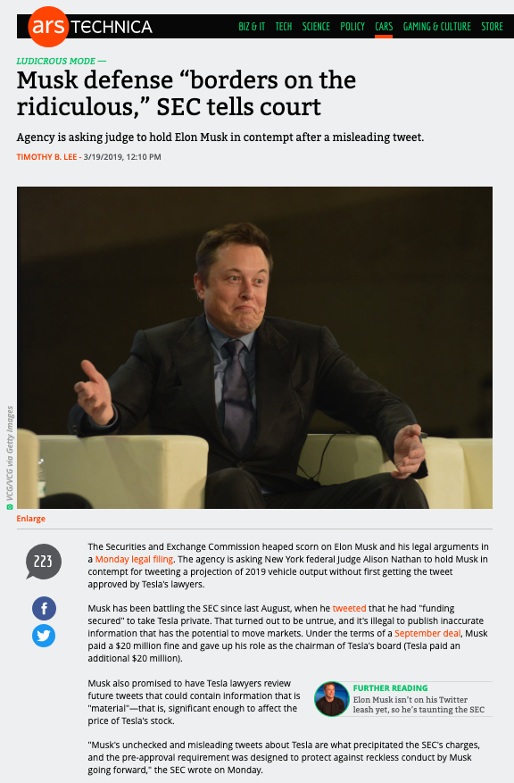

Slide 30
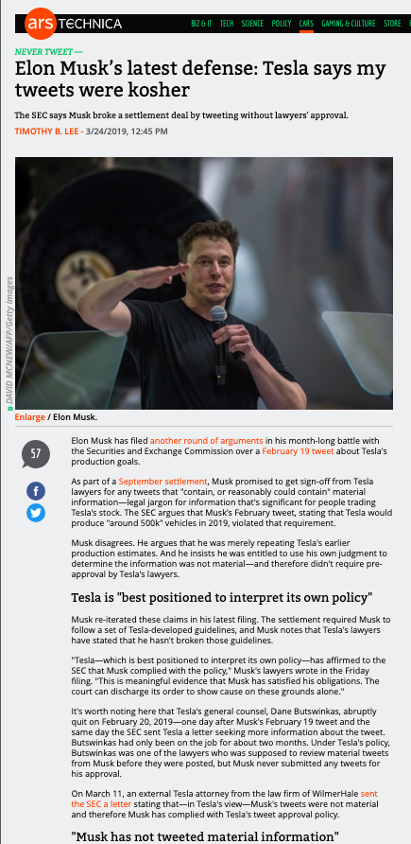

Slide 31
QUESTIONS?
THOUGHTS?
DISCUSSION?

Slide 32
Pause

Slide 33
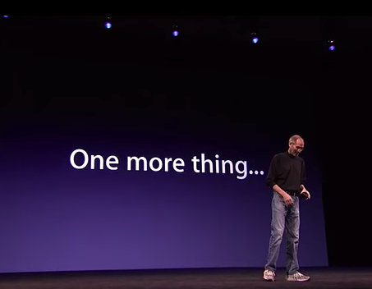

Slide 34
Law-firms
Issues/concerns
1. Mine

Slide 35
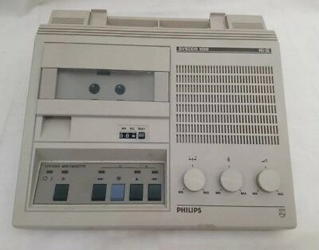

1981-1982: The Saturday Tapes

Slide 36
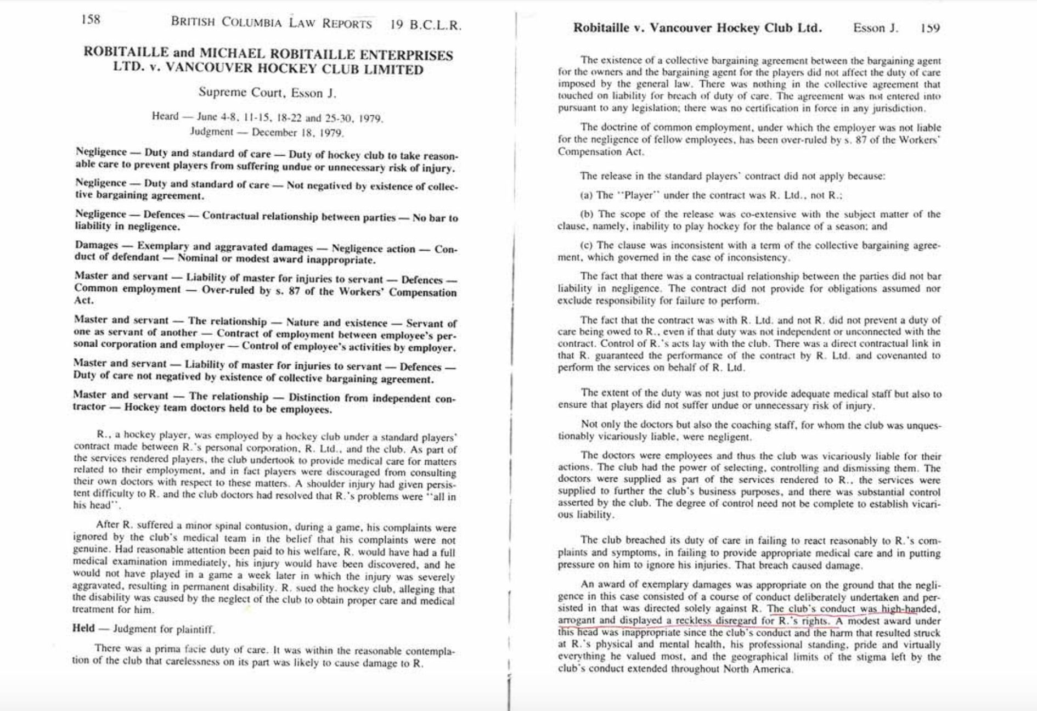
LUNCH

Slide 37

The Expert Witness

Slide 38
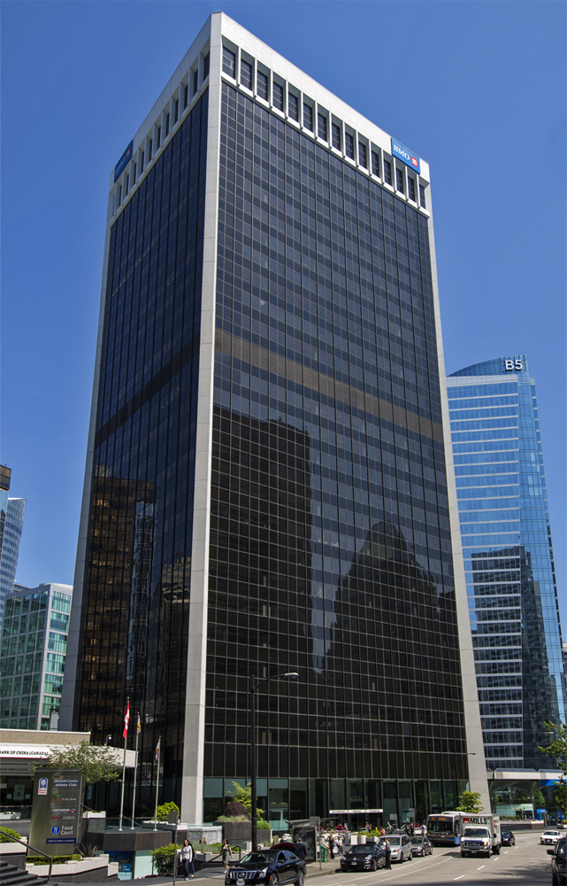
No job/ JOB

Slide 39

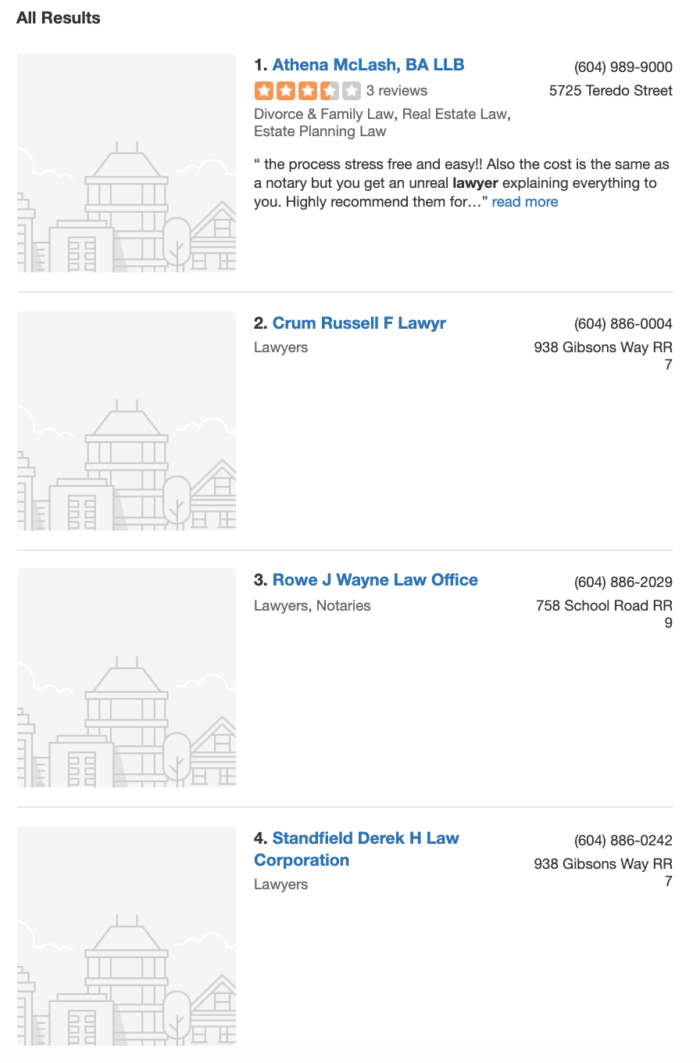
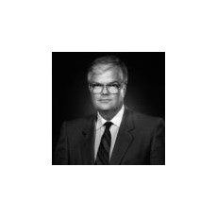
I was taught. Will you be?
Gowan T. Guest, Q.C.

Slide 40

The brilliant alcoholic

Slide 41
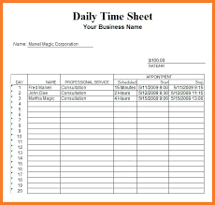
Young Partners

Slide 42

“Eat what you kill” & killing the profession

Slide 43
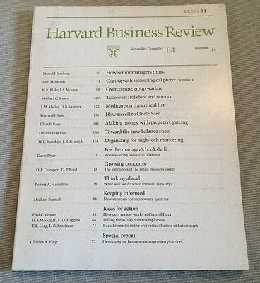

Slide 44
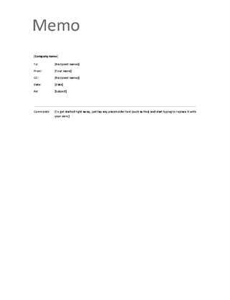
The Memo

Slide 45
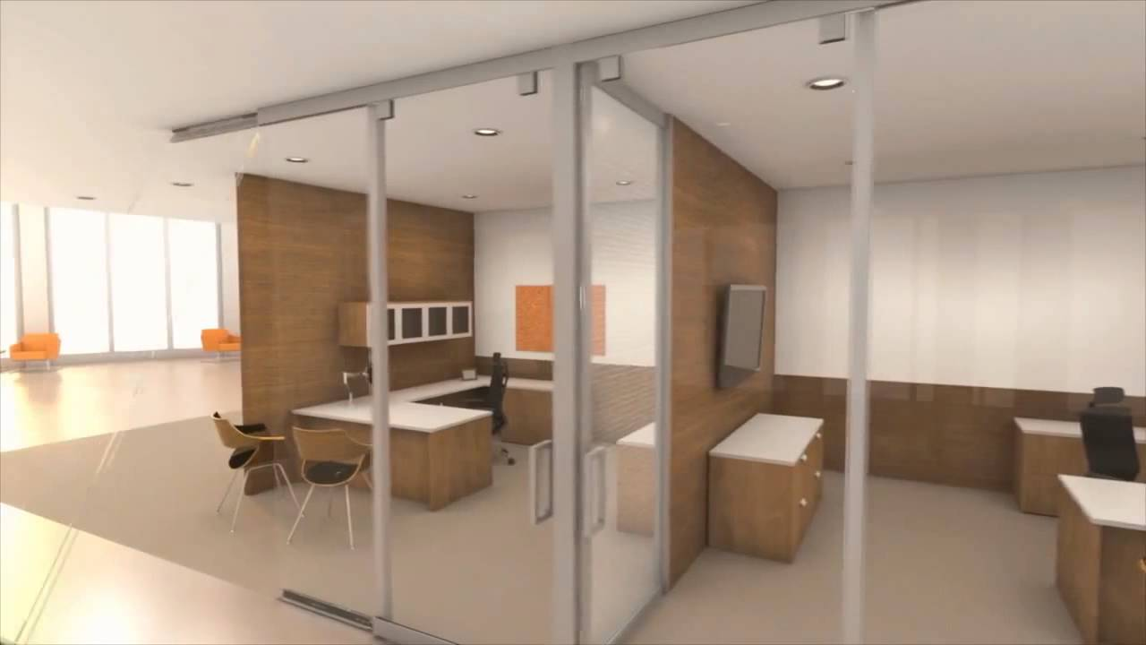
The memo not sent

Slide 46
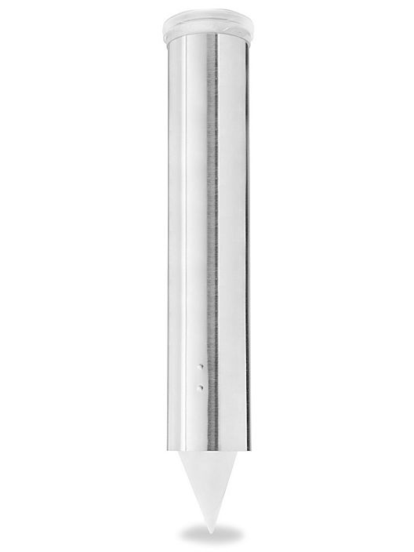
The memo my friend sent

Slide 47
Partnership =
SPEAKER-PHONE?

Slide 48
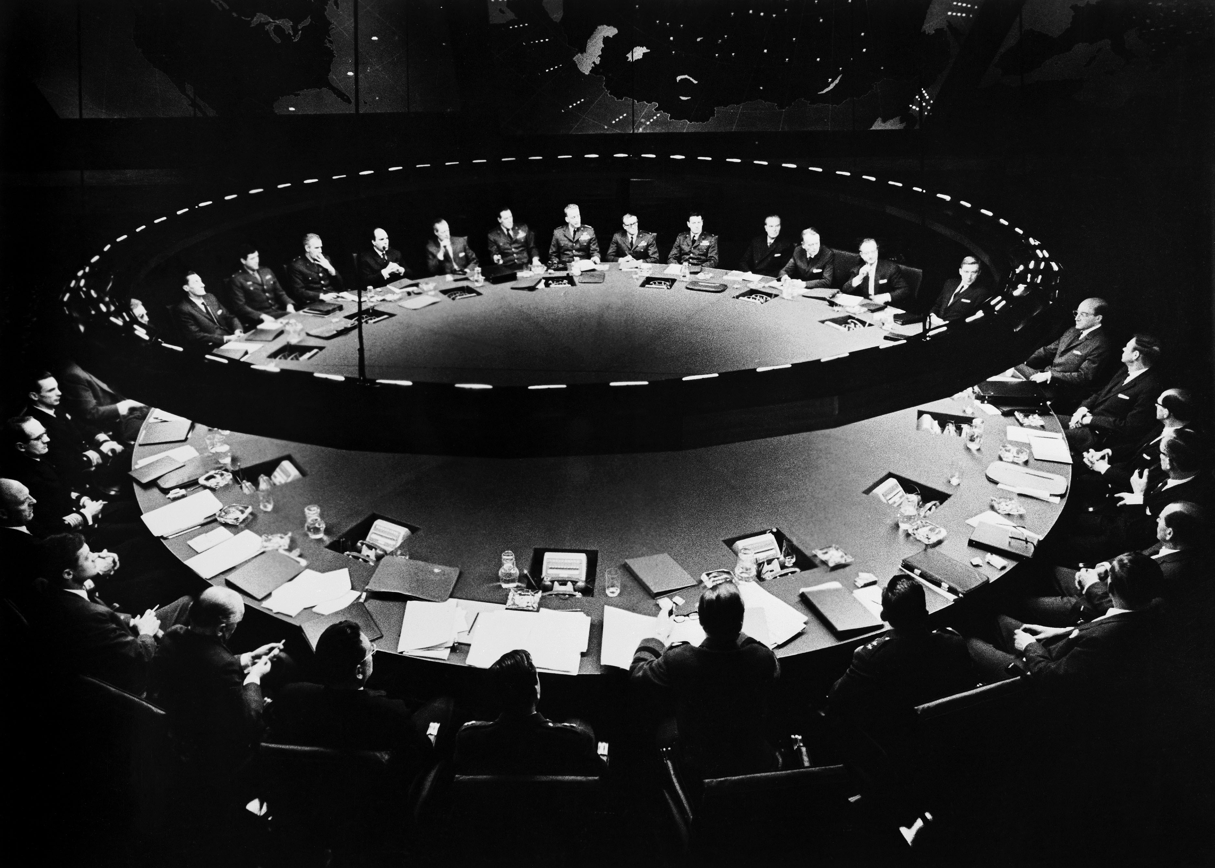
Partners Meetings

Slide 49



How to leave early…

Slide 50
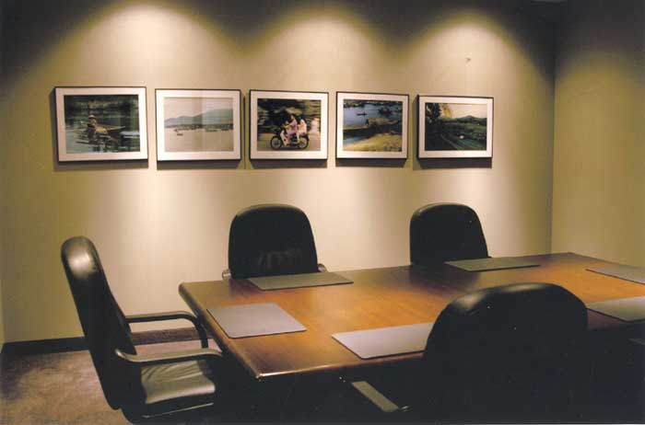
10-9

Slide 51

No agenda

Slide 52
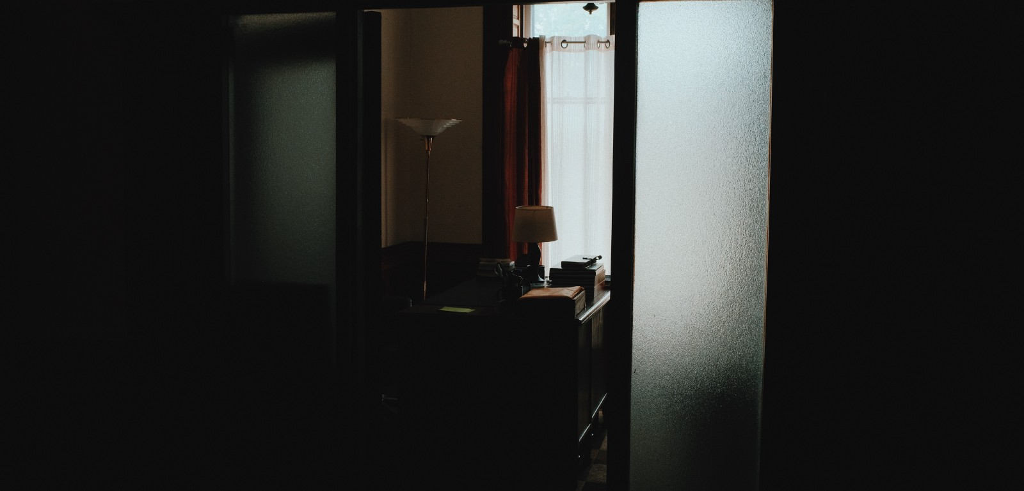
The dangers of off-hours

Slide 53
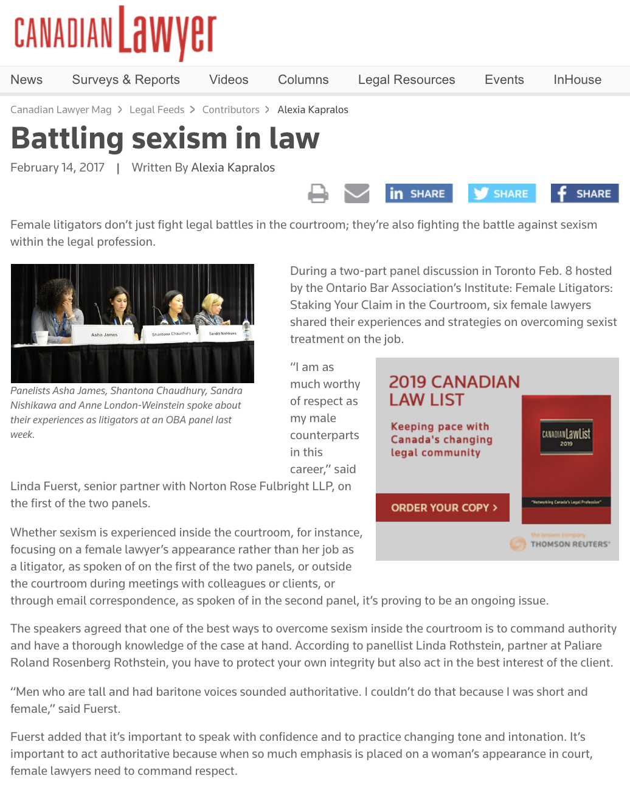

Slide 54
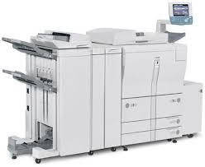

Slide 55


Slide 56


Slide 57


Slide 58
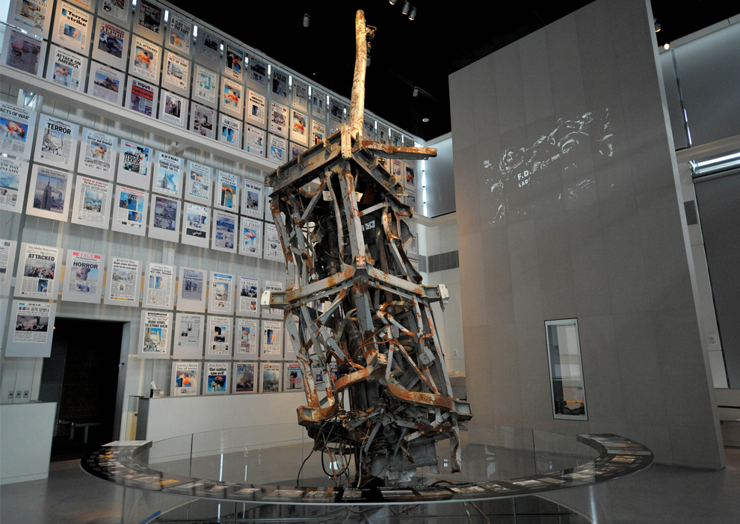
More…

Slide 59

Who?

Slide 60
Partners not
LLC

Slide 61
Clients to
Transactions

Slide 62
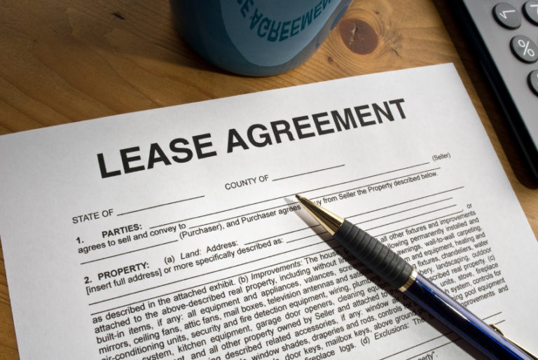

Slide 63
Law-firms
Issues/concerns
2. Yours

Slide 64
How do I say 'no' to tasks that I morally disagree with? I also don't want to be the 'bad' lawyer in the room, or be seen as one who doesn't like to take up a challenge.

Slide 65
What happens if I make a mistake - in law school, mistakes are not really talked about, you pass a class then move on -- I also don't want to be yelled at for making a mistake.

Slide 66
What do you do when the lawyers you look up to as a mentor start doing questionable things?

Slide 67
The billable hour is a staple of practicing in a firm. Yet, when I’m given an assignment, how do I know how long I should spent on it? I am anxious about ensuring that I do not spend too much, or too little, time on each matter.

Slide 68
How do you know how much time to spend on assignments?

Slide 69
Time management. This is related to the above point, but goes more towards how to balance multiple ongoing files. I’m unsure how to approach the management of my workload and files.

Slide 70
My main concern for working in private practice and as a lawyer generally is how to adequately manage peoples expectations over when work will be done for them. I feel like at the start of my career it will be very difficult to gauge how long a task or assignment will take me to complete, which will lead to inaccurate estimation on my part.

Slide 71
Are there excessive expectations to socialize with the firms lawyers and/or the clients?

Slide 72
What can I do when my mentor leaves?

Slide 73


A MATTER OF PERSPECTIVE

Slide 74

Conclusion

Slide 75
SEE YOU
IN 2 WEEKs!

Slide 76

Always include a cat picture

Slide 77
In learning you will teach
And in teaching you will learn
Phil Collins' Son of Man (1999)

Slide 78
Our Academic Partners

