Slide 1

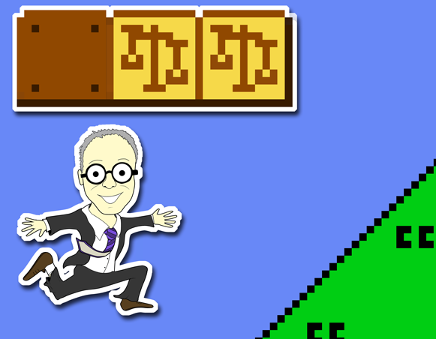
“Scenarios…Part 3”
Talk 8
LAWF 3780
Challenges of In-House & Corporate Counsel
TRU Faculty of Law
Spring, 2019
Jon Festinger Q.C.
Centre for Digital Media
QMUL School of Law (CCLS)
Festinger Law & Strategy
http://commlaw.allard.ubc
@jonfestinger
jon_festinger@thecdm.ca

Slide 2
Hello
LAW F 3780
Challenges of In-House
& Corporate Counsel

Slide 3
WELCOME
BACK

Slide 4


Slide 5
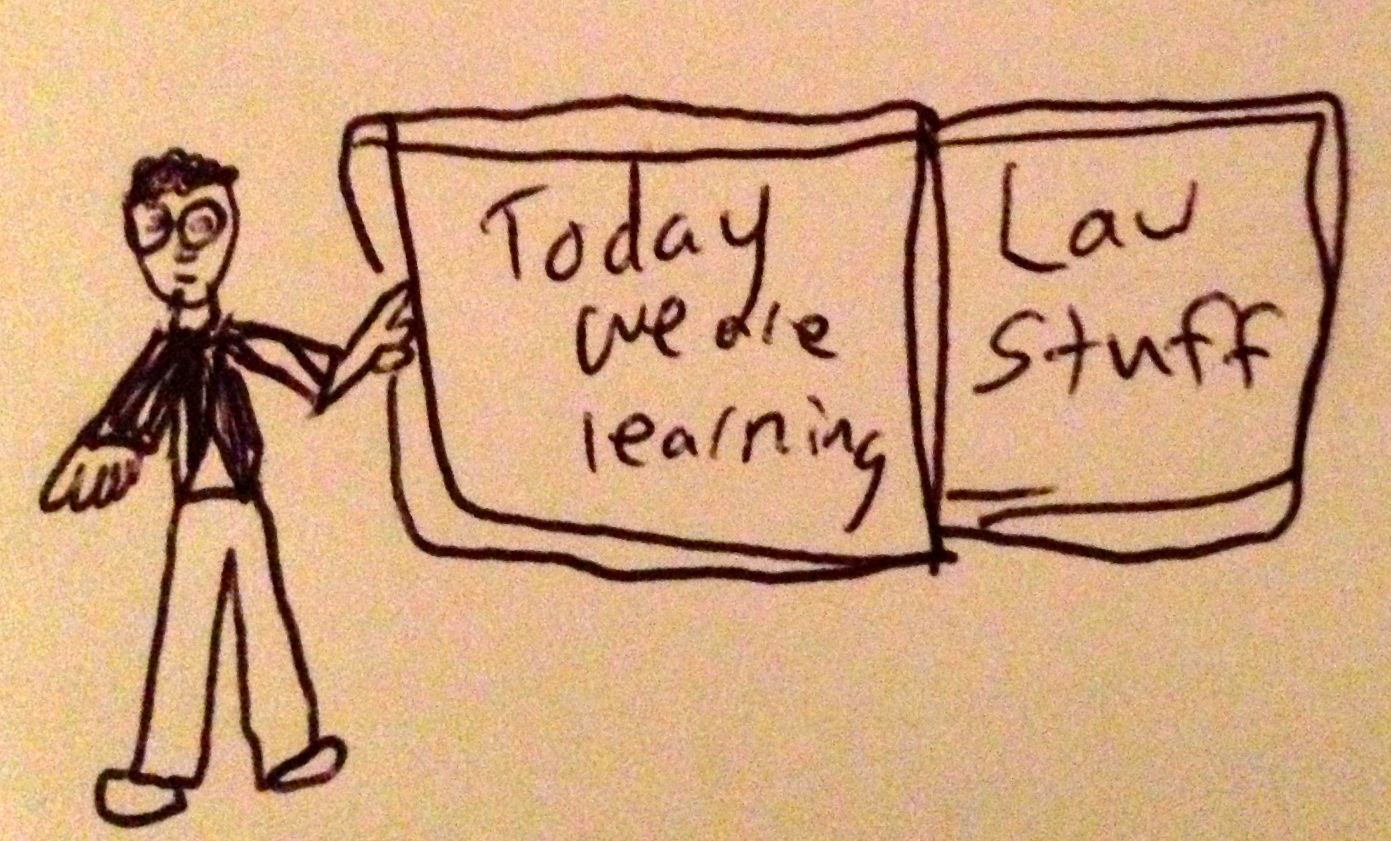

Slide 6
Logistics

Slide 7
EVALUATION
Term paper = 50% of the final grade.
5000 word paper
The paper is due on the last day of the exam period at 4:00 p.m.
Class Participation = 50% of the final grade
30% of the mark will be based on group preparation of a Class Discussion, with a Discussion Outline provided to the class—preferably by posting on the course website—a week before.
20% for student participation in other course activities including seminar discussions etc.

Slide 8
Paper Confessional
(or what I learned one winter holiday)
Legal/normative reasoning/argument including footnote/bibliography support & Contribution/Move forward → 60%
Presentation including layout, headings, grammar, language/writing skills, “tightness” → 25%
Topic/Originality/Degree of Difficultly → 15%
THIS IS NOT A RUBRIC. IT IS A SELF ASSESSMENT.

Slide 9
Group Presentations
2-3 (ideally) per group
Sign-up at the break or email me
Any topic – not constrained by what I’m talking about that week
Consult with me re the topic you want to take on
Post one thing you want us to read or watch

Slide 10
Group Presentations:
All in?

Slide 11
Evaluation Tips
Term paper topics need not be discussed with me, but often helpful to you if you do.
Term paper can be on your presentation topic.
Participation: In-class or other contributions, including attendance.
Group presentation need not be on that week’s topic (20 minute per student multiplier suggested 2-4 per group to 60 minute max).

Slide 12
Grades (primarily)
Paper → Quality
Participation → Effort

Slide 13
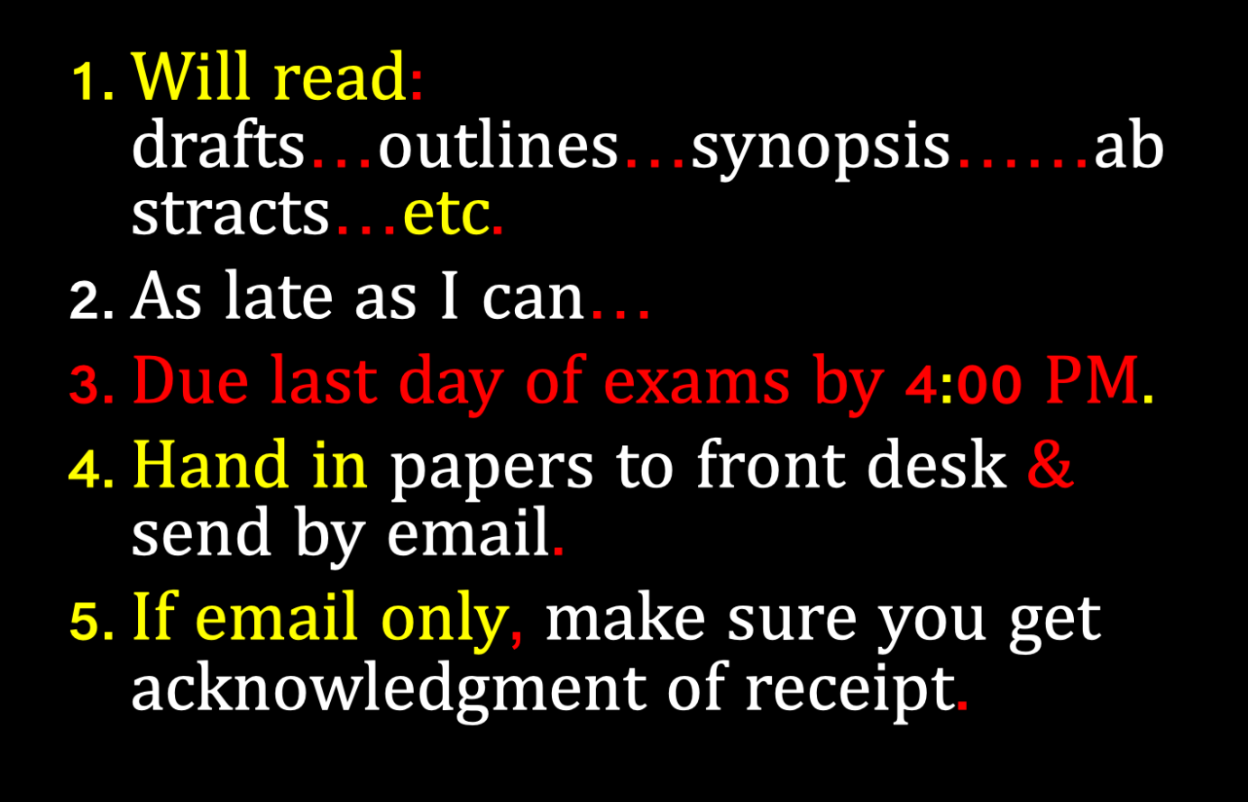

Slide 14
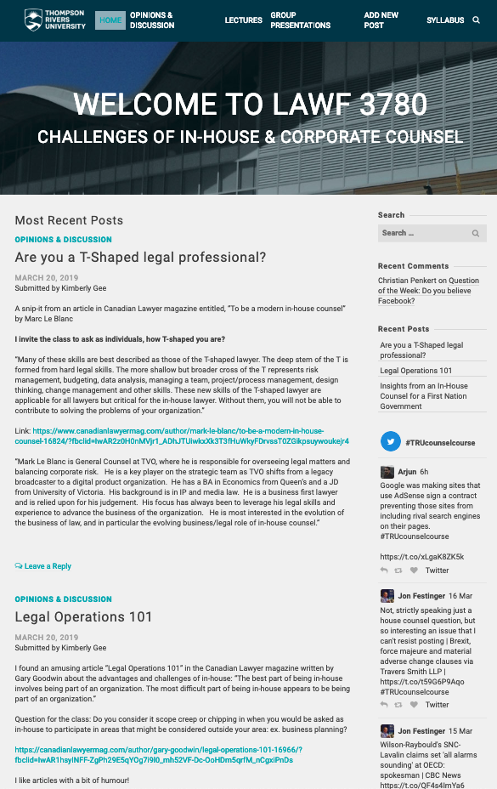
Website

Slide 16
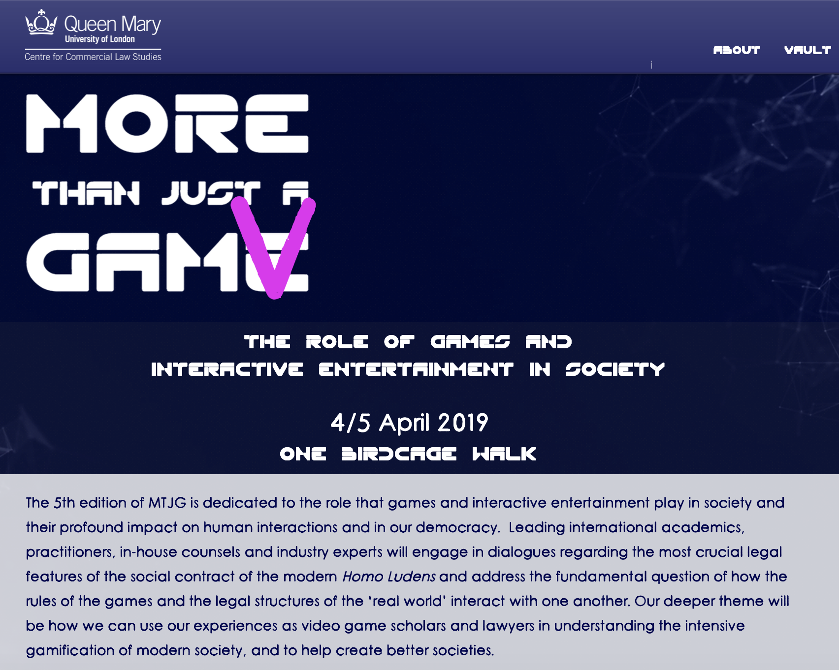
No class April 4, 2019

Slide 17
Counsel:
The Game

Slide 18
Law-firms
1 issue/concern

Slide 19
QUESTIONS?
THOUGHTS?
DISCUSSION?

Slide 20

Pause

Slide 21
News of the Week

Slide 22
Yours?

Slide 23

Which
hat?

Slide 24
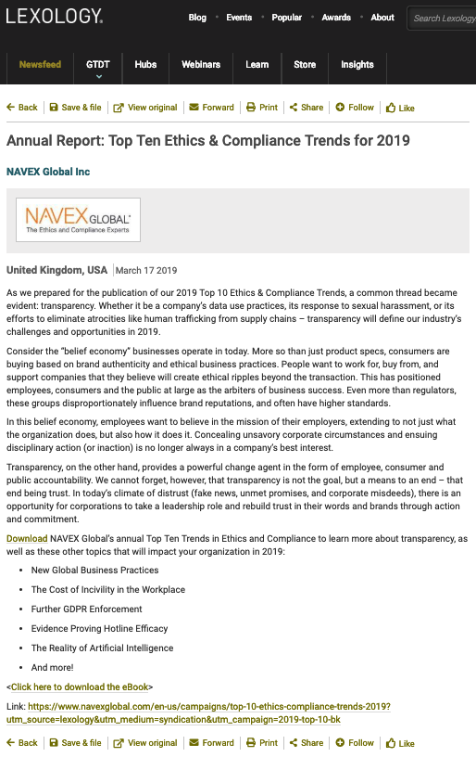

Slide 25
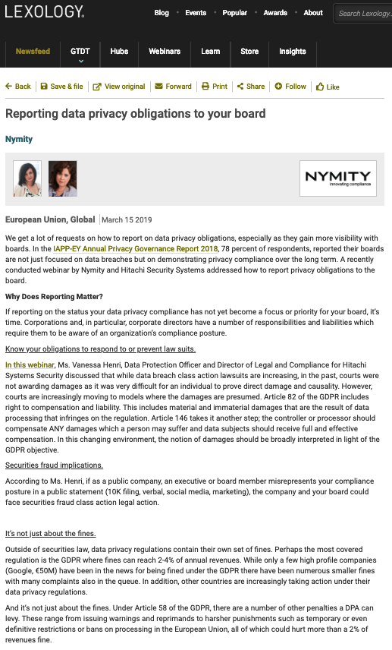

Slide 26


Slide 27
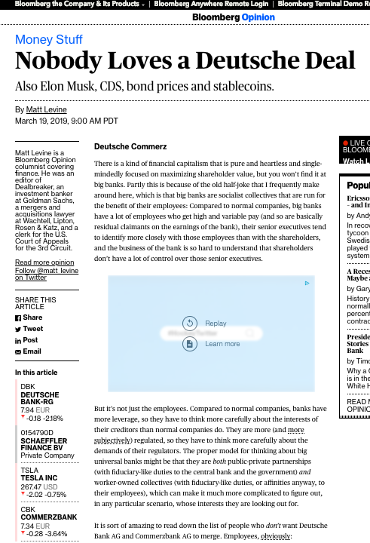

Slide 28

Follow-up on Insurance

Slide 29
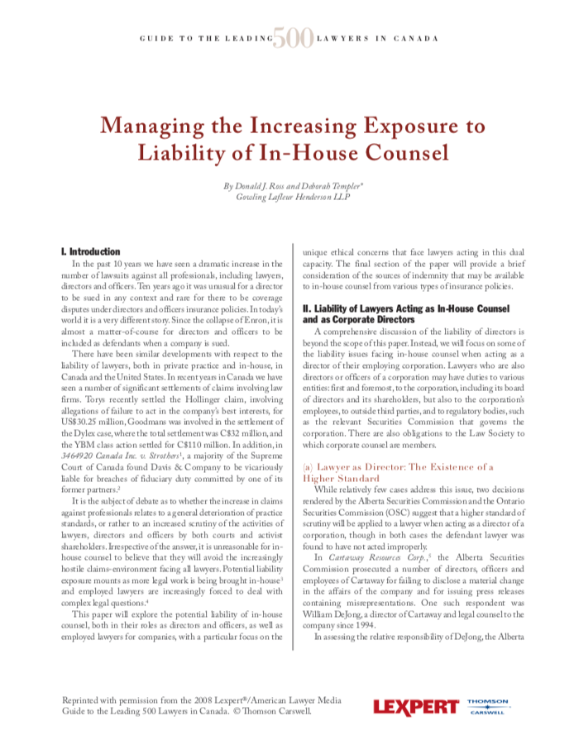

Slide 30
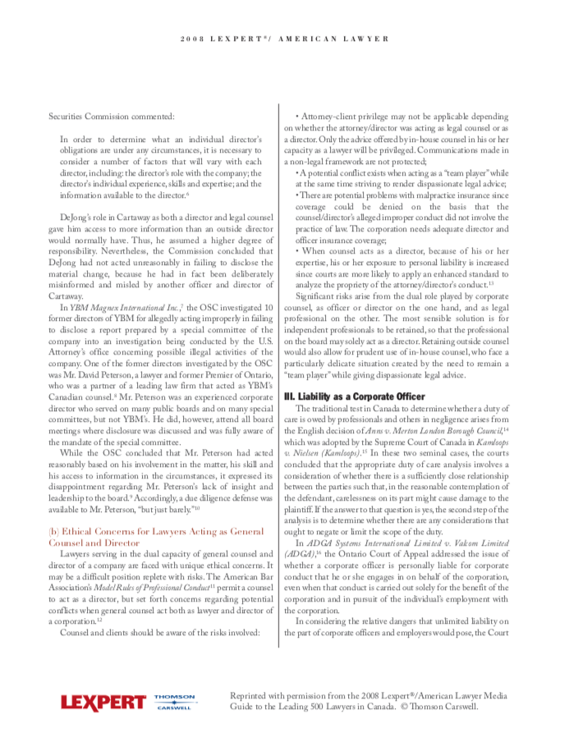

Slide 31
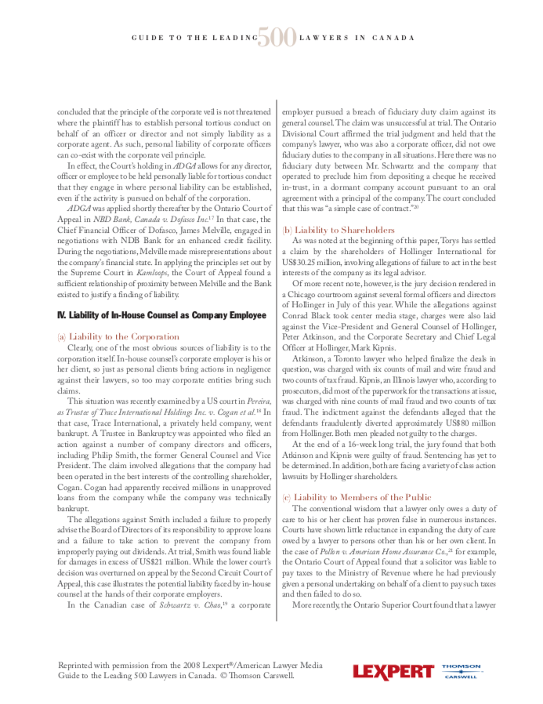

Slide 32
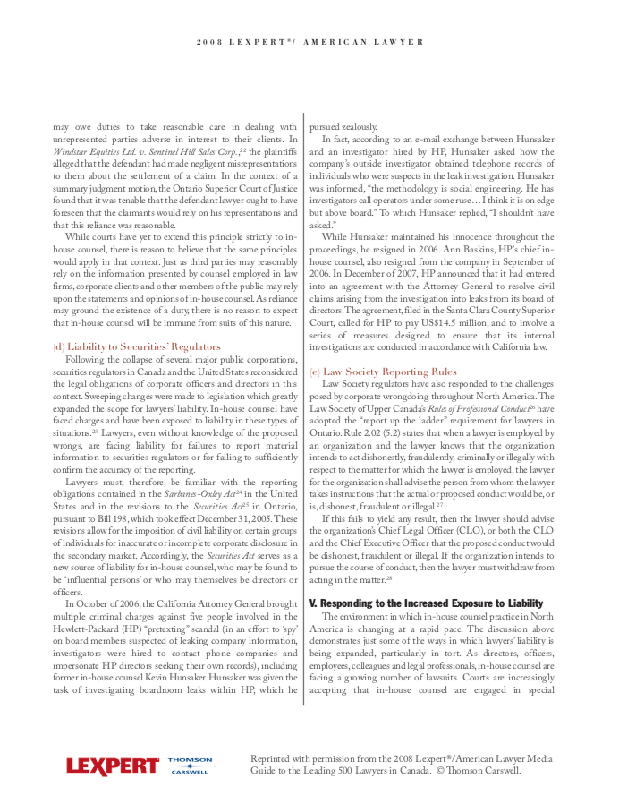

Slide 33
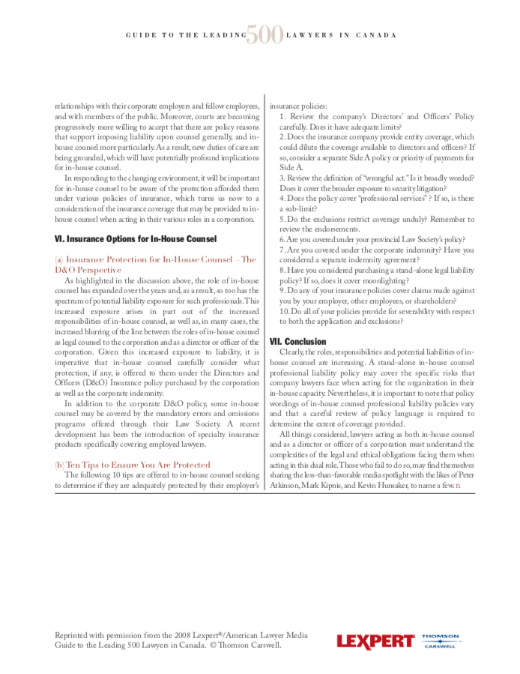

Slide 34
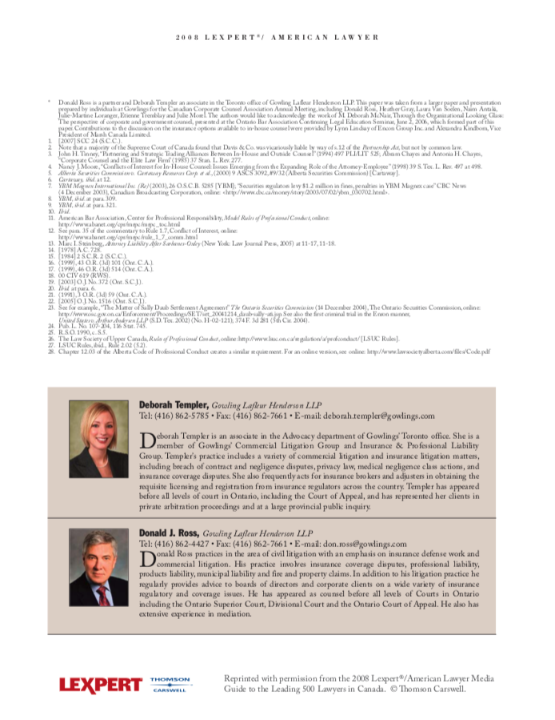

Slide 35
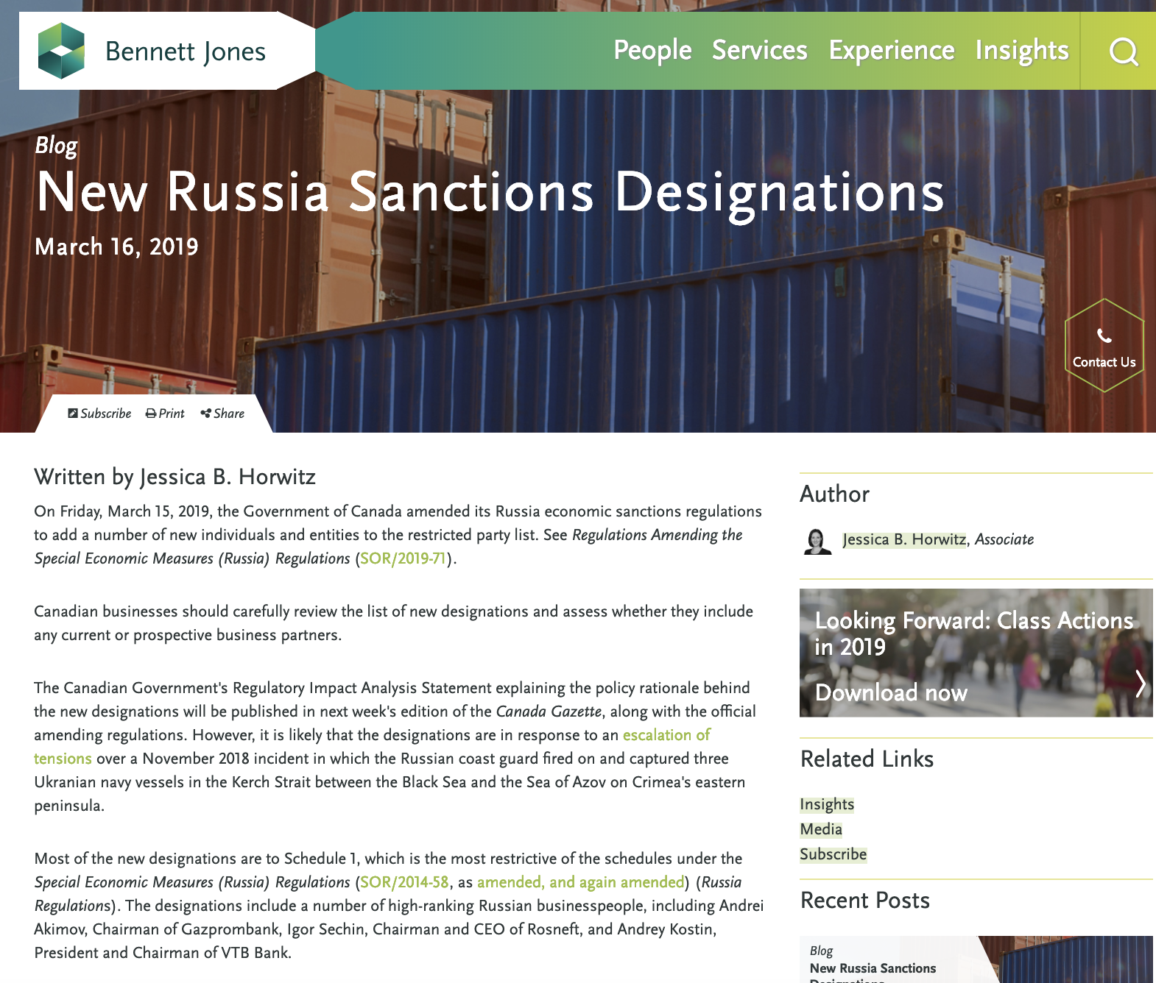
News of the Week Case Study

Slide 36
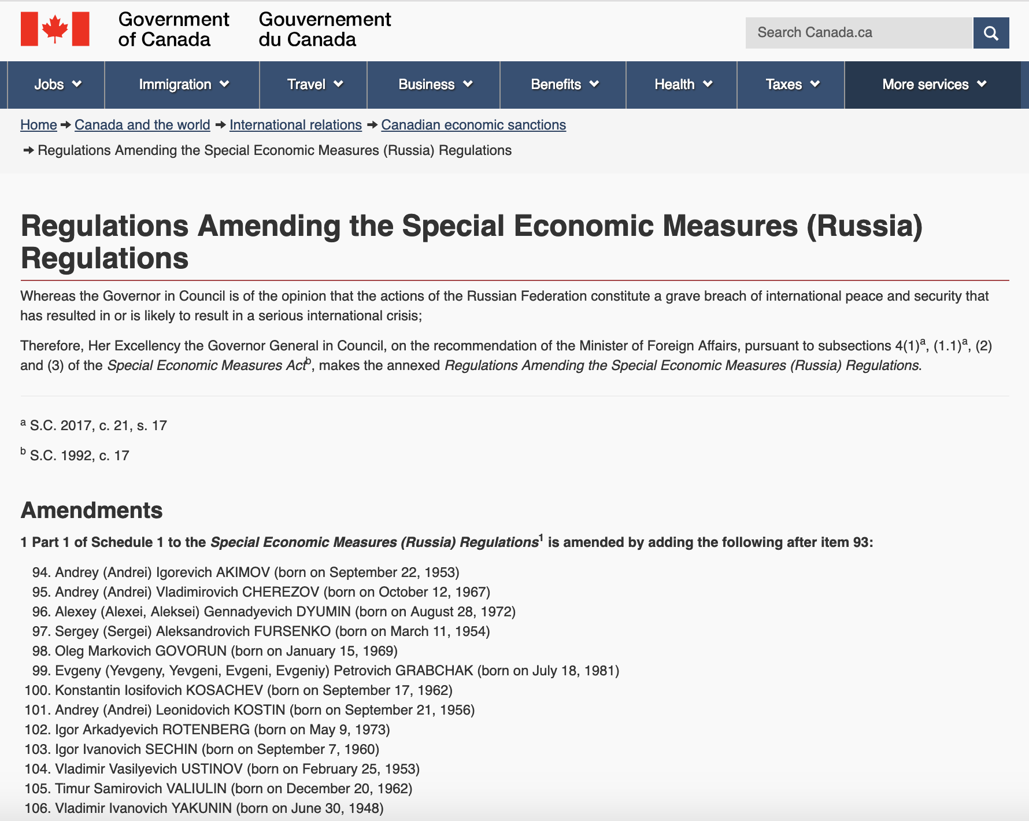

Slide 37
QUESTIONS?
THOUGHTS?
DISCUSSION?

Slide 38
Pause

Slide 39

What would you do?

Slide 40


Slide 41
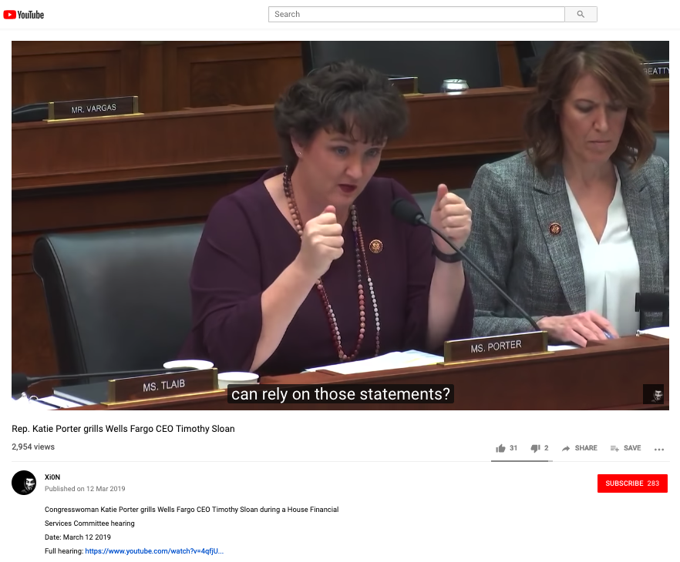
https://youtu.be/JQkNrykwwMo

Slide 42
+ Postscript re governance #1

Slide 43

Is Corporate Governance synonymous with…
Shareholders rights?

Slide 44
LOOK CLOSELY…
“Shareholders Rights”
leads directly to…………
→→→→→→→→→→→
$$$$$$$$$$$$$$$$$$$

Slide 45
On the other hand…consider
“Corpocracy”
= corporate + bureaucracy

Slide 46
USA v. Canada
In the U.S., while “Director’s duties” are owed to the corporation, a sale of the corporation shifts those duties to maximizing shareholder value (Revlon Inc. v MacAndrews & Forbes Holdings 1986).
Canadian corporate Directors always must act honestly and in good faith with a view to the best interests of the corporation itself. The fiduciary duty and the duty of care are always owed to the corporation, even during a sale process. Of course these duties are owed to the corporation and all its “stakeholders”, including shareholders, but the financial interests of shareholders or any one class of shareholders will not necessarily prevail. The BCE case demonstrates this.
If anything is paramount, it is the Business Judgment Rule which defers to the company’s Directors.

Slide 47
+ Postscript re governance #2

Slide 48
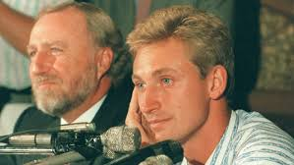
Back to:
369413 Alberta Ltd v. Pocklington
(2000) 194 D.L.R. (4th) 109 (Alta. C.A.)

Slide 49
Nothing to do with #99 (directly)
Gainers was a significant Canadian meat-packing company.
In acute financial distress, Gainers breached an agreement it had not to sell or dispose of its assets without the prior written consent of the Province of Alberta.
Peter Pocklington owned Pocklington Foods Inc. which held shares in Gainers and was Gainer’s sole director.
The Province sued Pocklington alleging that Pocklington had “induced” the breach by signing a director’s resolution transferring certain shares in another company owned by Gainers (valued in the millions) to another of his own companies, Pocklington Holdings Ltd., for $100.
The Court awarded the Province $4.7 million in damages as against Pocklington.

Slide 50
Think about the distinctions…
Gainers liable for breach in any event.
Provable through Pocklington’s actions as agent or Director?
Is Pocklington liable as Director if outside the narrow exemption of the principle in Said v. Butt (servant acting bona fide within the scope of his authority procures or causes the breach of a contract)? Note that Agda indicates liability is possible even if acting bona fides.
Pocklington always could be liable personally for inducing breach of contract by Gainers.
Which fits best?

Slide 51

THREE NOTES…
None of the methods on the previous slide are really piercing the corporate veil.
Seems that “inducing breach of contact” is a favorite method of achieving a similar result as to liability without piercing.
The paucity of actual “piercing” cases and the lack of clarity around the doctrine makes alternative methods arguably more attractive.

Slide 52
Elements of Inducing
Breach of Contract
Fruman J.A. set out them out:
In order to find that a defendant intentionally induced a breach of contract, seven elements must be established:
i) the existence of a contract;
ii) knowledge or awareness by the defendant of the contract;
iii) a breach of the contract by a contracting party;
iv) the defendant induced the breach;
v) the defendant, by his conduct, intended to cause the breach;
vi) the defendant acted without justification; and
vii) the plaintiff suffered damages…

Slide 53
“Justification” is possible
(just not this time)…
“In some situations, a defendant’s plea of justification may avoid liability…The defence of justification is available when the defendant caused the breach while acting under a duty imposed by law…
Directors of companies owe duties to the corporation; they are obliged both at common law and under Statute to act in the best interests of the company…
Therefore, when the interests of the company are best served by breaking its contractual commitments, the director’s act of inducement is justified because it is “taken as a duty”…

Slide 54
The decision…
Pocklington has not demonstrated any legitimate business interest of Gainers that could have been served by the 350151 share transfer…
By transferring the 350151 shares to his own company, Pocklington was not discharging his legal duty to act honestly and in good faith with a view to the best interests of Gainers; he was acting solely in his own interests. As no legitimate interest of Gainers could possibly be served by the transaction, the court need not go on to consider whether Pocklington’s act was aimed at depriving Alberta of the benefits of its contract. Pocklington’s position as director cannot provide justification for his actions.”

Slide 55
Alternate Reading (just for fun)…
Pocklington has not demonstrated any legitimate… interest of the Oilers that could have been served by the Gretzky… transfer…
By transferring Gretzky…Pocklington was not discharging his ownership duty to act honestly and in good faith with a view to the best interests of the Oilers; he was acting solely in his own interests. As no legitimate interest of the Oilers could possibly be served by the transaction, the court need not go on to consider whether Pocklington’s act was aimed at depriving the fans of the benefits of the Gretzky contract. Pocklington’s position as owner cannot provide justification for his actions..

Slide 56
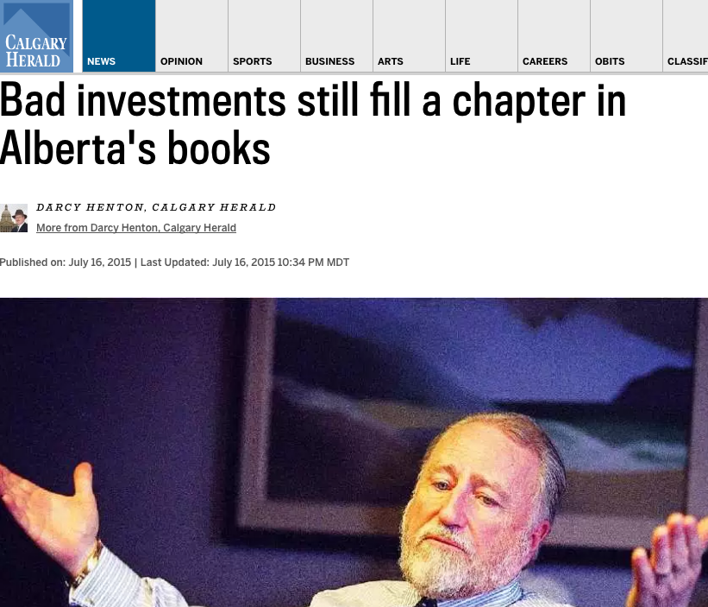

Slide 57
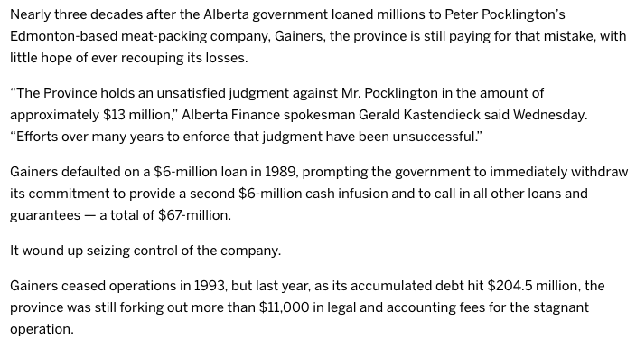

Slide 58
+ Postscript re governance #3

Slide 59
S. 142 BC BCA
Duties of directors and officers
142 (1) A director or officer of a company, when exercising the powers and performing the functions of a director or officer of the company, as the case may be, must
  (a) act honestly and in good faith with a view to the best interests of the company,
  (b) exercise the care, diligence and skill that a reasonably prudent individual would exercise in comparable circumstances,
  (c) act in accordance with this Act and the regulations, and
  (d) subject to paragraphs (a) to (c), act in accordance with the memorandum and articles of the company.
(2) This section is in addition to, and not in derogation of, any enactment or rule of law or equity relating to the duties or liabilities of directors and officers of a company.

Slide 60
A (cynical) G.C.’s view…
…of what “best interests of the company” and “best interests of the shareholders” really mean.
Bait & Switch to “shareholders”
When not uttered by a court, those words seem to align almost shockingly well with the financial best interests of whoever is uttering them.

Slide 61
QUESTIONS?
THOUGHTS?
DISCUSSION?

Slide 62
Pause

Slide 63
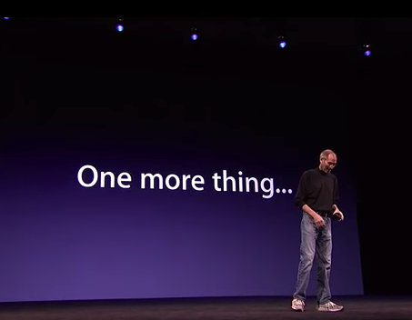

Slide 64
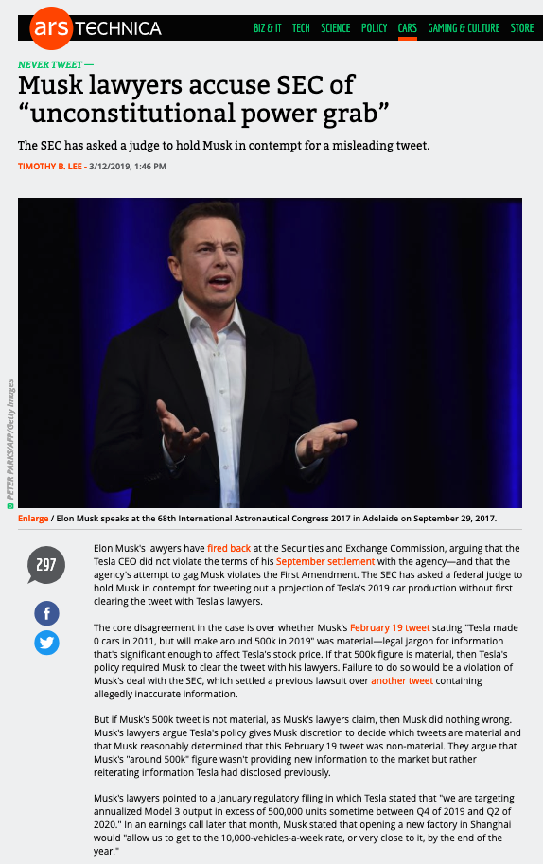

Slide 65
QUESTIONS?
THOUGHTS?
DISCUSSION?

Slide 66
Pause

Slide 67
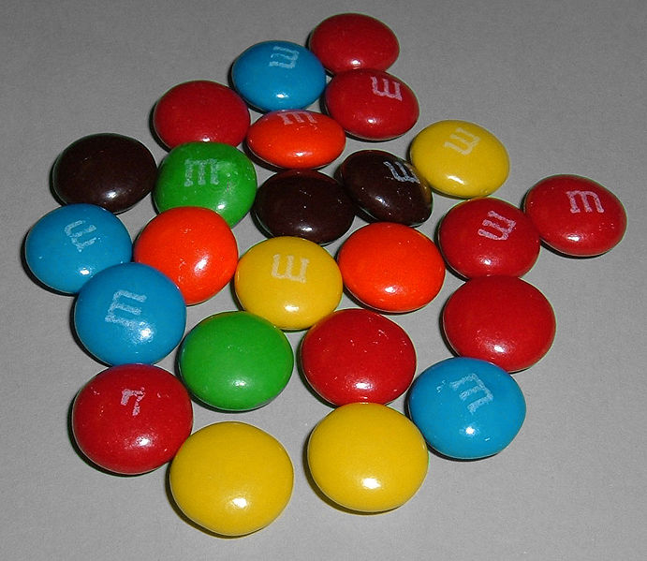

A MATTER OF PERSPECTIVE

Slide 68

Conclusion

Slide 69
SEE YOU
NEXT WEEK!

Slide 70

Always include a cat picture

Slide 71
In learning you will teach
And in teaching you will learn
Phil Collins' Son of Man (1999)

Slide 72
Our Academic Partners

