Slide 1
In-house Counsel: A case study on various scandals
Hodson Harding
Christian Penkert
Jim Ashford
Jorgan Tennant

Slide 2
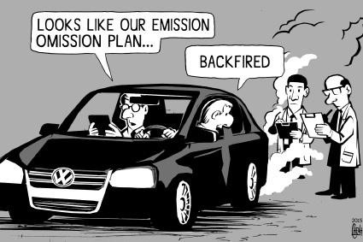
Volkswagen emission scandal

Slide 3
What?
In 2017, Volkswagen agreed to plead guilty to criminal charges and settle a federal investigation into its "clean diesel" emissions fraud -- for $4.3 billion in civil and criminal penalties.
For nearly a decade, from 2006 to September 2015, Volkswagen anchored its U.S. sales strategy on a breed of cars that turned out to be a hoax. They were touted as “Clean Diesel” vehicles.
About 580,000 such sedans, SUVs, and crossovers were sold in the U.S. under the company’s VW, Audi, and Porsche marques.
It was all a software-conjured mirage. The exhaust control equipment in the VW diesels was programmed to shut off as soon as the cars rolled off, spewing illegal levels of nitrogen oxides into the atmosphere, causing smog, respiratory disease, and premature death.

Slide 5
Who?
Attorney A was "the in-house attorney principally responsible for providing legal advice in connection with VW AG's response to U.S. emissions issues.
The attorney told VW employees that a litigation hold would soon apply to certain documents, statements which employees "understood to mean that they should delete documents prior to the hold being issued.
Employees then deleted thousands of documents.
Notes:
What exactly did Attorney A say to employees that caused them to start rapidly hitting delete? Were VW workers actually instructed to destroy documents, even implicitly? The document doesn't say.
It's possible that any destruction of documents was simply a result of poor communication, rather than obstruction.
The best case interpretation of the facts in the plea agreement is that the attorney did not clearly and accurately define the employees' obligations and the potential ramifications of destroying evidence, and the employees misinterpreted the warnings of a coming litigation hold. The attorney presumably did not explain that deleting documents relevant to a criminal investigation is a separate offense.

Slide 6
WHY?
Volkswagen’s conduct was egregious, a concerted fraud around the core value proposition of “clean diesel.”
Somebody at Volkswagen deliberately conspired to manipulate tests run by a multitude of government agencies to mask emissions.
One tenet of the New Normal is that we’ve moved into a world of transparency where any improper action is almost certain to be revealed over time. Which leads to the iconic DieselGate question:
What did Volkswagen’s lawyers know, and when did they know it?

Slide 7
How?
Most of the literature around the role of lawyers and their ethical duty is incredibly relevant.
The real question is “were the lawyers engaged enough in the business to know what was going on?” If they were, it seems certain that they could have prevented this manipulation from occurring.
So how can lawyers truly be effective in managing risk?
Notes:
By offering sage and ethical counsel, which in the aggregate reduces risk.
Maybe spend less time broadly claiming to reduce risk, and more time really understanding the business and the sources of risk. Skilled lawyers can combine the roles of a trusted problem solver with independent judgment andintegrated understanding, working with the people making risk-based decisions. Since these kind of corporate shortcuts almost always result in disaster in a transparent world, it’s just common sense and enlightened self-interest that any manager can apply to avoid them. It doesn’t require a distinctive notion of professional formation to, as the president says, “don’t do stupid stuff,” and it may be that a lot of our self-definition around professional norms reduces the chance of being appropriately engaged.
In Volkswagen, not knowing was just as bad as knowing and acquiescing. Maybe we should start talking about a duty to know what’s going on.

Slide 8
Prevention: A Summary
Learn
Adapt
Stay Updated
Notes:
By offering sage and ethical counsel, which in the aggregate reduces risk.
Maybe spend less time broadly claiming to reduce risk, and more time really understanding the business and the sources of risk. Skilled lawyers can combine the roles of a trusted problem solver with independent judgment andintegrated understanding, working with the people making risk-based decisions. Since these kind of corporate shortcuts almost always result in disaster in a transparent world, it’s just common sense and enlightened self-interest that any manager can apply to avoid them. It doesn’t require a distinctive notion of professional formation to, as the president says, “don’t do stupid stuff,” and it may be that a lot of our self-definition around professional norms reduces the chance of being appropriately engaged.
In Volkswagen, not knowing was just as bad as knowing and acquiescing. Maybe we should start talking about a duty to know what’s going on.

Slide 9
Nevsun Resources Ltd.
In 2014 three Eritrean refugees filed a lawsuit against Nevsun Resources, a BC Corporation headquartered in Vancouver, alleging the company was complicit in the use of forced labour.
In 2016 the BCSC rejected Nevsun’s motion to dismiss, ruling the case should proceed in BC due to doubts that the plaintiffs will get a fair trial in Eritrea.
In 2017 the BCCA rejected Nevsun’s appeal to dismiss, allowing the claim to proceed on the basis of inter alia crimes against humanity, slavery, forced labour, and torture.
First time a Canadian appellate court has permitted a mass tort claim for modern slavery.
January 23rd 2019 arguments for both parties proceed to SCC.
Outcome currently unavailable due to a sealing order.

Slide 10
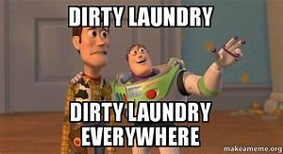
Background
In 2007 Nevsun entered an agreement with the State of Eritrea to develop the Bisha Gold Mine.
Plaintiffs seek damages on behalf of all Eritrean nationals who were forced to work at the Bisha Mine since its inception.
Principle allegations: use of forced labour; torture; cruel, inhuman or degrading treatment; crimes against humanity; conversion; battery; unlawful confinement; negligence; conspiracy; and negligent infliction of mental distress.

Slide 11
Background
Nevsun patently denies all allegations:
To date the court battle has been an attempt by Nevsun to obtain an order under the CJPTA providing that the matter should appropriately be held in Eritrea.
Nevsun has tried to distance itself from the issue by saying that the Mine is actually owned by the Bisha Mine Share Company - Problem is that BMSC is actually a wholly-owned subsidiary.
In-house lawyers’ clients include wholly-owned subsidiaries (Mutual Life Assurance Co of Canada v Canada, 1988 Carswell Ont 423 (Ont. H.C.).

Slide 12
“Conscripted Labour”?
From the beginning the Plaintiffs have maintained that the operations at the Bisha Mine are premised on slavery. In response, Nevsun uses the clever (albeit odd) euphemism “conscripted labour”.
Eritrea operates a National Service Program:
Six-month military training program plus a twelve-month military service program whereby individuals are placed in military, government, or “other workplaces for training”.
Plaintiffs claim the NSP “rules” are just words:
Not permitted to leave Bisha Mine - upwards of 6 years on-site
Conditions include working 12+ hours/day, 50 degree temperatures, regular beatings, food rations, accommodations are huts with no beds or electricity.

Slide 13
Is Eritrea Suited to Hear This Matter?
Eritrea is a member of the UN, recognized by Canada.
Eritrea is governed by the People’s Front for Democracy and Justice.
Only political party since independence; has never held an election.
Eritrea does not have a Constitution:
Legislature has not convened since 2002. Laws are “passed, amended, and repealed by government decree only”.
Government closed only law school in 2002.
No private legal practice licence has been issued since 1995.
Does not recognize causes of action for forced labour, torture, slavery, crimes against humanity etc.
Judges are appointed by the NSP, have no right to leave work, may be detained without process, and are subject to travel restrictions,
No right to counsel; trials are closed to public; no appeals; courts are not bound by res judicata.

Slide 14
Moral of the Story
The in-house team at Nevsun has a duty to the company.
To the extent that this means share prices/profit simpliciter they are apparently doing their job (it is literally a gold mine).
To the extent the best interests of the company include the company’s image (or basic decency), their performance metric is less clear.
For in-house counsel at major multinational companies, is it your responsibility to be in-tune with on-the-ground operations?
If it is, then how do you reconcile your professional (Canadian) obligations with legal rules that are completely adverse in the nation at issue?
How do you reconcile your obligations as a lawyer where your company is doing something illegal by Canadian standards?

Slide 15
What Does it all Mean?
The ramifications of this case more broadly have implications for the role of in-house counsel:
If the company can be held liable for its behaviour overseas in a more meaningful way, then the role of in-house counsel at multinational firms is about to get a whole lot more complicated.

Slide 16
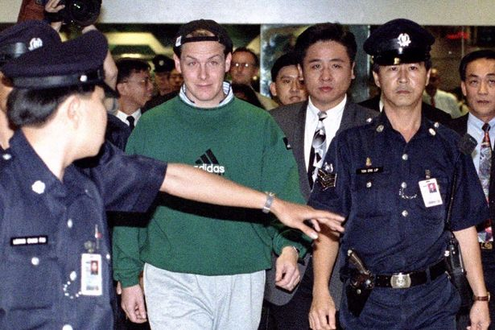
Barings Bank – Organizational Failure

Slide 17
Background
Barings Bank was a British Bank founded in 1762. The bank collapsed into administration in 1995 after losing £827 million (£1.6 billion or 2.8 billion CAD today). This collapse resulted from the banks failure to foresee the risk that one trader was taking with the banks available short-term funds.
The losses were caused exclusively by one trader in Barings Singapore office who was executing a series of escalating unauthorized trades over a period of years. The trader, a man by the name of Nick Leeson was holding two conflicting roles within the office at the time, acting as both the head of settlements and the office’s head of trading.

Slide 18
Why is this interesting 25 years later?
As in-house counsel, it is important to ensure that the company is operating legally, and complying with regulatory requirements. Obviously, it is necessary that employees are not committing fraud
It is also important that company practices and procedures set in place to avoid these issues are being followed. Nick Leeson was deceiving his superiors through fraudulent accounting of his trades. There was no reason for this not to be detected much earlier than it really was.
The directors of the company and the senior executives were not fulfilling their fiduciary obligations to the company.
Baker v Secretary Of State For Trade And Industry, [2000] EWCA Civ 59 (25 February 2000).

Slide 19
Nick Leeson’s trading strategy and fraud
In July of 1992, Leeson opened account 88888, which he designated as a client account. Leeson apparently hide losses from certain proprietary trades in this account.
“By mid-December 1994, Leeson was taking extraordinary gambles in the market and making daily requests for substantial funds from Barings in London; despite rather feeble attempts to question these requests, the funds were always provided. Ultimately Baring Brothers authorised UK £538 million to fund Leeson’s activities, a sum that was both illegal and frighteningly close to the bank’s entire assets”
“All this time there was growing alarm in the markets about Leeson’s increasingly peculiar activities: three weeks prior to the collapse, the ‘Barings overhang’ had become common gossip among traders in Singapore, Tokyo and London. Neither was this information hidden from senior managers at Baring Securities: they were warned many times by market professionals, their own traders, and had received no less than five warning letters from SIMEX concerning Leeson’s activities.”
Stein, M., 2000. The risk taker as shadow: a psychoanlytic view of the collapse of barings bank. Journal of Management Studies, 37(8), pp.1215-1230.
Notes:
THE RISK TAKER AS SHADOW: A PSYCHOANALYTIC VIEW OF THE COLLAPSE OF BARINGS BANK*Mark stein

Slide 20
Hearing from the people that were there
https://www.youtube.com/watch?v=CkhcpcuZvV4
From 34:02 to 35:59

Slide 21
Issues that Barings should have been aware of
Leeson was able to execute these trades without any oversight. An issue that largely stemmed from his position holding two roles that conflict with each other.
Reporting procedures were not being followed within the organization. In order to sustain these positions in the market, Barings was putting a lot of cash into the Leeson’s activities in order for these trades to be executed.
Another potential issue is that this arose as a result of Barings getting into proprietary trading without prior experience. Previously, Barings had only been using clients money to execute trades. This highlights the importance of knowing your business.

Slide 22
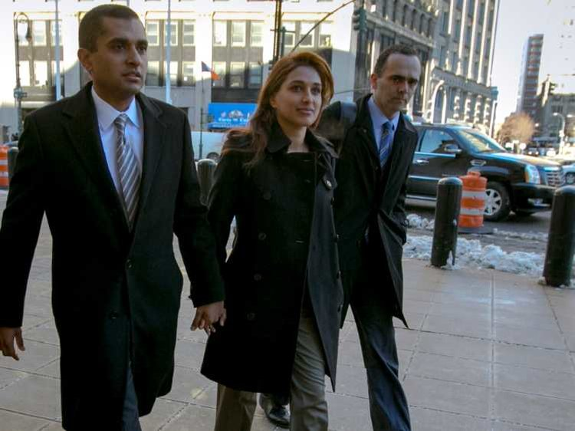
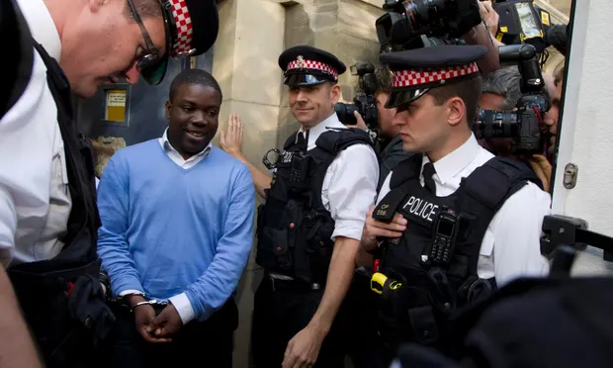
Takeaway for in-house counsel
Know your company and know the business that you are in.
Preventing fraud and incompetence. Several high level managers, executives, and board members were incompetent in their duties to the company.
Barings collapsed due to its inability to have proper risk management policies in place and because of the complete lack of corporate structure to deal with issues.
There was ignorance to internal audits and warnings about Nick Leeson’s activities that should not have been ignored.

Slide 23
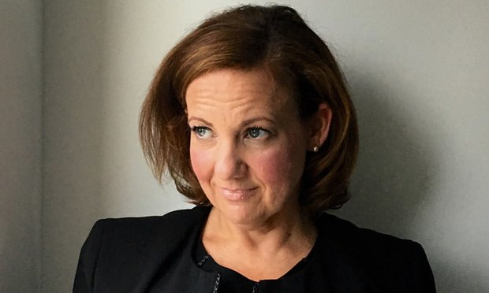
Revisiting Wendy Jaffe and Lionsgate
Ms. Jaffe is in-house counsel, harassed by general counsel Wayne Levin.
Outside investigator hired to look into the matter. Ms. Jaffe declined to cooperate because investigation was not being conducted seriously/was not independent.
How should Lions Gate have handled this better?

Slide 24
Sexual Harassment as a Corporate Issue
Half of Canadian Women say they have been subjected to sexual harassment at work.
28% say they have experienced non-consensual touching in the workplace (overwhelming majority did not report the incidents).
And yet…
94% of Canadian executives believe that sexual harassment is not a problem at their company.
93% believe they have a corporate culture that prevents sexual harassment.
69% believe that it is less of a problem than 15 years ago.
2007 U of C study determined single biggest predictor of sexual harassment in the workplace is how permissive an organization is towards this behavior.

Slide 25
How to Navigate Workplace Sexual Harassment as In-House Counsel?
“It falls on the shoulders of in-house counsel to ensure that their company policies, procedures, and investigative techniques can withstand the heightened scrutiny of a #MeToo movement”
The extent of the employer’s liability and the remedial consequences that may be imposed will be affected by 3 things:

Slide 26
Steps Taken To Avoid the Harassment
Creating harassment policies and procedures.
Implementing the policies through management and employee training.
Using progressive discipline where there are violations.
Sample Policy: https://ca.practicallaw.thomsonreuters.com/w-004-1817?originationContext=document&transitionType=DocumentItem&contextData=(sc.Default)&firstPage=true&bhcp=1

Slide 27
2. How Quickly and Effectively the Employer Responds to a complaint
Promptly investigating and responding to complaints.
Ensuring that the investigation is carried out by a neutral third party.
Ensuring that all evidence is considered in the investigation.

Slide 28
3. Steps the Employer Takes to Prevent a Recurrence
Taking steps to end the harassment.
Implementing corrective measures with the harasser.
Following up with the complainant to ensure that there has been no recurrence of the harassment or reprisal for filing the complaint.

Slide 29
Takeaways
Have a policy in place!
Choose your investigator wisely.
Ensure that employees are familiar with the policy/receive training.
Not just about the corporation.

Slide 30
sources
https://www.bchrc.net/sexual_harassment
https://kentemploymentlaw.com/2018/workplace-sexual-harassment-an-employment-law-perspective/
https://www.canadianlawyermag.com/article/managing-metoo-15860/
https://www.wsj.com/articles/at-lions-gate-a-drama-in-the-legal-department-1532104228
http://angusreid.org/me-too/
https://www.cbc.ca/news/canada/british-columbia/mandalena-lewis-bc-court-of-appeal-westjet-1.5029027
https://www.canadianlawyermag.com/author/jim-middlemiss/navigating-sexual-harassment-in-a-metoo-world-16228/
https://www.ubyssey.ca/features/one-year-later-now/
Harassment: Overview
Practical Law Canada Practice Note Overview w-002-9150

