Slide 1
Ethical Issues
For in-house counsel

Slide 2
The general council has one foot planted firmly in the shifting treacherous terrain of the law, and the other planted just as firmly in the oozing swamp of business
Timothy Terell (Law Professor)

Slide 3
It’s my company and I’ll decide what to tell the board.
Conrad Black

Slide 4
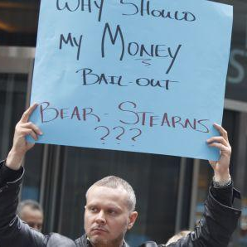
Changing
Roles and Responsibilities
The financial crisis of the early 2000’s that swept both wall street and bay street as well as the peculiar but spectacular rise of the class action have undoubtedly been the major catalyst in the addition and evolution of in-house counsel’s investigatory responsibilities and powers. corporate officers, directors as well as outside regulators increasingly expect in-house counsel to be proactive in investigating and ferreting out complaints that may result in any liability to the corporation

Slide 5
IN-HOUSE CORPORATE COUNCIL
ETHICAL
INVESTIGATIONS
BY JUSTIN KLASSEN

Slide 6
Internal investigations may be necessary in order to uncover and deal with wrongdoing within the corporation, ensure compliance with applicable laws and regulations or minimize the long term criminal and civil liability of its client the corporation.

Slide 7
How can in-house counsel conduct investigations in an ethical, legal, and comprehensive manner?

Slide 8
The ethical woes of
Conrad Black
8

Slide 9
Laws &
Regulations

Slide 10
1
An employer must conduct a preliminary investigation under section 175 and a full investigation under section 176 respecting any accident or other incident that:
a
is required to be reported by section 172,
b
resulted in injury to a worker requiring medical treatment,
c
did not involve injury to a worker, or involved only minor injury not requiring medical treatment, but had a potential for causing serious injury to a worker, or
The Workers Compensation Act
d
was an incident required by regulation to be investigated.
173 Incidents that must be investigated (slide)
2
Subsection (1) does not apply in the case of a vehicle accident occurring on a public street or highway.

Slide 11
What are the events that could trigger an investigation?
THE HUMAN RIGHTS CODE
[RSBC 1996] CHAPTER 210
43 A person must not evict, discharge, suspend, expel, intimidate, coerce, impose any pecuniary or other penalty on, deny a right or benefit to or otherwise discriminate against a person because that person complains or is named in a complaint, might complain or be named in a complaint, gives evidence, might give evidence or otherwise assists or might assist in a complaint or other proceeding under this Code.
(section 43 of the HUMAN RIGHTS CODE [RSBC 1996] CHAPTER 210)
Notes:
11

Slide 12
While other investigations that an ethically minded counsel would look into include:
Harassment
Bullying
Workplace Illness
Workplace Injury
Whistleblowing
12

Slide 13
Let’s return to Conrad Black.
13

Slide 14
Some case law on insufficient investigations
Porta v. Weyerhaeuser Canada Ltd., 2001 BCSC 1480 (CanLII)
“Where the investigation conducted in the first instance by a defendant asserting just cause is insufficiently broad to establish the full nature and circumstances of the misconduct...it follows that the defendant will similarly be impeded in discharging its onus of proof in connection with its claim of just cause (at para. 14).
Notes:
14

Slide 15
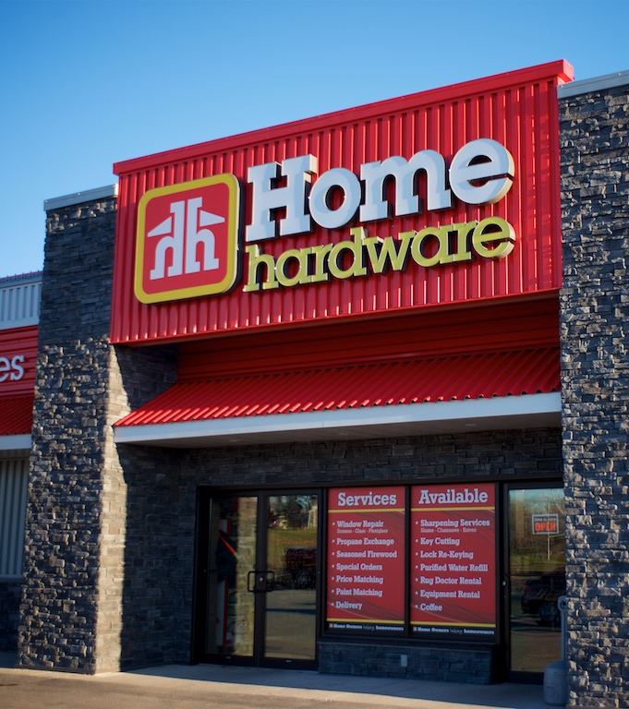
Continued...
Elgert v. Home Hardware Stores Limited 2011 ABCA 112
“When evaluating the employer’s conduct in the context of punitive or aggravated damages, it is important to acknowledge that an employer ... .should not be punished simply because an investigation was clumsy or a jury subsequently concludes that the allegation was not substantiated ... There is no specific standard of investigation that employers must follow; what is required will vary depending on the facts surrounding the employer, its policies, sophistication, experience and the workplace. Courts must not require such a high standard of investigation that there is a chilling effect on employer’s manner of dealing with allegations of sexual harassment. (at para 88)
Notes:
15

Slide 16
Continued...
“Nevertheless, how the employer reacts is subject to judicial scrutiny. Its responsibilities do not give it license to conduct an inept or unfair investigation or to behave in malicious, vindictive or outrageous ways. “ (at para 89)
Notes:
16

Slide 17
PROS
AND
CONS

Slide 18
Back to Conrad Black
WHEN THE REGULATOR IS INVOLVED
The Executive Summary
FThe Business of Business is Conrad Black
"This story is about how Hollinger [International] was systematically manipulated and used by its controlling shareholders for their sole benefit, and in a manner that violated every concept of fiduciary duty,"
"Behind a constant stream of bombast regarding their accomplishments as self-described 'proprietors'Black made it his business to line his pockets at the expense of Hollinger almost every day, in almost every way they could devise”
Corporate Kleptocracy
Fundamental Breach of Fiduciaray Duties
“At Hollinger, Black as both CEO and controlling shareholder, together with his associates, created an entity in which ethical corruption was a defining characteristic of the leadership team."
The non-compete payments were “so far off normal practice that it is no wonder Black described them in a letter to Radler as 'the splendid conveyance of the non-competition agreements from which you and I profited so well'..."

Slide 19
Cons to an
in-house
The major issue with internal investigations is that there are no clear winners for anybody. In many ways it operates a lot like litigation, there is always somebody unhappy at the end of it and normally the end result is that people within the corporation are very stressed.

Slide 20
Ensuring an Ethical Investigation

Slide 22
Appellate tribunal orders Law Society of Upper Canada to pay DeMerchant & Sukonick $1.3M in legal costs.
22

Slide 23
OUTSIDE
OPTIONS
23

Slide 24
Evidentiary documentation and the destruction of evidence.
“Time and time again, it is the obstruction that results in the demise of white- collar offenders.… Martha Stewart went to jail for obstruction of justice. She was acquitted of securities fraud.”
- Jacob Frenkel SEC prosecutor
24

Slide 25
The Destruction of Evidence Cont.
Conrad Black removing boxes from the offices of Hollinger International in violation of a court order
25

Slide 26
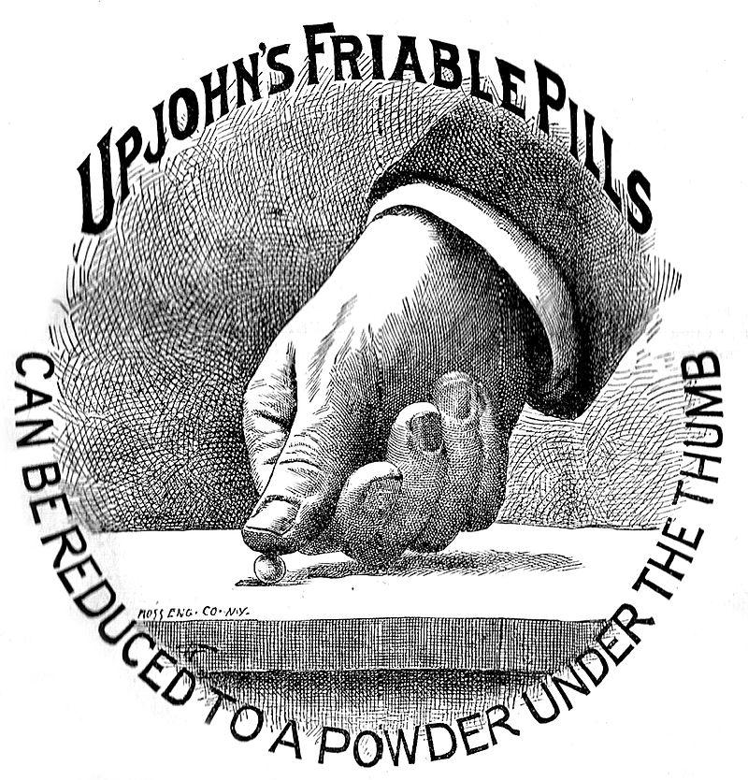
UPJOHN
WARNINGS
Upjohn Co. v. United States, 449 U.S. 383,

Slide 27
THE ISSUE
OF PRIVILEGE
Alberta (Information and Privacy Commission) v. University of Calgary 2016 SCC 53
Lizotte v. Aviva Insurance Co. of Canada 2016 SCC 52
IGGillis Holdings Inc. v. Minister of National Revenue 2018 FCA 51
27

Slide 28
Internal Investigation Management
A lot of internal investigations are basically impossible to conduct covertly. So there needs to be significant thought into how this is managed and what you might say to people within the organization how are asking questions. Here the major concern revolves around keeping witness identities, and possible perpetrators identities confidential.

Slide 29
Reporting
your findings.
Ethics

Slide 30
In
Conclusion
By JUSTIN KLASSEN
www.yourwebsite.com

Slide 31
Practice insurance
Ethical concerns for in-house counsel

Slide 32
Practice insurance
In-house counsel are exempt from the Law Society requirement to maintain practice insurance
With the current growth of in-house lawyers, this may be a problem of concern
How would you respond to a lawsuit against you personally arising from your role as in-house counsel?

Slide 33
What does the law society say?
“Lawyers who are employed (including dependent contractors) may want to consider the risk of claims arising in respect of your employment activities. Lawyers seeking protection are likely able to acquire insurance in the private market. Other options may include adding yourself as an insured to any liability insurance policy held by the employer or obtaining an indemnity from the employer.”

Slide 34
Insurance coverage
You should first identify insurance coverage that you might have through a professional errors & omissions policy or management liability policy held by your employer
1) Are you an officer?
2) What capacity were you acting in?

Slide 35
Options for ensuring coverage
1) express inclusion
2) amend company by-laws
3) employed lawyers liability insurance coverage

Slide 36
Indemnity
Contractual agreement made between two parties, in which one party agrees to pay for potential losses or damages caused by the other party
Employer must be permitted by governing legislation and its constating documents to grant an indemnity

Slide 37
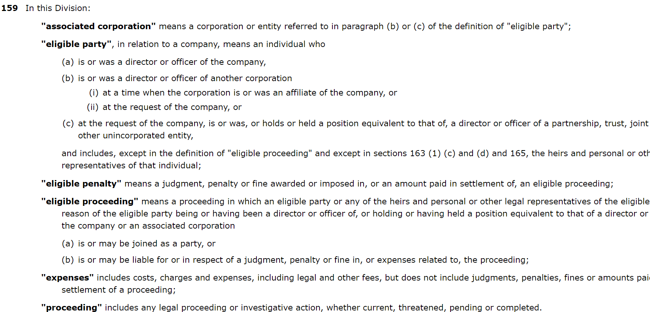
BC Business Corporations act

Slide 38
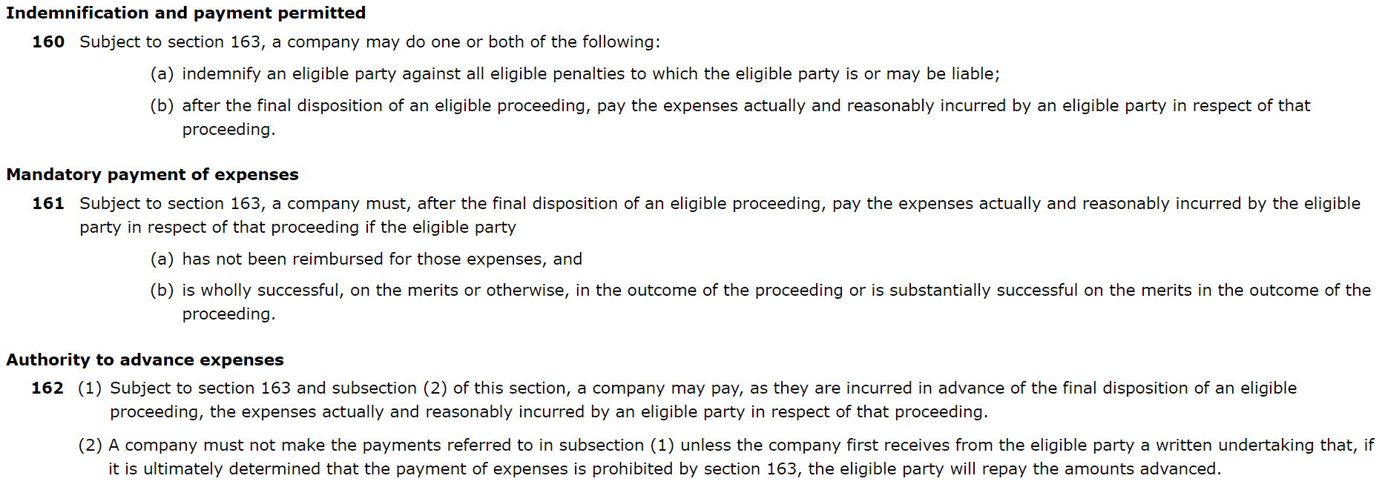
BC Business Corporations act

Slide 39
BC Business Corporations act

Slide 40
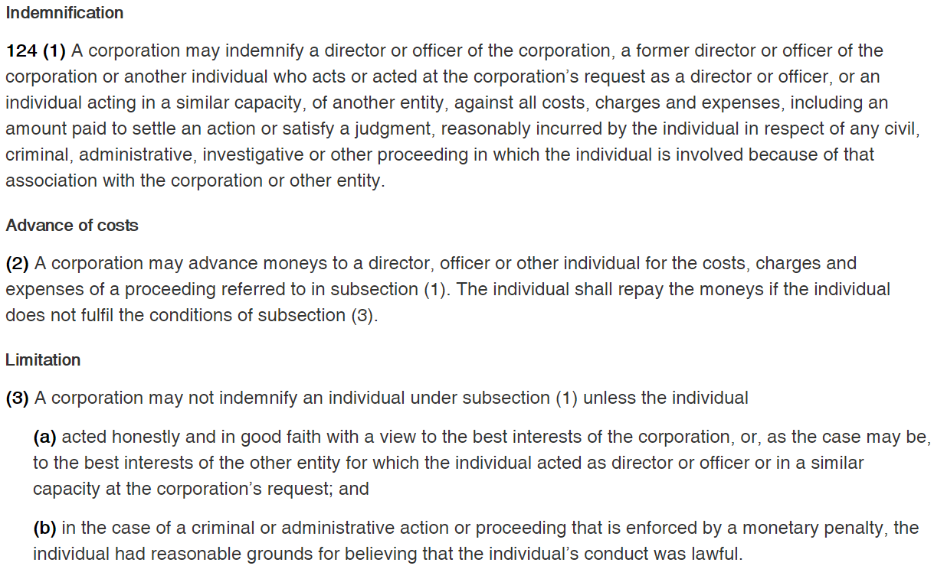
Canada business Corporations act

Slide 41
Canada business Corporations act
Officer means an individual appointed as an officer under section 121, the chairperson of the board of directors, the president, a vice-president, the secretary, the treasurer, the comptroller, the general counsel, the general manager, a managing director, of a corporation, or any other individual who performs functions for a corporation similar to those normally performed by an individual occupying any of those offices;

Slide 42
Constating documents
An employer must also be permitted by constating documents to grant an indemnity
For example, the articles of incorporation usually have specific indemnity provisions

Slide 43
21. Indemnification
In this Article 21:
“eligible penalty” means a judgment, penalty or fine awarded or imposed in, or an amount paid in settlement of, an eligible proceeding;
(2) “eligible proceeding” means a legal proceeding or investigative action, whether current, threatened, pending or completed, in which a director, former director or alternate director of the Company (an “eligible party”) or any of the heirs and legal personal representatives of the eligible party, by reason of the eligible party being or having been a director or alternate director of the Company:
(a) is or may be joined as a party; or
(b) is or may be liable for or in respect of a judgment, penalty or fine in, or expenses related to, the proceeding;
21.2 Mandatory Indemnification of Directors
Subject to the Business Corporations Act, the Company must indemnify a director, former director or alternate director of the Company and his or her heirs and legal personal representatives against all eligible penalties to which such person is or may be liable, and the Company must, after the final disposition of an eligible proceeding, pay the expenses actually and reasonably incurred by such person in respect of that proceeding. Each director and alternate director is deemed to have contracted with the Company on the terms of the indemnity contained in this
Article 21.2.
21.3 Permitted Indemnification
Subject to any restrictions in the Business Corporations Act, the Company may indemnify any person.

Slide 44
Privilege and confidentiality
Ethical concerns for in-house counsel

Slide 45
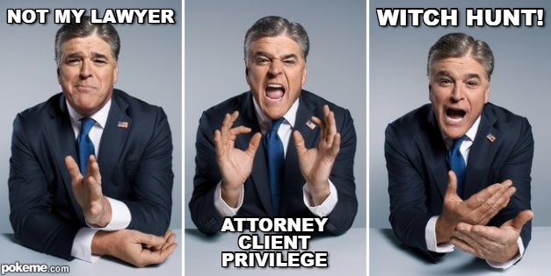
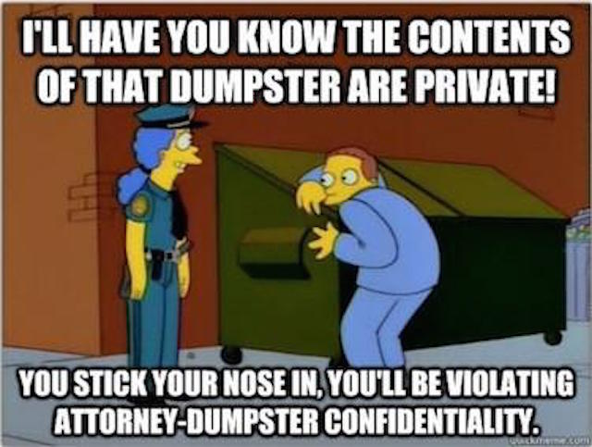
SOLICITOR

Slide 46
What is solicitor-client privilege?
Arises when:
Where legal advice of any kind is sought
From a professional legal adviser in their capacity
Communications relating to that purpose
Are made in confidence
By the client
Are at their instance permanently protected
From disclosure by them or their legal advisor
Except if waived

Slide 47
What is solicitor-client privilege?
Reason for privilege:
“the purpose of privilege is to ensure that a solicitor may, for the purpose of preparing himself to advise or conduct proceedings, proceed with complete confidence that the protected information or material he gathers from his client and others for this purpose, and what advice he gives, will not be disclosed to anyone except with the consent of his client”
Hodgkinson v. Simms (BCCA)

Slide 48
What is confidentiality
Ethical duty of confidentiality
Applies to all information learnt working for a client
The duty exists regardless of source or confidential status before information became part of the solicitor-client relationship
Survives the end of the lawyer client relationship (McCormick)
Wider than privilege
Source of duty is the LSBC Code of Professional Conduct 3.3-1

Slide 49
Exceptions
Solicitor-client privilege | Confidentiality
Public safety Innocence of an accused Advice to facilitate a crime | Future harm/public safety (3.3-3) Defend misconduct/criminal offence/civil liability by lawyer (3.3-4) To collect fees (3.3-5) To secure legal or ethical advice from another lawyer (3.3-6) To detect/ resolve conflicts of interest from new employment (3.3-7) Expressly or impliedly authorized by the client (3.3-1(a)) Required by law or a court to do so (3.3-1(b)) Required to deliver the information to the Law Society (3.3-1(c))

Slide 50
Application to in-house counsel
Does solicitor-client privilege apply the same way to in-house counsel?
YES
Does the duty to maintain confidentiality apply to in-house counsel?
YES
Do special concerns arise?
YES

Slide 51
When does privilege apply?
Does not always apply
Will arise when:
The communication must be between a solicitor and client
The communication must be made in confidence
The communication must be made in the course of seeking legal advice

Slide 52
Who does the privilege belong to?
Not the board
Not the shareholders
The corporation

Slide 53
Special concerns for in-house counsel
Thoughts?

Slide 54
Special concerns for in-house counsel
When acting as the corporate secretary
Typically when acting in a non-legal capacity, privilege will not apply
When providing non-legal advice
Privilege will not apply to purely business advice
Advice "as to what should be done in the relevant legal context”
Iintertwined business/legal advice has been protected (risky)

Slide 55
Special concerns for in-house counsel
When asked to comment on ongoing legal issues for the purposes of an audit
Joint CBA-AASB policy statement that sets a framework to make disclosures that do not intend to waive privilege
Disclosure letter to auditors may not be privileged
Subject matter should still retain privilege
When disclosure compelled doctrine of limited waiver has been applied

Slide 56
Special concerns for in-house counsel
Acting in the capacity of privacy officer
Federal privacy legislation cannot compel privileged information
BC privacy legislation protects privileged information from disclosure
Information disclosure is not necessarily a waiver of privilege
When disclosure compelled doctrine of limited waiver may be applied

Slide 57
Deal teams
Working external with non-legal actors as part of a team
E.g. an accountant analyzing financial statements for the formation of a legal opinion of deal
Generally covered by solicitor-client privilege
Widely recognized that privilege applies to non-lawyer employees assisting in preparing legal advice

Slide 58
Whistleblowing
Solicitor client privilege does not apply when a client is seeking advice on how to commit a crime
Client confidentiality does still apply
What does this mean for in house counsel?

Slide 59
Whistleblowing
What does this mean for in house counsel?
Client confidentiality must be maintained
No whistleblower protection from LSBC
Only “up-the-ladder” reporting is permissible (and required)
This means going to the person above the lawyer on the chain of command
What if this person is the CEO or owner? Then what?
In the United States lawyers are allowed to breach confidentiality to blow the whistle on illegal activity

Slide 60
How to maintain privilege?
Identify when acting as legal counsel
Have policies to separate operational and legal advice
Communications practices
Ensure procedures are followed
Follow up on possible loss of privilege
Have waiver avoidance strategies

Slide 61
References
Mills, K. B. Privilege and the In-House Counsel”(2003). Alta. L. Rev., 41, 79.
Patzelt, R. (2011). Solicitor & Client Privilege, A brief perspective from in-house counsel (Rep.).
Code of Professional Conduct for British Columbia (the BC Code) – annotated. Retrieved from https://www.lawsociety.bc.ca/support-and-resources-for-lawyers/act-rules-and-code/code-of-professional-conduct-for-british-columbia/
FAQ - Privilege and Confidentiality for In-House Counsel. Retrieved from http://www.cba.org/Publications-Resources/Practice-Tools/Ethics-and-Professional-Responsibility-(1)/Solicitor-Client-Privilege/FAQ-Privilege-and-Confidentiality-for-In-House-Cou

