Slide 1


“With great power…” Part 3
Talk 4
LAWF 3780
Challenges of In-House & Corporate Counsel
TRU Faculty of Law
Spring, 2019
Jon Festinger Q.C.
Centre for Digital Media
QMUL School of Law (CCLS)
Festinger Law & Strategy
http://commlaw.allard.ubc
@jonfestinger
jon_festinger@thecdm.ca

Slide 2
Hello
LAW F 3780
Challenges of In-House
& Corporate Counsel

Slide 3

Terrific Thursdays

Slide 4
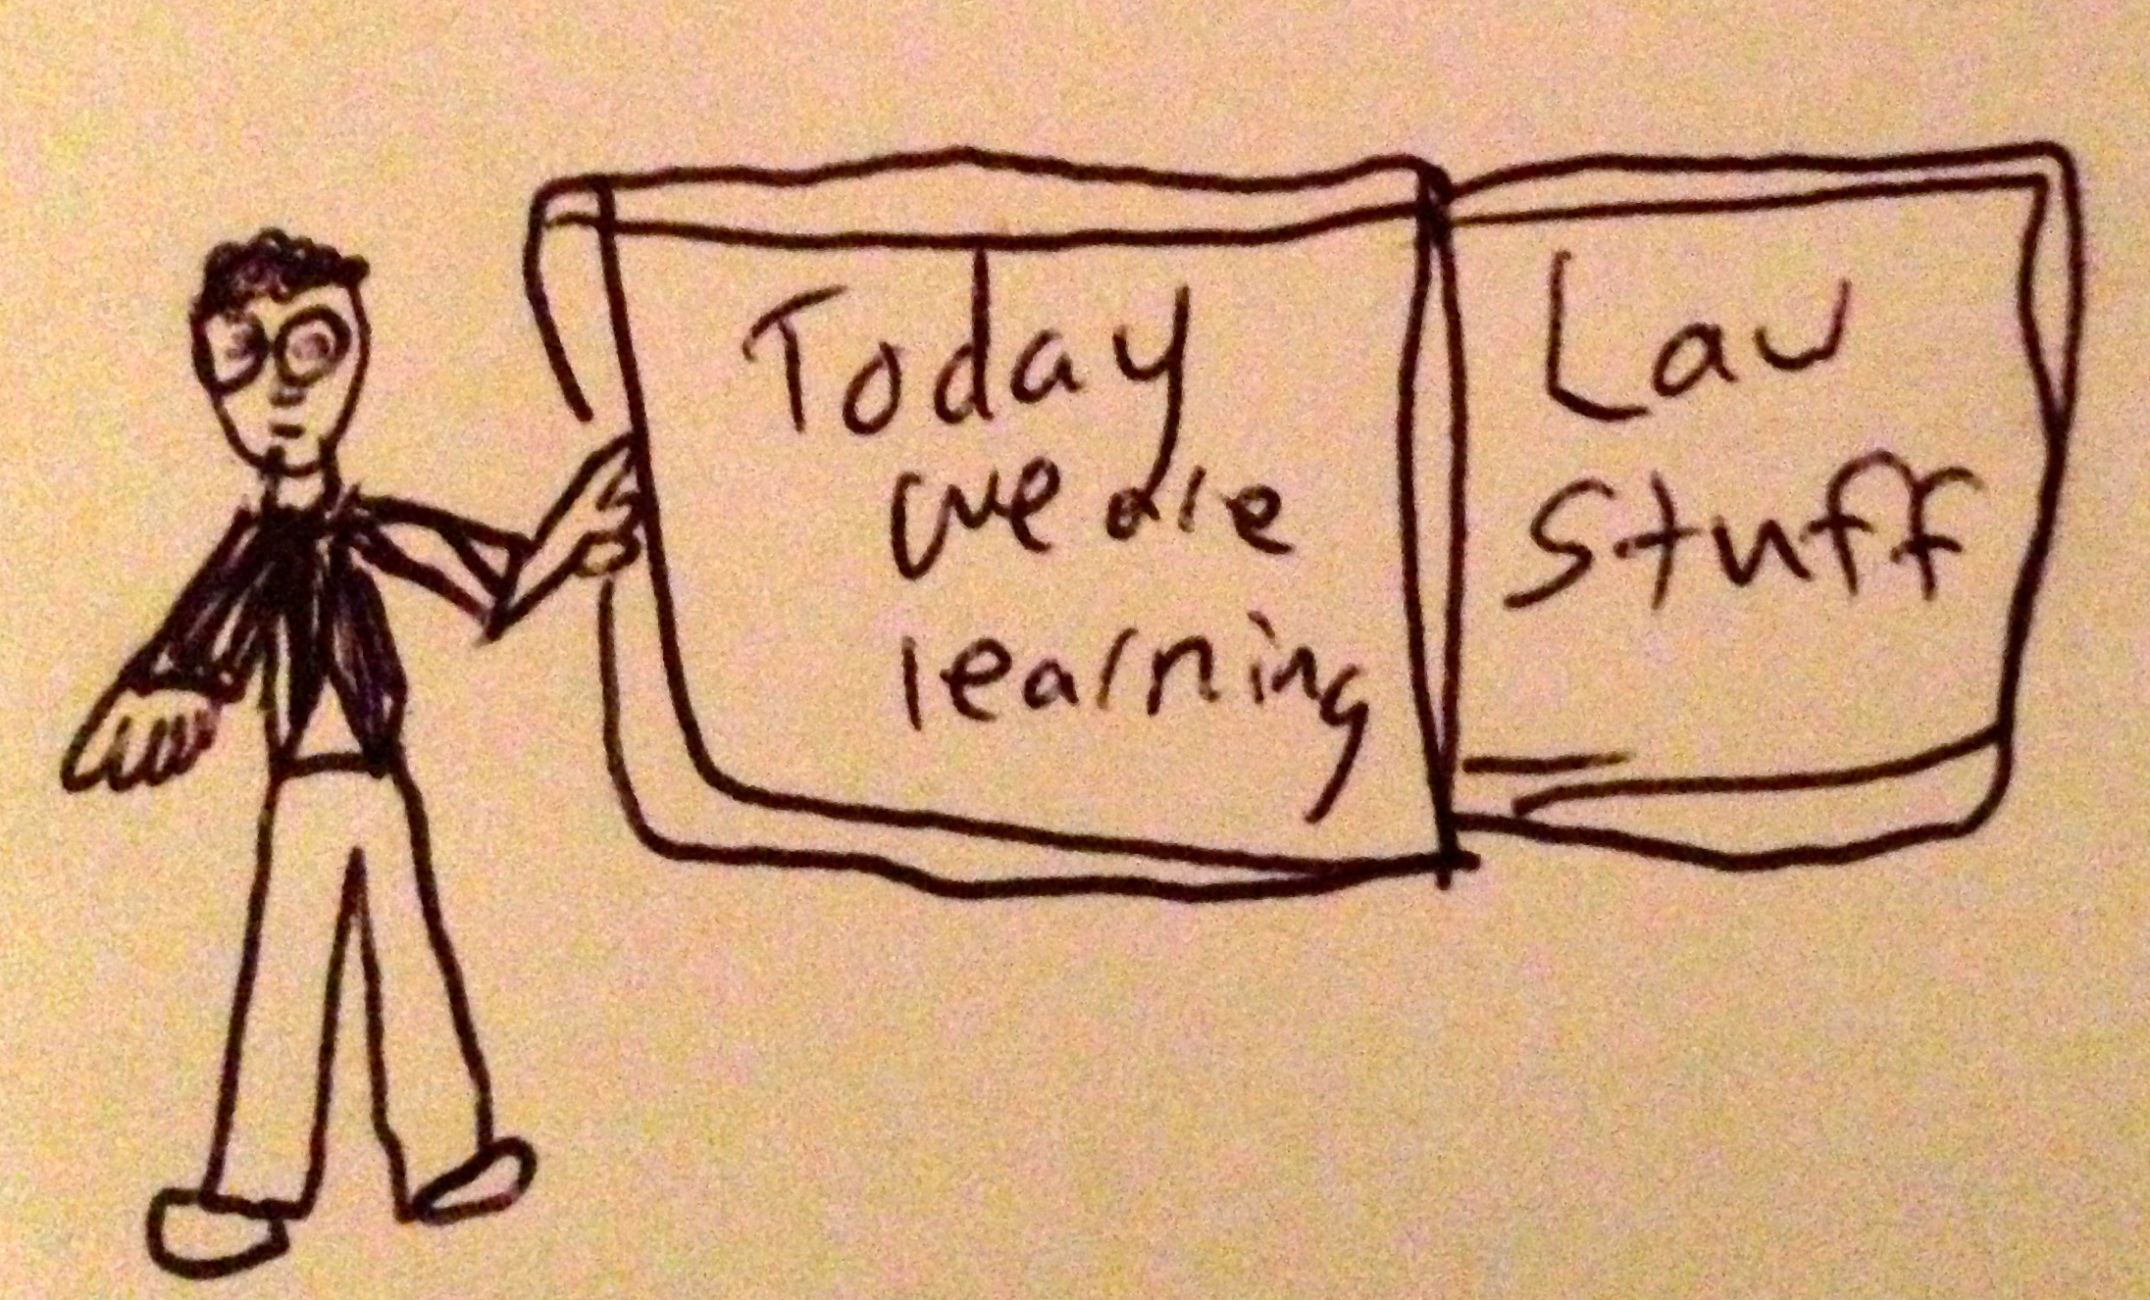

Slide 5
Logistics

Slide 6
EVALUATION
Term paper = 50% of the final grade.
5000 word paper
The paper is due on the last day of the exam period at 4:00 p.m.
Class Participation = 50% of the final grade
30% of the mark will be based on group preparation of a Class Discussion, with a Discussion Outline provided to the class—preferably by posting on the course website—a week before.
20% for student participation in other course activities including seminar discussions etc.

Slide 7
Paper Confessional
(or what I learned one winter holiday)
Legal/normative reasoning/argument including footnote/bibliography support & Contribution/Move forward → 60%
Presentation including layout, headings, grammar, language/writing skills, “tightness” → 25%
Topic/Originality/Degree of Difficultly → 15%
THIS IS NOT A RUBRIC. IT IS A SELF ASSESSMENT.

Slide 8
Group Presentations
2-3 (ideally) per group
Sign-up at the break or email me
Any topic – not constrained by what I’m talking about that week
Consult with me re the topic you want to take on
Post one thing you want us to read or watch

Slide 9
Group Presentations:
All in?

Slide 10
Evaluation Tips
Term paper topics need not be discussed with me, but often helpful to you if you do.
Term paper can be on your presentation topic.
Participation: In-class or other contributions, including attendance.
Group presentation need not be on that week’s topic (20 minute per student multiplier suggested 2-4 per group to 60 minute max).

Slide 11
Grades (primarily)
Paper → Quality
Participation → Effort

Slide 12
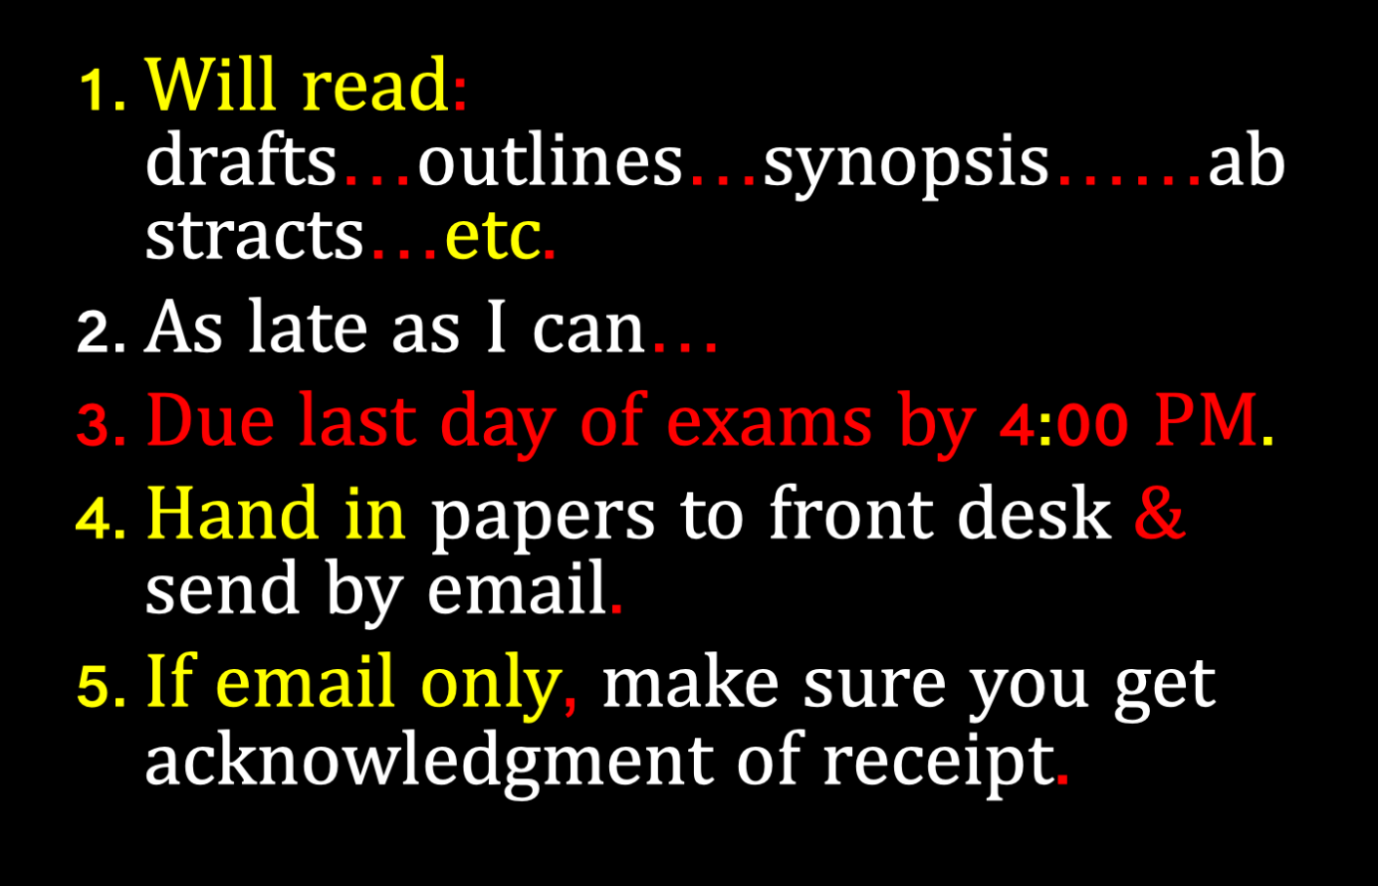

Slide 13
Website
?!

Slide 14


Slide 15
QUESTIONS?
THOUGHTS?
DISCUSSION?

Slide 16

Pause

Slide 17
IS ANY JURISDICTION
KEEPING GOOD
STATS?

Slide 18
Australia
“The most recent Law Society National Profile Report (April 2015) found that 15.8% of practising lawyers in Australia worked for corporations and 9.6% worked in government. More relevantly, while between 2011 and 2014 the number of practising lawyers in Australia increased by 12%, the number of corporate lawyers increased by 22% and the number of government lawyers increased by 19%. In addition, in particular legal markets the proportions of corporate and government lawyers are significant, for example, in the ACT 44.3% of practising lawyers are employed in government while in NSW 19.3% of practising lawyers are employed by corporations. It is also important to note that for these purposes "corporations" include not-for-profit organisations and NGOs.”
https://programsandcourses.anu.edu.au/2019/course/LAWS8325#terms

Slide 19
QUESTIONS?
THOUGHTS?
DISCUSSION?

Slide 20
Pause

Slide 21
News of the Week

Slide 22
Yours?

Slide 23
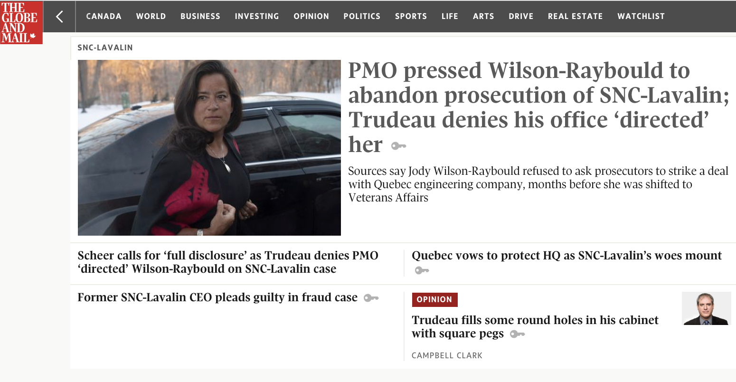

Slide 24


Slide 25


Slide 26


Slide 27


Slide 28


Slide 29

Wait!…What?…Rewind…

Slide 30


Slide 31


Slide 32


Slide 33
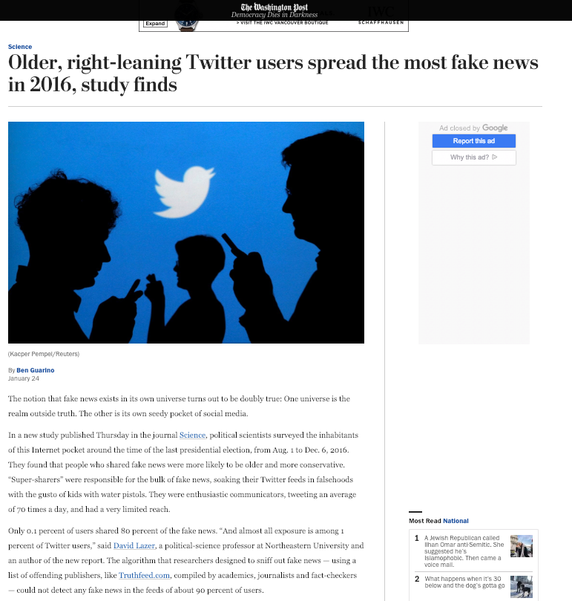

Slide 34


Slide 35


Slide 36
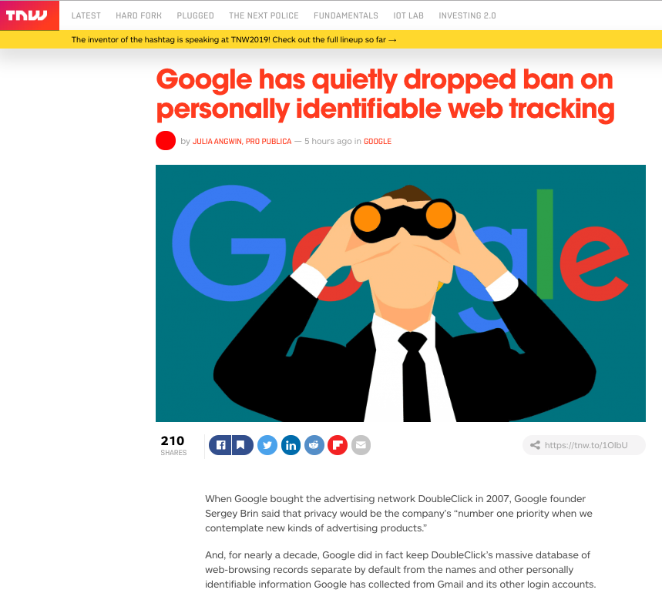

Slide 37
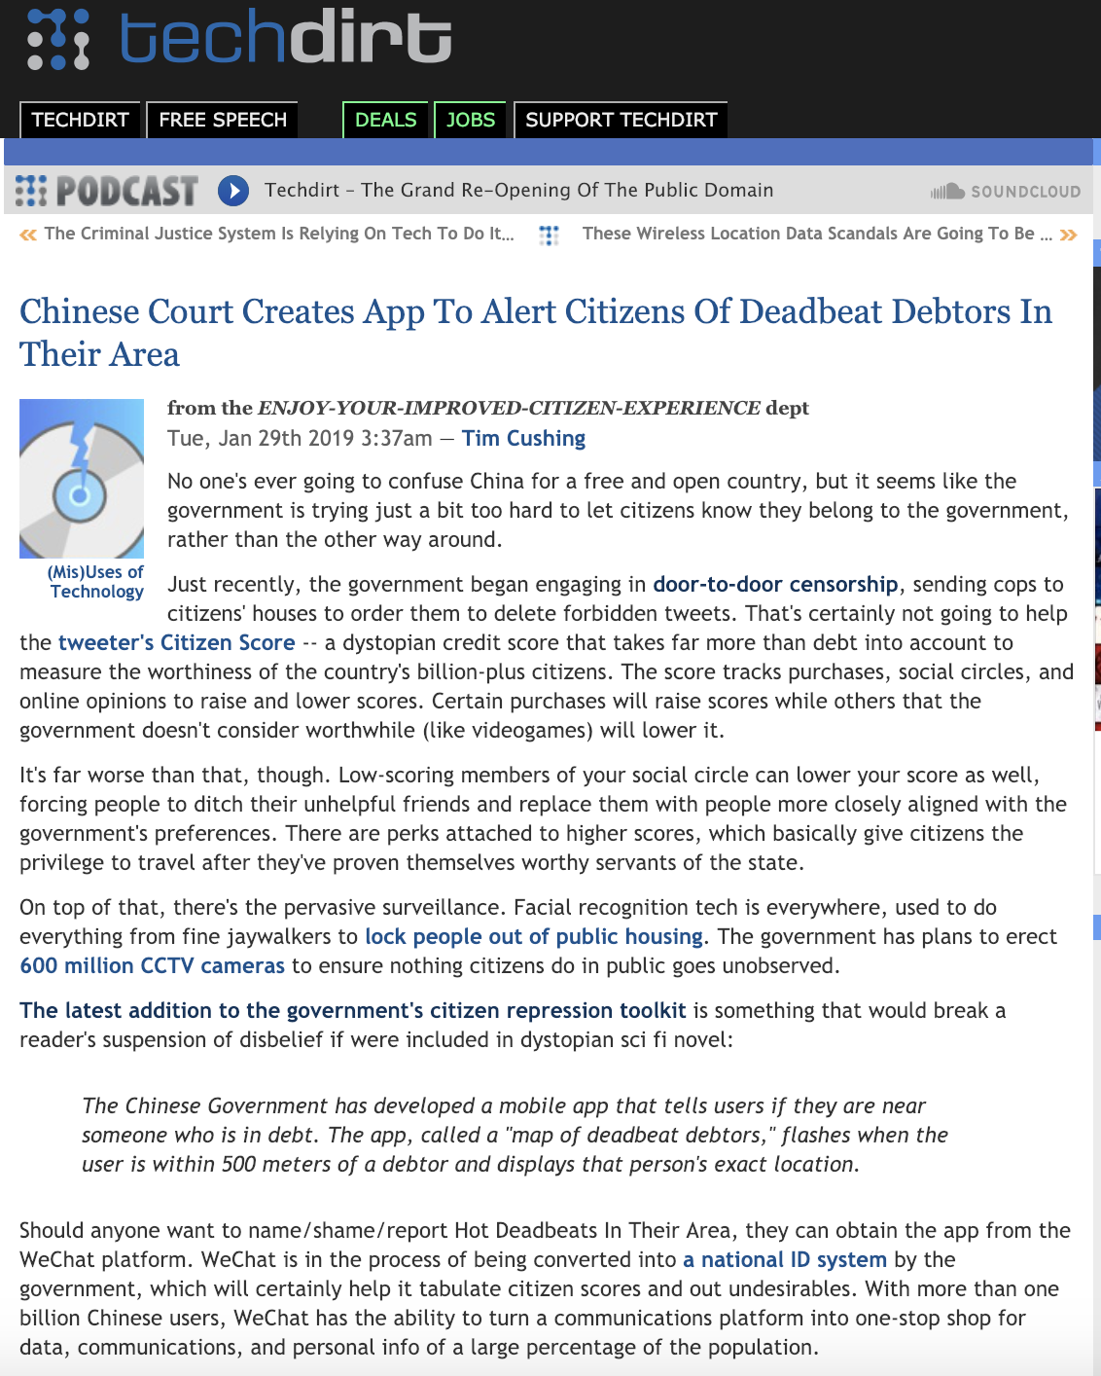

Slide 38


Slide 39


Slide 40


Slide 41
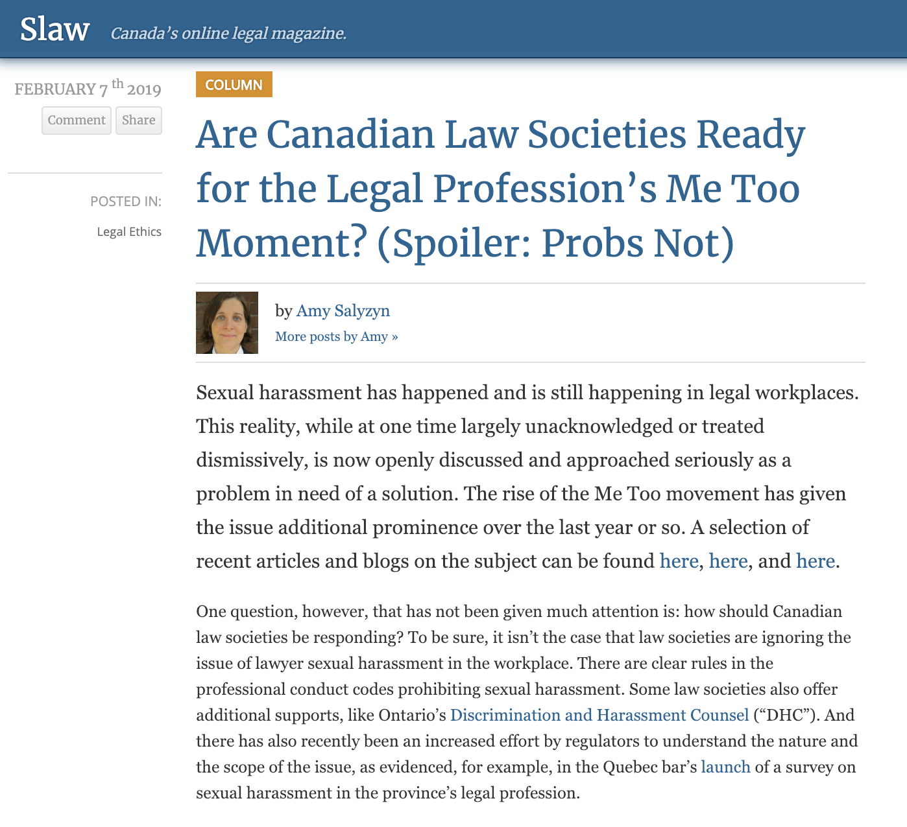

Slide 42
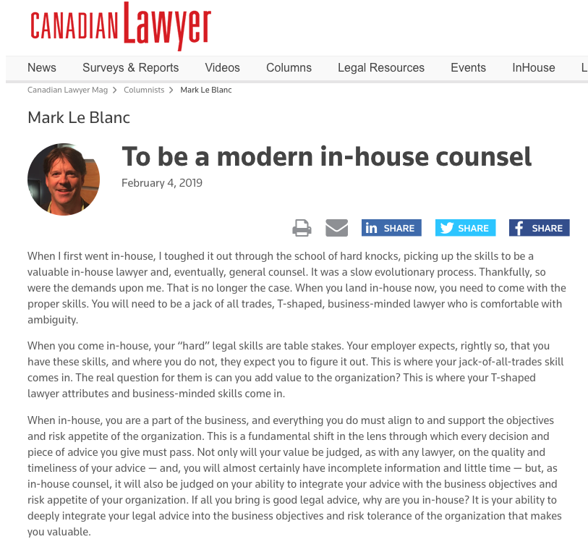

Slide 43
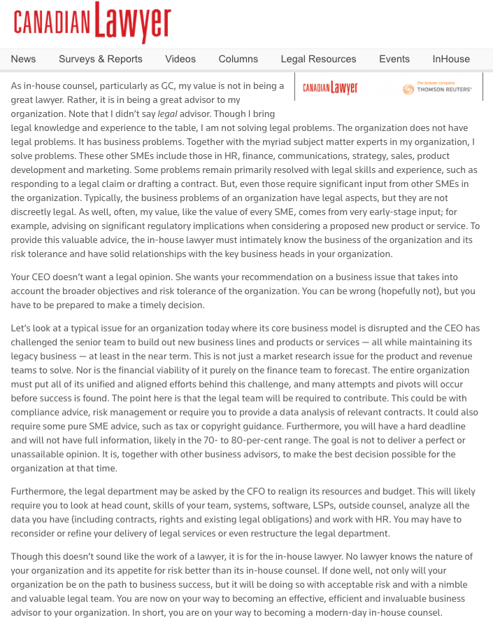

Slide 44
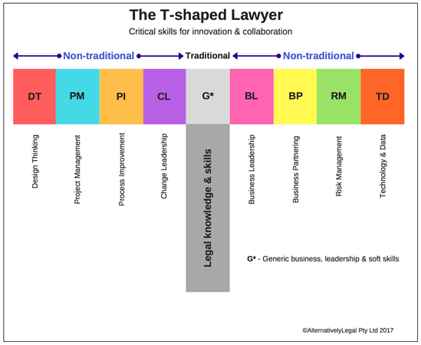

Slide 45
Plus shaped lawyer?
+

Slide 46


Slide 47
Bottom Line Contribution
Through Risk Management
?

Slide 48
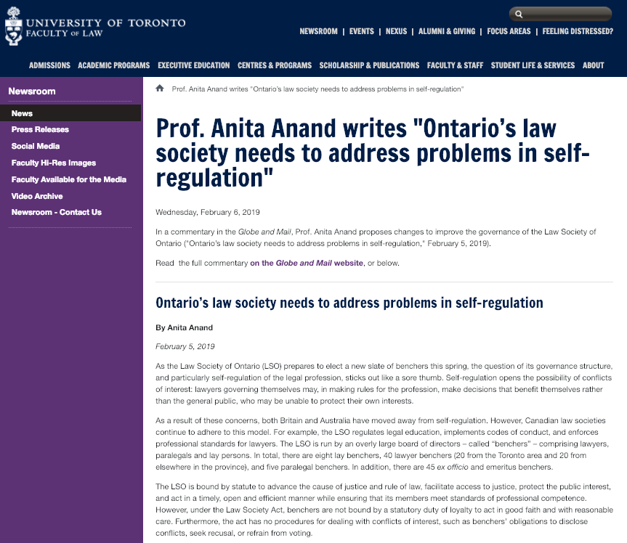

Slide 49
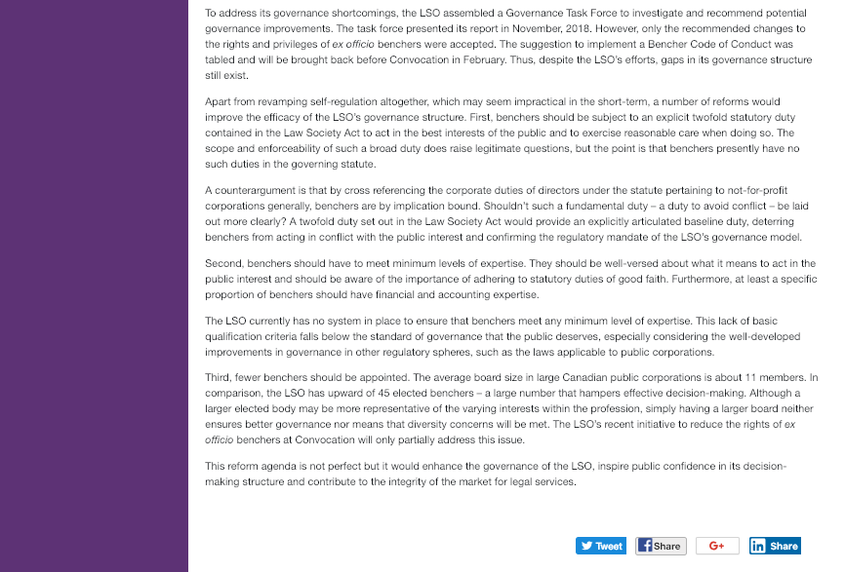

Slide 50


Slide 51
Pause

Slide 52
QUESTIONS?
THOUGHTS?
DISCUSSION?

Slide 53
Yours?

Slide 54
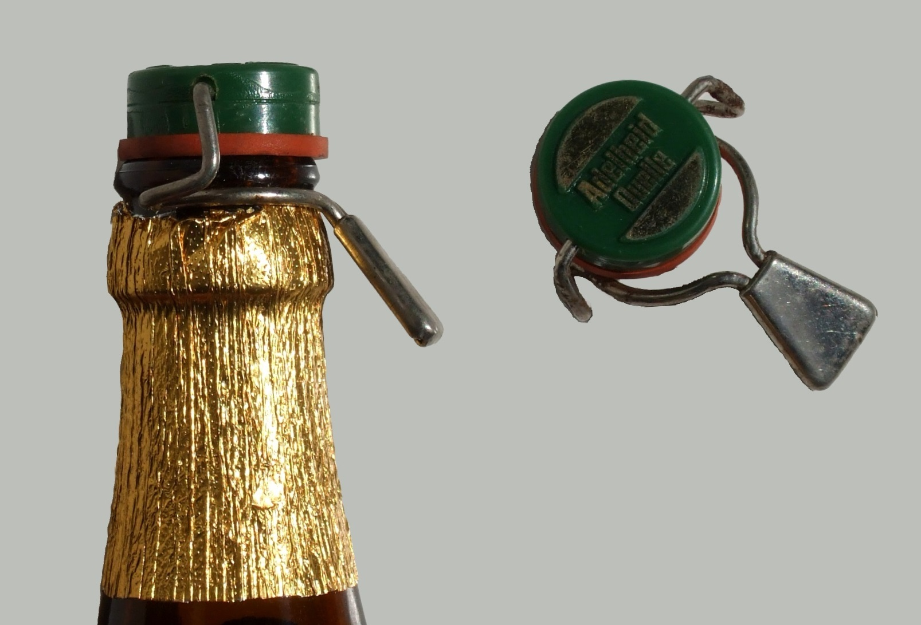
Recapping

Slide 55
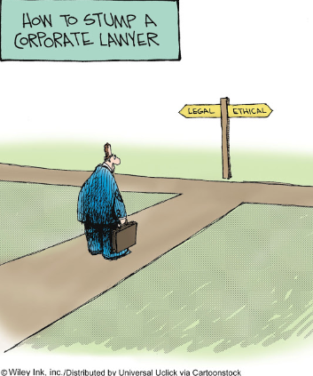
The course in one cartoon

Slide 56
Examine the question from the perspective of:
1. An out-side counsel
2. An in-house counsel
What do you see?

Slide 57
Basic Problem?
Employer/employee relationship is a conflict of interest?
3.4-1 A lawyer must not act or continue to act for a client where there is a conflict of interest, except as permitted under this Code. Commentary
[1] As defined in these rules, a conflict of interest exists when there is a substantial risk that a lawyer’s loyalty to or representation of a client would be materially and adversely affected by the lawyer’s own interest… A client’s interests may be seriously prejudiced unless the lawyer’s judgment and freedom of action on the client’s behalf are as free as possible from conflicts of interest.

Slide 58
[5] The value of an independent bar is diminished unless the lawyer is free from conflicts of interest…The lawyer-client relationship is a fiduciary relationship…This obligation is premised on an established or ongoing lawyer client relationship in which the client must be assured of the lawyer’s undivided loyalty, free from any material impairment of the lawyer and client relationship.
[8] Conflicts of interest can arise in many different circumstances. The following examples are intended to provide illustrations of circumstances that may give rise to conflicts of interest. The examples are not exhaustive.
  (d) A lawyer,..or a family member has a personal financial interest in a client’s affairs or in a matter in which the lawyer is requested to act for a client…
    (i) A lawyer owning a small number of shares of a publicly traded corporation would not necessarily have a conflict of interest…because the holding may have no adverse influence on the lawyer’s judgment...

Slide 59
Basic Problem? Huge?
Separation of Legal Advice
& Decision Making?
Are you doing both?
Should you be doing both?
'A man who is his own lawyer
has a fool for a client.'

Slide 60
Basic Conundrum?
Good governance is invisible

Slide 61

…invisible.
Measured by the number of crises that don’t manifest.

Slide 62

Poor Governance is SUPER VISIBLE

Slide 63
Pause

Slide 64
QUESTIONS?
THOUGHTS?
DISCUSSION?

Slide 65

Structural
Principled
Framework

Slide 66
Or should we call them…
RULES

Slide 67

1. Lawyer First
“Hat” you were trained for
Law Society obligations not mitigated by being in-house
Attracts privilege

Slide 68
1A. Canons of Legal Ethics
(Chapter 2 – Standards of the Legal Profession)
These Canons of Legal Ethics in rules 2.1-1 to 2.1-5 are a general guide and not a denial of the existence of other duties equally imperative and of other rights, though not specifically mentioned. A version of these Canons has formed part of the Code of Professional Conduct of the Law Society of British Columbia since 1921. They are included here both for their historical value and for their statement of general principles that underlie the remainder of the rules in this Code.
A lawyer is a minister of justice, an officer of the courts, a client’s advocate and a member of an ancient, honourable and learned profession.
In these several capacities, it is a lawyer’s duty to promote the interests of the state, serve the cause of justice, maintain the authority and dignity of the courts, be faithful to clients, be candid and courteous in relations with other lawyers and demonstrate personal integrity.

Slide 69
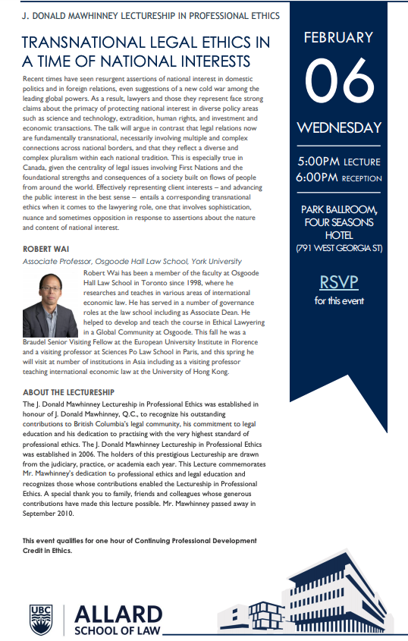

2.1-1 To the state
(a) A lawyer owes a duty to the state, to maintain its integrity and its law. A lawyer should not aid, counsel or assist any person to act in any way contrary to the law…

Slide 70
2.1-3 To the client
(a) A lawyer should obtain sufficient knowledge of the relevant facts and give adequate consideration to the applicable law before advising a client, and give an open and undisguised opinion of the merits and probable results of the client’s cause. The lawyer should be wary of bold and confident assurances to the client, especially where the lawyer’s employment may depend on such assurances. The lawyer should bear in mind that seldom are all the law and facts on the client’s side, and that audi alteram partem (hear the other side) is a safe rule to follow.
(b) A lawyer should disclose to the client all the circumstances of the lawyer’s relations to the parties and interest in or connection with the controversy, if any, that might influence whether the client selects or continues to retain the lawyer. A lawyer must not act where there is a conflict of interests between the lawyer and a client or between clients.

Slide 71
(c) Whenever the dispute will admit of fair settlement the client should be advised to avoid or to end the litigation…
(e) A lawyer should endeavour by all fair and honourable means to obtain for a client the benefit of any and every remedy and defence that is authorized by law. The lawyer must, however, steadfastly bear in mind that this great trust is to be performed within and not without the bounds of the law. The office of the lawyer does not permit, much less demand, for any client, violation of law or any manner of fraud or chicanery. No client has a right to demand that the lawyer be illiberal or do anything repugnant to the lawyer’s own sense of honour and propriety…
(g) A lawyer should not, except as by law expressly sanctioned, acquire by purchase or otherwise any interest in the subject-matter of the litigation being conducted by the lawyer. A lawyer should scrupulously guard, and not divulge or use for personal benefit, a client’s secrets or confidences. Having once acted for a client in a matter, a lawyer must not act against the client in the same or any related matter

Slide 72
2.1-5 To oneself
(a) A lawyer should assist in maintaining the honour and integrity of the legal profession, should expose before the proper tribunals without fear or favour, unprofessional or dishonest conduct by any other lawyer and should accept without hesitation a retainer against any lawyer who is alleged to have wronged the client…
(d) No client is entitled to receive, nor should any lawyer render any service or advice involving disloyalty to the state or disrespect for judicial office, or the corruption of any persons exercising a public or private trust, or deception or betrayal of the public.
(e) A lawyer should recognize that the oaths taken upon admission to the Bar are solemn undertakings to be strictly observed.
(f) All lawyers should bear in mind that they can maintain the high traditions of the profession by steadfastly adhering to the time-honoured virtues of probity, integrity, honesty and dignity.

Slide 73
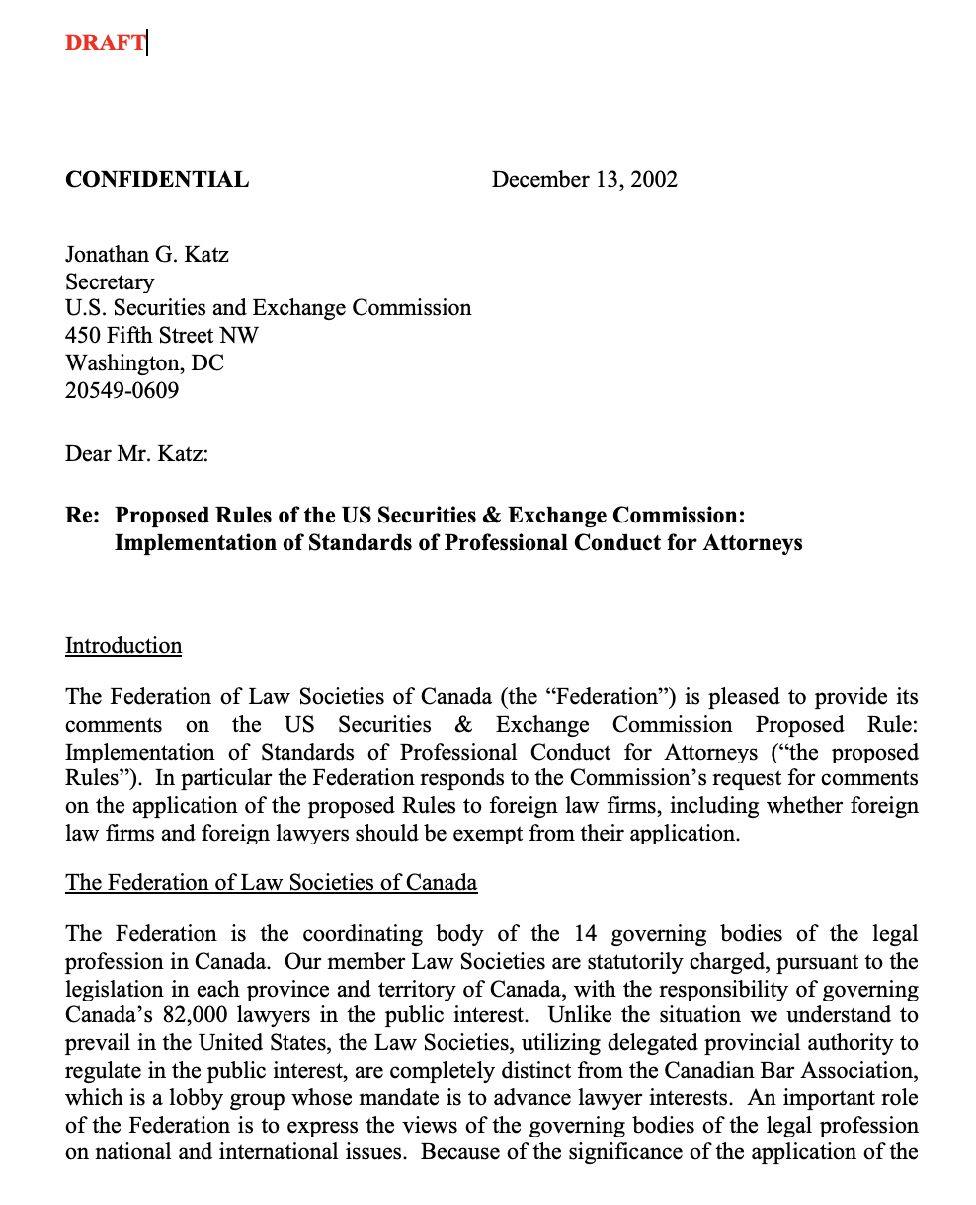

Slide 74
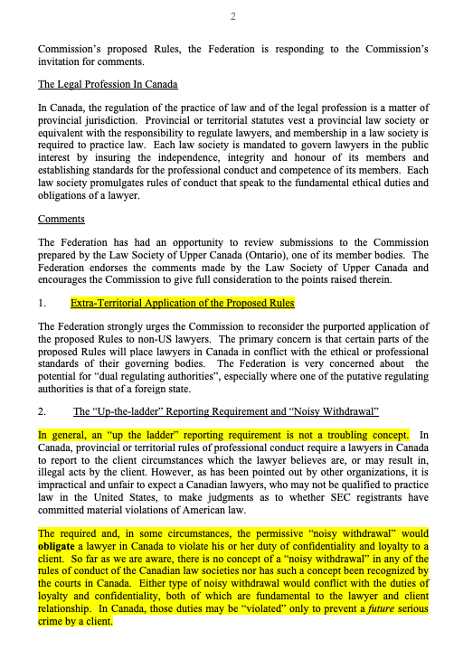

Slide 75
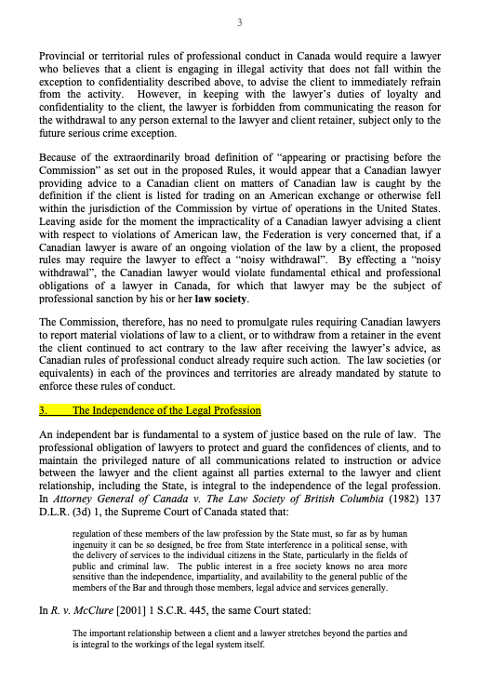

Slide 76
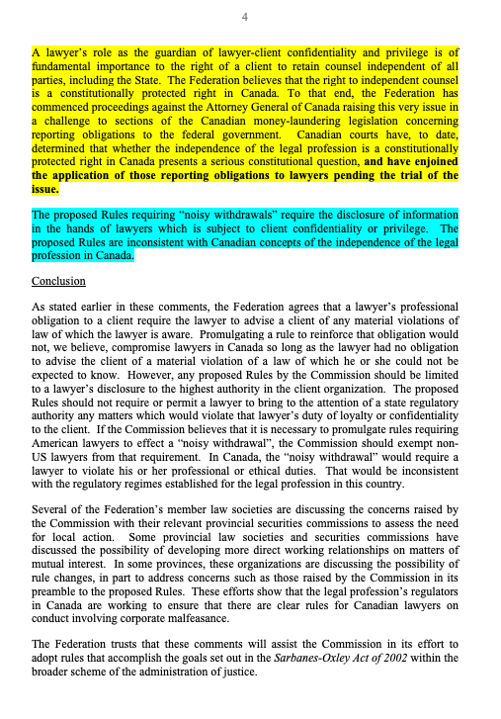

Slide 77
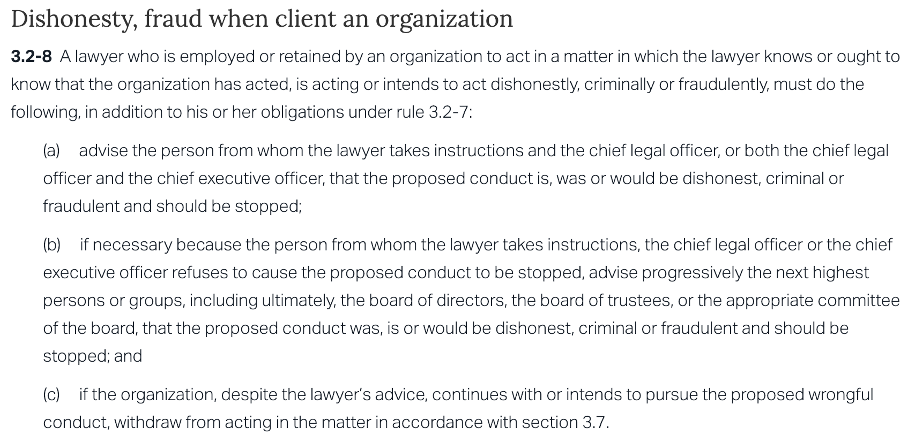

Slide 78

Filed for bankruptcy Dec. 2, 2001

Slide 79
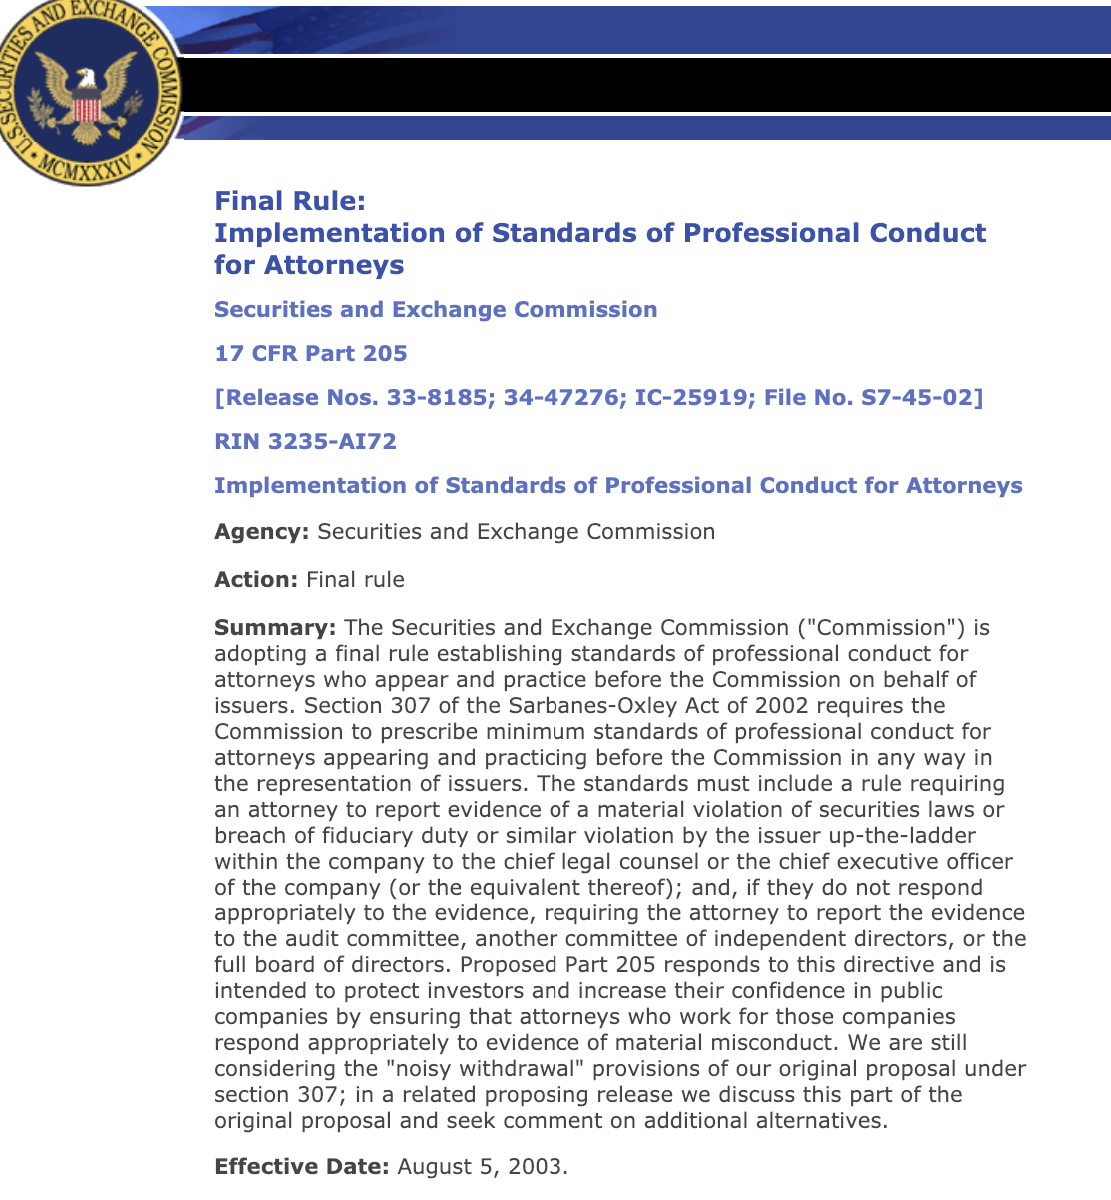

Slide 80
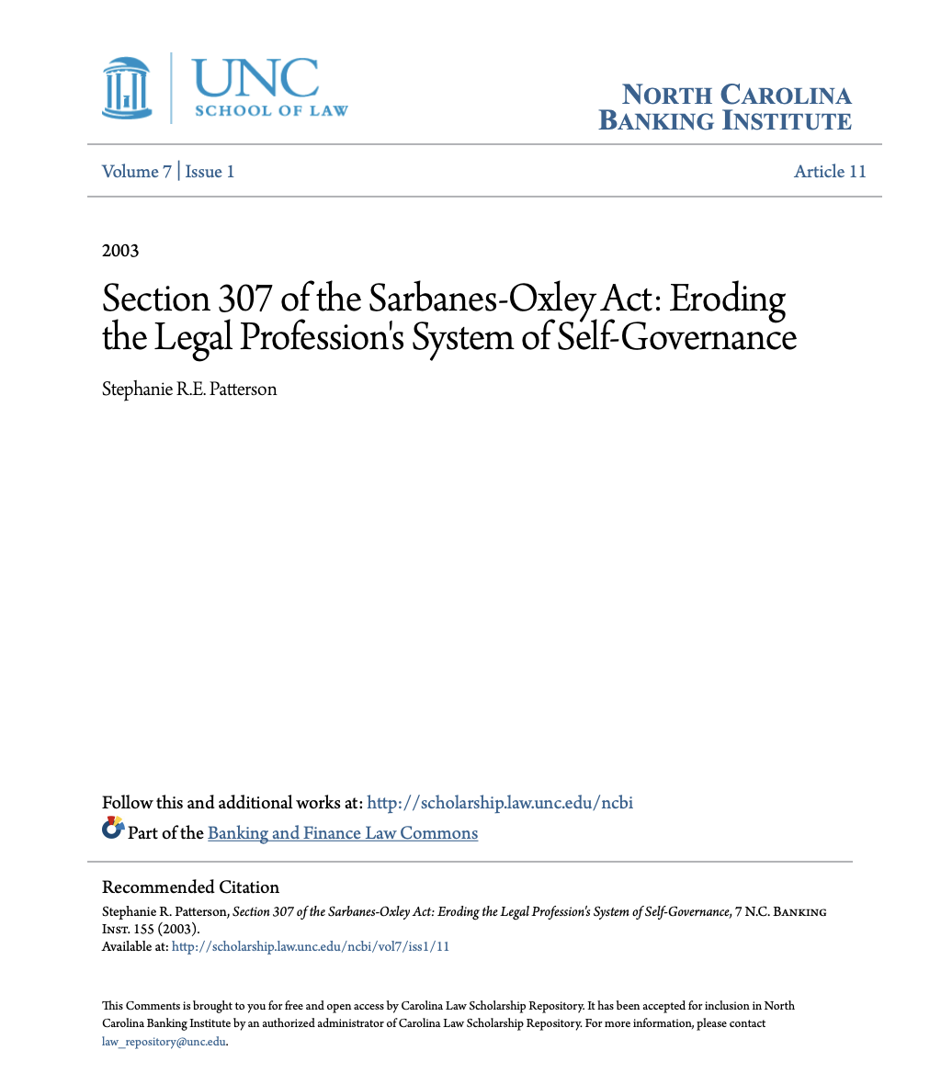

Slide 81
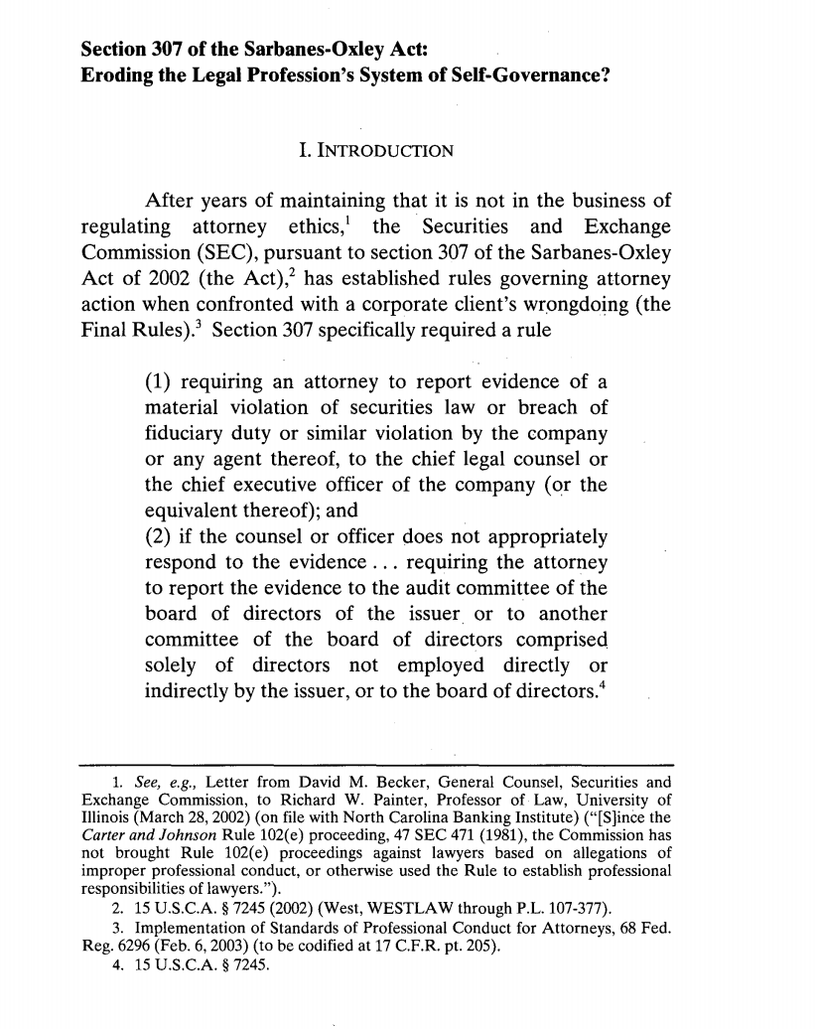

Slide 82
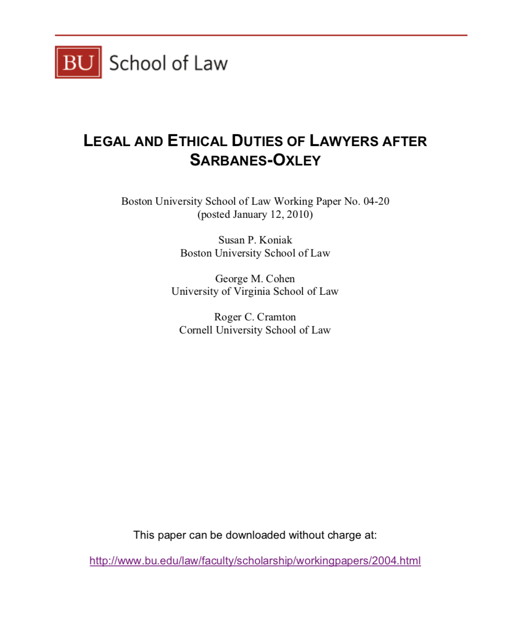

Slide 83
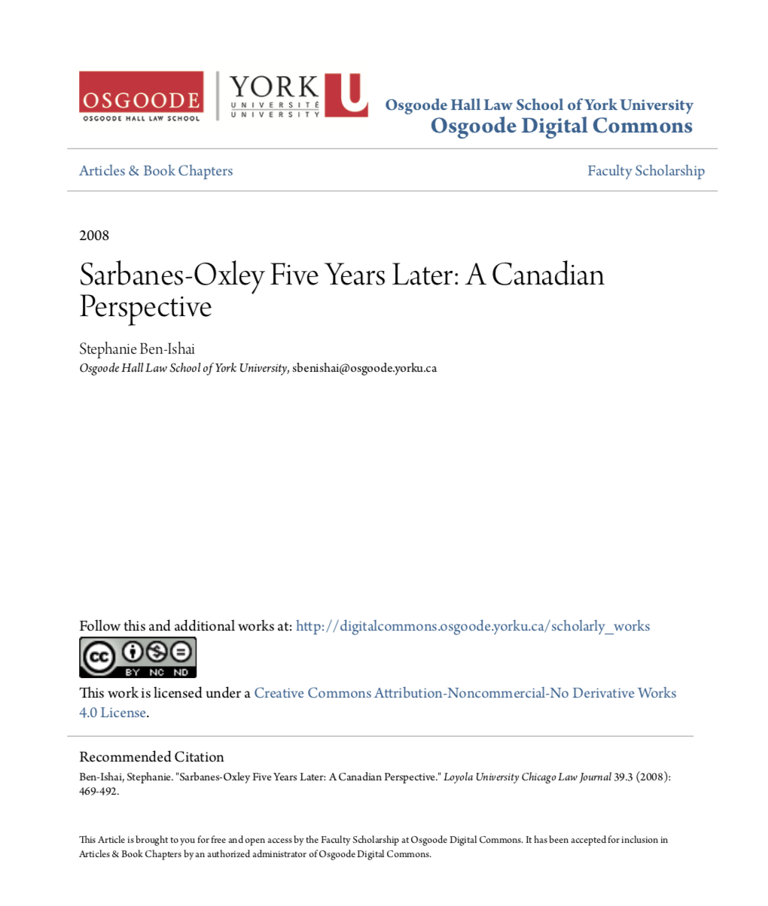

Slide 84
2. Avoid conflicts
Understand & acknowledge conflicts are possible, even likely, and realistically inevitable.
Identify conflicts that that affect your ability to act as counsel.
Where there is a conflict, disclose and dis-engage
When in doubt refer the work…

Slide 85

2A. You act only for the company; & act only “in the best interests of the company”.

Slide 86
3. Identify your hat in context
If you are acting in another capacity than lawyer, should you be acting as your own lawyer or have the lawyering referred out (either internally or externally)?

Slide 87

Which hat?

Slide 88


Slide 89

4. Establish the scope of your lawyer hat

Slide 90
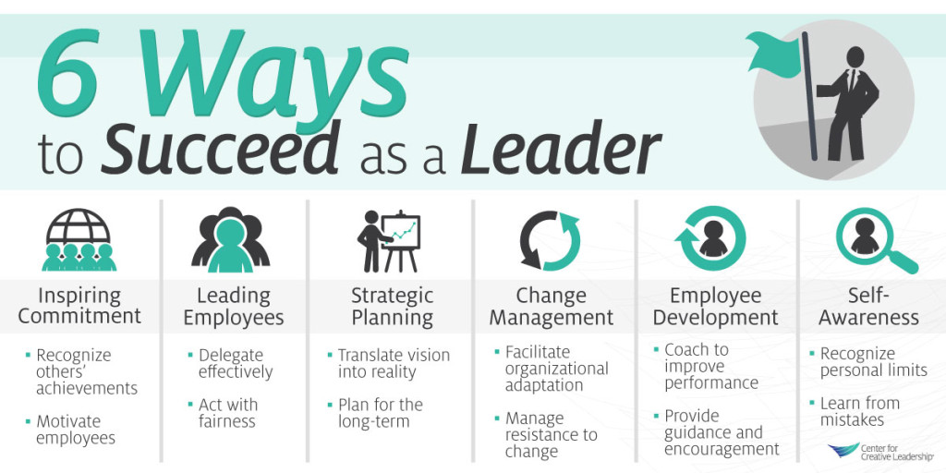
5. LEAD

Slide 91


A MATTER OF PERSPECTIVE

Slide 92

Conclusion

Slide 93
SEE YOU
IN A FEW WEEKs!

Slide 94

Always include a cat picture

Slide 95
In learning you will teach
And in teaching you will learn
Phil Collins' Son of Man (1999)

Slide 96
Our Academic Partners

