Slide 1
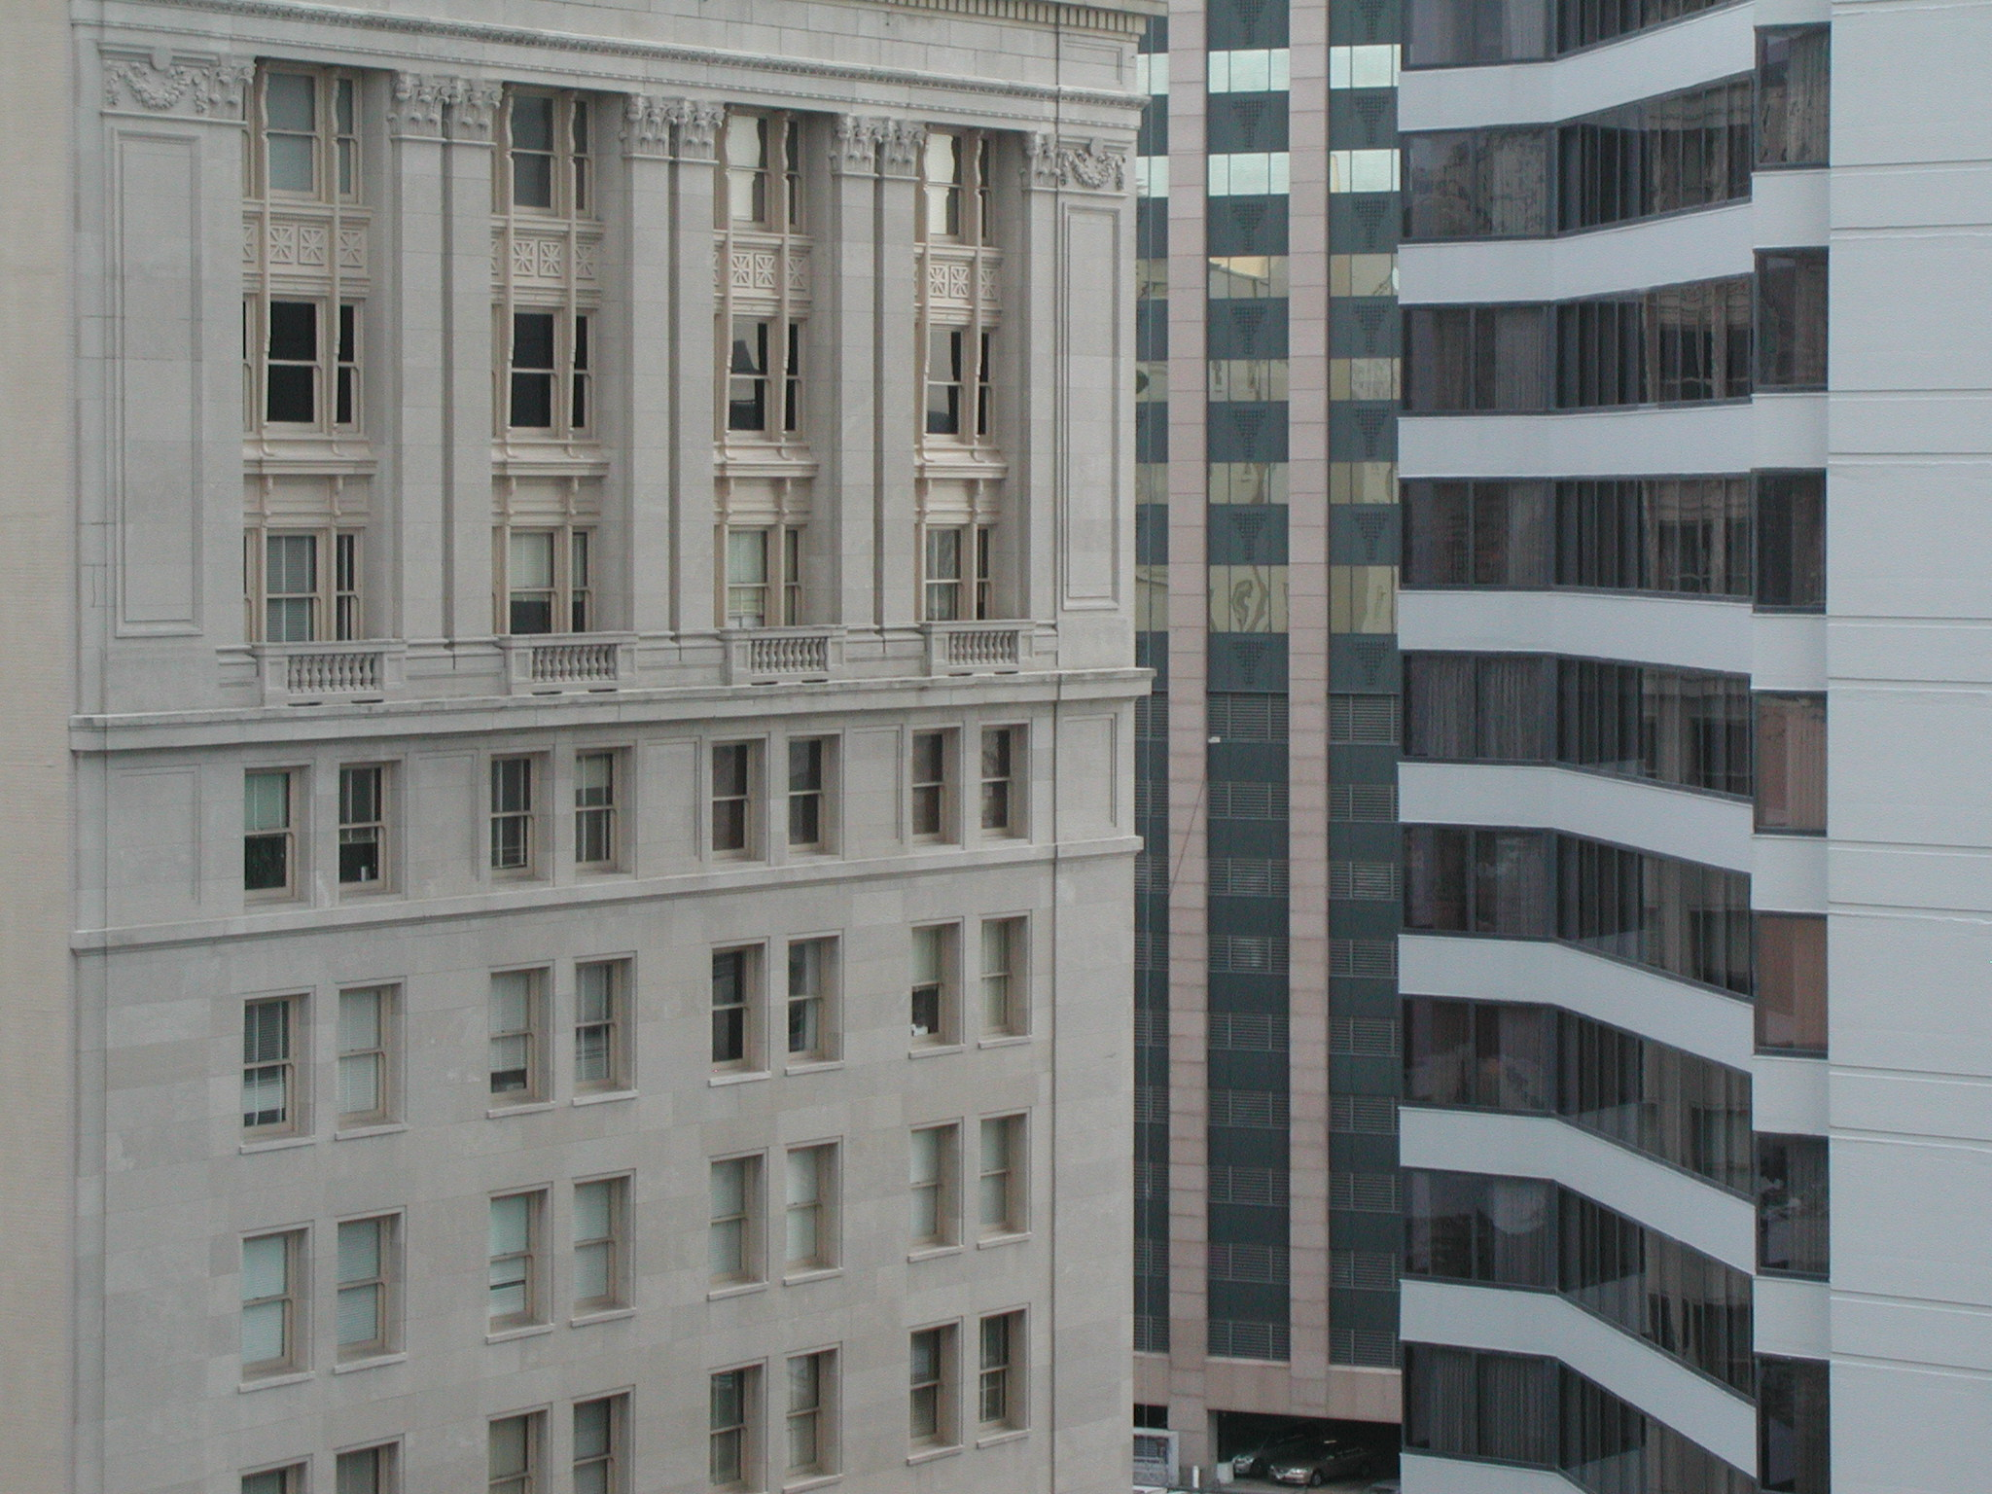

“With great power…” Part 2
Talk 3
LAWF 3780
Challenges of In-House & Corporate Counsel
TRU Faculty of Law
Spring, 2019
Jon Festinger Q.C.
Centre for Digital Media
QMUL School of Law (CCLS)
Festinger Law & Strategy
http://commlaw.allard.ubc
@jonfestinger
jon_festinger@thecdm.ca

Slide 2
Hello
LAW F 3780
Challenges of In-House
& Corporate Counsel

Slide 3

Terrific Thursdays

Slide 4
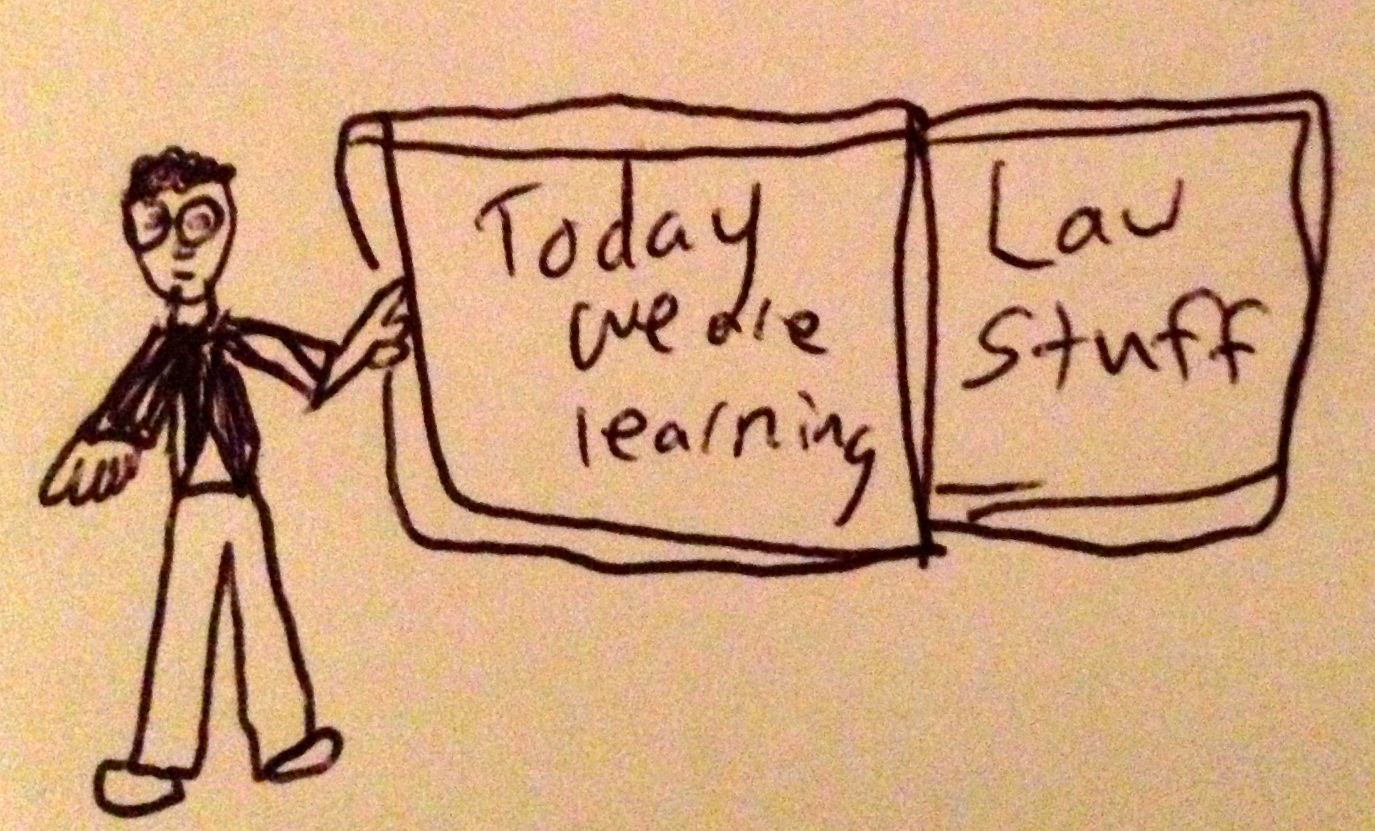

Slide 5
Logistics

Slide 6
EVALUATION
Term paper = 50% of the final grade.
5000 word paper
The paper is due on the last day of the exam period at 4:00 p.m.
Class Participation = 50% of the final grade
30% of the mark will be based on group preparation of a Class Discussion, with a Discussion Outline provided to the class—preferably by posting on the course website—a week before.
20% for student participation in other course activities including seminar discussions etc.

Slide 7
Paper Confessional
(or what I learned one winter holiday)
Legal/normative reasoning/argument including footnote/bibliography support & Contribution/Move forward → 60%
Presentation including layout, headings, grammar, language/writing skills, “tightness” → 25%
Topic/Originality/Degree of Difficultly → 15%
THIS IS NOT A RUBRIC. IT IS A SELF ASSESSMENT.

Slide 8
Group Presentations
2-3 (ideally) per group
Sign-up at the break or email me
Any topic – not constrained by what I’m talking about that week
Consult with me re the topic you want to take on
Post one thing you want us to read or watch

Slide 9
Group Presentations
Sign-up at the break

Slide 10
Possible Methodology for this…
Coming
Up

Slide 11
Evaluation Tips
Term paper topics need not be discussed with me, but often helpful to you if you do.
Term paper can be on your presentation topic.
Participation: In-class or other contributions, including attendance.
Group presentation need not be on that week’s topic (20 minute per student multiplier suggested 2-4 per group to 60 minute max).

Slide 12
Grades (primarily)
Paper → Quality
Participation → Effort

Slide 13
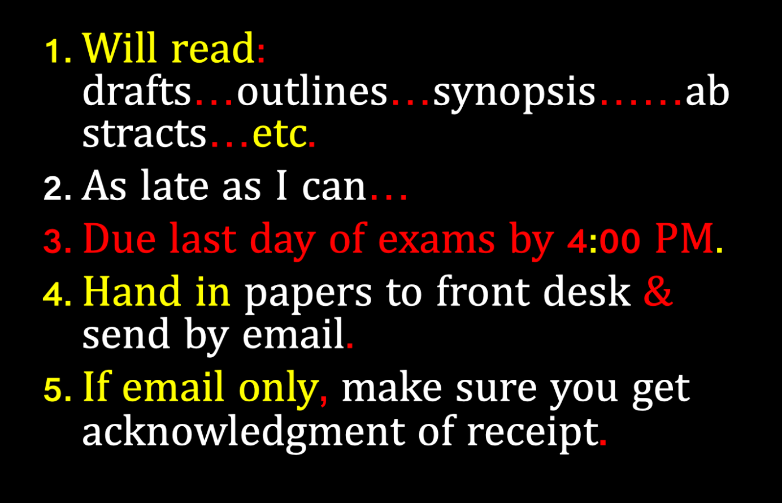

Slide 14
QUESTIONS?
THOUGHTS?
DISCUSSION?

Slide 15
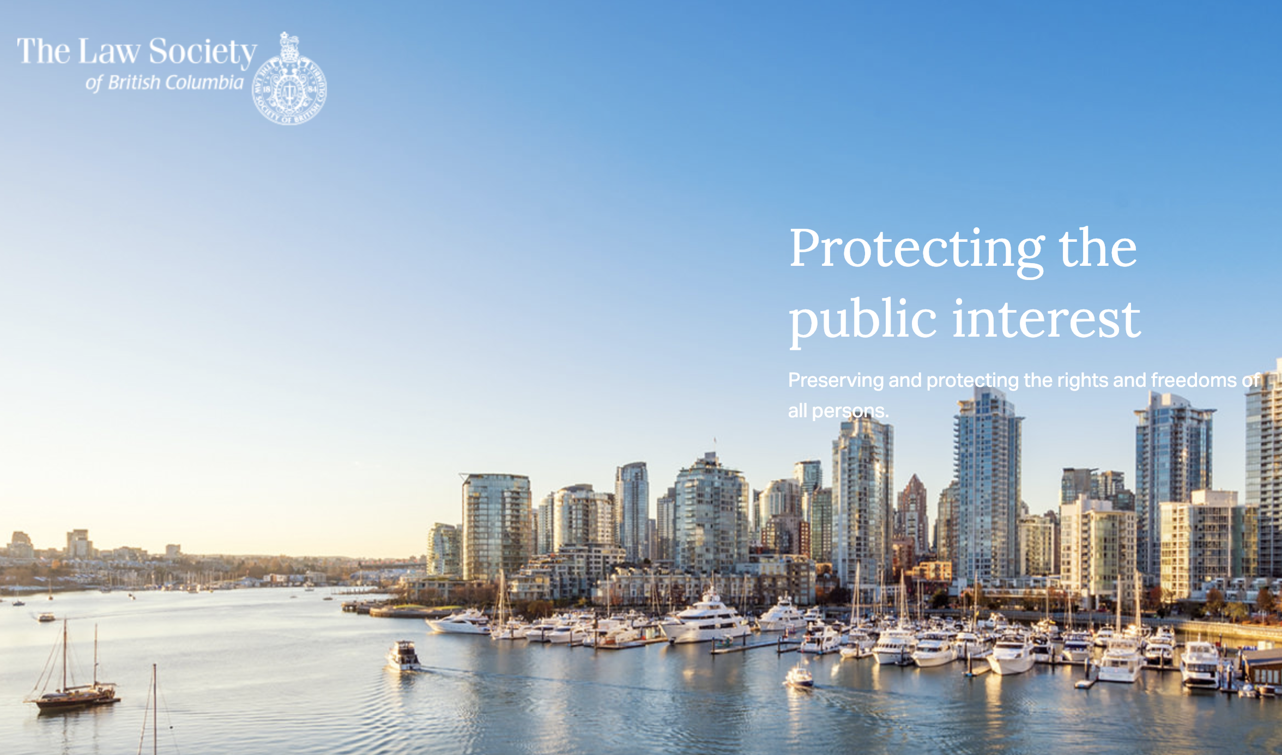
Follow up to first week…

Slide 16
12,000 lawyers practicing law in B.C
8,700 insured
Therefore 3,300 government, in-house & other lawyers practicing law
0 citations (disciplinary cases)
Some, not many, complaints
In-house lawyers not insured

Slide 17
IS ANY JURISDICTION
KEEPING GOOD
STATS?

Slide 18
News of the Week

Slide 19
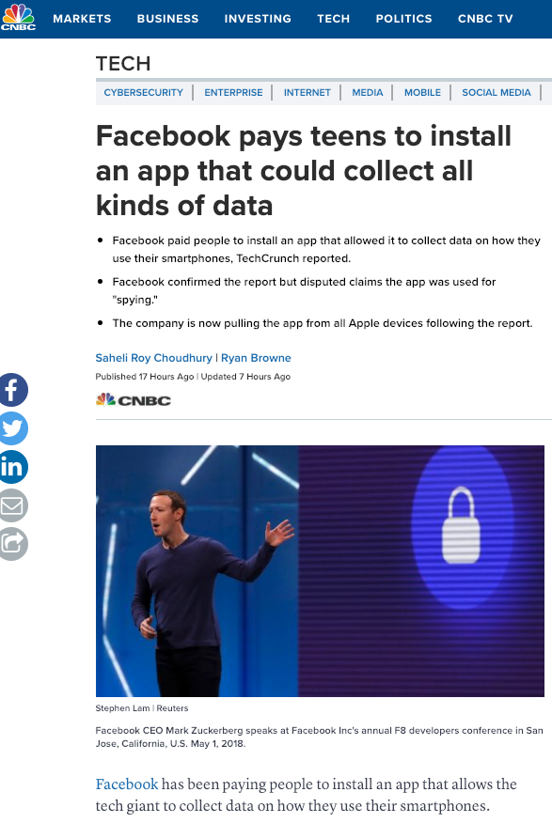

Slide 20
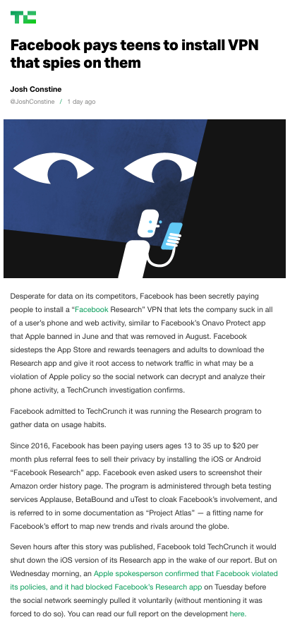

Slide 21
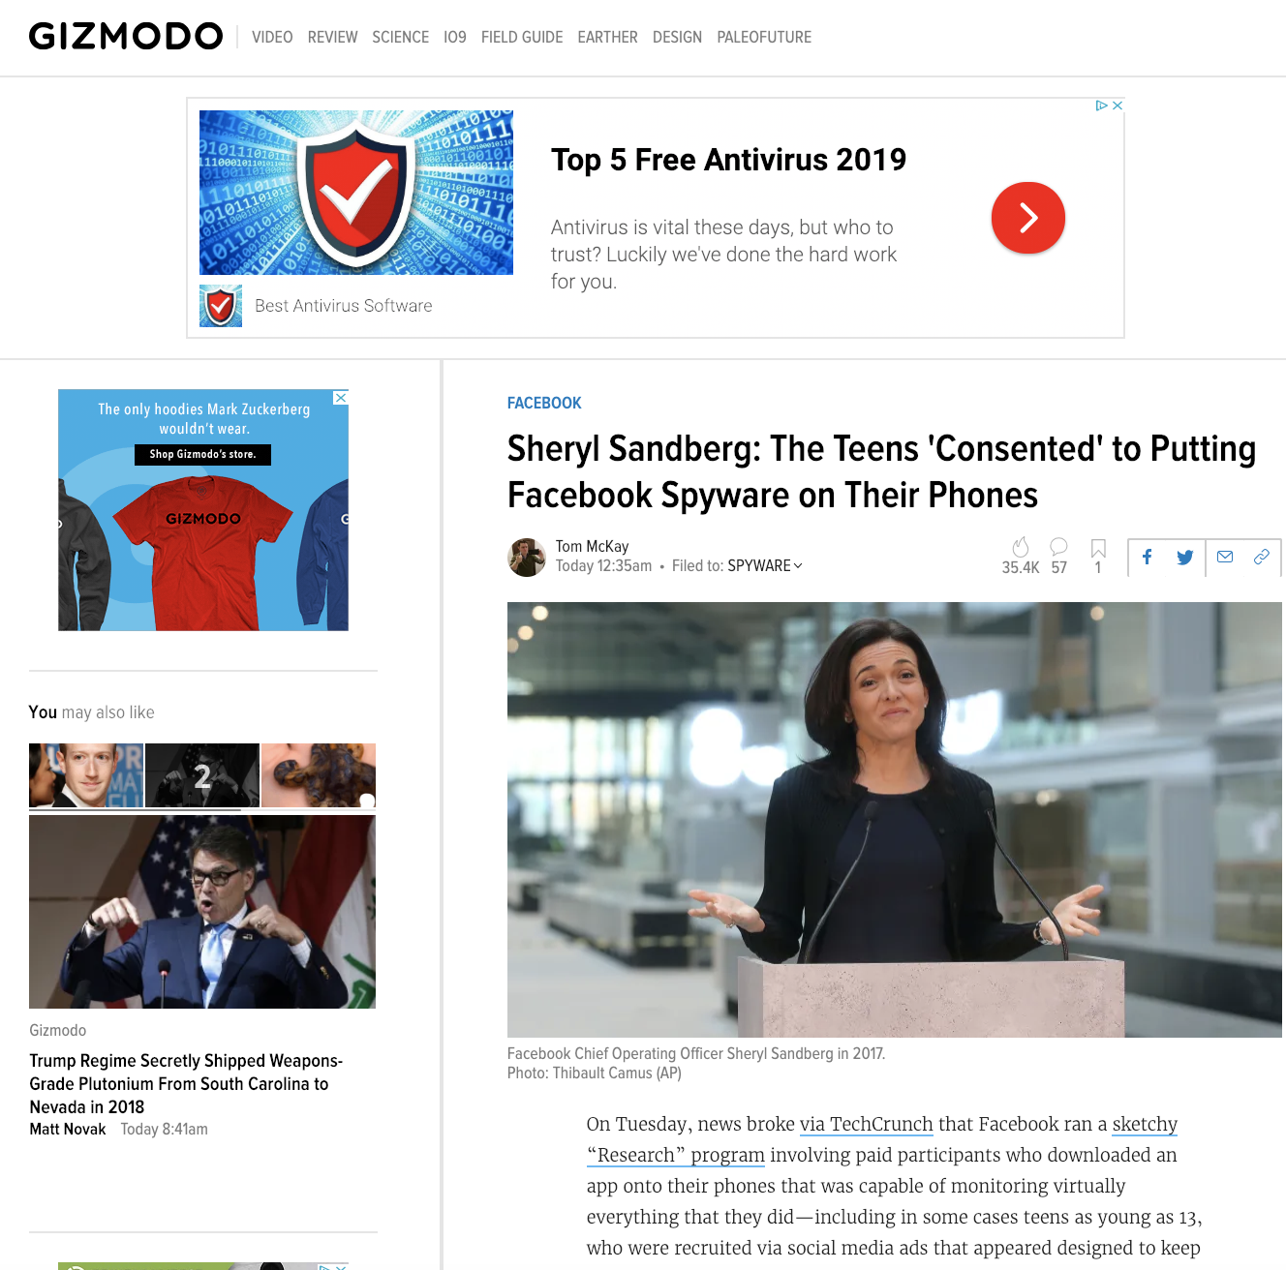

Slide 22
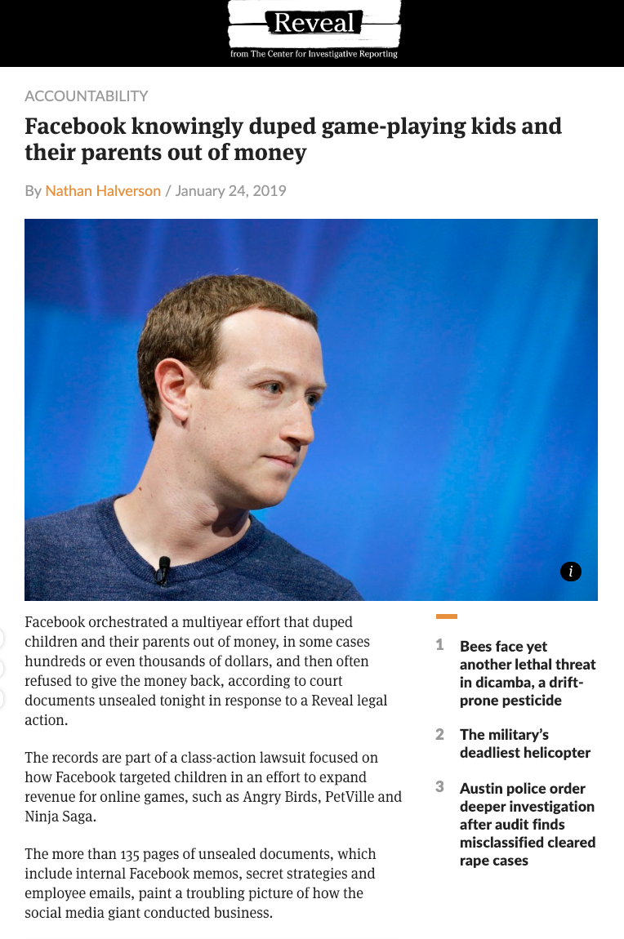
Hot on the heels of…

Slide 23
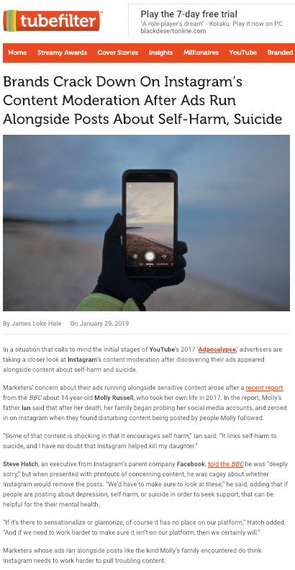

Slide 24


Slide 25
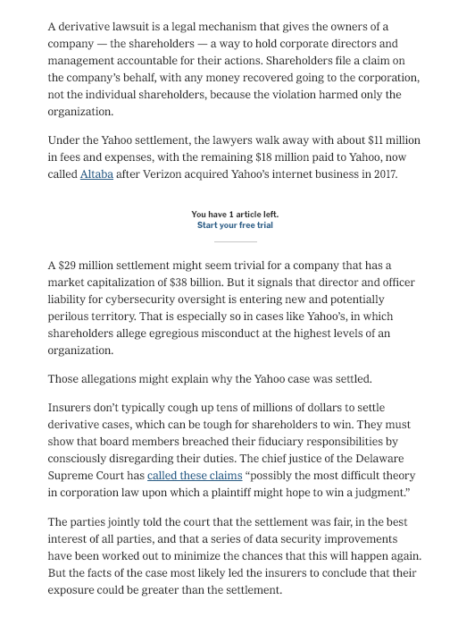

Slide 26
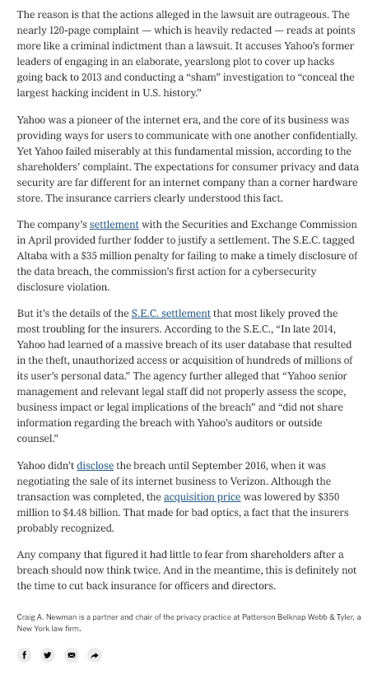

Slide 27
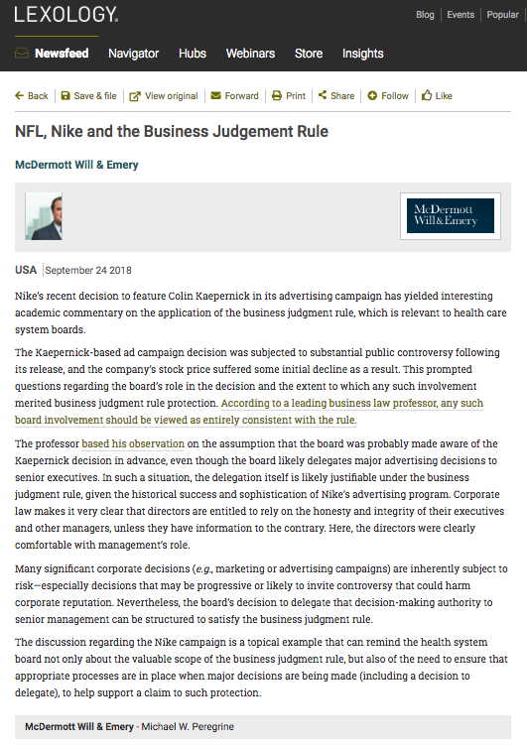

Slide 28
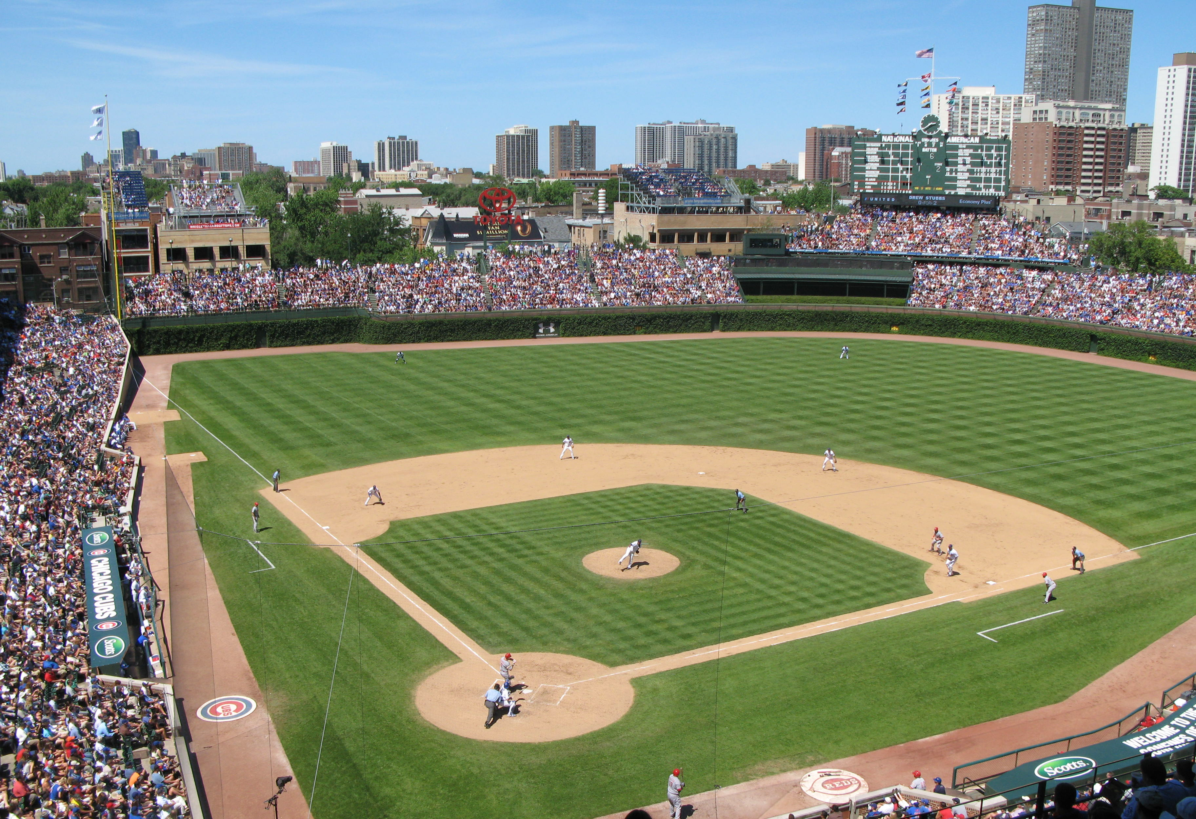
Remember Shlensky v. Wrigley
237 N.E.2d 776 (Ill. App.1968)?

Slide 29
Mr. Phillip K. Wrigley was a director of the Chicago National League Ball Club (Inc.), which was the company that owned the Chicago Cubs. The Board tended to follow Mr. Wrigley’s lead for a variety of reasons not relevant to the outcome of this case. Although every other major league team had installed lights to allow for night games, Defendant did not install them for the Cubs because he was concerned that night baseball would be detrimental to the surrounding neighborhood.
Mr. Shlensky, a minority shareholder of the Chicago National League Ball Club (Inc.), brought a derivative action against the decision not to install lights. A derivative action is where an action is brought against the corporation in essence in the name of the corporation. Hence the word “derivative” as the right to bring action is derived from the corporation itself, and what is in the best interests of the corporation. Much more on this concept later in this course, but Wrigley v. Shlensky is a useful introduction to the concept.

Slide 30
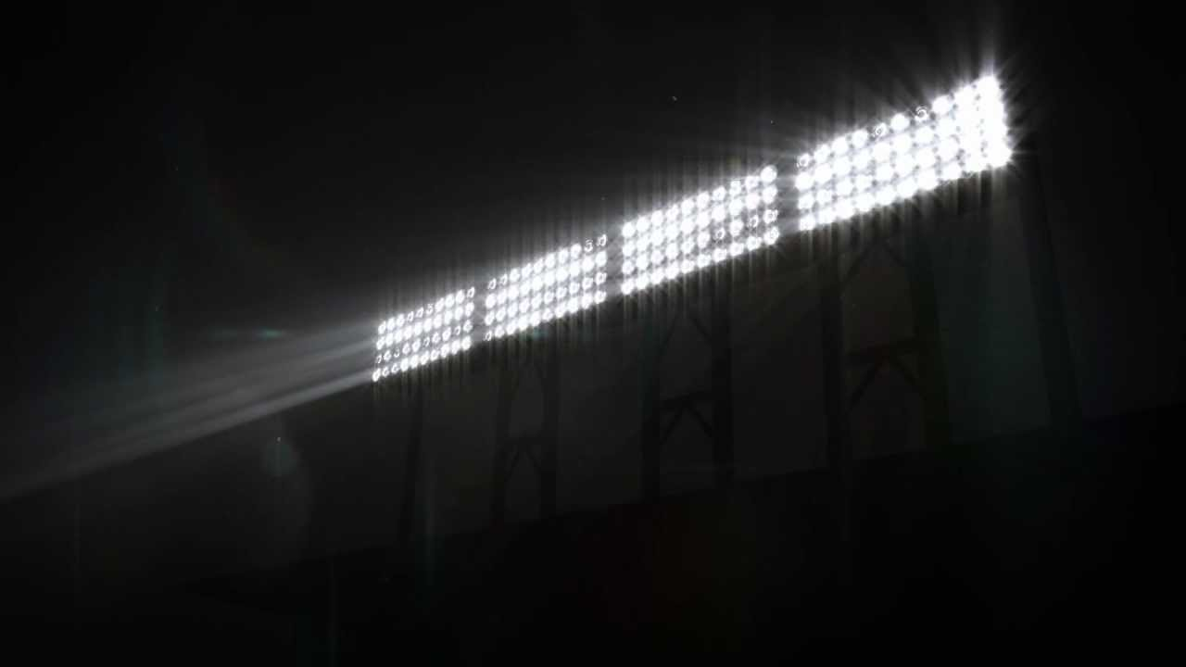
In his argument, ostensibly on behalf of the Chicago National League Ball Club (Inc.), Mr. Shlensky pointed out that the team was losing money, and that the other Chicago team, the White Sox, had higher attendance during the weekdays because they played at night. Therefore in his view the Cubs would draw more people with weekday night games. Shlensky argued that Wrigley’s first concern ought to be with the shareholders rather than the neighborhood.
The issue in the case was whether decisions made by Wrigley should be overruled absent a showing of fraud, illegality or a conflict of interest?

Slide 31
The decision was not to overrule Wrigley’s determination on the issue of lights. The court cited some reasons why the light installation could be detrimental, such as lowering the property value of the park itself, a lack of proof that financing would be available for lights and some uncertainty whether the costs would in fact be offset by increasing revenues. In essence the court set out that business decisions should not be disturbed just because a reasonable case can be made that the policy chosen by the company might not be the wisest possible. This was all the more true where there was no evidence of illegality, fraud or a conflict of interest
The court upheld the directors’ decision. Moreover the court reasoned (as the directors themselves had not) that a decline in the quality of life in the local neighbourhoods might in the long run hurt property values around Wrigley Field, harming shareholders’ economic interests.
In many ways this decision on those like it can be seen as a form of abstention by judiciary; an unwillingness to supplant the business judgment of a properly constituted and motivated Board of Directors. This so-called “BUSINESS JUDGMENT RULE” establishes a presumption against judicial review of duty of care claims.

Slide 32
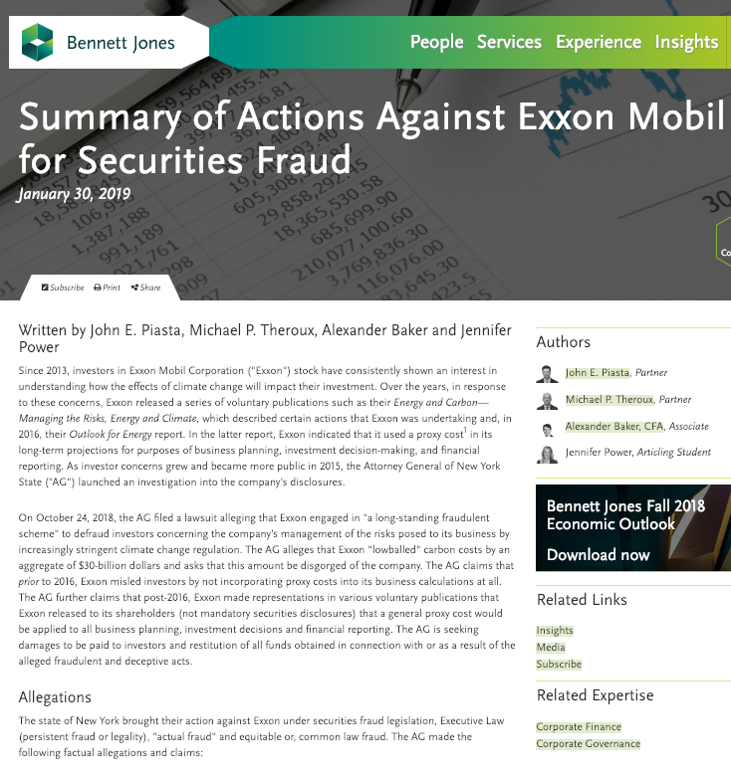

Slide 33
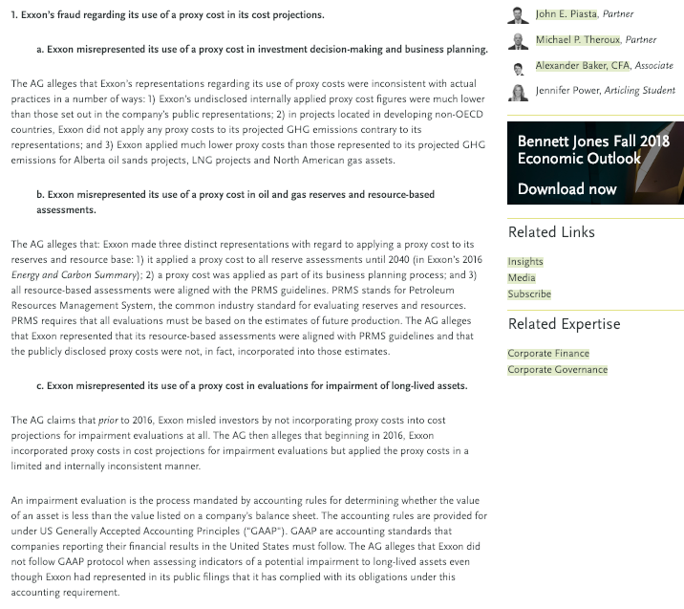

Slide 34
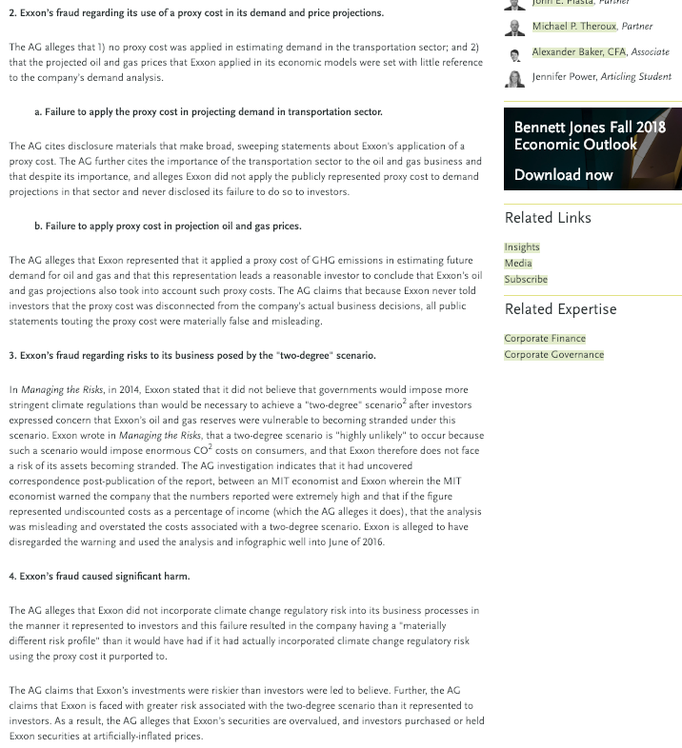

Slide 35
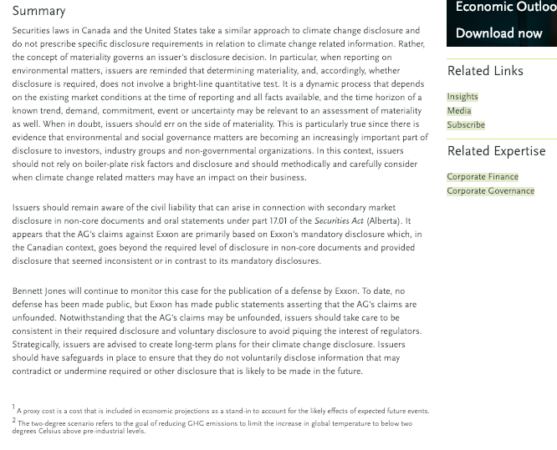

Slide 36
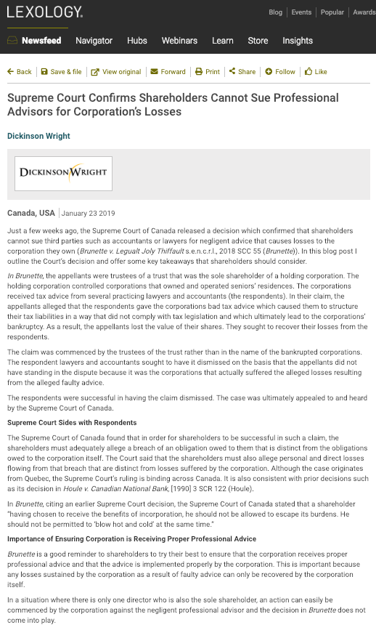

Slide 37
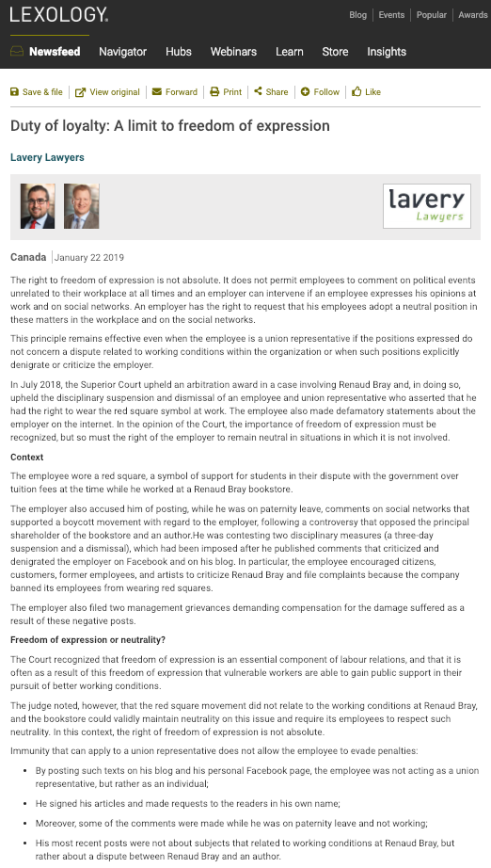

Slide 38
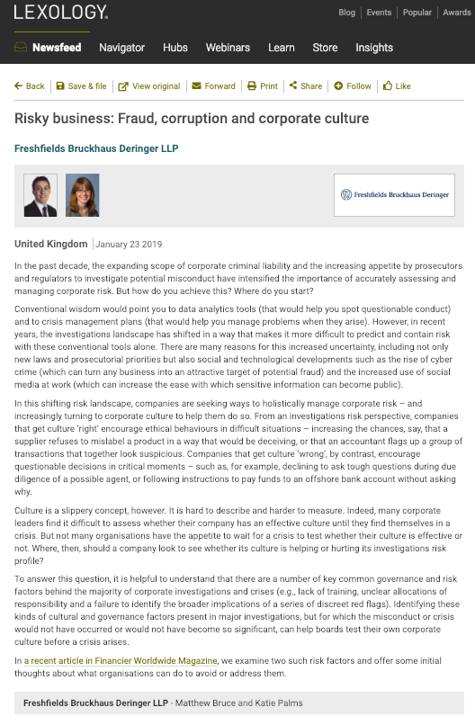

Slide 39
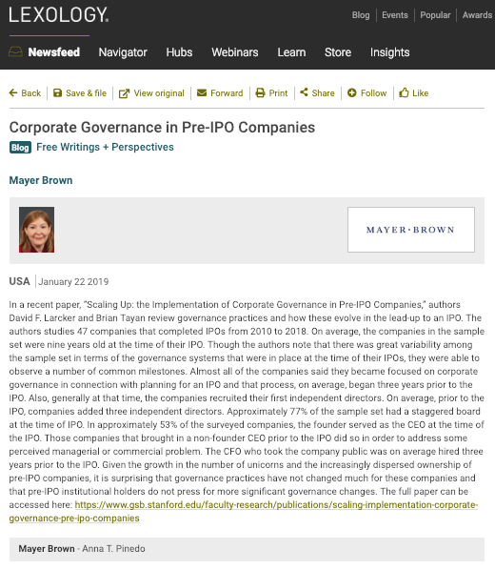

Slide 40
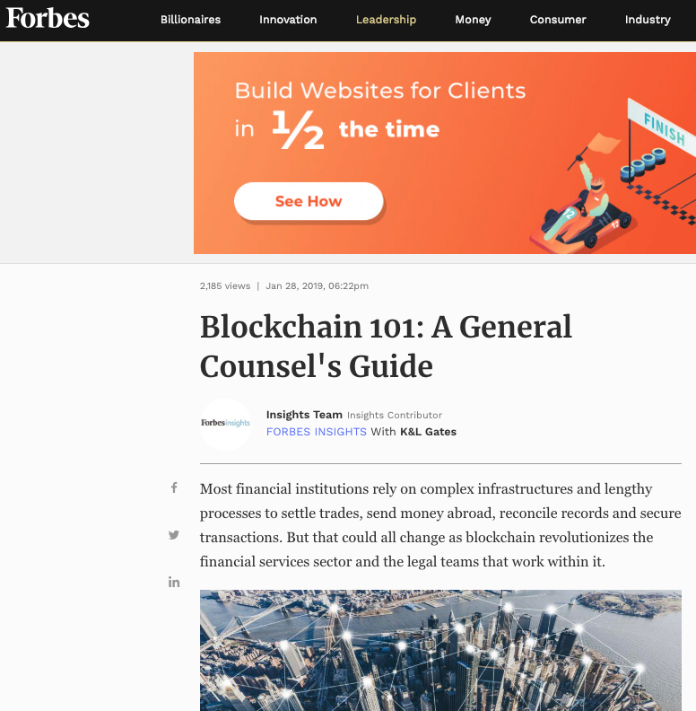

Slide 41
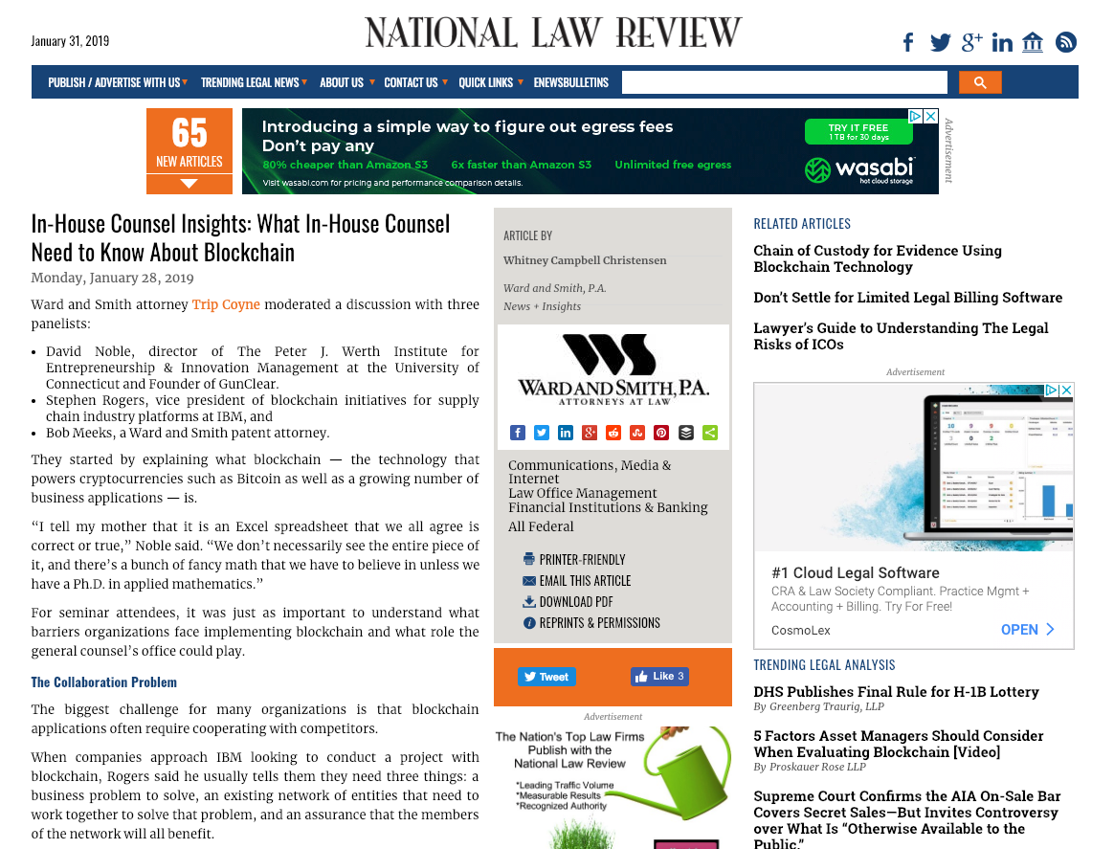

Slide 42
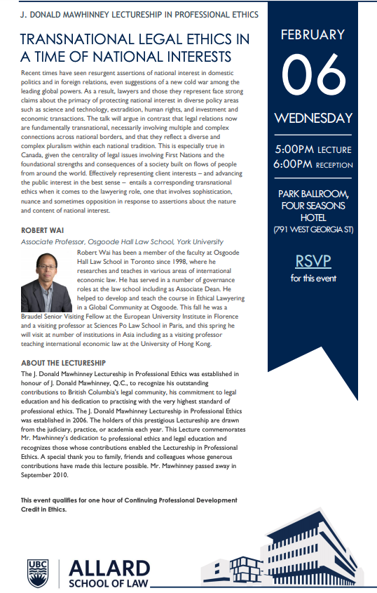

Slide 43
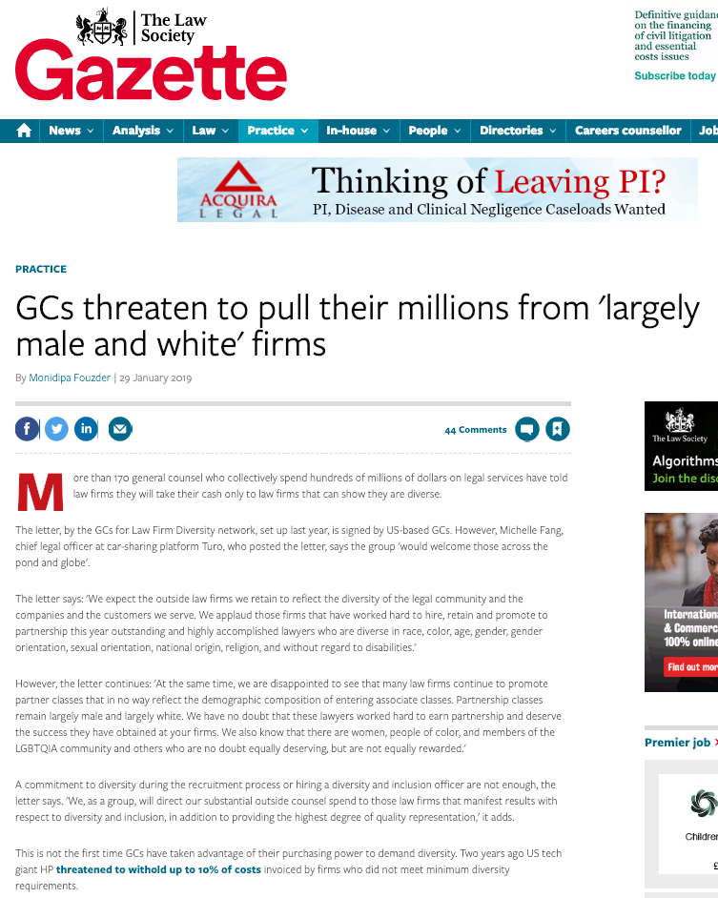

Slide 44

Pause

Slide 45
QUESTIONS?
THOUGHTS?
DISCUSSION?

Slide 46
Yours?

Slide 47
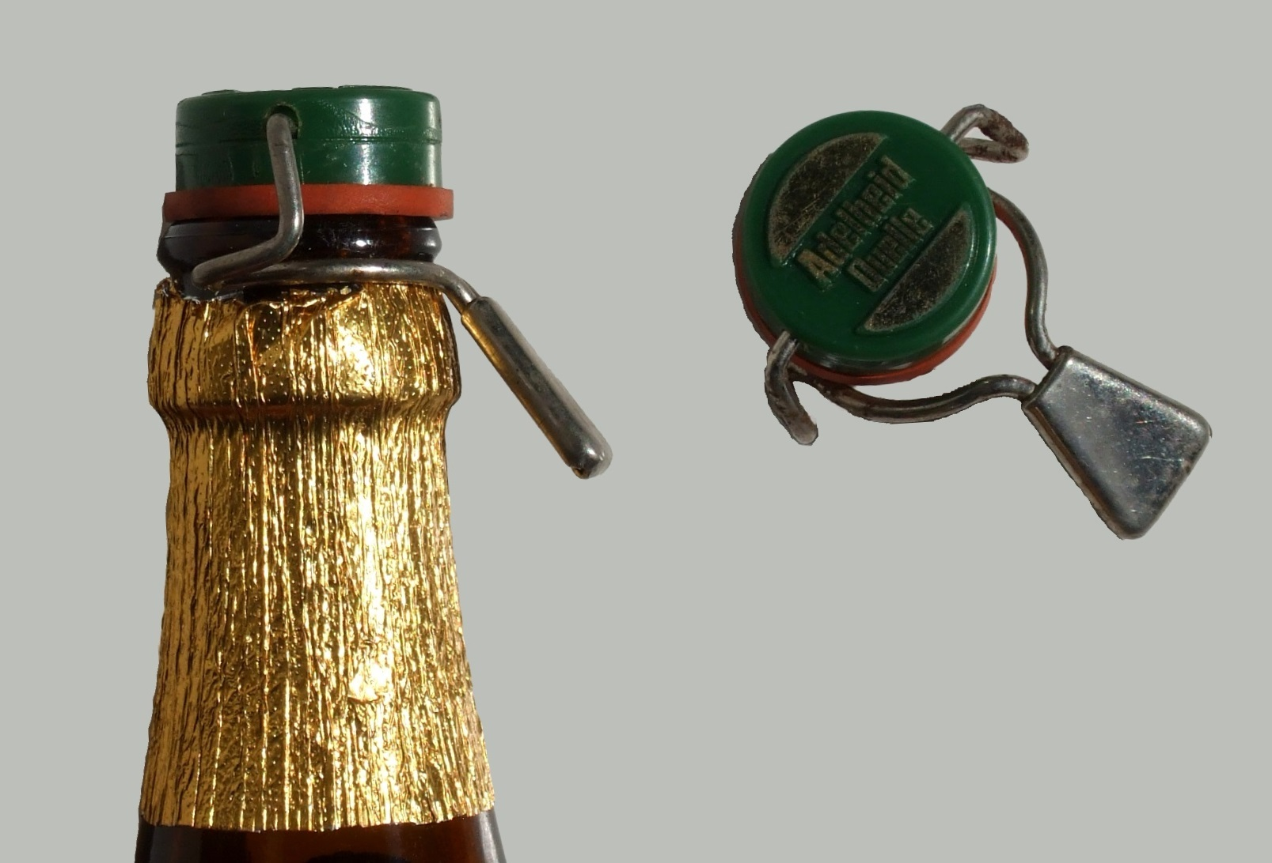
Recapping

Slide 48

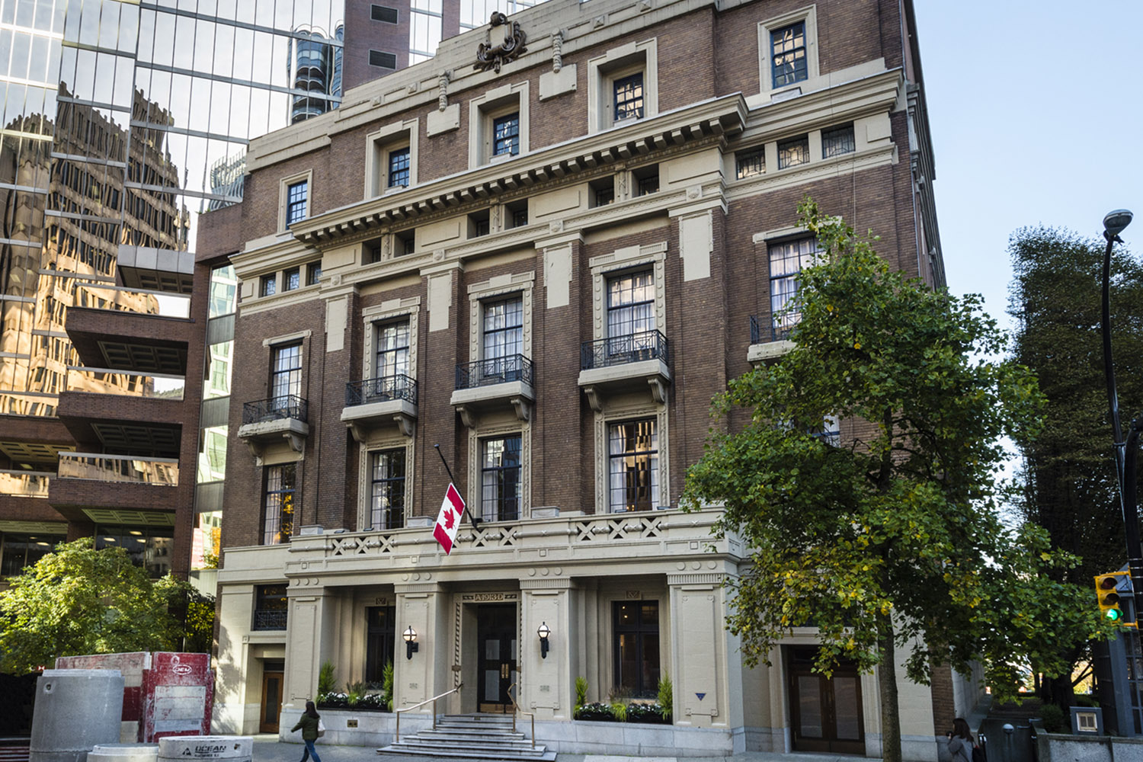
Speaking of Excess…trapped or team player?

Slide 49

Entry drug to…?

Slide 50
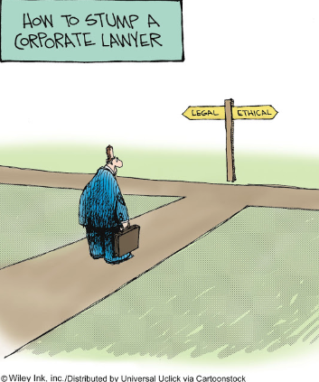
The course in one cartoon

Slide 51
Examine the question from the perspective of:
1. An out-side counsel
2. An in-house counsel
What do you see?

Slide 52
Basic Problem?
Employer/employee relationship is a conflict of interest?
3.4-1 A lawyer must not act or continue to act for a client where there is a conflict of interest, except as permitted under this Code. Commentary
[1] As defined in these rules, a conflict of interest exists when there is a substantial risk that a lawyer’s loyalty to or representation of a client would be materially and adversely affected by the lawyer’s own interest… A client’s interests may be seriously prejudiced unless the lawyer’s judgment and freedom of action on the client’s behalf are as free as possible from conflicts of interest.

Slide 53
[5] The value of an independent bar is diminished unless the lawyer is free from conflicts of interest…The lawyer-client relationship is a fiduciary relationship…This obligation is premised on an established or ongoing lawyer client relationship in which the client must be assured of the lawyer’s undivided loyalty, free from any material impairment of the lawyer and client relationship.
[8] Conflicts of interest can arise in many different circumstances. The following examples are intended to provide illustrations of circumstances that may give rise to conflicts of interest. The examples are not exhaustive.
  (d) A lawyer,..or a family member has a personal financial interest in a client’s affairs or in a matter in which the lawyer is requested to act for a client…
    (i) A lawyer owning a small number of shares of a publicly traded corporation would not necessarily have a conflict of interest…because the holding may have no adverse influence on the lawyer’s judgment...

Slide 54
Basic Problem? Huge?
Separation of Legal Advice
& Decision Making?
Are you doing both?
Should you be doing both?
'A man who is his own lawyer
has a fool for a client.'

Slide 55
Basic Conundrum?
Good governance is invisible

Slide 56

…invisible.
Measured by the number of crises that don’t manifest.

Slide 57
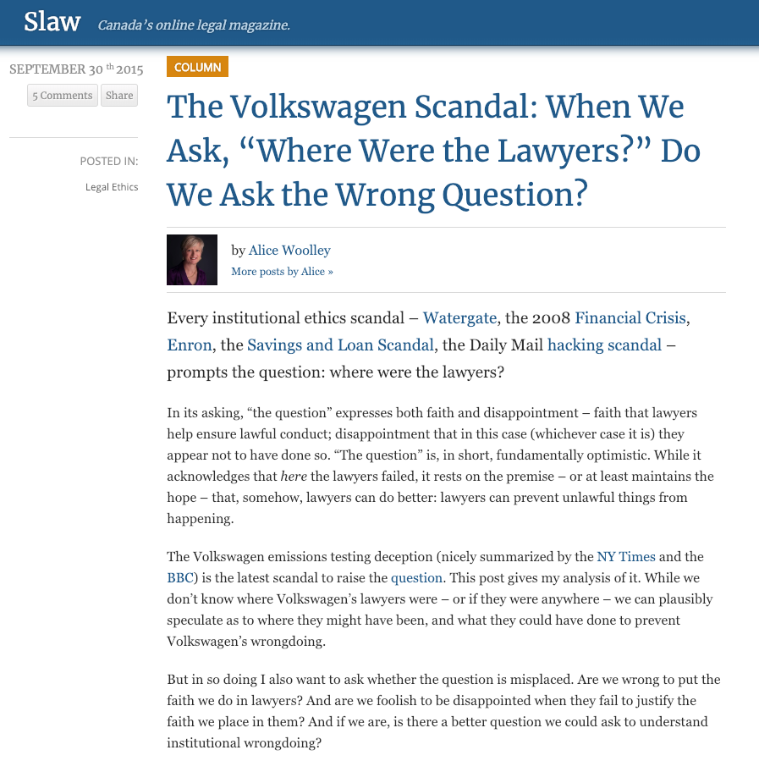
Poor Governance is SUPER VISIBLE
ABA Journal

Slide 58
Pause

Slide 59
QUESTIONS?
THOUGHTS?
DISCUSSION?

Slide 60
Syllabus Exercise Part 2 RESULTS
Coming
Up

Slide 61
Possible Methodology for
Group Presentations
& much of the course (?)
Coming
Up

Slide 62
You?

Slide 63

About you & what might interest you..

Slide 64
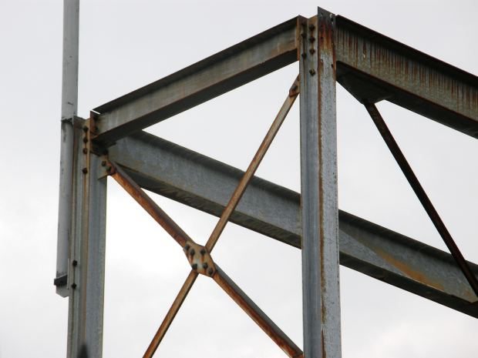
Structural Framework

Slide 65
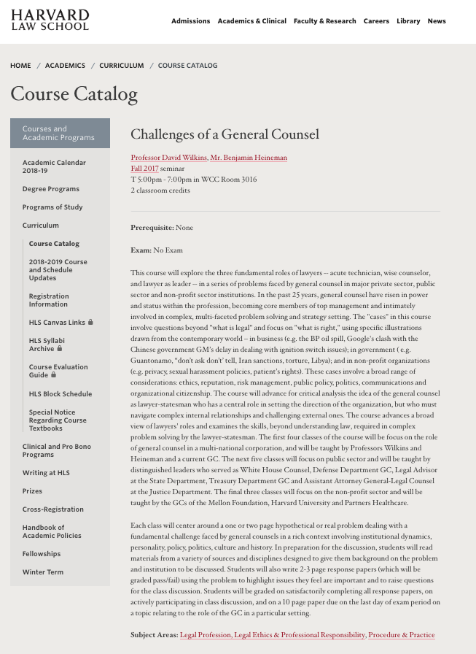
https://hls.harvard.edu/academics/curriculum/catalog/default.aspx?o=72164

Slide 66
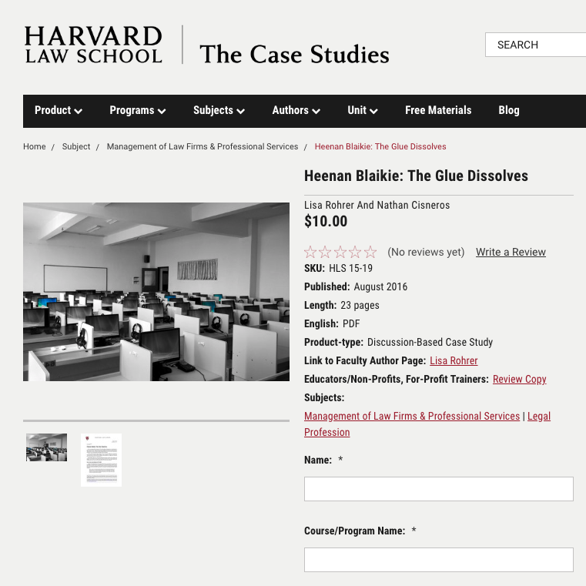
Case Study Method?

Slide 67
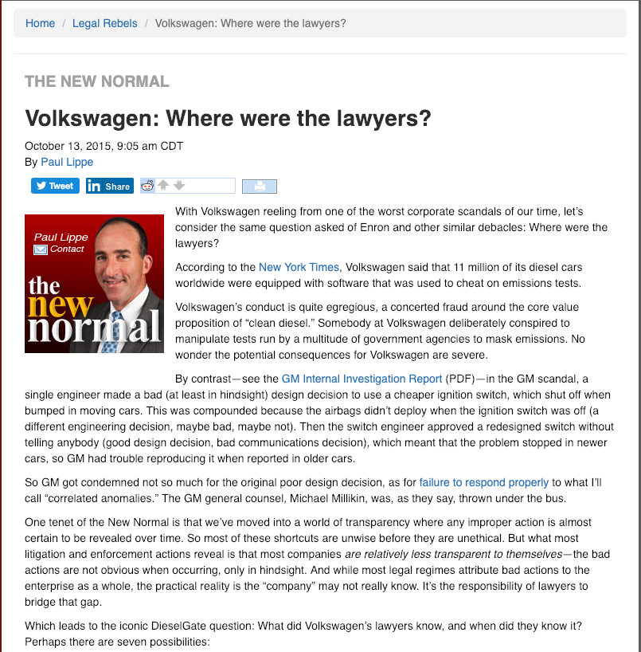
ABA Journal

Slide 68
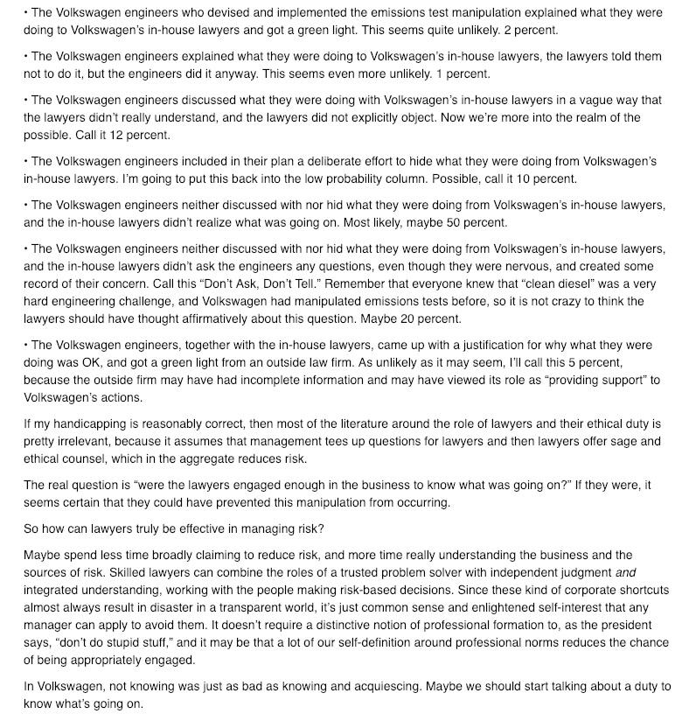

Slide 69
Now

Slide 70
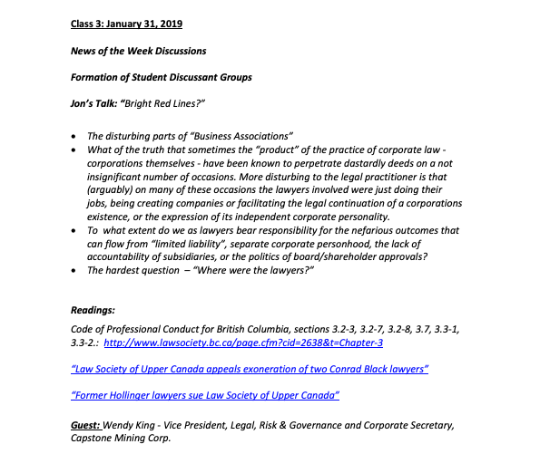
Syllabus Exercise Part 2 RESULTS
TWEN

Slide 71


Slide 72
Course is meant to primarily be about themes, situations & problem solving.
What’s missing
among those?

Slide 73
You said…A Role Playing Exercise…
Two possibilities:
Anyone or a committee (?) who want’s to create one with me (anyone love to design “Murder Mystery” party games?)
Does a group want to do it as their presentation?

Slide 74
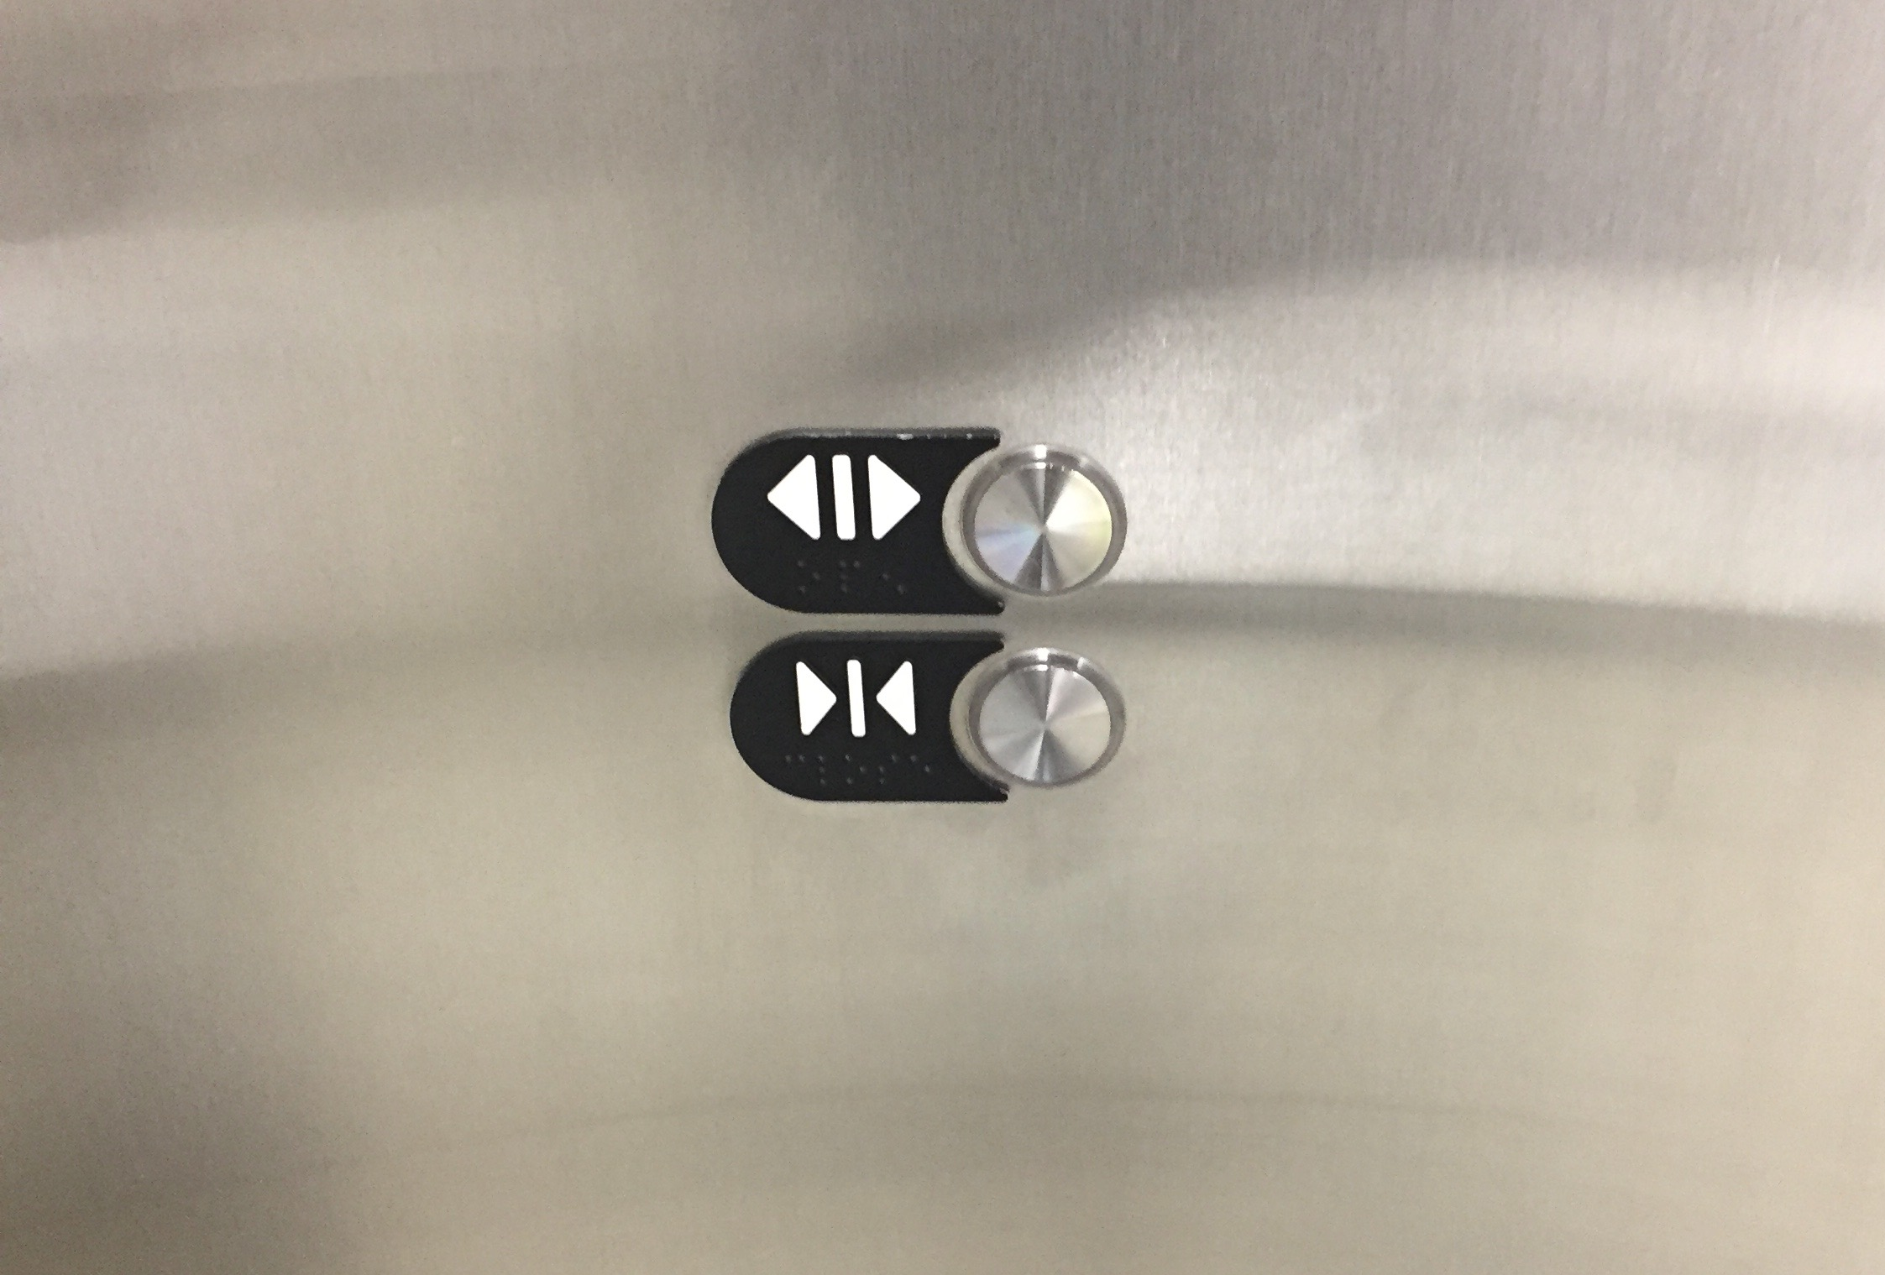
You will notice media, entertainment, corporate & sports themes.

Slide 75
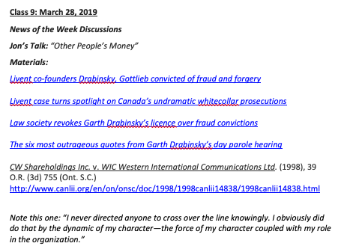
You said…Securities/Takeover Problems

Slide 76
You asked…Punishments for corporate counsel wrongdoing?
BC Law Society data…0 citations (disciplinary cases)
Some, not many, complaints
In-house lawyers not insured
But Robert Strother of Davis & Co.?

Slide 77
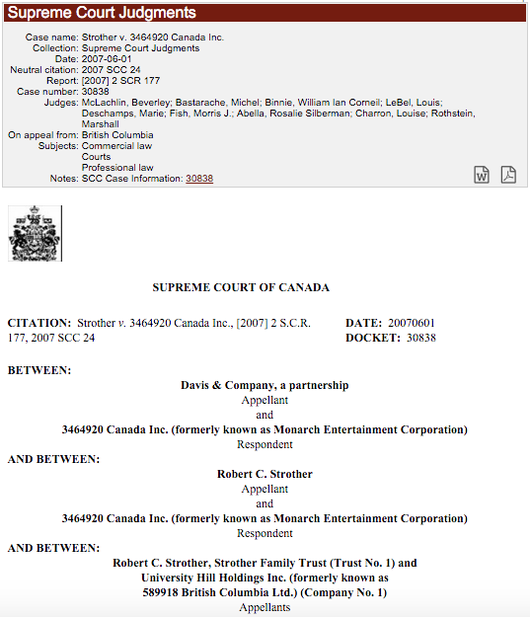

Slide 78
Strother v. 3464920 Canada Inc., [2007] 2 S.C.R. 177
Breach of fiduciary duty & breach of confidence
Fiduciary duty includes duty of loyalty
Relationship between duty of loyalty and avoiding conflicts of interest

Slide 79
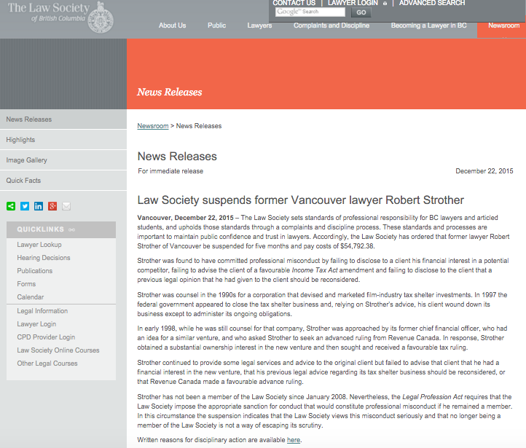

Slide 80
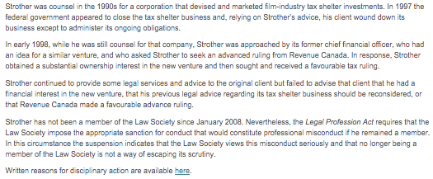

Slide 81
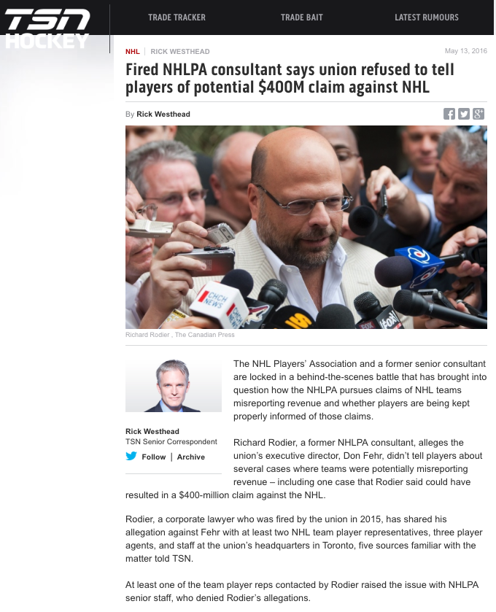

Slide 82
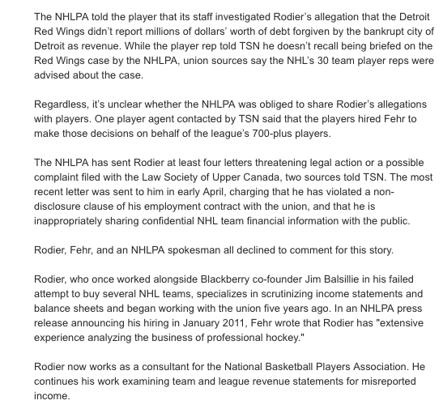

Slide 83
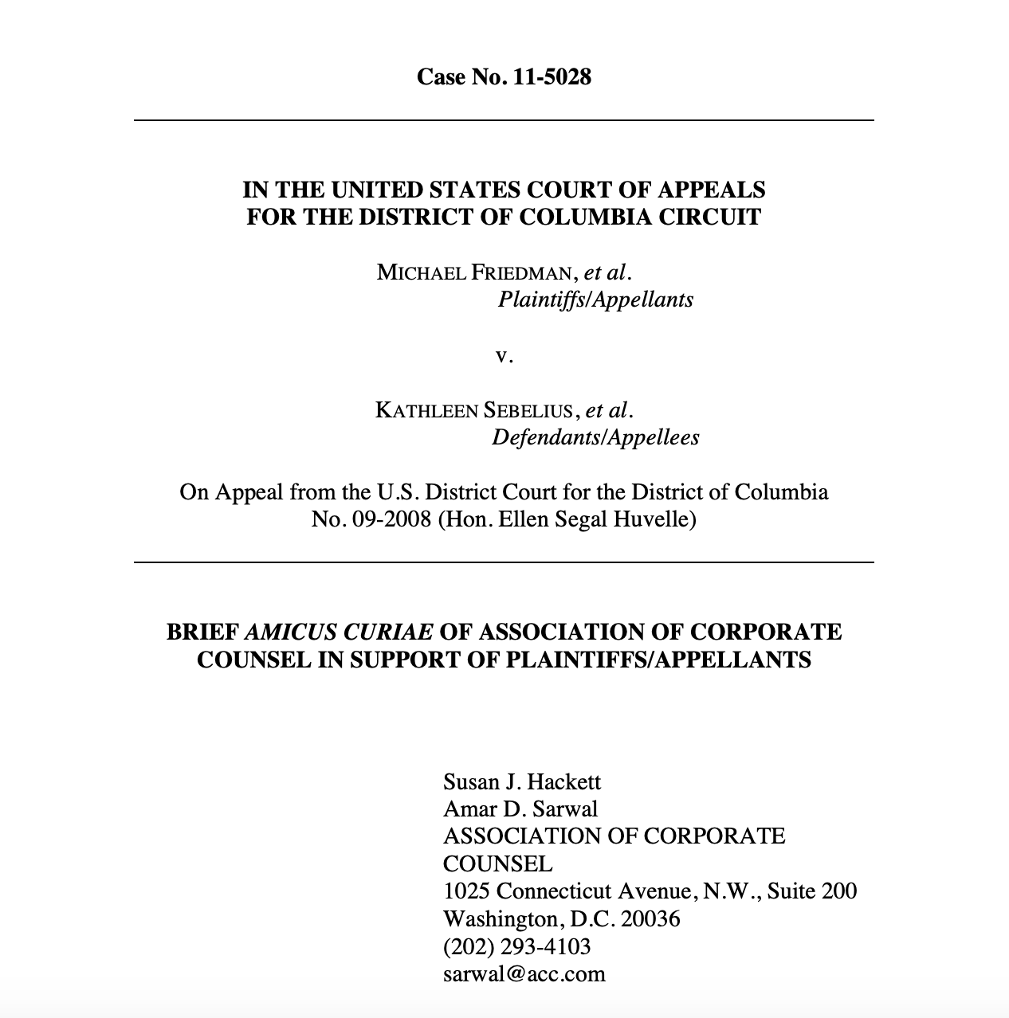

Slide 84
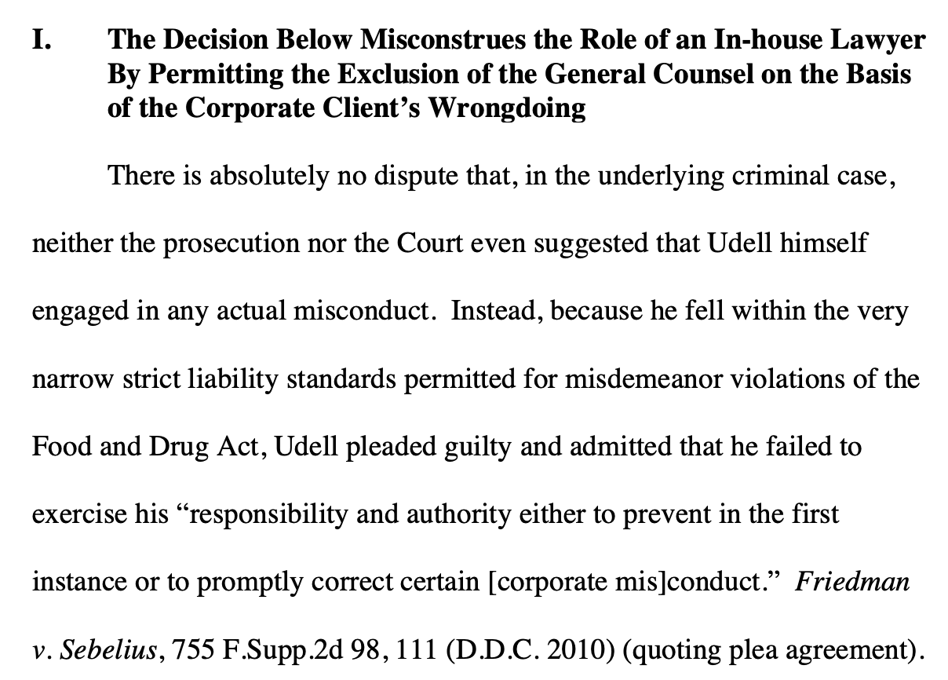

Slide 85
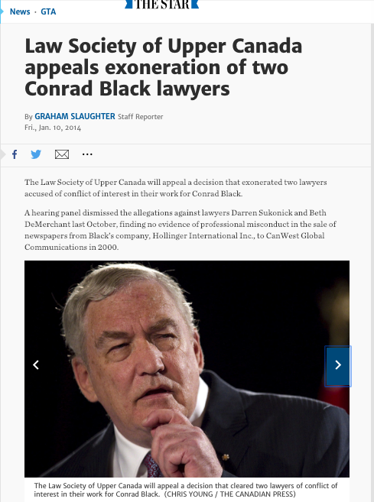
Most serious of all…

Slide 86
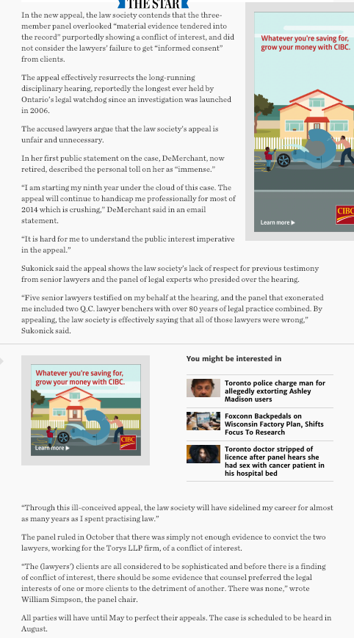

Slide 87
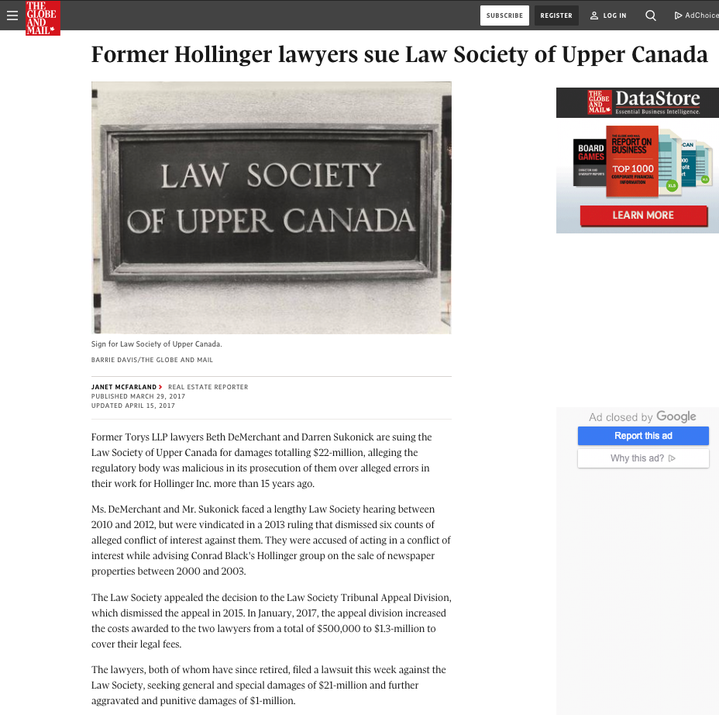

Slide 88
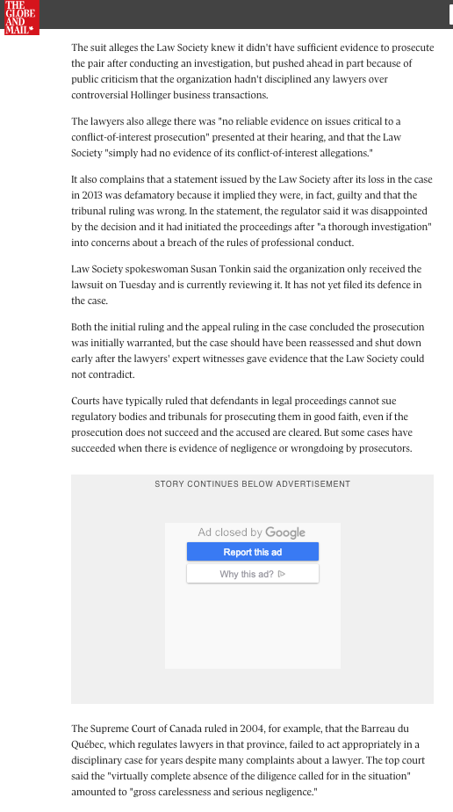

Slide 89
You asked…what are the limits of in-house counsel? When do outside lawyers need to be hired?
AWESOME QUESTIONS

Slide 90
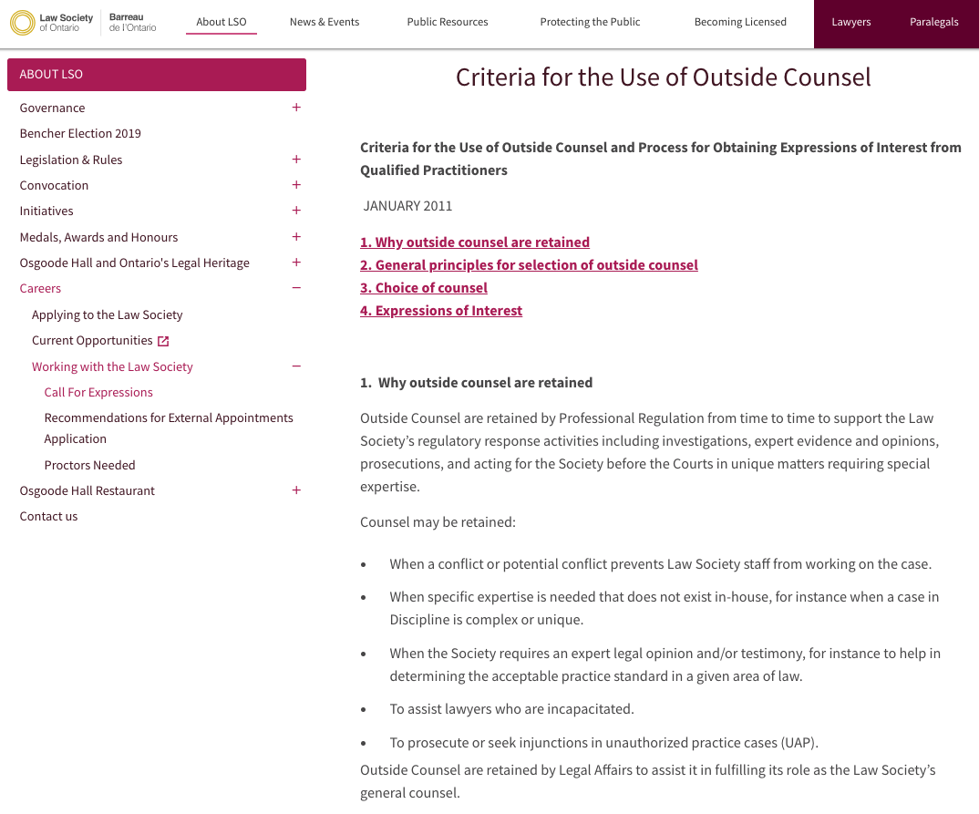

Slide 91


Slide 92
123. (4) A director is not liable under section 118, 119 or 122 if he relies in good faith on
(a) financial statements of the corporation represented to him by an officer of the corporation or in a written report of the auditor of the corporation fairly to reflect the financial condition of the corporation; or
(b) a report of a lawyer, accountant, engineer, appraiser or other person whose profession lends credibility to a statement made by him.

Slide 93
Query in this context…
C.L.O.
(Who is not member of local bar)

Slide 94
What about
SOLICITOR-CLIENT PRIVILEDGE?
In R. v. Campbell [1999] 1 SCR 565, the Supreme Court of Canada held (citing Minter v. Priest, [1929] 1 K.B. 655 C.A.)that whether a lawyer works as in-house counsel or external counsel does not affect the creation or the character of solicitor-client privilege. In either context, only advice given by lawyers within a solicitor-client relationship is protected.

Slide 95
In a 2004 decision, Pritchard v. Ontario (Human Rights Commission), 2004 1 SCR 809 the Supreme Court of Canada (citing R v. Campbell) reaffirmed the highly context-specific evaluation required to determine whether privilege attaches to an in-house lawyer's advice:
  "Owing to the nature of the work of in-house counsel, often having both legal and non-legal responsibilities, each situation must be assessed on a case-by-case basis to determine if the circumstances were such that the privilege arose. Whether or not the privilege will attach depends on the nature of the relationship, the subject matter of the advice, and the circumstances in which it is sought and rendered."

Slide 96
You are VP Business Development in your organization and are sometimes asked for legal advice. Is your legal advice privileged?

Slide 97

You asked…Differences between in-house lawyers the world over???

Slide 98

Speaking of solicitor-client privilege…

Slide 99


Slide 100
What/where else?
Good question…

Slide 101
You asked…What about being in-house at smaller companies?
Value - efficiency - expertise - immediacy - full attention thresholds required to decide to have a counsel.
Unless you are a founder…
Or have multiple responsibilities.

Slide 102
You wondered…Will the need for in-house counsel go away because of on-line law firms or A.I.?
THOUGHTS?
DISCUSSION?

Slide 103


No, because of specialized entity specific knowledge.

Slide 104

The question
of GUESTS?

Slide 105



Slide 106
Take-aways and/or summaries
IDEAS ON
HOW BEST?

Slide 107
QUESTIONS?
THOUGHTS?
DISCUSSION?

Slide 108


Slide 109


Slide 110



Slide 111


Slide 112


Slide 113


Slide 114


Slide 115


Slide 116


Slide 117

Now, back to our regularly scheduled programming…

Slide 118

“With great power…”

Slide 119


Slide 120



Slide 121


Slide 122


Slide 123


Slide 124


Slide 125


Slide 126


Slide 127
Useful metaphor only
You are a hero (because everyone is per Campbell & Post-structuralism)
Don’t be a “Hero”.

Slide 128
Hence
case
studies…

Slide 129
History
Motivations
Conflicts
Characters
Narratives

Slide 130
Possible Methodology for
Group Presentations
?

Slide 131

Follow the counsel through the maze and its decision points

Slide 132
And bear in mind…

Slide 133
Alternative is Topic Presentations…
Privilege in all its permutations
Conflicts of interest in all its permutations including dealing with subsidiaries and/or parent companies
Specific securities law obligations
Responsibilities to Directors (including audit committee, special committees, and independent Committees)
“Whistle-Blower” rules and risks
Counsel’s obligations when your company is being bid on or taken-over
GDPR & Data Protection
Sexual Harassment issues
Investigations
Media including the press & social media
etc.

Slide 134

Gordian Knots

Slide 135


Slide 136
Pause

Slide 137
QUESTIONS?
THOUGHTS?
DISCUSSION?

Slide 138


Slide 139
Nominate a great in-house counsel

Slide 140


Slide 141


Slide 142


A MATTER OF PERSPECTIVE

Slide 143

Conclusion

Slide 144
SEE YOU NEXT WEEK!

Slide 145

Always include a cat picture

Slide 146
In learning you will teach
And in teaching you will learn
Phil Collins' Son of Man (1999)

Slide 147
Our Academic Partners

