Slide 1


“With great power…” Part 1
Talk 2
LAWF 3780
Challenges of In-House & Corporate Counsel
TRU Faculty of Law
Spring, 2019
Jon Festinger Q.C.
Centre for Digital Media
QMUL School of Law (CCLS)
Festinger Law & Strategy
http://commlaw.allard.ubc
@jonfestinger
jon_festinger@thecdm.ca

Slide 2
Hello
LAW F 3780
Challenges of In-House
& Corporate Counsel

Slide 3

Terrific Thursdays

Slide 4
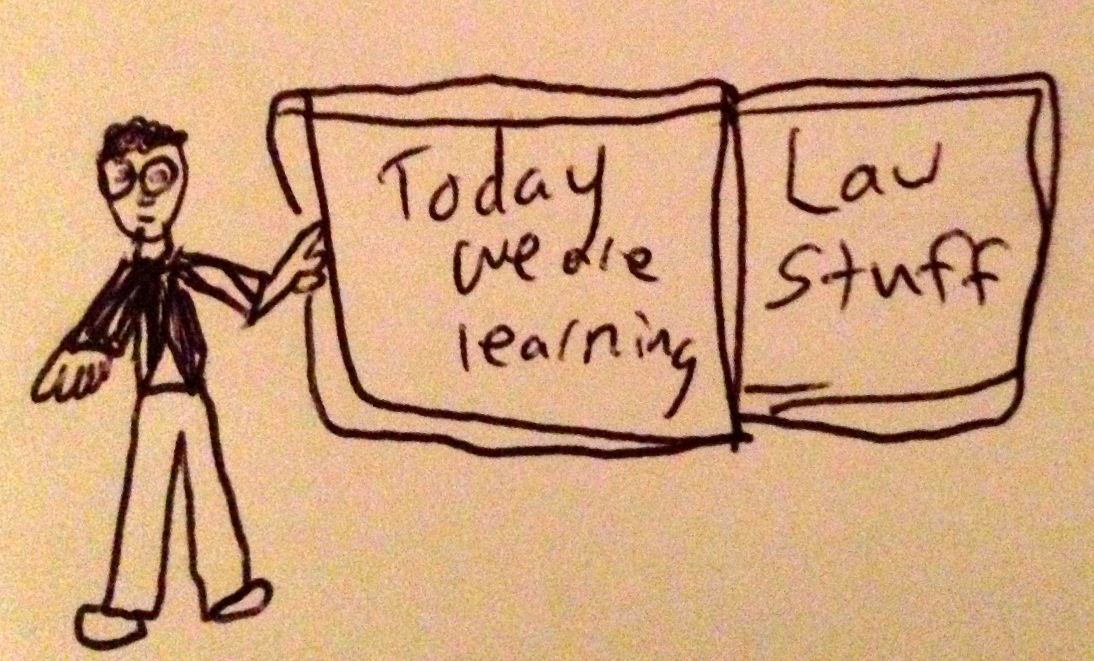

Slide 5
Logistics

Slide 6
Grading

Slide 7
EVALUATION
Term paper = 60% of the final grade.
5000 word paper
The paper is due on the last day of the exam period at 4:00 p.m.
Class Participation = 40% of the final grade
25% of the mark will be based on group preparation of a Class Discussion, with a Discussion Outline provided to the class—preferably by posting on the course website—a week before.
15% for student participation in other course activities including seminar discussions etc.

Slide 8
Paper Confessional
(or what I learned one winter holiday)
Legal/normative reasoning/argument including footnote/bibliography support & Contribution/Move forward → 60%
Presentation including layout, headings, grammar, language/writing skills, “tightness” → 25%
Topic/Originality/Degree of Difficultly → 15%
THIS IS NOT A RUBRIC. IT IS A SELF ASSESSMENT.

Slide 9
Group Presentations
2-3 (ideally) per group
Sign-up at the break or email me
Any topic – not constrained by what I’m talking about that week
Consult with me re the topic you want to take on
Post one thing you want us to read or watch

Slide 10
Possible Methodology for this…
Coming
Up

Slide 11
Evaluation Tips
Term paper topics need not be discussed with me, but often helpful to you if you do.
Term paper can be on your presentation topic.
Participation: In-class or other contributions, including attendance.
Group presentation need not be on that week’s topic (20 minute per student multiplier suggested 2-4 per group to 60 minute max).

Slide 12
Grades (primarily)
Paper → Quality
Participation → Effort

Slide 13
Will read: drafts…outlines…synopsis……abstracts…etc.
As late as I can…
Due last day of exams by 4:00 PM.
Hand in papers to front desk & send by email.
If email only, make sure you get acknowledgment of receipt.

Slide 14
QUESTIONS?
THOUGHTS?
DISCUSSION?

Slide 15
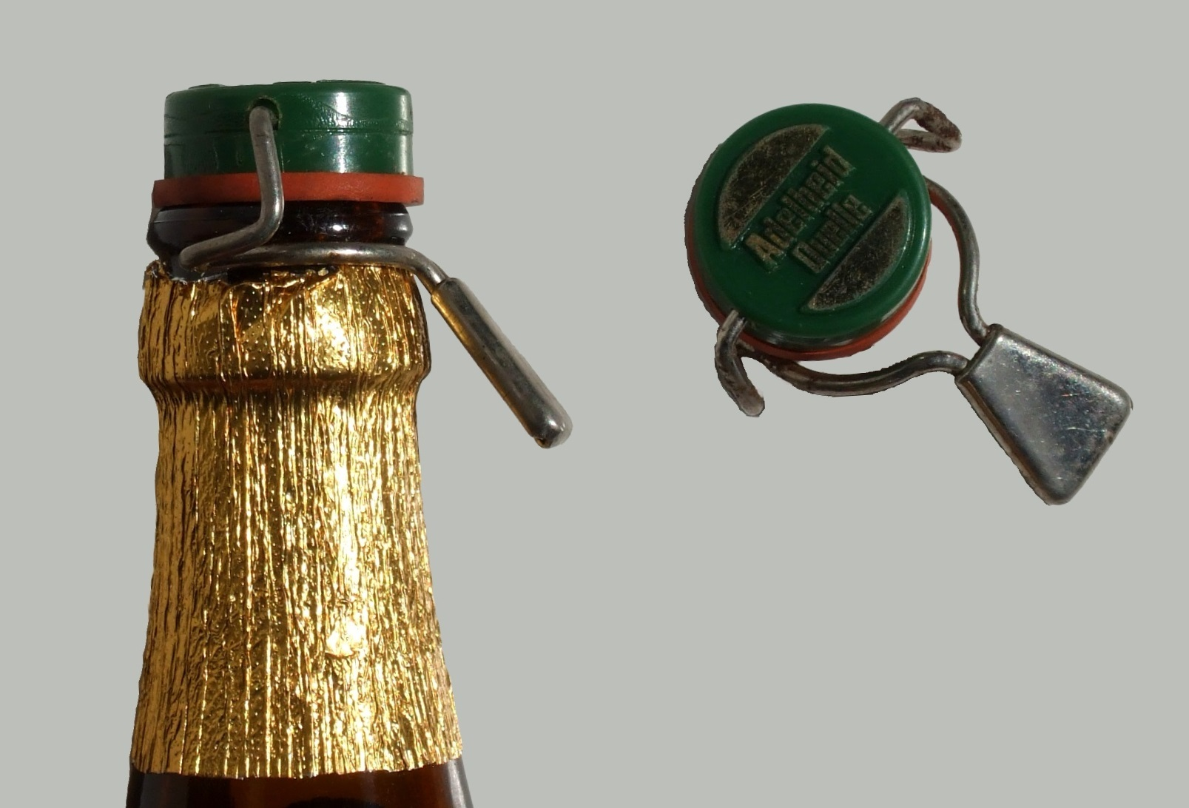
Recapping

Slide 16

Pick your meme

Slide 17
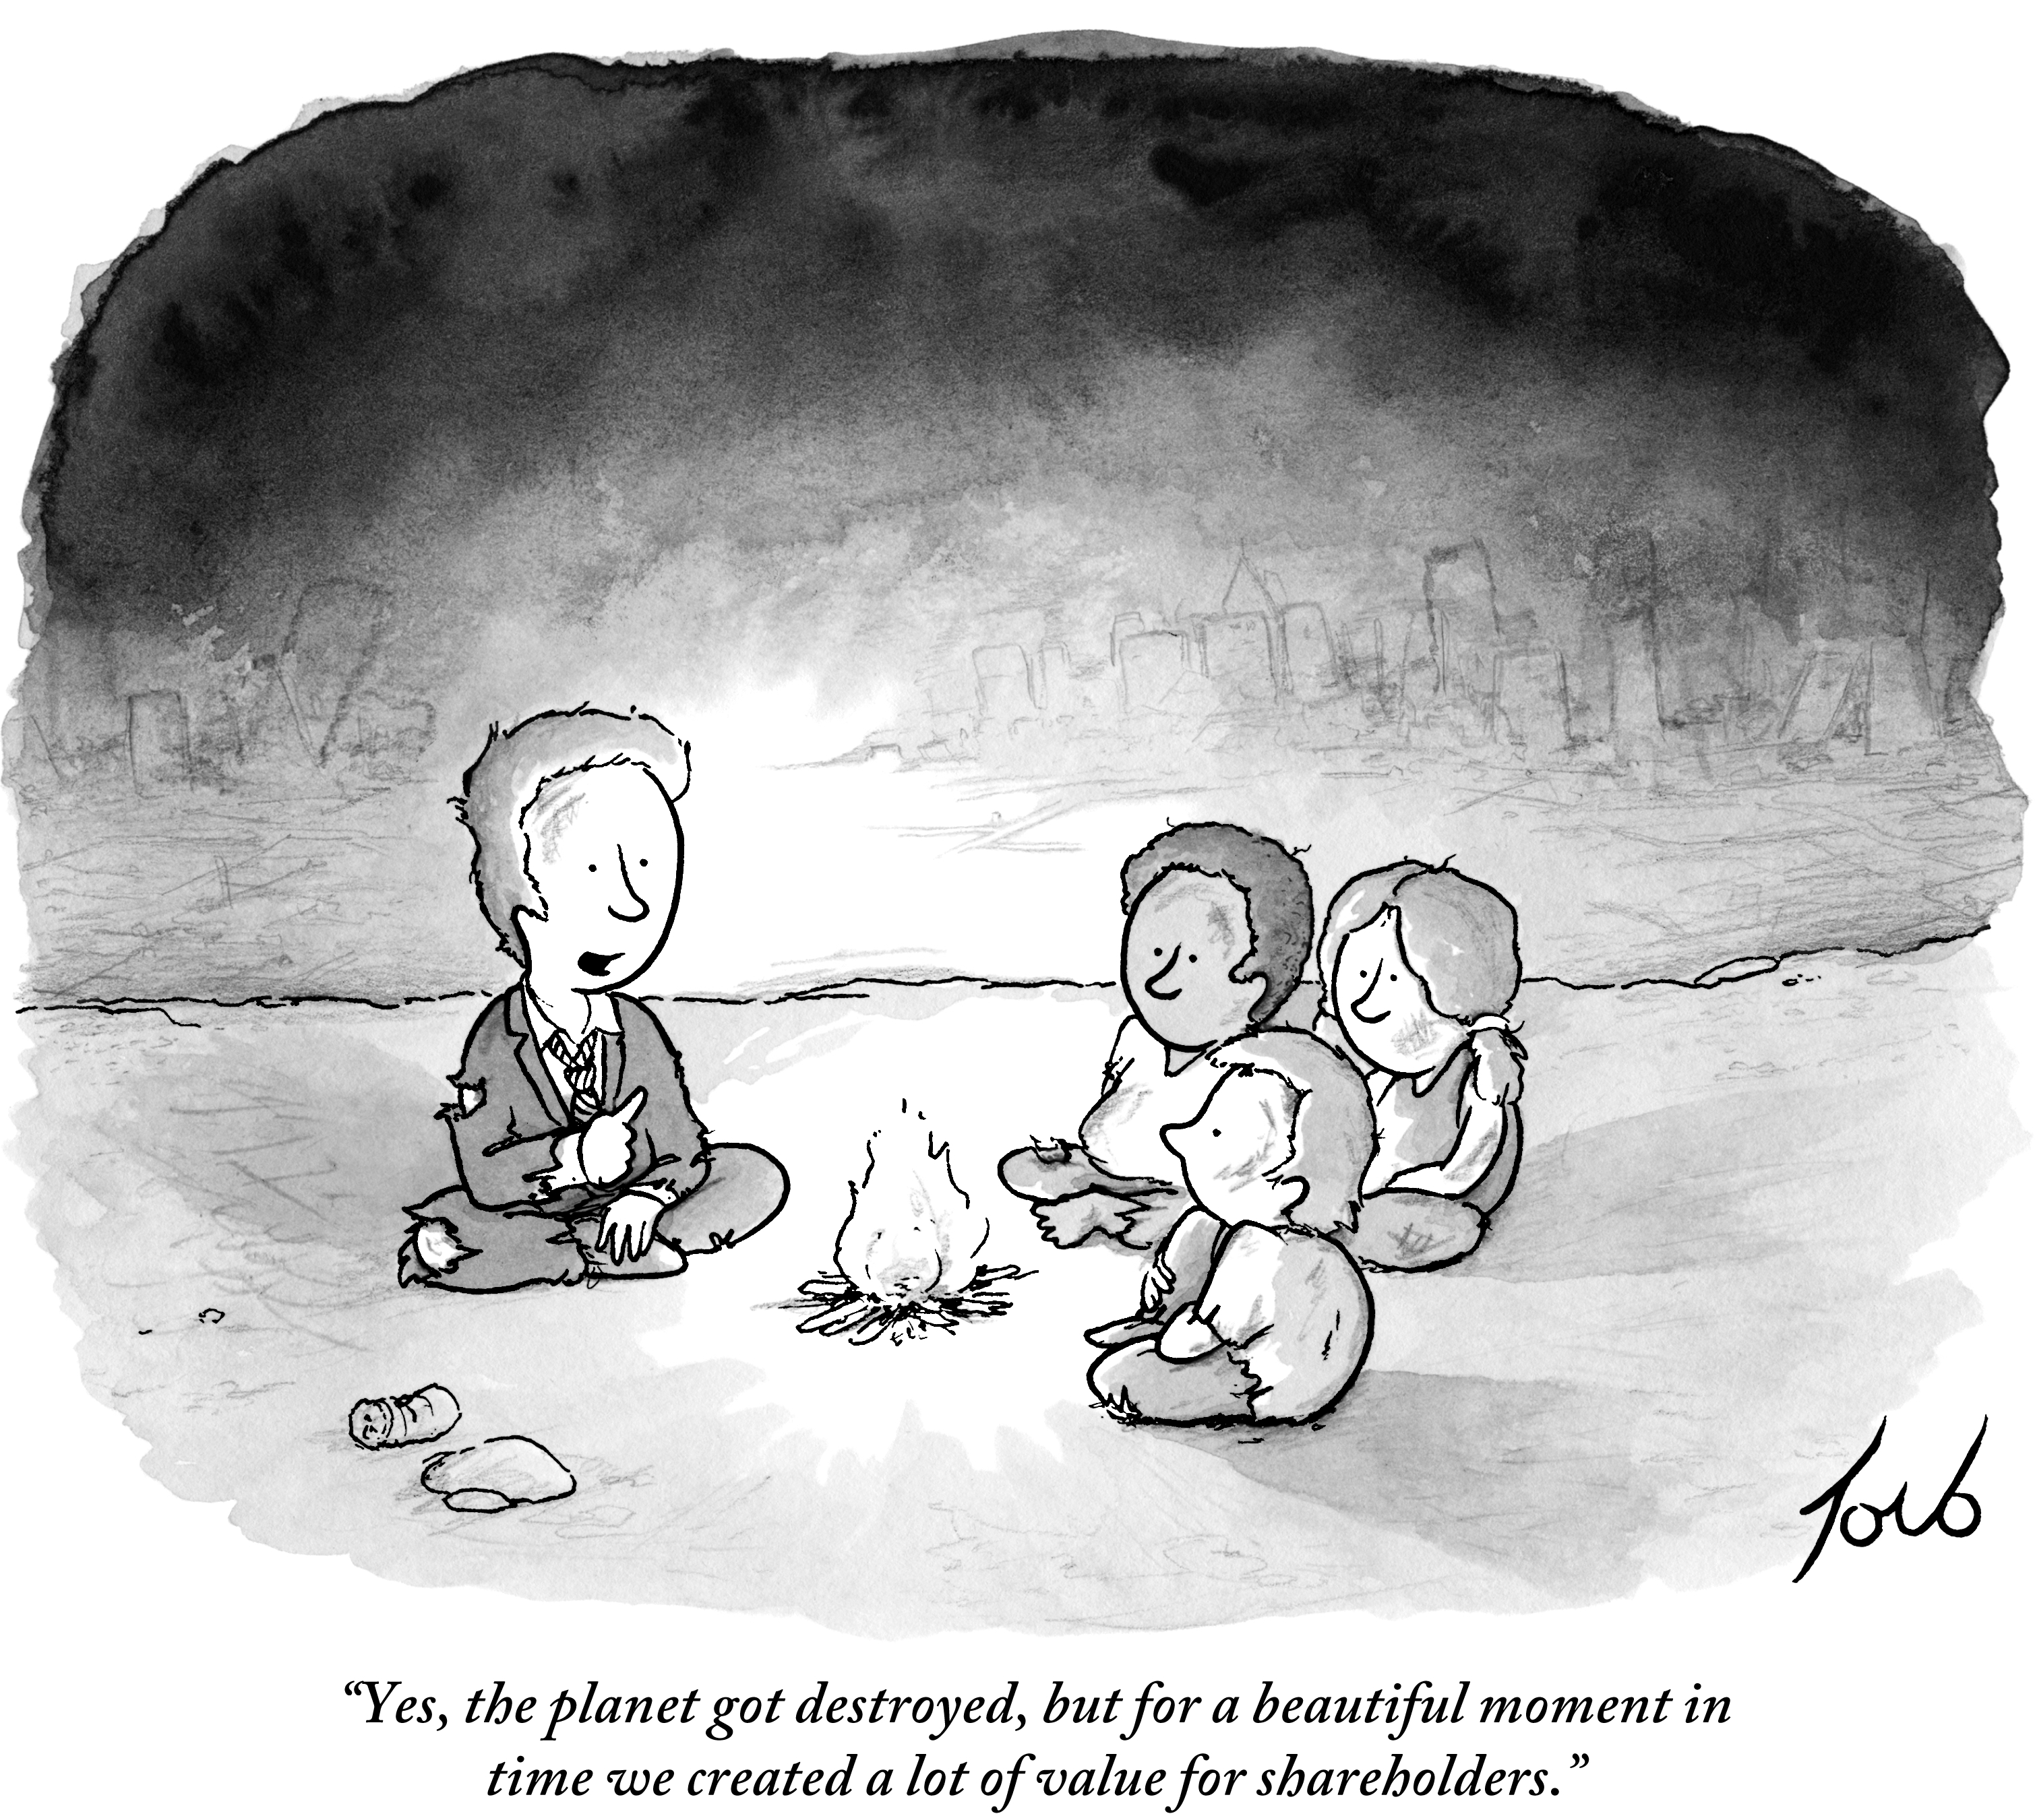
1

Slide 18
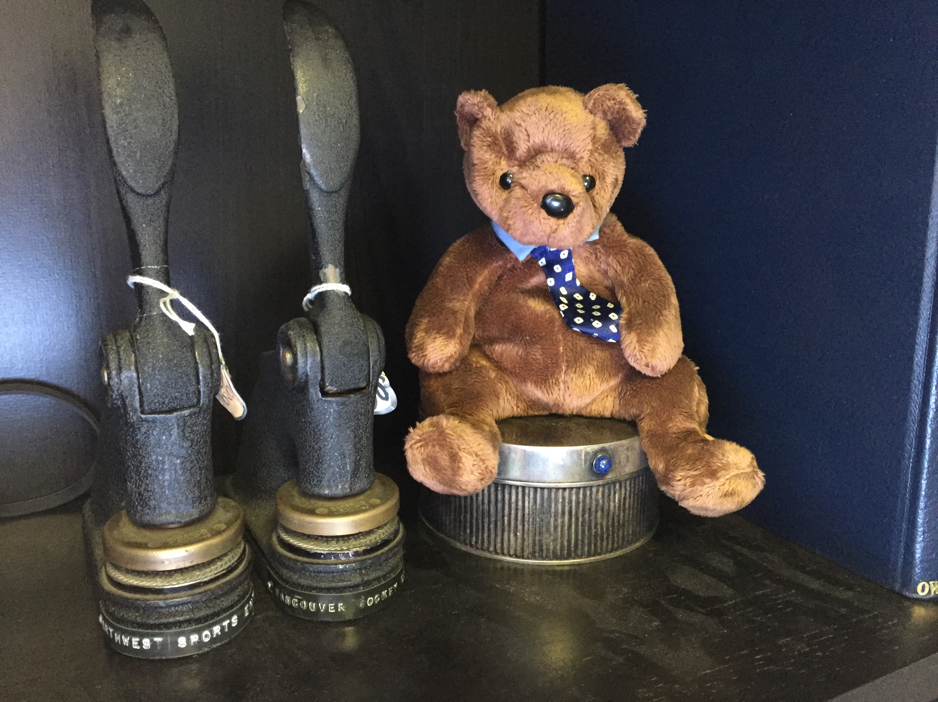
2

Slide 19
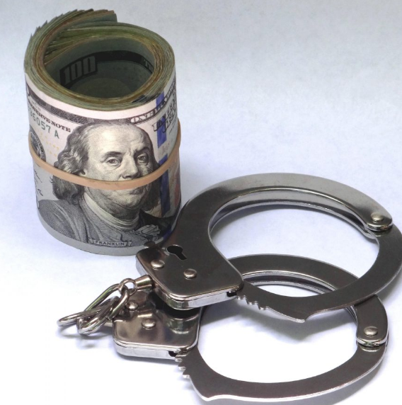
3

Slide 20

4

Slide 21
Which meme appeals to you most in the context of this course?

Slide 22

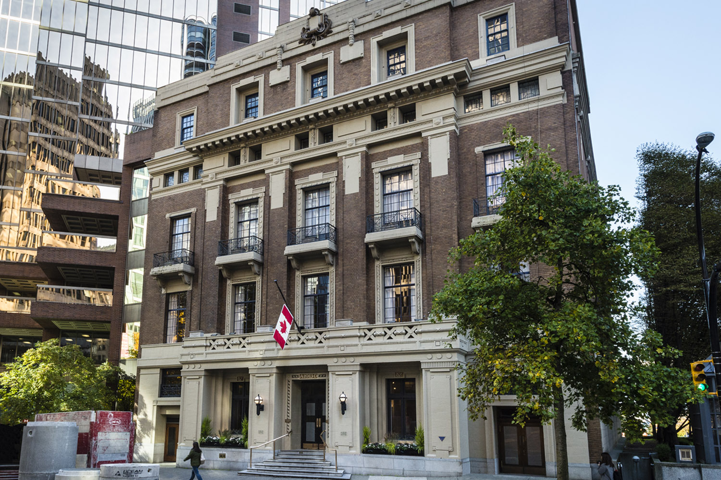
Speaking of Excess…trapped or team player?

Slide 23

What about…?

Slide 24
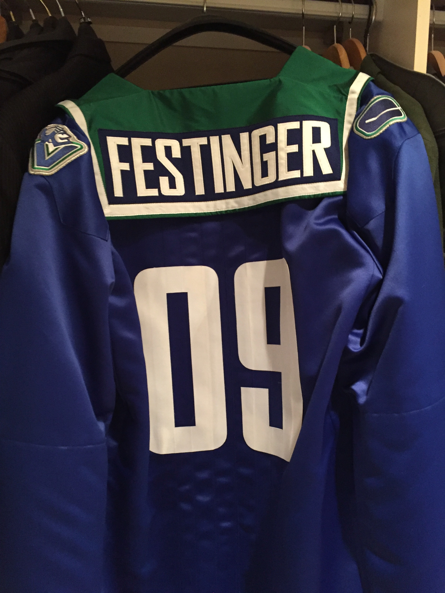
Perks that mean something…

Slide 25

Pause

Slide 26
FURTHER…
THOUGHTS?
DISCUSSION?

Slide 27
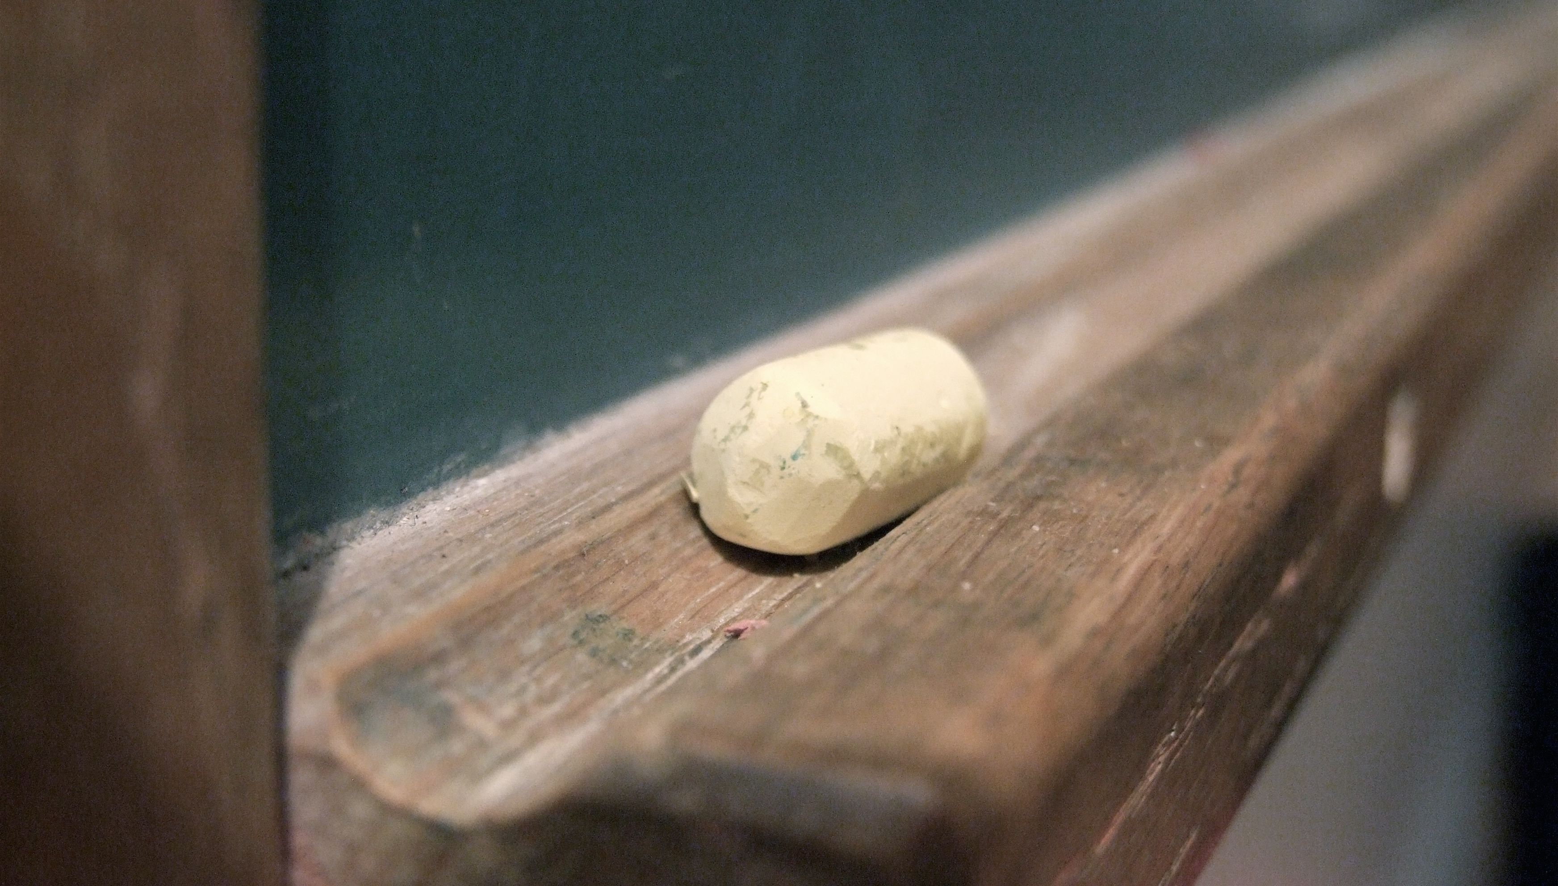
Pedagogy

Slide 28

Pedagogic Goals
One word:
ENGAGEMENT
Two words:
CREATING PERSPECTIVE
Three words:
APPRECIATING (ETHICAL) COMPLEXITY

Slide 29

Pedagogic Emphasis
Ground in (current) events
Emphasize ethics
Find relevance
Encourage exploration

Slide 30

You Did Syllabus Exercise Part 1
TWEN

Slide 31


Slide 32
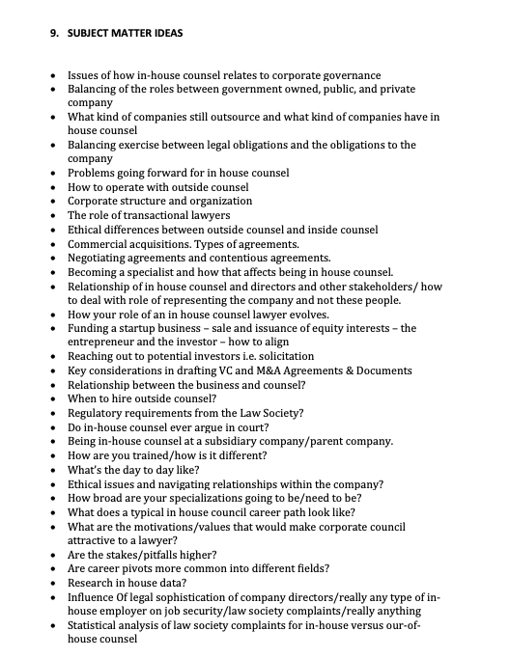
Results → TWEN

Slide 33
Syllabus Exercise Part 2
Coming
Up

Slide 34
Pause

Slide 35
QUESTIONS?
THOUGHTS?
DISCUSSION?

Slide 36
News of the Week

Slide 37
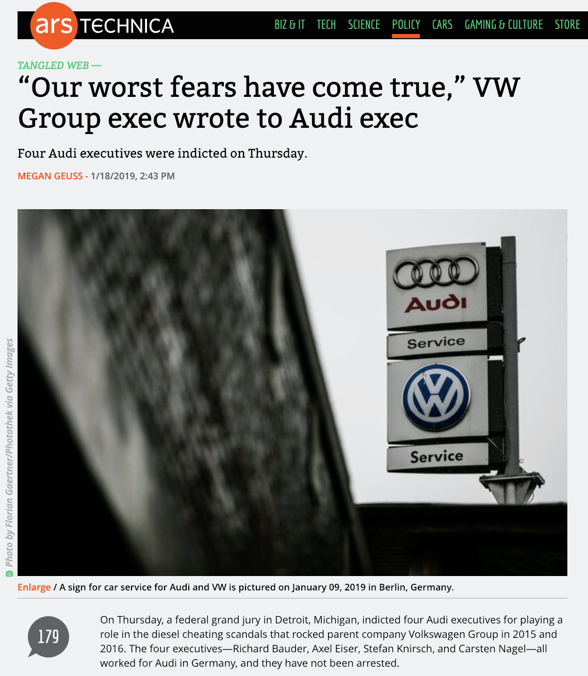

Slide 38
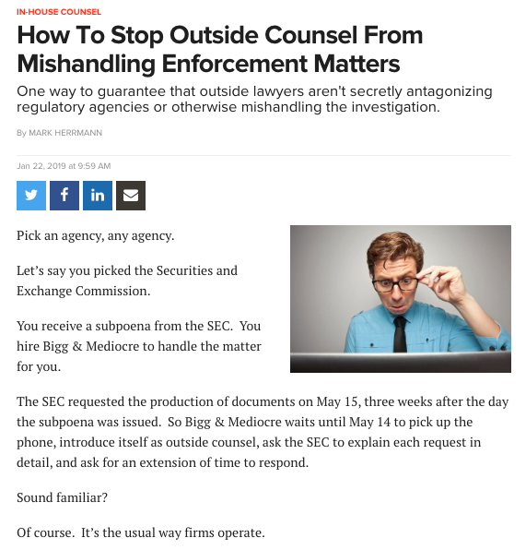

Slide 39
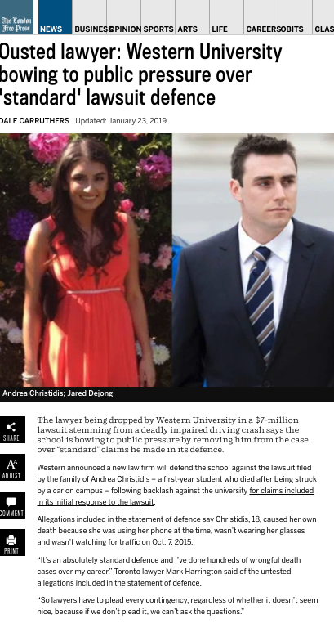

Slide 40
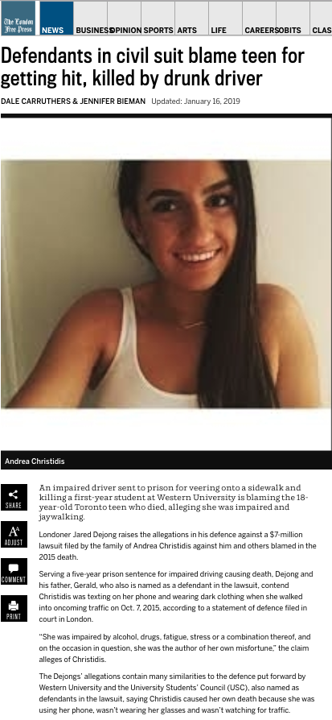

Slide 41
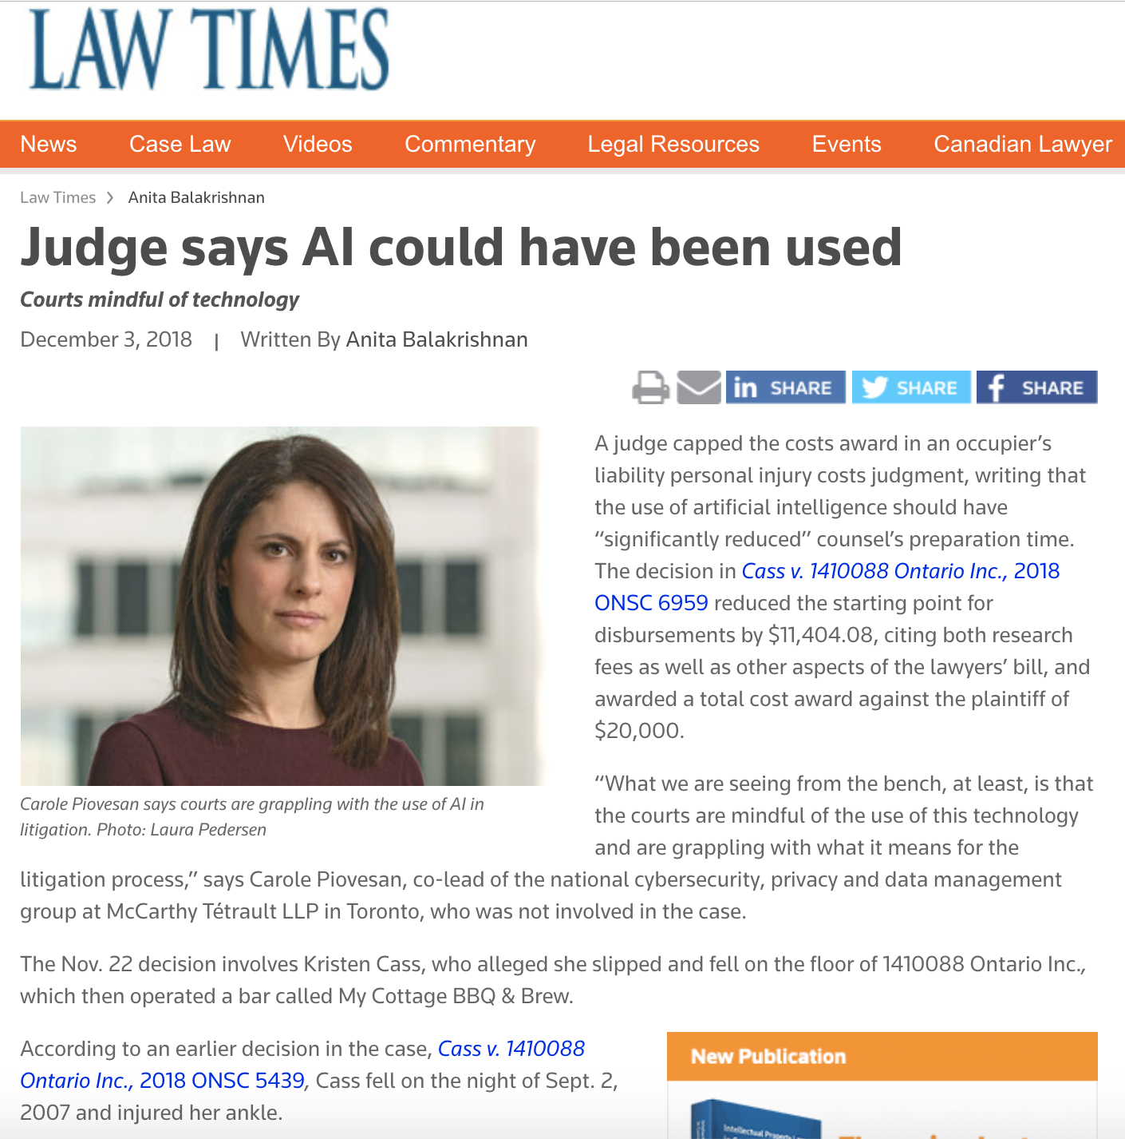

Slide 42
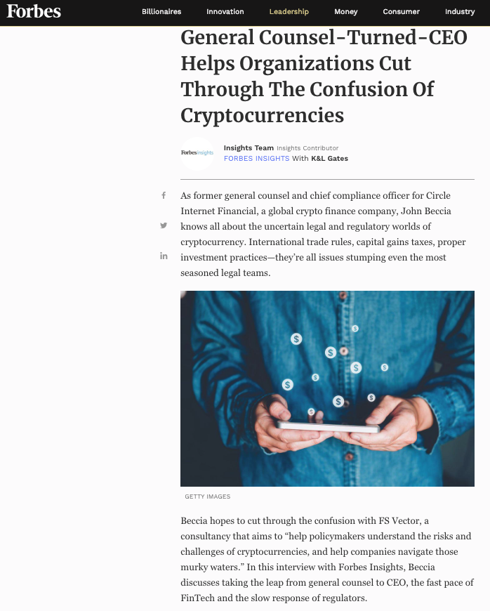

Slide 43
Pause

Slide 44
QUESTIONS?
THOUGHTS?
DISCUSSION?

Slide 45
Yours?

Slide 46
News of the Weeks
Thought-starter Edition

Slide 47
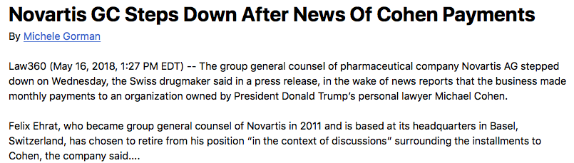

Slide 48
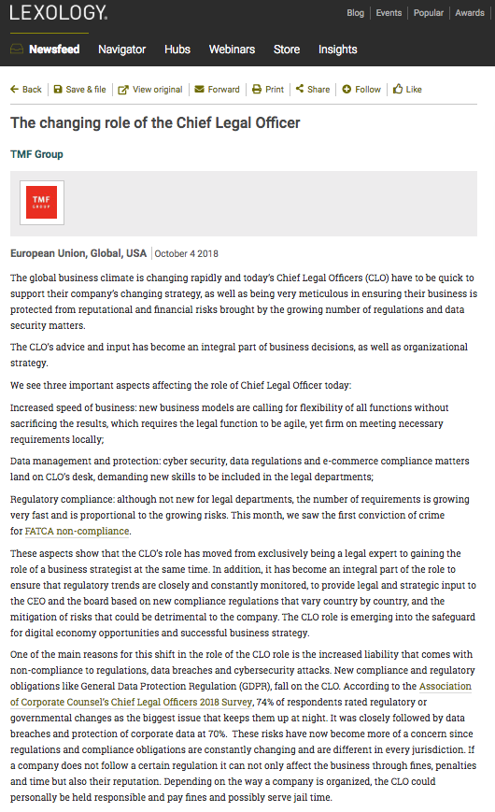

Slide 49
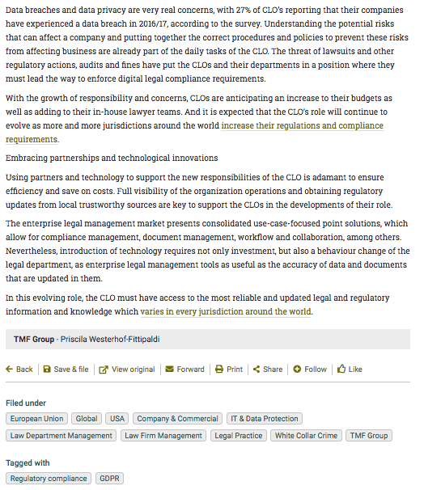

Slide 50
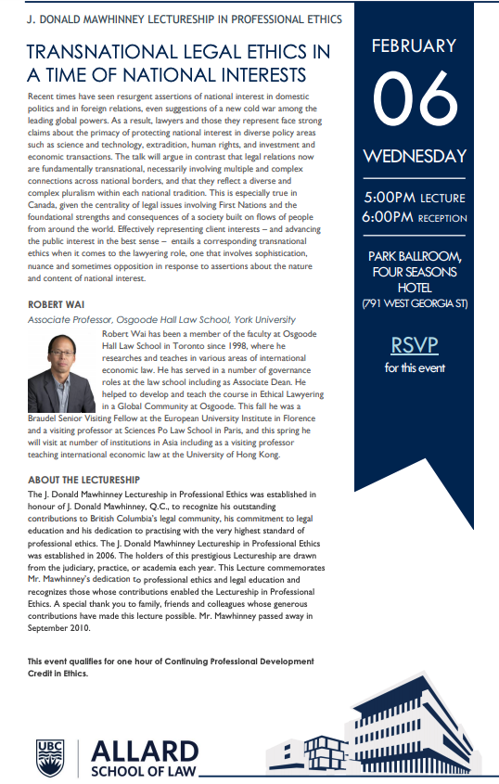

Slide 51
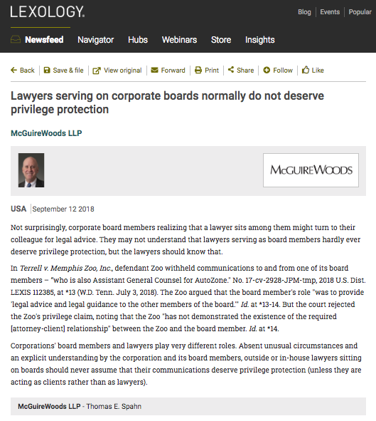

Slide 52
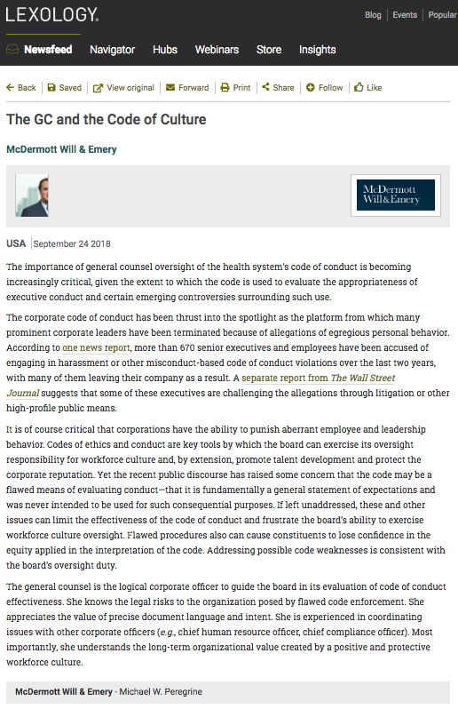

Slide 53
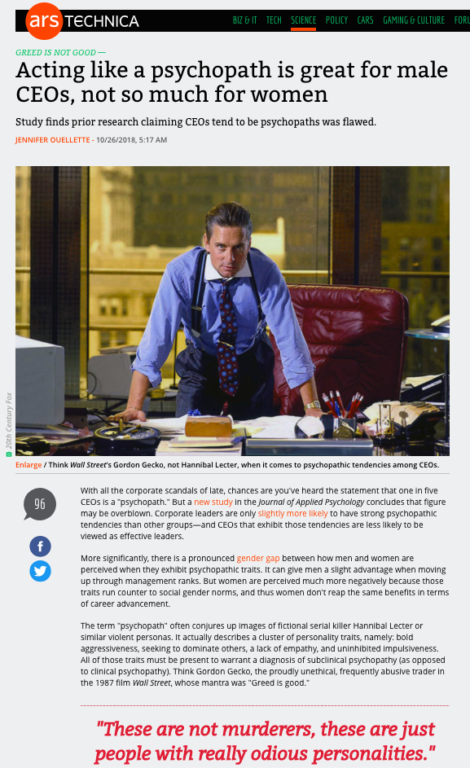

Slide 54
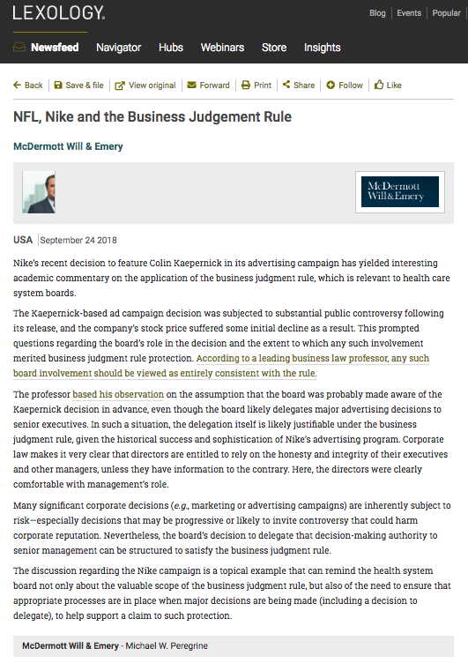

Slide 55
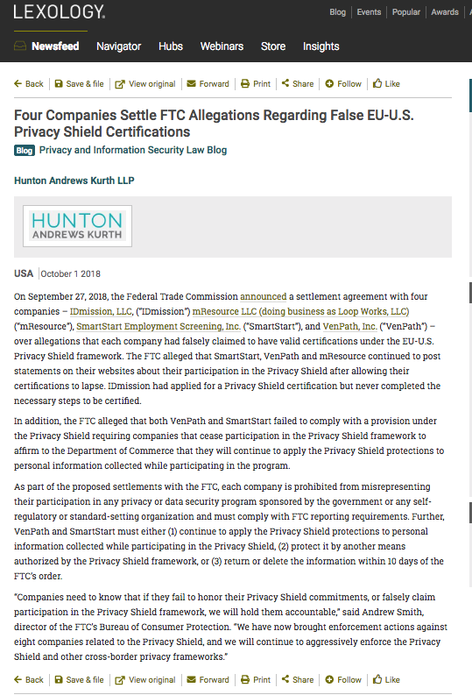

Slide 56
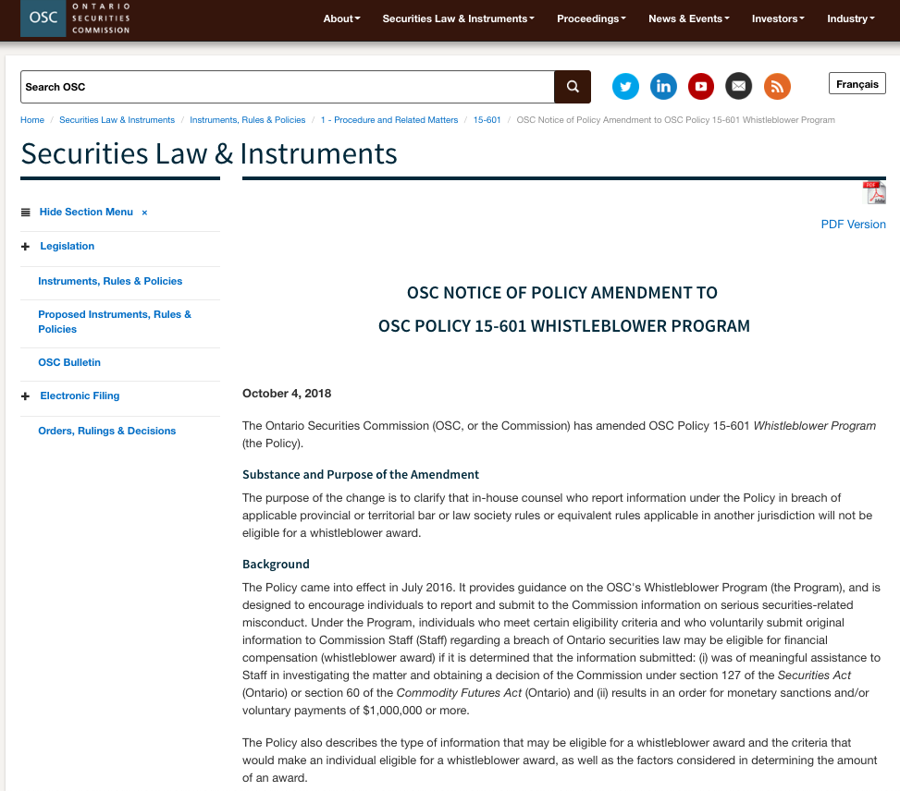

Slide 57
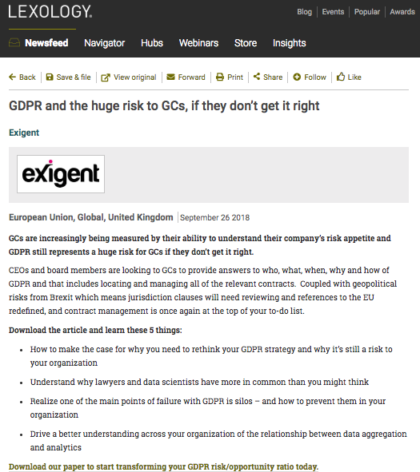

Slide 58
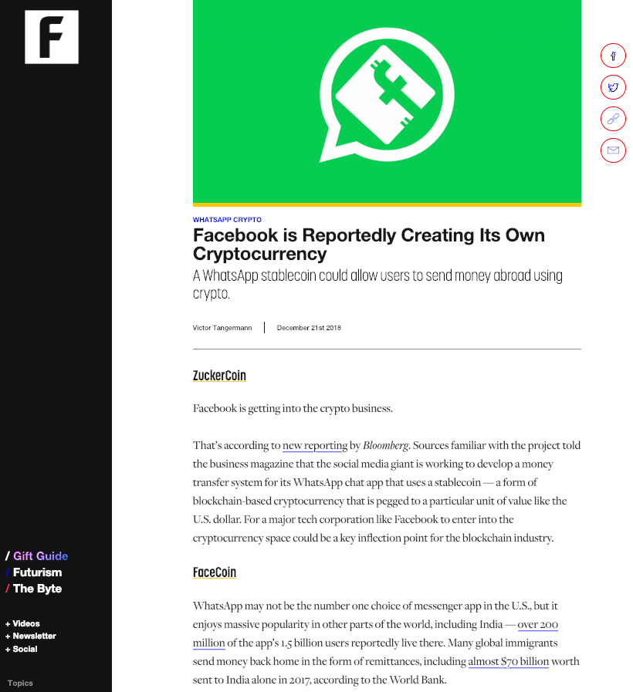

Slide 59
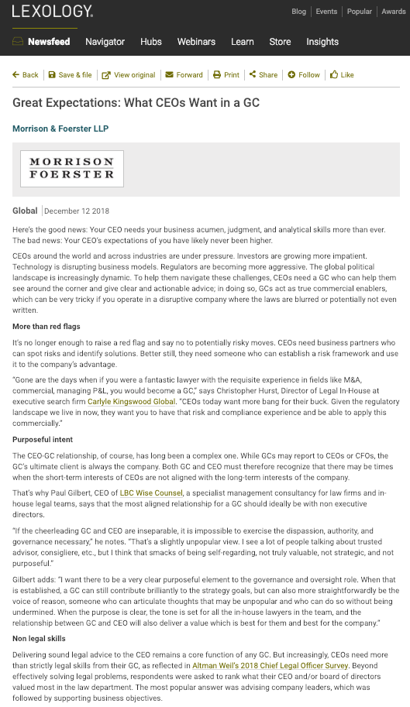

Slide 60
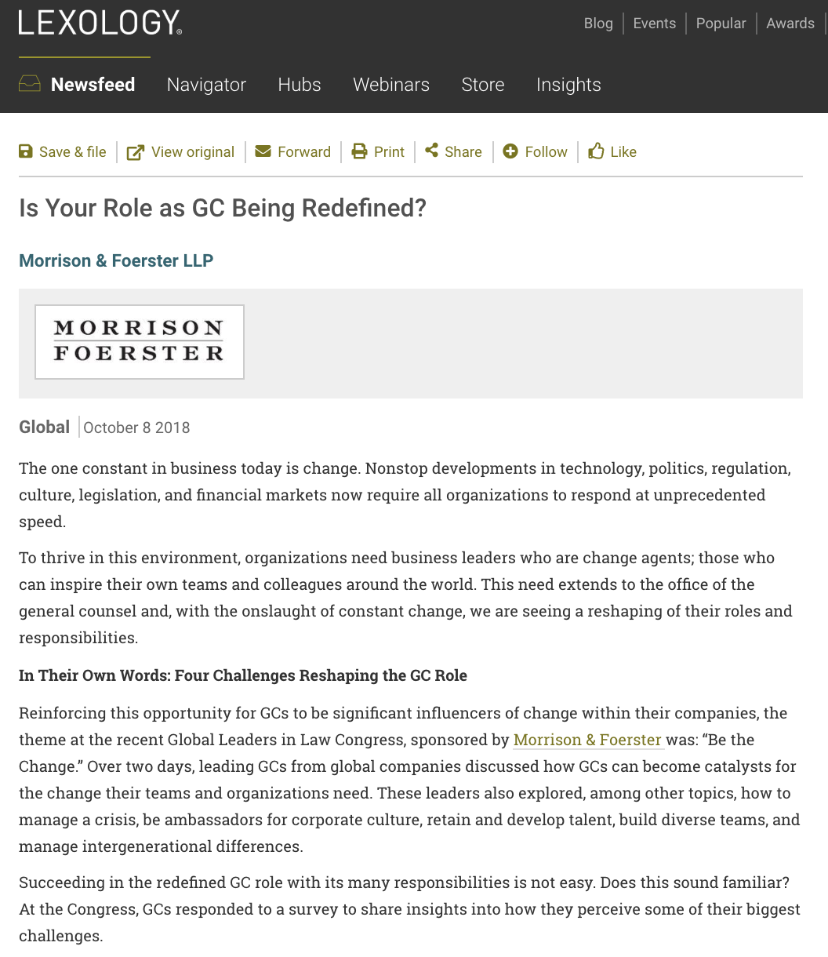

Slide 61
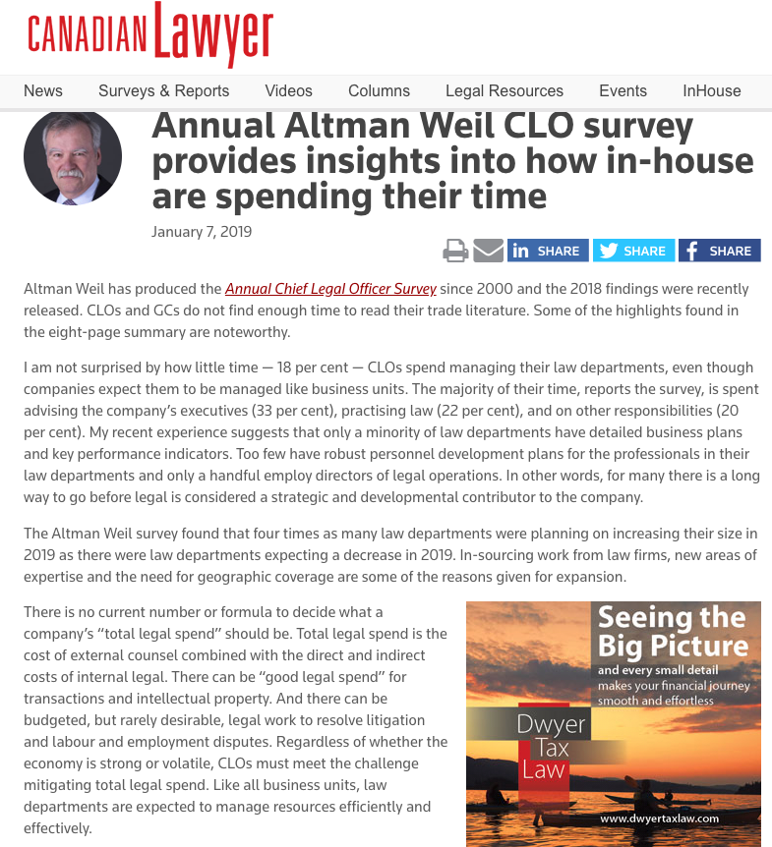

Slide 62
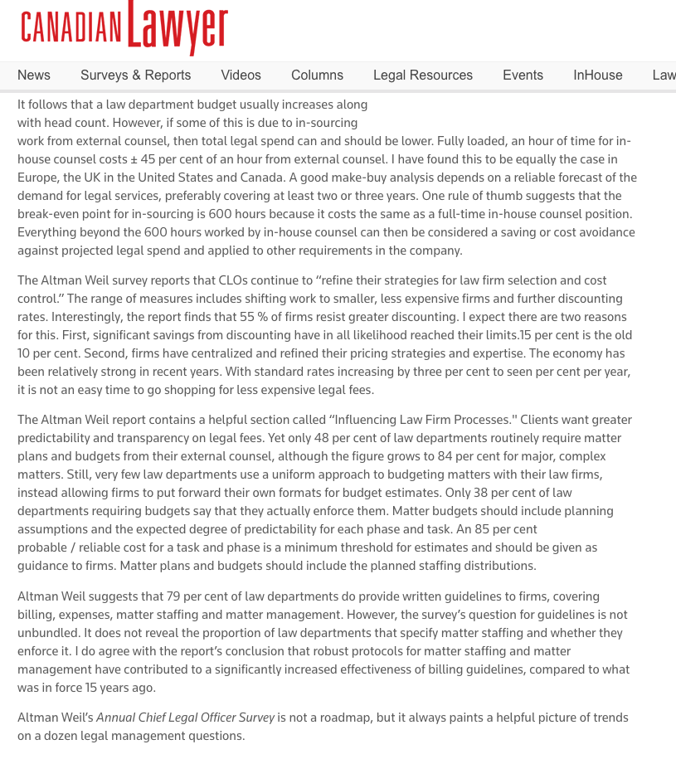

Slide 63
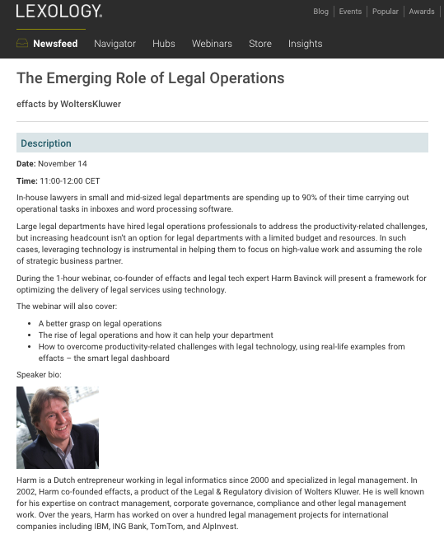

Slide 64


Slide 65
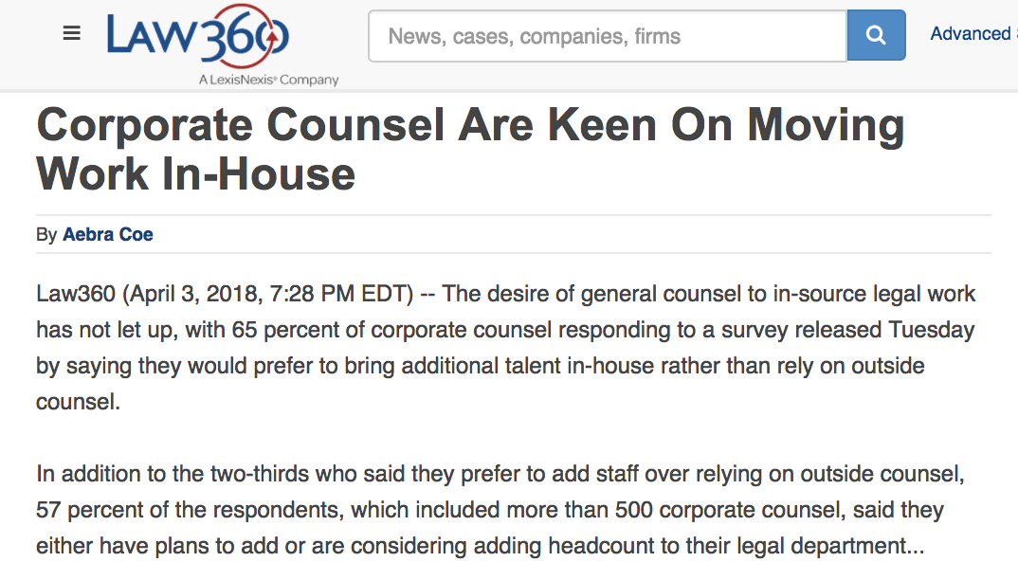

Slide 66
Pause

Slide 67
QUESTIONS?
THOUGHTS?
DISCUSSION?

Slide 68
Yours?

Slide 69

Structural Framework

Slide 70
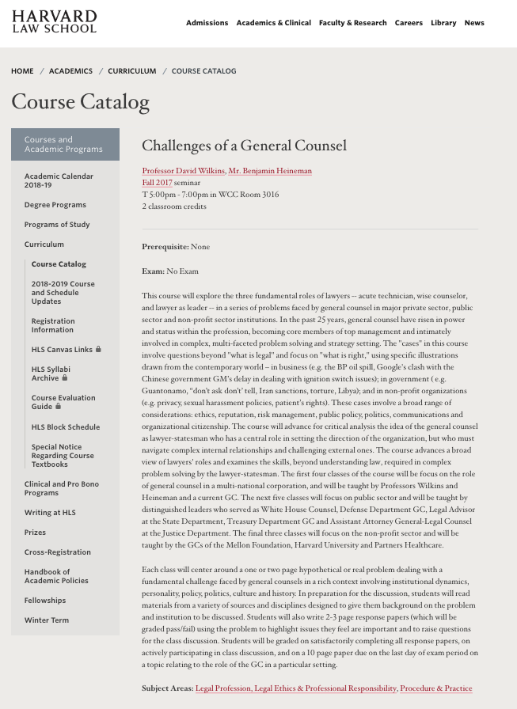
https://hls.harvard.edu/academics/curriculum/catalog/default.aspx?o=72164

Slide 71
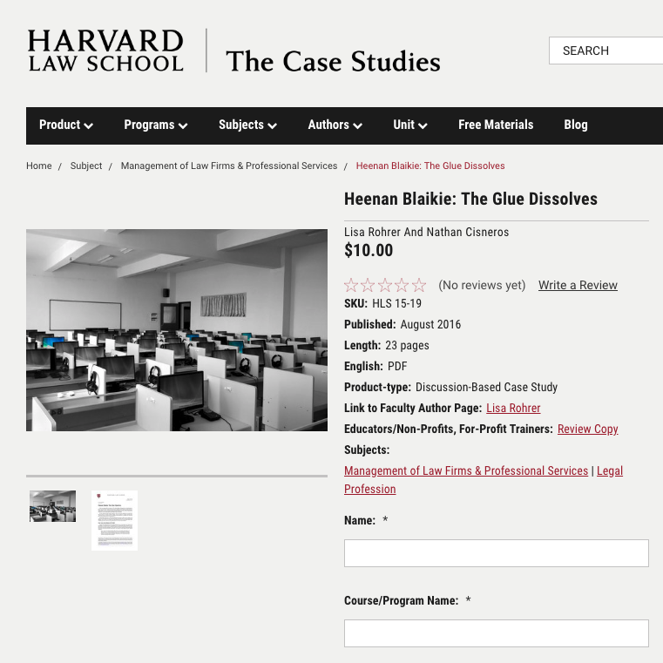
Case Study Method?

Slide 72
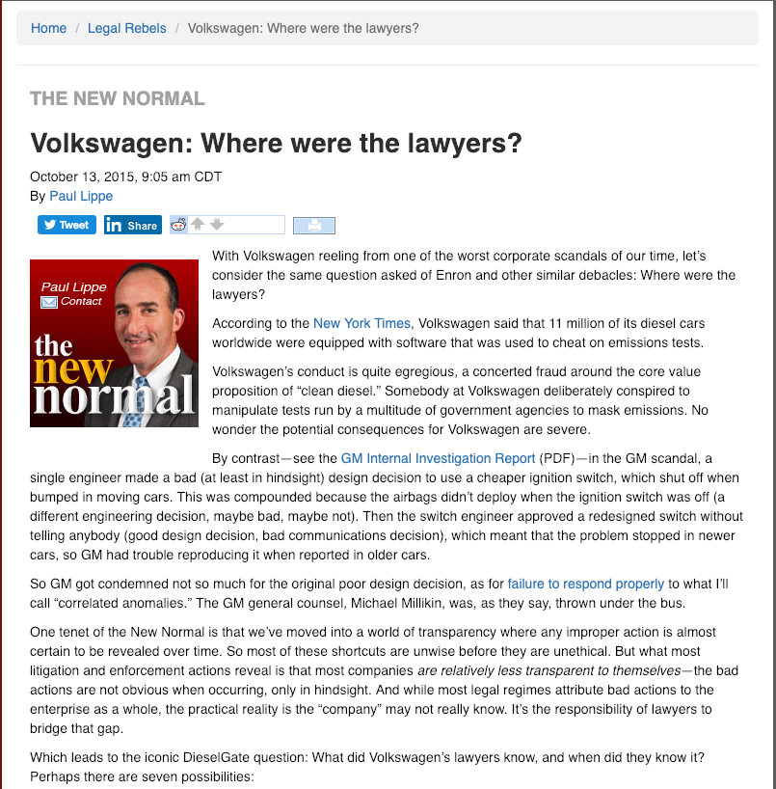
ABA Journal

Slide 73
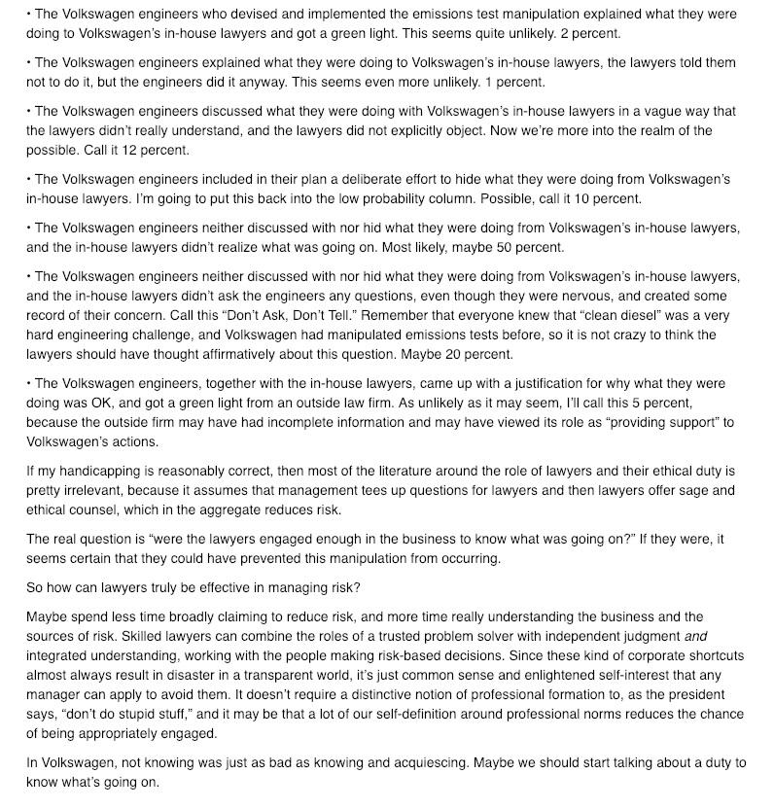

Slide 74
Possible Methodology for
Group Presentations
& much of the course (?)
Coming Up next week

Slide 75
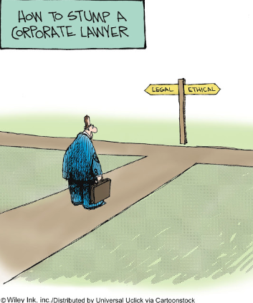
The course in one cartoon

Slide 76
Examine the question from the perspective of:
1. An out-side counsel
2. An in-house counsel
What do you see?

Slide 77
Complications
Employer/Employee
Good governance is invisible
Others????

Slide 78
Basic Problem?
Employer/employee relationship is a conflict of interest?
3.4-1 A lawyer must not act or continue to act for a client where there is a conflict of interest, except as permitted under this Code. Commentary
[1] As defined in these rules, a conflict of interest exists when there is a substantial risk that a lawyer’s loyalty to or representation of a client would be materially and adversely affected by the lawyer’s own interest… A client’s interests may be seriously prejudiced unless the lawyer’s judgment and freedom of action on the client’s behalf are as free as possible from conflicts of interest.

Slide 79
[5] The value of an independent bar is diminished unless the lawyer is free from conflicts of interest…The lawyer-client relationship is a fiduciary relationship…This obligation is premised on an established or ongoing lawyer client relationship in which the client must be assured of the lawyer’s undivided loyalty, free from any material impairment of the lawyer and client relationship.
[8] Conflicts of interest can arise in many different circumstances. The following examples are intended to provide illustrations of circumstances that may give rise to conflicts of interest. The examples are not exhaustive.
  (d) A lawyer,..or a family member has a personal financial interest in a client’s affairs or in a matter in which the lawyer is requested to act for a client…
    (i) A lawyer owning a small number of shares of a publicly traded corporation would not necessarily have a conflict of interest…because the holding may have no adverse influence on the lawyer’s judgment...

Slide 80
Basic Problem? Huge?
Separation of Legal Advice
& Decision Making?
Are you doing both?
Should you be doing both?
'A man who is his own lawyer
has a fool for a client.'

Slide 81
Basic Conundrum?
Good governance is invisible

Slide 82

…invisible.
Measured by the number of crises that don’t manifest.

Slide 83
Poor Governance is SUPER VISIBLE
ABA Journal

Slide 84
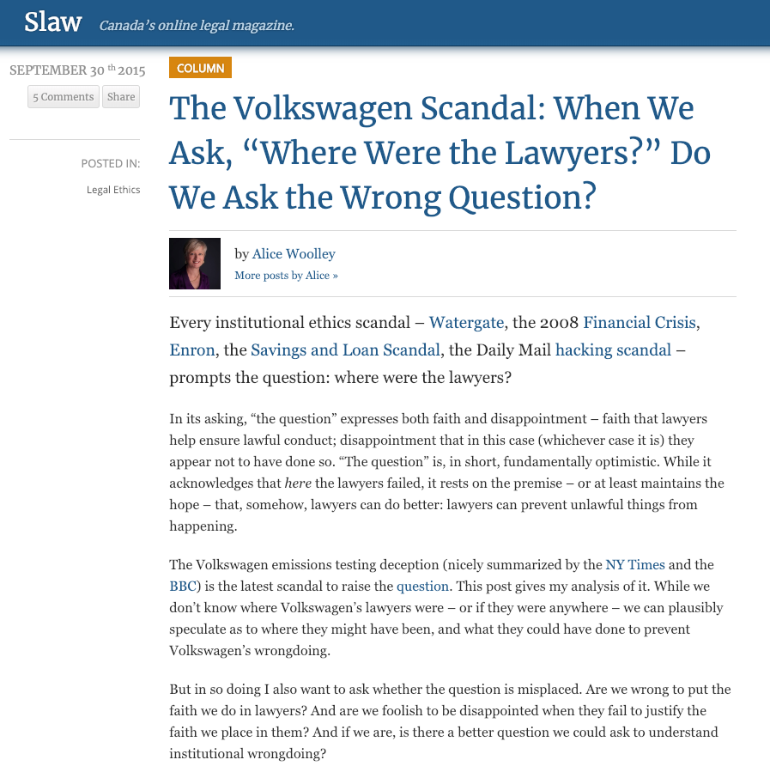

Slide 85
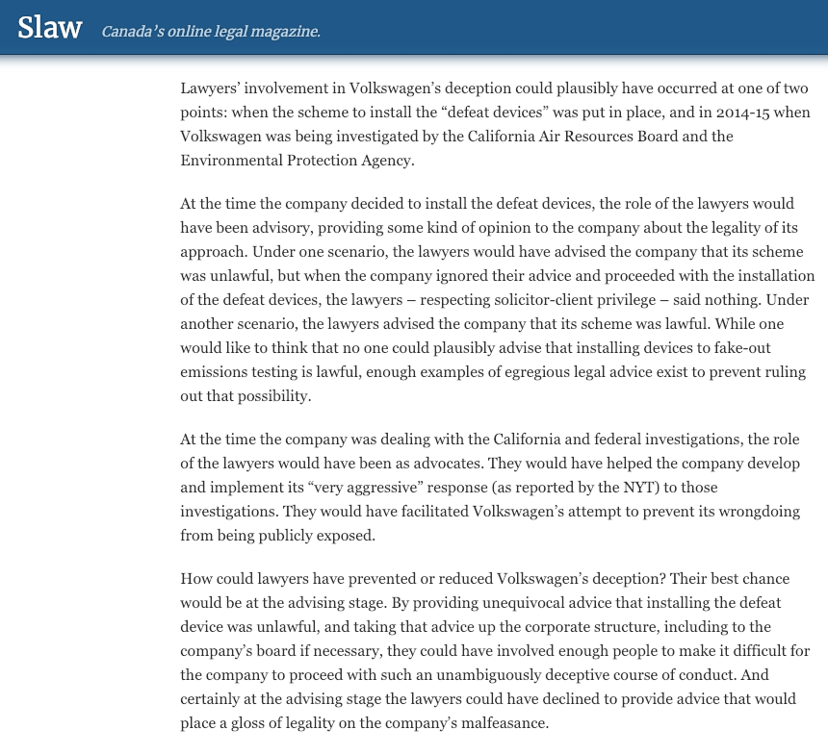

Slide 86
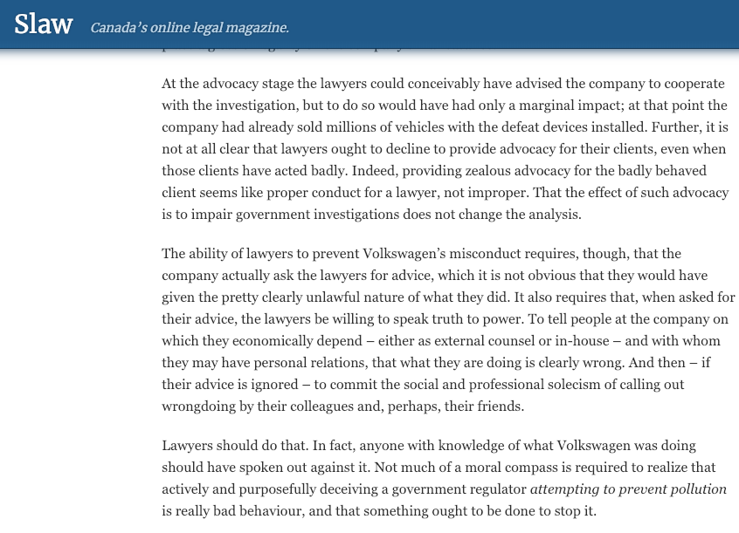

Slide 87
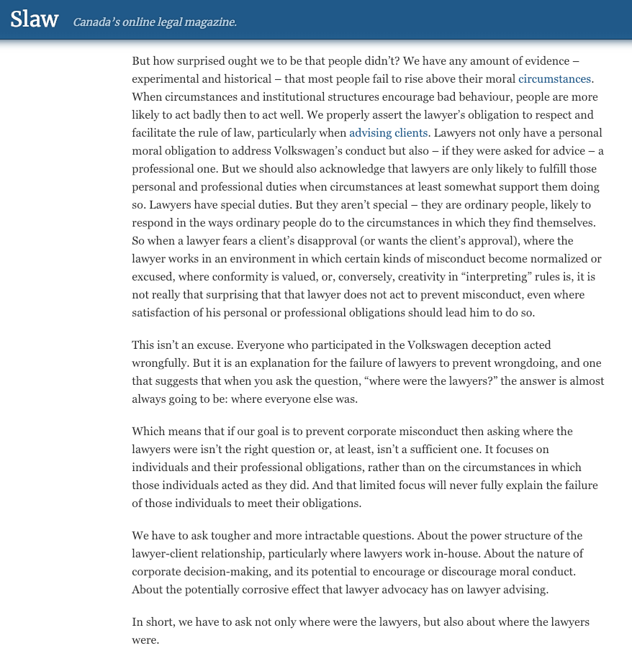

Slide 88
Now

Slide 89
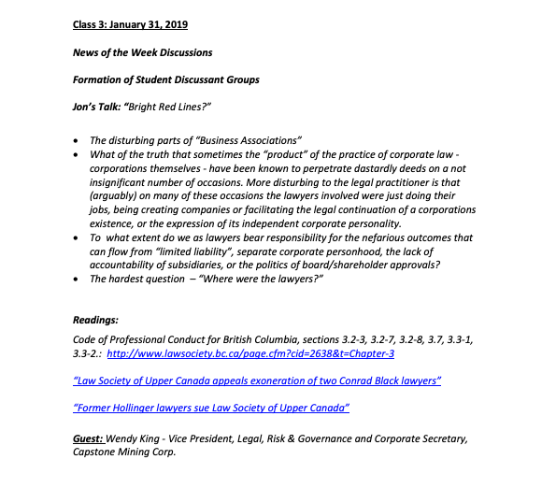
Syllabus Exercise Part 2
TWEN

Slide 90
Course is meant to primarily be about themes, situations & problem solving.
What’s missing
among those?

Slide 91
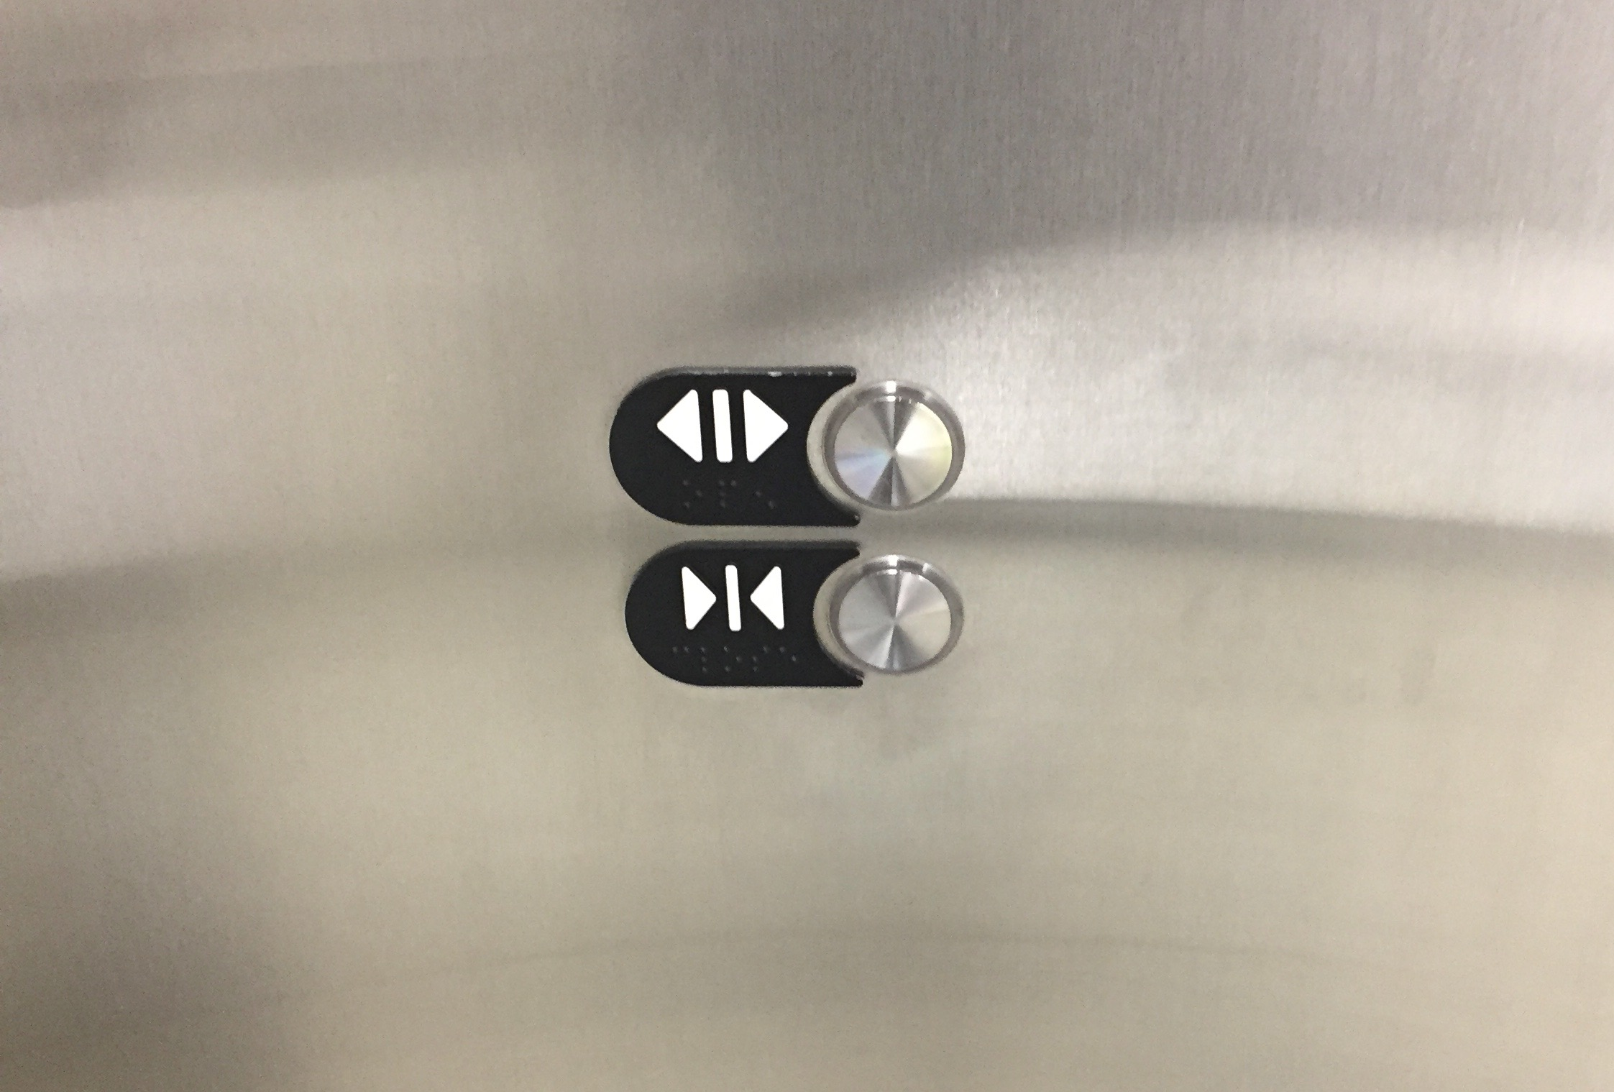
You will notice media, entertainment, corporate & sports themes. Why?

Slide 92

The question
of GUESTS?

Slide 93
QUESTIONS?
THOUGHTS?
DISCUSSION?

Slide 94


Slide 96

Please e-mail

Slide 97
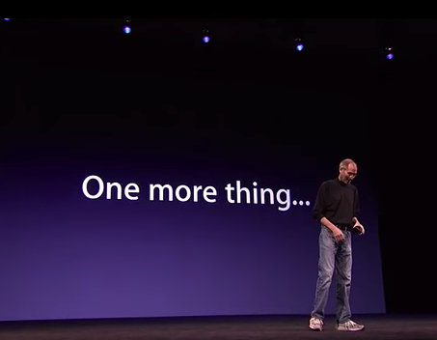

Slide 98
Nominate a great in-house counsel

Slide 99
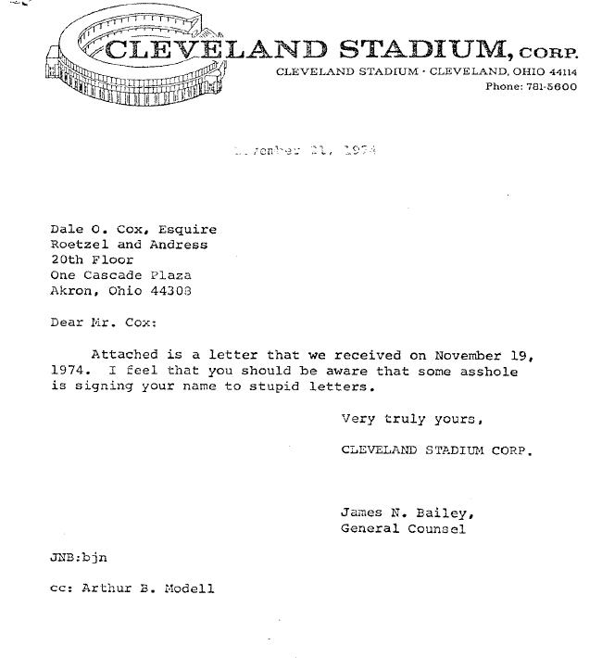

Slide 100


A MATTER OF PERSPECTIVE

Slide 101

Conclusion

Slide 102
SEE YOU NEXT WEEK!

Slide 103

Always include a cat picture

Slide 104
In learning you will teach
And in teaching you will learn
Phil Collins' Son of Man (1999)

Slide 105
Our Academic Partners

