Slide 1
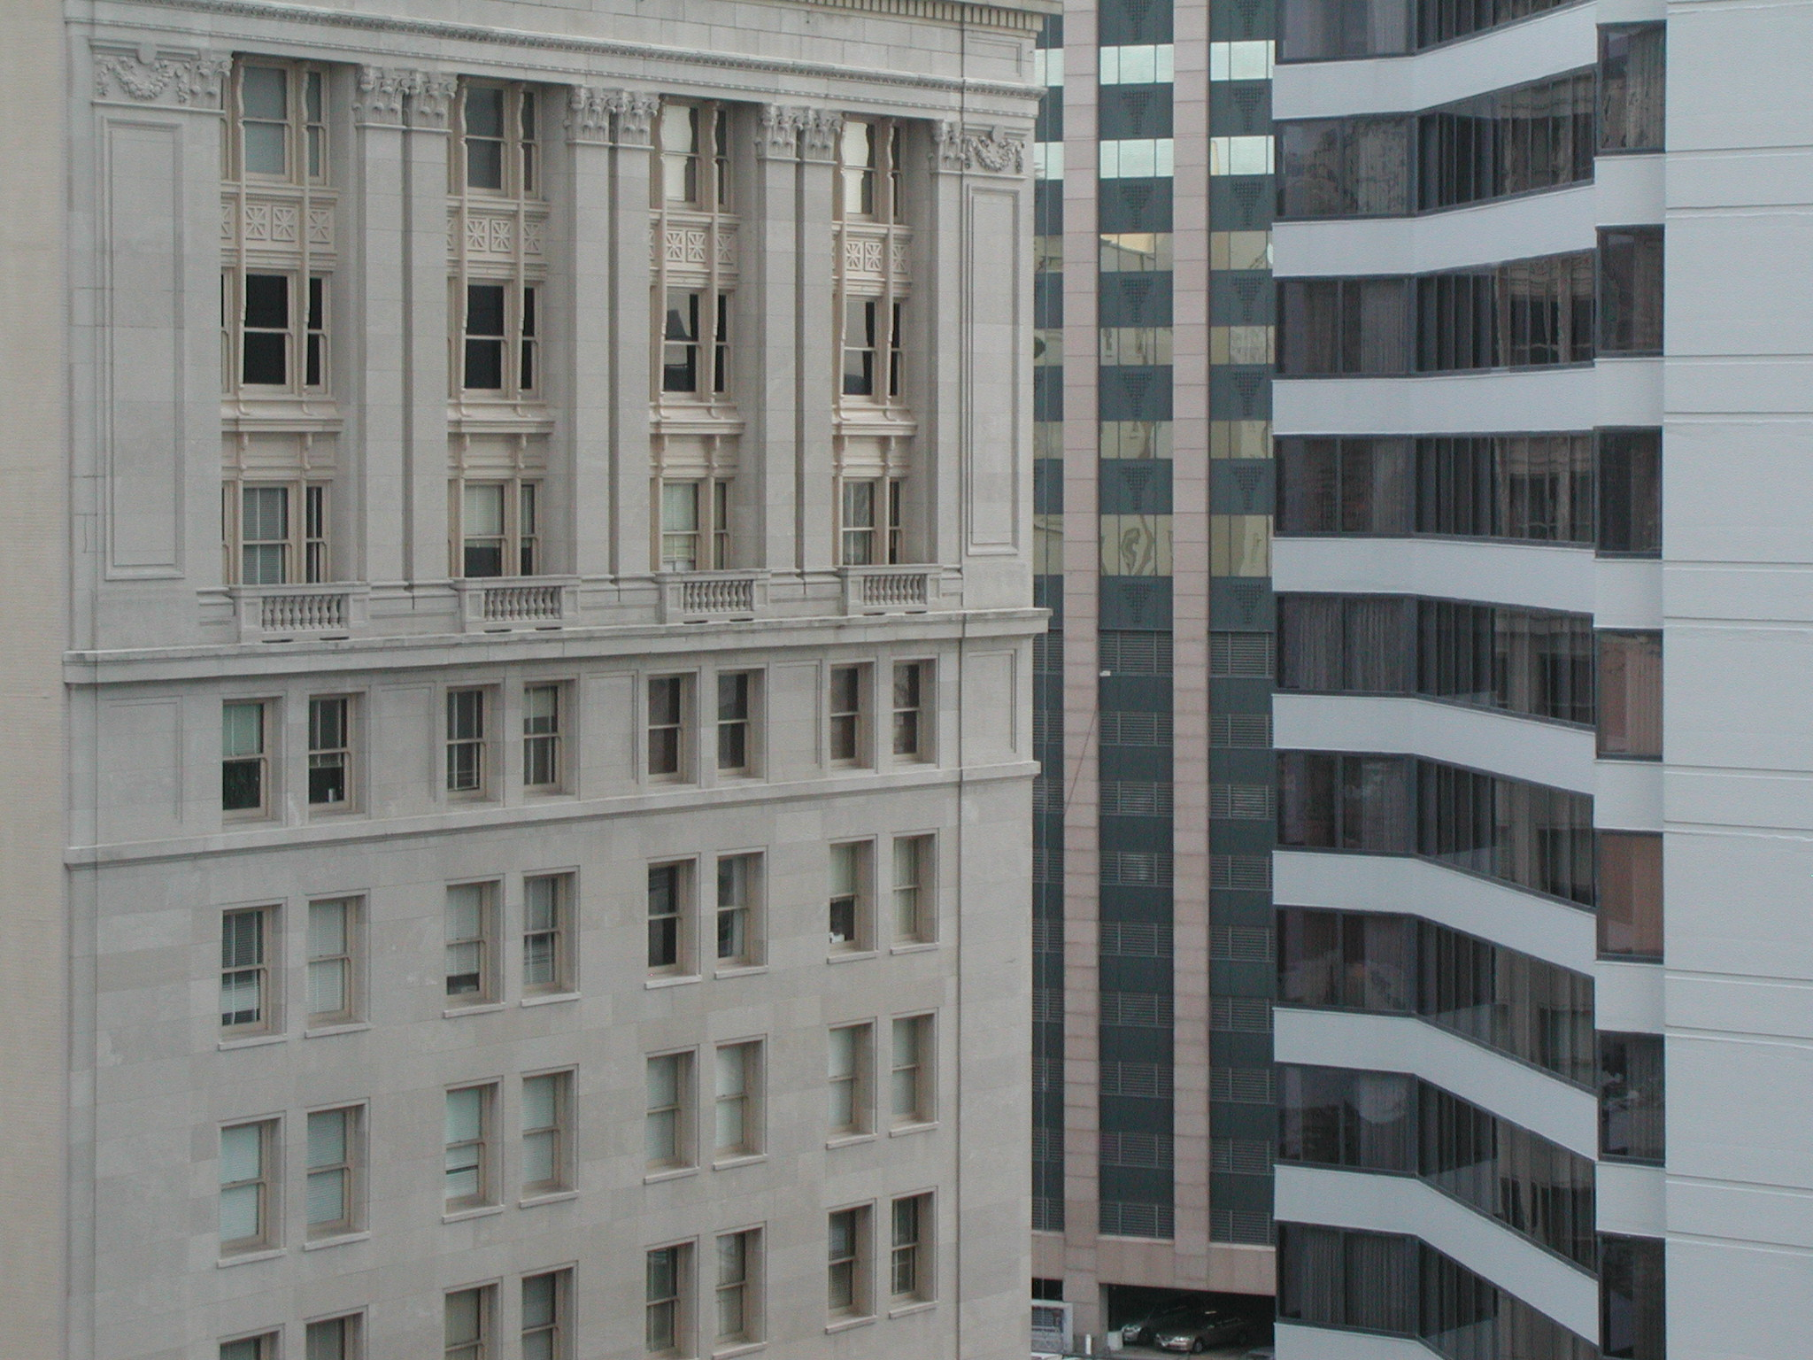

Introduction to the Course
Talk 1
LAWF 3780
Challenges of In-House & Corporate Counsel
TRU Faculty of Law
Spring, 2019
Jon Festinger Q.C.
Centre for Digital Media
QMUL School of Law (CCLS)
Festinger Law & Strategy
http://commlaw.allard.ubc
@jonfestinger
jon_festinger@thecdm.ca

Slide 2
Hello
LAW F 3780
Challenges of In-House
& Corporate Counsel

Slide 3

Terrific Thursdays

Slide 4
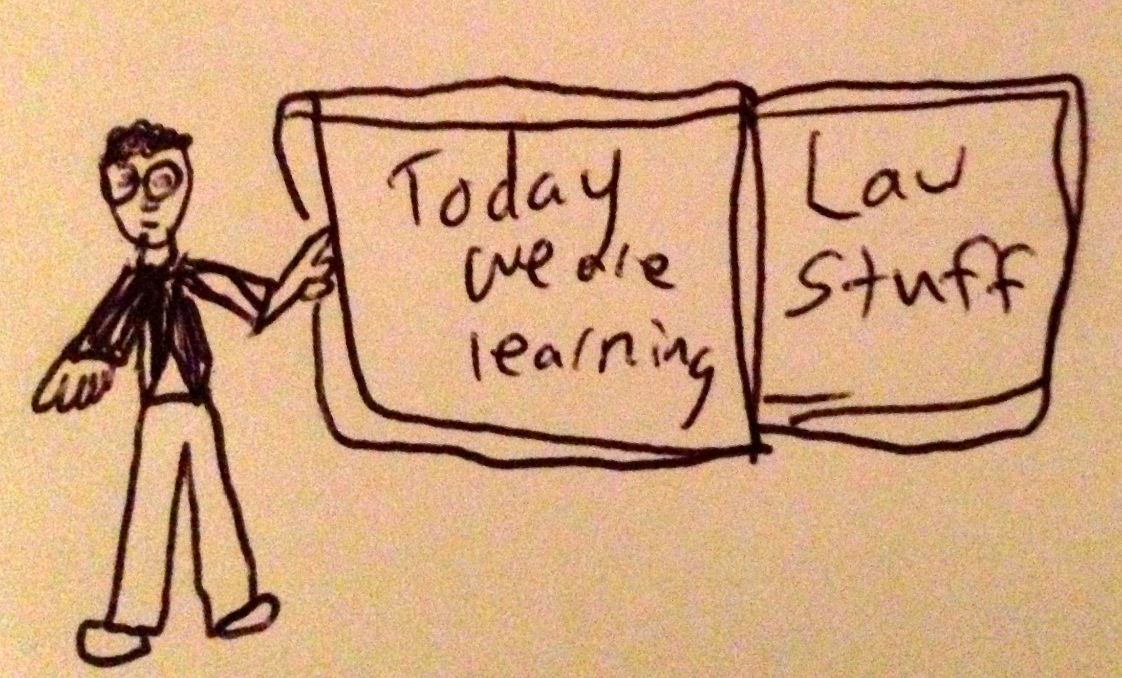

Slide 5
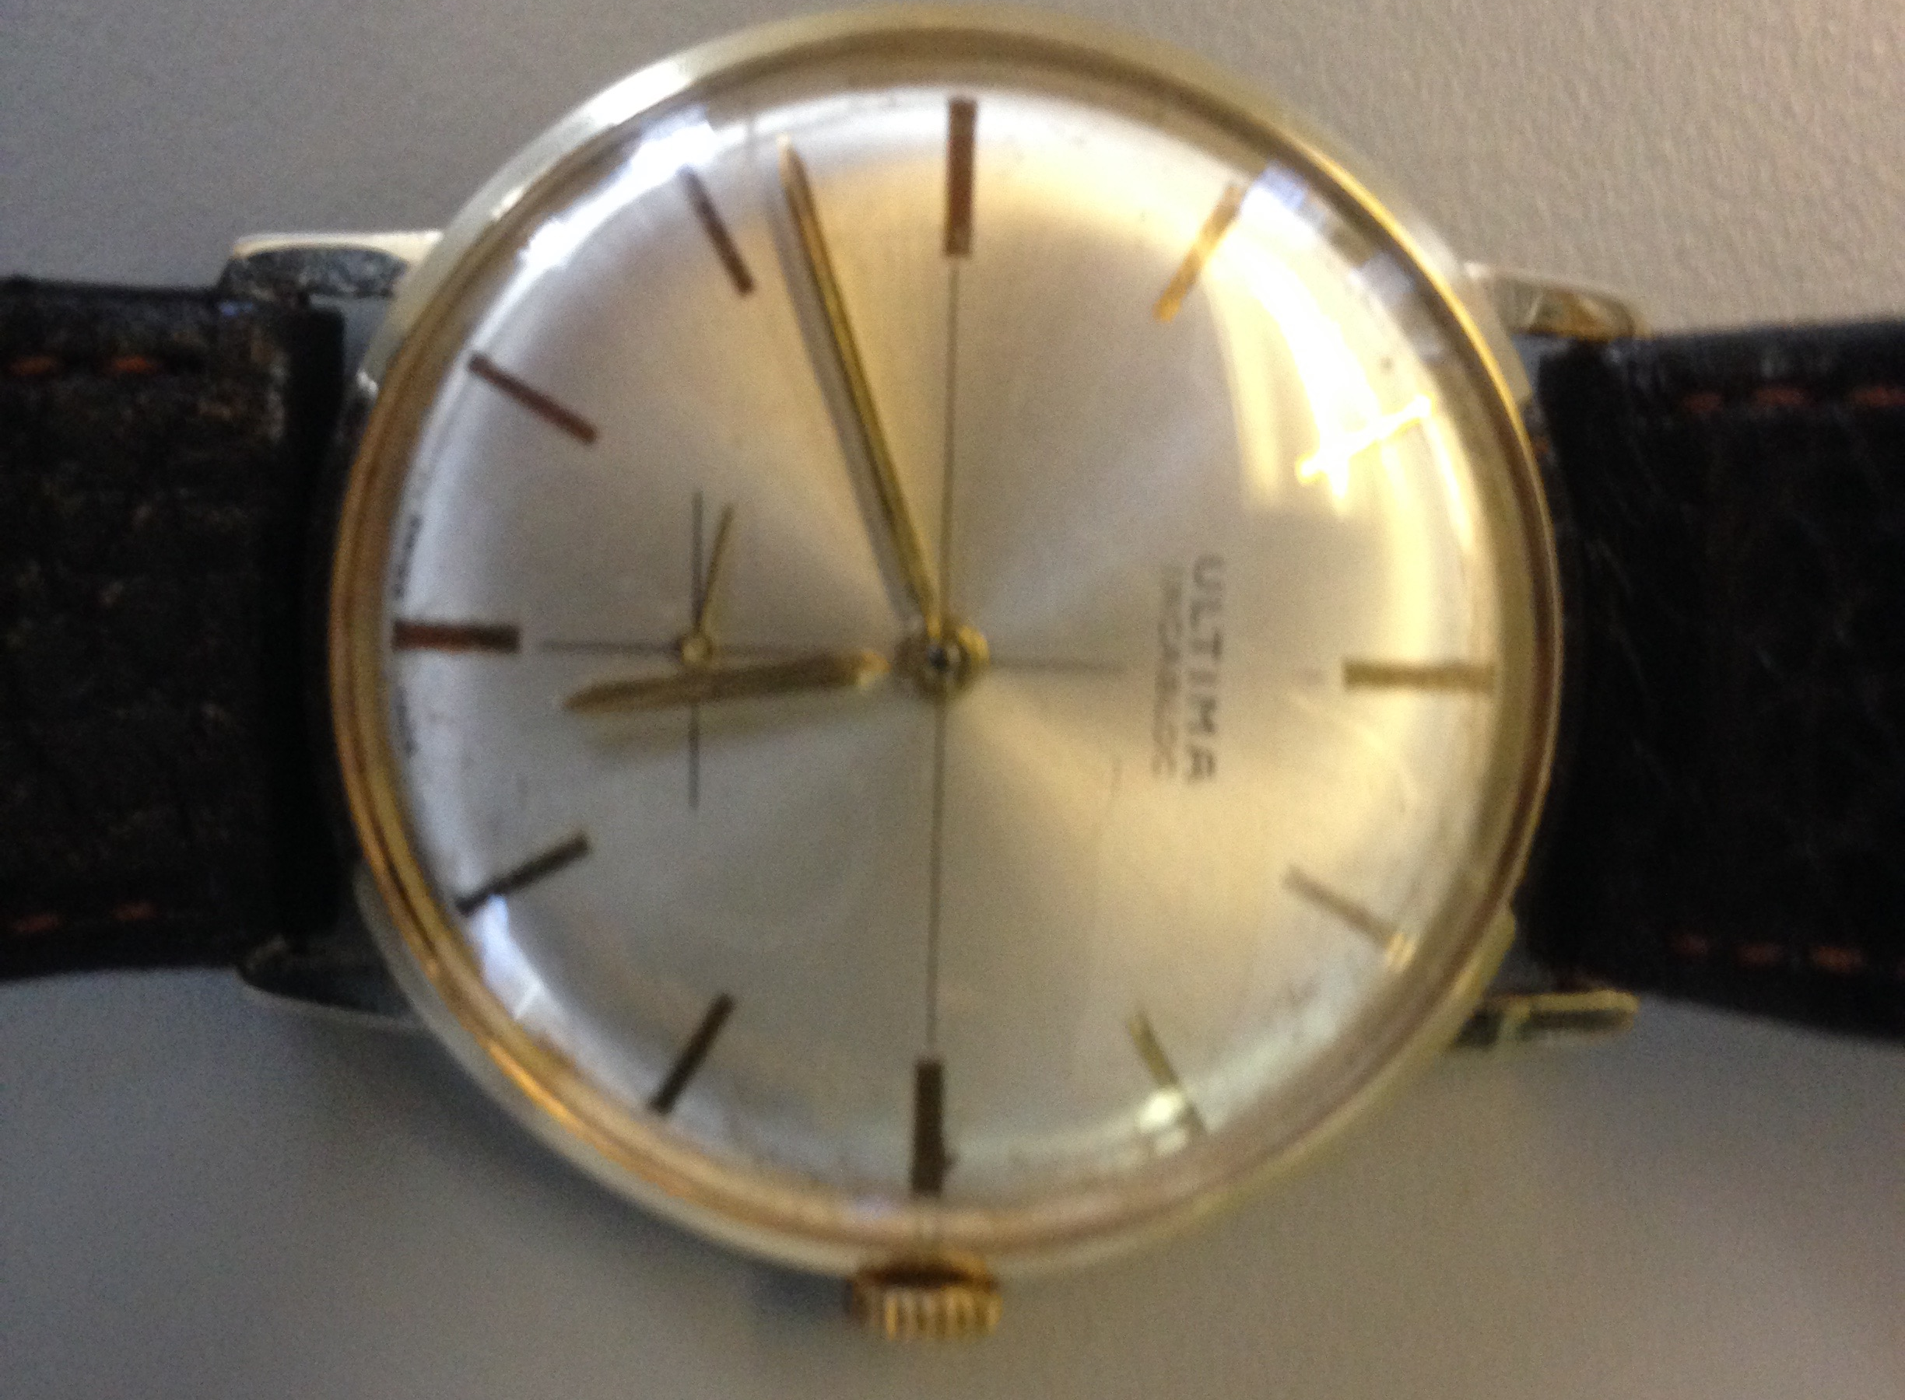
No, we will not spend the whole three hours….

Slide 6

Basics Part 1

Slide 7
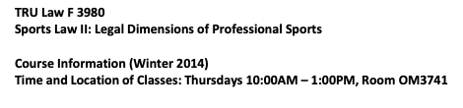
It was a dark & stormy night….
Wednesday January 15, 2014

Slide 8
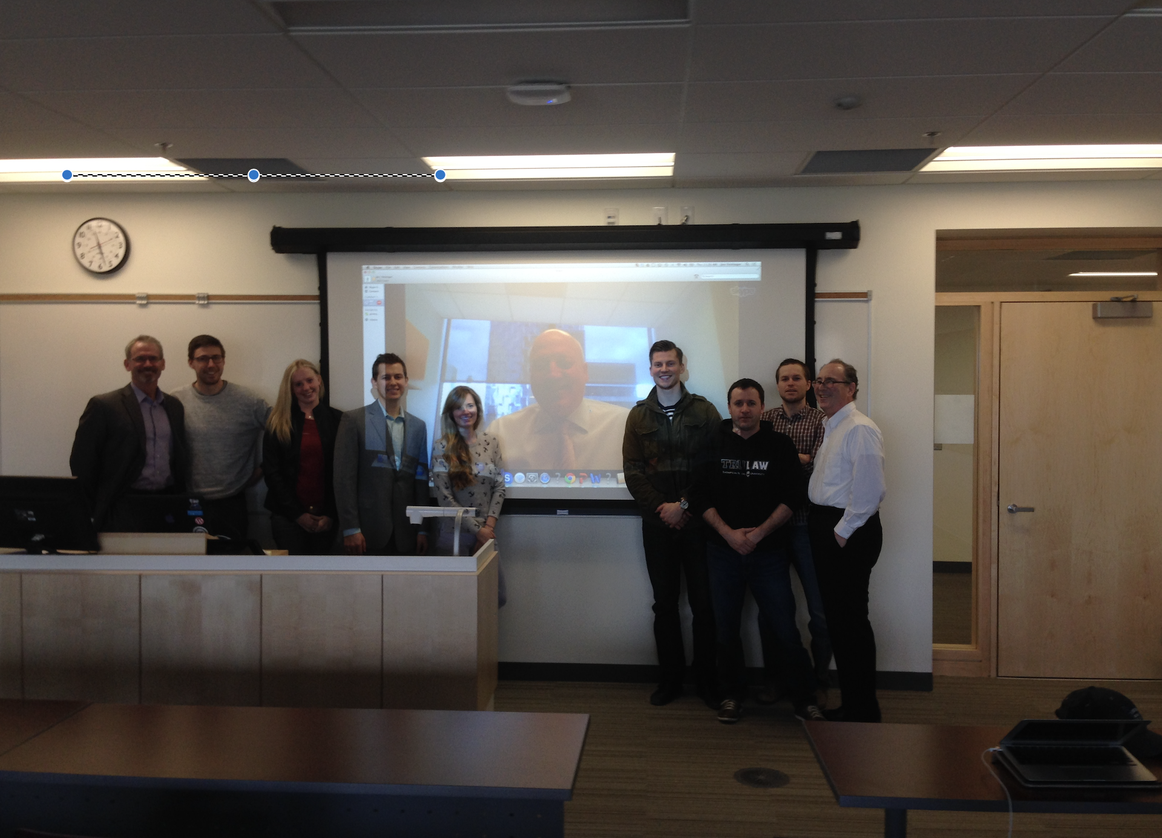

Slide 9
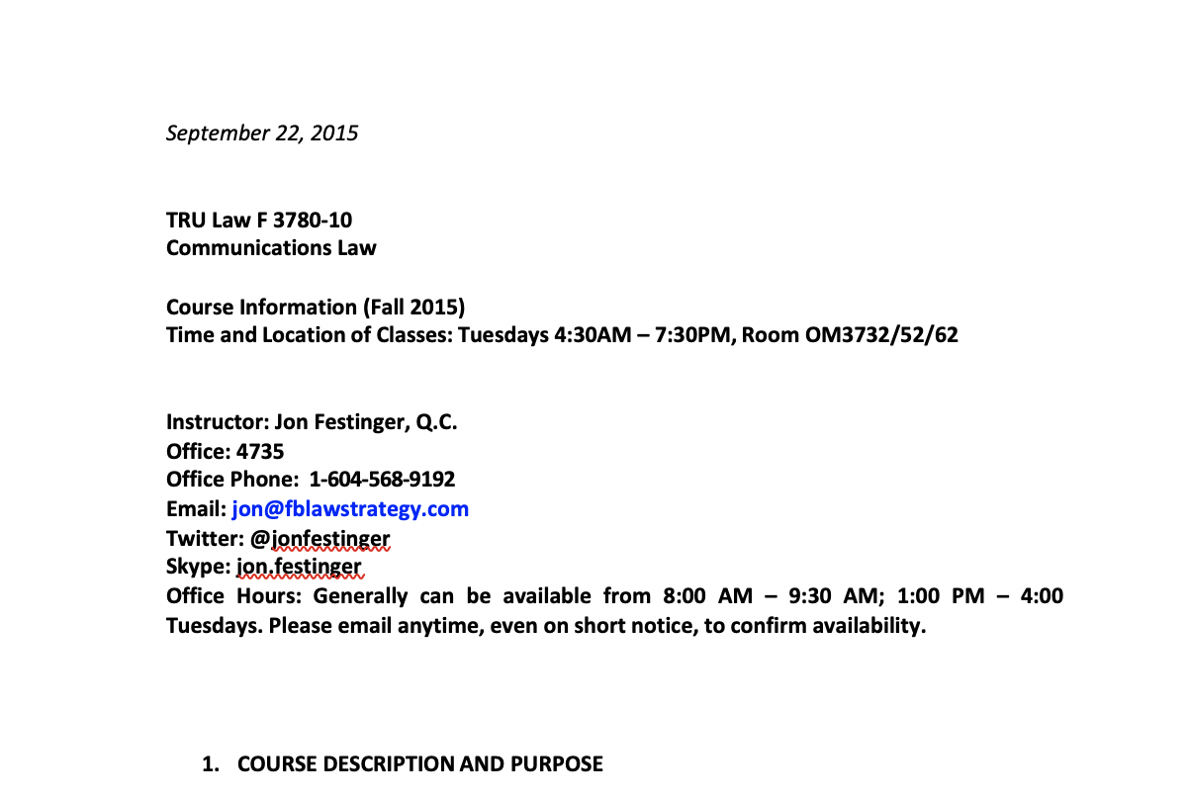

Slide 10

Pause

Slide 11
QUESTIONS?
THOUGHTS?
DISCUSSION?

Slide 12
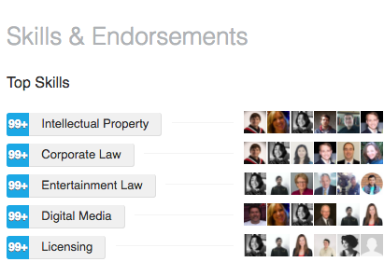
Basics Part 2: Who me?

Slide 13


Slide 14
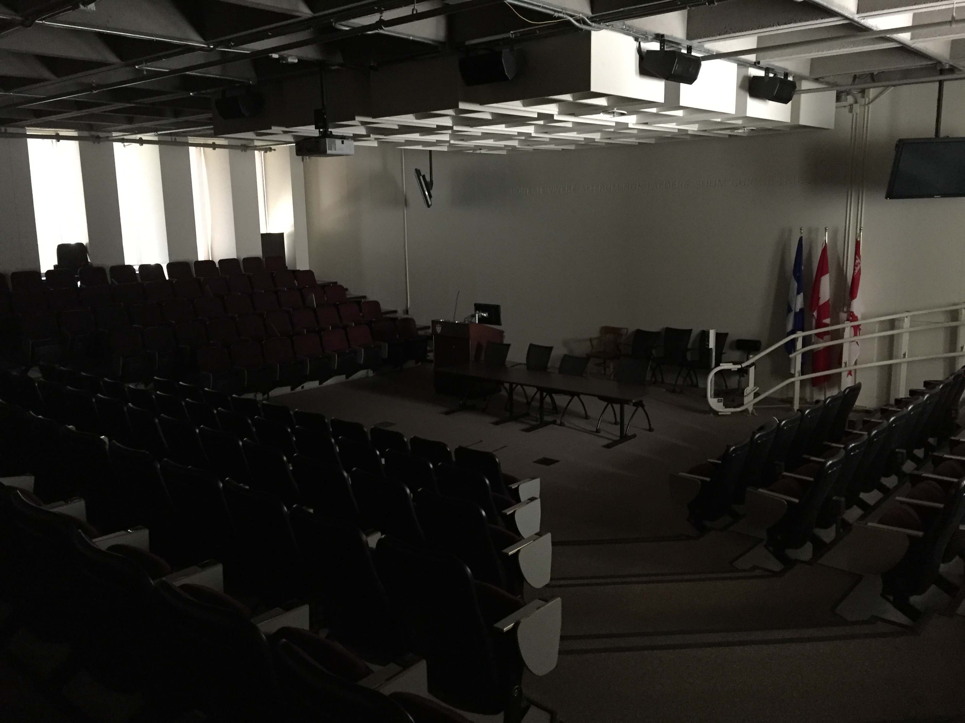

Slide 15


Slide 16



Slide 17


Slide 18


Slide 19


Slide 20

Back to the law…

Slide 21

Every Canadian Kids Dream?

Slide 22
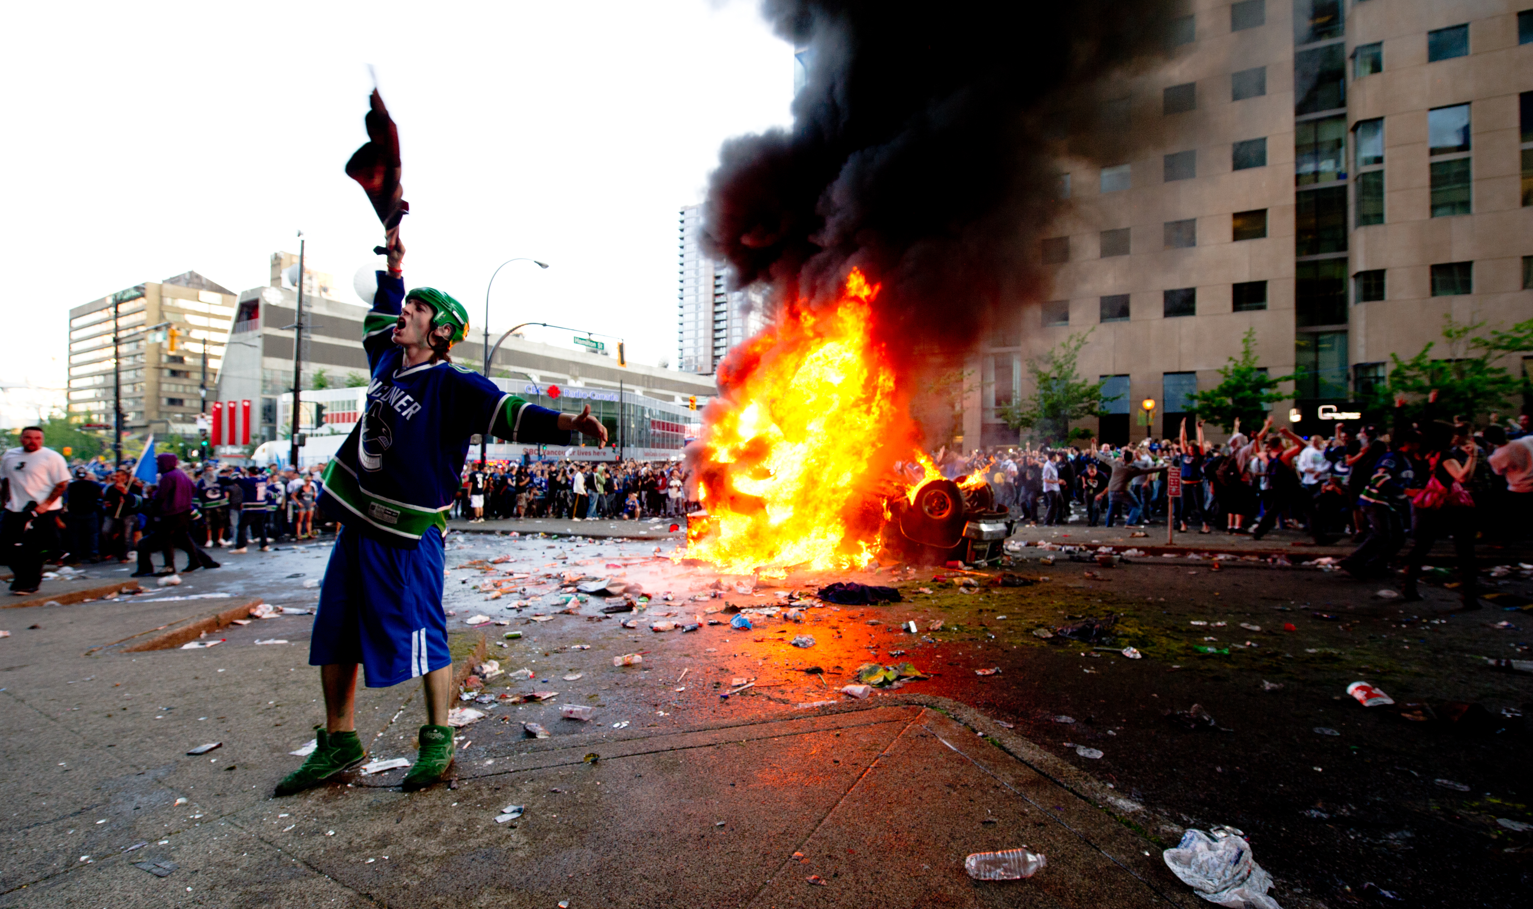
Left the Canucks in 2010…before

Slide 23
Pause

Slide 24
QUESTIONS?
THOUGHTS?
DISCUSSION?

Slide 25

Basics Part 3: Pick your meme

Slide 26
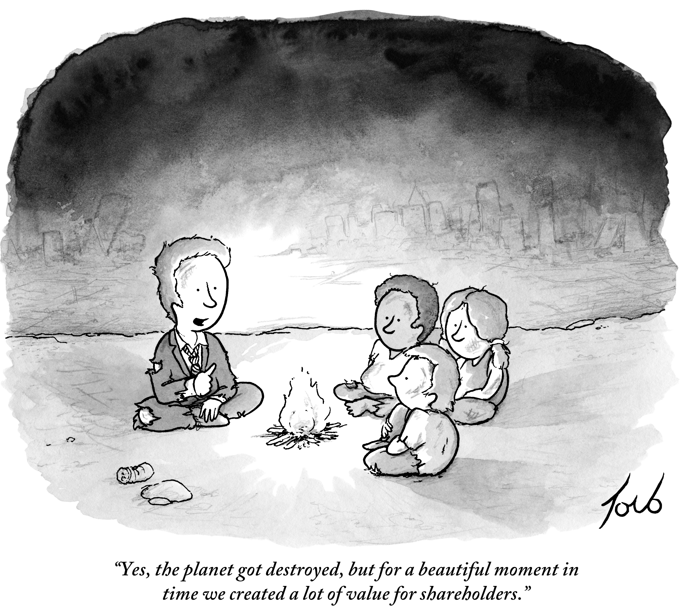
1

Slide 27
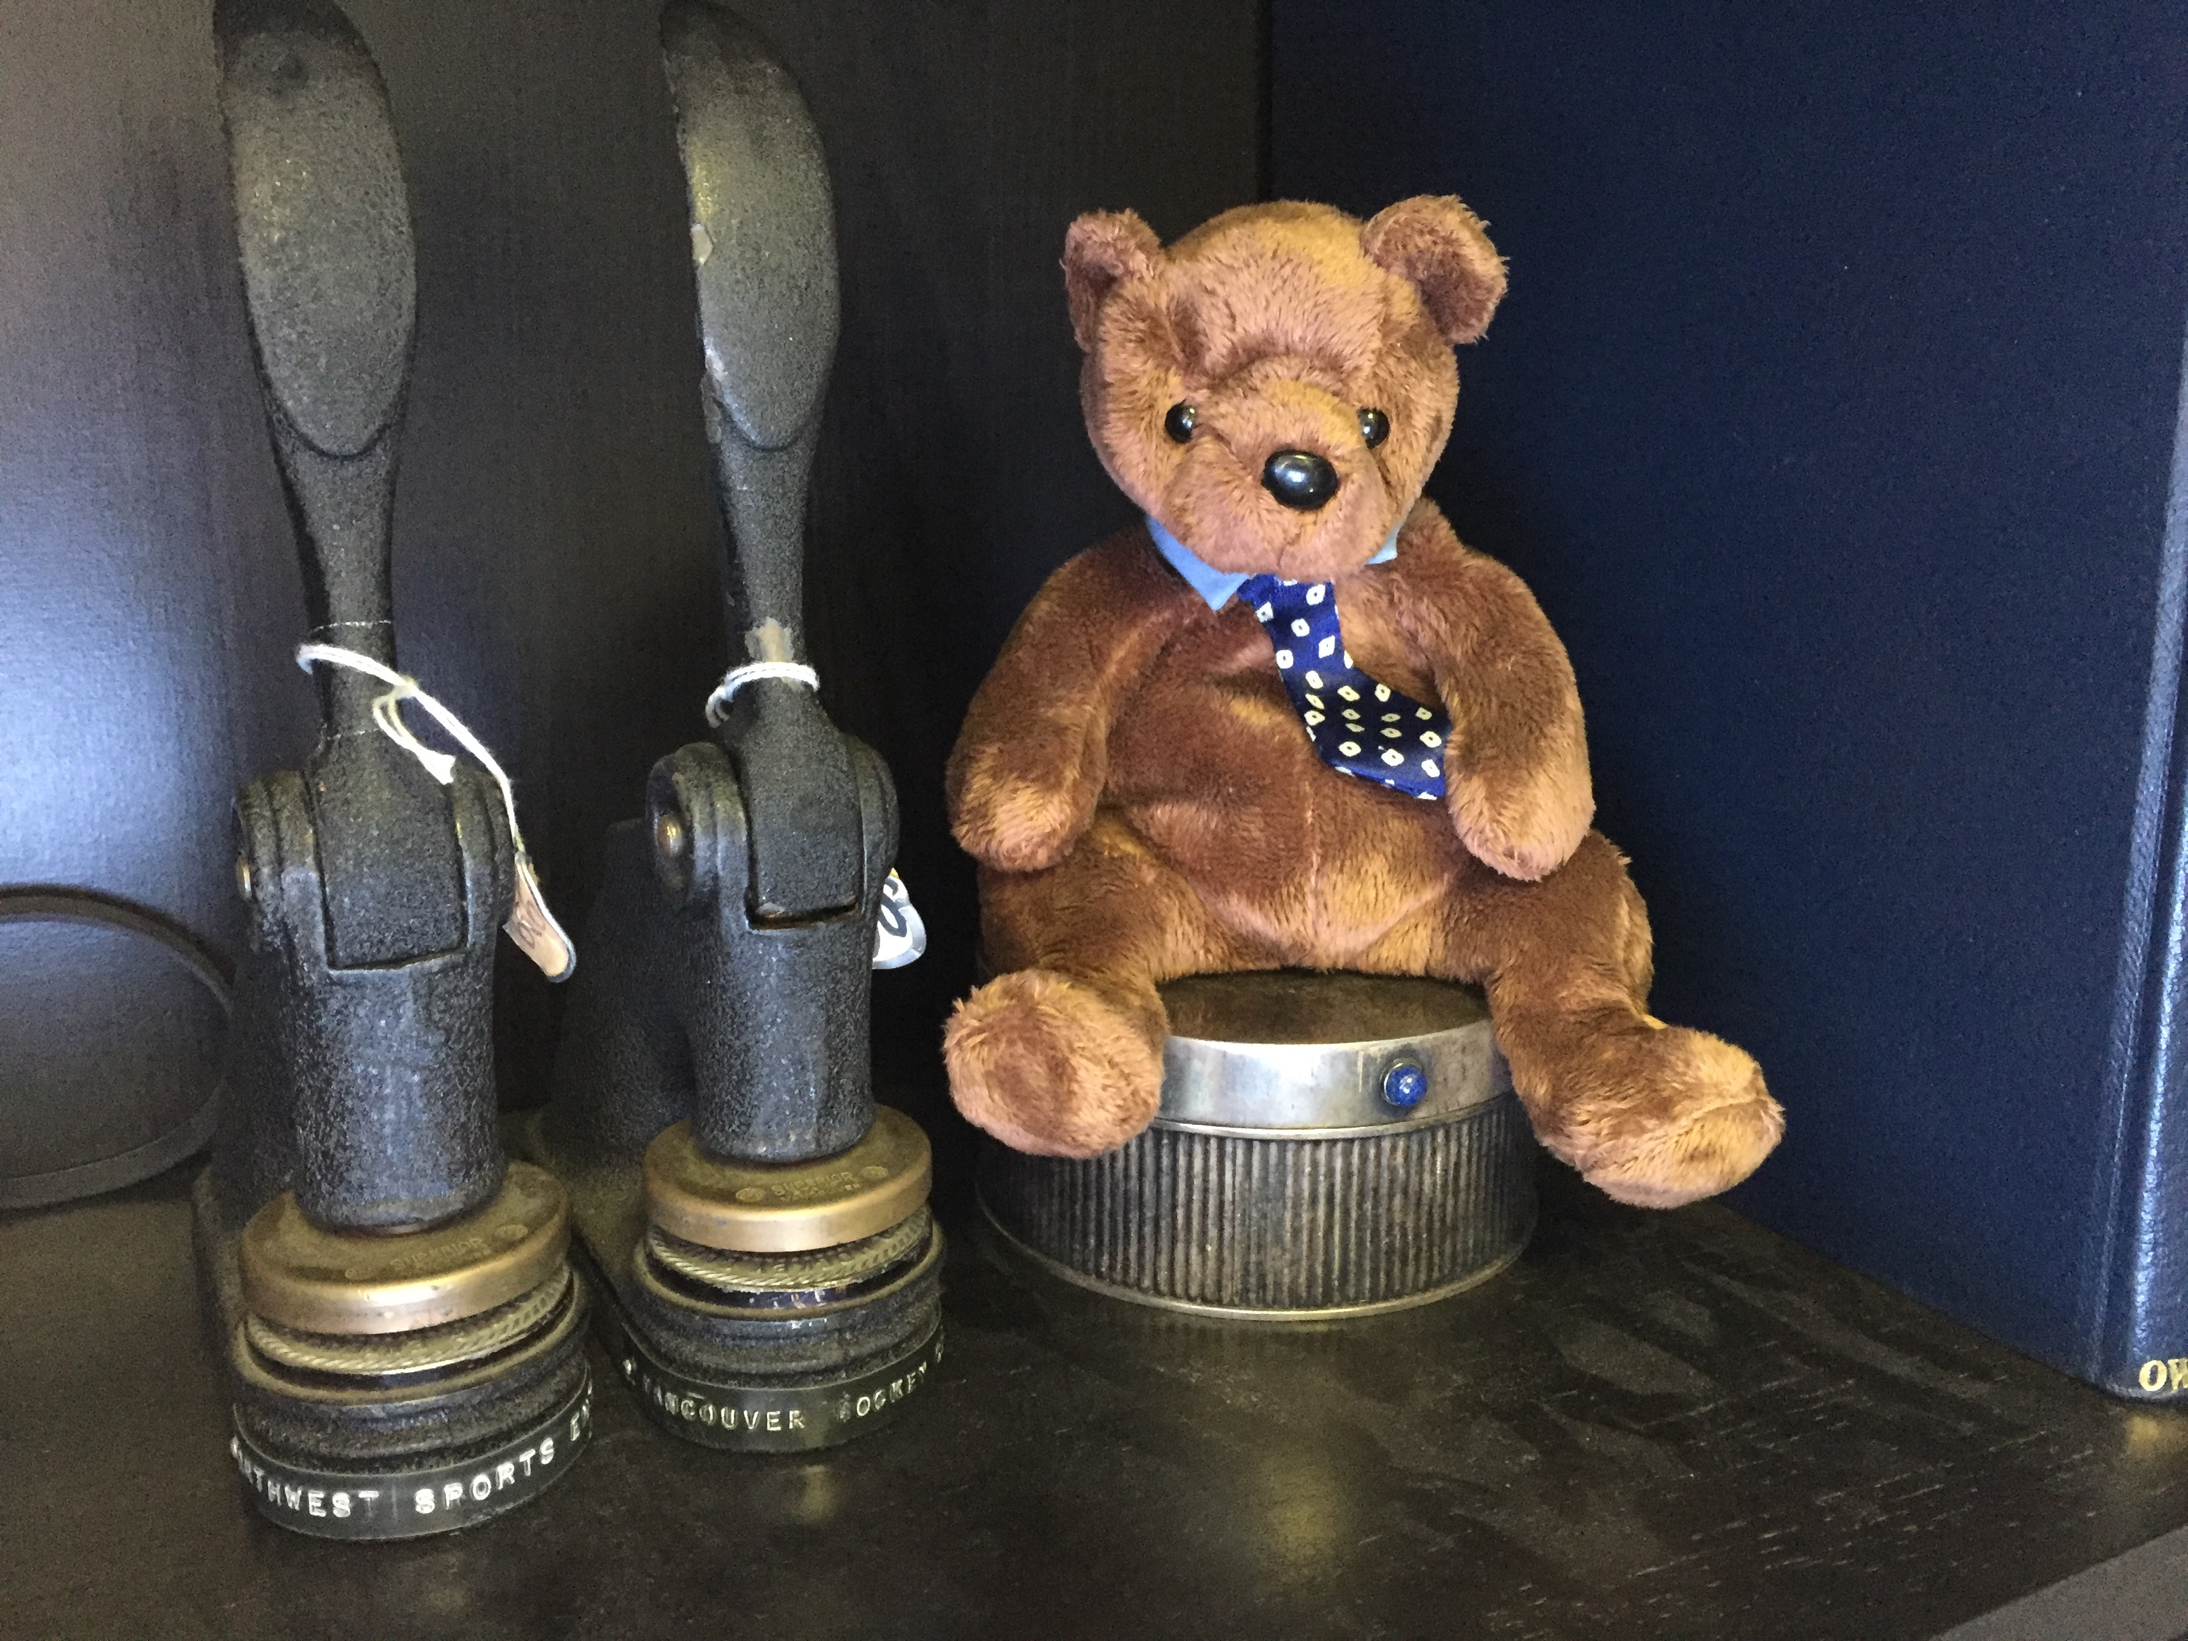
2

Slide 28
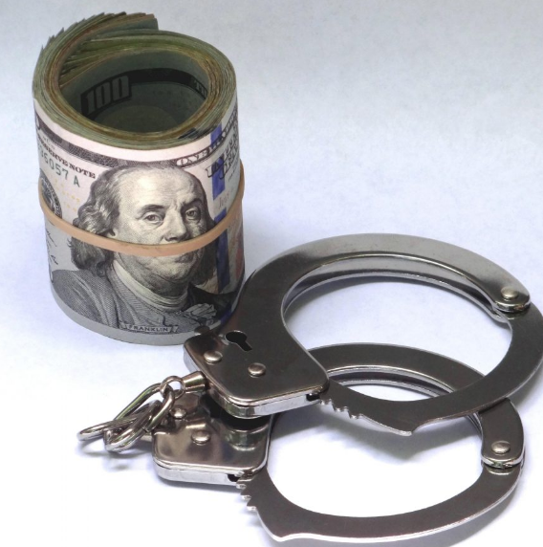
3

Slide 29
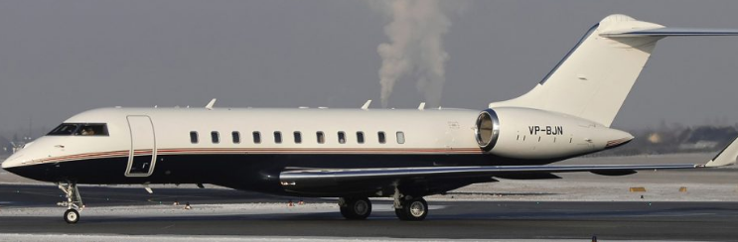
4

Slide 30
Which meme appeals to you most in the context of this course?

Slide 31
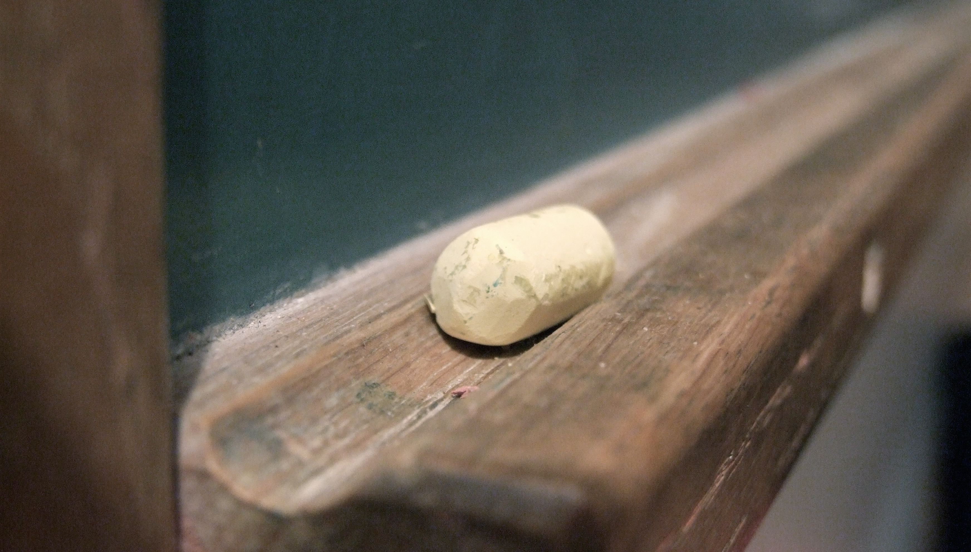
Basics Part 4: Pedagogy

Slide 32
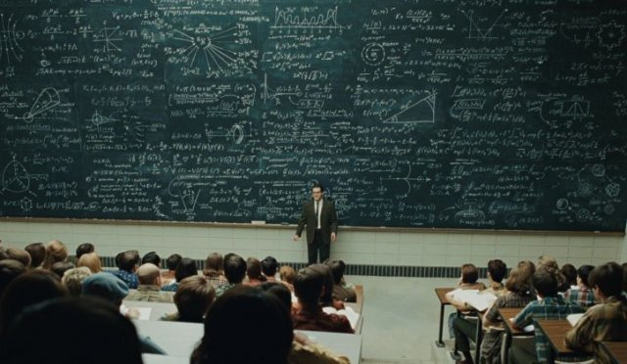
Pedagogic theory please?…

Slide 33
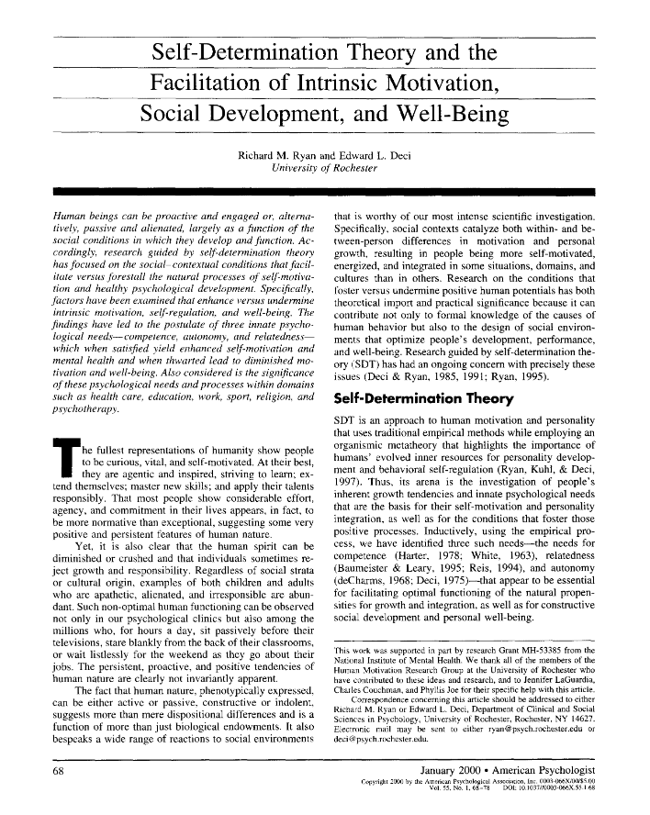

Slide 34

Pedagogic Goals
One word:
ENGAGEMENT
Two words:
CREATING PERSPECTIVE
Three words:
APPRECIATING (ETHICAL) COMPLEXITY

Slide 35
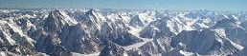
Pedagogic Emphasis
Ground in (current) events
Emphasize ethics
Find relevance
Encourage exploration

Slide 36
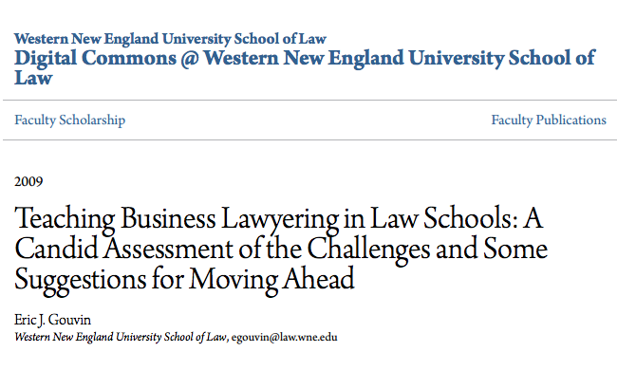

Slide 37
Rediscover Practice
Bring Problems into Your Doctrinal Courses
Re-tool a Course into a Simulation
Consider Putting Together a "Deals" Course
Or, Consider a Basic Business Transactions Course
Help Out With Your Business Clinic
Invite Guest Lecturers to Bring a New Dimension to Your Classes
Explore Team Teaching
Encourage the Smart Use of Adjuncts
Champion More Ambitious Curriculum Revision

Slide 38
What’s missing from the list?

Slide 39
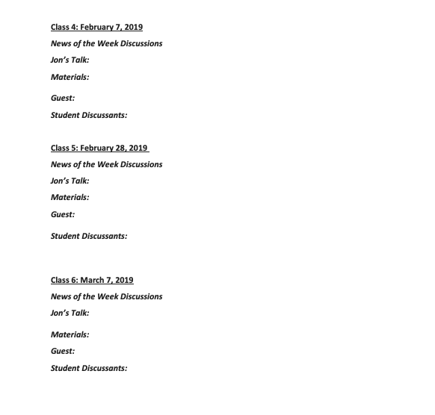
Syllabus Exercise Part 1
TWEN

Slide 40


Slide 41
Basics Part 5
News of the Week

Slide 42
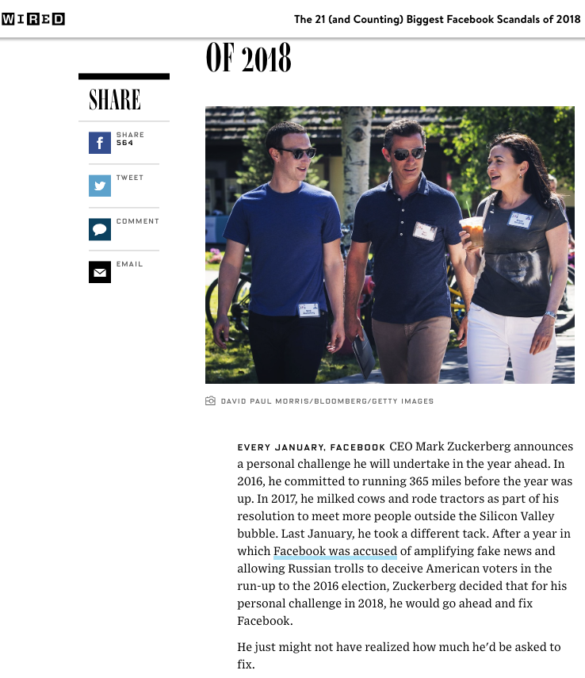
Sample…

Slide 43
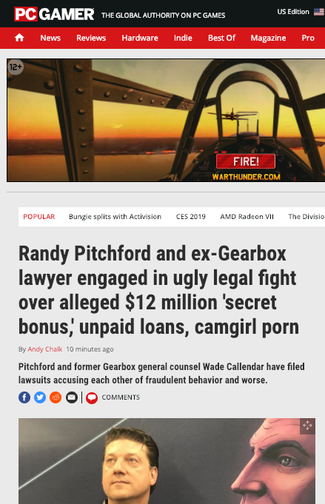

Slide 44
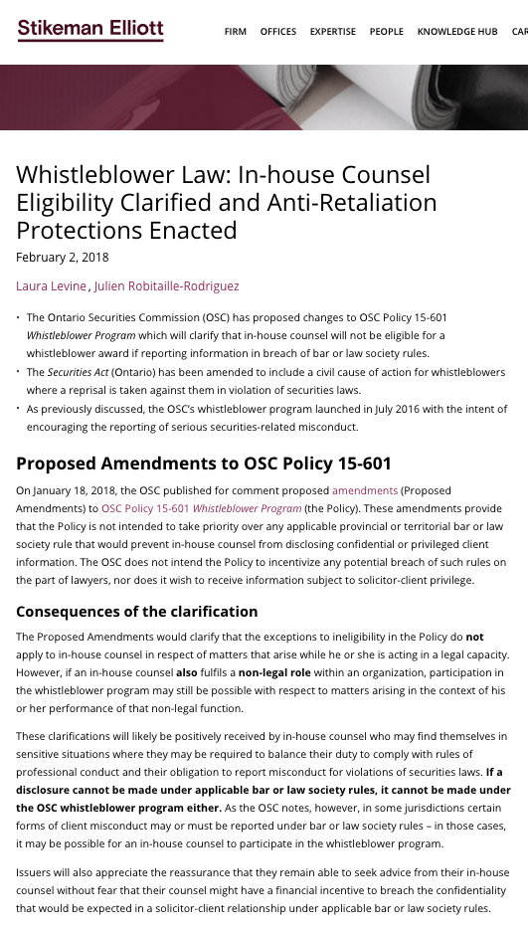

Slide 45
Yours?

Slide 46
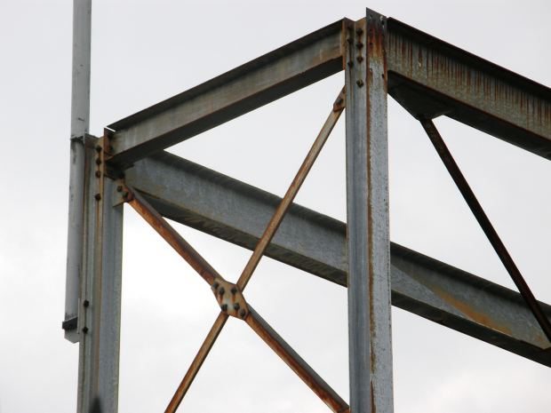
Legal
Framework
Basics Part 6

Slide 47
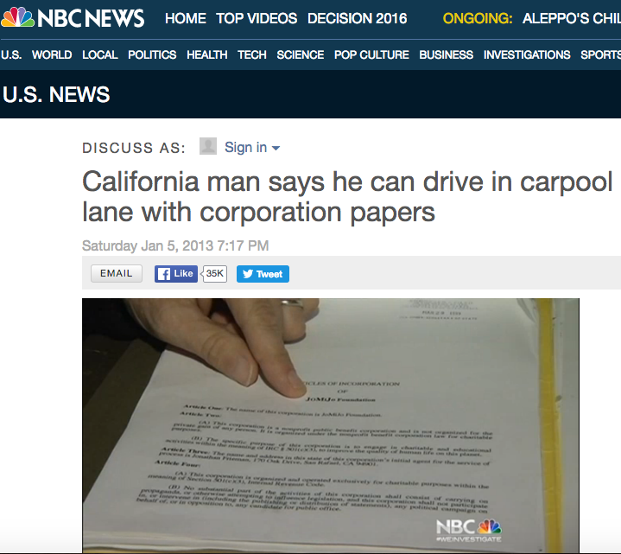
Context

Slide 48
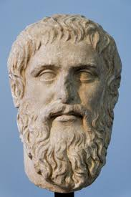
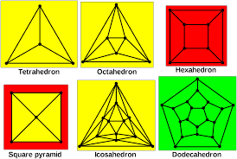
Problem 1 = Artificiality
Platonic forms

Slide 49

Problem 2 = Confusion
The Trinity
Roles of Management
Roles of Directors
Roles of Shareholders
Who is the corporation?

Slide 50
Impacts…
Ethics
Governance
Pierce the corporate veil?
Regulate?

Slide 51
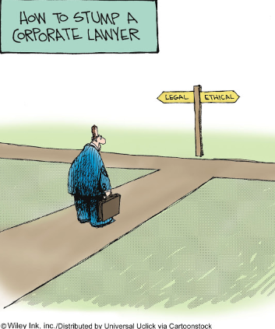
The course in one cartoon

Slide 52
Examine the question from the perspective of:
1. An out-side counsel
2. An in-house counsel
What do you see?

Slide 53
Complications
Employer
Good governance is invisible
Others????

Slide 54
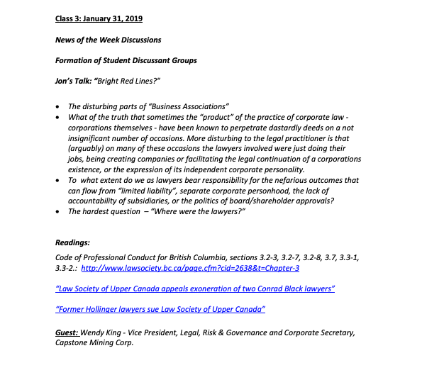
Syllabus Exercise Part 2
Next Week
TWEN

Slide 55
QUESTIONS?
THOUGHTS?
DISCUSSION?

Slide 56
Basics Part 7: Grading

Slide 57
EVALUATION
Term paper = 60% of the final grade.
5000 word paper
The paper is due on the last day of the exam period at 4:00 p.m.
Class Participation = 40% of the final grade
25% of the mark will be based on group preparation of a Class Discussion, with a Discussion Outline provided to the class—preferably by posting on the course website—a week before.
15% for student participation in other course activities including seminar discussions etc.

Slide 58
Paper Confessional
(or what I learned one winter holiday)
Legal/normative reasoning/argument including footnote/bibliography support & Contribution/Move forward → 60%
Presentation including layout, headings, grammar, language/writing skills, “tightness” → 25%
Topic/Originality/Degree of Difficultly → 15%
THIS IS NOT A RUBRIC. IT IS A SELF ASSESSMENT.

Slide 59
Group Presentations
3 (ideally) per group
Sign-up at the break or email me
Any topic – not constrained by what I’m talking about that week
Consult with me re the topic you want to take on
Post one thing you want us to read or watch

Slide 60
Evaluation Tips
Term paper topics need not be discussed with me, but often helpful to you if you do.
Term paper can be on your presentation topic.
Participation: In-class or other contributions, including attendance.
Group presentation need not be on that week’s topic (20 minute per student multiplier suggested 2-4 per group to 60 minute max).

Slide 61
Grades (primarily)
Paper → Quality
Participation → Effort

Slide 62
Will read: drafts…outlines…synopsis……abstracts…etc.
As late as I can…
Due last day of exams by 4:00 PM.
Hand in papers to front desk & send by email.
If email only, make sure you get acknowledgment of receipt.

Slide 63
QUESTIONS?
THOUGHTS?
DISCUSSION?

Slide 64
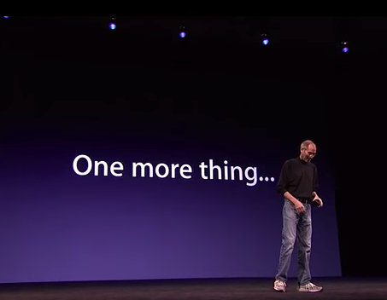

Slide 65
Who is the greatest (& best known) lawyer to be an in-house counsel?

Slide 66
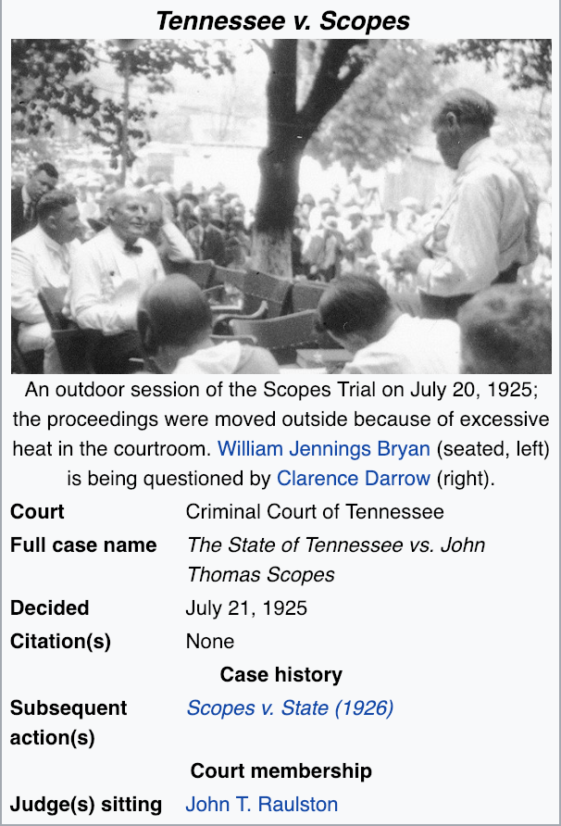

Slide 67


A MATTER OF PERSPECTIVE

Slide 68

Conclusion

Slide 69
SEE YOU NEXT WEEK!

Slide 70

Always include a cat picture

Slide 71
In learning you will teach
And in teaching you will learn
Phil Collins' Son of Man (1999)

Slide 72
Our Academic Partners

