Slide 1
A Day in the Life of In-House Counsel
Elizabeth Cunningham, Aman Taggar and Alisha Mangat

Slide 2
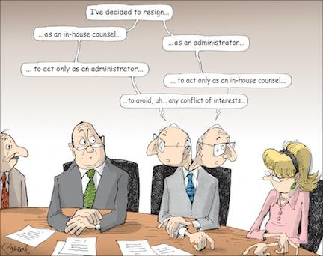
Considerations for In-House Counsel

Slide 3
Samantha McWilliams - Senior Legal Counsel at Rogers Communications in Toronto
Rogers Legal Counsel (2014-2017), Senior Legal Counsel (2017 - Present)
CBC Legal Counsel (2006 - 2013), Senior Legal Counsel (2013 - 2014)
Associate at Weaver, Simons LLP (2004 - 2006)

Slide 4
Why in-house counsel? Wanted to be closer to business decisions and business deal life cycle.
Rogers in Toronto: 35 lawyers, 12 paralegals/clerks and support staff.
Differences? Rogers is trialing a one day per week work from home policy, women routinely take 12 months off for mat leave, men take pat leave, working on weekends is the exception rather than the rule.
Insurance? Fall under an exemption for Law Pro.
Duty of loyalty is the to company as a whole.
Legal services for all of Rogers’ companies. Media, Consumer, Enterprise, M&A, employment, real estate, board support.
Risk manager and influencer. Wear the hat of both lawyer and business person

Slide 5
Jessie Porteus - Legal Counsel at Coca-Cola Amatil
Coca-Cola Amatil Legal Counsel (2015 - Present)
King and Wood Mallesons Solicitor (2013 - 2015)
Refugee Advice and Casework Service (RACS) Secondee Solicitor and Migration Agent (2014 - 2017)
Federal Court of Australia (2012 - 2013)

Slide 6
Overview of In-house Counsel
In-house lawyers are commercially driven, highly trusted legal advisers who work with an organisation.
They’re ‘more than just lawyers’.
In-house lawyers are often generalists.
Generally do not have billable hours.

Slide 7
A Typical Day In-House Counsel
8am: Check emails, prioritise your tasks for the day and respond to the quick questions.
9am: Attend legal team meeting to discuss workload.
9:30am-10:30am: Attend your legal clinic, where business clients can turn up and ask quick questions and obtain legal advice.
10:30am-12:30pm: Review a large customer agreement and type up your changes in tracking. You need to call the client to clarify some questions before you send them the typed-up contract.
12:30pm-1pm: Lunch.
1pm-2pm: Phone call with marketing team on their new marketing campaign, including a new tagline which they’ve asked you to apply for as a trade mark. You email your IP law firm to apply for the trademark.

Slide 8
2pm-3pm: You receive an urgent email about an employee issue. You put aside the sponsorship agreement you had planned to review at this time, to advise HR on what to do next.
3pm-4pm: Review the sponsorship agreement that has been sitting in your inbox for a few days. You see that the client hasn’t used the right template, so you call them to let them know where to find the right template. You also respond to some emails that have come through, and notice that 5 more contracts have been sent to you for review. You put them in your to-do list and schedule time in your calendar to attend to them.
4pm-6pm: The major M&A deal that has been bubbling away in the background has started gaining momentum – you review some documents that have come through on the dataroom and call the strategy team and external law firm to discuss next steps.
6pm-7pm: The sponsorship agreement comes back in the correct format, so you review this document and send it back to the client.
7pm: you send emails to the clients who sent you work during the day to acknowledge you’ve received them and will get back to them as soon as you can.

Slide 9
Ethical Considerations for In-House Counsel
In-house counsel face ethical challenges that differ from those faced by outside counsel.
The Model Code of Professional Conduct of the Federation of Law societies (Model Code) provides practical guidance for addressing these unique challenges.
All provinces and territories of Canada other than Quebec, Nunavut and New Brunswick have implemented the Model Code.
In-house counsel should refer and adhere to the specific rules of professional conduct in their jurisdiction when considering their professional and ethical obligations.

Slide 10
The Role of In-House Counsel
Duty of Loyalty
Duty to commit to the company cause
Duty of candour
Duty to avoid conflicting interests
Duty of confidentiality

Slide 11
Identifying the Client
One of the principal ethical challenges faced by in-house counsel is identifying the client. In-house lawyers represent the company. However, a company acts through several authorized constituents, including the company's:
Officers
Directors
Employees
Shareholders or members
Agents or other representatives

Slide 12
Identifying the Client Cont.
In-house counsel is required to act in the interest of the company (Mode Code Rule 3.2-3)
Dilemma may arise when an employee with interests adverse to the company seeks an in-house lawyers advise on a company legal matter.
In-house lawyers clients includes wholly owned subsidiaries (Mutual Life Assurance Co. of Canada v Canada, 1988 Carswell Ont 423 (Ont. H.C.)

Slide 13
Solicitor Client Privilege (SCP)
The application of SCP to in-house counsel’s communications depends on the context. The SCP protects communications between in-house counsel and company personnel when the following three elements are met:
The communication is between a lawyer and client
The communication is intended to be confidential
The communication is for the purpose of seeking or receiving legal advice
Given the following guidelines do you guys think that copying or ccing in-house counsel protects that communication under SCP?

Slide 14
Processes that Create and Protect Privilege
Mark communication with “Privileged and Confidential” notion.
Educate the legal department and other employees.
Ensure that the company routinely enters into confidentiality agreements.
Use legal department letterhead rather than corporate letterhead.
Limit circulation of legal advice.
Engage external counsel for sensitive matters and outside jurisdiction
Send a memorandum to let individuals know that the right to assert or waive privilege is retained by the company and not individual employees.

Slide 15
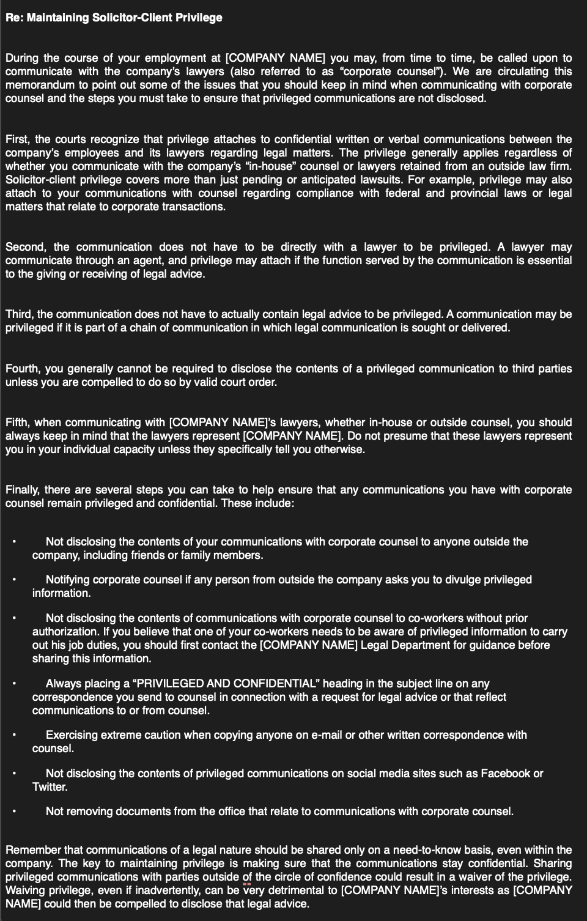

Slide 16
Confidentiality
Confidentiality is key to lawyer-client relationship and broader than rules of privilege.
The duty maintaining confidence over all information pertaining to their client.
Duty may be more complex for in-house lawyers as opposed lawyers in private practice.
Duty extends to the supervision of the law departments non-legal staff.
Barred from using confidential information gained from past legal services to benefit the current company.
Notes:
#1 Whereas privilege only applies to certain communications between lawyers and their clients, all information shared with counsel, including that the client has consulted the lawyer, is covered by the duty of confidentiality.
#2 The duty of confidentiality requires lawyers to maintain confidence over all information pertaining to their client but privilege only prevents the entry of certain communications into evidence in legal proceedings.
#3 In-house lawyers must comply with the same duty of confidentiality imposed on lawyers in private practice. Compliance with the duty of confidentiality may be more complex for in-house lawyers who have access to a broader quantity of confidential information than external lawyers. In-house lawyers will have access to information concerning all aspects of the company’s business and affairs and spanning a wide range of oral, written and electronic communications and other sources of company information such as databases, paper and electronic files.
#4 An in-house lawyer's duty of confidentiality also extends to the supervision of the law departments’ non-legal staff that have access to confidential information. When providing confidential information to staff, in-house counsel should:
Only disclose such confidential information as is necessary to complete a task
Particularly with sensitive information, keep the relevant officers, directors, other senior employees or external counsel informed about who from the law department is involved in the file and has access to confidential information.
Ensure that staff are aware of confidential nature of the information and educated about how to maintain confidentiality
Company entering into confidentiality agreements
#5: In-house lawyers may be tempted to use confidential information gained from past legal services to the benefit of the company but are barred from doing so by their duty of confidentiality. The duty of confidentiality is ongoing and in-house lawyers continue to owe the duty to all former clients who they served in private practice or at other companies for whom they acted as in-house counsel. The duty may also be owed to persons for whom the lawyer did not act or did not enter into a formal lawyer-client relationship with if, in the course of seeking legal advice, such person divulge confidential information to the lawyer

Slide 17
Women as In-House and General Counsel

Slide 18
Women as In-House and General Counsel
More women in in-house and general counsel positions than ever before
Fortune 500 Companies: 28% women as top counsel
Shows underrepresentation of women at the top
More than half of recent law graduates in Canada have been women
Similar statistics in the US

Slide 19
Challenges: Sexism and Discrimination
Many women in general counsel and in-house counsel positions face discrimination from male colleagues and opposing counsel
Lack of respect, demeaning comments, ignored when they provide input or negotiate a deal
Men seeking to go in-house are seen as “strategic and business savvy”, women are seen as trying to find a job that is “easier” and will allow them to better work and family pressures

Slide 20
Challenges: Pay Gap
Survey by The Counsel Network and The Canadian Corporate Counsel Association (CCCA): Wage gap between men and women in in-house positions in Canada is currently at 11%
Encouraging improvements in addressing wage gap disparity, but still a long way to go to achieve equal pay
The most substantial gaps continue to be seen at higher wage levels

Slide 21
Challenges: Lack of Diversity
Can be an issue as some companies have been slow to embrace diversity in upper leadership, both in terms of gender and ethnicity
This makes it difficult for women, especially women of colour, to get their foot in the door
This is starting to have repercussions. Lack of diversity at a firm, especially in leadership roles, is now more often seen as a red flag of a firm/company that others don’t want to work with

Slide 22
Hannah Gordon - Chief Administrative Officer and General Counsel for the San Francisco 49ers
JD: Stanford Law, 2008
Current: Chief Administrative Officer and General Counsel for the San Francisco 49ers NFL team and Levi’s Stadium
https://youtu.be/u_Ka4awcCQk?t=14

Slide 23
ALWAYS INCLUDE A CAT PICTURE

Slide 24
Sources:
https://www.lawyersweekly.com.au/corporate-counsel/24768-what-does-a-typical-day-look-like-for-in-house-counsel
https://ca.practicallaw.thomsonreuters.com/Document/I2df977843c8111e698dc8b09b4f043e0/View/FullText.html?transitionType=Default&contextData=(sc.Default)&clientid=CUNNINGHAM+ELIZABETH&firstPage=true&bhcp=1&OWSessionId=19145f0c6c9146edafad66efe90cd429&skipAnonymous=true#co_anchor_a000008
https://ca.practicallaw.thomsonreuters.com/3-623-5717?originationContext=document&transitionType=DocumentItem&contextData=(sc.Default)&firstPage=true&bhcp=1
https://business.financialpost.com/legal-post/why-in-house-lawyers-are-extremely-happy

